Slide 1
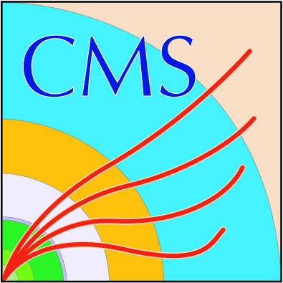
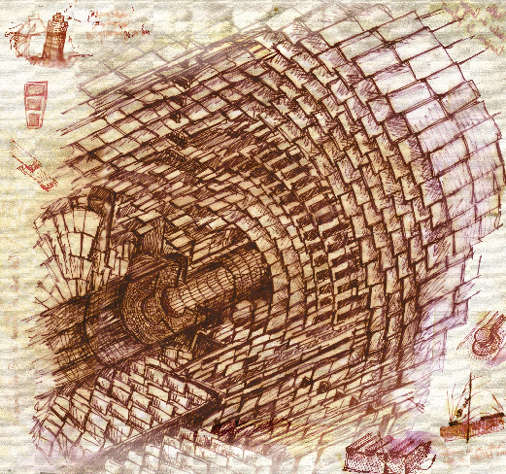
DC-DC Conversion Powering Concepts
for CMS Pixel and Strip Trackers at SLHC
Katja Klein (HGF Detector Fellow)
with Lutz Feld, Rüdiger Jussen, Waclaw Karpinski, Jan Sammet
1. Physikalisches Institut B, RWTH Aachen University
Third HGF Detector Workshop
Heidelberg, October 4th, 2010

Slide 2
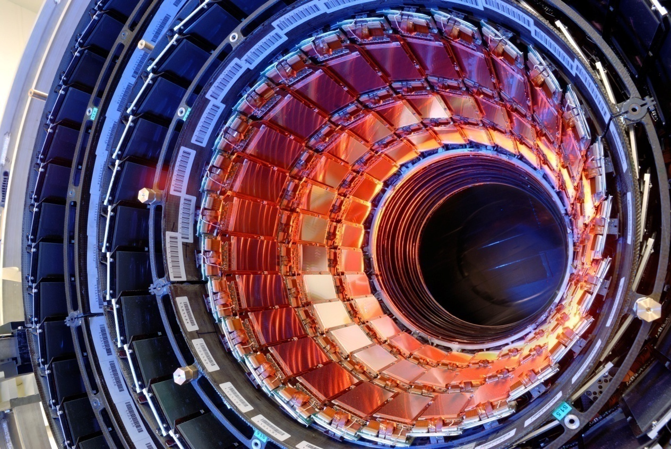
The CMS Tracker Upgrade
LHC Phase 1 (2010-20): 1-2⋅10³⁴cm⁻²s⁻¹; LHC Phase 2 (2020-30): 5⋅10³⁴cm⁻²s⁻¹
Around 2016: Exchange of the CMS pixel detector
Less material, reduced data losses etc.
Number of readout chips (ROCs) increases by factor 1.9
Unacceptable power losses in cable trays
Compatibility with existing power supply chain desirable
→ DC-DC buck converters with conversion ratio of 2-3
Around 2020: Exchange of the CMS tracker
Higher granularity → more readout channels
Additional functionality (track trigger) needs power
→ DC-DC converters with conversion ratio of 8-10

Slide 3
DC-DC Buck Converters
Idea: on-detector voltage conversion: P = U⋅I = (rU)⋅(I/r) with r > 1
➔ lower power losses in cables & less material
DC-DC buck converters
Duty cycle D = t_{on}/T
Conversion ratio r = V_{in}/V_{out} = I_{out}/I_{in} = 1/D
Similarity to our parallel powering scheme (grounding, safety)
High currents (~3A) with high efficiency
Comparably simple & compact
Output regulation by Pulse Width Modulation logic (not shown)
Challenges
Radiation tolerance of high voltage (~15V) power transistors
Magnetic field tolerance → air-core inductor
Minimization and control of noise emissions (conductive & radiated)
Maximization of efficiency & minimization of material and size

Slide 4
Buck ASIC Development
Technology evaluation by F. Faccio (CERN) Leakage current, R_{on}, I_{DS} = f(V_{ds}) vs. TID < 350Mrad & fluence < 10¹⁶/cm²
Best candidate: IHP SGB25V GOD 0.25µm SiGe BiCMOS (IHP, Germany)
“Back-up“: AMIS I3T80 0.35µm (ON Semiconductor, US)
Buck converter ASIC development (St. Michelis, CERN)
Four prototypes: AMIS1 (2008) & AMIS2 (2009), followed by IHP1 & IHP2 (both 2010)
IHP2 is the most complete prototype up to now, however:
severe problems with latch-up (formation of parasitic thyristor → short circuit)
recent heavy ion irradiation revealed SEB effect in NLDMOS transistors
“third generation“ transistors used are less rad.-tolerant than previous generation (IHP1)
→ Development in IHP technology on hold
Next step: development of more complete chip in AMIS technology (functional up to 300Mrad & 5⋅10¹⁵ p/cm², no SEB)
SEB = Single Event Burnout = ionizing particle in source turns parasitic npn transistor on → destructive current

Slide 5
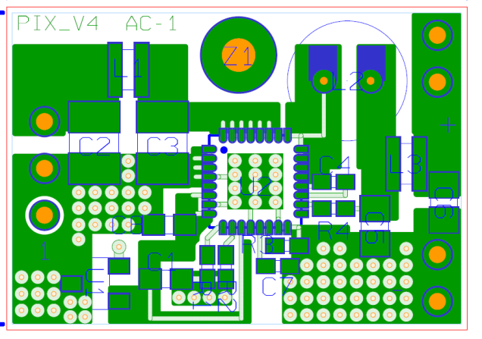
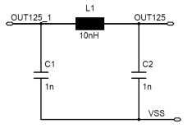
Buck Converter Development at Aachen
Development of prototypes with radiation-tolerant chip; optimization & system tests
“AMIS2_PIX_V4“:
m = 2.7g
Chip: AMIS2 by St. Michelis &
F. Faccio (CERN)
V_{IN} < 12V
I_{OUT} < 3A
V_{OUT} programmable (3.3V)
Switching frequency f_{S} ≈ 1.3MHz
18mm
PCB:
2 copper layers a 35μm
25mm
Air-core toroid:
Custom-made toroid, ∅ ≈ 6mm,
height = 7mm, L ≈ 550nH, R_{DC} ≈ 90mΩ
Input and output π-filters
L = 12.1nH, C = 22µF
Cooling contact

Slide 6
Commercial Buck Converter
Not radiation-hard, but useful for comparisons
“AC2“:
m = 1.1g
Chip: Enpirion EQ5382D
V_{in} = 2.4-5.5V(rec.)/7.0V(max.)
I_{out} ≤ 0.8A
f_{s} ≈ 4MHz
12mm
PCB:
2 copper layers a 35μm
19mm
Air-core toroid:
Custom-made toroid, ∅ ≈ 6mm,
height = 7mm, L ≈ 550nH, R_{DC} ≈ 90mΩ
Input/output filters (C||C)
Can be combined with
external pi-filter
K. Klein et al., CERN-2009-006
& Talk at 3rd Annual HGF Workshop

Slide 7
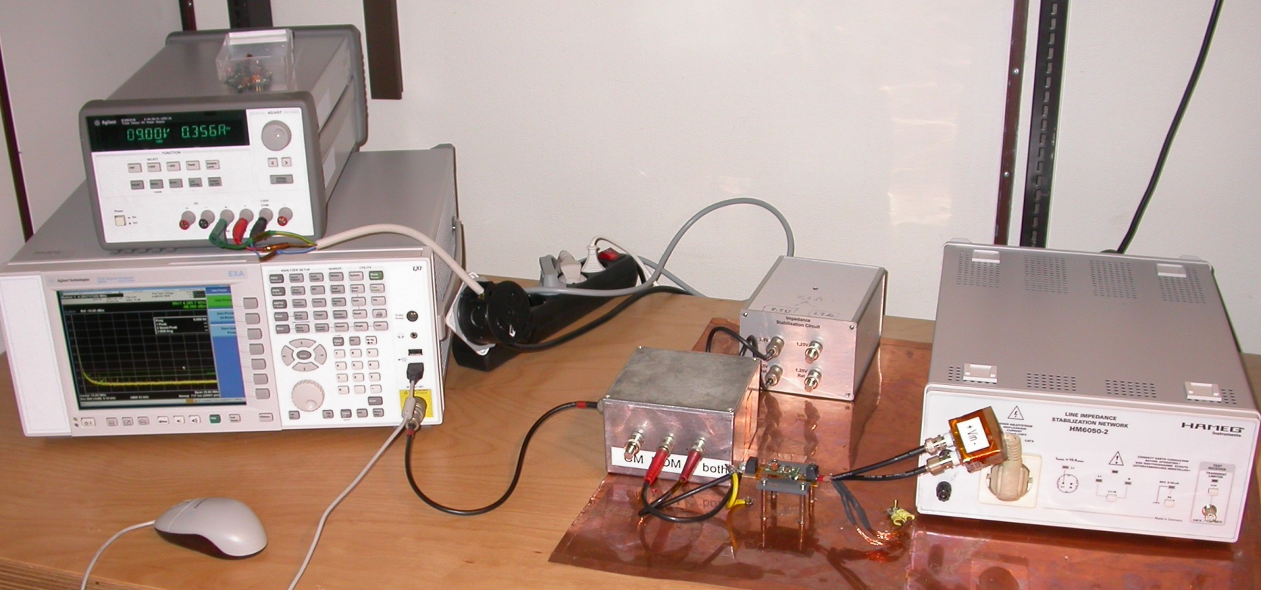
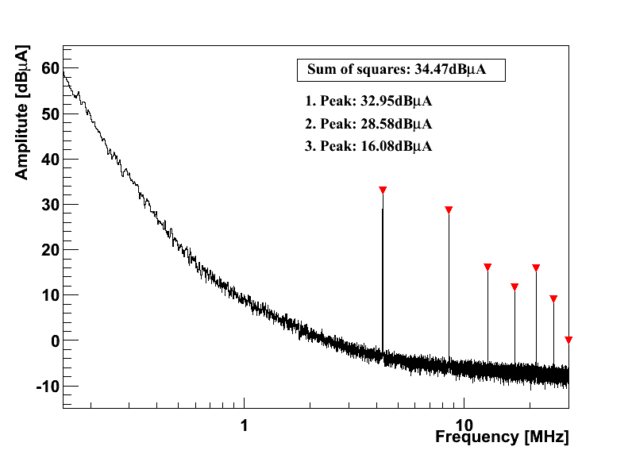
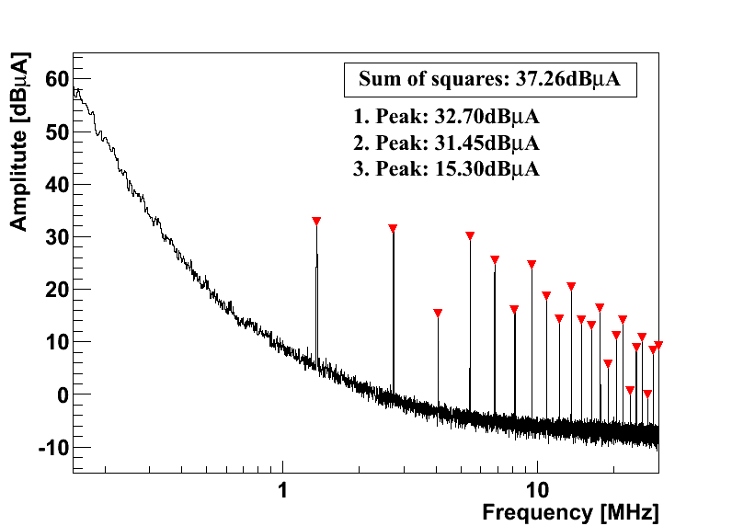
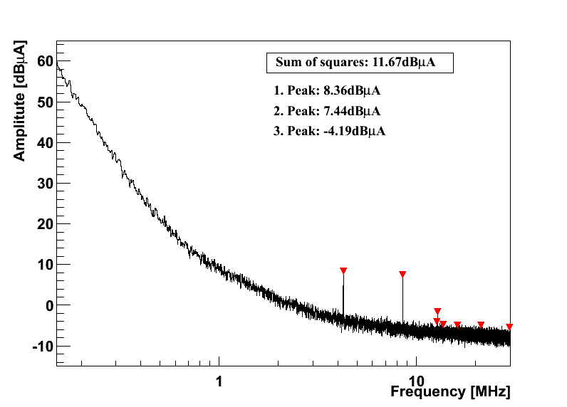
Conductive Noise: Differential Mode
Load
GND
LISN = Line Impedance Stabilization Network
Spectrum Analyzer
PIX_V4
Vin = 10V
Vout = 3.3V
AC2
Vin = 5.5V
Vout = 1.25V
Plus additional
pi-filter

Slide 8
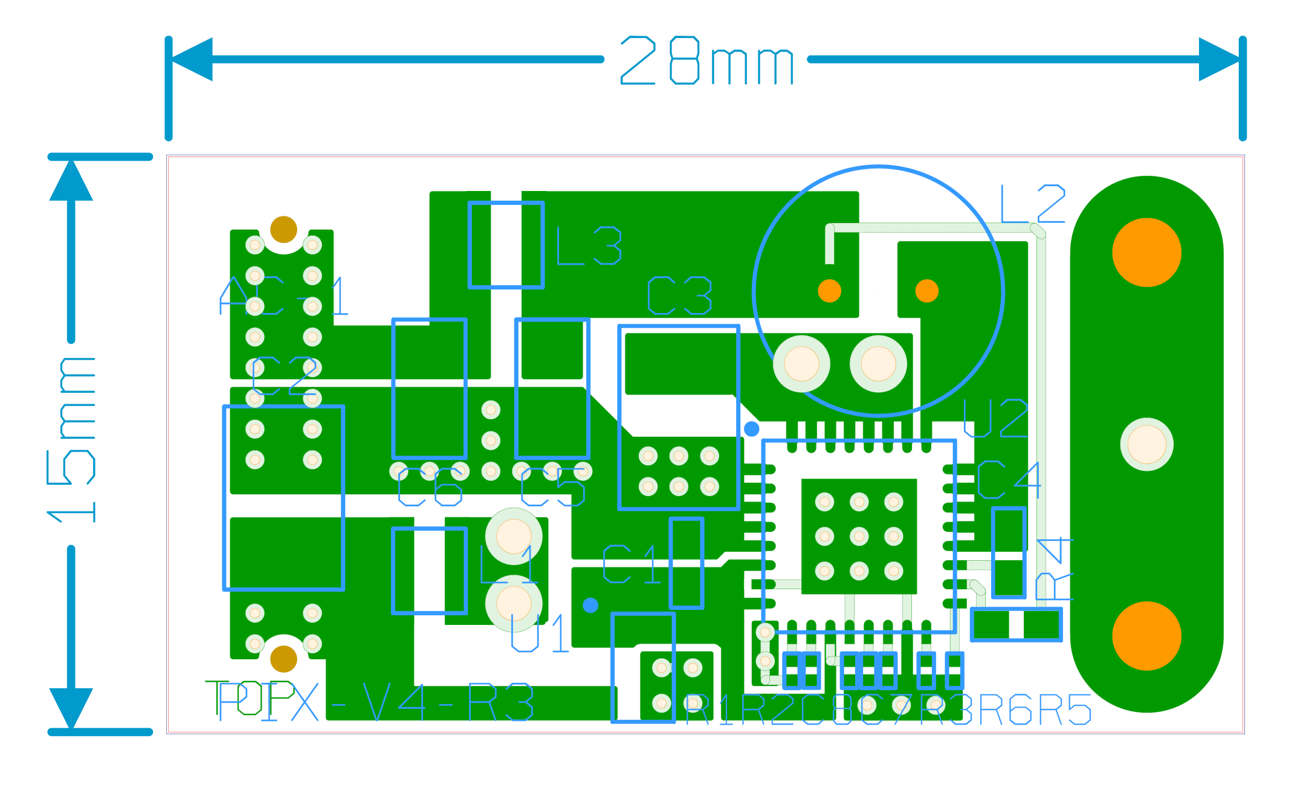
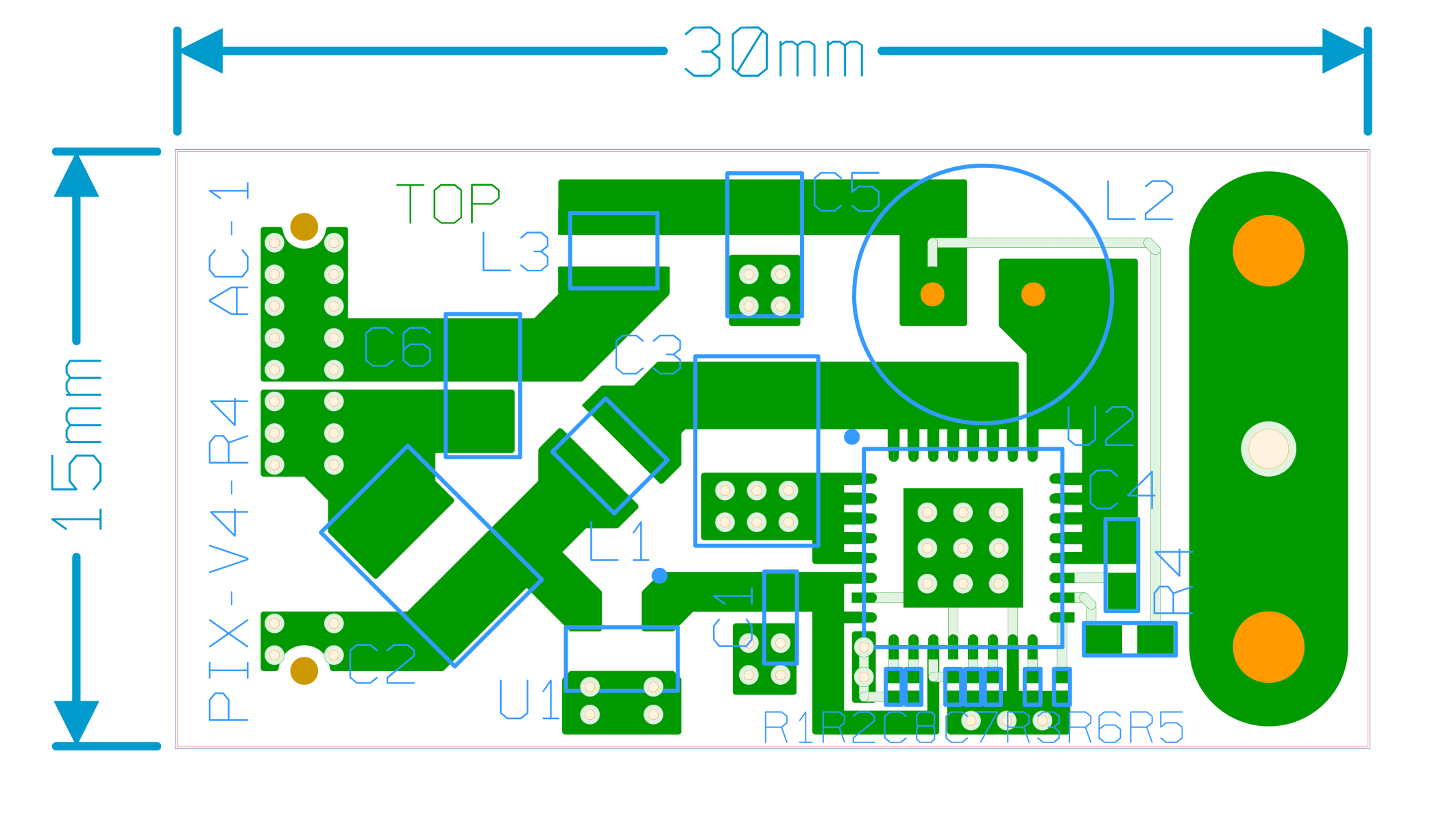
Layout Variants with AMIS2 Chip
PIX_V4_long:
L & C of output pi-filter moved further away
PIX_V4_R3:
input & output on same side,
shorter return path for output current ripple
PIX_V4_R4:
input & output on same side,
different placement of
passives, ground “islands“
(inspired by CERN design)

Slide 9
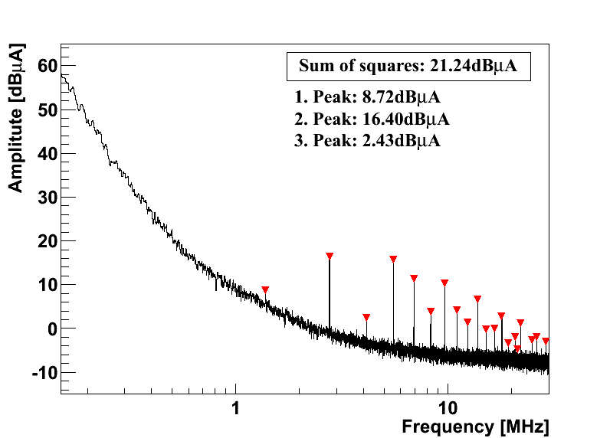
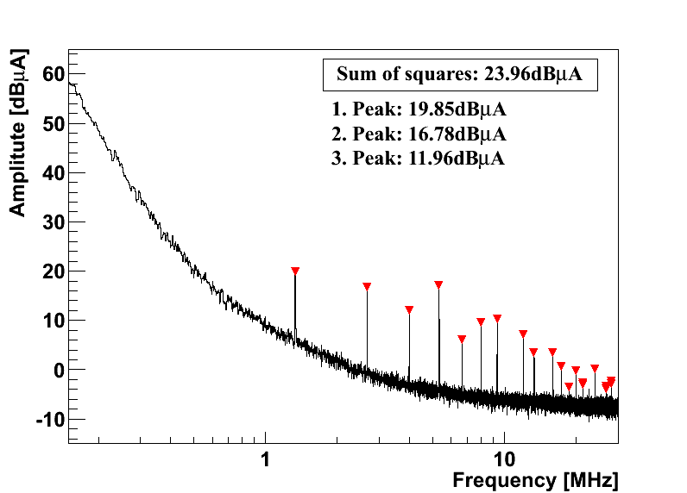
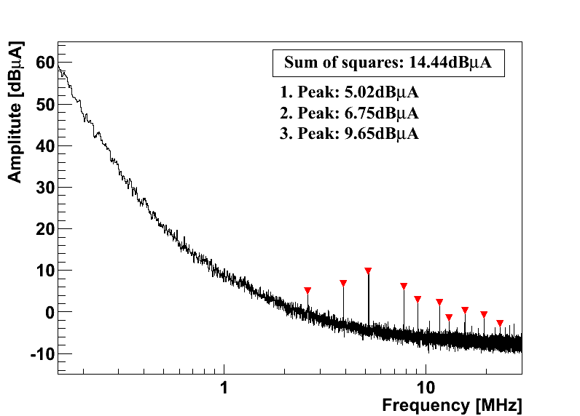
Differential Mode Noise at Output
PIX_V4
Vin = 10V
Vout = 3.3V
PIX_V4_long
PIX_V4_R3
PIX_V4_R4

Slide 10
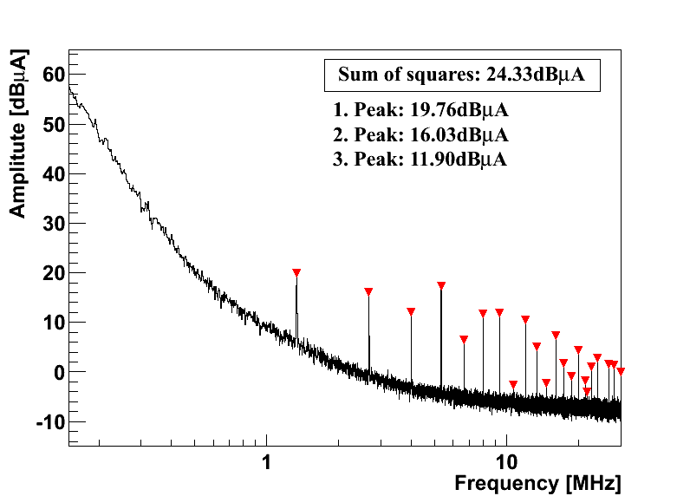
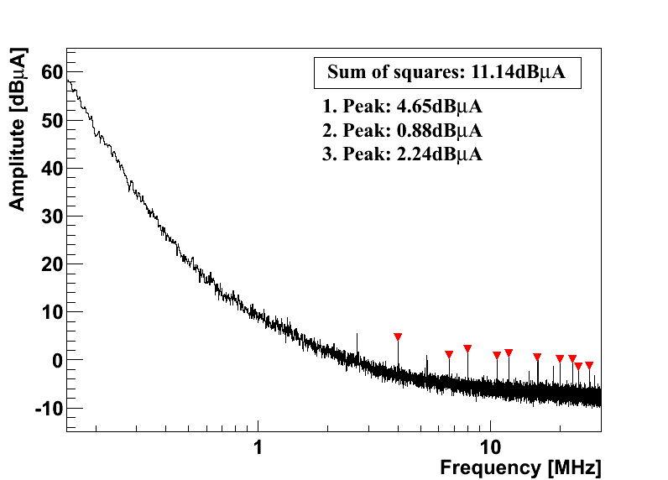
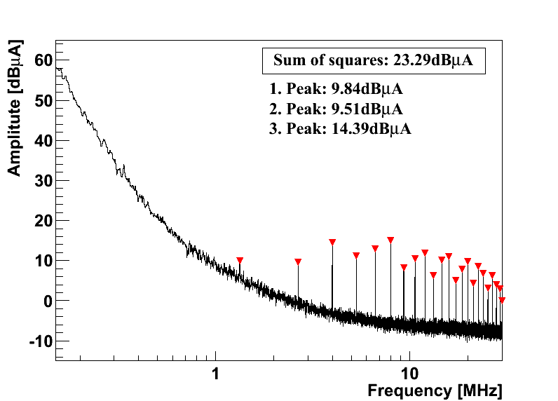
Reducing the Conductive Noise
AMIS2_PIX_V4_R3
Output
pi-filter
DM, output
L
C
C
C
C
L
Input
pi-filter
Coupling between caps of output pi-filter makes filter ineffective
Vin wire connection between L & C moved from back to top side and connected first to the capacitor → improvement of input filter effectiveness
No significant effect from coil orientation or shape of power/ground planes found
DM, input

Slide 11
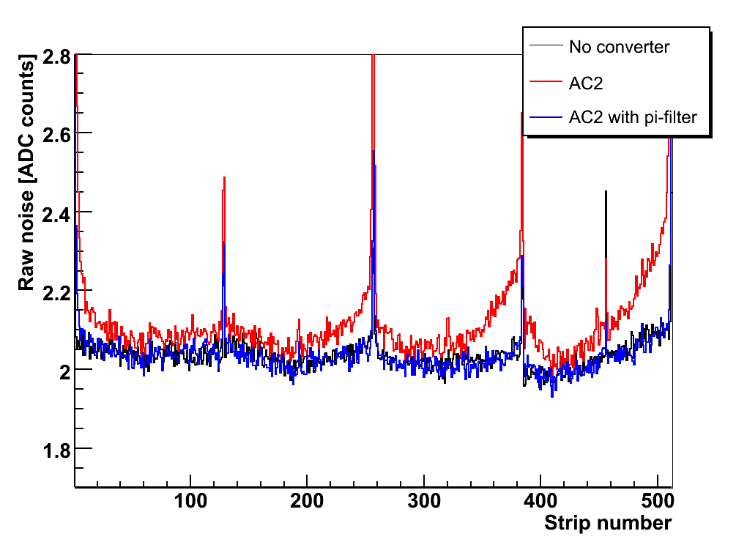
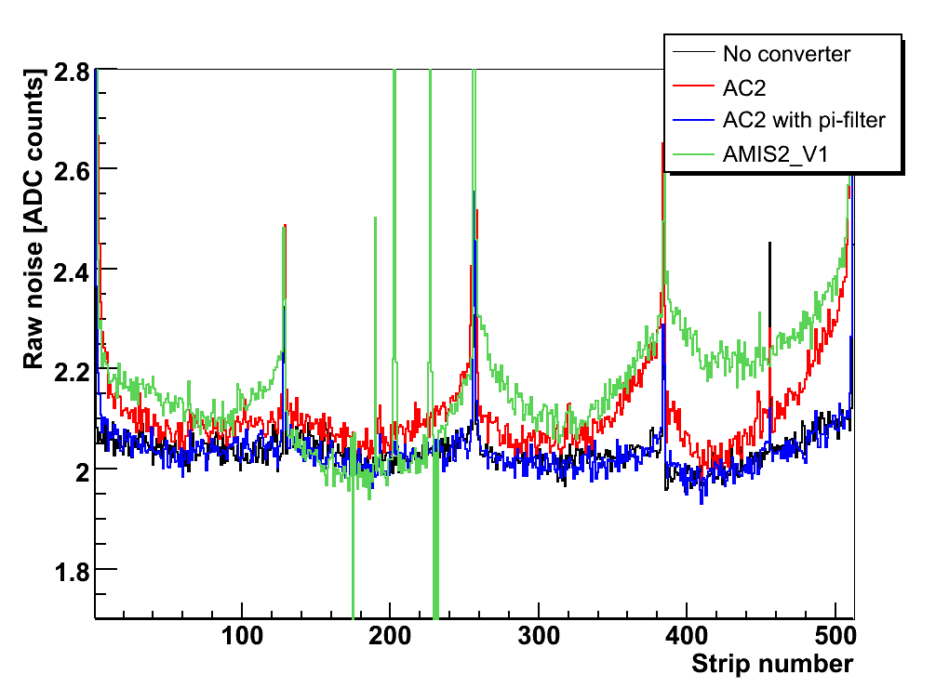
Strip Tracker System Tests
CMS silicon strip modules:
APV25 readout chips in 0.25µm CMOS
-128 x pre-amplifier, CR-RC shaper (τ = 50ns), pipeline
- analogue readout, on-chip common mode subtraction
Per chip: 0.06A at 1.25V & 0.12A at 2.50V
Radiative coupling → increase of noise over all strips
Ripple on 1.25V line → increase of noise on edge strips
--- Conventional powering
--- AC2
--- AC2 + pi-filter
--- Conventional powering
--- AC2
--- AC2 + pi-filter
--- Conventional powering
--- AC2
--- AC2 + pi-filter
--- AMIS2_V2 (sim. to PIX_V4)
--- Conventional powering
--- AC2
--- AC2 + pi-filter
--- AMIS2_V2 (sim. to PIX_V4)
Zoom onto edge channels

Slide 12
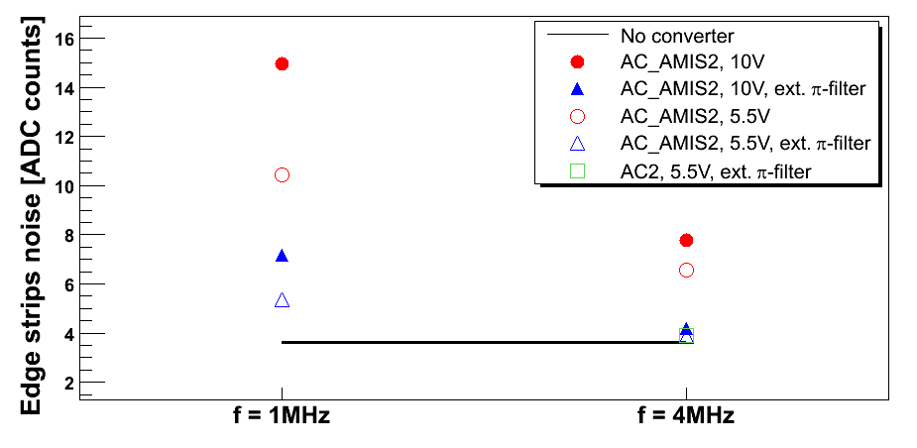
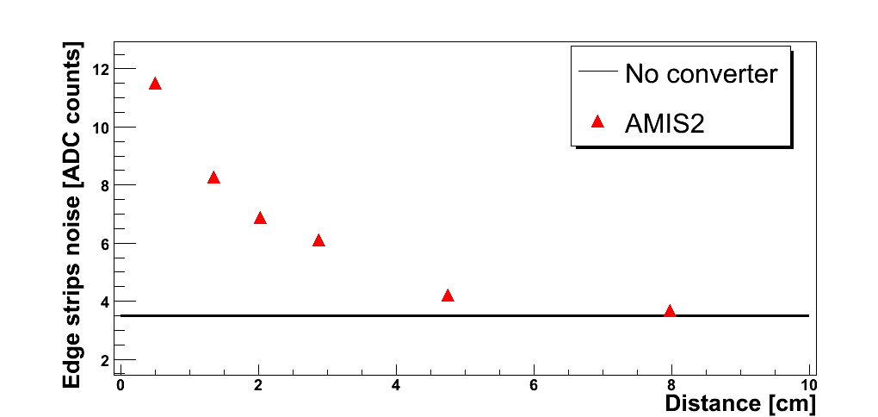
Strip Tracker System Tests
Noise depends on inductor current ripple and decreases for
larger duty cycle D (lower input voltage)
higher switching frequency f_{s} [depends also on module susceptibility]
better filtering (additional pi-filter)
larger inductance L
larger distance (radiated emissions!)
V_{in}
Add.
pi-filter
f_{s}
K. Klein et al., 2010 JINST 5 C07009

Slide 13
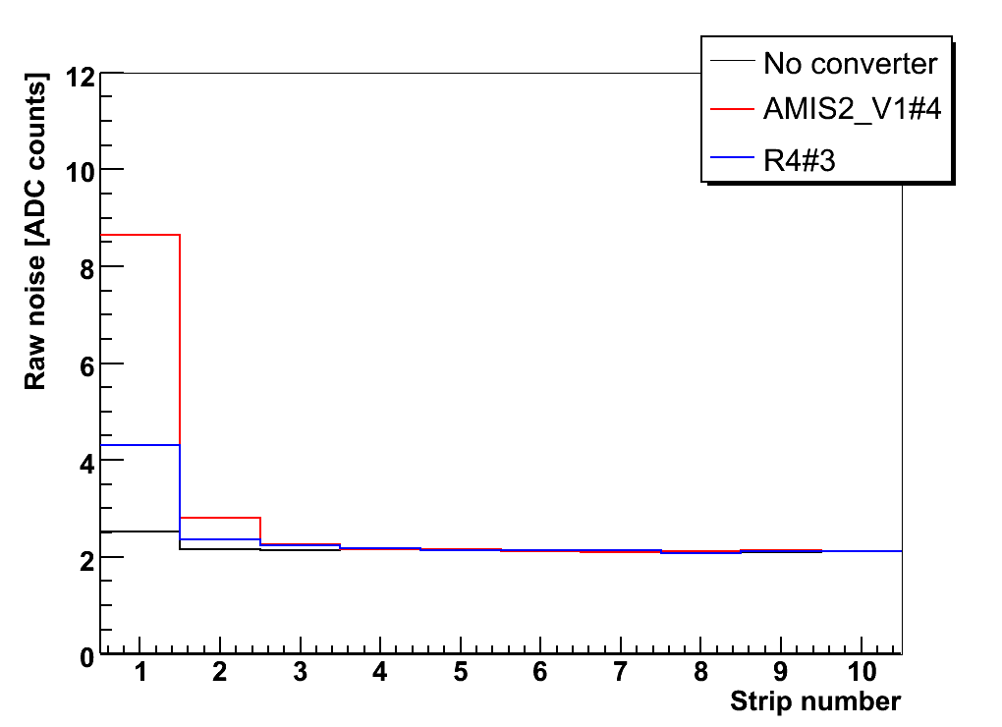
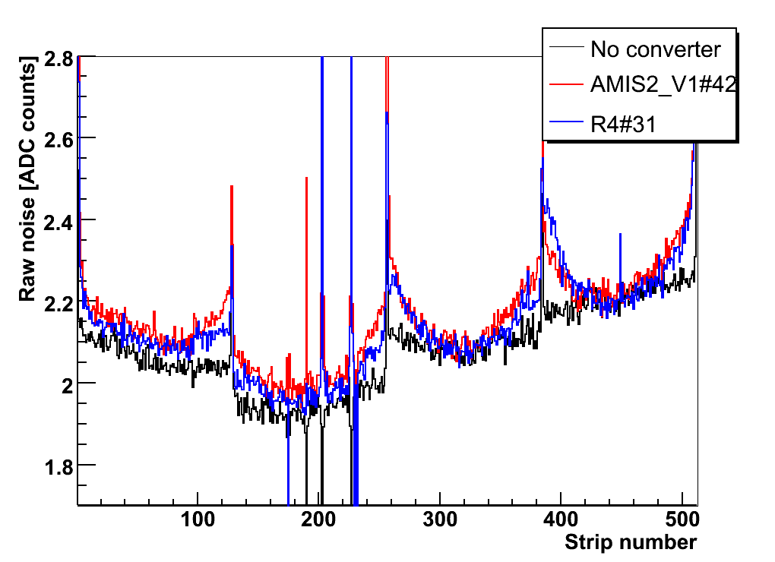
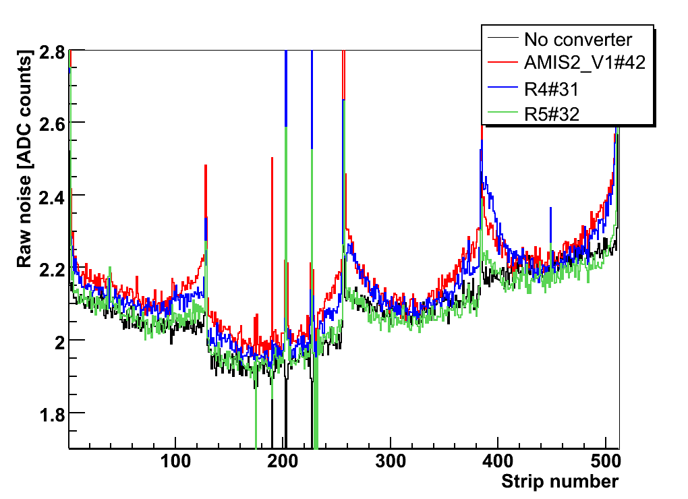
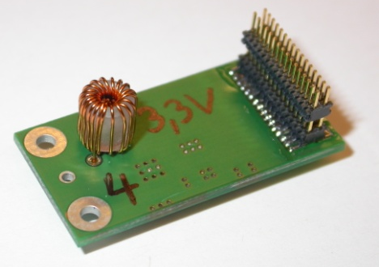
Strip Tracker System Tests
--- Conventional powering
--- AMIS2_V1 (sim. to PIX_V4)
--- AMIS2_PIX_R4
--- Conventional powering
--- AMIS2_V1 (sim. to PIX_V4)
--- AMIS2_PIX_R4
--- AMIS2_PIX_R5
--- Conventional powering
--- AMIS2_V1 (sim. to PIX_V4)
--- AMIS2_PIX_R4
Less conductive noise with PIX_V4_R4
Reduction of radiative pick-up when coil is soldered on backside of board (R5)

Slide 14
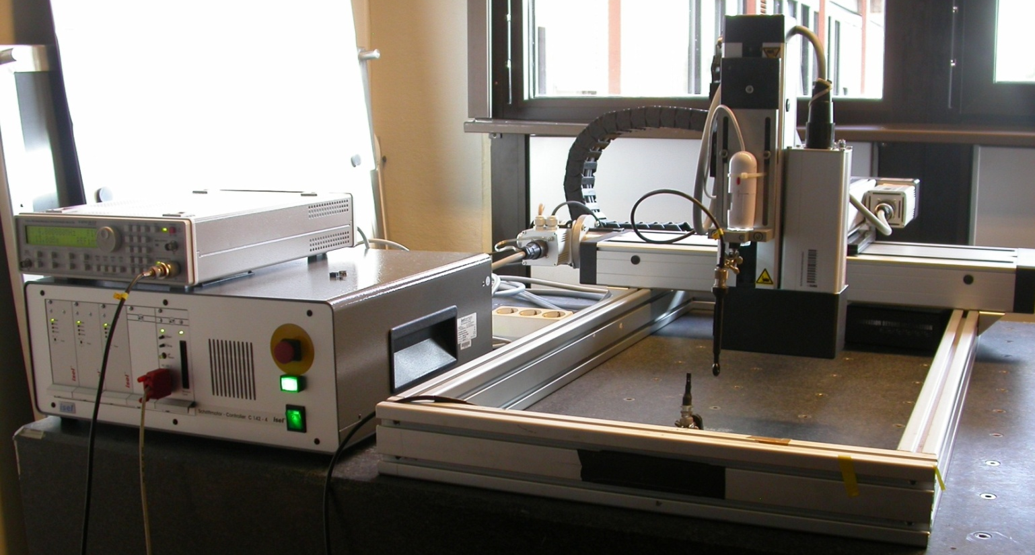
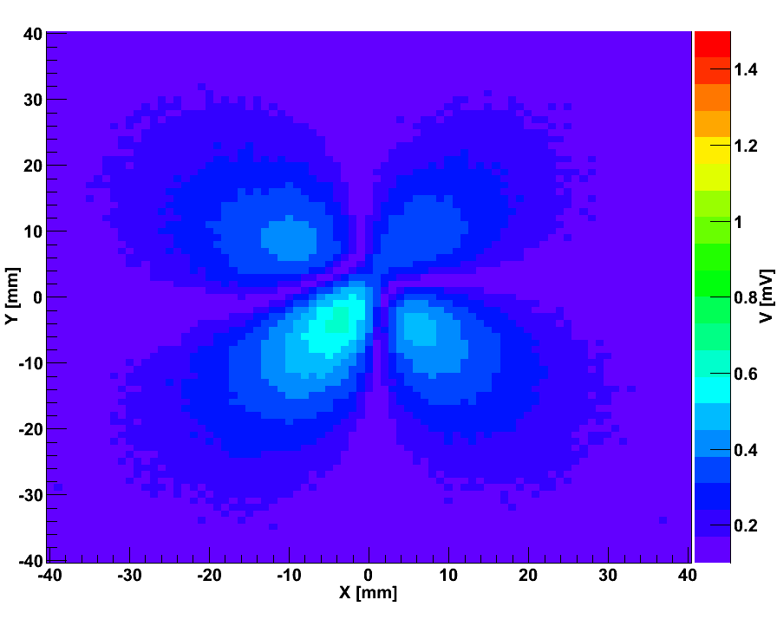
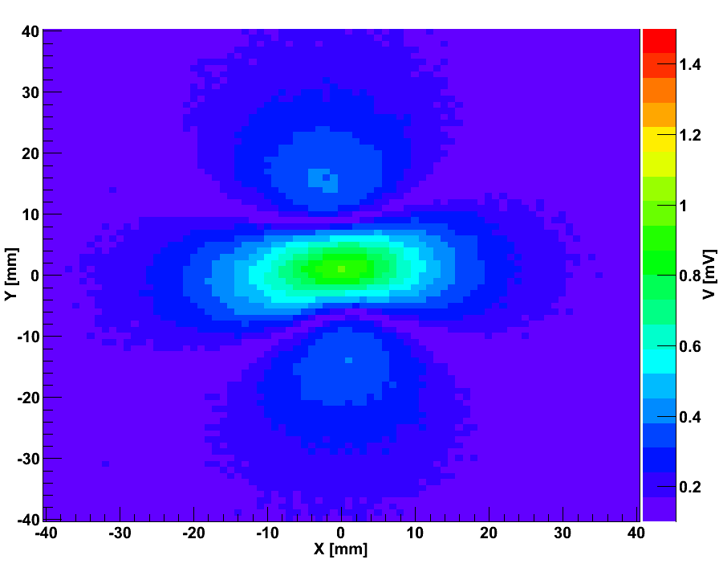
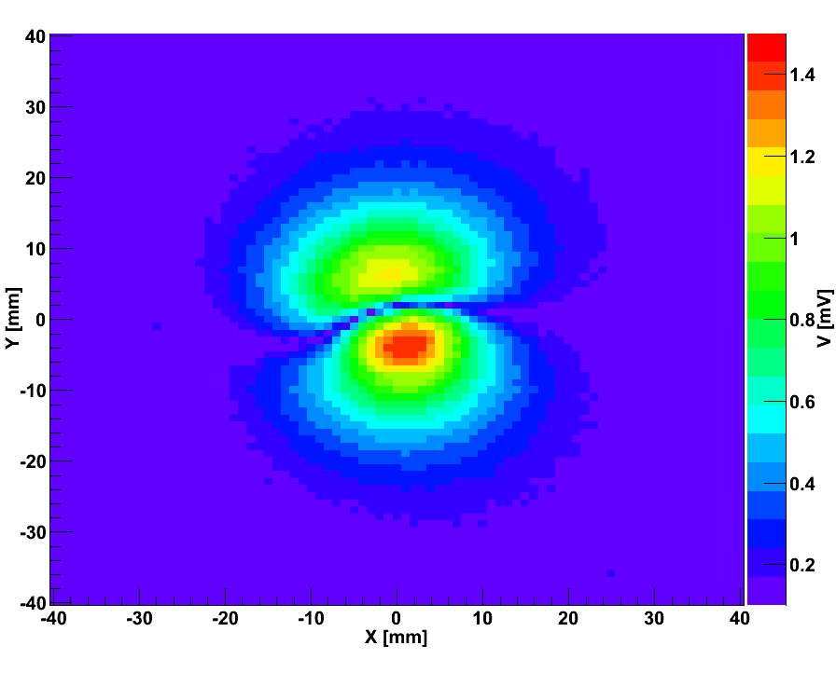
Radiated Noise Emissions
Large fast changing currents through inductor → magn. near field can induce noise
Field of air-core toroid has a multi-polar shape → module noise depends on angle
Emitted field is
measured with a
pick-up probe and
spectrum analyzer
[height of 1. peak]
z
y
x
Scanning table
Measured components of magnetic field in x-y-plane, 1.5 mm above coil:
B_{x}
B_{y}
B_{z}
B_{z}

Slide 15
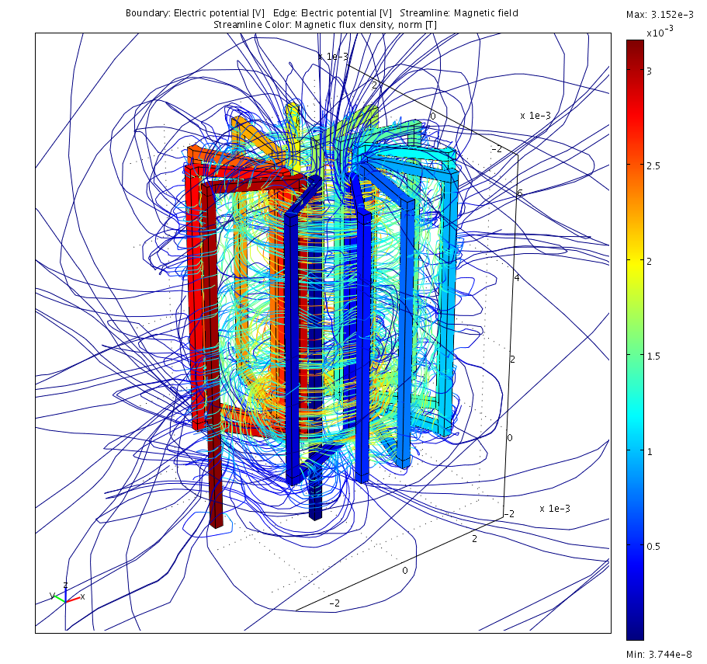
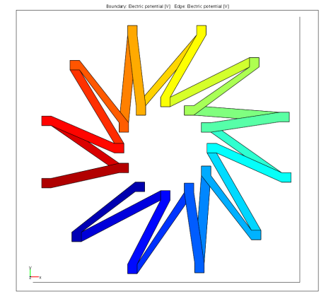
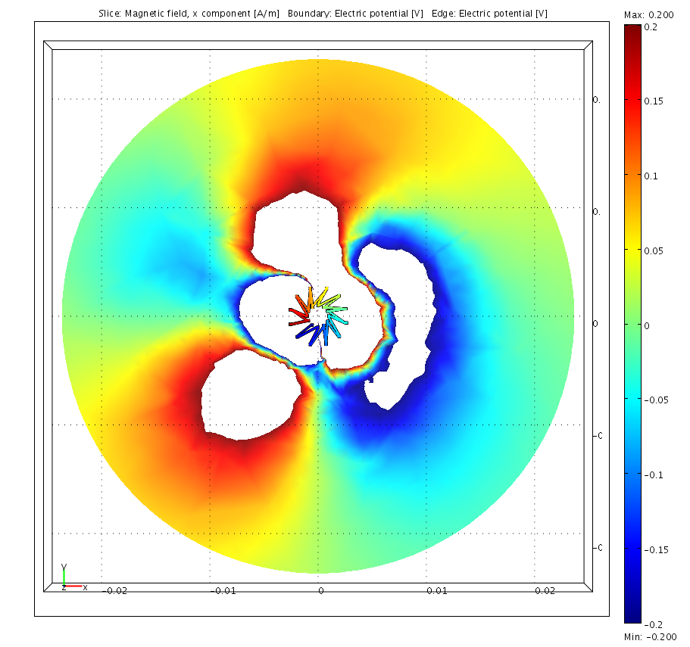
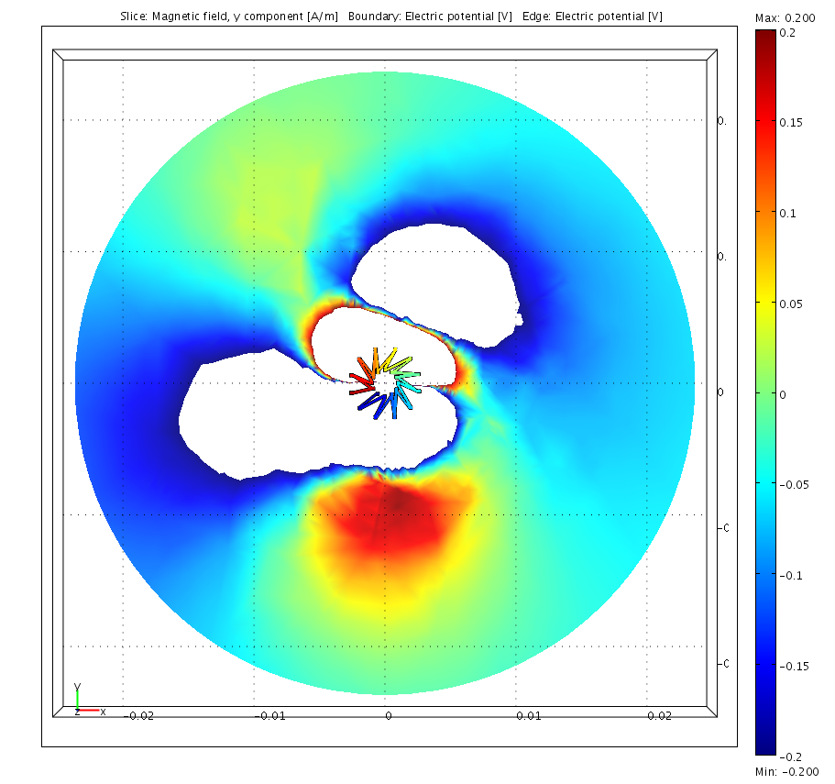
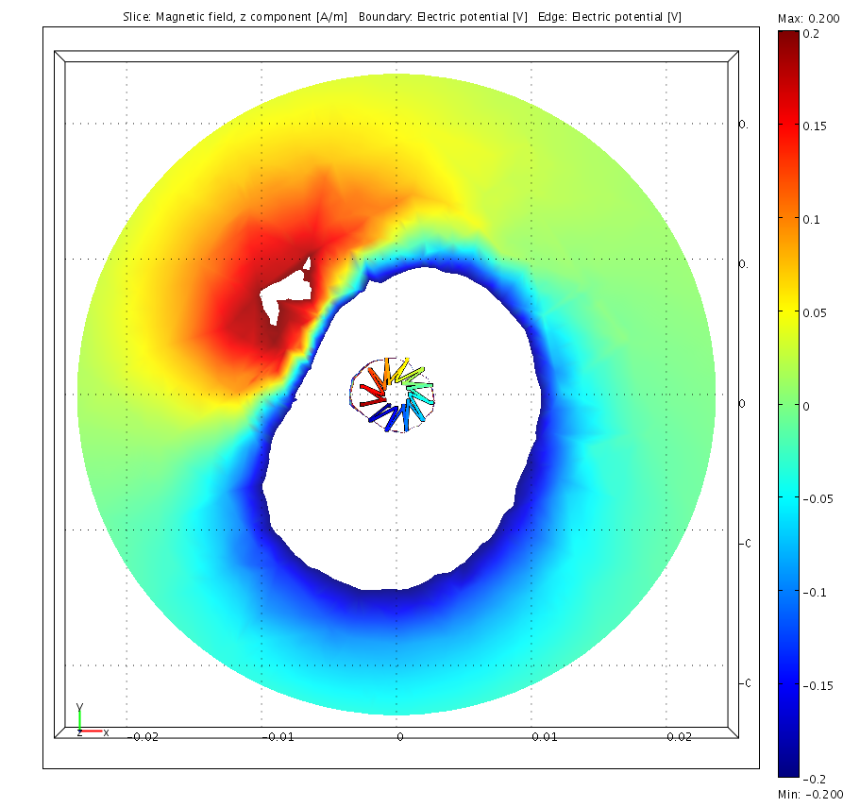
Radiated Noise Emissions
Qualitatively confirmed by DC simulation in COMSOL multiphysics
12 turns
R_{o} = 2.5mm
R_{i} = 1.1mm
L_{sim} = 206nH
Simulated components of magnetic field in x-y-plane, 1.5 mm above coil:
B_{X} [A/m]
0.2
B_{Y} [A/m]
0.2
B_{Z} [A/m]
0.2
White regions: under- or overflow
-0.2
-0.2
-0.2
Effect has been understood to originate from “twisting” of windings

Slide 16
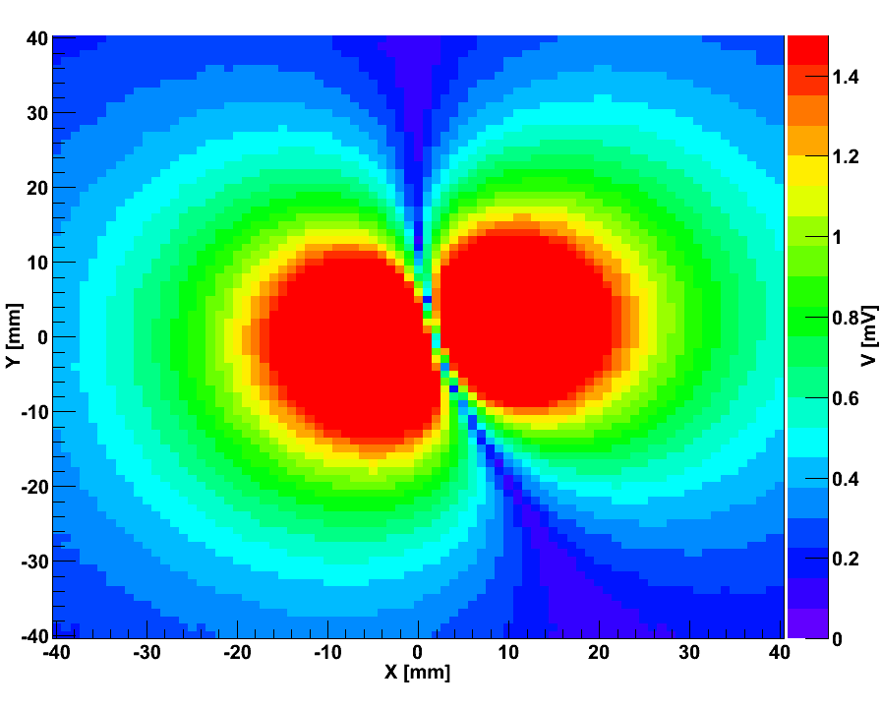
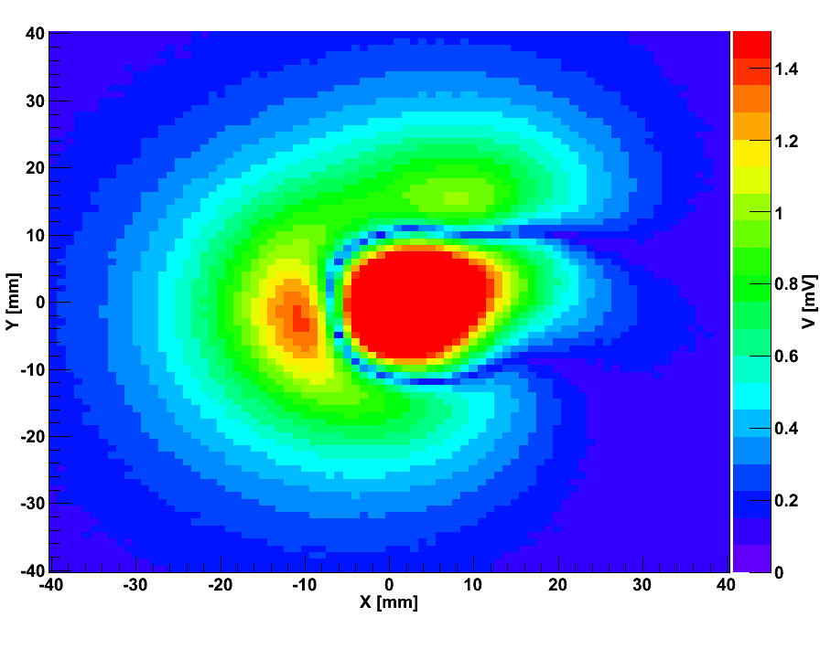
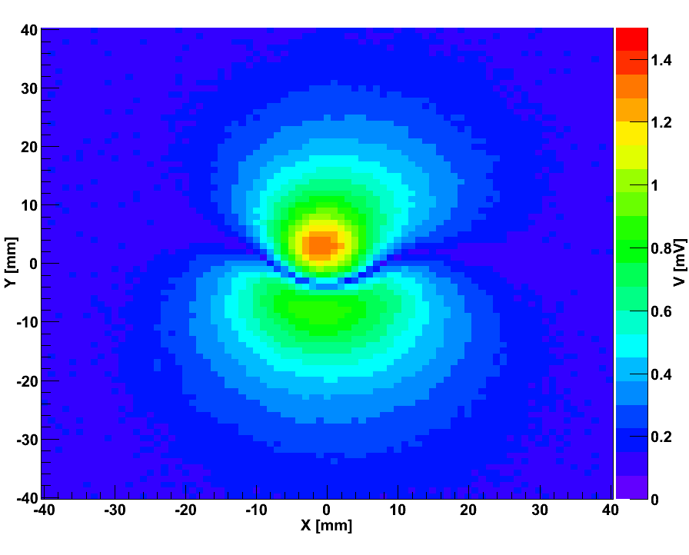
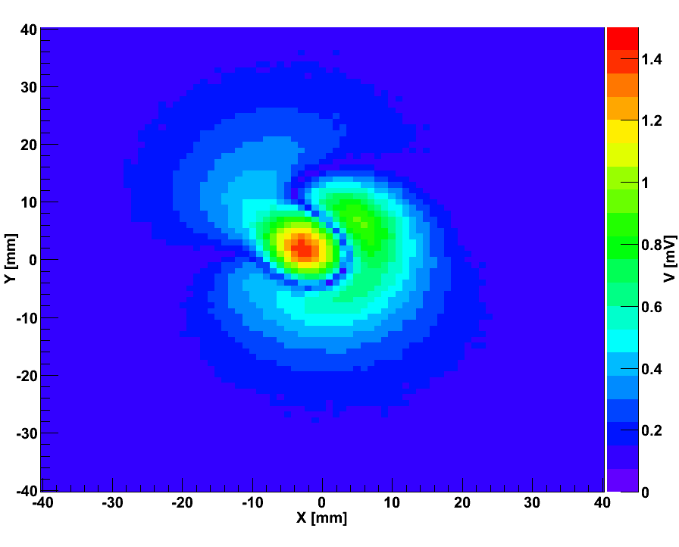
Inductor Evolution
Solenoid
Large toroid
Nom.:
538nH,
90mΩ,
~ 500mg
618nH,
104mΩ,
783mg
Mini toroid
Optimized toroid
596nH,
38mΩ,
660mg
460nH,
80mΩ,
330mg

Slide 17
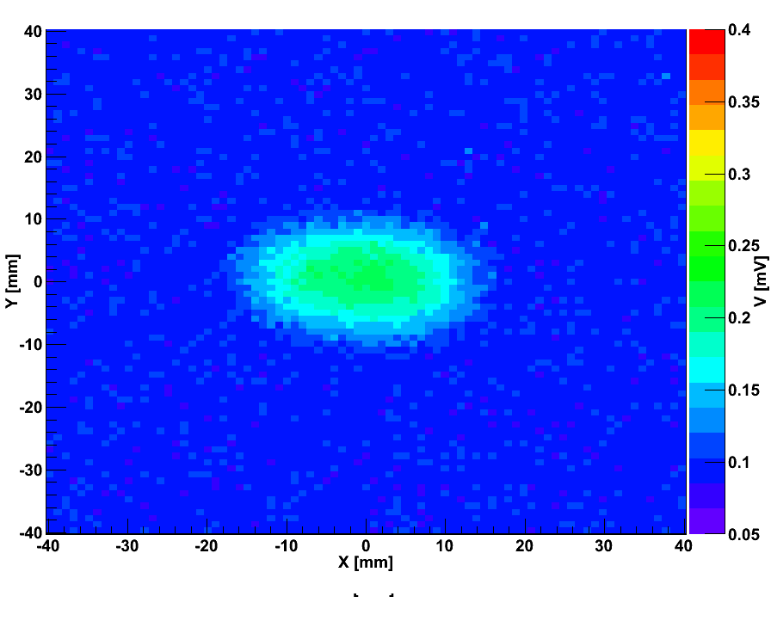
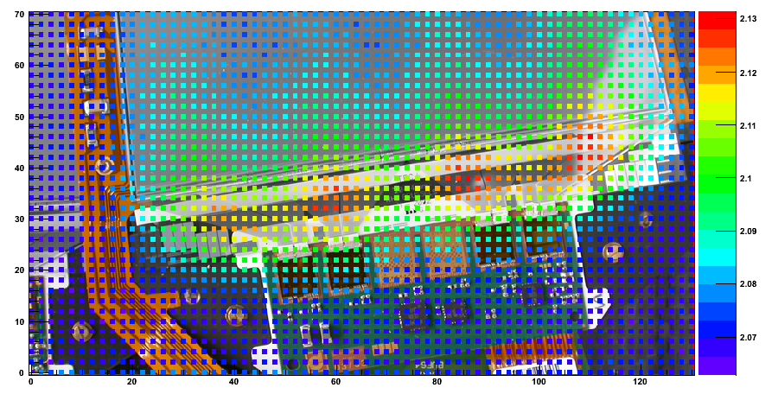
Radiated Emissions and Strip Modules
Tiny inductor operated from sinus wave generator & swept across silicon strip module
→ module noise measured as function of inductor position
f = 1MHz
d = 10mm
“point-like“ field
B_{z} couples into pitch adapter region
Loop closed via cap. coupling to backplane
Explains shape of noise
Average module noise
[ADC counts]

Slide 18
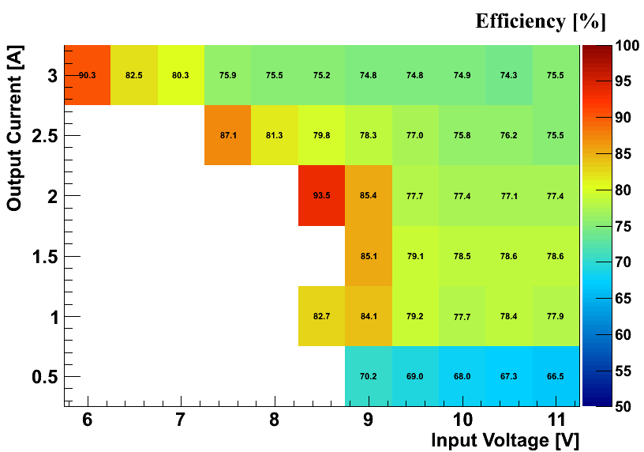
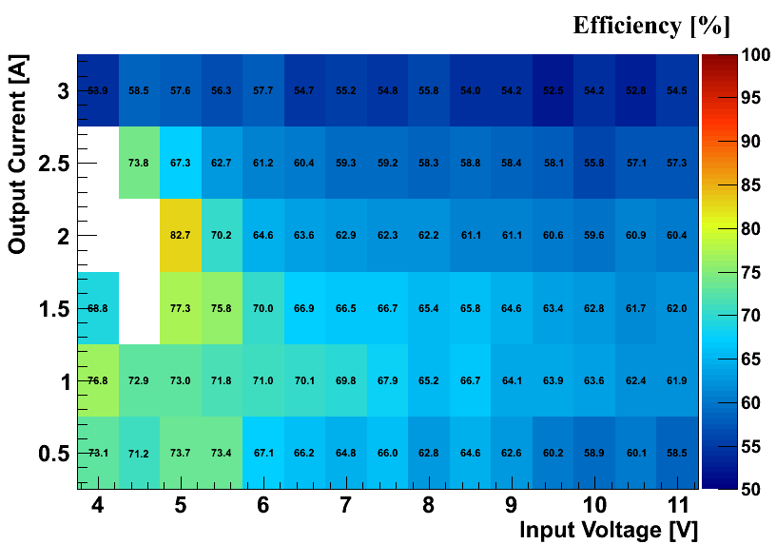
Efficiency
PIX_V4_R3, V_{out} = 3.3V
PIX_V4_R3, V_{out} = 1.25V
White regions: regulation not working properly, V_{out} too low
Phase 1 conditions: V_{out} = 3.3V, I_{out} = 3A, conversion ratio of 2-3 → about 75% efficiency: not too bad
Phase 2 conditions: V_{out} = 1.25V, I_{out} = 3A, conversion ratio of 8-10 → about 55% efficiency: too low

Slide 19
Efficiency
Resistive losses ~ 1/f_{s}; switching & driving losses ~ f_{s}
Resistive losses from
chip (R_{on})
wire bonds → flip chip packaging
inductor → inductor with lower R_{DC}
Need to balance efficiency vs. mass, volume & EMC
AMIS2_V2
V_{in}=10V, V_{out}=1.2V, I_{out}=1A
Vin = 10V
Vout = 3.3V

Slide 20
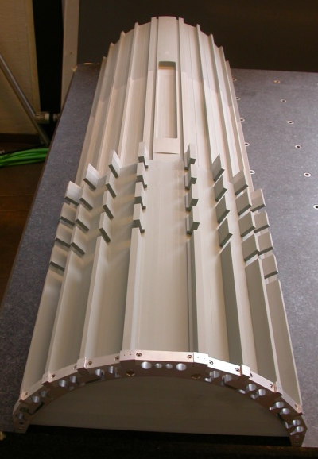
Implementation into CMS Pixel System
One converters powers 2-4 pixel modules
Conv. ratio 2-3; V_{out} = 2.3V & 3.5V; I < 3A
Integration for pixel barrel onto support tube
2.2m
Pseudorapidity η ~ 4 → material uncritical
Large distance to modules → radiation uncritical
Fast on-chip regulators → ripple uncritical (?)
Space tight, but managable
CO₂ cooling
“Easy“ access during shutdowns
DC-DC
converters
Analog
Opto-Hybrids
Connection
area
Pixel
modules
Mock-up for
integration studies

Slide 21
Summary
Development, characterization & optimization of buck prototypes for the CMS tracker upgrade, based on rad.-tolerant AMIS2 ASIC by CERN
PCB design conceptually simple, but low-noise, low-mass design is subtle
Conductive & radiative noise coupling studied with CMS strip modules
Efficiency acceptable for Phase 1 and further improvements possible
Effort has shifted towards application for the CMS pixel upgrade (2016)
Technical proposal, cost estimate, production planning
Next ASIC prototype by CERN
System aspects, integration and cooling of converters

Slide 22
Back-up Slides

Slide 23
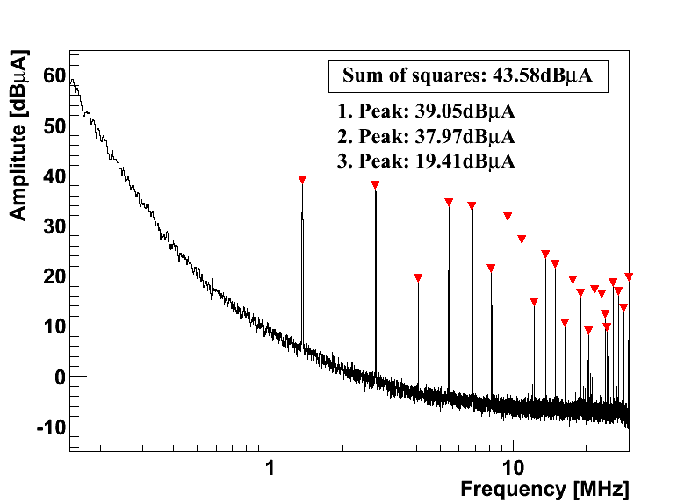
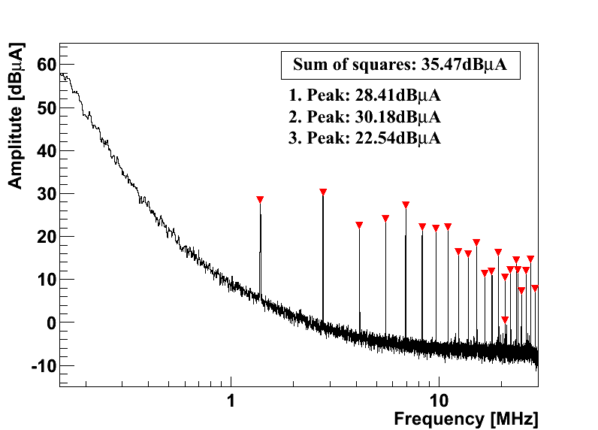
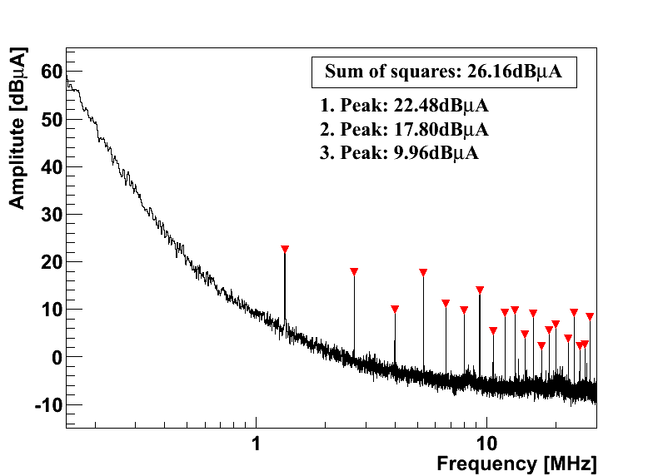
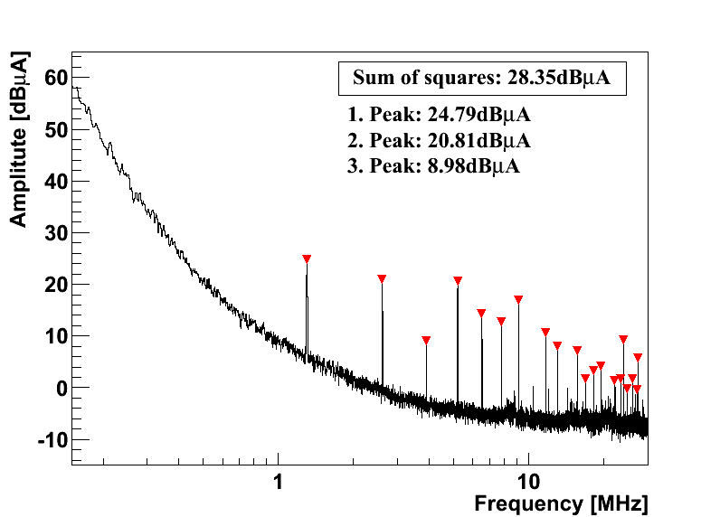
Common Mode Noise at Output
PIX_V4
Vin = 10V
Vout = 3.3V
PIX_V4_long
PIX_V4_R3
PIX_V4_R4

Slide 24
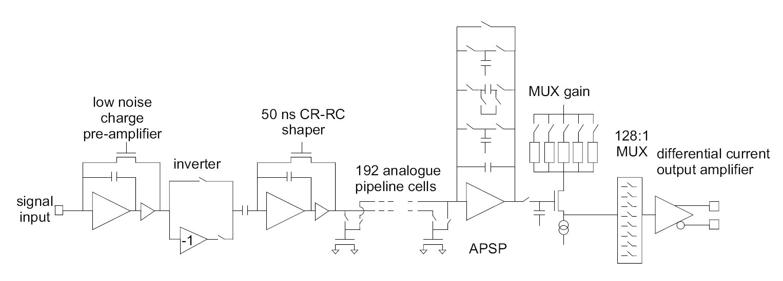
The APV25
f = 1/(2π⋅50nsec) = 3.2MHz

Slide 25
On-Chip Common Mode Subtraction
128 APV inverter stages powered from 2.5V via common resistor (historical reasons) ⇒ mean common mode (CM) of all 128 channels is effectively subtracted on-chip
Works fine for regular channels which see mean CM
CM appears on open channels which see less CM than regular channels
CM imperfectly subtracted for channels with increased noise, i.e. edge channels
pre-amplifier
inverter
V250
V250
R (external)
V125
strip
v_{CM}
v_{IN}+v_{CM}
v_{OUT} = -v_{IN}
VSS
Node is common to all 128 inverters in chip

Slide 26
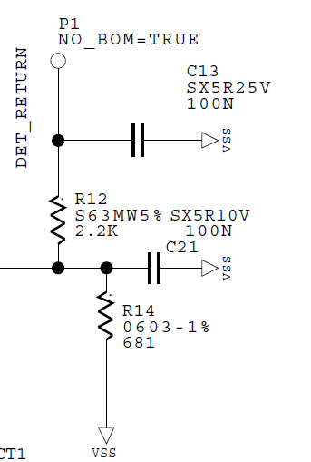
Module Edge Strips
APV25 pre-amplifier
V250
V125
strip
bias ring
VSS=GND
[Mark Raymond]
Edge strips are capacitively coupled to bias ring
Bias ring is AC coupled to ground
Pre-amplifier is referenced to 1.25V
If V125 is noisy, pre-amp reference voltage fluctuates against input
This leads to increased noise on edge channels
[Hybrid]

Slide 27
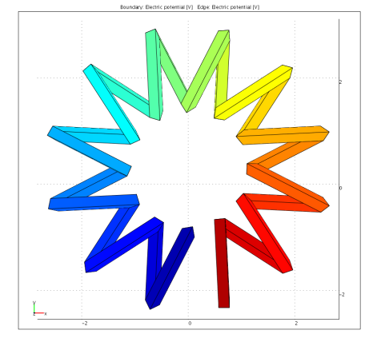
Radiated Noise Emissions
B_{X} [A/m]
B_{Y} [A/m]
B_{Z} [A/m]
Perfect
windings
Realistic
Extra
twisted

