Slide 1
GBP Report
M. Bruschi (INFN Bologna)

Slide 2
Technical note
Summary
  1. Make note clearer for non-experts.
  2. Discuss Tables and Figures to make clear what is the message to be taken from them.
  3. Make Figures large enough to see easily. Have labels on axes. Use large enough format for labels and numbers. Add "LUXE-TDR" to figures.
  4. Discuss in the introduction the use of two identical detector systems.
  5. Add section about the changes made to the CDR and why they were done.
  6. Add short section about the data structure and computing aspects.
  7. Add section of background.
Next meeting: Tuesday, January 25, 2022, 11:30 CET

Slide 3
Test Beam at ELBE (mail from D. Bemmerer)
The ELBE beam time coordinator supplied a first draft schedule. Your experiment (RP2591) is shown to run from 23.04.2022 06:00 - 25.04.2022 06:00.
There are in principle alternative dates available in the immediately following days up to 05.05.2021, but it would involve a complex dance of several proposals and beam lines changing slots.
Please check the draft dates, so that I can ask for changes if needed.
Plan to make a 1-2 days visit to the facility toward the end of January (COVID situation allowing)

Slide 4
CAEN readout system
A point was risen from some of INFN PD group electronics experts (Devis Pantano , Flavio Dal Corso) about the “low” (1.5 – 15 pF) input capacitance of the CAEN readout system which could cause a not negligible cross-talk (inter-strip capacitance ~ 2 pF)
It was decided to further investigate the point, since in any case it is important to have a full electronics simulation to properly implement digitization
Flavio has already implemented a preliminary simulation based on the info provided in the CAEN data sheets
  there are important uncertainties about the input amplifier electronics scheme
  work in progress (it was started just before Xmas)
A presentation on this is expected at one of the next meetings

Slide 5
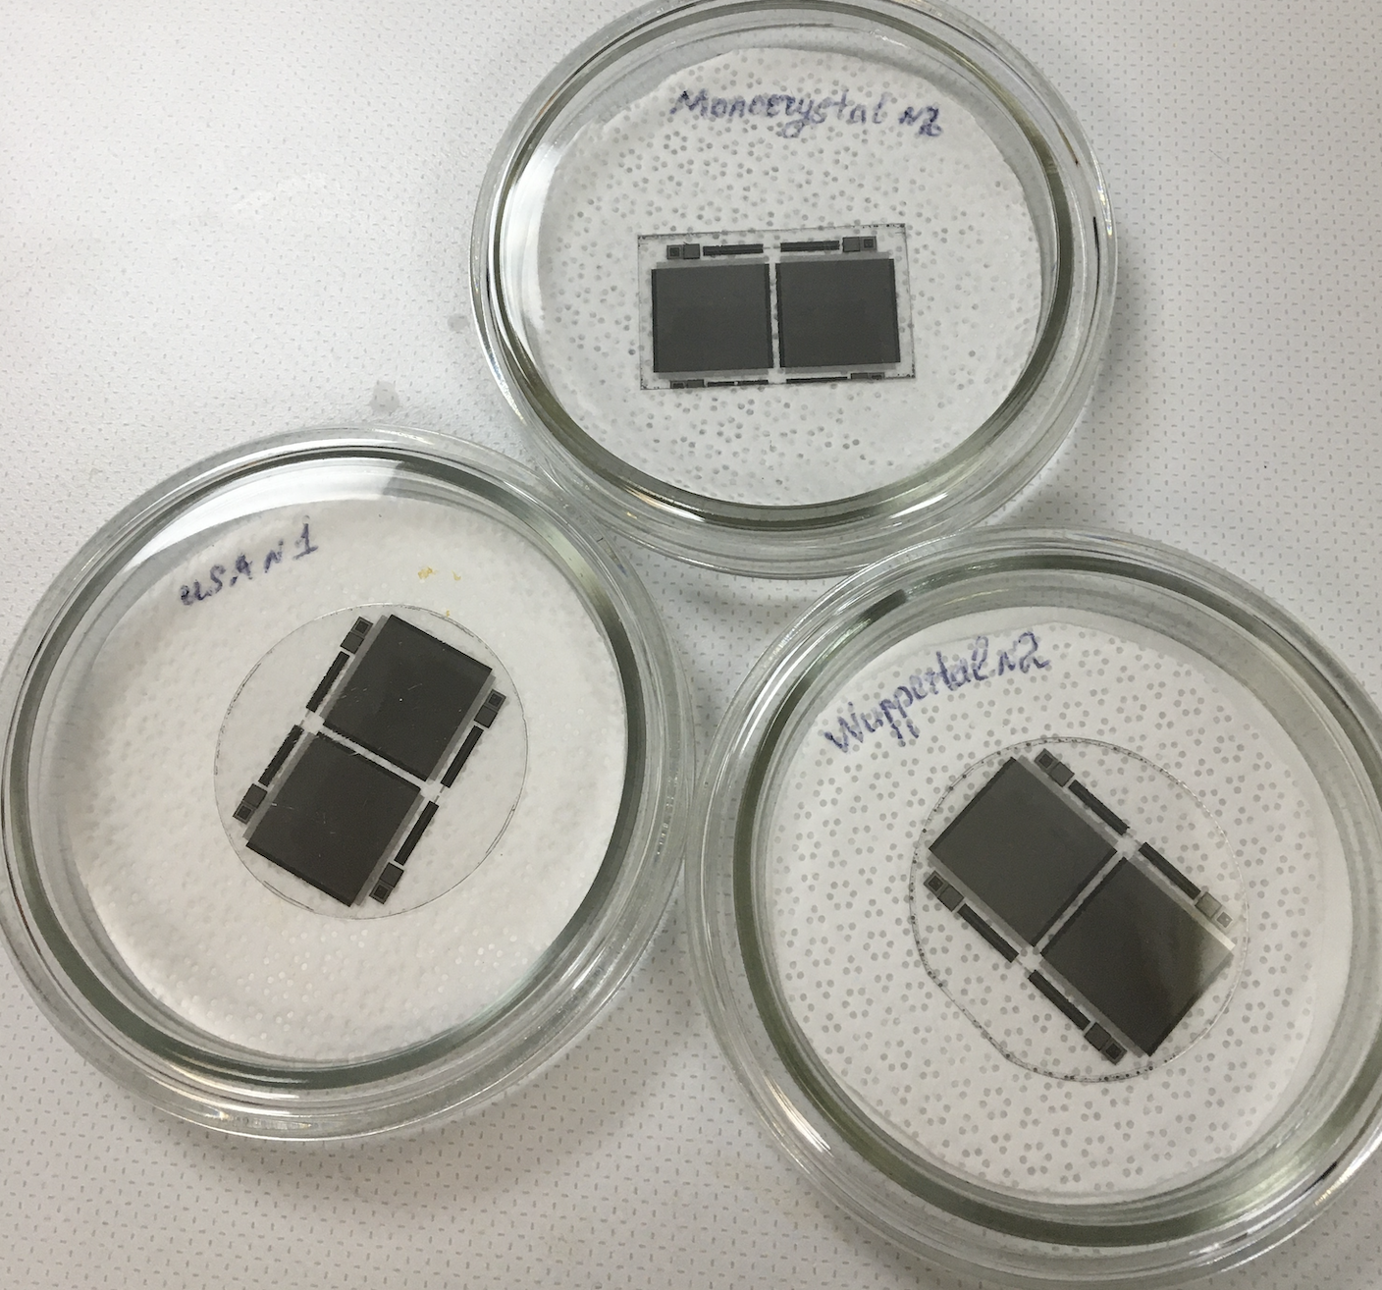
LUXE WG
We have setup two working groups
  Detector (Anton + PD and Tomsk detector experts)
  MC (Pietro and Kyle + MC experts)
    First meeting this afternoon at 16:00
    https://indico.desy.de/event/32872/
Regular reports on these activities at the general GBP meetings
First test batch of microstrip sensors was produced
Will be tested in January 2022.

Slide 6
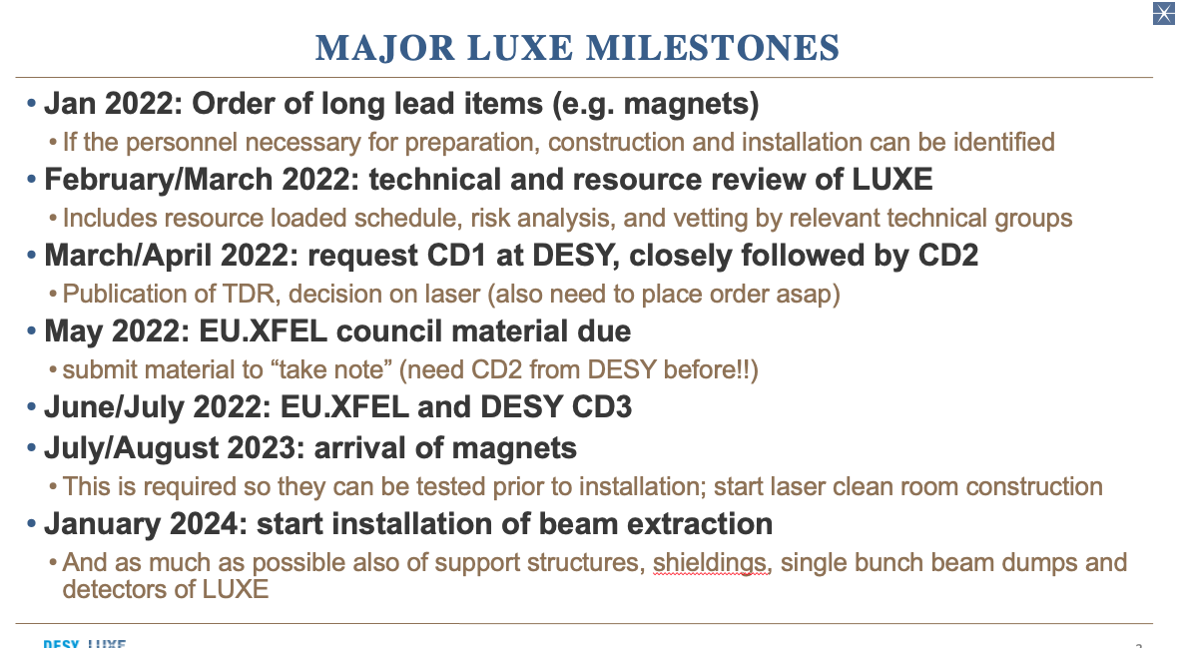

Slide 7
Backup

Slide 8
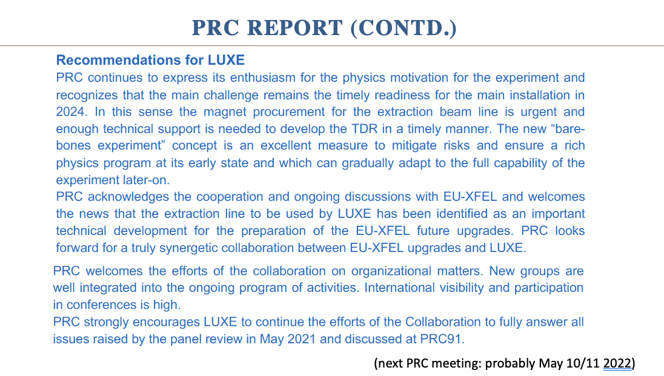

Slide 9
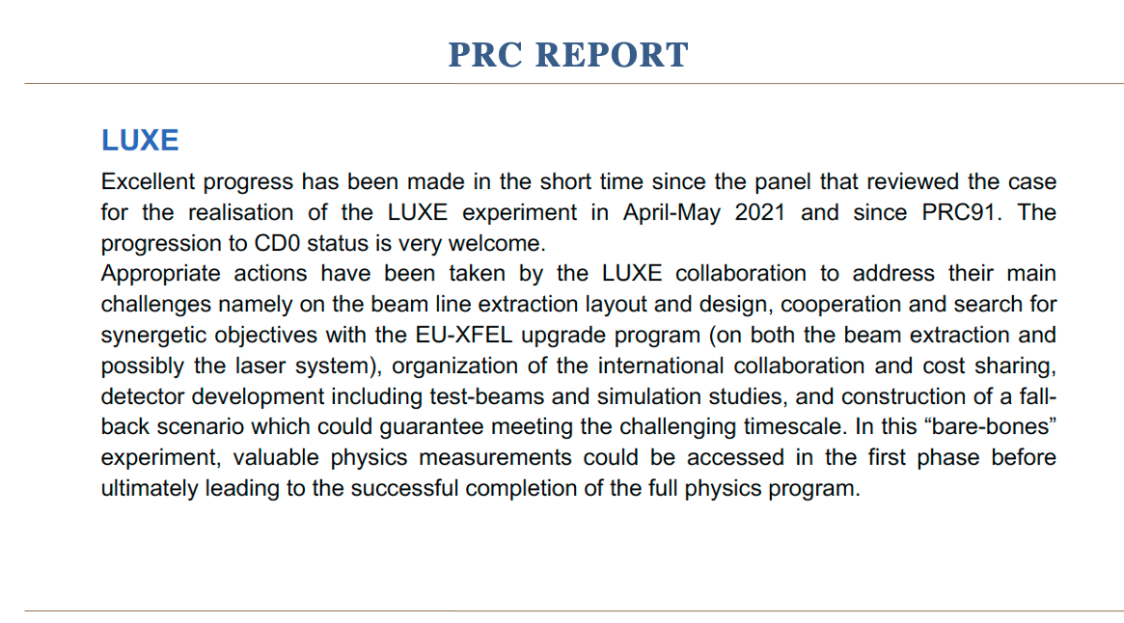

Slide 10
Miscellaneous
Critical path
  Detector performance to reconstruct ξ
Status of the support PCB
  Design exists
  Simulation on discharge free layout in Bologna
  Production in Bologna
  Available from June 2021
Status of the test beam PCB
  Design exists
  Production in Padova
  Must be available end of February
Status of the Patch Panel
  Requirements should be frozen by the end of January
  Available from June 2021

Slide 11
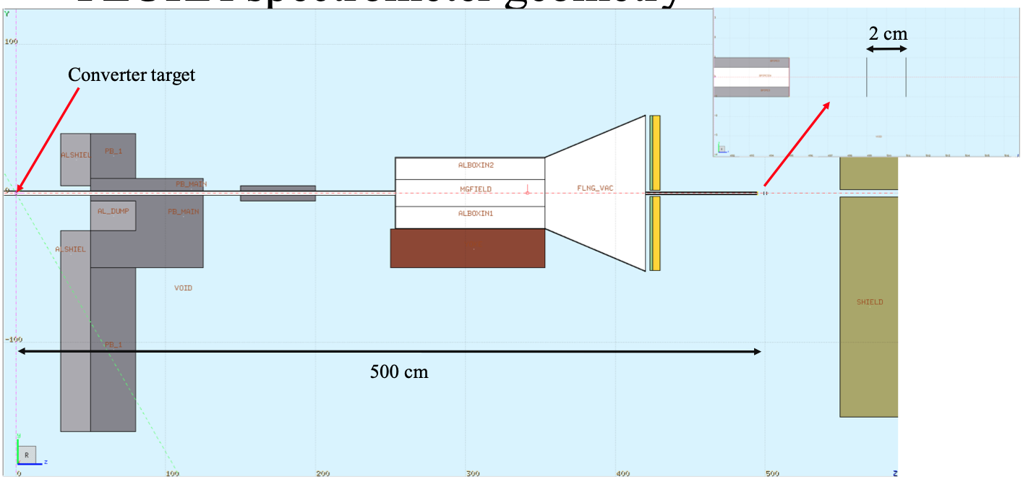

Slide 12
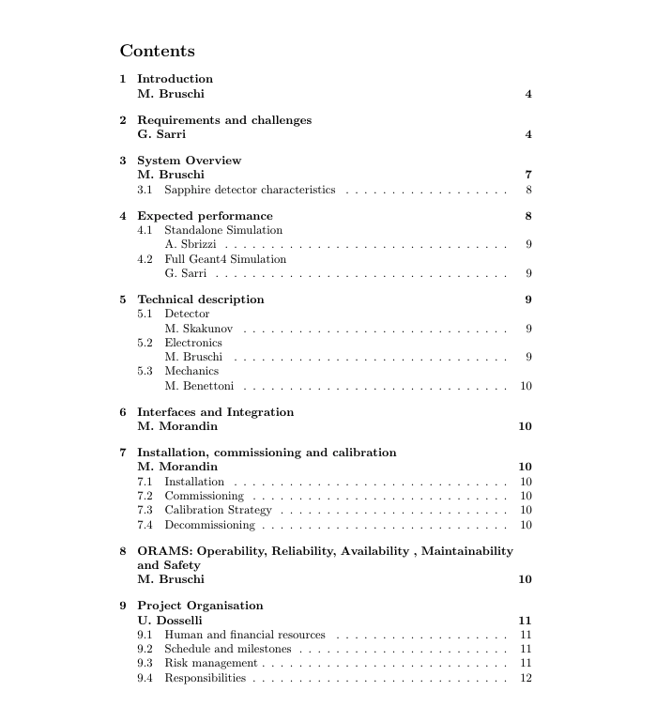


→
→

Slide 13
News on TN 1
The first draft of the technical notes should be ready for an internal review by next week Thursday November 4th.
among other information, the note should contain a draft of the resource loaded schedule and of the installation planing in appendices
in order to help filling the installation planing you can use as a very good example, the planing that was put together by Mauro Morandin from the gamma profiler team ( https://syncandshare.desy.de/index.php/s/Ds6QaDNRCcpcLNE ).
It would be nice if you could come up with a baseline planing and with a more aggressive schedule where we try to fit the installation in a 6 weeks shutdown.
Also try to explain which assumptions are made and what sort of area needs to be accessed for each steps
For information, we have planned special review session of these items during the workshop on Monday and Wednesday morning (https://indico.desy.de/event/31855/).

Slide 14
News on TN 2
For the installation of individual subdetectors there are three scenarios we need to consider:
1) installation during 2024 shutdown
2) installation during winter shutdown (4-6 weeks): this would e.g. be the 2025 winter shutdown which likely will be shortened (4 weeks)
3) installation during summer shutdown (2 weeks): this would e.g. the summer 2025 shutdown
Need to understand for each detector if it is possible to install it in scenario 1), 2) and/or 3). If e.g. scenario 1) is missed (for technical or financial reasons) do we have a fall-back solution (i.e. scenario 2) or 3)) or not that can be done (e.g. by doing extensive testing on the surface ahead of installation etc.)

Slide 15
TN 3: Open points
We need to go through our TN document and make a realistic estimate about when we can send it around to the collaboration (I do not think it will be ready for November 4)
Proposal: on Thursday November 4 we have a special EDITORIAL meeting to check the status of the document and formulation of a reliable deadline date

Slide 16
Test beam request
Deadline for application: November 8
Draft of the request circulated for comments: no comments received
  Propose to send out the document today or tomorrow
Visit to the lab: Propose to know the dates which will be allotted for our test and plan a trip a couple of weeks before

Slide 17
Today’s meeting
Reports about the lab tests (Padova, Tomsk)
Reports about MC simulation (performances, digitization): Belfast, Padova

Slide 18
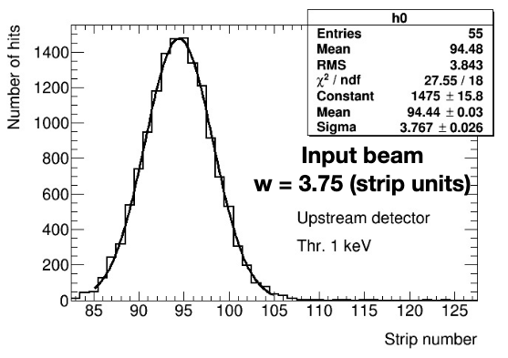
GBP measurement principles
GBP can measure X and Y distributions precisely (SA MC sample: Nγ ~ 10⁷,exp. ~10⁹ )
  Amplitude (A): ~1%
  Mean (M): ~3 μm
  Sigma (σ): ~3 μm
(Still) unknown systematics sources
  CCE
    Digitization must be implemented in MC
    CCE must be studied as a function of the dose
  Electronic noise (probably negligible)

Slide 19
Info for LUXE – Stability monitor
(relative measurements)
GBP can be a precise shot by shot stability monitor
Provide, for instance, 2D plots containing
  A_{Y} vs A_{X}
  M_{Y} vs M_{X}
  σ_{Y} vs σ_{X}
These type of plots will measure precisely (~1% level) the beam conditions and stability at the IP
  Unique measure provided by GBP amongst all the LUXE detectors

Slide 20

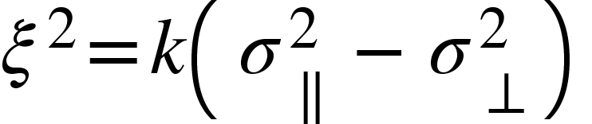
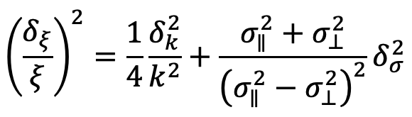
Info for LUXE – ξ measurement
(absolute measurement)
MC simulation presently available only for ξ>>1 (LCF Approximation)
  Thanks to Tom for having provided quickly MC samples usable for the technical note
  improvements in modelling ongoing, ready in a couple of months
Ratio σ∥/σ⟂ ~ ξ (proposed in CDR)
  it is applicable with lower electron energies
  Present MC simulation give other hints
A model-independent method of extracting a₀ has been proposed by Tom and others
VERY DIFFICULT TO REACH dξ/ξ~2.5% with the latter approach (it needs, at least, ξ>>1): must be carefully studied

Slide 21
Info for LUXE – ξ measurement
(absolute measurement)
GBP
  Amplitude
  Mean
  Sigma
Laser
  ξ (from 3D monitor)
XFEL electrons
  Amplitude
  Mean
  Sigma
Extract ξ_{Nominal} for each BX by using MC simulation and the inputs above mentioned
  The simulation of the gamma beam seen by the GBP should be quite straightforward

Slide 22
GBP Detector calibration
Use special runs with tungsten converter foil (~ 10^7 gammas/BC)
Acquire several shots by moving the station position and measure detector response and compare with MC simulation (I assume electron beam initial condition is well measured)

Slide 23
Test beam request
Deadline for application: November 8
Draft of the request is ready and circulated for comments
  Deadline for comments: Monday October 18, then submitted to the ELBE
Visit to the lab
  postponed
  Constraints (days excluded)
    October 20-29
    Mondays
  Machine developments (visit possible, but with caveats)
    November 8-12
    December 6-10
  I will propose some dates in December in a forthcoming DOODLE

Slide 24
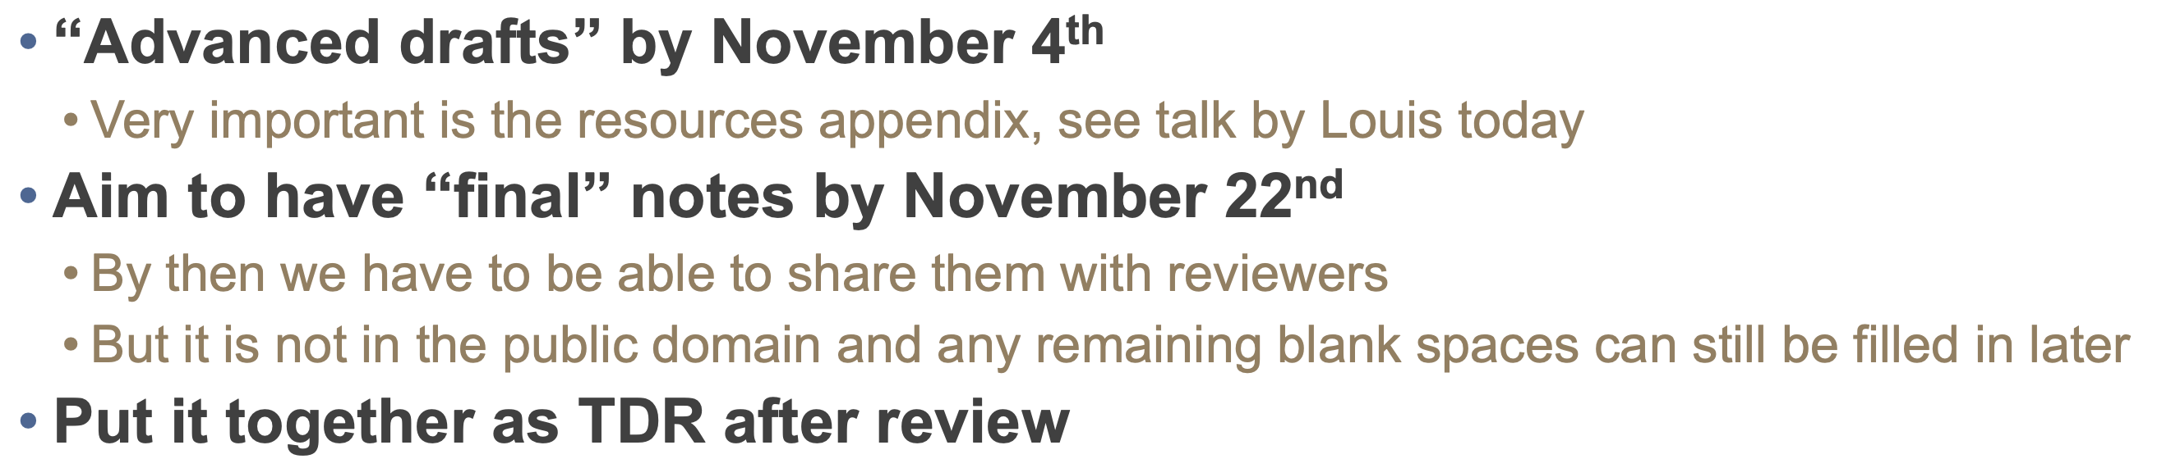
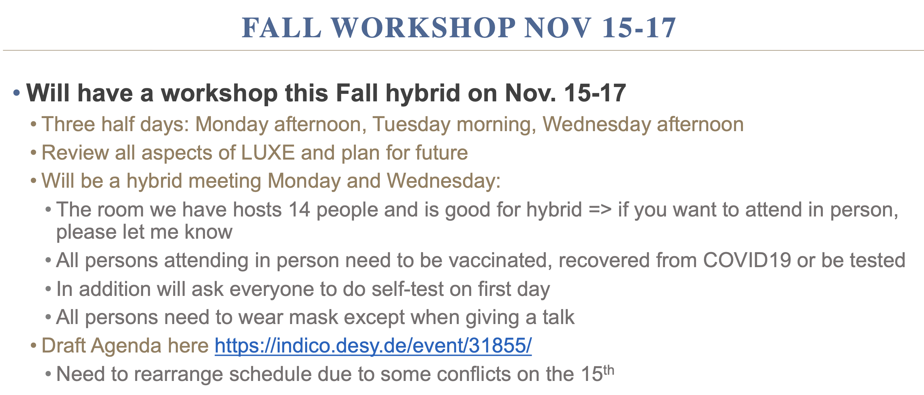
Other news
Timeline for the technical note

Slide 25
GBP collaboration tasks
Detector
  Procurement (DESY, U. TOMSK, INFN PD)
  Production (TOMSK)
  Design and Integration (DESY, BELFAST, PD, BO, TOMSK)
  Tests
    Characterization in the lab (DESY, PD, BELFAST –laser tests at RAL-)
    CCE uniformity (DESY, PD, TOMSK)
    Test Beam (DESY, BO, PD, TOMSK, BELFAST)
Mechanics (PD)
  Design (DESY, PD System Eng.)
  Production
  Tests, Commissioning
Electronics (BO)
  Design
  Production
  Tests, Commissioning
Data Acquisition (milestones in the readout talk)
Slow control
  HV,LV
  Table movements (PD)
  Calibrations (BO)
Data Quality (DESY, PhD)
MC
  Detector performances (PD –PhD-, BELFAST)
    Stand Alone
    LUXE
Data Analysis (DESY, PhD, BELFAST)

Slide 26
Q/A
Q: Do you have any general purpose support structure available for placing solid state detectors on beam ? Since we have to design the PCB supporting the detector we could probably adapt the design in order to fit the PCB in another supporting tool.
A: We generally mount our detectors with Bosch profiles. I attach a couple of photos from two weeks ago which may give you an impression. You may also place material simply on a flat table.
Q: Do you have movable tables where to place the device under test? If so, which are the characteristics?
A: We have an electropneumatic lifting device which can also move left/right, remote controlled. In each direction, at least 10 cm motion is possible.
Q: Which is the cable length needed to transmit the detector signals in the counting room ? Do you have already some signal cable installed which could be used ? which type are they ? Do you have also HV cables ? which type and which connectors?
A: We have already installed BNC signal cables and SHV high voltage cables of ca. 20m length each to the counting room. Adding other cables might be complicated because the cable ducts as far as I know have been closed with some fire resistant material, after the cables were placed there.
Q: Which is the typical bunch duration assuming 10e6 electrons per bunch at 40 kHz repetition rate?
A: I believe this can be relatively freely set based on your requirements, using the macro- und micro-pulsing capabilities. Do you have a desired bunch length?

Slide 27
Technical Note Status
The CDR text already implemented
  Must be updated by the different editors
The writing of the document must start to be delivered to Beate at the beginning of November
Critical sections (strongly rely on MC)
  Expected Performances
  Calibration
  Also: a lot of organization parts to be thought and written from the scratch
We will start today with the MC status
  Decision on what can be ready for the end of October
  Organization of the work, milestones

Slide 28
LUXE Gamma Beam Profiler test beam requirements
Period: Beginning 2022
Experimental setup:Three samples to be tested
  1 sapphire waferfrom university wafer dz~150 um, 4 strips 0.5x20 mm2
  1 sapphire wafer from Cristal company dz~150 um, 4 strips 0.5x20 mm2
  1 sapphire wafer company in Wuppertal dz~105 um, 4 strips 0.5x20 mm2
Very basic support pcb with signal output on lemo cable.
Given the signal charge (tens of pC) the readout setup can be also placed in a safe area and the signal acquired during the irradiation
The 4 channels can be readout by a scope or with other system to be decided.
Important the possibility to record signals amplitude and duration and also the charge of the signals (for CCE measure) and the HV currents as well.
All the setup must be placed in a safely reachable area or otherwise remotely controlled.
Remote control of all the setup is in any case advisable (also in case the system is accessible directly during irradiation)
Signals should be recorded after interval of 1 MGy irradiation up to at least 10 MGy for each sample.
Also, important to take data at different HV (at least 4 different voltages)
Given the steep worsening of the detector response with the absorbed dose, probably some more data points in the first MGy should be taken

Slide 29
Beam conditions
If we assume beam spot area 5 mm^2, then we need 2.5 nA beam to get local dose rate 1 MGy/hour.
For signal measurement we may assume resolved bunches of 10^6 electrons per bunch.
Could be that both requirements are compatible if we have ~ 40 kHz bunch repetition rate, then we can use stable beam conditions and use DAQ only in signal measurement mode and HV current measurement during irradiation.
So then we do ~1 hour irradiation, get signal measurement, then repeat it 10 times for each sensor. We need at least 2 days, 3 shifts per day (3x8 hours).
In principle 6-8 people can do it.
Energy of the beam particles is not critical: 10-20 MeV is good.
We should figure out, what equipment/DAQ can be provided by the ELBE lab, if dose measurement by extra thermoluminiscent dosimeters are possible (3 dosimeters for 3 sensors downstream samples) and if accommodation of 8 people is feasible at ELBE guesthouse.
Covid regulations on site should be considered.

Slide 30
Input from the ELBE (Daniel Bemmerer)
Requests should be maximum 2 days
if needed, it is possible to have extra 8h shifts in the future provided that the lab has a short notice (I do not know how well we can use this opportunity. But 8h can be handled by 2 people and this could make things easier)
ELBE has a foyer to accommodate us
Instrumentation
  1) Digital scopes. We have several fast 4-channel scopes, at least one can be dedicated to your experiment. These would be 4 channels, 5 GS/s digital scopes. Alternatively, we have 16 channels (1 is broken, so it is 15) of 2 GS/s Acquiris digital oscilloscope.
  2) Ionisation chamber. The one we have is a Roos Chamber Type 34001, 0.35 cm^3, with display either in charge or in water dose. This is an integral measurement, can be read out from the counting room but won’t be directly connected to the scope so no high-resolution time correlation.
HV system is crucial for the measurement and should be probably provided by us

Slide 31
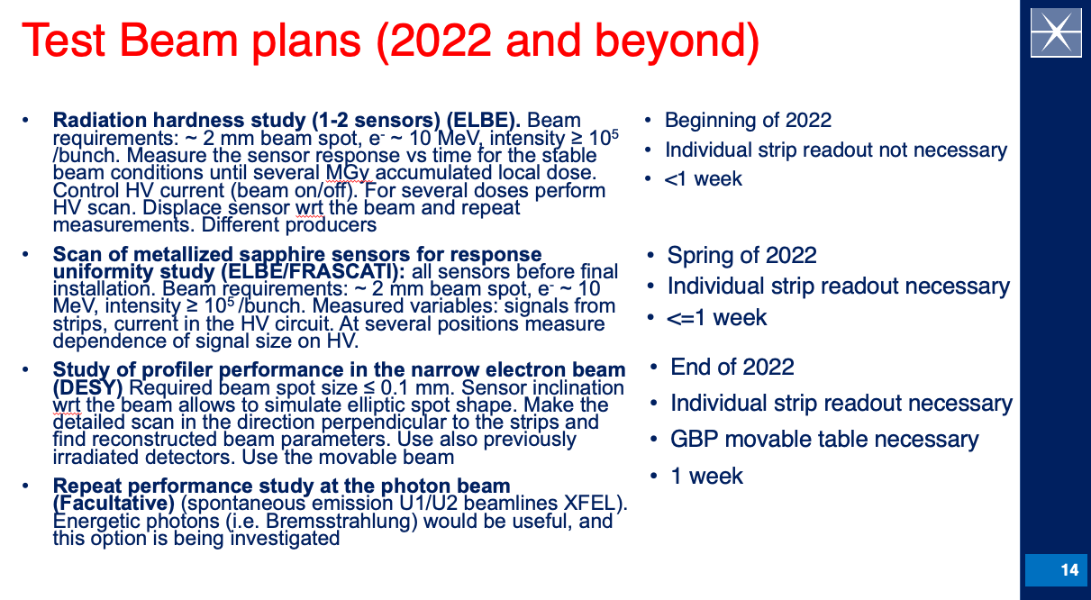
First quarter 2022
Third quarter 2022
First quarter 2023

Slide 32
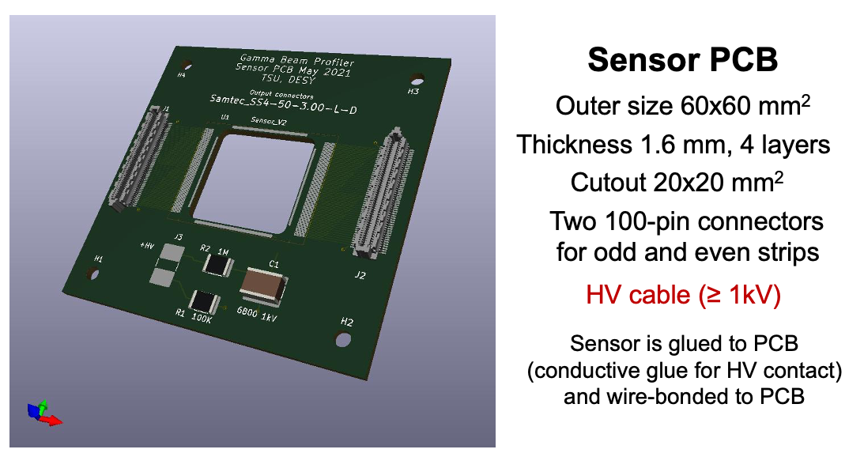
Status of support PCB production
Gerber files submitted to Bologna expert at the end of June 2021
First comment: Increase lines spacing from 40 um to 60 um
Five companies contacted at the beginning of August to produce the PCB
Only one answered until now
HV cable (<=1 kV)

Slide 33
Status of support PCB production
Only one company answered until now
  The offers are rather expensive
    EPIG (Au-Ni pads for bonding): 10 samples (min) → 5 keuro (fine if Al wires used)
    ENEPIG (Au-Pd pads for bonding): 10 samples (min) → 6 keuro
    The 1.6 mm thickness will guarantee the needed stiffness for bonding the detector
  Other offers should come soon
The design must be updated
  60 um spacing
  Design a second PCB for vertical strips
Main questions
  Who is making the design ?
  Should we produce the PCB in Italy or Russia ?

Slide 34
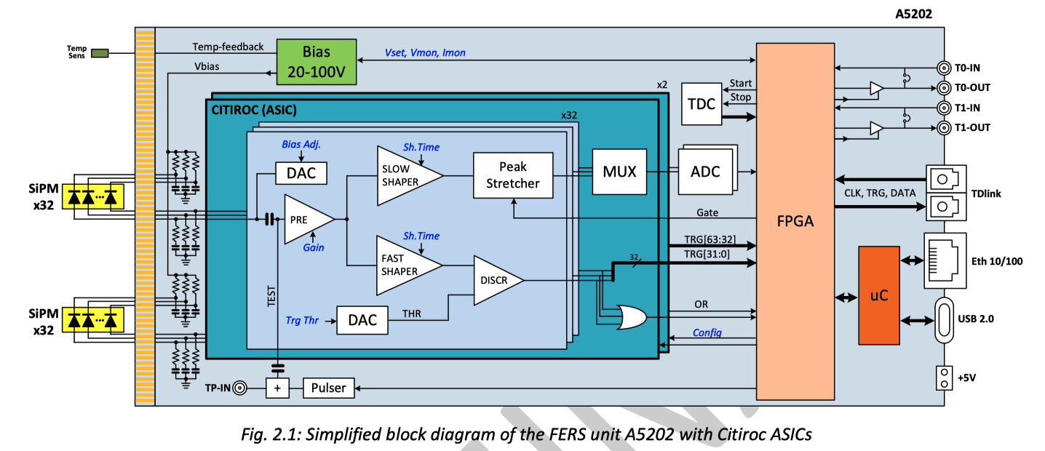
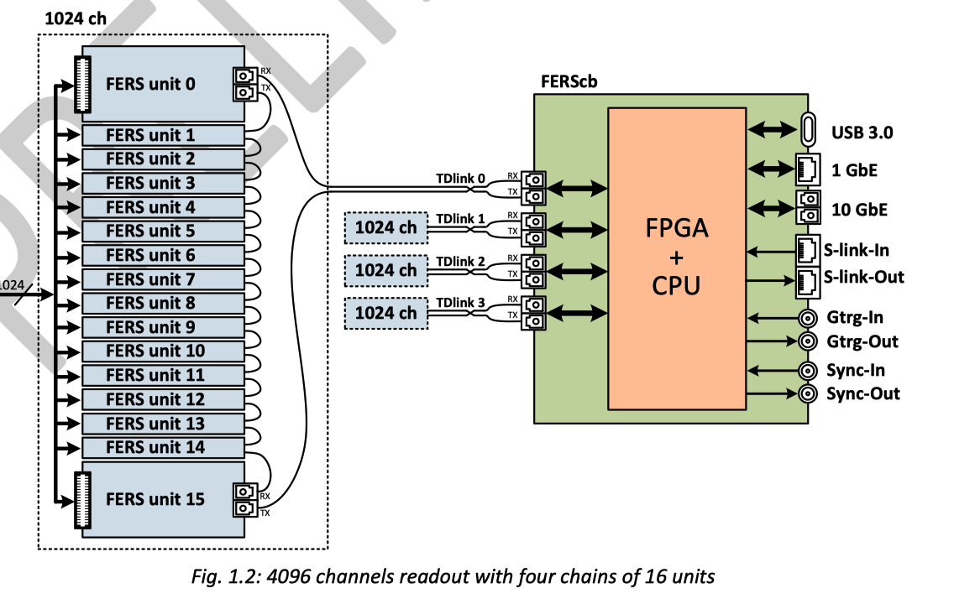
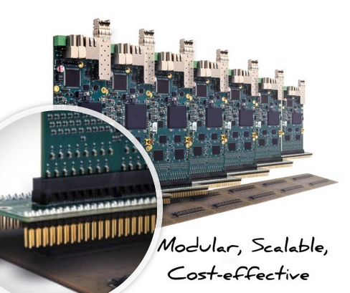
Readout electronics
It is a rather simple design
  Signal strength: ~30 pC/BX (max. at first detector)
  Low rate: 10 Hz
Sample-and-Hold capacitor matrix
  Control logic for switching and multiplexing outputs to read them out
Read out card: existing commercial solution
  FERS-5200 modular reading system developed by CAEN based on CITIROC (Orsay)
  64 channels per card (dynamic range13 bits)
INFN Bologna will design and build a patch panel (PP) to distribute the detector's signals to the readout boards plugged into it.
  6 M.U. agreed with the Electronics Service in 2022 for design of PP

Slide 35
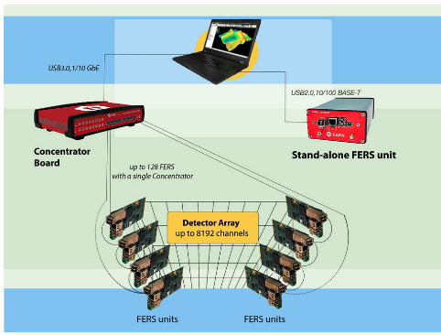


Readout system
DT5215 Concentrator Board for FERS-5200
A5202 64 Channel Citiroc unit for FERS-5200

Slide 36
Important news
From: Yan Benhammou
Sent: 22 July 2021 12:50
To: Marco Bruschi
Cc: Yan Benhammou; Louis Helary
Subject: Re: Gamma beam profiler readout
Dear Marco,I checked and :
- you can connect to an external clock (NIM/VSDL) so it could accept the TLU signal
- the software is under windows. There is two ways to communicate: ethernet or USB. I think that it will be easy to encapsulate the ethernet frames within a EUDAQ component. It could be more difficult with the USB port but still doable.
Good News for the use
of CAEN FERS 5200 system

Slide 37
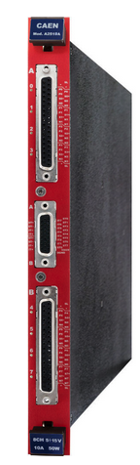
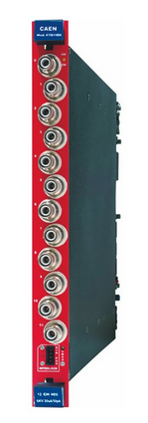
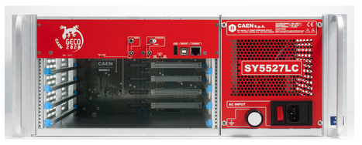
HV System
SY5527LC - 4 Slot LOW COST Universal Multichannel Power Supply System
A2519CA - SYx527 L.V. channels 15V 5A (50W) - DB37 - Individual Floating - Current Controlled (8 ch)
A1561H 12 Channel 1 kV/20 µA Common Floating Return Boards

Slide 38
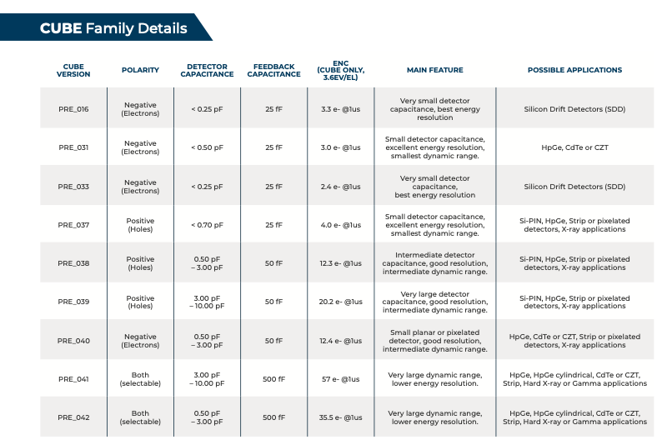
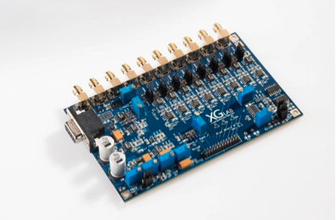
Very low-noise electronics to test sapphire
https://www.xglab.it/products/cube/
Strip capacitance: 1.84 pF
MIP signal:22 eh/um
Thickness: 100 um
CCE: 50%
Total signal: 1100 el
Total noise: 12.4 el
Starting kit:
5 CUBE (400 euros/piece)
1 Bias Board 8CH
(800 euros/piece)

Slide 39
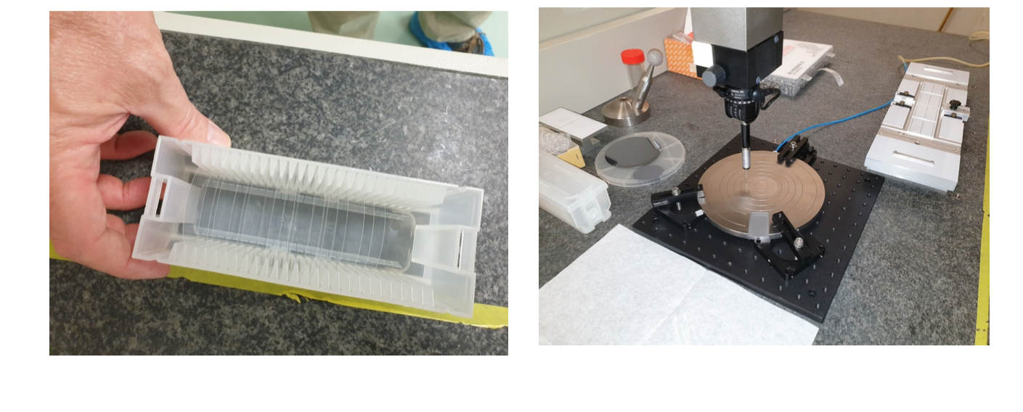
Measurements on wafers started in Padova

Slide 40
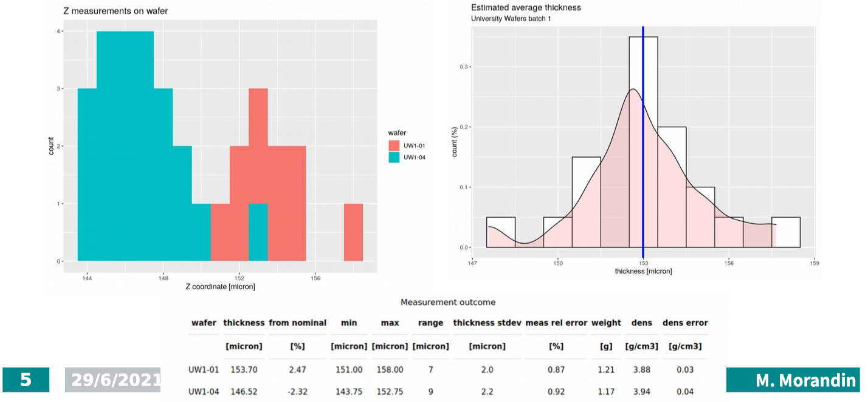
Thickness measurements
Uniformity of response tests with radioactive source starting

Slide 41
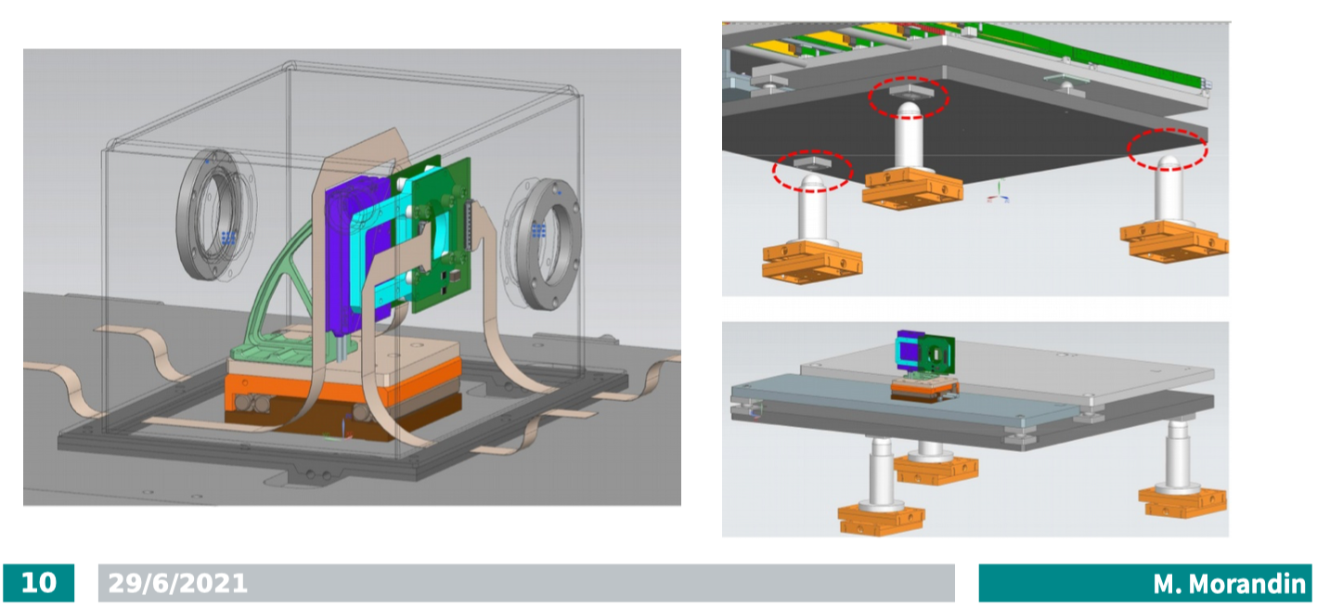
First design of the precision movement support

Slide 42
Status of the Test Beam Requests
A proposal for the tests to be performed prepared by Sergej and me and submitted to ELBE expert Daniel Bemmerer
Zoom meeting with DB on 25/08 to preliminarly discuss our proposal
  The proposal is substantially fine (some improvemenys needed)
  Must be completed with a two page description of the physics case for the need of our tests and submitted to the test beam facility organizing committee before the end of September (decision in October)
  Suggestion not to ask more than 2 days (we proposed 48 hours in three days, so we need to cover 3 eight hours shift per day)
  There are realistic possibilities to get our beam time in Jan/Feb 2022
  If needed, there is the possibility to get additional 8 hours shift later with short time notice from the machine experts
Some instrumentation needed for tests can be provided by the ELBE laboratory
  Digital scopes. There are several fast 4-channel scopes, at least one can be dedicated to our experiment. These would be 4 channels, 5 GS/s digital scopes. Alternatively, there are 16 channels (1 is broken, so it is 15) of 2 GS/s Acquiris digital oscilloscope
  Ionisation chamber. The one proposed is a Roos Chamber Type 34001, 0.35 cm^3, with display either in charge or in water dose. This is an integral measurement, can be read out from the counting room but won’t be directly connected to the scope so no high-resolution time correlation
    MC simulation will be needed for the conversion to GBP detector doses
I can prepare the documents for the final submission by the end of September
  Extended discussion on this test beam at ELBE at the meeting on September 16th

Slide 43
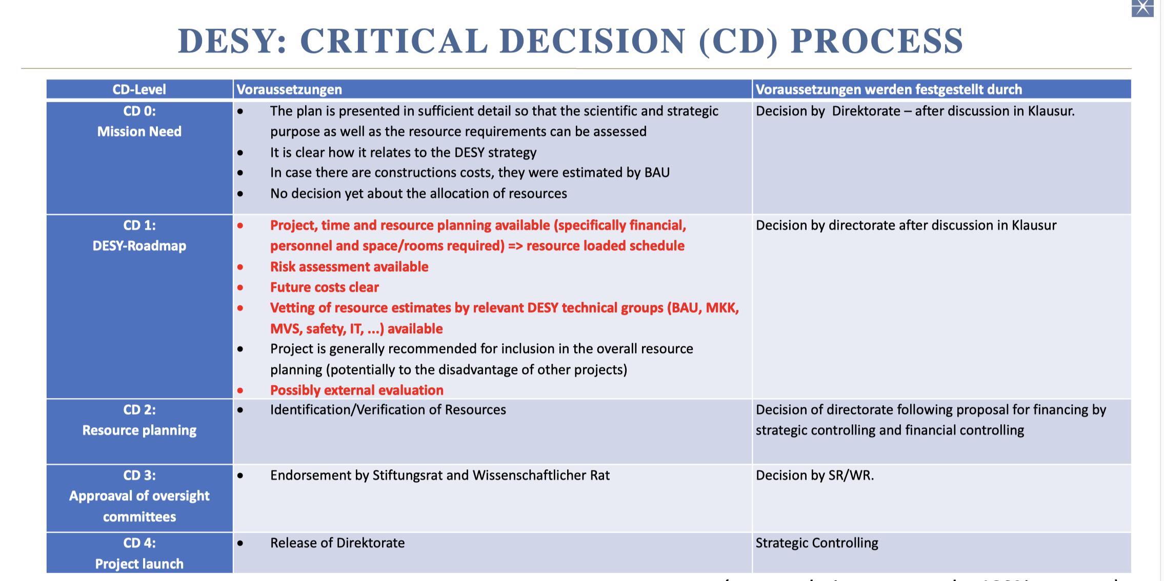

Slide 44
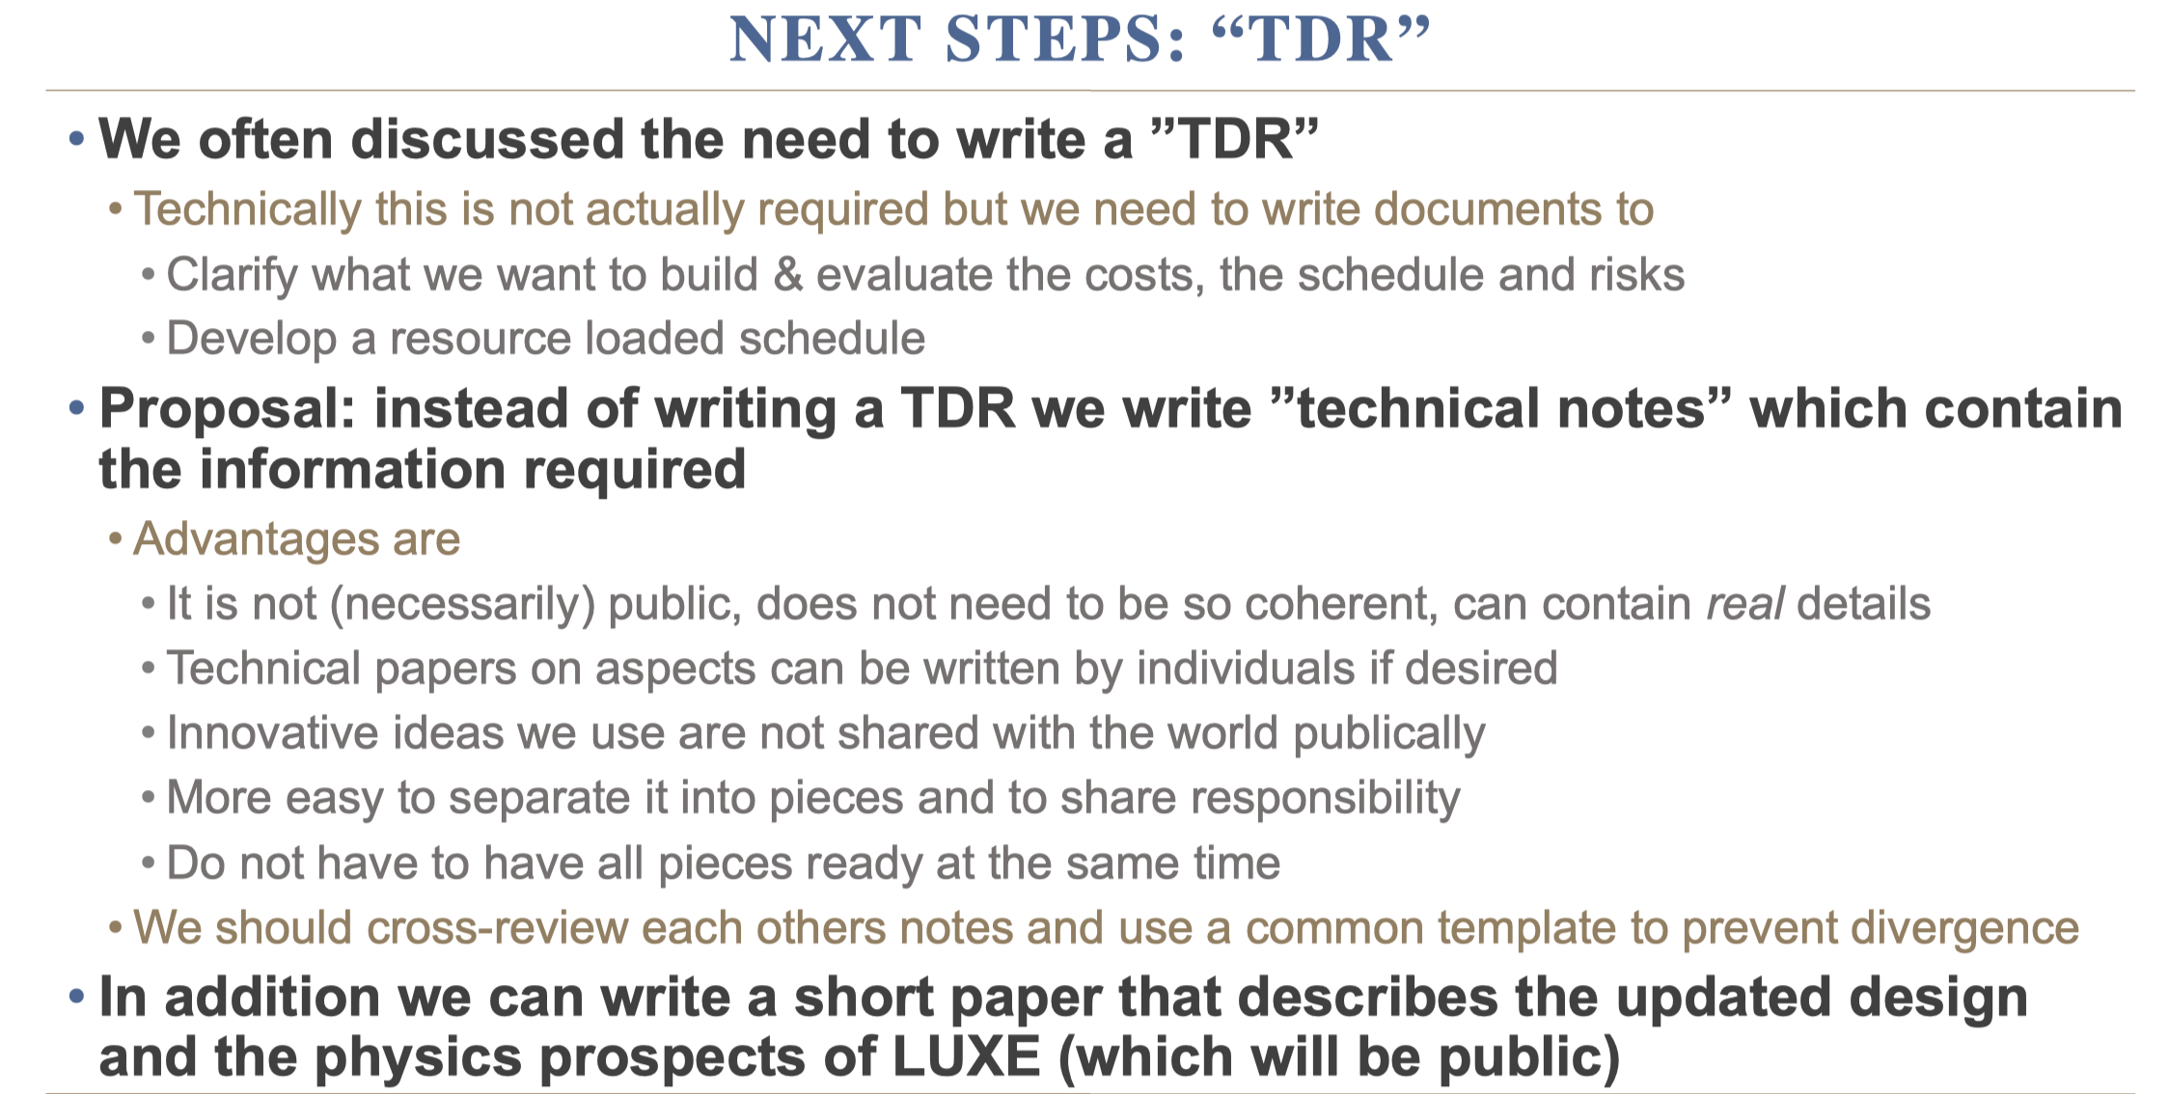

Slide 45


https://www.overleaf.com/read/zdsbztjptkyb

Slide 46
GBP collaboration tasks
Detector
  Procurement (DESY, U. TOMSK, INFN PD)
  Production (TOMSK)
  Design and Integration (DESY, BELFAST, PD, BO, TOMSK)
  Tests
    Characterization in the lab (DESY, PD, BELFAST –laser tests at RAL-)
    CCE uniformity (DESY, PD, TOMSK)
    Test Beam (DESY, BO, PD, TOMSK, BELFAST)
Mechanics (PD)
  Design (DESY, PD System Eng.)
  Production
  Tests, Commissioning
Electronics (BO)
  Design
  Production
  Tests, Commissioning
Data Acquisition (milestones in the readout talk)
Slow control
  HV,LV
  Table movements (PD)
  Calibrations (BO)
Data Quality (DESY, PhD)
MC
  Detector performances (PD –PhD-, BELFAST)
    Stand Alone
    LUXE
Data Analysis (DESY, PhD, BELFAST)

Slide 47
Timeline for the technical note
Editors decided by this week end
Editors will receive the Overleaf link to edit the document
First version ready for beginning of October
Second version to be submitted to LUXE ready for the end of October
Critical path
  MC simulation
    Waiting for LP (simplified version) implemented in FULL Geant4
    Important summary on LP status (see Gianluca’s talk later)
    GBP digitization must be implemented
    Performances must be quoted
  Calibration strategy

Slide 49
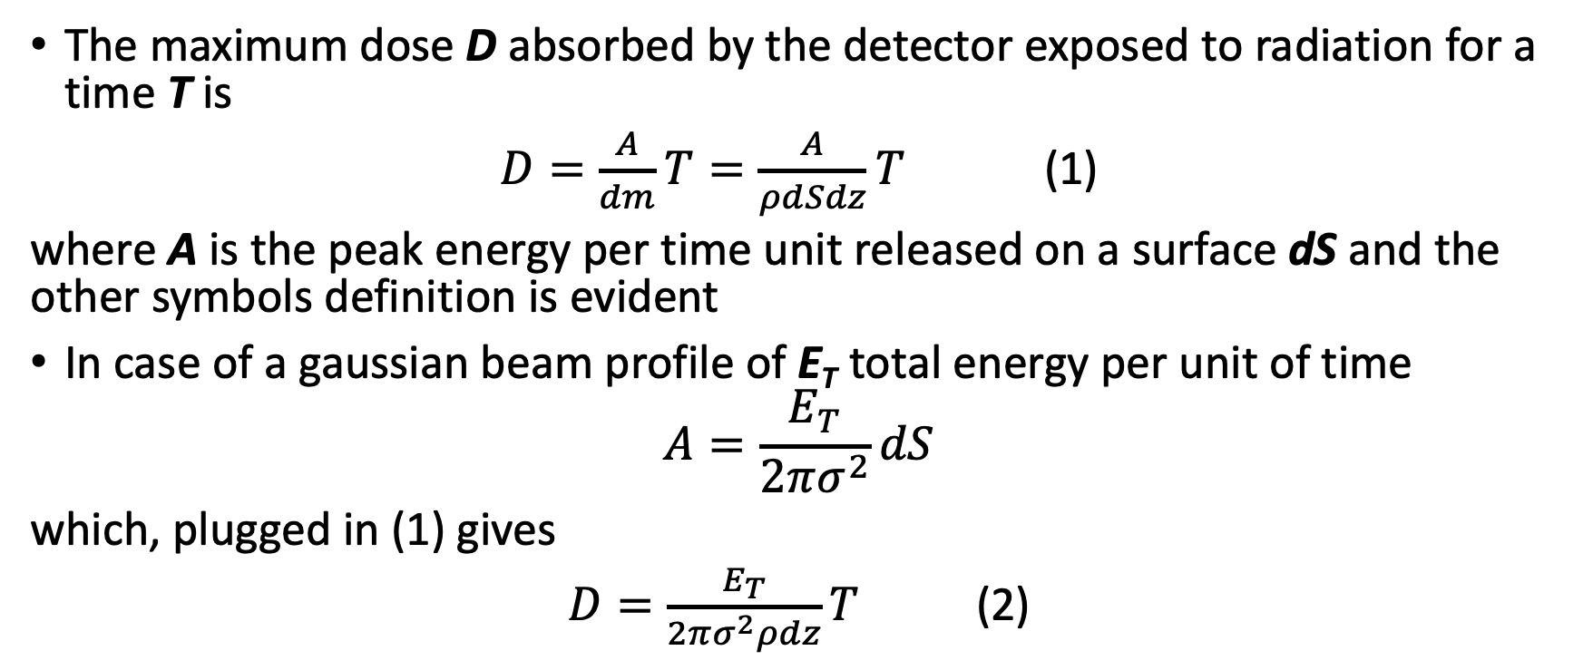
The maximum dose absorbed by a material
The maximum dose D absorbed by the detector exposed to radiation for a time T is
$D=\frac{A}{dm}T=\frac{A}{ρdSdz}T$ (1)
where A is the peak energy per time unit released on a surface dS and the other symbols definition is evident
In case of a gaussian beam profile of E_{T} total energy per unit of time
$$A=\frac{E_{T}}{2πσ^{2}}dS$$
which, plugged in (1) gives
$D=\frac{E_{T}}{2πσ^{2}ρdz}T$ (2)

Slide 50
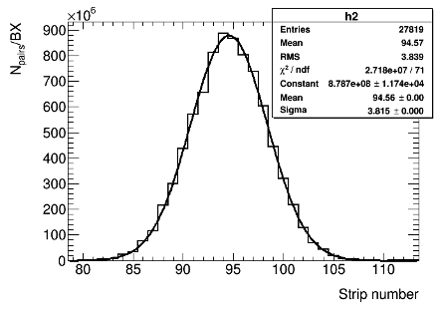
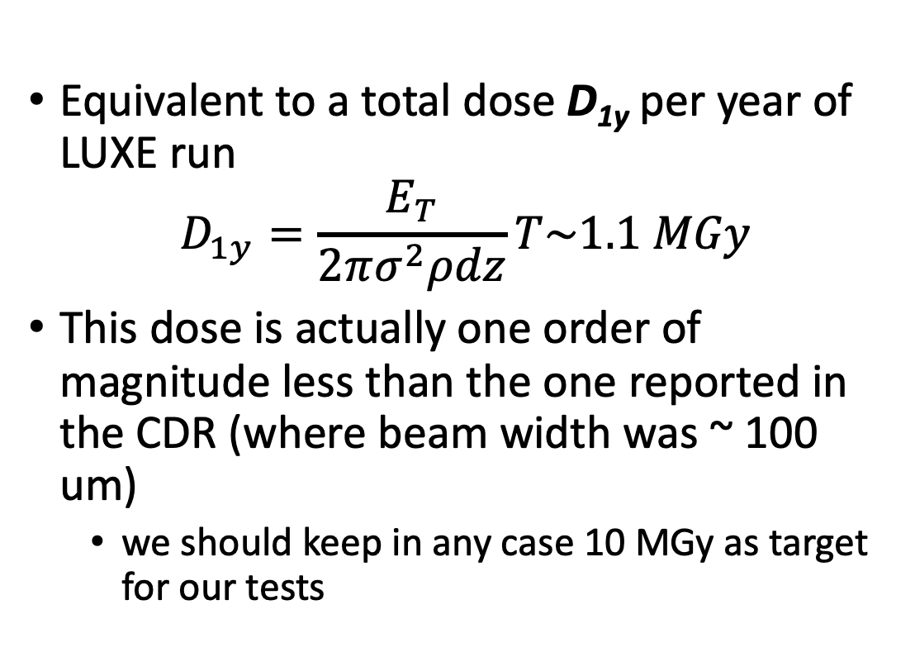
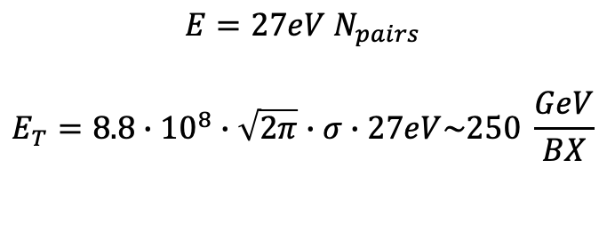
Maximum GBP dose in LUXE
Equivalent to a total dose D_{1y} per year of LUXE run
$$D_{1y}=\frac{E_{T}}{2πσ^{2}ρdz}T\sim 1.1 MGy$$
This dose is actually one order of magnitude less than the one reported in the CDR (where beam width was ~ 100 um)
  we should keep in any case 10 MGy as target for our tests
$$E=27eV N_{pairs}$$
$$E_{T}=8.8∙{10}^{8}∙\sqrt{2π}∙σ∙27eV\sim 250 \frac{GeV}{BX}$$

Slide 51
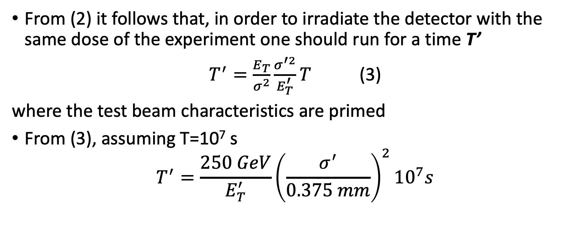
Total dose in a test beam
From (2) it follows that, in order to irradiate the detector with the same dose of the experiment one should run for a time T’
$T^{′}=\frac{E_{T}}{σ^{2}}\frac{σ^{′2}}{E_{T}^{′}}T$ (3)
where the test beam characteristics are primed
From (3), assuming T=10⁷ s
$$T^{′}=\frac{250 GeV}{E_{T}^{′}}{\left(\frac{σ^{′}}{0.375 mm}\right)}^{2}{10}^{7}s$$

Slide 52
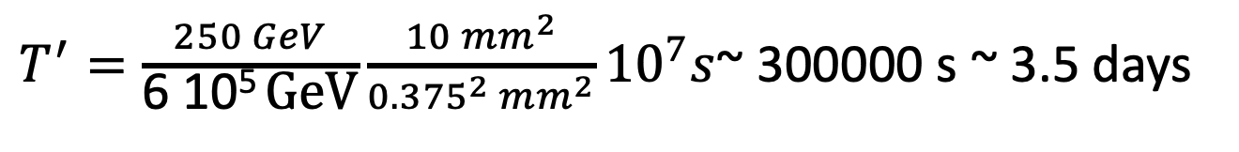
Frascati
Beam spot: 1cm x 1mm
Beam Intensity: 10¹⁰e/s @ 60 keV (MIP energy release) = 6 10⁵ GeV/s
$T^{′}=\frac{250 GeV}{\text{6 10}\text{5} \text{GeV}}{\frac{10 {mm}^{2}}{{{0.375}^{2} mm}^{2}}10}^{7}s$~ 300000 s ~ 3.5 days

Slide 53
HZDR (Helmoltz Zentrum Dresden Rossendorf)
Beam spot: 4 mm diameter → 12.6 mm2
20 MeV electrons → dE/dx ~ 7.2 MeV/cm (Al2O3) ~ 70 keV (dz=100 um)
Max Beam current 0.1 mA → After collimator: 0.03 mA → 2 10¹⁴ e/s →1.4 10¹⁰ GeV !
In this condition: T’_{MIN}~ 20 s !
A beam current of 25 nA would allow to measure in 1 day

Slide 54
Detector current vs beam current at ELBE
0.03 mA → 2 10¹⁴ e/s → ~ 2 10¹⁴ x 70 keV/27 eV x 0.5 cce x 1.6 10 ⁻¹⁹
About 40 mA ~ uniformly distributed on 12.6 mm2 (40 strips)
HV = 200V → 8 Watt on the detector !
The CAEN A7038 3 has 100 uA max Current and 500 pA Current monitor resolution
  This constraints the beam currents in the range (0.125E-3,0.25) uA
The max detector current in LUXE: 250 GeV/27 eV x 0.5 cce x 1.6 E-19 ~ 740 pA
  is this acceptable with the A7038 32/48 ratings ?
  Mod A1561H can read 50 pA (but 20 uA max current) : https://www.caen.it/products/a1561h/

Slide 55
Test structures on sapphire wafer (tbd)
Per 2-inch wafer:
2 Standard strip sensors
2 Test structures
23x10 mm
Configuration of electrodes
on the test structure could be
different from the nominal one.
Number of strips, width, pitch
are to be discussed ASAP.
23x22 mm

Slide 56
Test Beam plans (2022 and beyond)
Radiation hardness study (1-2 sensors) (ELBE). Beam requirements: ~ 2 mm beam spot, e⁻ ~ 10 MeV, intensity ≥ 10⁵ /bunch. Measure the sensor response vs time for the stable beam conditions until several MGy accumulated local dose. Control HV current (beam on/off). For several doses perform HV scan. Displace sensor wrt the beam and repeat measurements. Different producers
Scan of metallized sapphire sensors for response uniformity study (ELBE/FRASCATI): all sensors before final installation. Beam requirements: ~ 2 mm beam spot, e⁻ ~ 10 MeV, intensity ≥ 10⁵ /bunch. Measured variables: signals from strips, current in the HV circuit. At several positions measure dependence of signal size on HV.
Study of profiler performance in the narrow electron beam (DESY) Required beam spot size ≤ 0.1 mm. Sensor inclination wrt the beam allows to simulate elliptic spot shape. Make the detailed scan in the direction perpendicular to the strips and find reconstructed beam parameters. Use also previously irradiated detectors. Use the movable beam
Repeat performance study at the photon beam (Facultative) (spontaneous emission U1/U2 beamlines XFEL). Energetic photons (i.e. Bremsstrahlung) would be useful, and this option is being investigated
Beginning of 2022
Individual strip readout not necessary
<1 week
Spring of 2022
Individual strip readout necessary
<=1 week
End of 2022
Individual strip readout necessary
GBP movable table necessary
1 week

Slide 57
First comments about readout PCB
So far the PCB expert in Bologna has only pointed out to me that isolation between tracks of 40 um is very challenging and not only does it limit the number of companies able to do it, it also increases costs.
As a first remark, he says that maybe even just 60 um (if possible per type of signal) would be much better.
More about this in the following days

Slide 58
Repository for documents
I put the relevant documents and their list (excel table) in a local Dropbox directory
  https://www.dropbox.com/s/fp3zru83xj46a4n/GBP_repository.xlsx?dl=0
Kyle is taking care to store and maintain his MC analysis codes in confluence
  https://confluence.desy.de/display/LUXE/Gamma+Beam+Profiler
  Please cross check all this material and send your comments

Slide 59
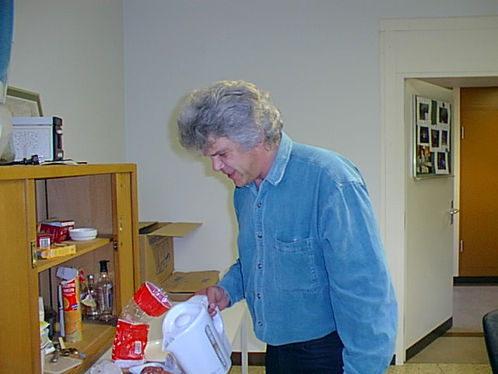
Sergej Schuwalow
Excellent physicist, deep-thinking minded
Great colleague in HERA-B (ECAL detector responsible)
Innovative (pioneering sapphire detector R&D)
Passionate about his vision of the world that he wanted discuss with us
  Article
  Slides
We will miss his skill and his guidance in our project

Slide 60
Sergej Schuwalow - II
Sergej gave a big impulse to our project, going to a level of detail which was quite ahead of times
  support PCB design
  First ideas on mechanics
  Test Beam strategy
All this helped and will help us greatly
But there is a long way to have a commissioned and running detector and many unexpected problems could show up: we have to be ready to face all this
How can we mitigate the missing support by Sergej?
  First step: contacted Beate who gave the connection to Jenny List who collaborated with Sergej. Waiting for a feedback
  Besides this we should have 2-3 detector experts who work together and get fully familiar with sapphire. Maybe we can ask for a Phd or post doc at DESY?
  Other ideas ?

