Slide 1
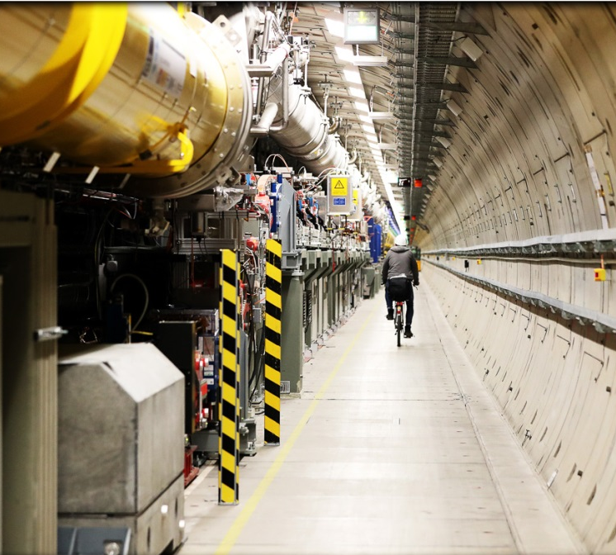
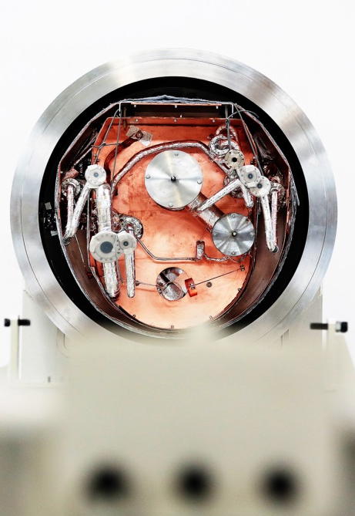
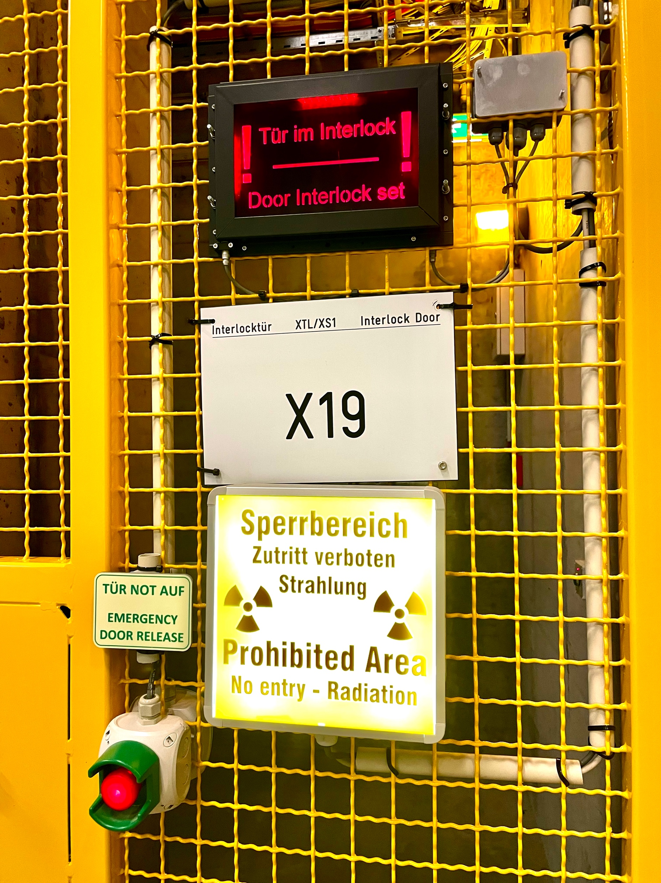
EuXFEL What is new in twenty-two
Matthias Scholz
January 18, 2022

Slide 2
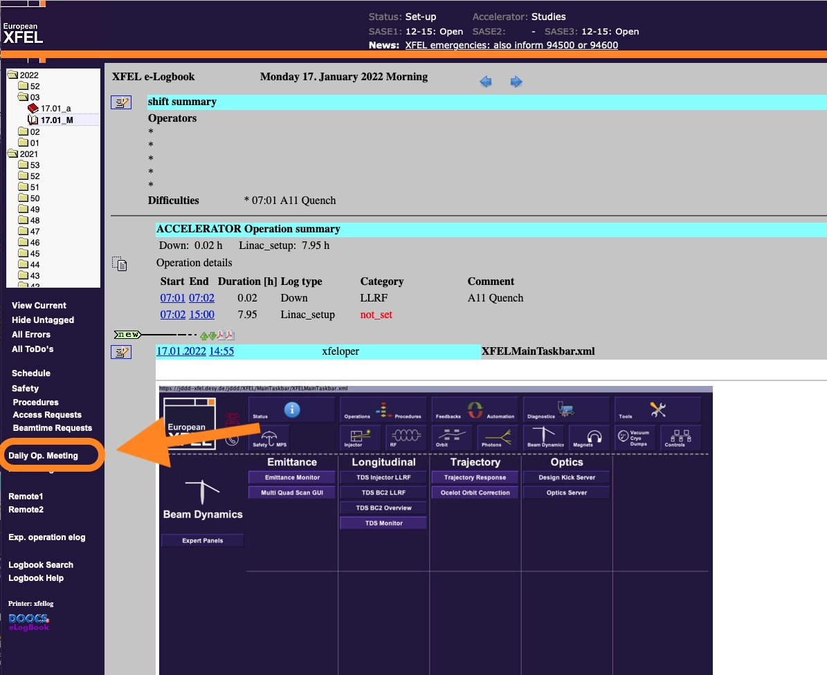
New time for the daily operation meeting
The daily operation meeting is now always held at 3:30 pm. This is to avoid the turbulent time in the control room during the shift change.
In addition, the late shift has some time to orientate itself and can then better communicate the current situation in the meeting.
My request: Remember the meeting when you are on late shift.
The easiest way to the meeting is the link in the logbook.

Slide 3
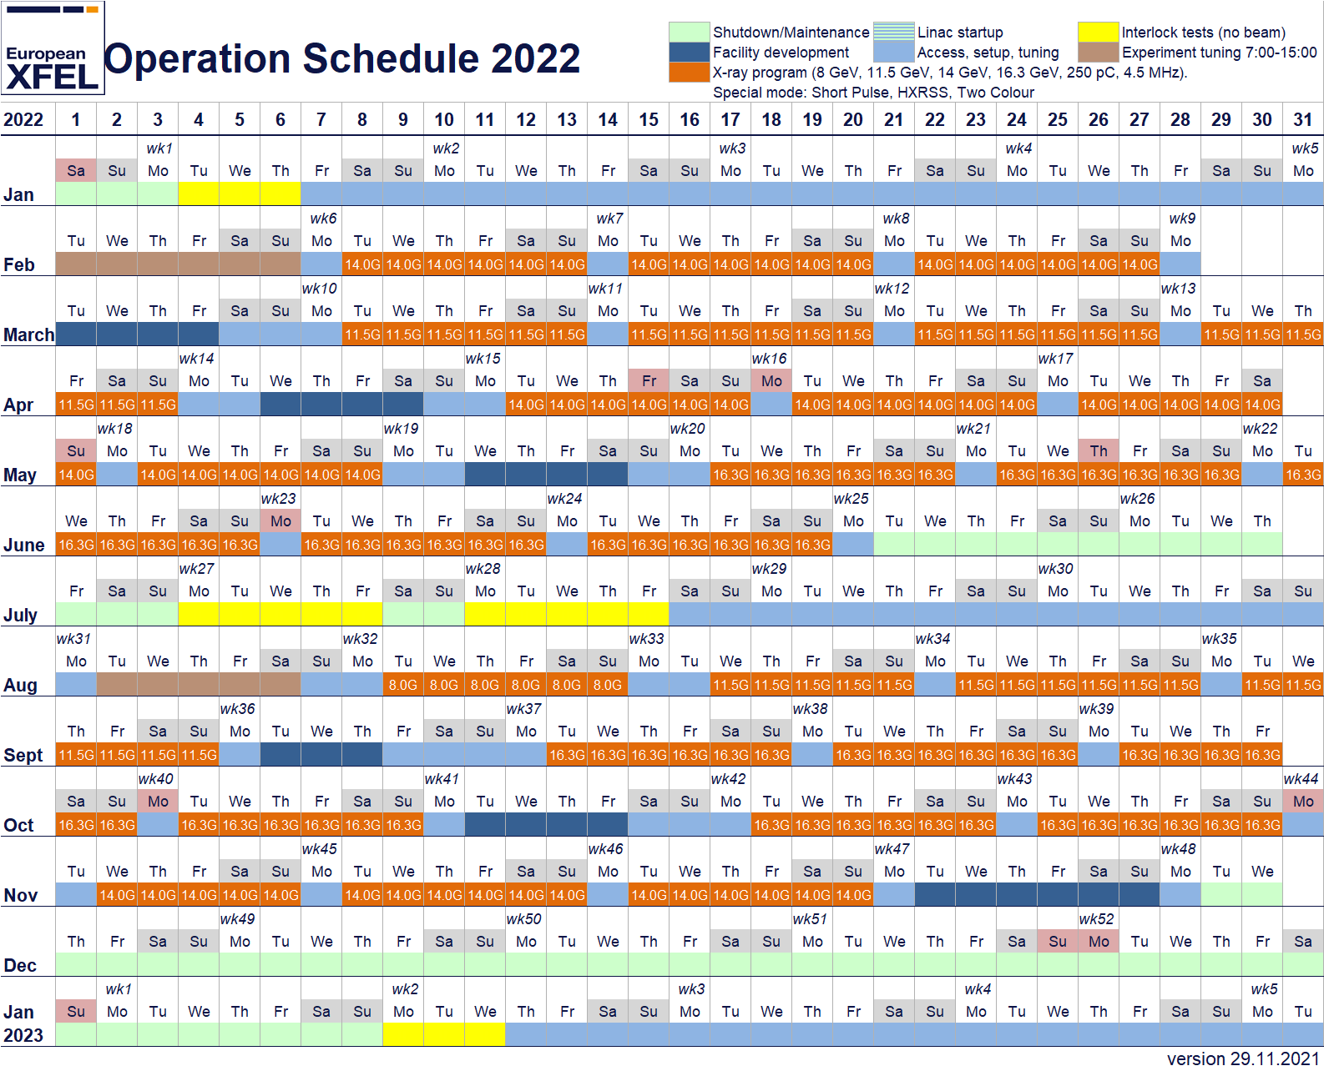
Operation 2022 overview
More delivery time (orange weeks) compared to 2021.
Reduced setup time on Mondays. Tuesdays are already for photon delivery.
On Monday mornings R&D if possible.
BBA in SASE2 in every blue (Facility development) week.
There is a 8 GeV run scheduled for the first time.

Slide 4
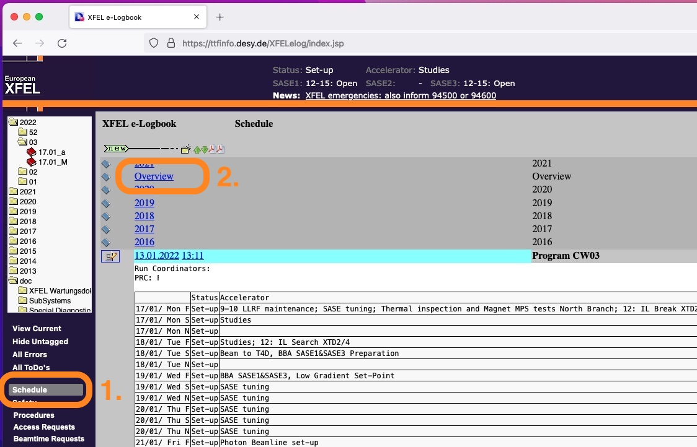
Operation 2022 overview
More delivery time (orange weeks) compared to 2021.
Reduced setup time on Mondays. Tuesdays are already for photon delivery.
On Monday mornings R&D if possible.
BBA in SASE2 in every blue (Facility development) week.
There is a 8 GeV run scheduled for the first time.
You can find the plan in the logbook:
Schedule
Overview

Slide 5
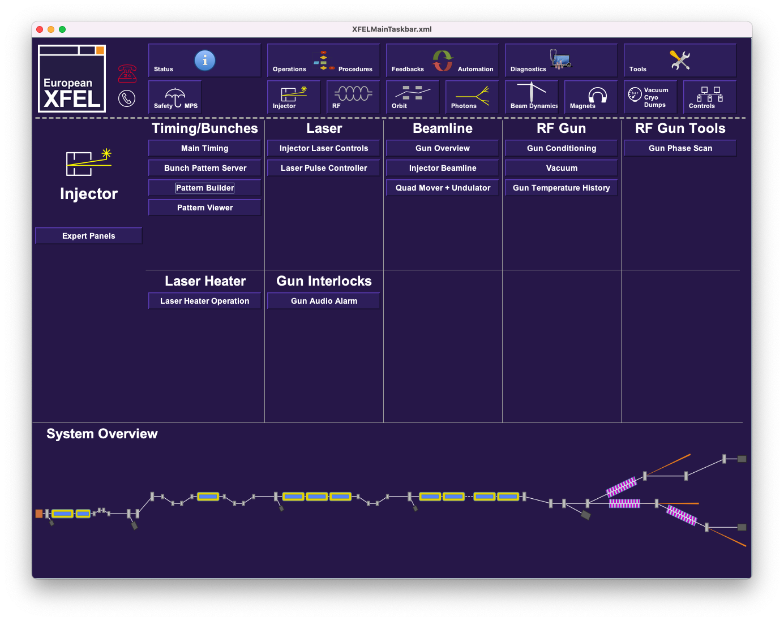
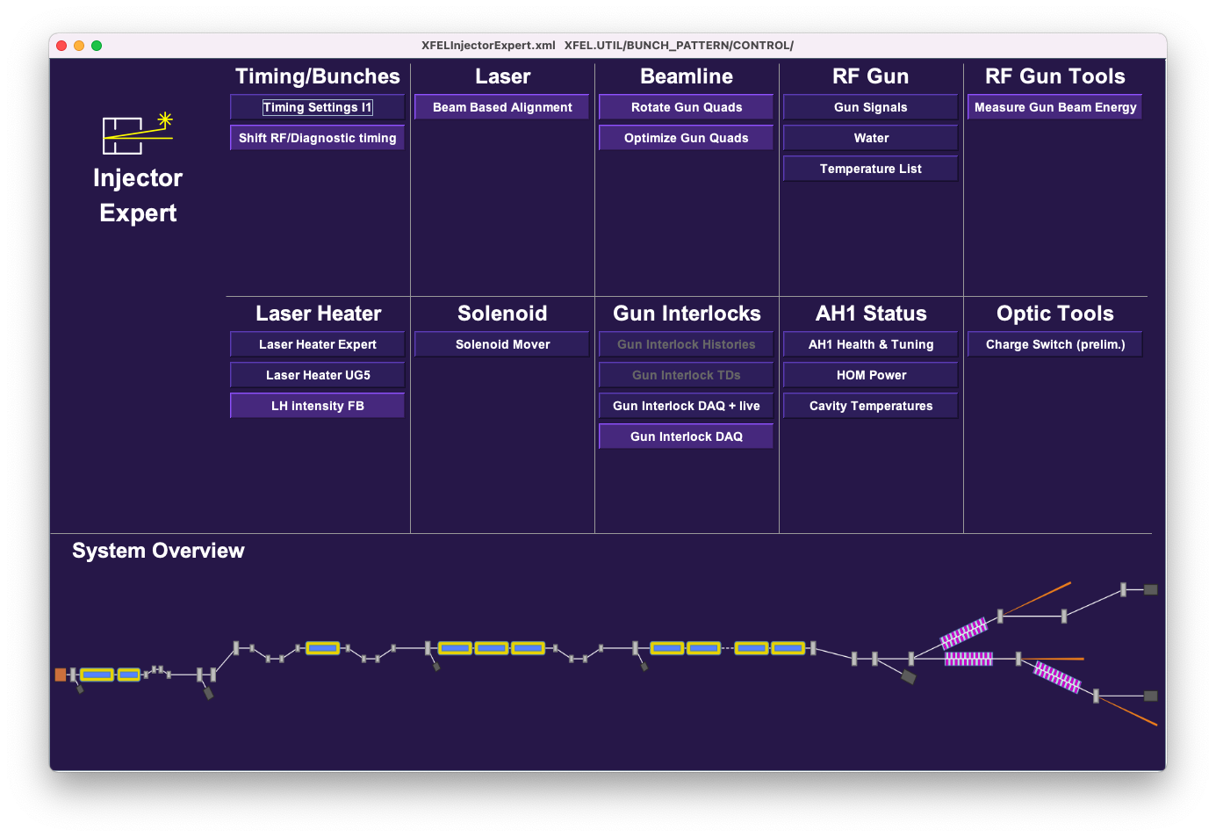
Clean-up of JDDD Main Panel
In order to increase the overview of the individual panels, rarely used buttons or those that are only intended for experts have been moved to a sub-panel.
The sub-panel can be opened via an ”Expert Panels” Button on the top left corner of the respective section.

Slide 6
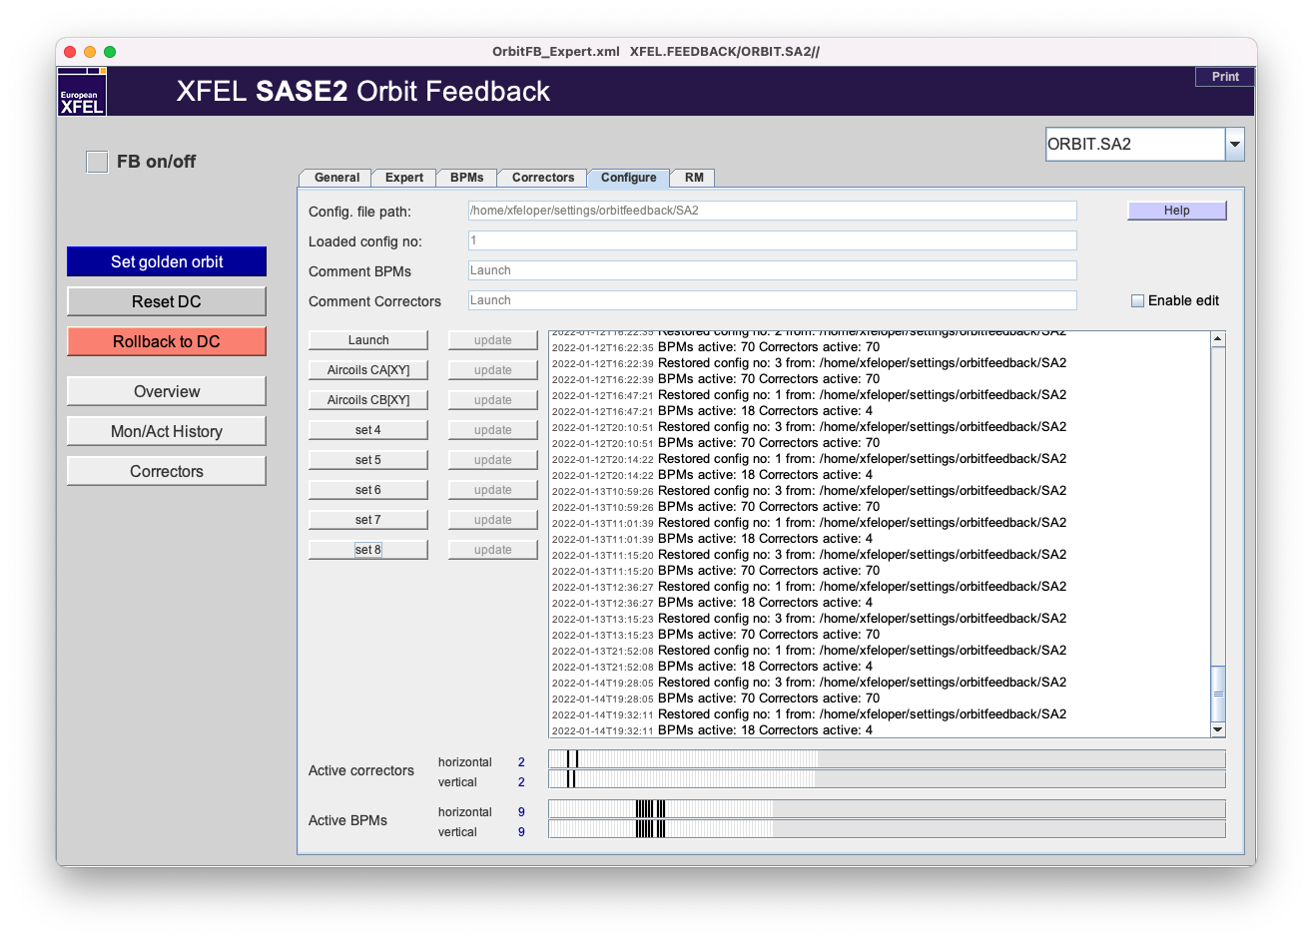
Trajectory feedback setup
It is not necessary any more to use the Matlab Tool to change the undulator trajectory feedback e.g. to air coils or launch.
This is now a build-in feature that can be found on the feedback’s panels.

Slide 7
Dump pumps
In the area of the dump pumps, modifications were made to protect the electronics from the increased radiation doses there.
This also led to the fact that we no longer need the pumps that are currently still visible on the dump panels.
The dumps are also shown in yellow on the JDDD-main panel.
No worries, this status is ok and the panels will be adjusted accordingly soon.

Slide 8
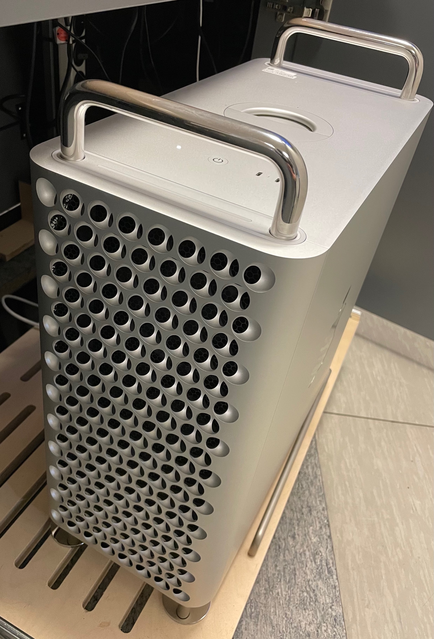
BKR consoles, new hardware
New monitors are now installed at all places including the photon consoles.
New Macs are now available at the accelerator consoles xfelbkr1- xfelbkr4 (the first 4 consoles starting on the right hand side).

Slide 9
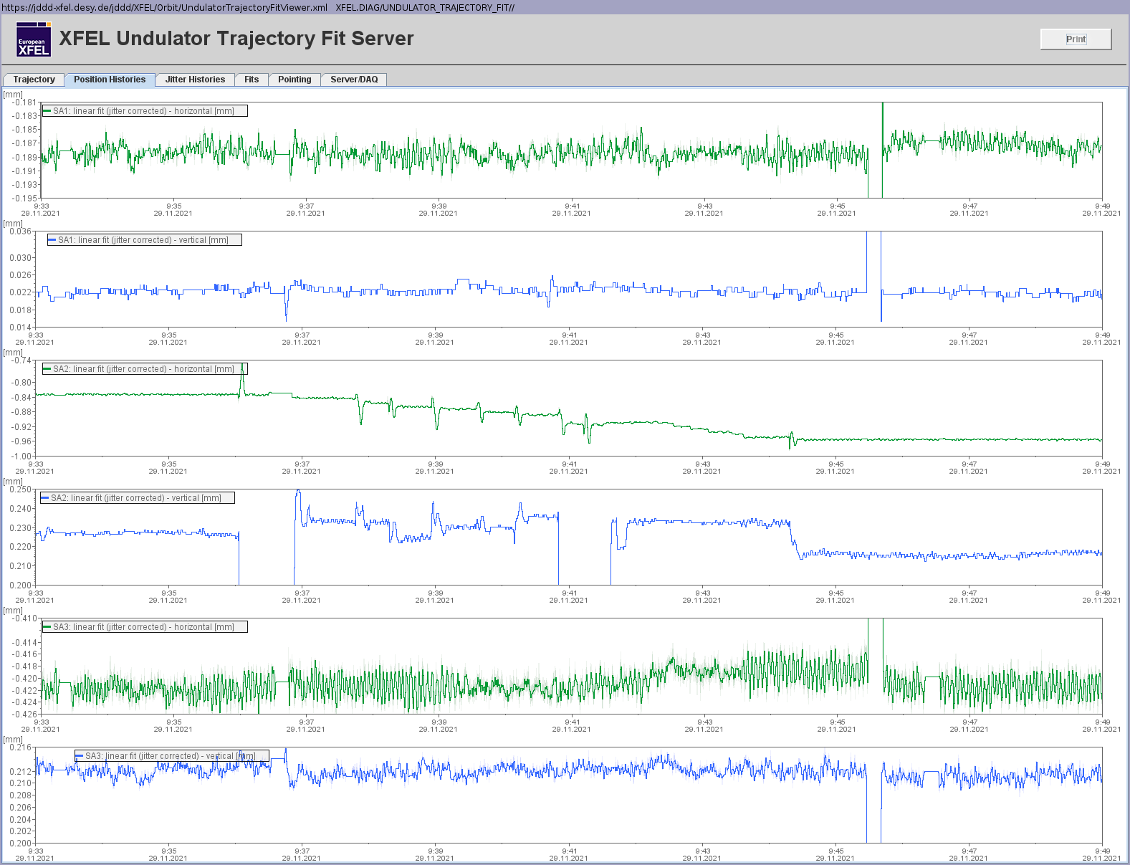
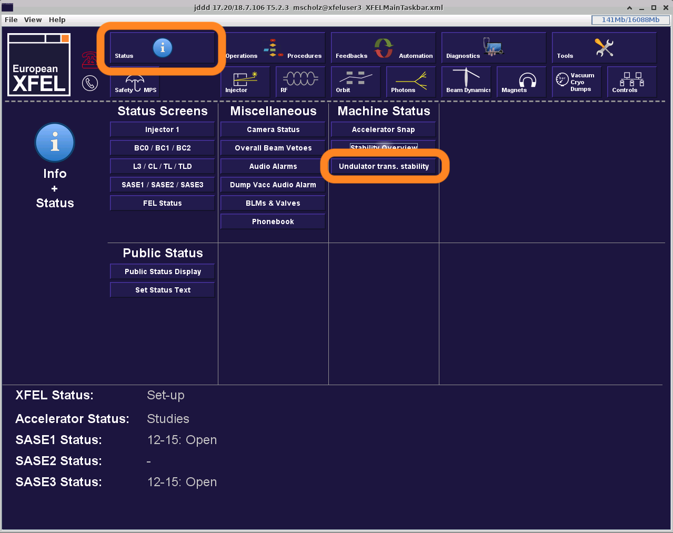
Undulator transverse stability
New panel with information about the undulator trajectory available.
These information help to evaluate the trajectory without jitter, the stability of the beam from shot to shot as well as the stability over time (pointing drifts).
Could be included to the shift documentation.

Slide 10
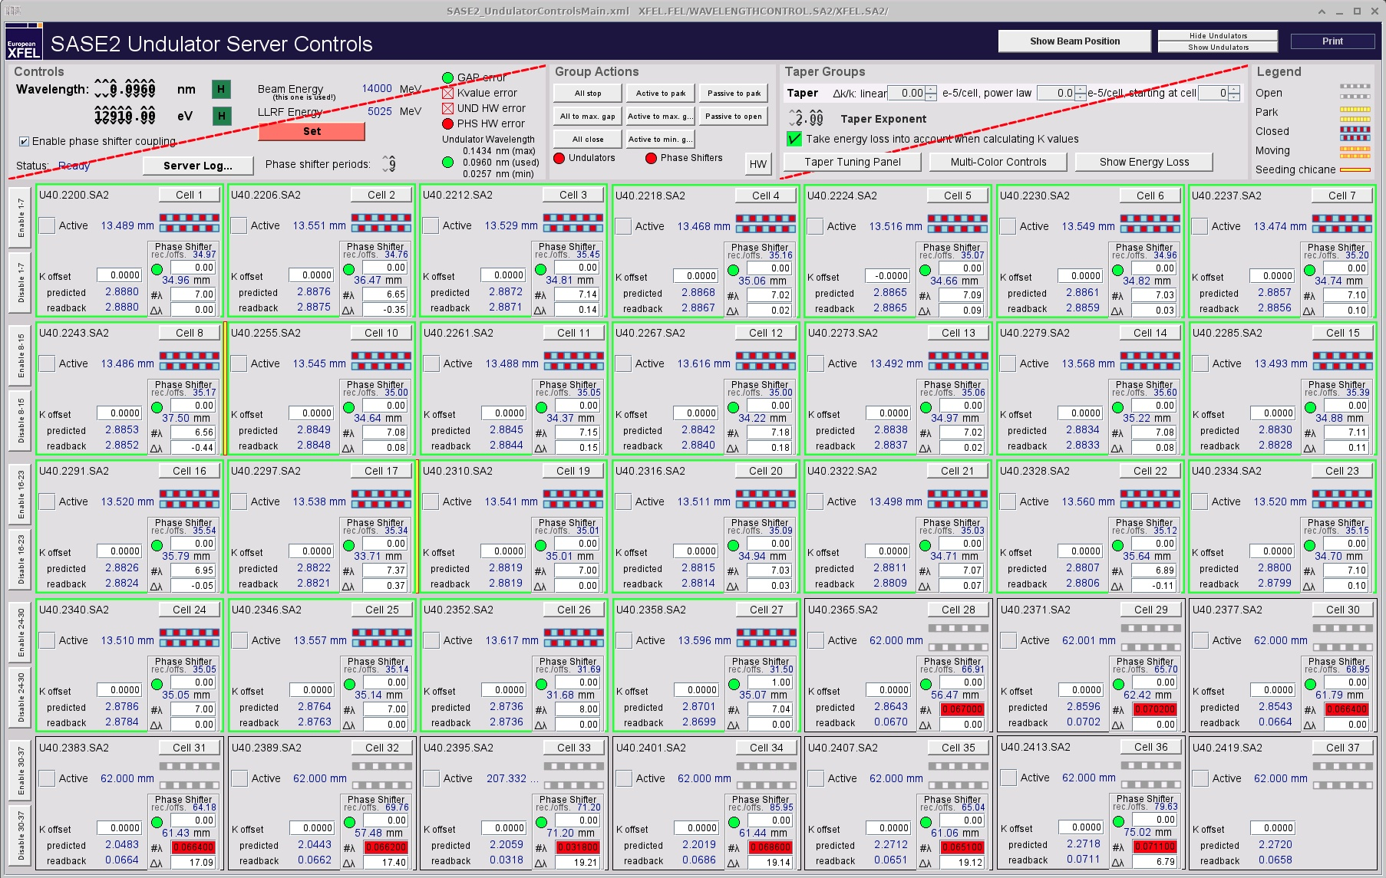
Phase shifter setup
Phase shifter offsets are no longer adjusted by the gap size in mm but by the phase in units of 2 pi.
The phase shifter scan tool was already adapted to that new parameter.

Slide 11
Intra bunch train orbit correction in the injector
As you may remember, we have always had non-negligible orbit deviations in the pulse trains in the injector.
This can now be mitigated with new kickers similar to the trajectory adaption kickers in the TL-section.
The new kickers are positions downstream the gun. The dark current kicker used to be placed at this location.
The tool will be the same as for the TL-section and the respective button will be placed in the ”Magnets” section of the main JDDD-panel.
The current Matlab-Tool will be replaced by a server-version soon.

Slide 12
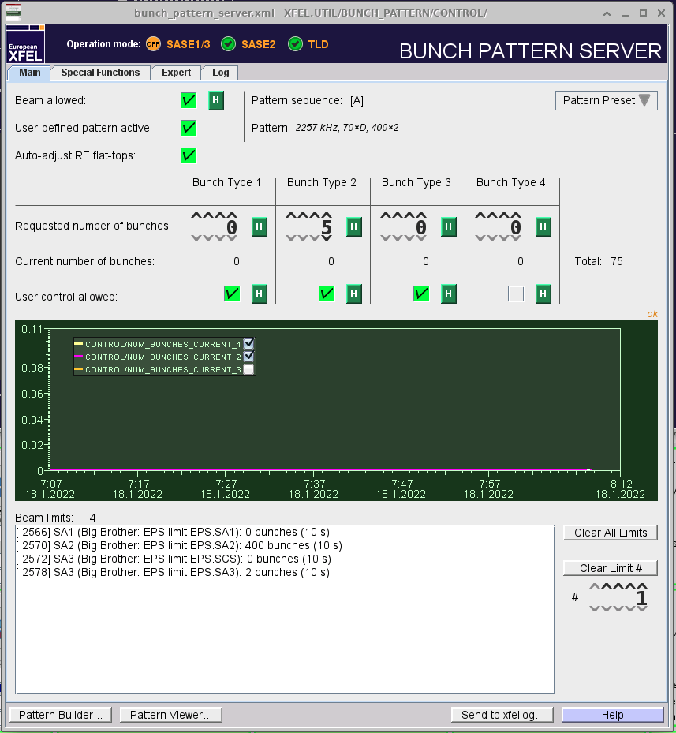
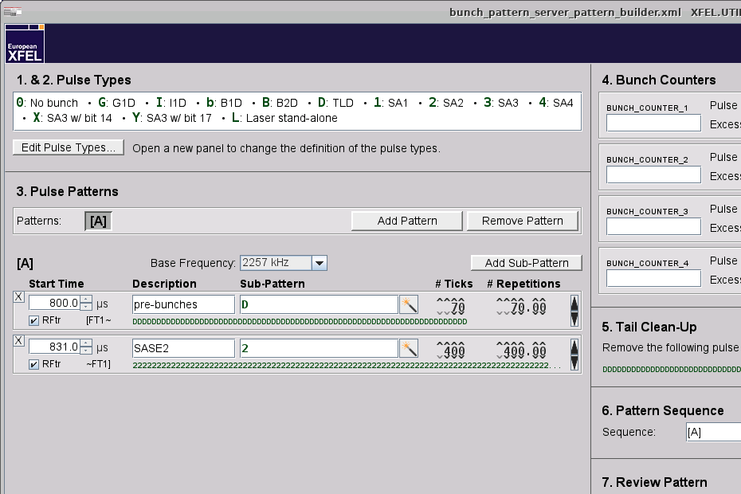
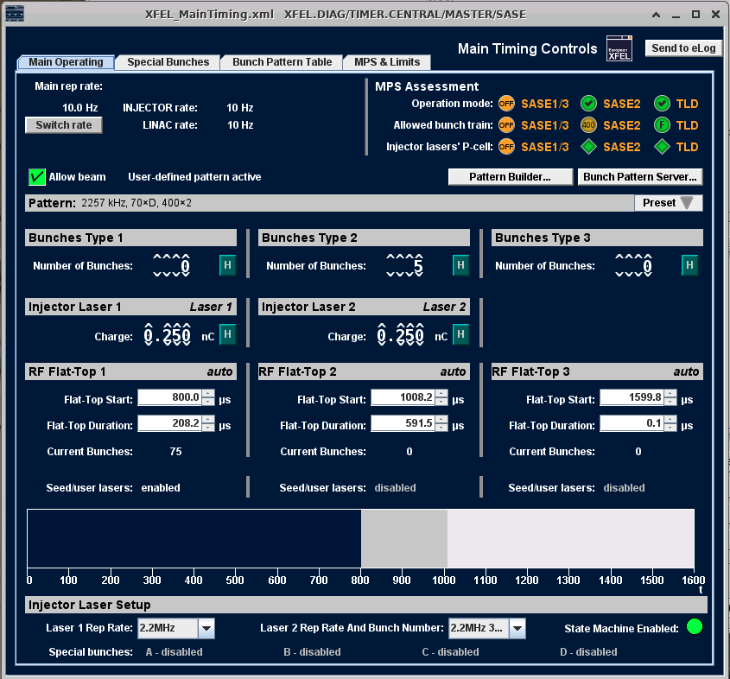
Flattop setup
It is now possible to set the start and length of flattops automatically in the bunch pattern builder.
Activate the feature in the bunch pattern server panel.
Check the boxes in the bunch pattern builder.
Get the start time and length setup for free.

Slide 13
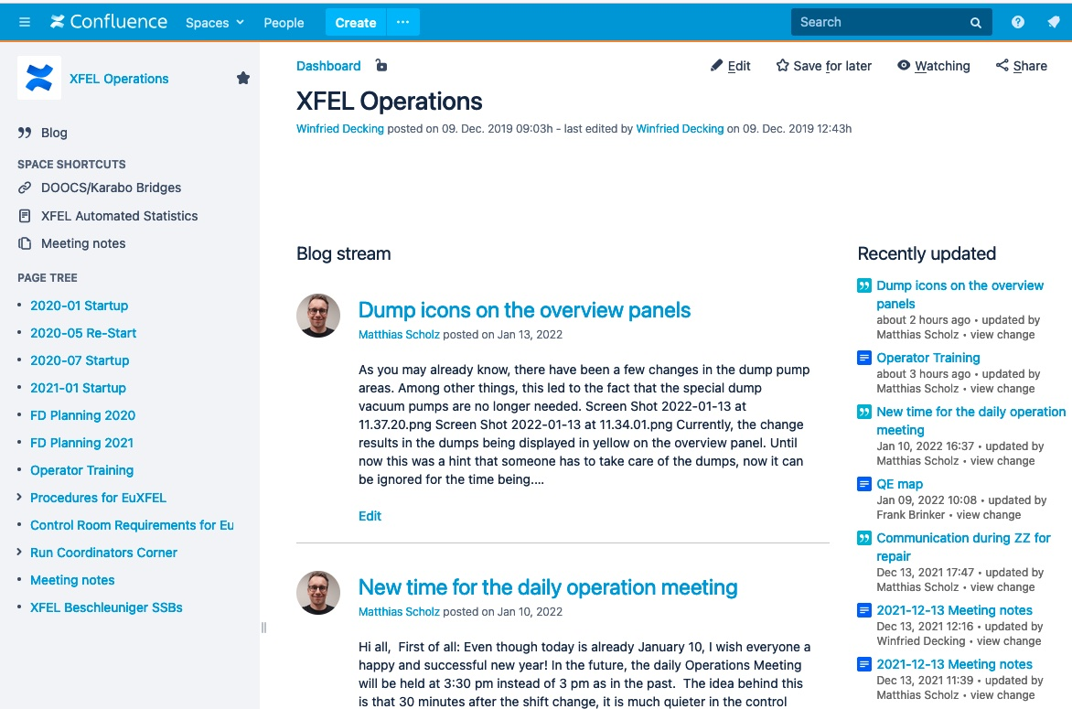
Please do not forget:
News is usually announced in the Operations Blog!
XFEL Operations on Confluence

