Slide 1
MT closing remarks
Ties Behnke/ Anke Susanne Müller

Slide 2
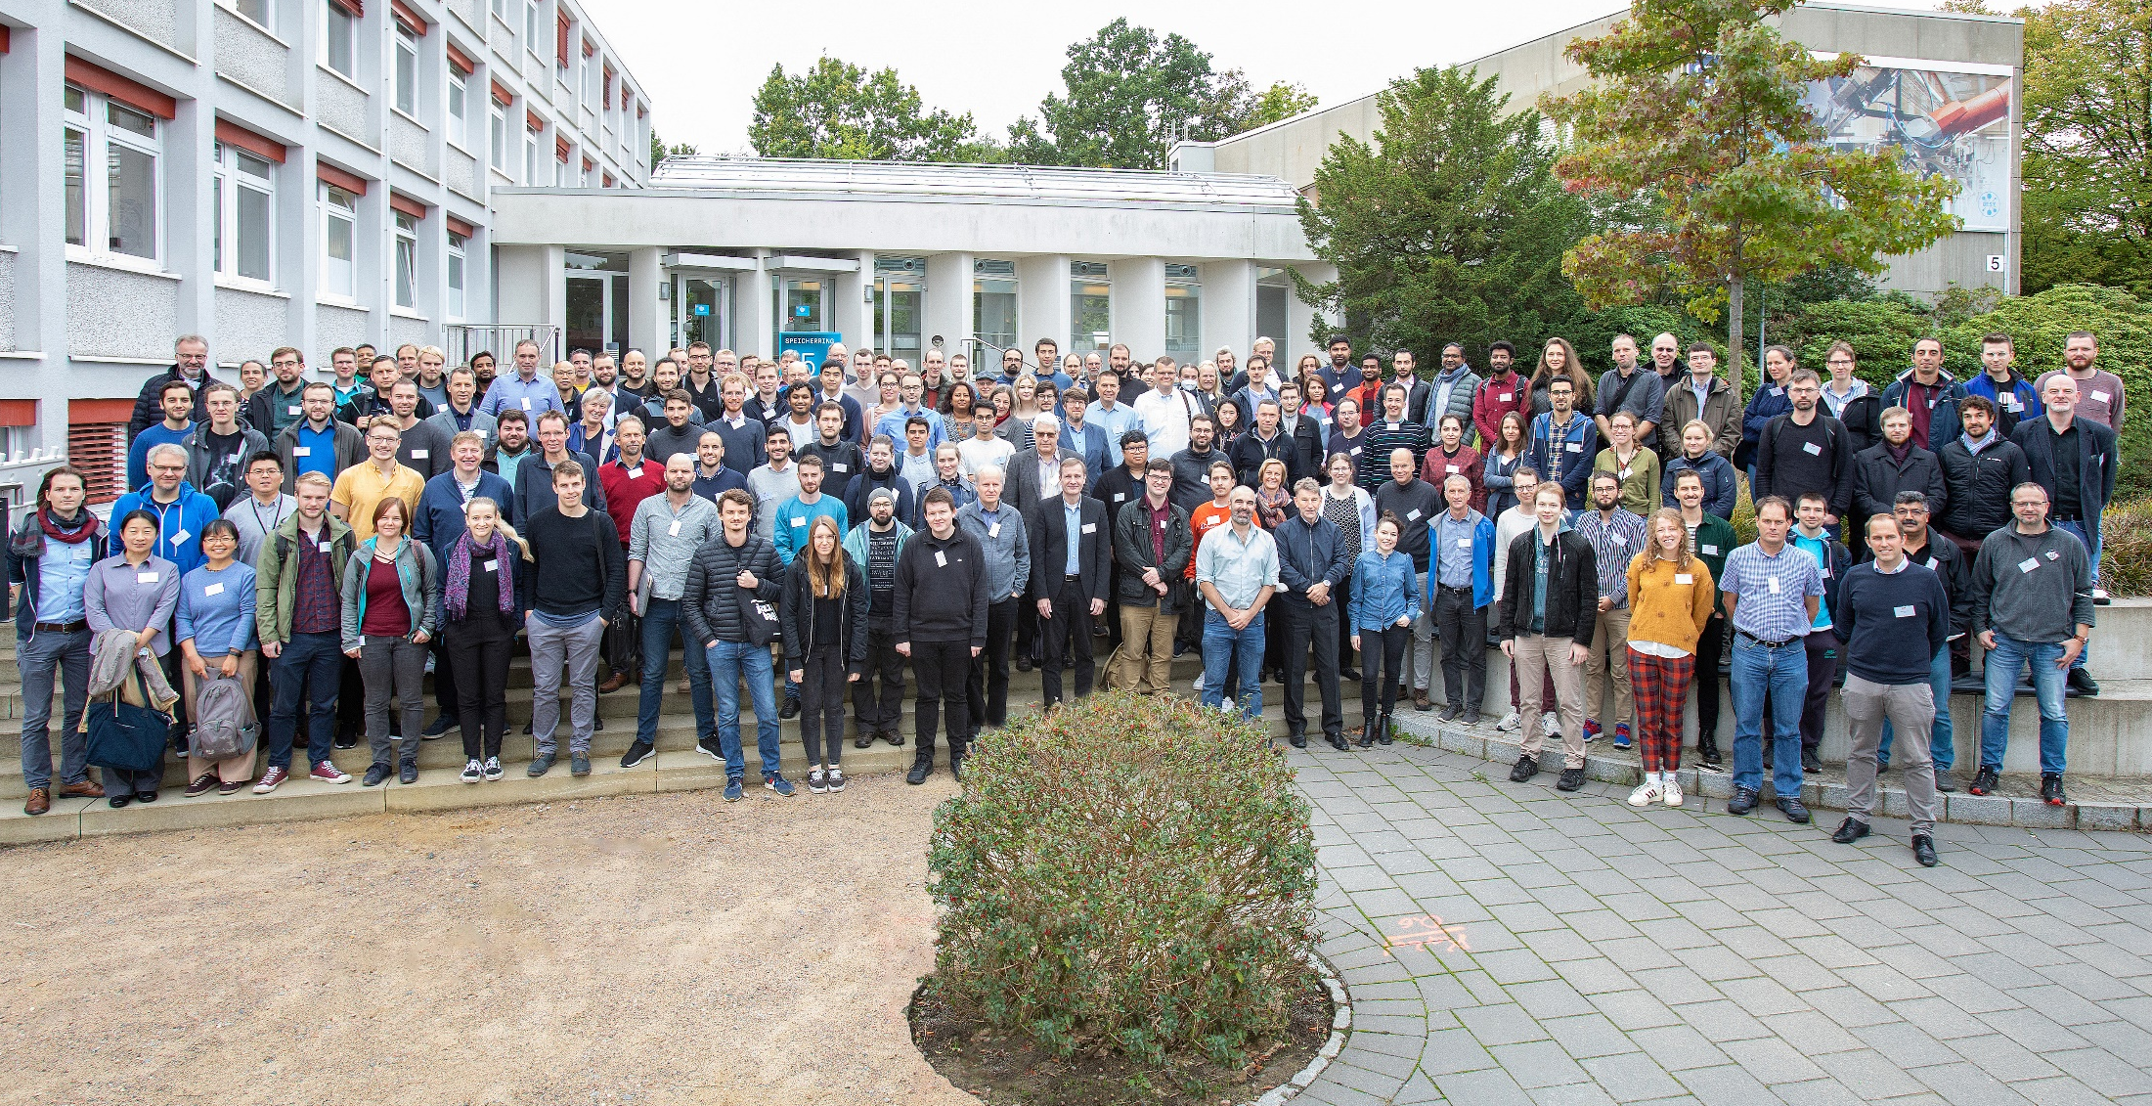
MT meeting in Hamburg
2022

Slide 3
MT meeting in Hamburg
Post Pandemic meeting in person, after three virtual meetings since 2020
268 registrants, 207 registered as “in person”
I counted at peak close to 160 people in the auditorium, 50+ online
Very lively parallel sessions
  Typically between 30-50 people in person, 20-30 people online
Poster session yesterday evening
  Rough count approx. 170 people or more attending

Slide 4
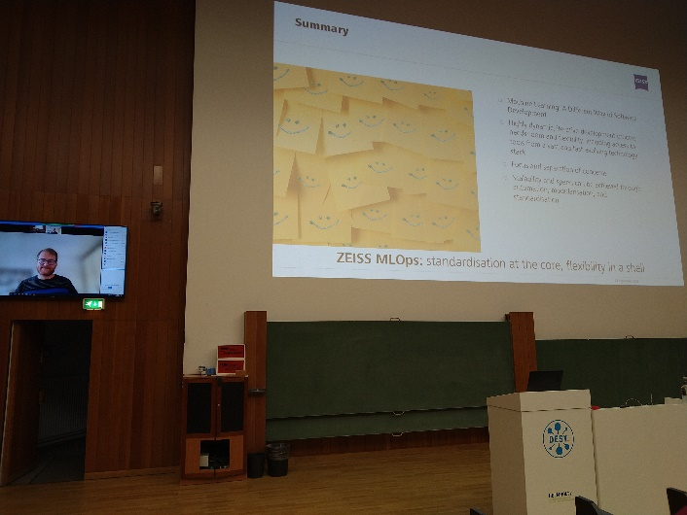
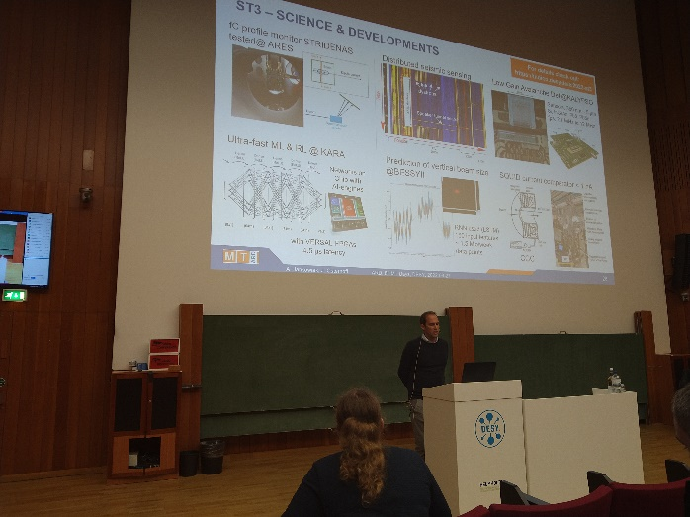
The program
Mixture between in-person (most) and remote talks
Overall worked well
  Allows us to get international speakers join us remotely
  Still the advantages of personal interaction have again become obvious

Slide 5
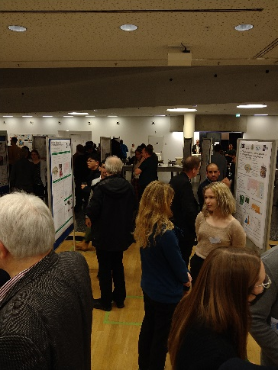
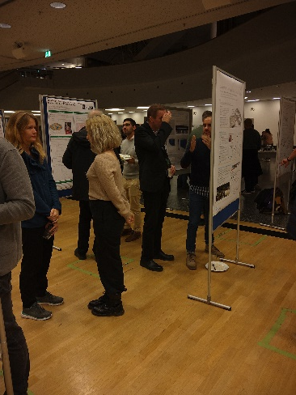
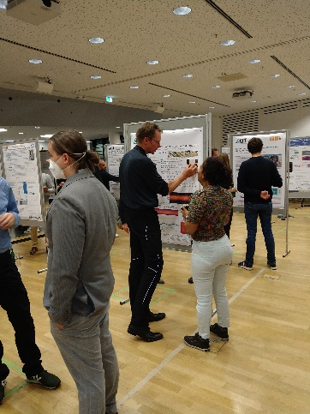
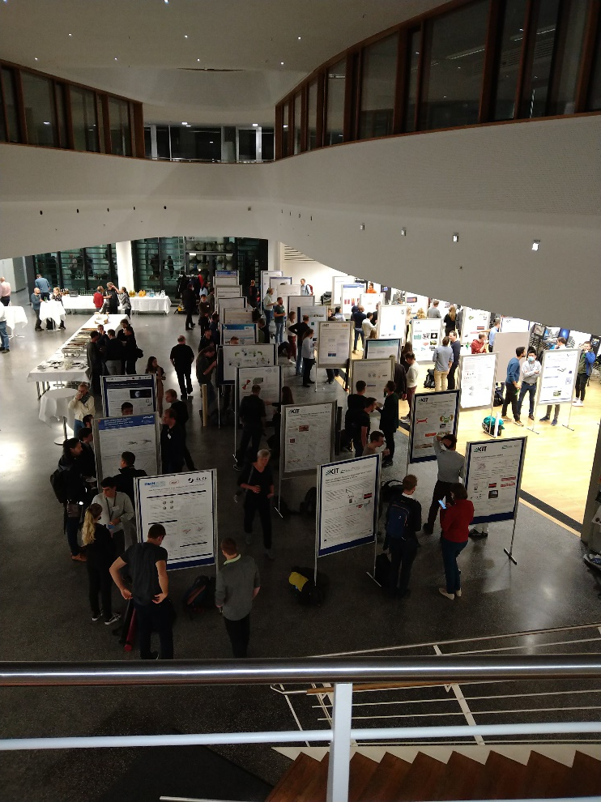
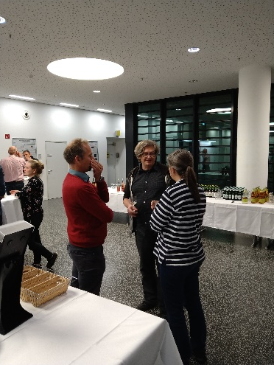
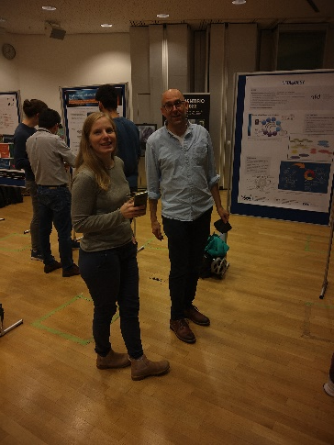
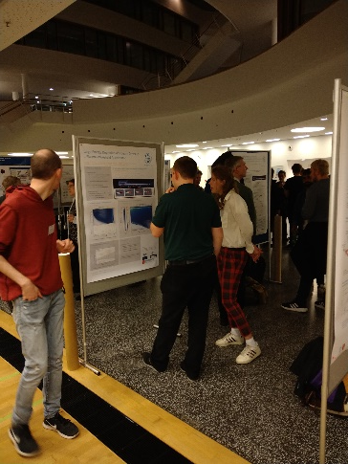
Poster Session and Dinner

Slide 6
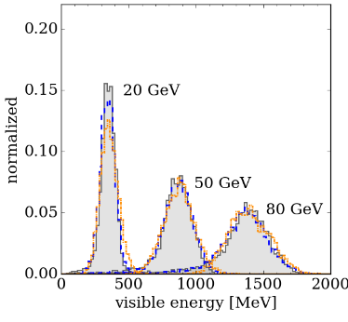
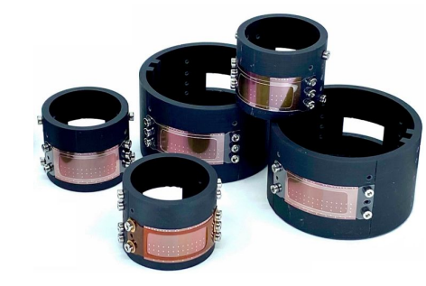
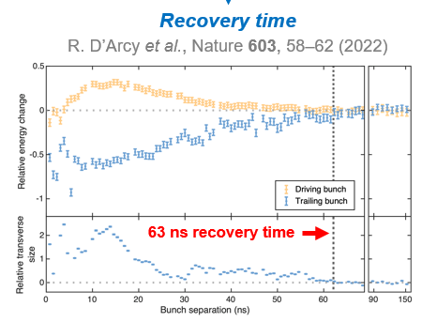
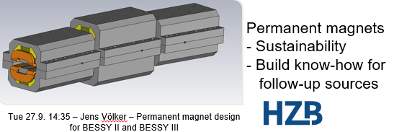
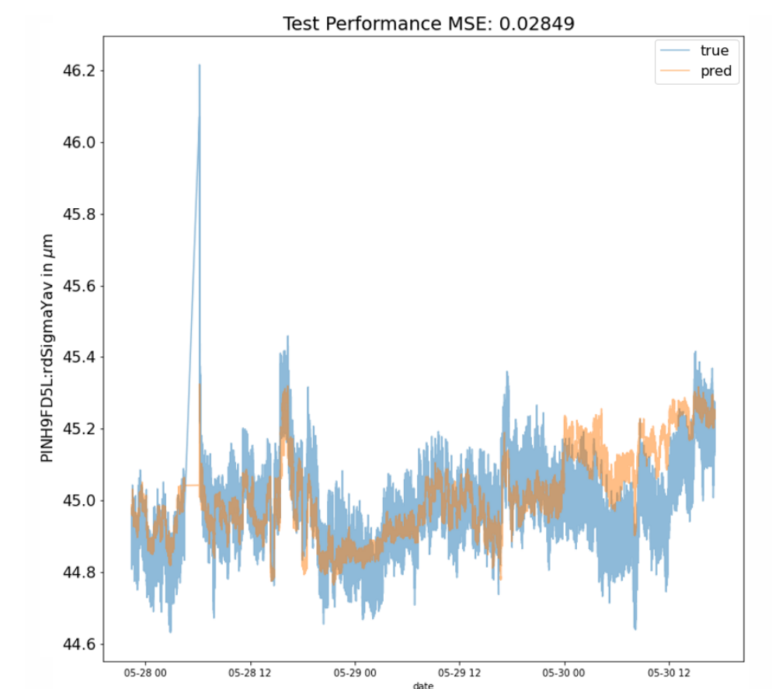
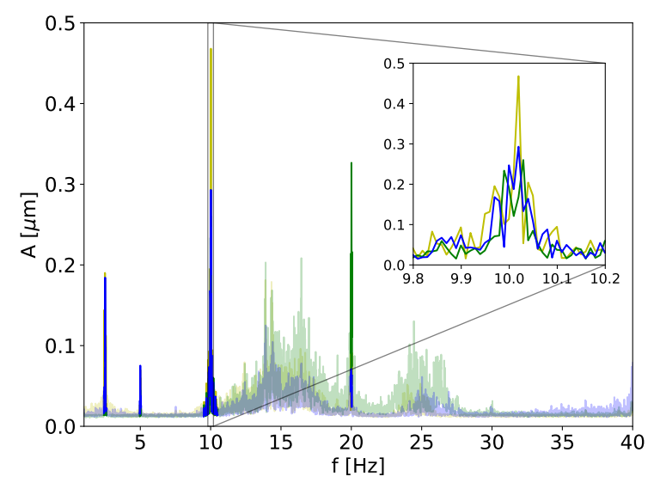
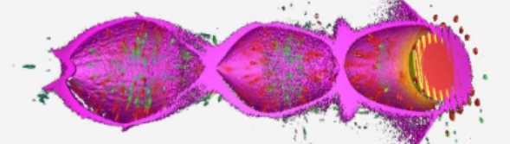
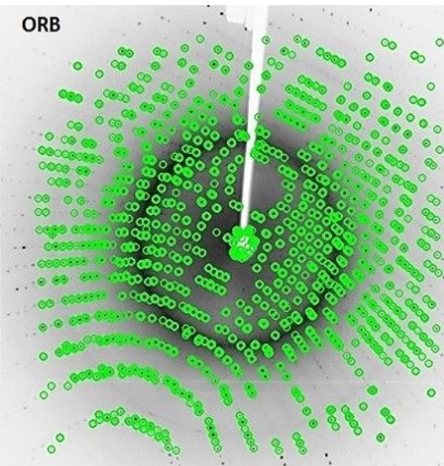
Matter and Technologies
We have seen exciting progress yesterday and today
AI research
Detectors
New accelerators
Energy efficiency
Imaging
Visibility means support
Cooperation optimizes the reach
Data and simulation

Slide 7
Thank you
Thank you to the participants!
Thanks you to the many people in the background at DESY who made this
meeting possible
We hope to see you al again at the next MT annual meeting in 2023
Hopefully in person
Date and venue not yet finalized

Slide 8
Tours
All six Tours will take place
Please use the tour you selected in front of the foyer: Your tour guides will
hold up the number of the tour
Time is short (if you want to still get some lunch)
And: remember, there are still parallel sessions in the afternoon

