Slide 1


RRR measurements of niobium samples after vacuum heat treatments with and without nitrogen
8. Annual MT Meeting
Christopher Bate
DESY MSL
Universität Hamburg - Institut für Experimentalphysik
Hamburg, 26.09.2022

Slide 2
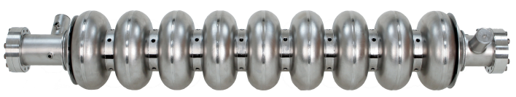
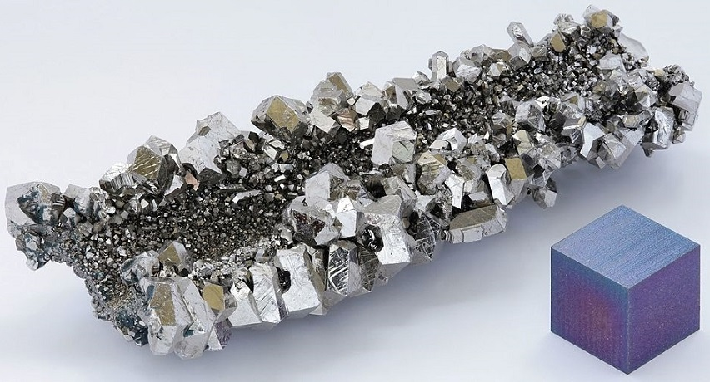
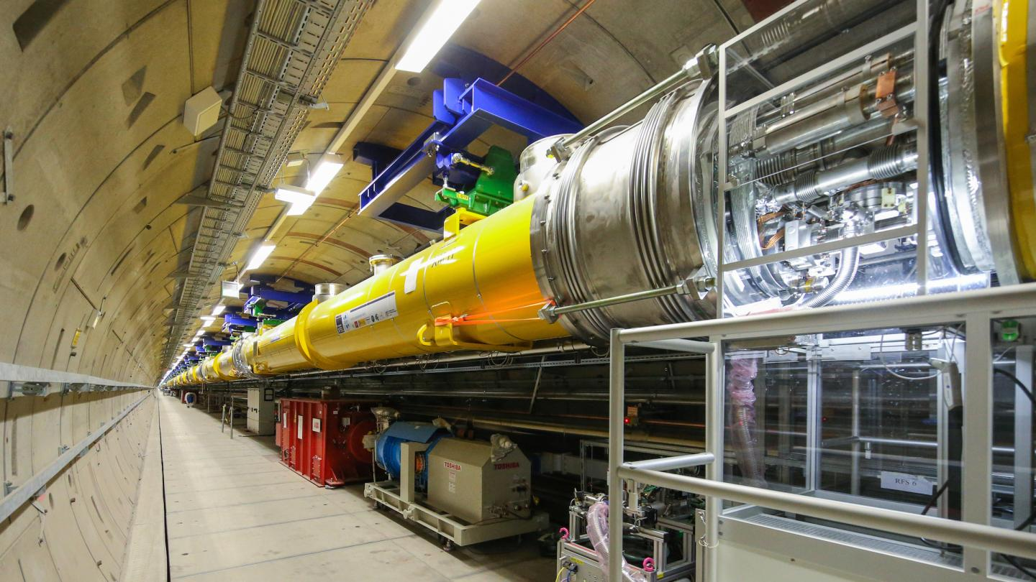
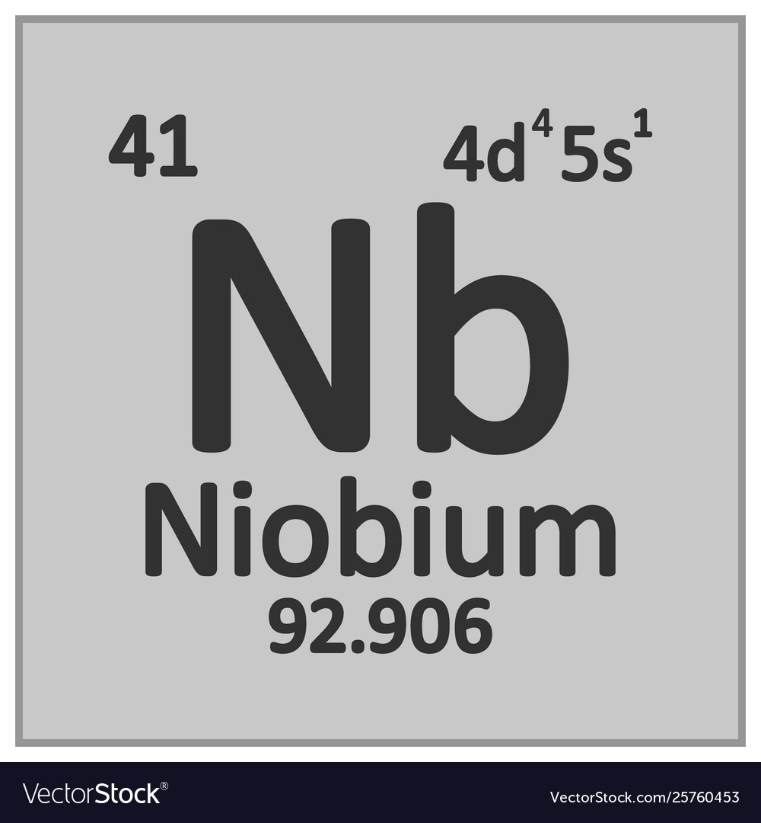
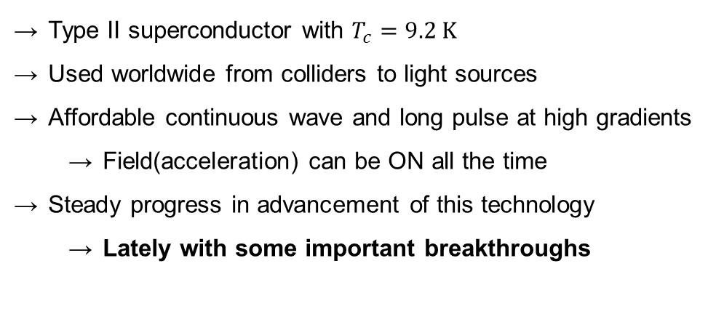
RF superconductivity
Niobium as material of choice for SRF cavities
EuCARD-BOO-2012-001 Editorial Series on.” (2012).
Type II superconductor with $T_{c}=9.2 \text{K}$
Used worldwide from colliders to light sources
Affordable continuous wave and long pulse at high gradients
  Field(acceleration) can be ON all the time
Steady progress in advancement of this technology
  Lately with some important breakthroughs
EU-XFEL

Slide 3
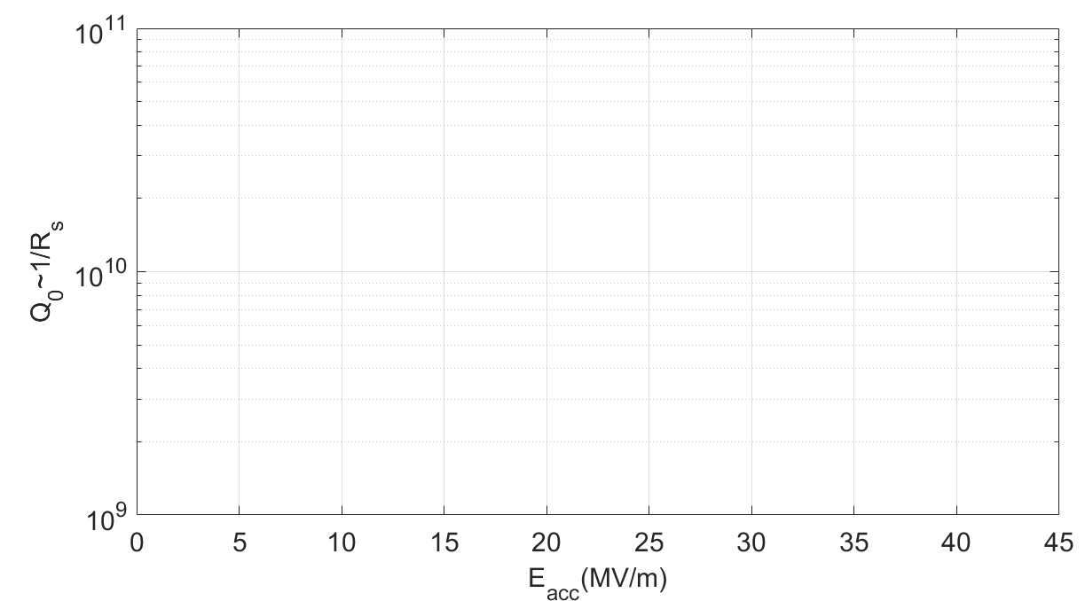
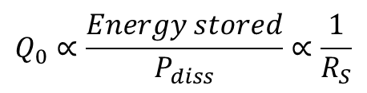

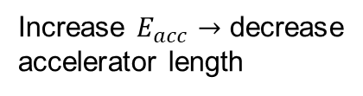
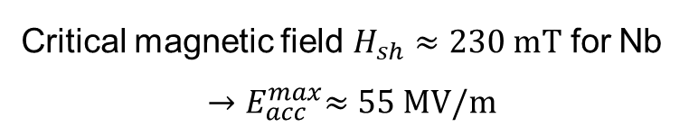
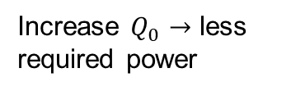

RF superconductivity
Increase $Q_{0}$ $→$ less required power
TESLA shaped cavity figure of merit
Increase $E_{acc}$ $→$ decrease accelerator length
Nitrogen Infusion as the main focus for my research
Standard cavity
N doped cavity
N infused cavity
Mid-T baked cavity
EuCARD-BOO-2012-001 Editorial Series on.” (2012).
$$Accelerating gradient −E_{acc}$$
cavities limited by quench
$$Q_{0}∝\frac{Energy stored}{P_{diss}}∝\frac{1}{R_{S}}$$
$$P_{diss}∝{R_{S}∙E}_{acc}^{2}$$
Critical magnetic field $H_{sh}≈230 \text{mT}$ for Nb
$${→E}_{acc}^{max}≈55 \text{MV}\text{/}\text{m}$$

Slide 4
RF superconductivity is a surface phenomenon
RF fields
RF fields
<1% thickness
Niobium
~3 mm
Oxide layers
RF currents <100 nm
Helium cooling
RF only probes the penetration depth (λ_{L} = 47 nm) of the material
→Final surface treatment is crucial to performance!

Slide 5
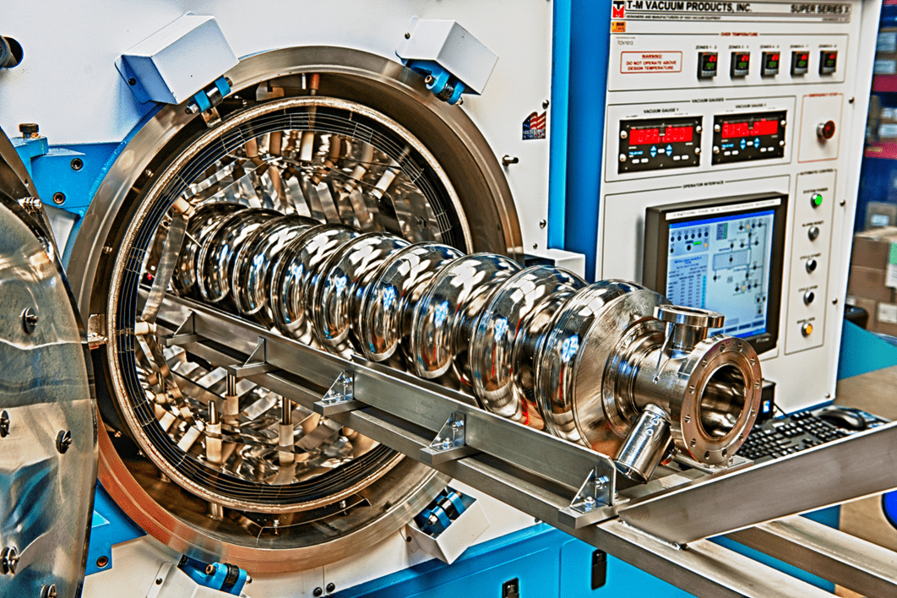
Nitrogen surface treatments
Cavities are processed in ultra-high-vacuum furnaces
https://td.fnal.gov/srf-capabilities/

Slide 6
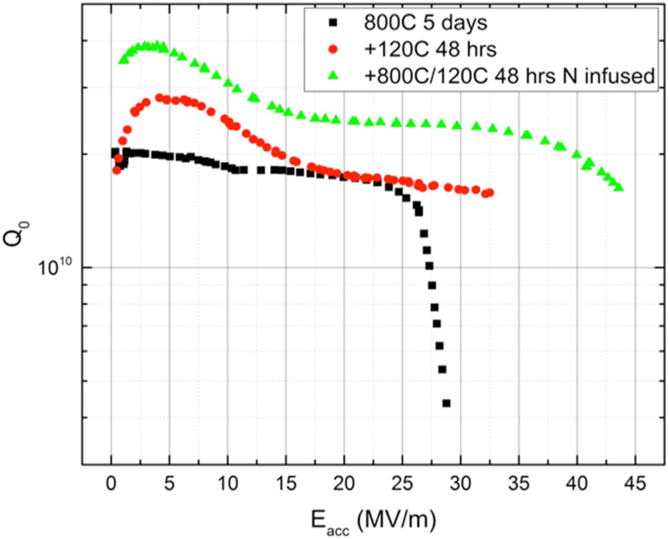
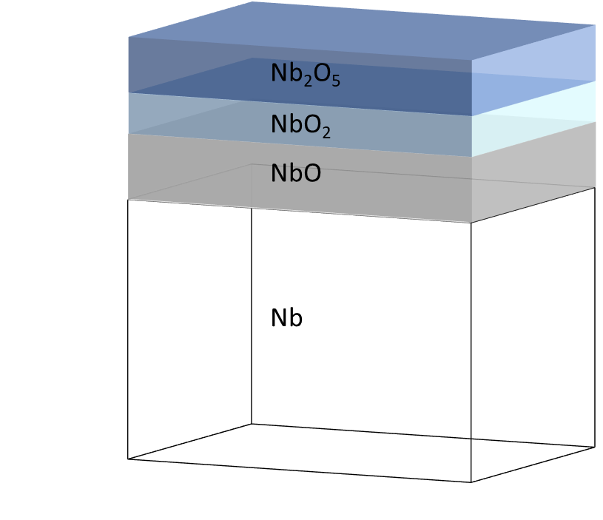
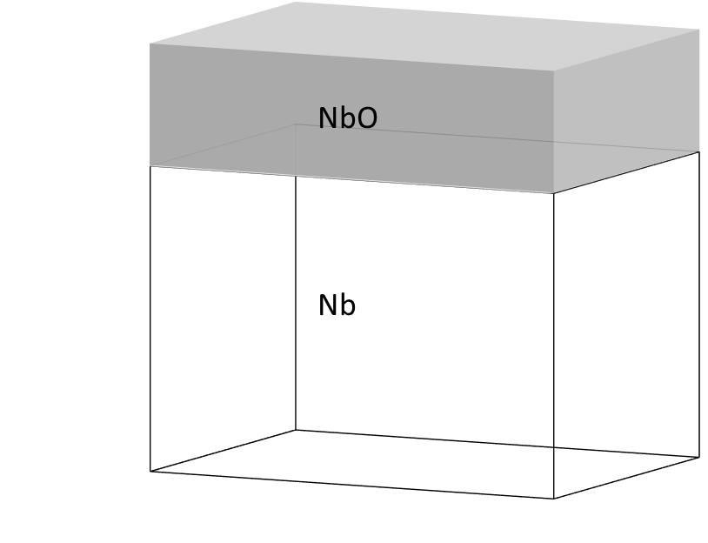
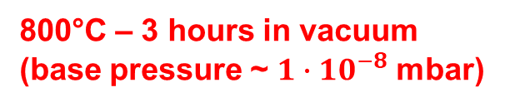
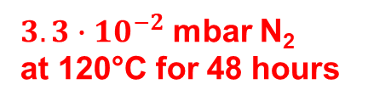
Nitrogen Infusion
A recipe developed at Fermilab
Nitrogen
x2
@800°C
?
HFQS
N,O,H,C
Low reproducibility at other labs
Underlying mechanism?
  Nitrogen?
  O, H, C Interstitials?
Supercond. Sci. Technol. 30 094004 (2017)
800°C – 3 hours in vacuum
(base pressure ~ $1∙{10}^{−8}$ mbar)
$3.3∙{10}^{−2}$ mbar N₂
at 120°C for 48 hours
No further steps needed!

Slide 7
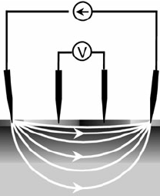
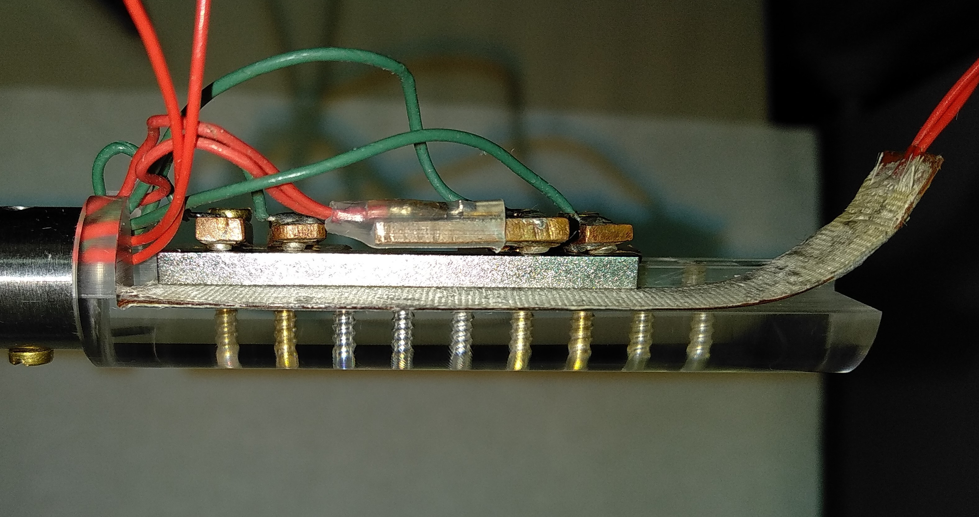
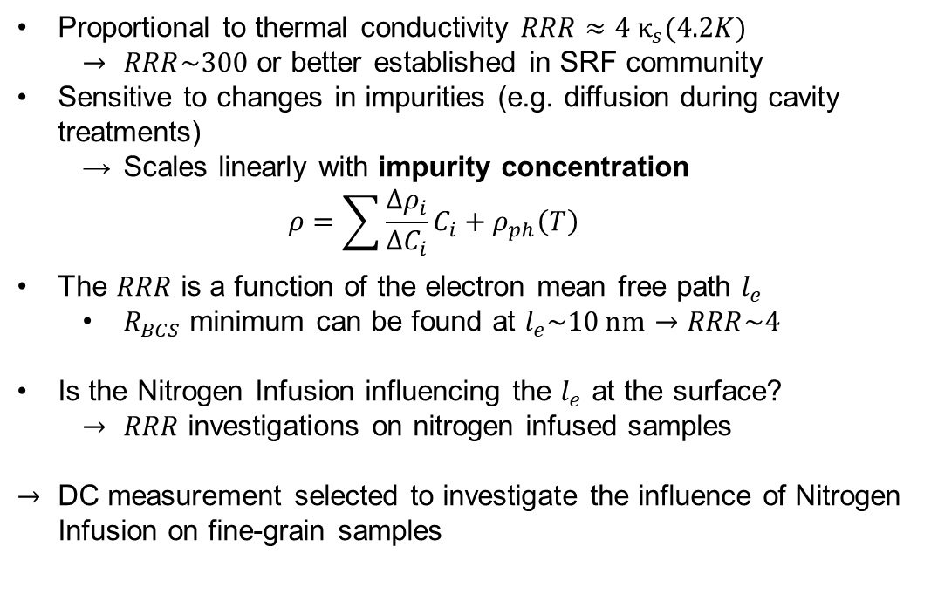
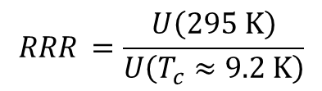

RRR measurements on samples
Residual Resistivity Ratio (RRR) - Resistive measurement
$$RRR=\frac{ρ\left(295 K\right)}{ρ\left(4.2 K\right)}$$
Proportional to thermal conductivity $RRR≈4 κ_{s}(4.2K)$
  $RRR\sim 300$ or better established in SRF community
Sensitive to changes in impurities (e.g. diffusion during cavity treatments)
  Scales linearly with impurity concentration
  $$ρ=\sum{\frac{∆ρ_{i}}{{∆C}_{i}}C_{i}+ρ_{ph}\left(T\right)}$$
The $RRR$ is a function of the electron mean free path $l_{e}$
  $R_{BCS}$ minimum can be found at $l_{e}\sim 10 \text{nm}→RRR\sim 4$
Is the Nitrogen Infusion influencing the $l_{e}$ at the surface?
  $RRR$ investigations on nitrogen infused samples
DC measurement selected to investigate the influence of Nitrogen Infusion on fine-grain samples
Pramana 93 (2019) 3, 51 DOI: 10.1007/s12043-019-1813-4
Nb sample
Heater
$${RRR}_{ }=\frac{U\left(295 \text{K}\right)}{U\left(T_{c}≈9.2 \text{K}\right)}$$

Slide 8
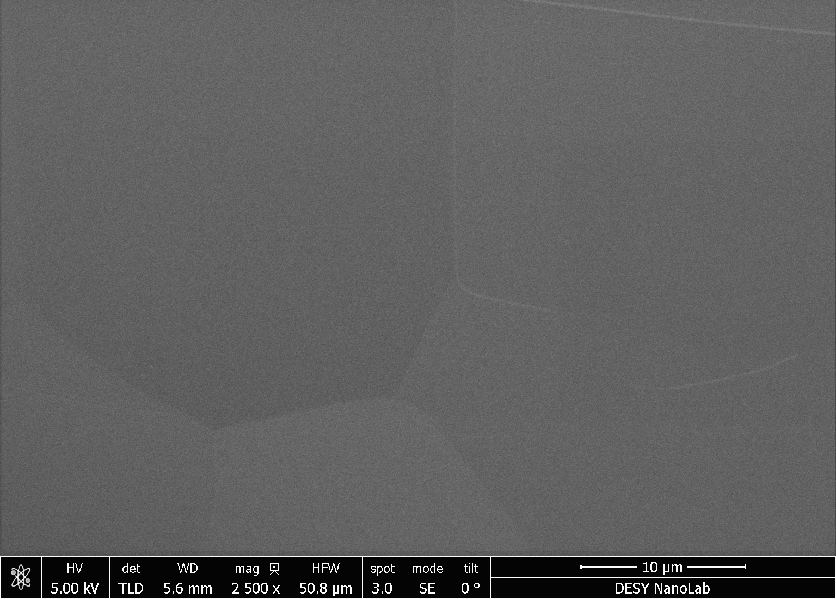

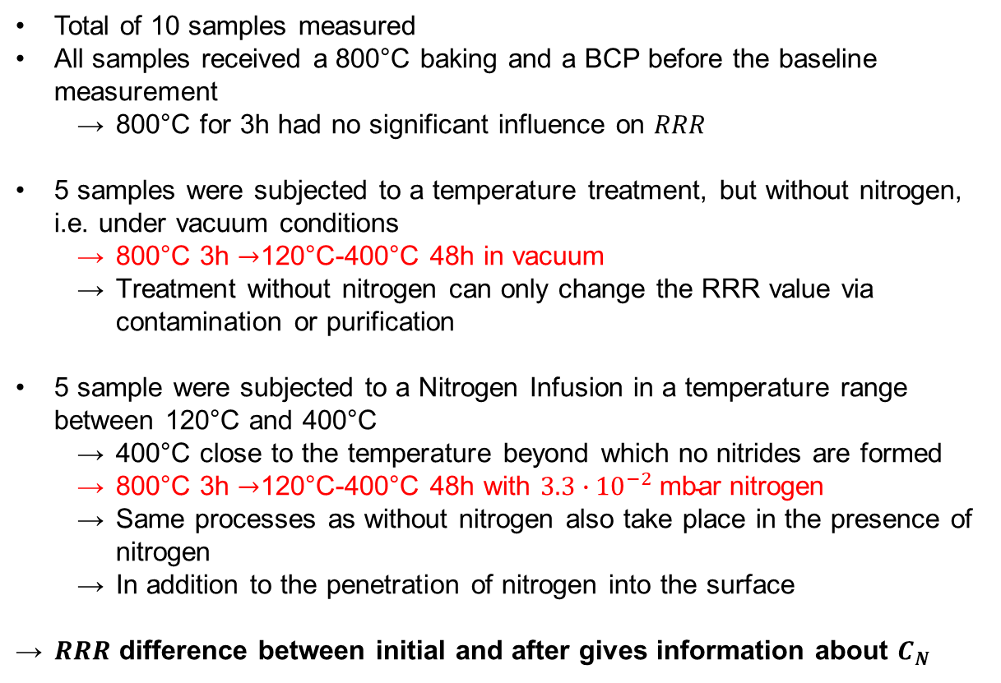



RRR measurements on samples
$∆RRR→C_{N}$
Total of 10 samples measured
All samples received a 800°C baking and a BCP before the baseline measurement
  800°C for 3h had no significant influence on $RRR$
5 samples were subjected to a temperature treatment, but without nitrogen, i.e. under vacuum conditions
  800°C 3h $→$120°C-400°C 48h in vacuum
  Treatment without nitrogen can only change the RRR value via contamination or purification
5 sample were subjected to a Nitrogen Infusion in a temperature range between 120°C and 400°C
  400°C close to the temperature beyond which no nitrides are formed
  800°C 3h $→$120°C-400°C 48h with $3.3∙{10}^{−2} \text{mbar}$ nitrogen
  Same processes as without nitrogen also take place in the presence of nitrogen
  In addition to the penetration of nitrogen into the surface
$RRR$ difference between initial and after gives information about $C_{N}$
$→$120°C-400°C 48h
in $3.3∙{10}^{−2} \text{mbar}$ N
800°C 3h
Clean surface no visible preicipitates on fine-grain sample after 400°C N-Infusion
Nitrogen
N,O,H,C
Impurities
$$C_{initial}+C_{new}$$
$$+ C_{N}$$

Slide 9
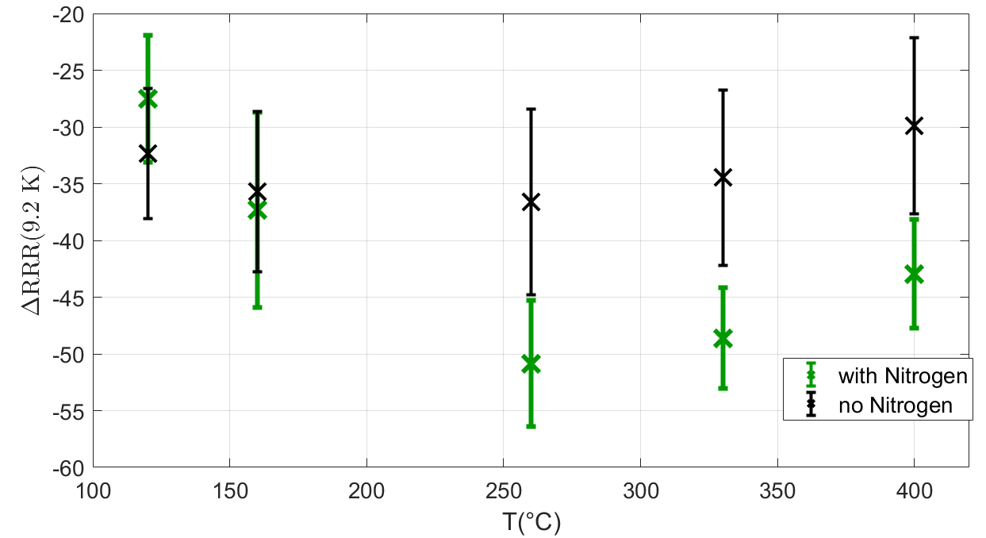
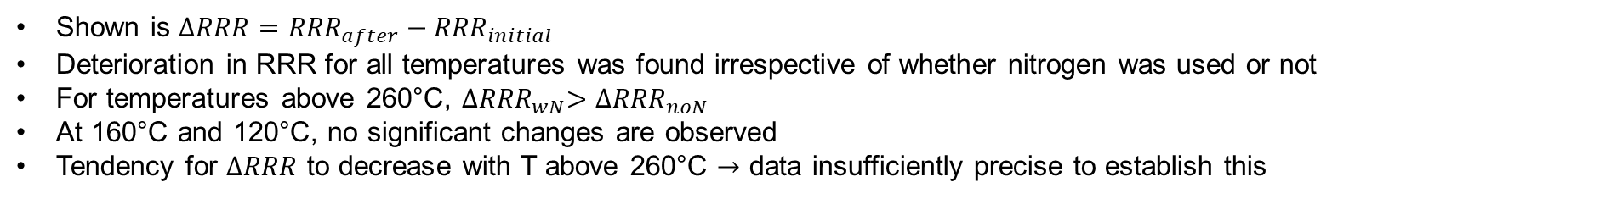
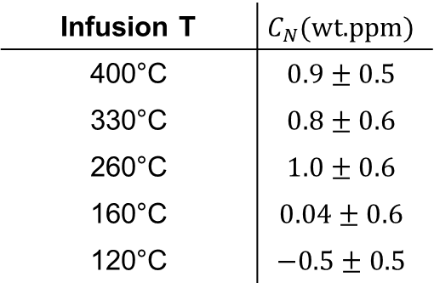
RRR measurements on samples
$∆RRR→C_{N}$
Infusion T | $$C_{N}(\text{wt}\text{.}\text{ppm}\text{)}$$
400°C | $$0.9±0.5$$
330°C | $$0.8±0.6$$
260°C | $$1.0±0.6$$
160°C | $$0.04±0.6$$
120°C | $$−0.5±0.5$$
Shown is $∆RRR={RRR}_{after}−{RRR}_{initial}$
Deterioration in RRR for all temperatures was found irrespective of whether nitrogen was used or not
For temperatures above 260°C, ${∆RRR}_{wN}>{∆RRR}_{noN}$
At 160°C and 120°C, no significant changes are observed
Tendency for $∆RRR$ to decrease with T above 260°C $→$ data insufficiently precise to establish this

Slide 10
Thank you

Slide 11
Backup

Slide 12
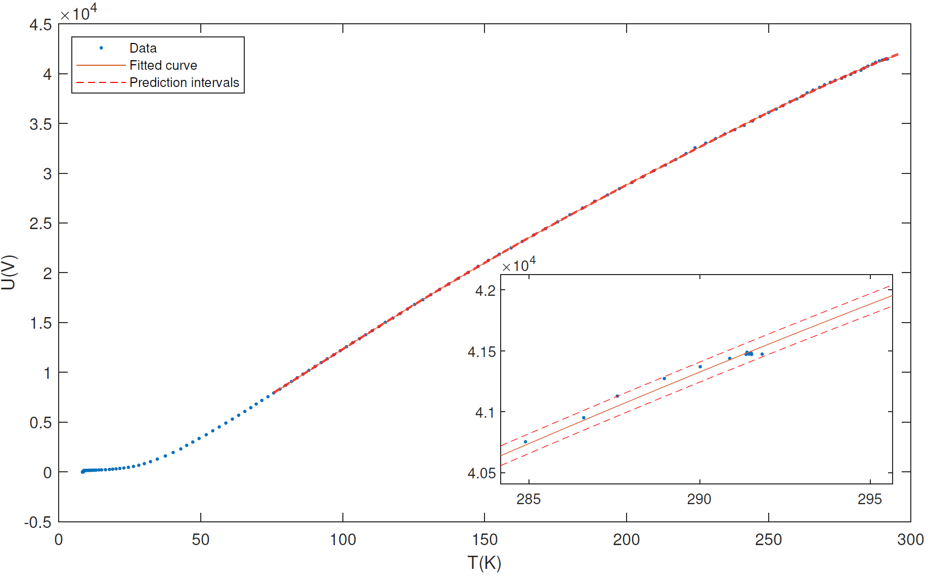
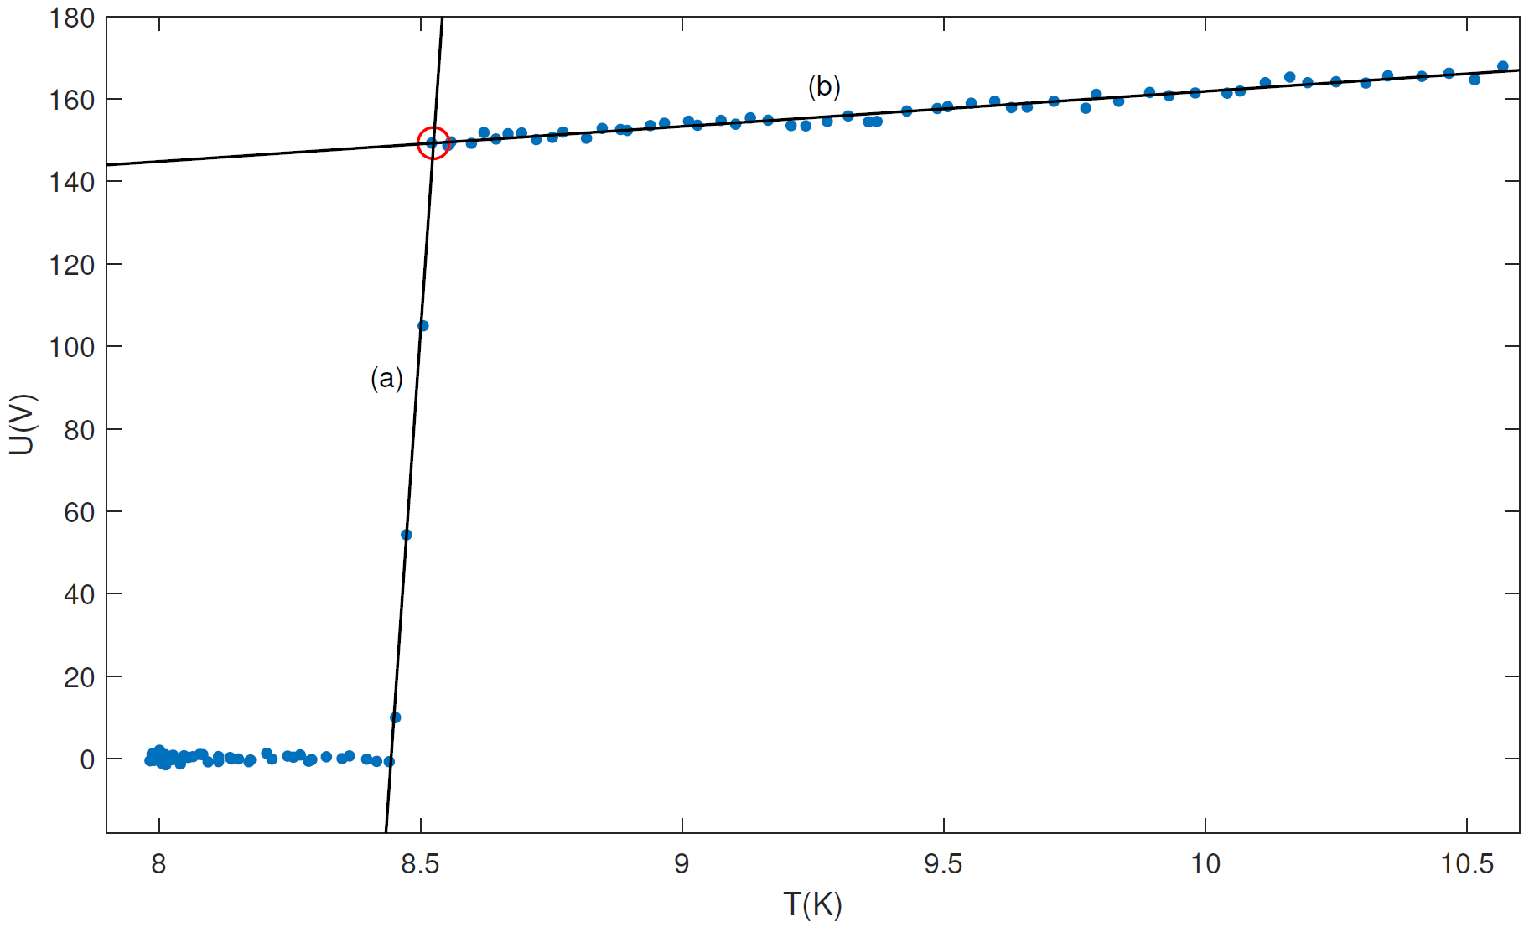
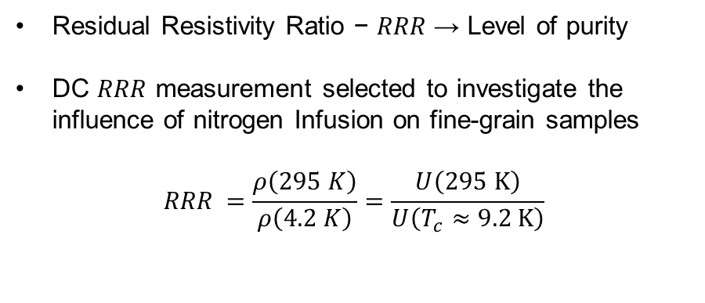
RRR measurements on samples
Resistive measurement
Nb sample
Heater
Residual Resistivity Ratio − 𝑅𝑅𝑅 → Level of purity
DC $RRR$ measurement selected to investigate the influence of nitrogen Infusion on fine-grain samples
$${RRR}_{ }=\frac{ρ\left(295 K\right)}{ρ\left(4.2 K\right)}=\frac{U\left(295 \text{K}\right)}{U\left(T_{c}≈9.2 \text{K}\right)}$$

Slide 13
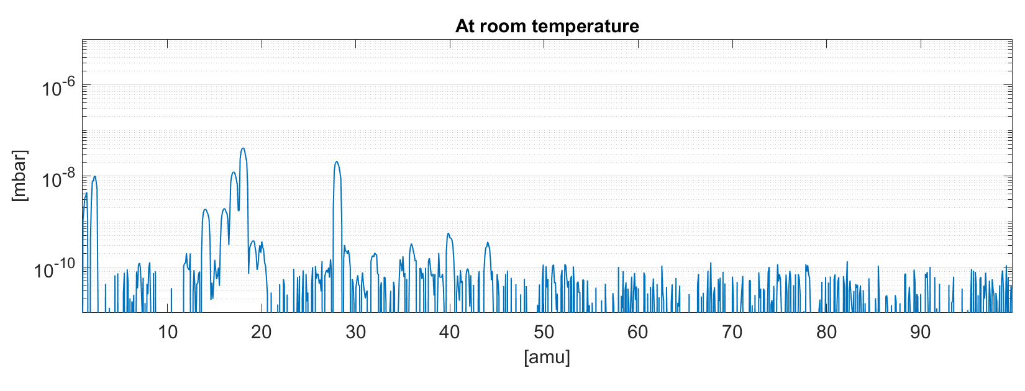
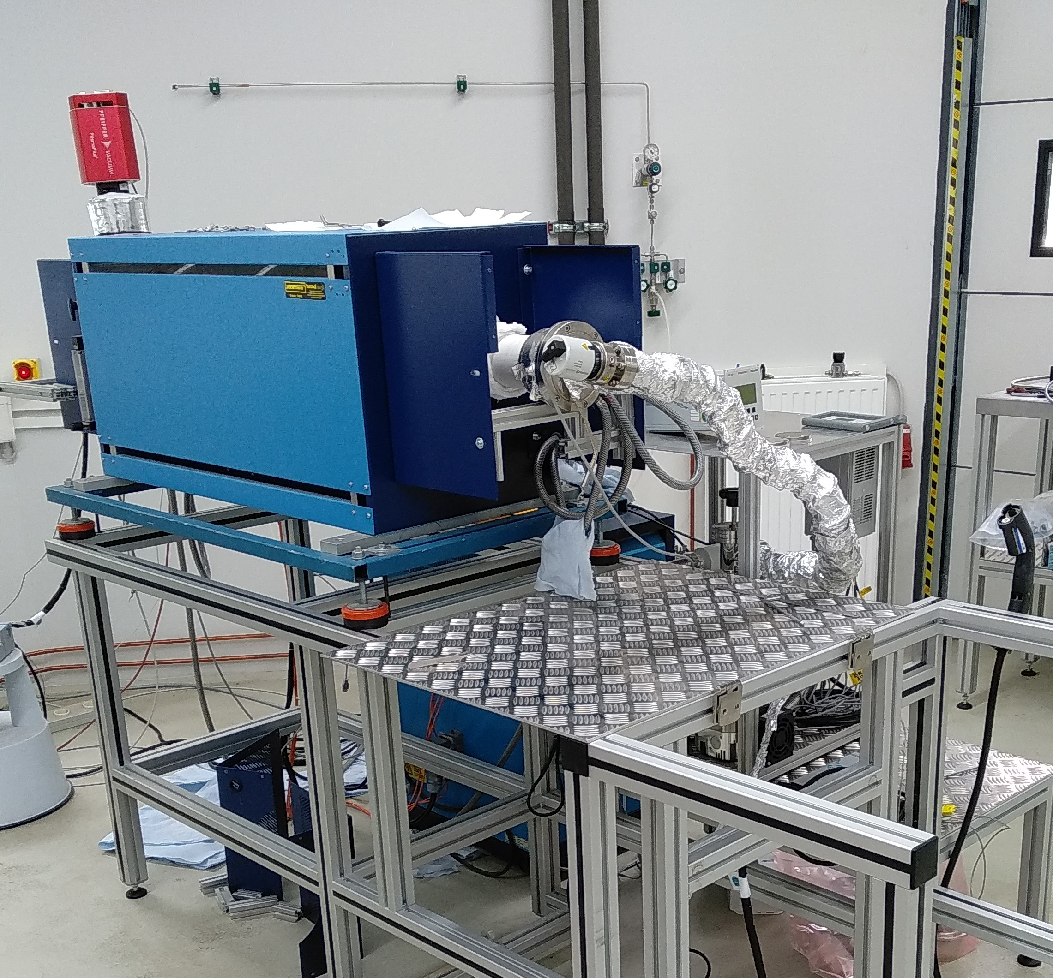
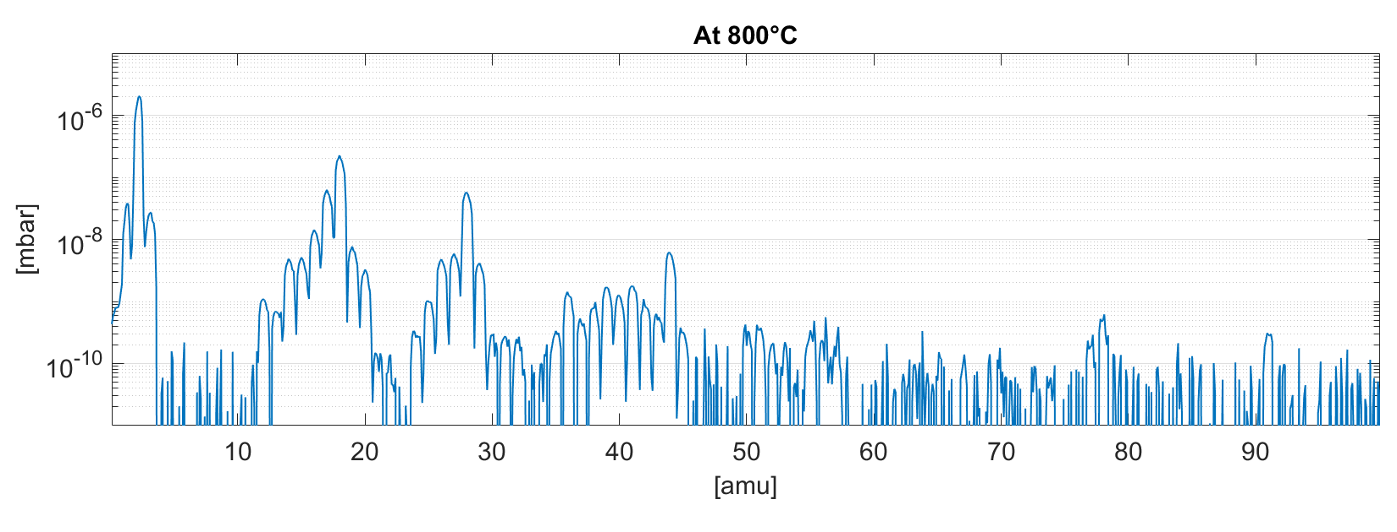
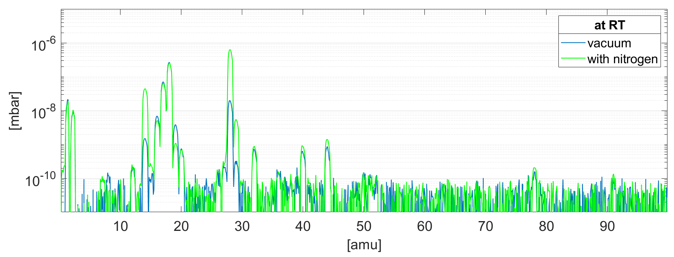

Sample furnace
Residual gas analysis (RGA)
Final pressure: $2×{10}^{−8}$mbar

