Slide 1

ST4 – plasma acceleration
Highlights and progress
U. Schramm (HZDR)
A. Maier (DESY)
Compiled (i.e. selected) from impressive
input from all partners …
Simulation development in DMA …

Slide 2
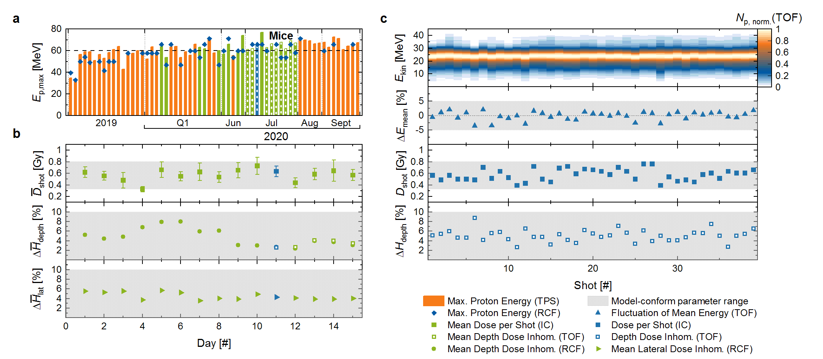
From plasma acceleration to plasma accelerators
i.e. basic research and application driven development
Improved beam (and driver) stability and control
Active management (and machine learning) feedback
Transport beam line development
[2020-2022]
LWFA
electron energy
PRL 126, 174801 (2021)
PRL 126, 104801 (2021)
TNSA
proton energy
Nature Phys.18, 316 (2022)
Closely related to and depending on DMA (and Innovation Pool) projects

Slide 3
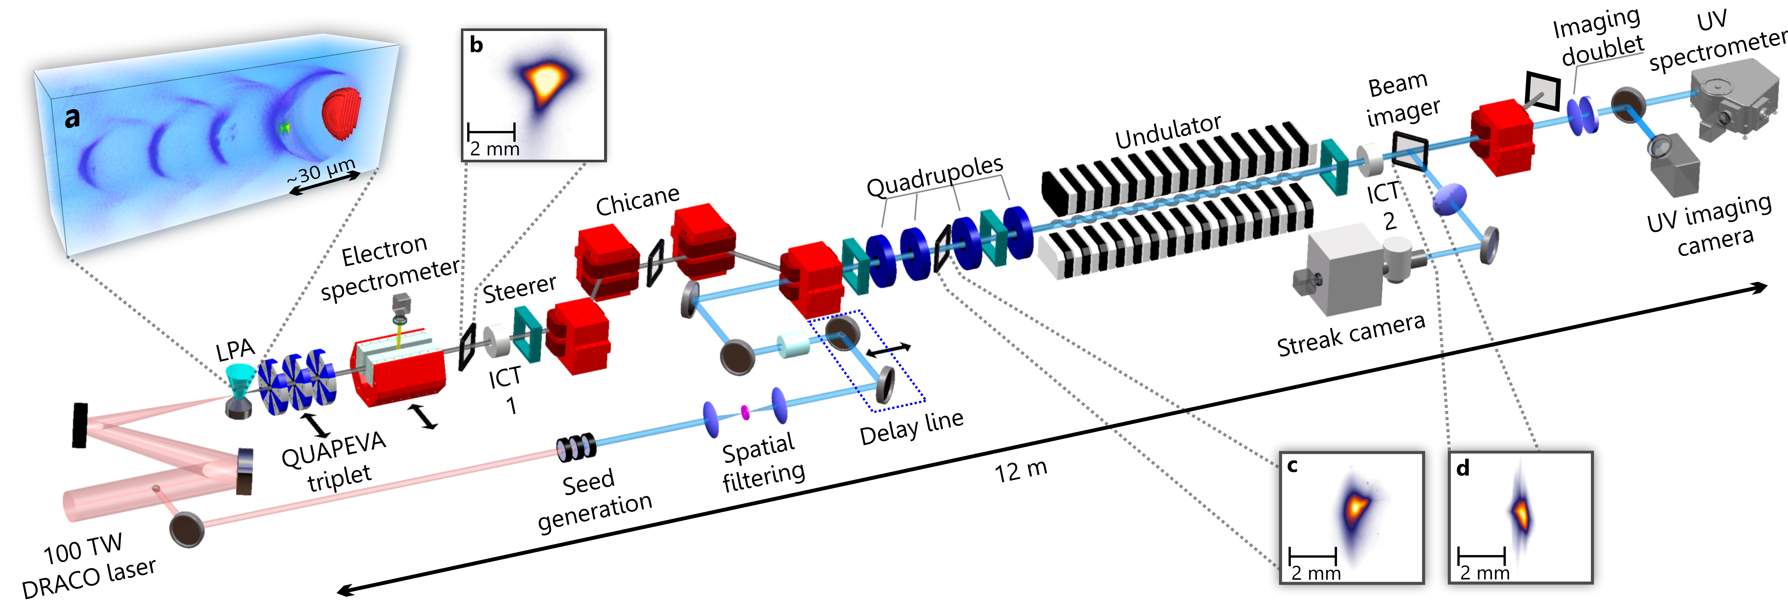
Increased stability and quality enables applications
Example: seeded FEL demonstration ( @ HZDR)
Nature Photonics, in review (2022)

Slide 4
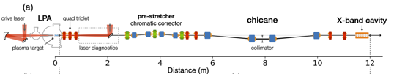
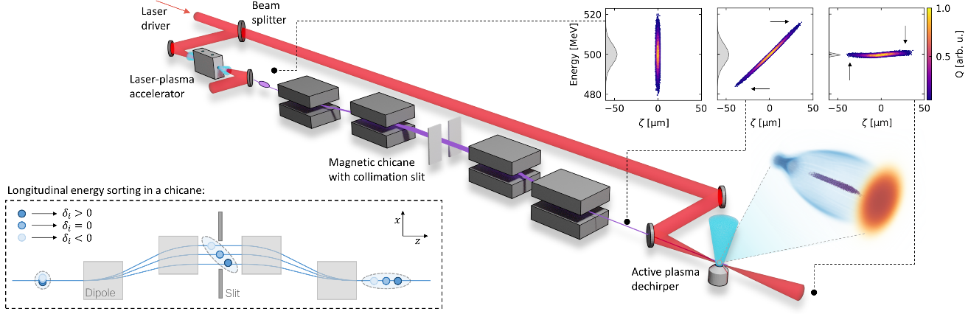
Beamlines for transport and phase space manipulation
merging laser plasma and advanced conventional schemes
Phys. Rev. AB 24, 111301 (2021)
Phys. Rev. Lett. 129, 094801 (2022)
Stabilizing LPA electron
beam in an x-band cavity
Dechirping (after decompression) in secondary
plasma stage

Slide 5
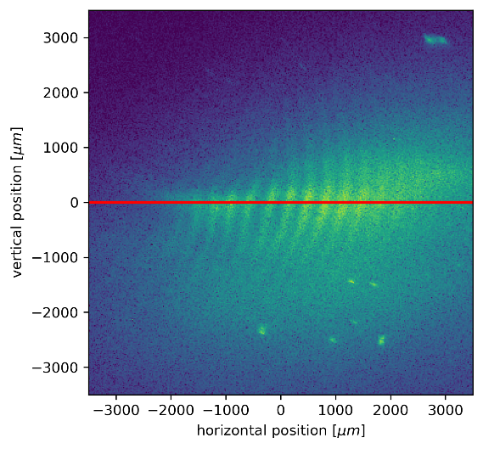
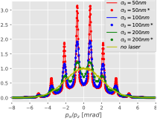

Innovative adapted beam diagnostics
Optical „pepperpot“ for nm emittance measurement
Laser interference
pattern
Modulated
electrons
Electron signal at
scintillation screen
e-
Modulation by laser interference pattern
electron beam source size of ~ 200
source size ~10 nm can be resolved
Small source ⬄ large peak
PRSTAB 24, 012803 (2021)

Slide 6
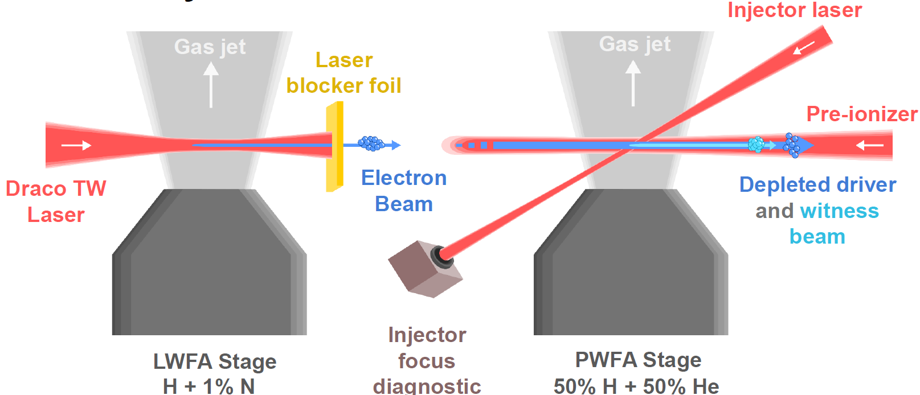
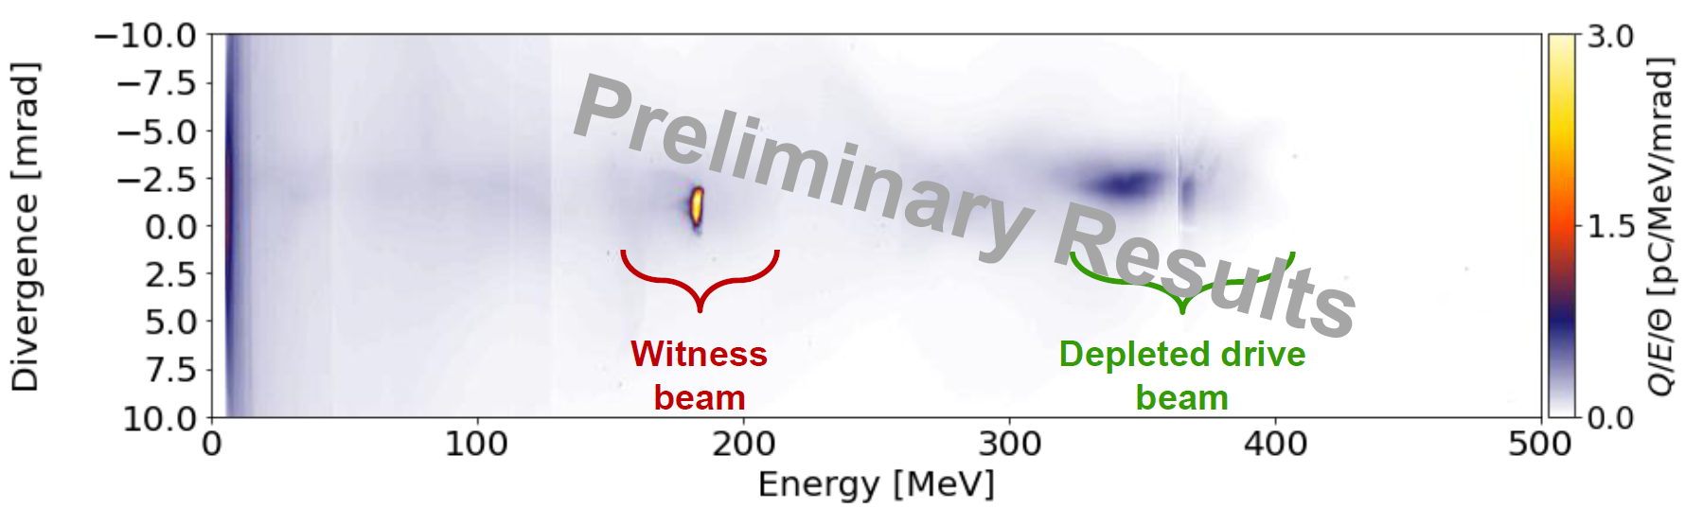
Increased LWFA peak current enables applications
Example: hybrid LWFA – PWFA as quality booster
localized optical injection
improved emittance and quality
dense plasma (short driver) enables optical wake visualization
Phys. Rev. Res. 3, L042005 (2021)
Nature Commun. 12, 2895 (2021)
Trojan injected witness
New J. Physics 24, 083034 (2022)
depleted LWFA driver

Slide 7
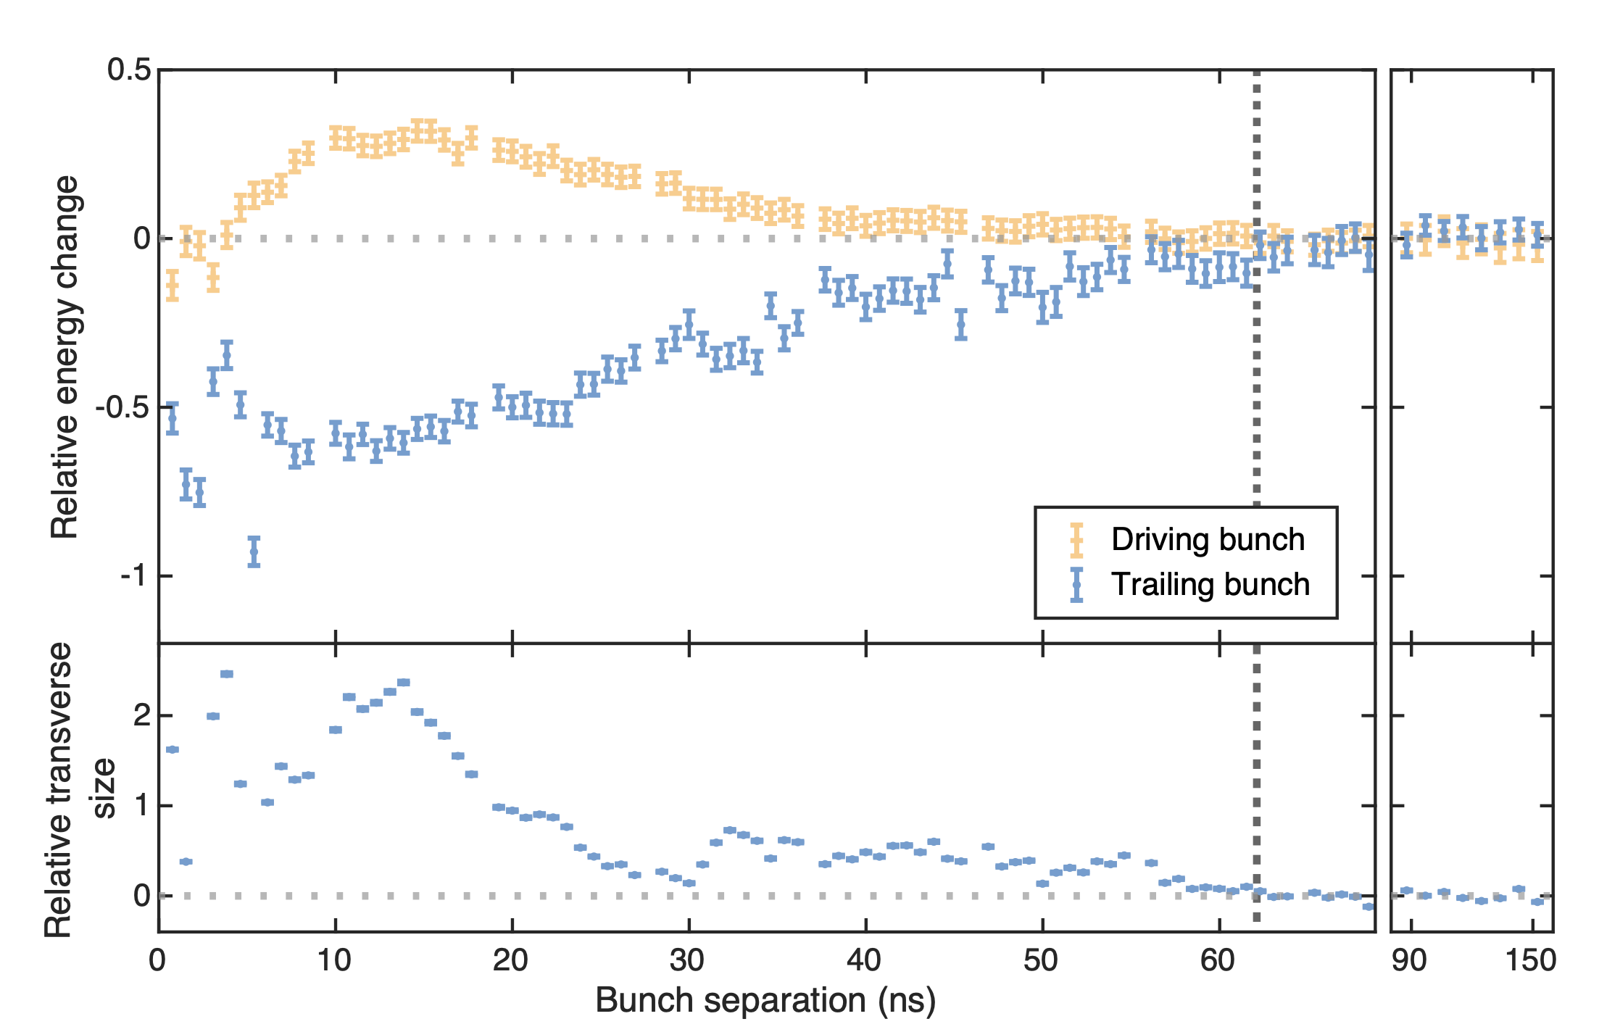
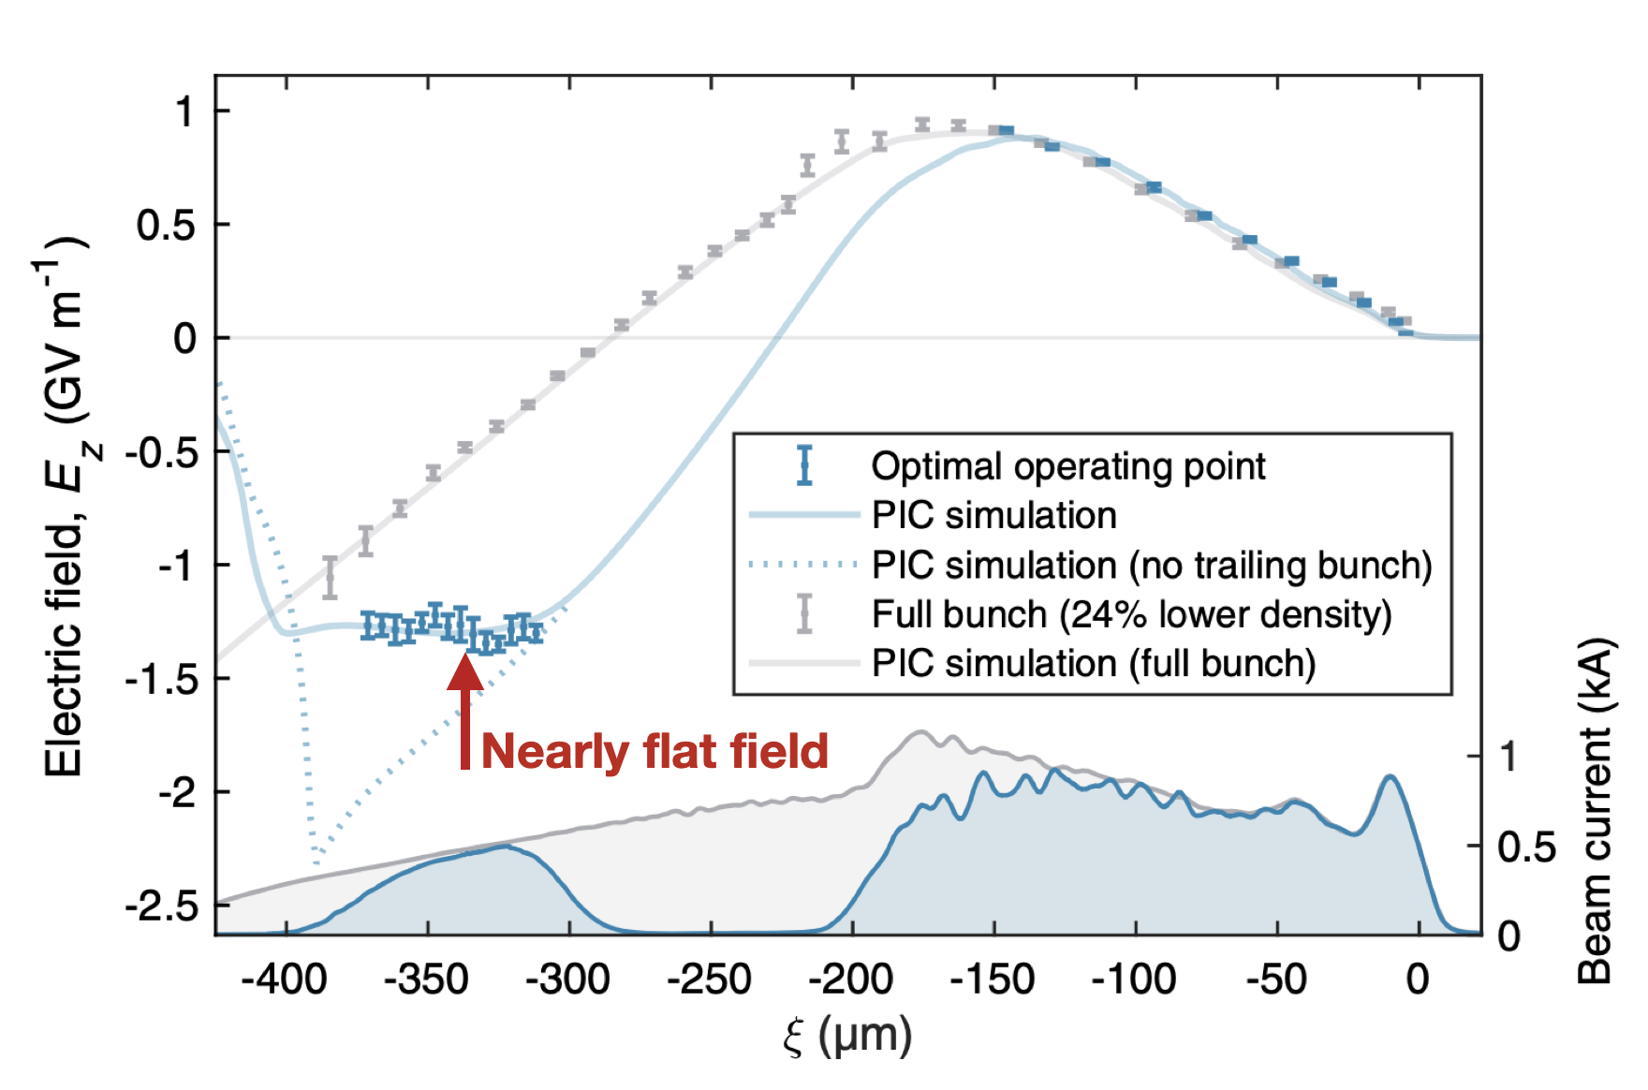
FLASHForward Goal – Develop a self-consistent plasma-accelerator stage with high beam quality, high energy-transfer efficiency, and high repetition rate
-> talk by R. d‘Arcy
Energy-Spread Preservation and High Efficiency in a Plasma-Wakefield Accelerator
Recovery time of a plasma-wakefield accelerator
63 ns recovery time
Beam loading of the plasma wake enables high-quality and highly efficient acceleration for sustainable applications
The plasma recovery time (~63 ns) implies that MHz repetition rates required for FEL and HEP applications are possible
Phys. Rev. Lett. 126, 014801 (2021)
Nature 603, 58–62 (2022)

Slide 8

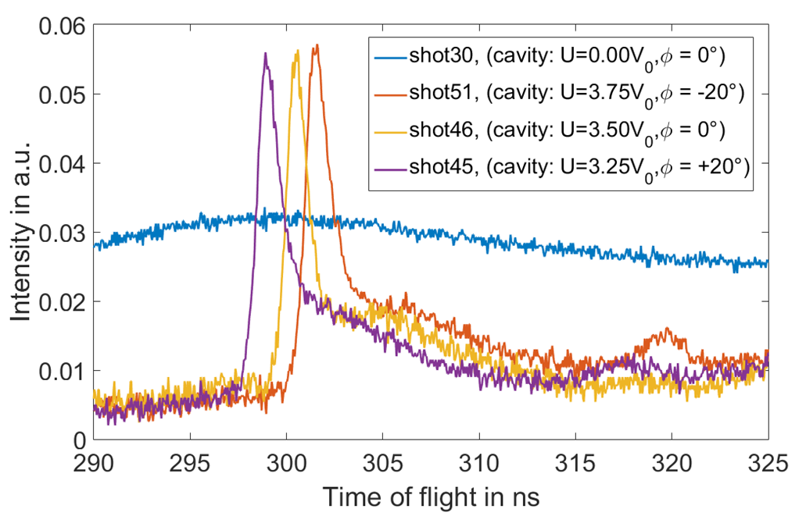
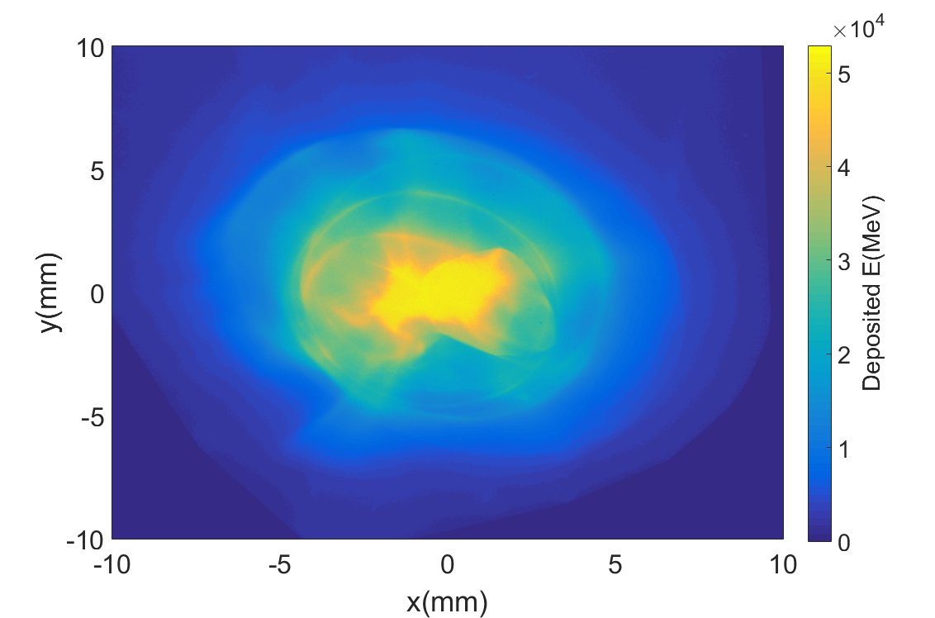
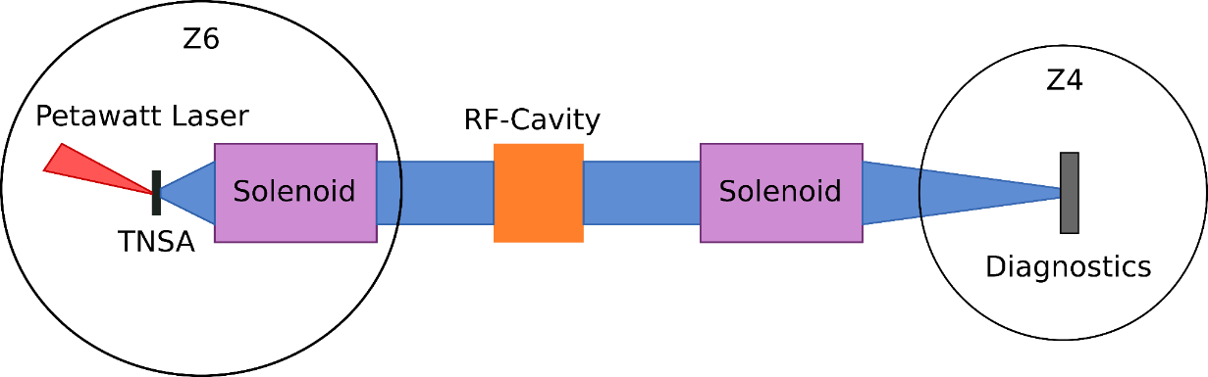

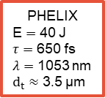
Beamlines for transport and phase space manipulation
0.6 MeV/u Carbon ion bunch
10⁹ ions in ~ 1.2ns pulse
low energy ion
stopping power experiments in
laser generated
plasmas planned
Solenoid 1
Energy Selection
Beam Collimation
Solenoid 2
Transversal Focussing
PHELIX
E $=$ 40 J
$τ=$ 650 fs
$λ$ $=$ 1053 nm
$d_{t}≈$ 3.5 µm
Diagnostics / Experiments
RF-Cavity
Temporal/Longitudinal Bunching

Slide 9
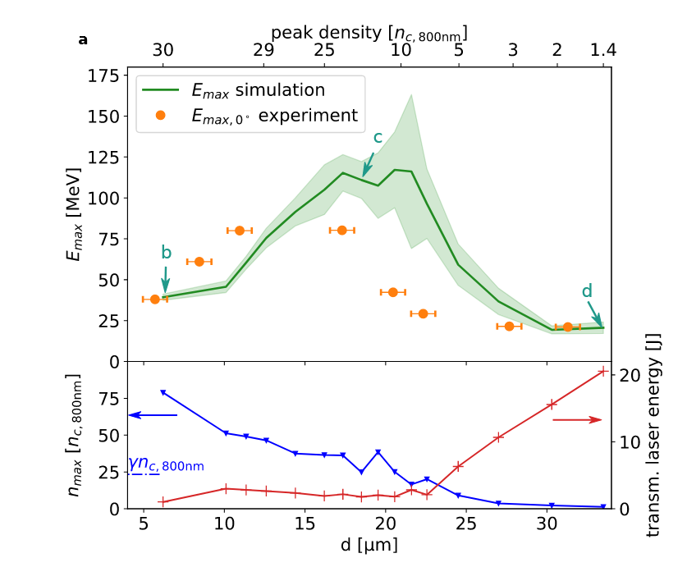

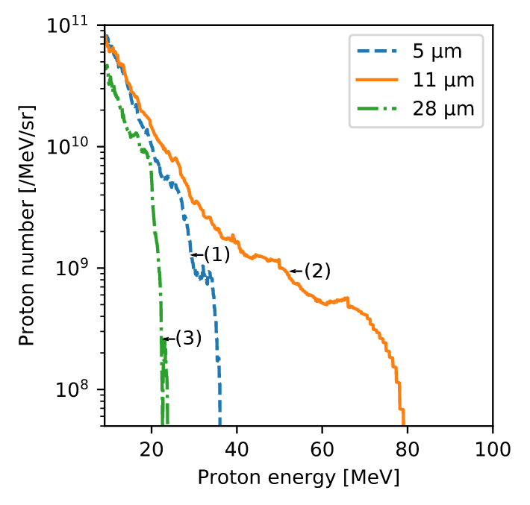

Solid target density tailoring boosts proton performance
Density controlled cryogenic solid hydrogen jet target
repetition rate compatible
MVA
RTF-RPA
TNSA
Novel exp. in revision (2022)
PPCF 64, 044010 (2022)
Sci. Reports 12, 7287 (2022)

Slide 10
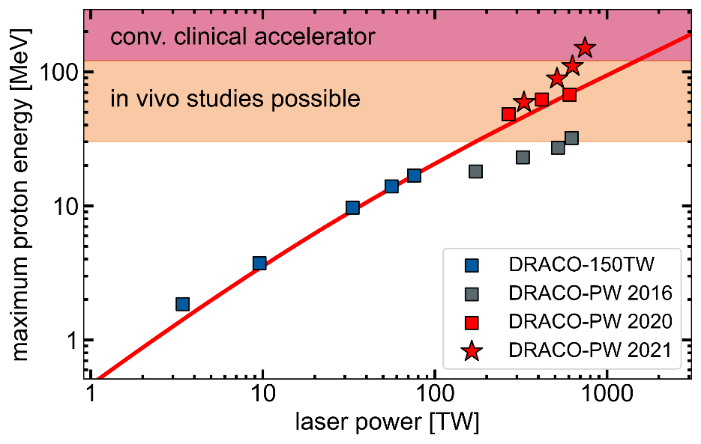

Laser matched density tailoring for highest performance
-> talk by T. Ziegler

Slide 11
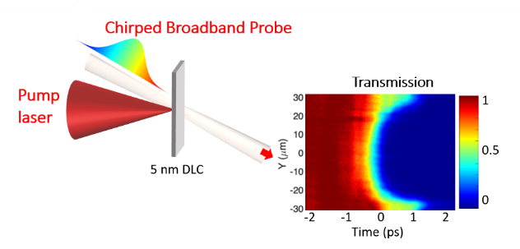
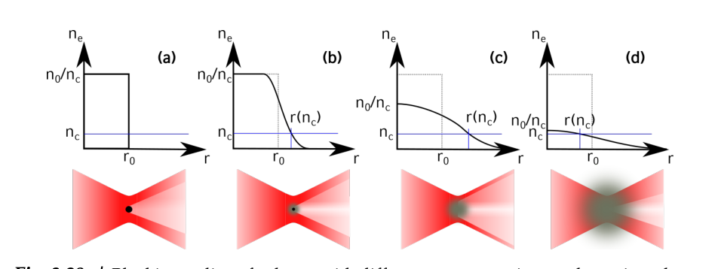
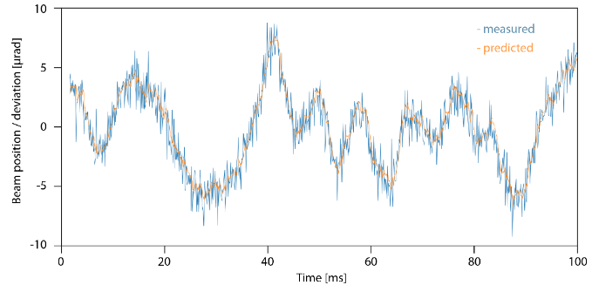
Further topics in short (1)
Laser induced ionization dynamics in thin foils
using chirped transmission probe
Single-shot space-time resolved transmission of probe pulse
High efficiency proton accleration from
levitated microspheres @JETi 200
Maximum efficiency (18 MeV/J) at matched expansion
Using neural networks for predictive beam
steering for laser beam stabilization

Slide 12
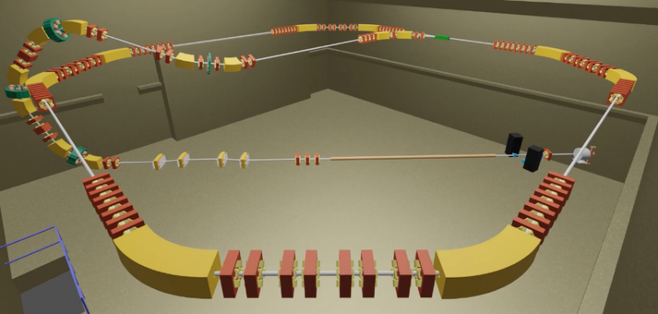

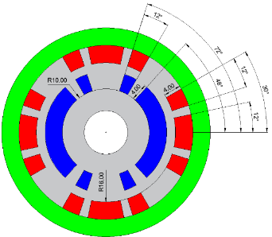

Further topics in short (2)
LPA injection into dedicated storage ring
High acceptance transfer line and ring lattice development
Beam dynamics studies ongoing
Joint injector development
Miniaturized HTS magnets and transport lines
-> talk by S. Fatehi
Laser acceleration of polarized hadron beams
Development, test, and operation of polarimeters for p, ³He
Experiments at PHELIX

Slide 13
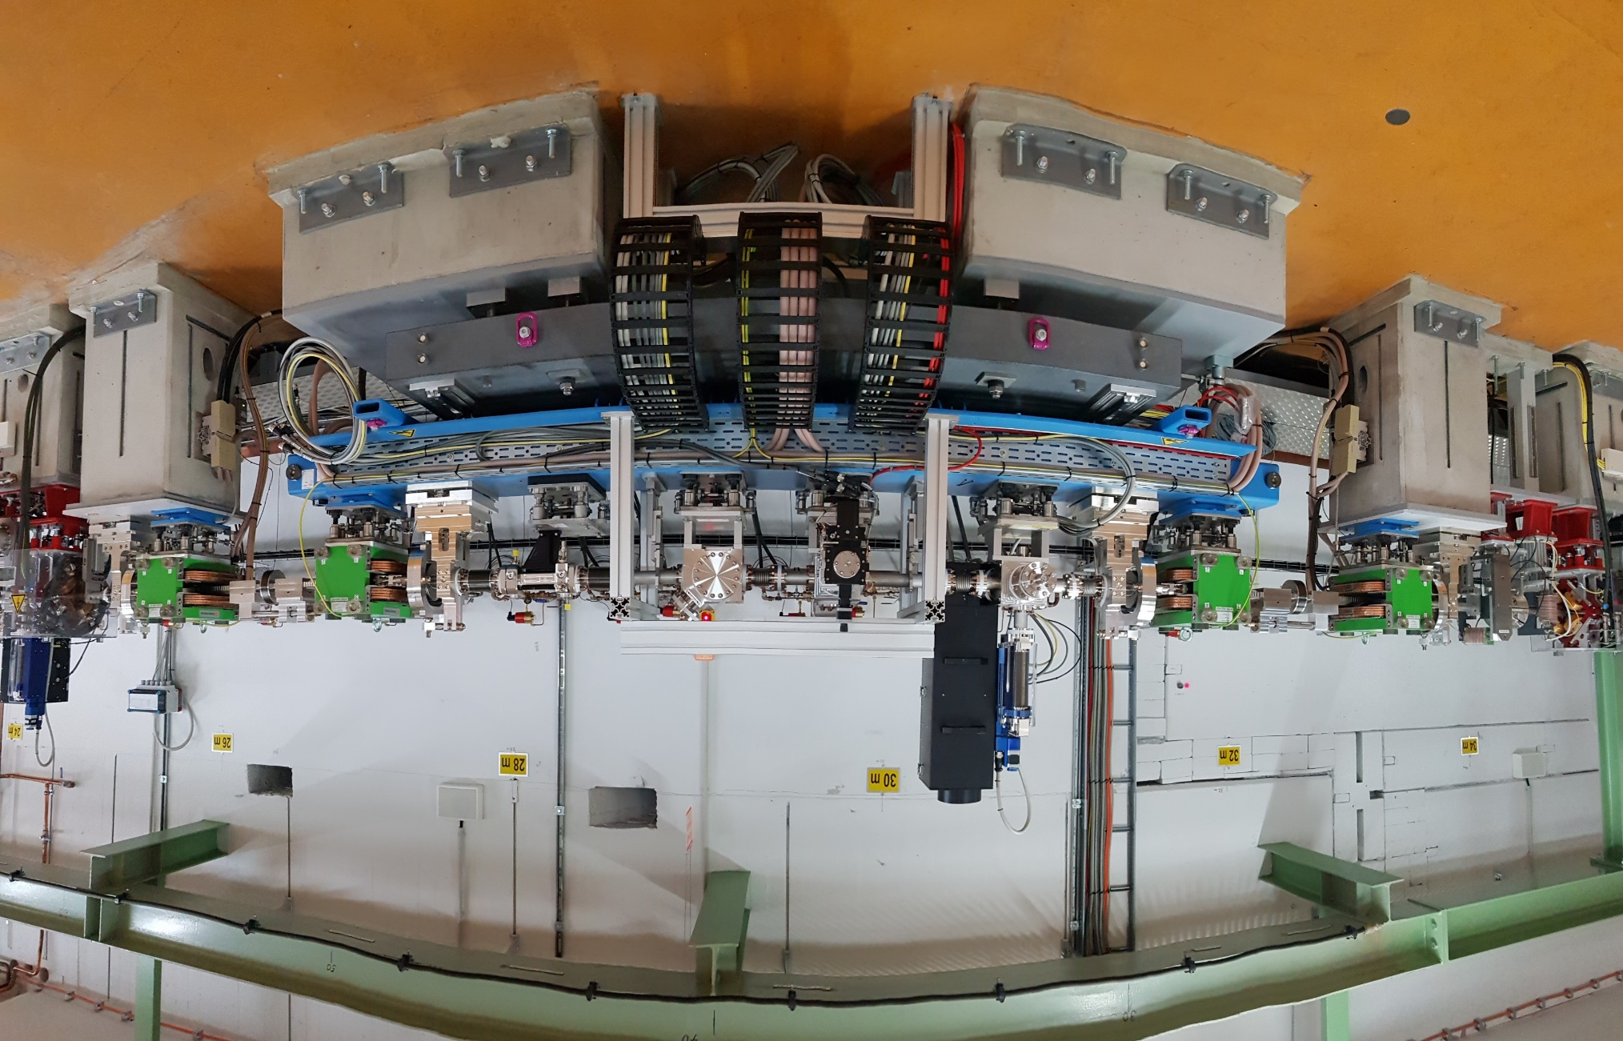
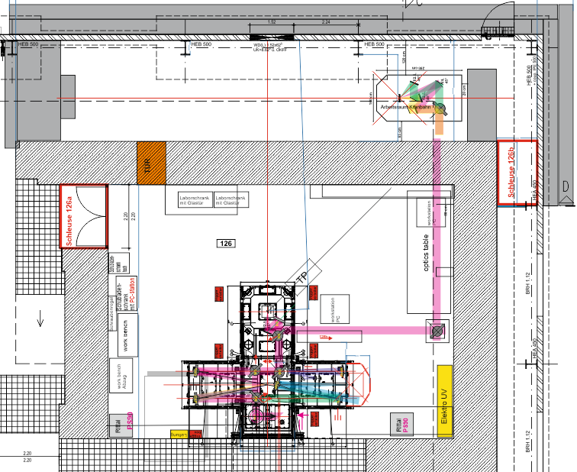
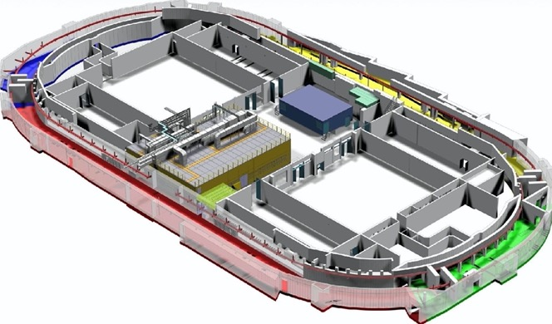
Most ATHENA infrastructures completed
collaboration based
Bunch compressor (figure) and
x-band deflection cavities at ARES
Joint penelope front-end development
Clean room installation ATHENA_h completed
New KALDERA lab ready by October 2022
Seed laser development finalized
Tunnel (red) being prepared for plasma injector
Novel labs in Jena -> talk A. Sävert

