Slide 1
Research Field Matter Dr. Michael Bussmann, Prof. Dr. Volker Gülzow Topic Speaker Data Management & Analysis
Overview DMA

Slide 2
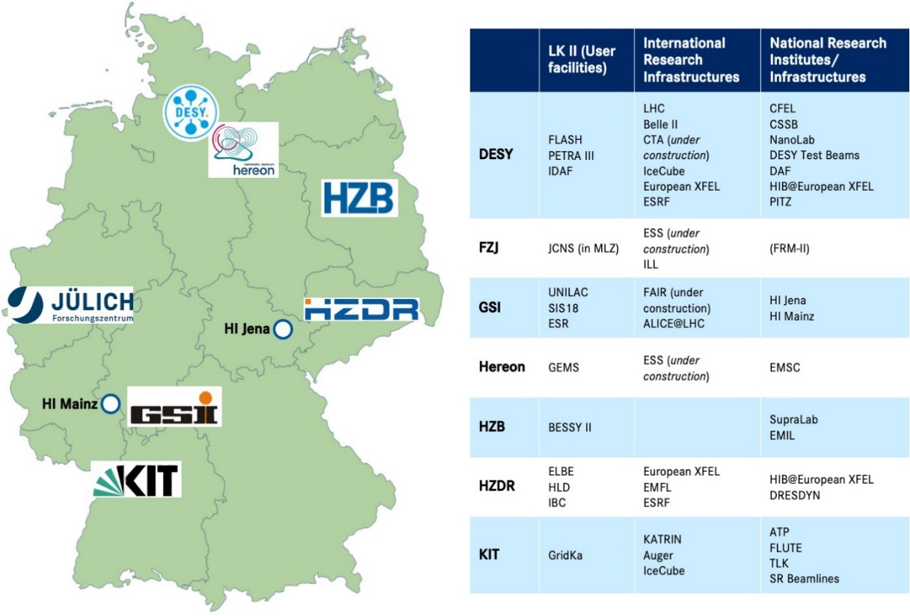
Research Field Matter
Digitalisation Strategy
Unique Research Facilities
Many scientific domains and a diverse user community from university, research institutes and industry
Digitalisation is important for
Efficient and sustainable operation
Optimum use of research infrastructures
Knowledge extraction from research data
Frontier science as a driver of innovation
Topic DMA established in POF IV

Slide 3
Research Field Matter
The 10 Goals of the Matter Digitaisation Strategy
Enabling frontier science through federated compute, data and service infrastructures across centres and communities
Sustaining technological leadership in scientific simulation, data analytics and machine/experiment control through cutting edge technologies such as AI, Exascale and Quantum Computing
Providing an integrated support infrastructure for the diverse user communities of our research infrastructure
Supporting user communities in disseminating and using scientific data in an open, sustainable and F.A.I.R. way (Open Science!)
Developing and building large-scale research infrastructures using modern IT technologies
Developing and using intelligent and autonomous systems for maintenance/operation of machines, instruments & experiments
Using resources sustainably, from energy to materials, from data to software
Fostering the careers of young researchers in computer, information and data science
Cooperating with industry partners on applied research
Growing transfer of knowledge and technologies to industry and society both nationally and internationally

Slide 4
Research Field Matter
Digitalisation Strategy
A digitalisation strategy aligned with all Helmholtz centers in Matter for the whole Research Field.
Set up for cross research field collaboration
Fitting to the strategic position paper “Digitalisierungsstrategie der Helmholtzgemeinschaft”
Concrete measures to reach the goals of the strategy

Slide 5
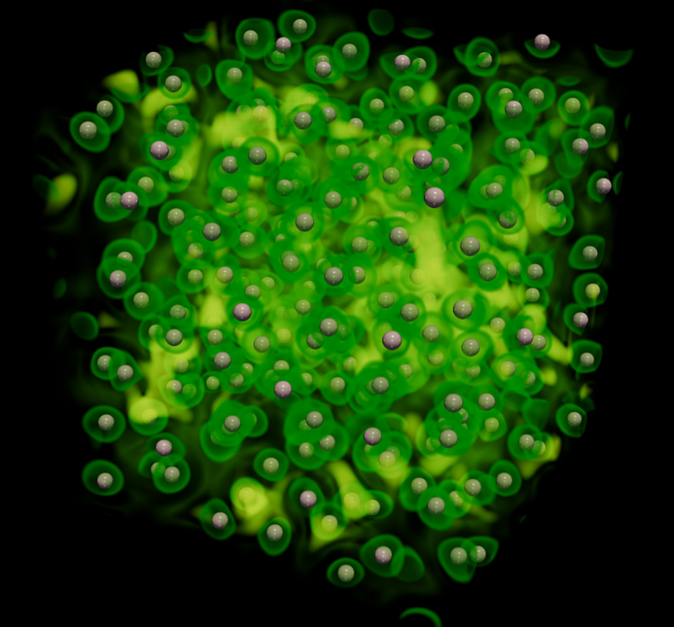
Programmfortschrittsbericht 2021
Highlight DMA
Renowned John Dawson Award for Excellence in Plasma Physics Research for Tobias Dornheim by the American Physics Society
A new Monte Carlo Method for the famous „Fermion Sign Problem“ that allows to study large-scale multi-particle quantum systems of interacting fermions.
This problem is computationally extremely hard (NP-hard) and the technologies developed by Tobias Dornheim allow to circumvent computational problems while producing highly accurate ab-inito data on these systems.

Slide 6
Today‘s session
Overview over the 3 DMA Subtopics
ST1 ─ The Matter Information Fabric
ST2 ─ The Digital Scientific Method
ST3 ─ The Digital Experiment and Machine
Exascale Data Management
F.A.I.R. Data & Meta Data
Long-term preservation
regular exchange &
common projects
Artificial Intelligence
Exascale Computing
Near-realtime analysis
Quantum Computing
Exascale Simulations
In-situ Data Analytics
Near-realtime feedback
Machine optimization

Slide 7
Research Field Matter
DMA connects to many different initiatives
+ Innopool

Slide 8
Research Field Matter
The state of DMA & next steps
Current DMA Leads: M. Bussmann / V. Gülzow, but we will need a replacement for Volker
We need to establish regular meetings again, especially a yearly in-person meeting
All Subtopics established
What is the best rate at which the subtopics meet regularly?
Is meeting online best or should the STs meet in person as well?
Some ST leads have changed labs, we need to have good representation of all labs
What is the state of the Deliverables & Milestones?
How can we better organize reporting?
How can we increase exchange between STs?
Collaboration within MT established
How do we decide what is ARD, DTS or DMA?
How do we increase crosstalk between topics?

Slide 9
Research Field Matter
The state of DMA & next steps
Collaboration with Programs MU & MML
Again, how do we decide what is DMA and what isn’t?
How do we strengthen collaboration with other programs and between centers?
Collaboartion with RF Information
Currently via Exascale (HZDR + more) & Quantum Computing (DESY + more)
Common Governanace with RF Information via a CCA?
More common subjects?
Collaboration outside Matter (Incubator, NFDI, EOSC, RDA, Euro-HPC, HSF, WLCG, LEAPS, …)
DMA is everywhere
But how do we make use of this?
How do we ensure synergies?
How do we make this better visible?

Slide 10
Research Field Matter
The state of DMA & next steps
POF V is coming
We have a common digitalisation strategy
What do we do with it?
What will be the outcome of POF IV and what will be the next steps in POF V?
Funding is coming from outside sources / third party funding
How do we ensure sustainability and growth of DMA?

