Slide 1
MIMOSIS – status & plans
M. Deveaux on behalf of the MIMOSIS-team

Slide 2
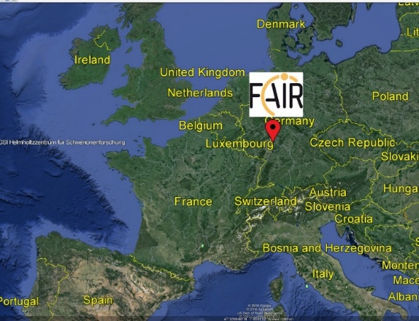
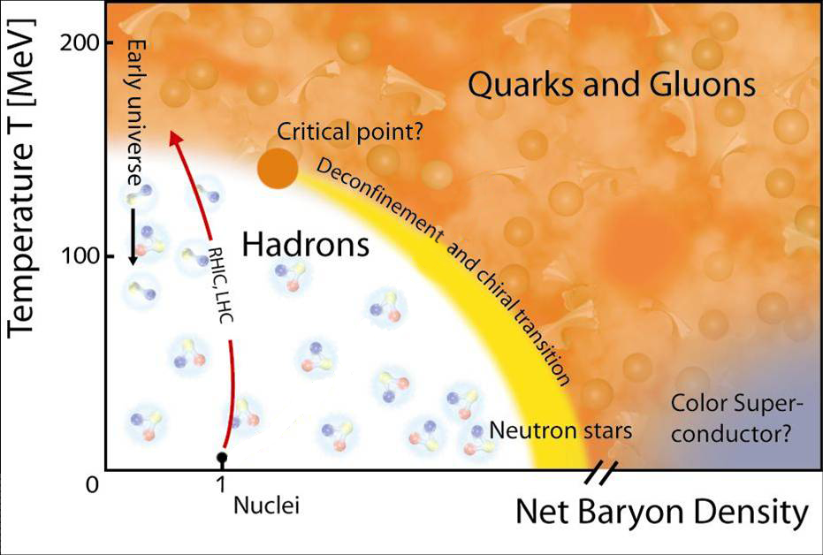
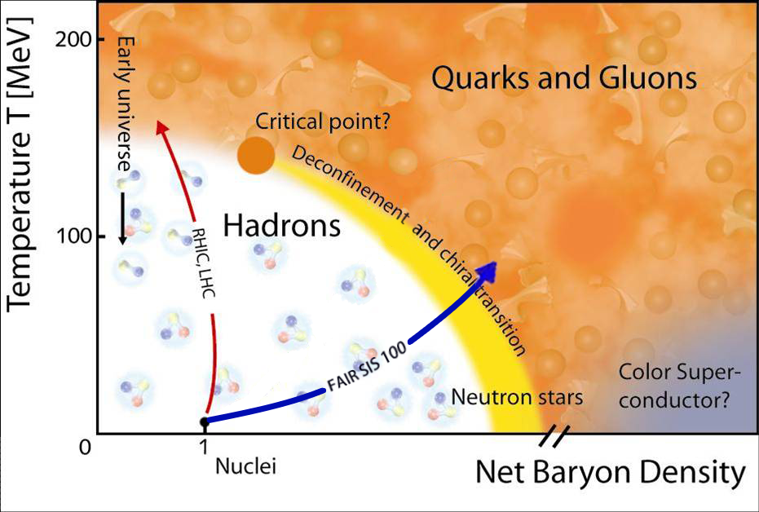
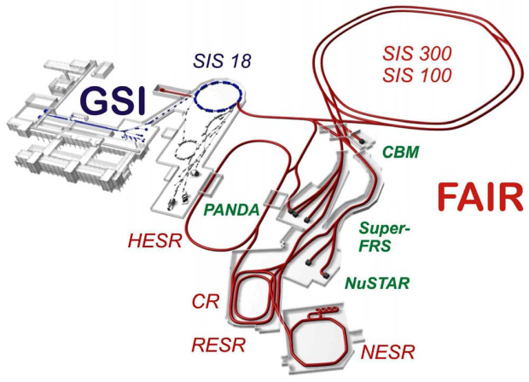
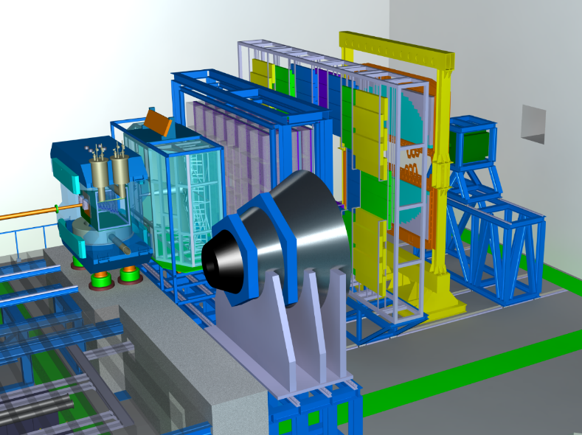
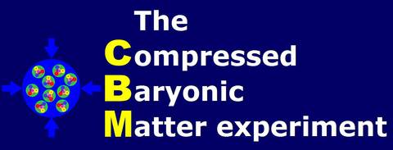
MIMOSIS - Motivation
999
CBM
CBM Micro Vertex Detector:
Find open charm in up to
100 kHz Au+Au collisions.
10 MHz p + Au collisions.

Slide 3
CBM-MVD Sensor requirements
 | Requirement
Time resolution | ~5 µs
Spatial resolution | ~5 µm
Sensor thickness | ~50 µm
Power dissipation | $≾$200 mW/cm²
Radiation doses (non-ionizing) | > 7x10¹³ n_{eq}/cm²
Radiation doses (ionizing) | > 5 Mrad
Radiation gradient on chip | 100%
HI-tolerance | 10 Hz/mm²
Rate (average/peak) | 150/700 kHz/mm²
Requied for good vertexing.
Calls for CMOS MAPS
Actively cooled, vacuum operation
Beyond ALPIDE
How to arrive there (starting from ALPIDE) based on 180 nm technology?

Slide 4
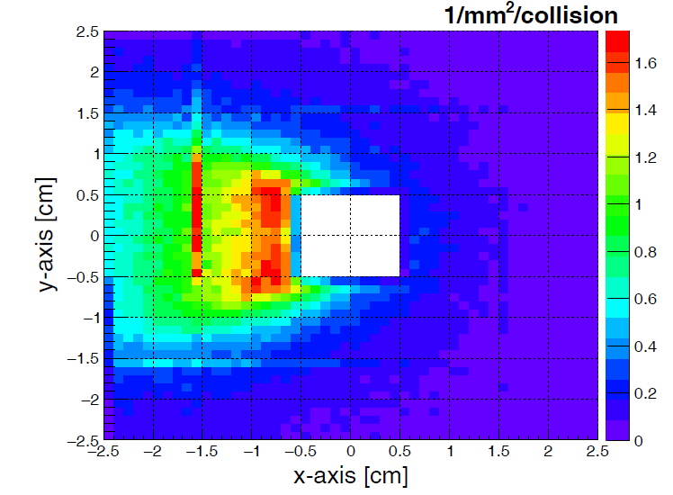
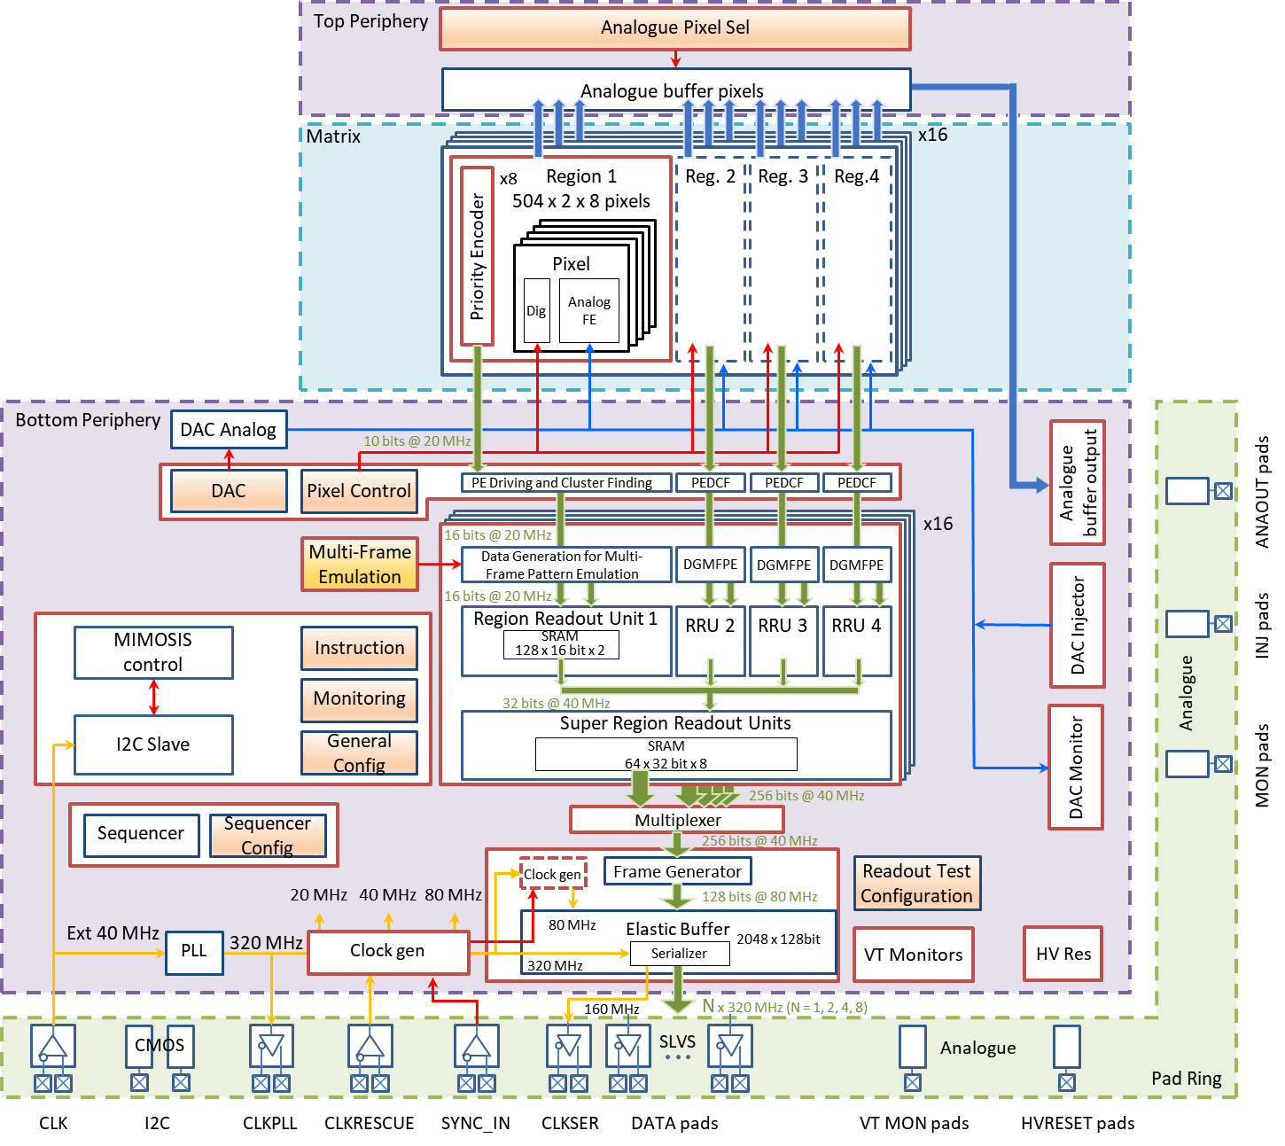
CBM – MVD, particular requirements
Sensor must handle 100kHz Au+Au
Sensor must handle occupancy
gradients in space.
Size of MIMOSIS-1
Sensor must handle beam
fluctuations in time.
Solution:
Discriminator on 27x30µm² pixel
( 5 µs readout time possible)
Multiple data concentration steps (early averaging of Poisson fluctuations)
Elastic output buffer
(max. 3x nominal beam for 50µs)
8 x 320 Mbps links (switchable)
Triple retundant electronics
(Become HI-tolerant)
Numerous self-test features.

Slide 5
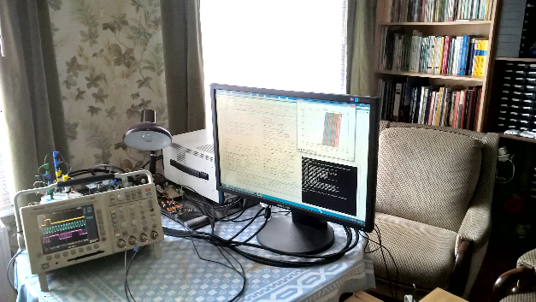
MIMOSIS R&D plan
MIMOSIS-0 (2018)
Demonstrate pixel concept.
Demonstrate zero suppression.
Demonstrate readout concept.
In synergy with:
MIMOSIS-1 (2020)
Full dimension sensor
Add buffer structure.
SEE hardening 1/2
MIMOSIS-1, 60µm thick
MIMOSIS-1
We are here
MIMOSIS-2 (Q2/2022e)
On-chip pixel grouping.
Final pixels.
SEE hardening 2/2
Commisioning during 2020 lock-down
MIMOSIS-3
Final sensor for mass production
All submissions:
Additional CE18 test structures to study specific design questions.

Slide 6
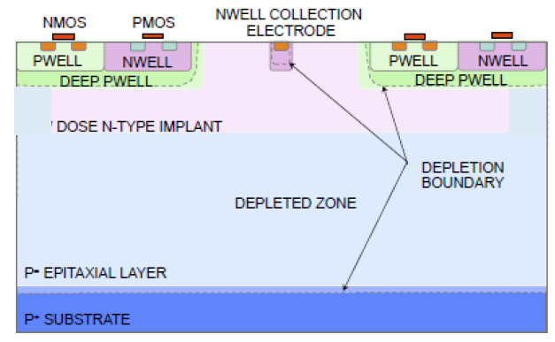
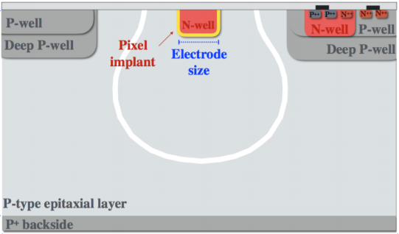
MIMOSIS-1
Size: 504 x 1024 pixels (3 cm x 13mm active)
Full set of data concentration buffers.
Pixels types: 2x DC, 2x AC (up to 20V depletion voltage)
A
B
C
D
AC-pixel
up to 20V HV top bias
MIMOSIS-1, 60µm thick
Back bias possible.
P-Well bias (ALPIDE) possible
Decoupling capacitor
Most likely Fully Depleted
Split 1
Split 4
First proposed by W. Snoeys et al.
H. Pernegger et al., 2017 JINST 12 P06008
Split 3
Standard
Rad. hard, candidate 2
Rad. hard, candidate 1

Slide 7
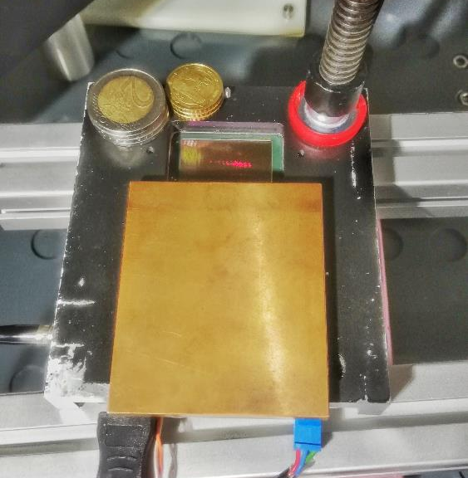
Past and confirmed beam tests (MIMOSIS-1)
Date | Location | Beam | Goal
13. – 14. Mar 2021 | GSI / mCBM | 1 AGeV Pb | Single-Event-Effects (SEE)
23. – 24. May 2021 | GSI / mCBM | 1 AGeV Xe | SEE
07. – 13. Jun 2021 | DESY | 5 GeV e⁻ | Performance
19. – 26. Sep 2021 | DESY | 5 GeV e- | Performance (X-ray irradiated)
05. – 12. Oct 2021 | CERN | ~100 GeV $π^{±}$ | Performance (neutron irradiated)
14. – 20. Feb 2022 | DESY | 5 GeV e- | Performance (mixed irradiated) ++
21. – 28. Mar 2022 | COSY | 0.3 – 3 GeV p | Performance, dE/dx?
23. – 29. May 2022 | GSI/UNILAC | 10 MeV Au | SEE, slow fragments
We are here
Irradiation campaigns:
Shielding for PCB-ICs
(X-rays @ KIT)
Date | Location | Radiation
Jul – Aug 2021 | Ljubjana (TRIGA) | ~1 MeV reactor neutrons
Sep 2021 | Karlsruhe (KIT) | ~10 keV X-rays
Q1 2022 | TRIGA+KIT | Neutrons + X-rays
Special thanks to IPHC for massive support in beam time preparation.
Meanwhile: 14 IPHC people (9-10 FTE) involved in MIMOSIS.

Slide 8
Testing for SEE @ GSI
Max LET expected in CBM-MVD
Xe
Pb
MIMOSIS-1 at the
mCBM beam dump
H. Hillemanns, Radiation Hardness of Monolithic Active Pixel Sensors and Readout Electronics for the ALICE Inner Tracking System Upgrade
https://indico.cern.ch/event/695271/contributions/2956083/attachments/ 1637991/2614211/CERN_LHC_Rad_symp_23042018_HHI.pdf
 | Beam | LET
13. – 14. Mar 2021 | Pb at 1.05 A GeV | 12 MeV cm²/mg
23. – 24. May 2021 | Xe at 1.3 A GeV | 5 MeV cm²/mg
Beam conditions simulate beam halo @ CBM.
Do not simulate high LET of slow nuclear fragments.

Slide 9
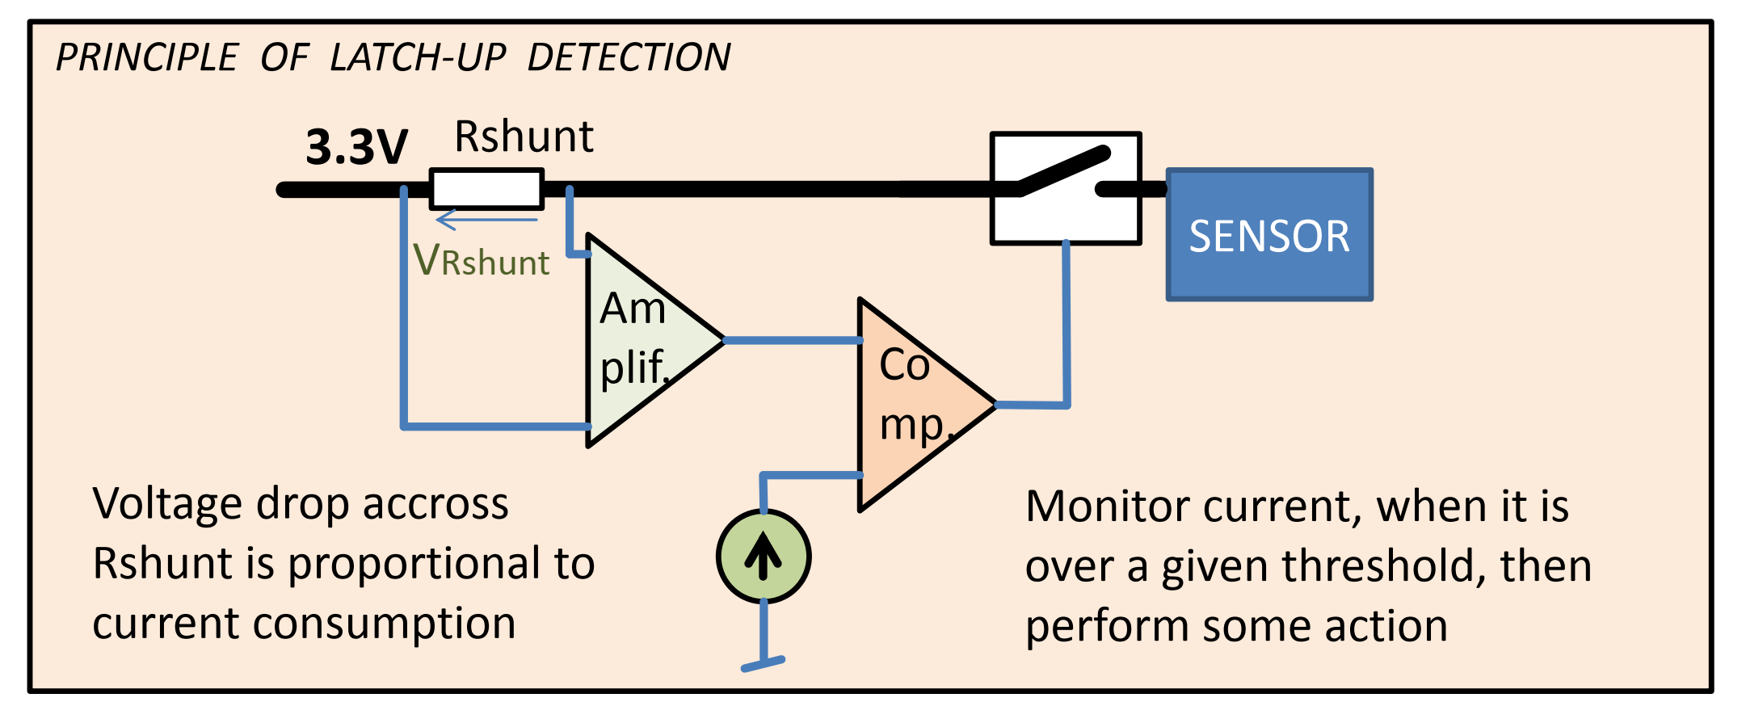
Experimental setup
Information accessible to experimenters
MIMOSIS-1 on PCB
OSCILLOSCOPE
Spill (data transfer)
PC
analog
Digital settings
Current drawn
digital
Data
Bit flip in digital
Voltage Drop over Shunt resistor ∝ I
Digital Front End Power
Sensing element Part Power
Soft reset
Voltage Drop over Shunt resistor ∝ I
No access to data
On-PCB buffers removed, not radiation hard).
First beam test:
"Latch up" if I increases by 15%.
Observation:
Bit flips may cause similar signatures
=> “fake“ latch-ups.
Second beam test:
Visual inspection.
Latch-up if soft reset does not recover consumption.
Overcurrent Protection PCB, resettable
I

Slide 10
Dosimetry: Source of uncertainty
Dosimetry with beam monitoring:
Only 2D projections, not very precise.
Time
Upside
down?
Time
Dosimetry foil (2nd beam time):
In saturation, only rough shape information.
Rough assumption: >70% of ions hit the sensor.

Slide 11
Findings
Projectile | SEE Cross Section (upper limit*) | Latch-up Cross Section (upper limit*) | Bitflip Cross Section (upper limit*)
Pb (1.05 A GeV) LET: 12 MeV cm²/mg | 8 x 10⁻⁸ cm² | N/A | N/A
Xe (1.3 A GeV) LET: 5 MeV cm²/mg | 6.5 x 10⁻⁹ cm² | 7 x 10⁻¹⁰ cm² | 4x10⁻⁹ cm²
preliminary
(* Mean + 1 x uncertainty, used to estimate sensor robustness during run.)
Qualitative findings:
Bit flips found to dominate SEE cross section.
=> Bug in Hamming code implementation identified. Will be fixed for MIMOSIS-2.
Expect ~1 SEE / 4 hours for each of the 16 most exposed sensors of the CBM-MVD.
Most conservative assumptions:
Exposed to highest allowed Pb-beam halo over full surface.
All SEE (including bit flips) are latch-ups
Assumes Hamming code protection fully absent.
Beam loss simulation:
Multiple spills at 600 kHz/mm² Xe (Max. beam, 20% of CBM beam loss).
=> No fatal error (slow control keeps reponding).
So far: Sensor performance satisfactory (despite bug). Study ongoing.

Slide 12
Beam tests (DESY and CERN)
Scintillator - Trigger
(not really used).
HV, VBB connector
Preliminary
Analysis status: Dec. 2021
Plots&Data analysis: R. Bugiel, H. Darwish
Coolant (+15°C)
Telescope
(6 planes)
Beam tests performed with MIMOSIS-1 telescope.
Includes sensors with 3x10¹⁴ n_{eq}/cm²; 5 MRad.
Very satisfactory results (but not yet ready for showing).
Get updated: A. Dorokhov, VCI 2022, 24. Feb. 22.
Preliminary
Analysis status: Dec. 2021
Below detection limit
~0.01% of all pixels (10⁻³ dark rate) masked.

Slide 13
Summary and conclusion
MIMOSIS is a CMOS MAPS
5µm / 5µs space/time resolution.
Low power (<<100 mW/cm²).
Advanced radiation tolerance.
20/80 MHz/cm² recorded rate (average/peak).
The MIMOSIS-1, first full size sensor is being tested for performance and radiation tolerance
Beam tests show very good detection performances.
First tests on SEE suggest reaching requirements for CBM.
Beam tests for doses up to 5 MRad and 3 x 10¹⁴ n_{eq}/cm² done, analysis progressing.
MIMOSIS will be made available to interested partners.
The MIMOSIS team:
J. Baudot, G. Bertolone, A. Besson, R. Bugiel, S. Bugiel, Z. El Bitar, G. Claus, C. Colledani, A. Dorokhov, G. Doziere, M. Goffe, A. Himmi, C. Hu, K. Jaaskelainen, F. Morel, H. Pham, M. Specht, I. Valin, M. Winter, Y. Zhao
J. Andary, B. Arnoldi-Meadows, I. Fröhlich, F. Hebermehl, M. Koziel,
F. Matejcek, J. Michel, C. Müntz, Q.Yang, J. Stroth
H. Darwish, M. Deveaux, O. Keller, C.J. Schmidt

