Slide 1
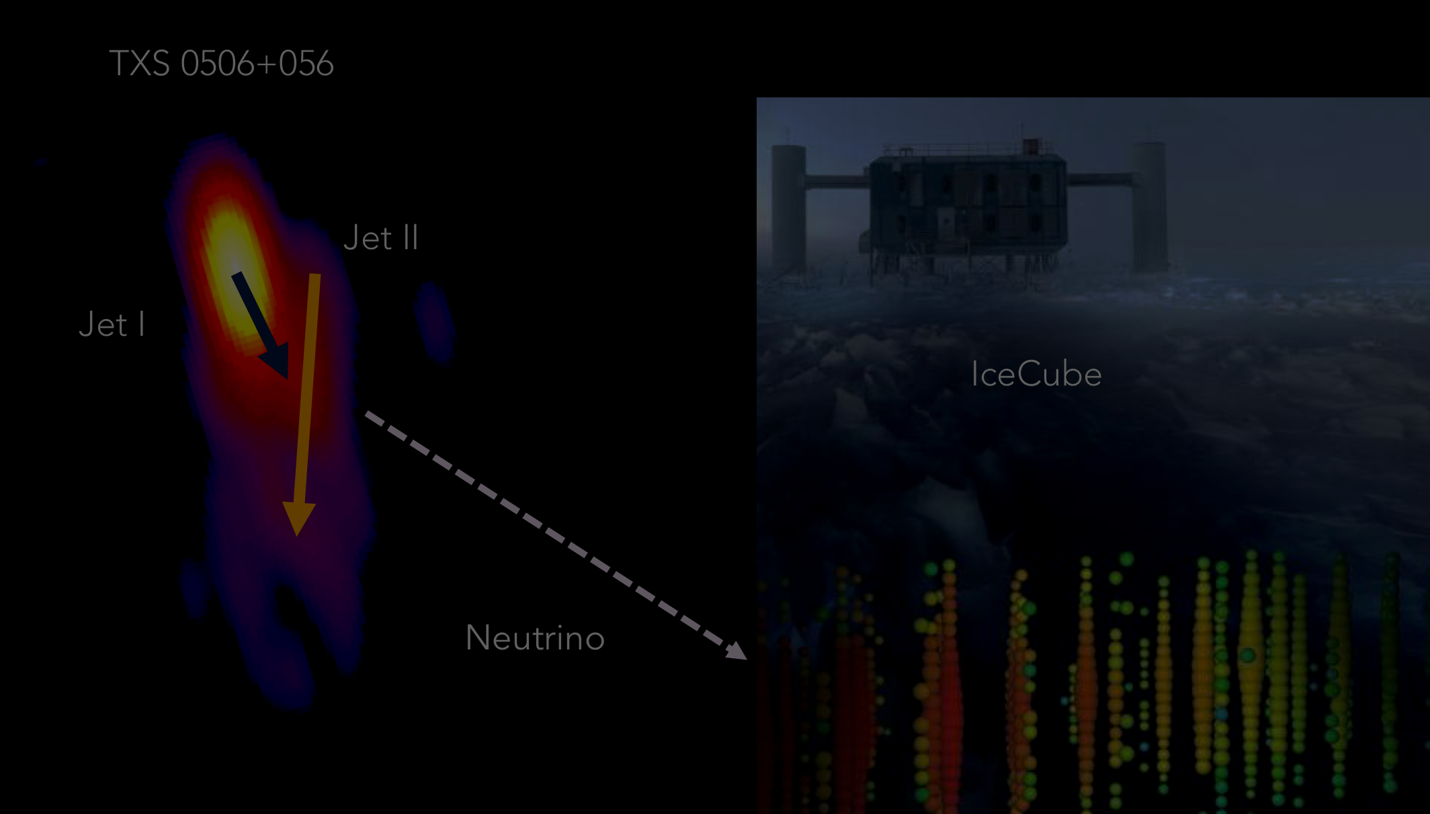



Neutrino Production in Blazar Jets
Markus Böttcher
SARChI Chair of Astrophysics and Space Physics
North-West University
Potchefstroom, South Africa
This work is based on the research supported in part by the National Research Foundation of South Africa (Grant Number 64789).

Slide 2
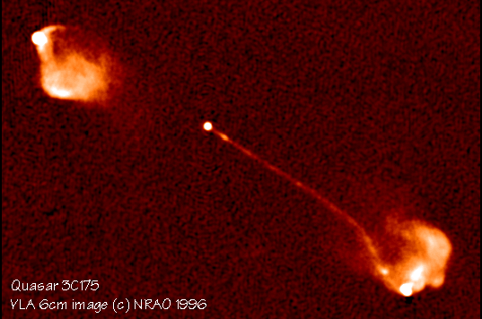
Blazars
0
Class of AGN consisting of BL Lac objects and gamma-ray bright Flat Spectrum Radio Quasars (FSRQs)
Rapidly (often intra-day) variable
Strong gamma-ray sources
Often one-sided radio jets, superluminal motion
Radio and optical polarization

Slide 3
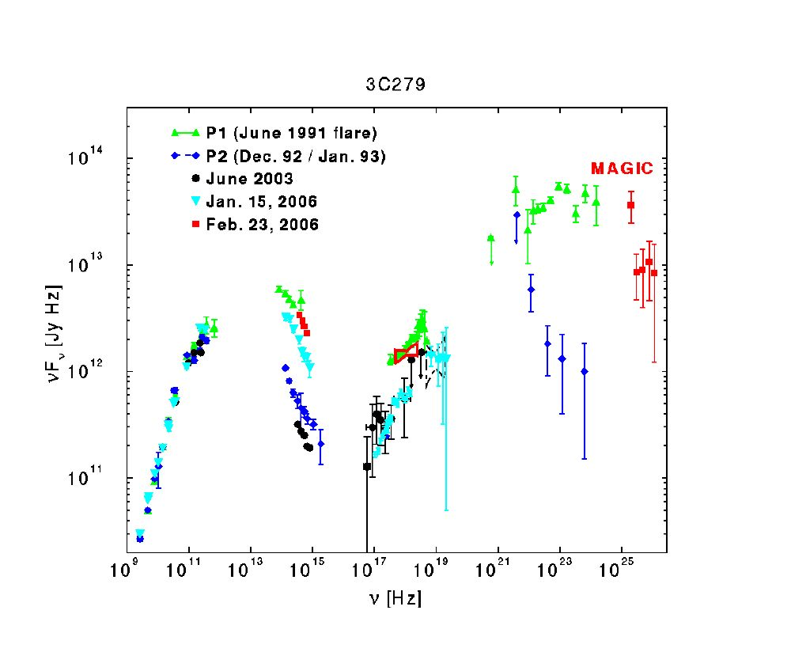
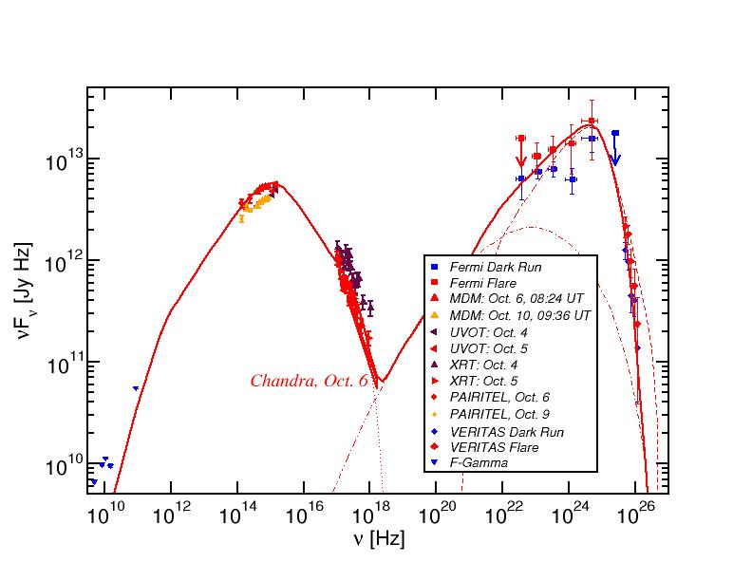
Blazar Spectral Energy Distributions (SEDs)
3C66A
Non-thermal spectra with two broad bumps:
Low-energy (electron synchrotron):
radio-IR-optical(-UV-X-rays)
High-energy (X-ray – γ-rays)

Slide 4
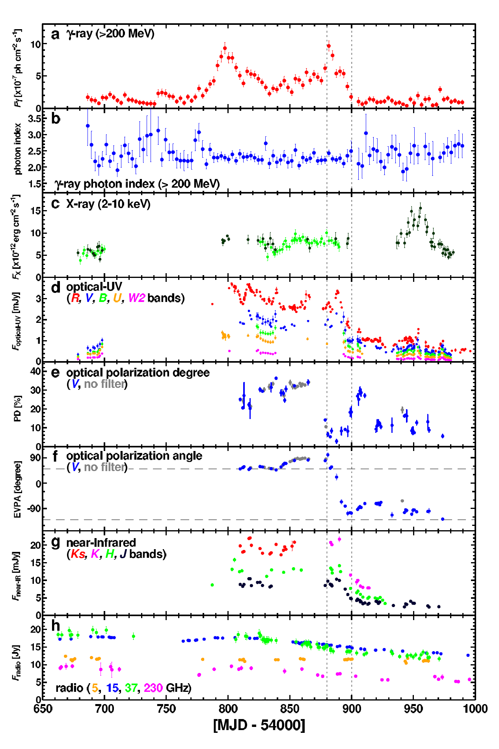
Blazar Variability
Multi-wavelength variability on various time scales (months – minutes)
Sometimes correlated, sometimes not
Observed optical polarization degrees
Π_{opt} <~ 30 %
Both degree of polarization and polarization angles vary.
Swings in polarization angle sometimes associated with high-energy flares!
(3C279: Abdo et al. 2010)

Slide 5
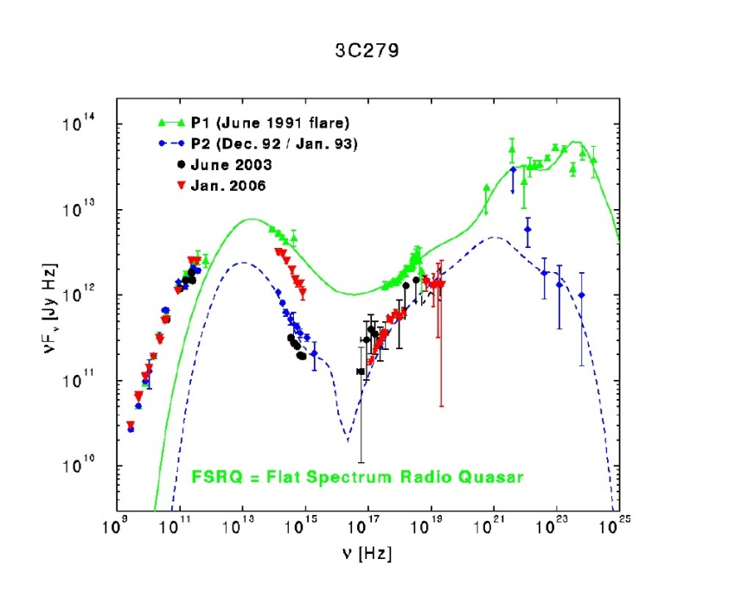
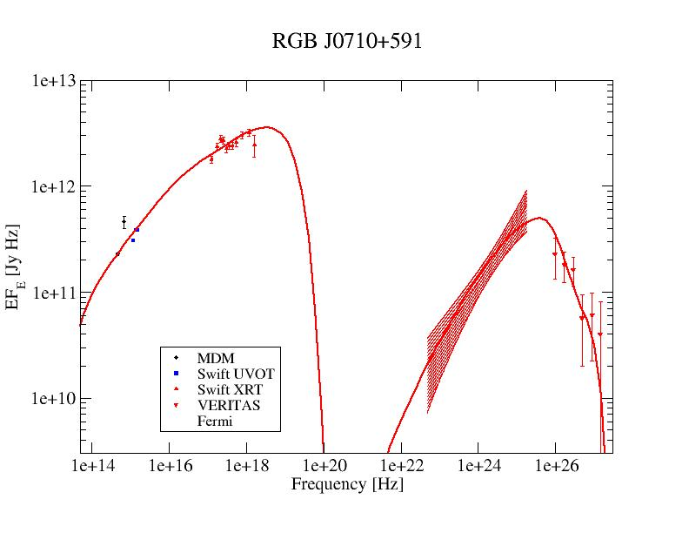
Blazar Classification
0
3C66A
(Abdo et al. 2011)
(Acciari et al. 2009)
(Hartman et al. 2000)
High-Synchrotron Peaked (HSP): High-frequency peaked BL Lacs (HBLs):
Low-frequency component from radio to UV/X-rays,
ν_{sy} > 10¹⁵ Hz
often dominating the total power
High-frequency component from hard X-rays to high-energy gamma-rays
Low-Synchrotron Peaked (LSP): Quasars (FSRQs)/ Low-frequency peaked BL Lac Objects (LBLs)
Low-frequency component from radio to optical/UV,
ν_{sy} ≤ 10¹⁴ Hz
High-frequency component from X-rays to γ-rays, often dominating total power
Intermediate-Synchrotron Peaked (ISP): Intermediate BL Lacs (IBLs):
Peak frequencies at IR/Optical and GeV gamma-rays,
10¹⁴ Hz < ν_{sy} ≤ 10¹⁵ Hz
Intermediate overall luminosity
Sometimes γ-ray dominated

Slide 6
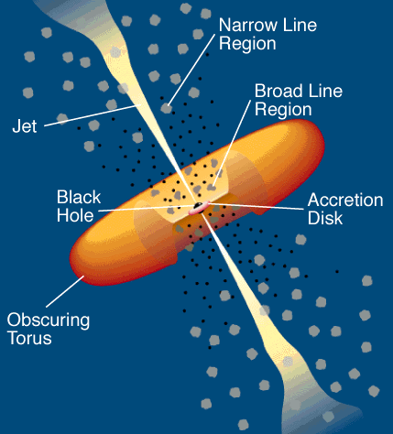
Blazar Models
0
Synchrotron emission
Relativistic jet outflow with Γ ≈ 10
νF_{ν}
Injection, acceleration of ultrarelativistic electrons
ν
Compton emission
Q_{e} (γ,t)
γ^{-q}
νF_{ν}
γ₁
γ₂
γ
ν
Leptonic Models
Seed photons:
Synchrotron (SSC), Accr. Disk + BLR + dusty torus + …

Slide 7
Blazar Models
0
Proton-induced radiation mechanisms:
Injection, acceleration of ultrarelativistic electrons and protons
Relativistic jet outflow with Γ ≈ 10
νF_{ν}
γ^{-q}
Q_{e,p} (γ,t)
ν
Proton synchrotron
γ₁
γ₂
γ
pγ → pπ⁰ π⁰ → 2γ
Synchrotron emission of primary e⁻
pγ → nπ⁺ ; π⁺ → μ⁺ν_{μ}
μ⁺ → e⁺ν_{e}ν_{μ}
νF_{ν}
Hadronic Models
→ secondary μ-, e-synchrotron
ν
Cascades …

Slide 8
Basics of Neutrino Production in Blazar Jets
p + γ → p + π⁰
or n + π⁺
π⁰ → 2γ
π⁺ → μ⁺ + ν_{μ} τ = 2.55×10⁻⁸ s
π⁻ → μ⁻ + ν_{μ}
μ⁺ → e⁺ + ν_{μ} + ν_{e} τ = 2.2×10⁻⁶ s
μ⁻ → e⁻ + ν_{μ} + ν_{e}
(σ_{pγ} ~ 0.6 mb)

Slide 9
Photo-Pion Production
Fractional energy output
Spectral index of target photon field
(Mücke et al. 1998)
Total energy output in neutrinos is ~ approx. equal to energy output in photons (from π⁰ decay + radiative losses of secondary electrons + μ± + π±).

Slide 10
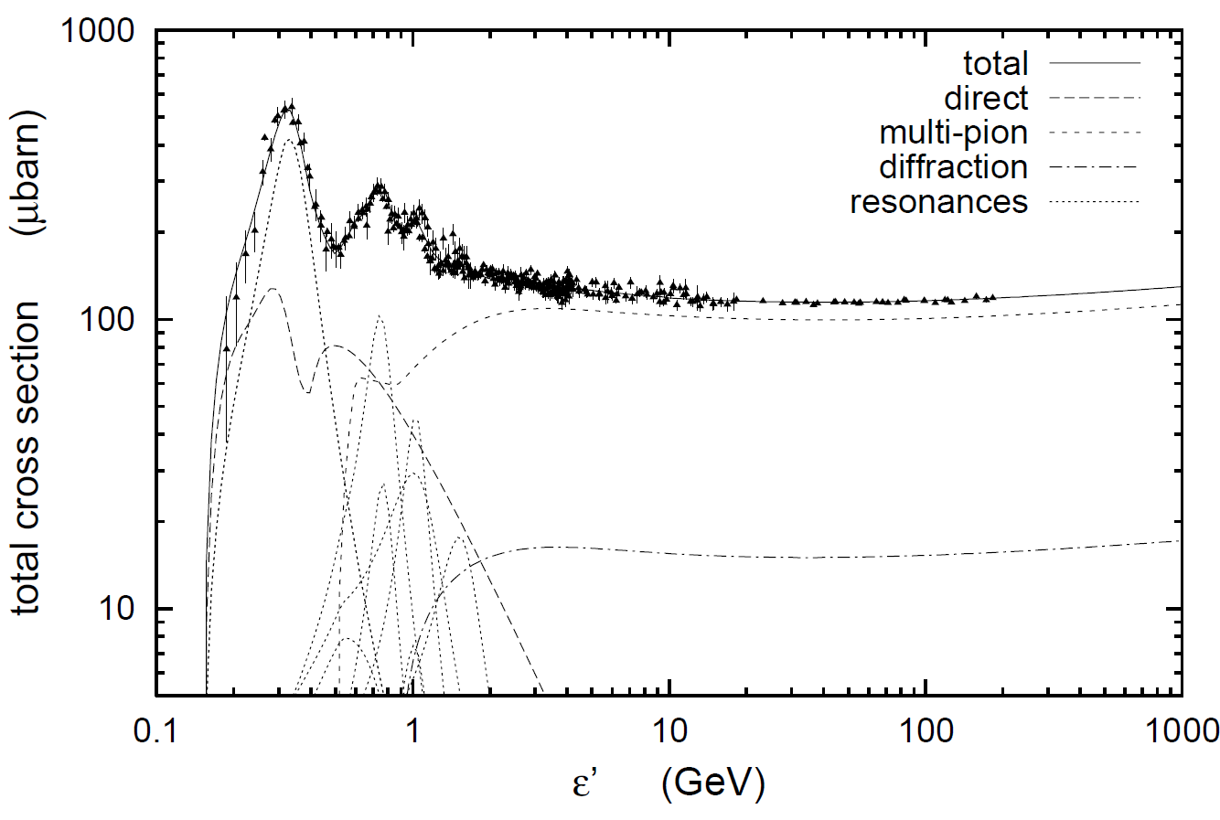
Photo-Pion Production
Δ⁺ resonance
(1232 MeV)
σ(pγ→pπ⁰) : σ(pγ→nπ⁺) = 2:1
(Baldini et al. 1998; Mücke et al. 2000)

Slide 11
Photo-Pion Production
Δ⁺ resonance
(1232 MeV)
Spectral index (n[ε] ~ ε^{−α}) of target photon field
Interaction Probability
(Mücke et al. 1999)
Center-of-Momentum energy
For realistic target photon fields, most interactions occur near threshold (at Δ⁺ resonance).

Slide 12
Photo-pion production - Energetics
p-γ threshold: ~ 10¹⁷ eV E_{t,eV}⁻¹
At Δ⁺ resonance:
s = E_{p}’ E_{t}’ (1 – β_{p}’ μ) = E_{Δ+}² = (1232 MeV)²
Each neutrino takes about ~ 5 % of the proton’s energy
To produce IceCube neutrinos (~ 100 TeV → E_{ν} = 10¹⁴ E₁₄ eV):
Need protons with E’_{p} ~ 200 E₁₄ δ₁⁻¹ TeV
and target photons with E’_{t} ~ 1.6 E₁₄⁻¹ δ₁ keV

Slide 13
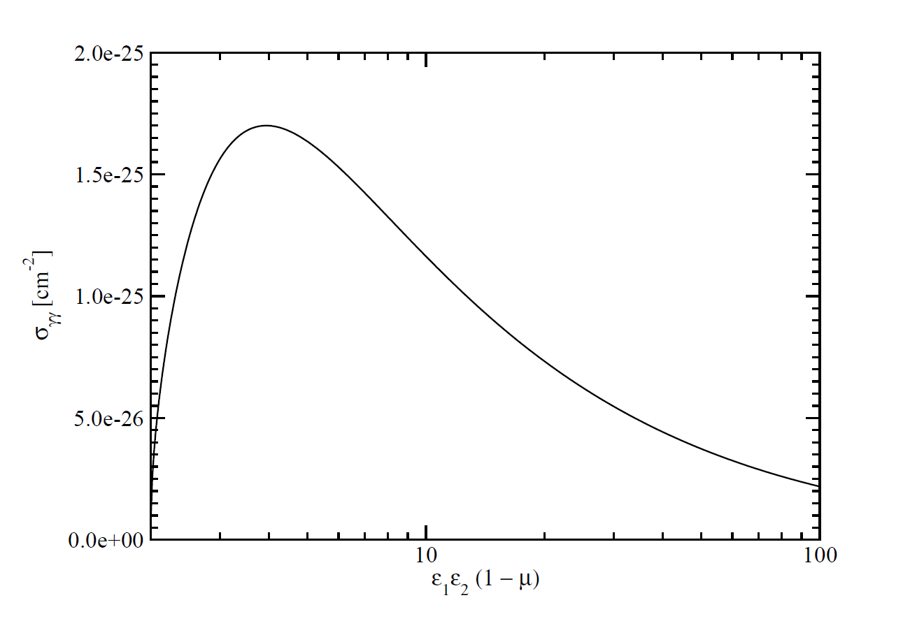
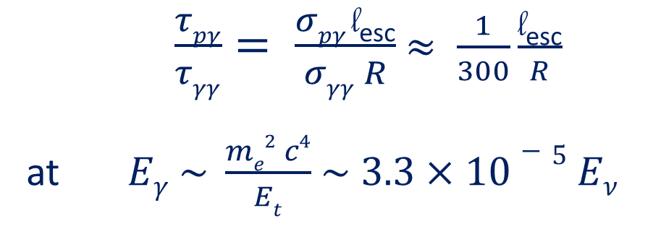
The pγ Efficiency Problem
Efficiency for protons to undergo pγ interaction ~ τ_{pγ} = l_{esc} σ_{pγ} n_{ph}
Likelihood of γ-ray photons to be absorbed ~ τ_{γγ} = R σ_{γγ} n_{ph}
σ_{pγ}
Efficient neutrino production sites are likely to be optically thick to gamma-rays
Expect no correlation between gamma-ray and neutrino activity!
σ_{γγ}
$\frac{τpγ}{τγγ}= \frac{σpγ \text{l}\text{esc}}{σγγ R}$ $≈ \frac{1}{300}\frac{\text{l}\text{esc}}{R}$
at $Eγ \sim \frac{me2 c4}{Et}$ $\sim 3.3×10−5 Eν$
l_{esc} = average length travelled by protons until escape
~ GeV – TeV γ-rays

Slide 14
Photo-pion production –
Origin of Target Photons
To produce IceCube neutrinos (~ 100 TeV → E_{ν} = 10¹⁴ E₁₄ eV):
Need protons with E’_{p} ~ 200 E₁₄ δ₁⁻¹ TeV
and target photons with E’_{t} ~ 1.6 E₁₄⁻¹ δ₁ keV
=> X-rays!
(At least) two possible scenarios:
Target photons co-moving with the emission region
E_{t}^{obs} ~ 16 E₁₄⁻¹ δ₁²/(1+z) keV
Observed as Doppler-boosted hard X-rays
Tightly constrained by observed hard X-ray flux -> Energetics constraints.
Target photons stationary in the AGN frame
E_{t}^{obs} ~ 160 E₁₄⁻¹/(1+z) eV
Observed as UV / soft X-rays, Doppler boosted into the emission-region frame
Much more relaxed energetics constraints.

Slide 15
Photo-pion production –
Origin of Target Photons
Possible sources of external UV / soft X-ray target photons:
Broad Line Region?
(Padovani et al. 2019)
Slow-moving sheath
(Tavecchio & Ghisellini 2005)
Accretion flow (RIAF)
(Righi et al. 2019)

Slide 16
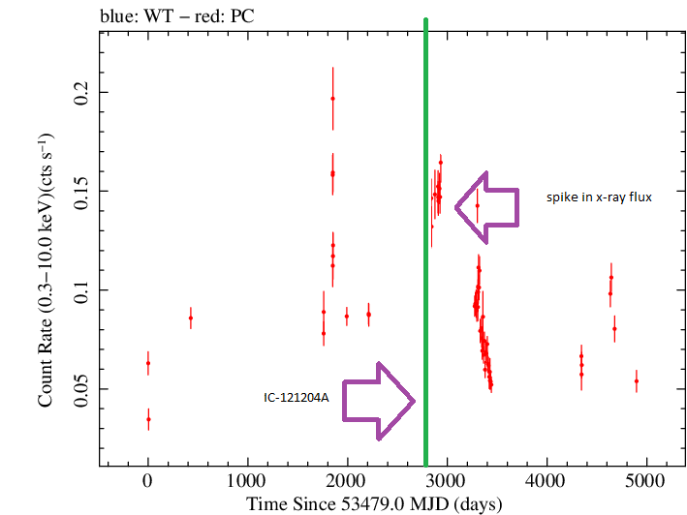
Tentative Associations of IceCube Neutrinos with Blazars
IC-35 (“Big Bird”, 2012) – PKS 1424-418 (Kadler et al. 2016)
2 PeV neutrino (HESE) on 4 Dec. 2012
Poorly reconstructed arrival direction
FSRQ at z = 1.522
Year-long γ-ray, X-ray, optical, and radio
outburst, dominated by core-flux increase.

Slide 17
Tentative Associations of IceCube Neutrinos with Blazars
IceCube-141209A – GB6 J1040+0617 (Garrappa et al. 2019)
  ~ 100 TeV HESE neutrino
  BL Lac object at z = 0.735
  γ-ray flux increase at the
  time of IceCube 141209A

Slide 18
Tentative Associations of IceCube Neutrinos with Blazars
IceCube-170922A – TXS 0506+056 (IceCube Collaboration et al. 2018a; Garrappa et al. 2019; Padovani et al. 2019; …)
290 TeV neutrino
“Masquerading” BL Lac object at z = 0.3365 with weak BLR emission (Padovani et al. 2019)
Neutrino event coincident with 4-week-long γ-ray high state
Highest-confidence
association and
most well-studied
potential neutrino-
emitting blazar
so far

Slide 19
Tentative Associations of IceCube Neutrinos with Blazars
2014 – 15 Neutrino Flare – TXS 0506+056 or PKS 0502+049 (IceCube Collaboration et al. 2018b; Britzen et al. 2019; Sumida et al. 2022; …)
  Search in archival data
  => Evidence for ~ 13 excess
  neutrinos from the direction
  of TXS 0506+056 in 2014
  – 2015 (~ 4 months around
  December 2014).
  No evidence for γ-ray activity
  from TXS 0506+056 during
  the neutrino flare.

Slide 20
Photo-Pion Models for TXS 0506+056
neutrinos
pion-induced cascades
(Cerruti et al. 2019)
Proton-synchrotron
Bethe-Heitler-induced
cascades
Models producing neutrinos and γ-rays by photo-pion production on synchrotron photons, predict too high neutrino energies!

Slide 21
Photo-Pion Models for TXS 0506+056
(Gao et al. 2019)
Models with p-γ induced γ-ray emission over-produce X-rays due to cascades!

Slide 22
Photo-Pion Models for TXS 0506+056
(Gao et al. 2019)
(Keivani et al. 2018)
Most models producing neutrinos and γ-rays require leptonic-dominated γ-ray production!

Slide 23
Photo-Pion Models for TXS 0506+056
Constraints from cascades
Neutrino-flare flux can be produced with moderate power requirements in the presence of dense external radiation field,
u_{t}’ >> u_{B}’.
γγ-absorption + Compton-supported cascades produce X-ray – γ-ray flux well below observed levels.
log₁₀(τ_{γγ}^{max})
=> No neutrino – γ-ray correlation expected!
(Reimer et al. 2019)

Slide 24
Tentative Associations of IceCube Neutrinos with Blazars
2014 – 15 Neutrino Flare – TXS 0506+056 or PKS 0502+049 (IceCube Collaboration et al. 2018b; Britzen et al. 2019; Sumida et al. 2022; …)
  Radio jet structure seems reveal two,
  possibly radiatively interacting jets.
  Neutrino-flare flux can be produced
  in case of vastly different jet speeds.
  (Britzen et al. 2019)

Slide 25
Tentative Associations of IceCube Neutrinos with Blazars
2014 – 15 Neutrino Flare – TXS 0506+056 or PKS 0502+049 (IceCube Collaboration et al. 2018b; Britzen et al. 2019; Sumida et al. 2022; …)
  Claim of coincidence of neutrino
  events with ejection of new radio
  components (Sumida et al. 2022):
  TXS 0506+056 – IceCube-170922A
  PKS 0502+049 – 2014 – 15
  neutrino flare
TXS 0506+056
PKS 0502+049

Slide 26
Tentative Associations of IceCube Neutrinos with Blazars
IC-150926A – 4FGL J1258.7-0452 (Franckowiak et al. 2020)
BL Lac object at z = 0.586
IceCube-161103A – GB6 J0244.7+1320 (Franckowiak et al. 2020)
BCU, unknown redshift
IceCube-190221A – AT20G J175841-161703 / 4FGL J1750.4-1721 (Franckowiak et al. 2020)
AT20G J175841-161703: BCU, unknown redshift;
4FGL J1750.4-1721: Unassociated.

Slide 27
Tentative Associations of IceCube Neutrinos with Blazars
IceCube-190730A – PKS 1502+106 (IceCube Collaboration et al. 2019; Franckowiak et al. 2020; Rodrigues et al. 2021)
  FSRQ at z = 1.84
  E_{ν} ~ 300 TeV
  Signalness = 67 %
  15th-brightest 4LAC source
(Franckowiak et al. 2020)

Slide 28
IceCube-190730A – PKS 1502+106 (IceCube Collaboration et al. 2019; Franckowiak et al. 2020; Rodrigues et al. 2021)
IceCube-190730A
  Neutrino event during a long-term radio outburst
  (started 2014).
  Low γ-ray activity, but
  moderate X-ray activity.
(Franckowiak et al. 2020)

Slide 29
Tentative Associations of IceCube Neutrinos with Blazars
IceCube-190730A – PKS 1502+106 (IceCube Collaboration et al. 2019; Franckowiak et al. 2020; Rodrigues et al. 2021)
  Study of different hadronic and lepto-hadronic models of multi-messenger emission of PKS 1502+106 by Rodrigues et al. (2021):
  Models with hadronically dominated X-ray / γ-ray emission consistent with detection of 1 neutrino during the quiescent γ-ray state.
(Rodrigues et al. 2021)

Slide 30
Tentative Associations of IceCube Neutrinos with Blazars
IceCube-200107 – 3HSP J095507.9+35510 (Giommi et al. 2020; Paliya et al. 2020; Krauss et al. 2020; Petropoulou et al. 2020)
HBL at z = 0.5573 (Paiano et al. 2020;
Paliya et al. 2020)
HESE with uncertain energy (E_{ν} ~ 330⁺²²³⁰ TeV)
Bright X-ray flare on the day after the neutrino
event (Swift ToO), but no γ-ray flare.
-270
(Giommi et al. 2020)
One other γ-ray blazar in the 90 % uncertainty region: 4FGL J0957.8+3423, but no flux enhancement in any band. (Krauss et al. 2020)

Slide 31
Tentative Associations of IceCube Neutrinos with Blazars
IceCube-200107 – 3HSP J095507.9+35510 (Giommi et al. 2020; Paliya et al. 2020; Krauss et al. 2020; Petropoulou et al. 2020)
  Extensive MWL campaign, including DDT NuSTAR + Swift ToO observations + GTC optical spectroscopy (Paliya et al. 2020); NICER DDT simultaneous with NuSTAR.
  Evidence for ~ 30 min hard-X-ray variability (NuSTAR).
  Contrary to TXS 0506+056, a
  scenario with a co-moving
  (el.-synchrotron) target photon
  field for p-γ neutrino production
  would be plausible, not violating
  any obs. constraints.
  Strong internal γγ absorption due
  to target photon field
  → No significant neutrino – γ-ray
  correlation expected.
Eddington bias:
N potential sources with probability 1/N to detect 1 neutrino => Expect 1 neutrino from ~ 1 of the sources.
N ~ 100 for a 3HSP J09907.9+35510 like source (Franckowiak et al. 2020).
Est. neutrino flux (event only)
XRT
NICER + NuSTAR
UVOT
January 8
January 11
Est. neutrino flux (Eddington bias)
(Paliya et al. 2020)

Slide 32
Tentative Associations of IceCube Neutrinos with Blazars
IceCube-200107 – 3HSP J095507.9+35510 (Giommi et al. 2020; Paliya et al. 2020; Krauss et al. 2020; Petropoulou et al. 2020)
  Detailed study of various lepto-hadronic scenarios by Petropoulou et al. (2020):
f_{mes} = t_{lc}/t_{pγ}
Single-zone models with co-moving (synchrotron) target photon field: Hadronically dominated high-energy emission, but systematically under-predicting Fermi-LAT spectrum.

Slide 33
Tentative Associations of IceCube Neutrinos with Blazars
IceCube-200107 – 3HSP J095507.9+35510 (Giommi et al. 2020; Paliya et al. 2020; Krauss et al. 2020; Petropoulou et al. 2020)
  Detailed study of various lepto-hadronic scenarios by Petropoulou et al. (2020):
All models predict << 1 neutrino during the flare – consistent with Eddington bias.

Slide 34
Tentative Associations of IceCube Neutrinos with Blazars
IceCube-211125 –AT2021afpi / 4FGL J0258.1+2030
  Neutrino of E ~ 117 TeV; 39 % probability of being astrophysical.
  Two potential counterparts:
    AT2021afpi:
      Young, narrow-line He-rich Nova detected by MASTER (Zhirkov et al. 2021; Stein et al. 2021; Taguchi et al. 2021);
      X-ray outburst at the time of the neutrino event (Paliya 2021).
    4FGL J0258.1+2030:
      Blazar of unknown type (uncertain z = 2.2, little other information available);
      also potential counterpart of IceCube-191231A: First potential counterpart to two neutrinos!
      Enhanced radio state (Kadler 2021);
      Poorly covered by Fermi-LAT; no detections in VHE gamma-rays; no information about X-ray state.

Slide 35
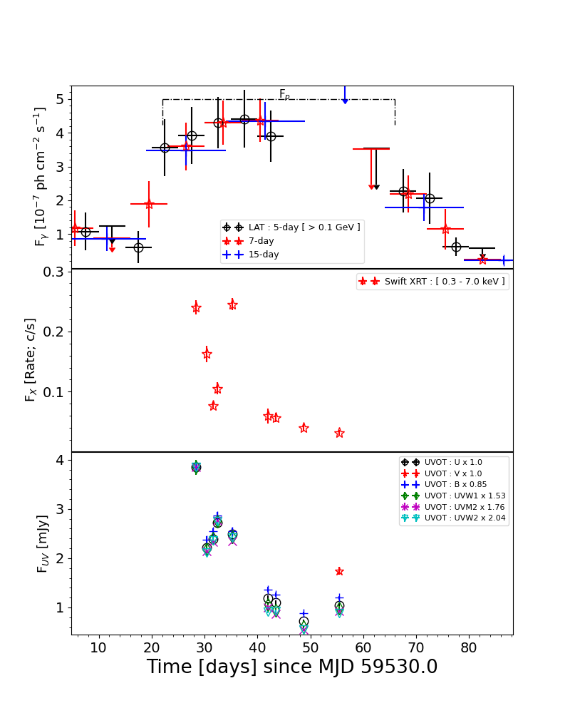
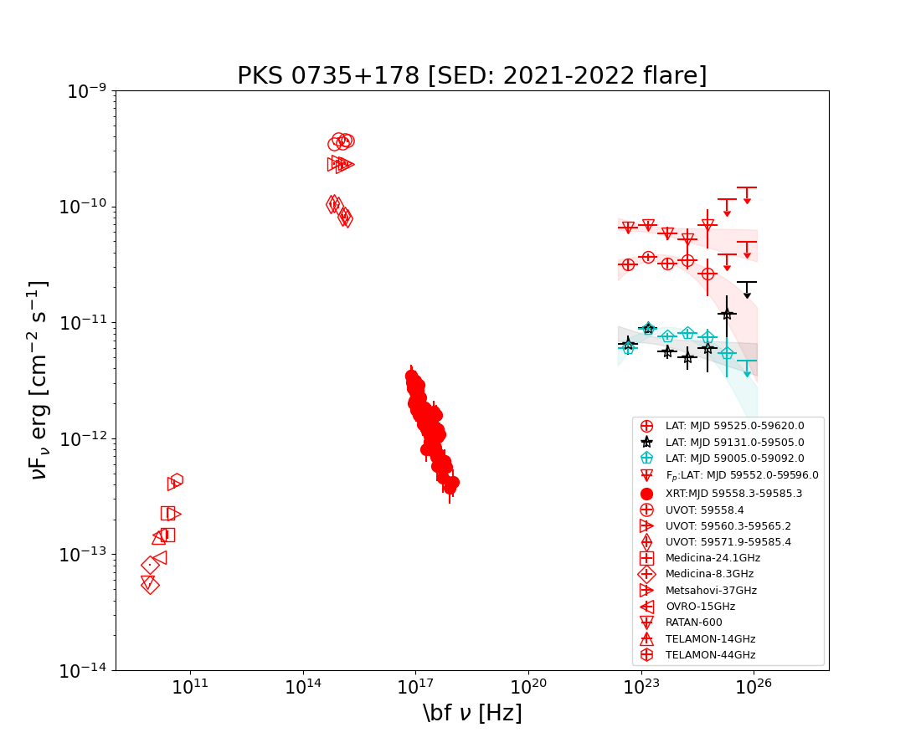
Tentative Associations of IceCube Neutrinos with Blazars
IceCube-211208 – PKS 0735+17
  FSRQ at z = 0.45
  Multi-wavelength flare, including X-rays and γ-rays, during and after the neutrino event
Chandra et al. (2022), in prep.

Slide 36
Tentative Associations of IceCube Neutrinos with Blazars
IceCube-2200225 – PKS 0215+015 / PKS 0205-010 (Garrappa et al. 2022; Kadler et al. 2022; Plavin et al. 2022; Nesci 2022)
  2 blazars in the vicinity of the neutrino event (Garrappa et al. 2022):
    FSRQ PKS 0215+015 (z = 1.715), ~1.75º from best-fit neutrino position.
    Long-term gamma-ray high state since mid-2021; long-term radio outburst
    (Kadler et al. 2022; Plavin et al. 2022); optical high state (Nesci 2022).
    No information on X-ray activity.
    Favoured as potential neutrino source.
    PKS 0205-010 (z uncertain), ~2.7º away. No significant activity reported in
    band.
IceCube-220304 – TXS 0310+022 (Kadler et al. 2022a,b)
    FSRQ at z = 0.994. Several-months-long radio flare in 2021, and strongly inverted radio spectrum during neutrino event.

Slide 37
Summary
Blazars are likely sources of very-high-energy neutrinos. Number of tentative associations steadily increasing.
Production of IceCube neutrinos requires
  Protons of ~ PeV energies
  Target photons of co-moving UV / X-ray energies, most plausibly from outside the jet
In many cases, models require leptonically dominated high-energy emission, with sub-dominant hadronic component.
No correlation between γ-ray and neutrino activity necessarily expected. Many observed associations during γ-ray low states, but elevated states at lower energies.
This work is based on the research supported in part by the National Research Foundation of South Africa (Grant Number 64789).

Slide 38
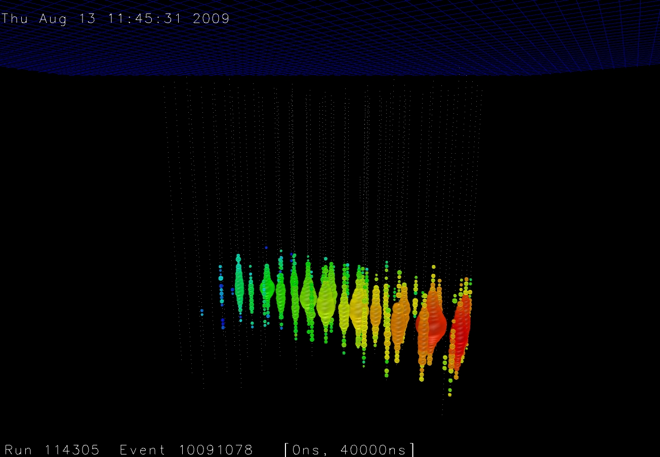
Thank you!
Any opinion, finding and conclusion or recommendation expressed in this material is that of the authors and the NRF does not accept any liability in this regard.

