Slide 1














Overview on GSI
Heavy Ion Accelerator Facility
ARD ST3 Annual Meeting September 2022
HZB Berlin, 7th of September 2022
Peter Forck, GSI
on behalf of the GSI Accelerator Department
For peace
and freedom
Solidarity
with Ukraine

Slide 2
The GSI Accelerator Facility
Synchrotron, Bρ=18 Tm, dB/dt up to 10 T/s
E_{max} p: 4.7 GeV & U: 0.9 GeV/u
Achieved e.g.: Ar¹⁸⁺: 1·10¹¹
U²⁸⁺: 3·10¹⁰ & U⁷³⁺: 1·10¹⁰
SIS: E_{max}=2 GeV/u
⇔ β=95%
ESR: Bρ=10 Tm
CRYRING, Bρ=1.4 Tm
Ion sources
Fragment
Separator
UNILAC: E_{max}=12 MeV/u ⇔β=16%
Fix-
target Exp.
Storage rings:
ESR
CRYRING
UNILAC: all ions p – U
Energy: 3 – 12 MeV/u
Pulse operation: 50 Hz, max. 5 ms
Up to 20 mA current
Radioactive beams
Nuclear Physics
Atomic & Plasma Physics
Bio Physics

Slide 3
Beam Time Schedule Feb.-June 2022: Exemplarily for March
3 ion
sources
proton beam
light ions Li&C
medium & heavy ions U
LINAC
users
LINAC rf power increase
for U beams
Synchr.
users
Storage
rings
LINAC beam current in front of synchrotron
Ion | H | Li | C | O | Ar | Fe | Ni | Au | Pb | Bi | U
Current [mA] | 1 | 0.005 | 0.045 | 1 | 3 | 0.05 | 0.025 | 0.025 | 0.5 | 0.015 | 0.5

Slide 4
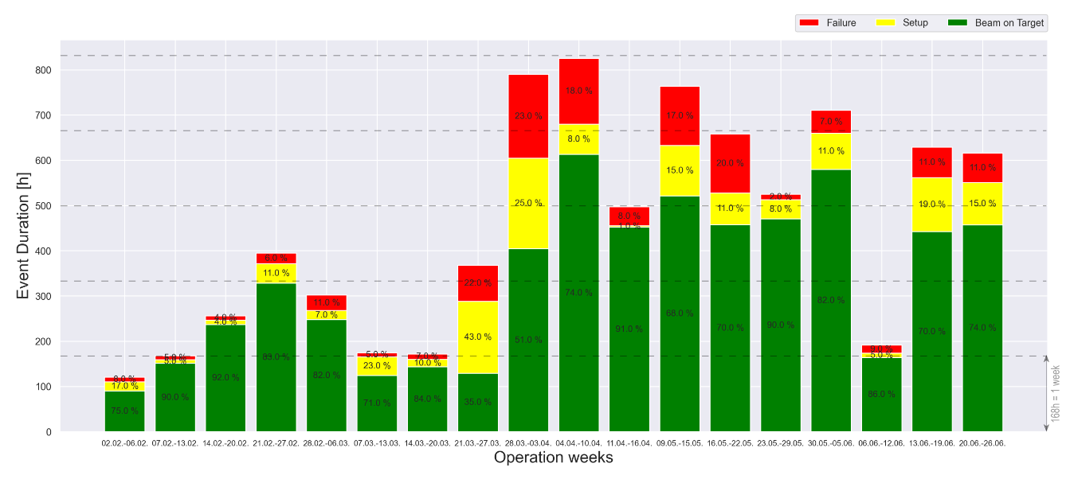
Beam Ability 2022
Features:
LINAC with 50 Hz pulsing, max. pulse length 5 ms
‘parallel’ operation,
i.e. each LINAC pulse can have different source and target
Synch SIS18 is filled by LINAC, typical cycle time ≈ 3 s
Storage ring might have hours storage times
March: previous slide
Proton beam
(mainly behind SIS)
Many ions & targets
Li&C
rf cond.
168h=1week
equivalent time for
beam-on-target
February
June
Operation weeks in 2022

Slide 5
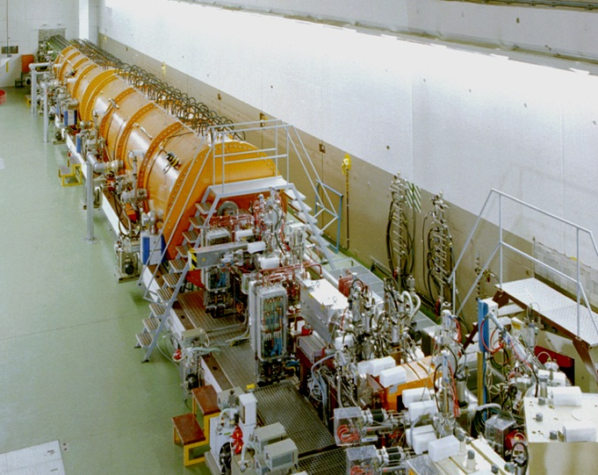
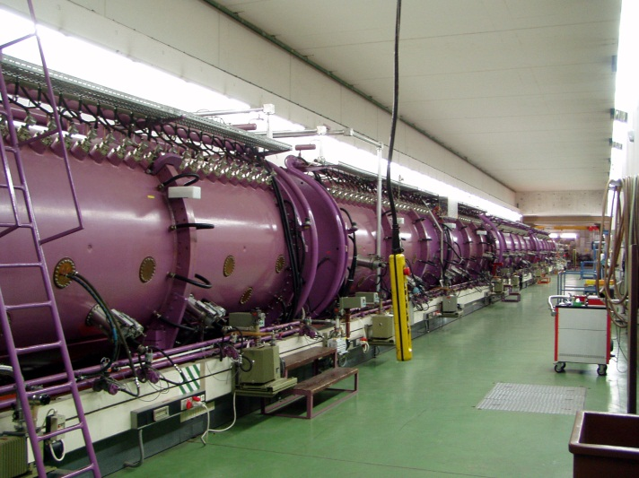
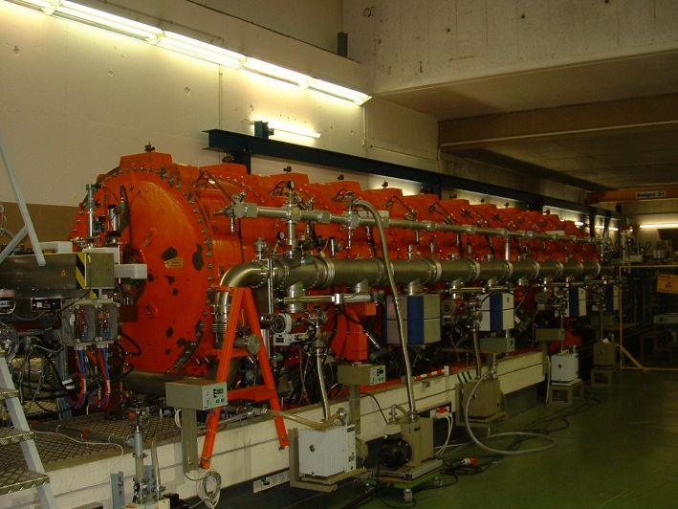
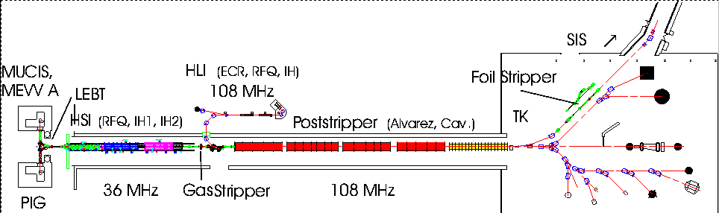
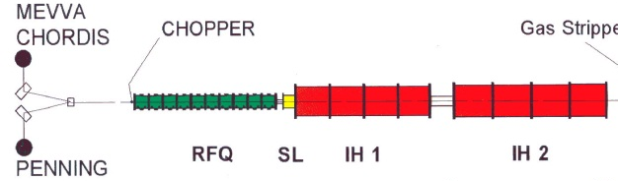
UNILAC at GSI: Overview
RFQ, IH1, IH2
Alvarez DTL
Single Gap Resonators
Transfer to
Synchrotron
All ions, high current, 5 ms@50 Hz, 36&108 MHz
HLI: (ECR,RFQ,IH)
To SIS ↑
MEVVA
MUCIS
U⁷³⁺
f_{rf} = 36 MHz
f_{rf} = 108 MHz
Foil Stripper
Alvarez DTL
RFQ IH1 IH2
U⁴⁺
U²⁸⁺
Gas Stripper
PIG
1.4 MeV/u
β = 0.054
11.4 MeV/u
β = 0.16
2.2 keV/u
β = 0.0022
120 keV/u
β = 0.016
10mm
Constructed in the 70th, Upgrade 1999,
→ Injector for FAIR ion operation

Slide 6
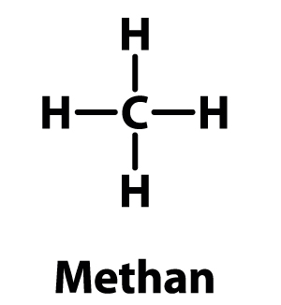
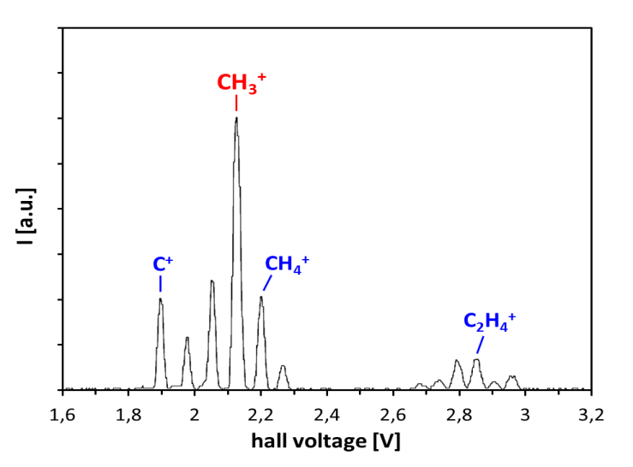
Proton Generation by molecular Ions
UNILAC: Built for heavy ion acceleration, e.g. 1st LINAC part ²³⁸U⁴⁺ i.e. A/q=238/4=59.5
For protons ¹H⁺: Reduce of rf-voltage by factor ≈60, But: Outside of amplifier regulation
Ion source
A. Adonin, R. Hollinger, et al.
Gas target at 1.4 MeV
C⁶⁺ , 6 emA
CH₃⁺ acceleration
Use of HSI heavy ion beam capabilies to acclerate hydro-carbon compounds
10mm
CH₃⁺ , 1 mA
Dissociation of CH-compounds + stripping
H⁺ , 3 emA

Slide 7
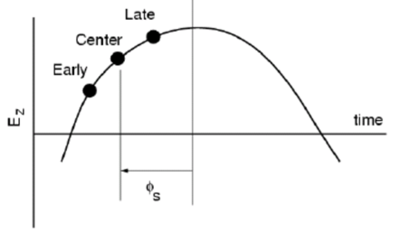
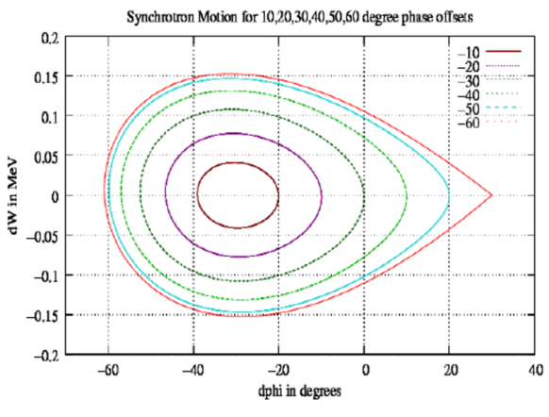
Proton Beam Dynamics with low Voltage & large Phase Offset
UNILAC: Built for heavy ion acceleration, e.g. 1st LINAC part ²³⁸U⁴⁺ i.e. A/q=238/4=59.5
For protons ¹H⁺: Reduce of rf-voltage by factor 60, BUT: Outside of amplifier regulation
Reference phase
ALVAREZ Rf-voltage < 1V (Φs ≈ -30°)?
  Φs ≈ -57° (U_{rf} ≈ 1.5V) 
  Φs ≈ -65° (U_{rf} ≈ 2.0V) 
  Φs < -65° (U_{rf} > 2.0V) 
pros and cons of large negative phases:
  smooth rf-operation  
  slightly reduced transmission 
  emittance blow up 
  longitudinal phase space? 
reduced synchr. phase?
Achievement:
≈3 mA before SIS18, sufficient for actual users
Typical emittance reached
(High current ≈50 mA by planned proton LINAC)
see also: A. Rubin, et al.
Brilliant beam acceleration at longitudinal phase advances far beyond 90°, LINAC 2020
Simulations on operation of the new UNILAC post-stripper with intense proton beams: longitudinal phase advances below and beyond 90°. Acc. Sem., GSI, 2020

Slide 8
Gas Stripper for efficient Change of Charge State: Hardware
UNILAC: Ion source high current, low charge state e.g. ²³⁸U⁴⁺
→ 1st LINAC part ²³⁸U⁴⁺ up to 1.4MeV/u (β=5.5%) → gas stripper ²³⁸U⁴⁺ → ²³⁸U²⁸⁺
→ 2nd part of LINAC ²³⁸U²⁸⁺ up to 11.4 MeV/u (β=15.5%)
However, only ≈ 15 % for q=28+ depending on gas and pressure
High pressure super-sonic gas jet required, inlet p = 120 bar, light molecules deliver small jet
Contradictory requirements: high density → good stripping, low density → lower straggling
Pulsed inlet to reduce gas load inn vacuum chamber

Slide 9
Gas Stripper for efficient Change of Charge State: Results
Results:
Higher yield of ²³⁸U²⁸⁺
for pulsed H₂ jet
Lower emittance
due to lower straggling
Talk by Simon Lauber: Novel beam dynamics for heavy ion acceleration
N₂
H₂
emittance [mm mrad]
beam current [emA]
emittance [mm mrad]
beam current [emA]
ion source
behind stripper
synchr.
ion source
behind stripper
synchr.
distance
distance

Slide 10
The GSI Accelerator Facility: Synchrotron
SIS: E_{max}=2 GeV/u
⇔ β=95%
Ion sources
Fragment
Separator
UNILAC: E_{max}=12 MeV/u ⇔β=16%
Fix-
target Exp.
Storage rings:
ESR
CRYRING

Slide 11
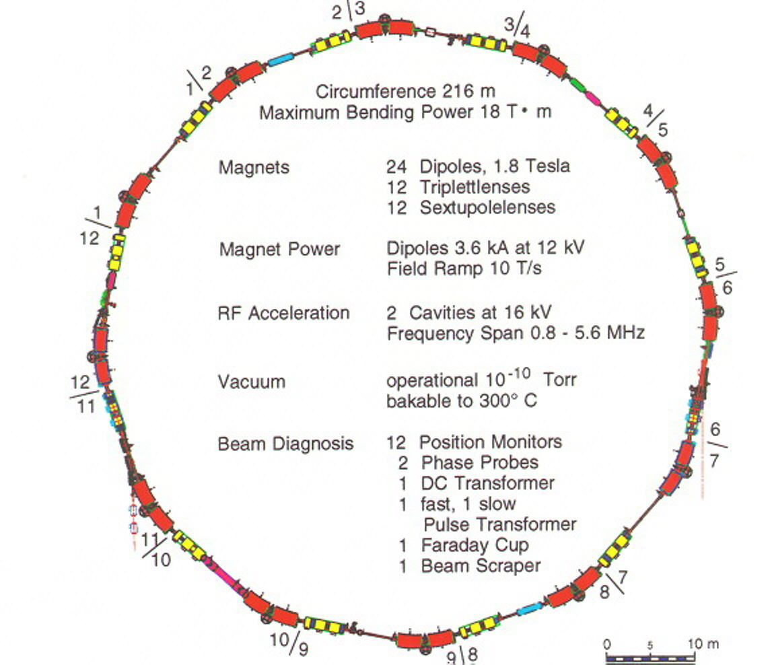
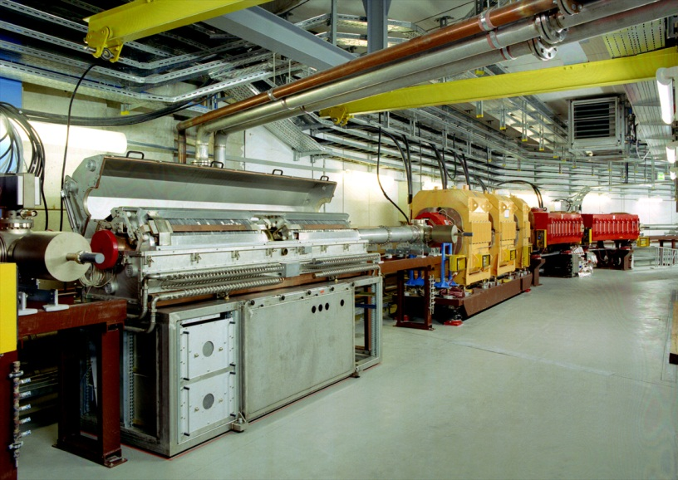
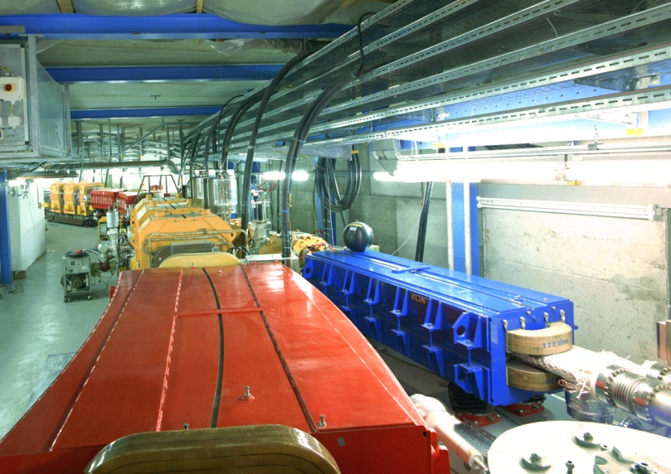
GSI Heavy Ion Synchrotron: Overview
rf cavity,
quadrupoles, dipoles
acceleration
acceleration
Important parameters of SIS-18
Important parameters of SIS-18
Circumference | 216 m
Inj. type | Multiturn
Energy range | 11 MeV → 2 GeV
Acc. RF | 0.8 → 5 MHz
Harmonic | 4 (= # bunches)
Bunching factor | 0.4 → 0.08
Ramp duration | 0.06 → 1.5 s
Ion range (Z) | 1 → 92 (p to U)
Ion (Z) | 1 → 92 (p to U)
Circumference | 216 m
Inj. type | Multiturn
Injection energy | 11 MeV/u
Max. final energy | ≈ 2 GeV/u
Ramp duration | 0.1 → 1.5 s
Acc. RF | 0.8 → 5 MHz
Harmonic | 4 (= # bunches)
Bunching factor | 0.4 → 0.08
Beam current | 10 µA to 100 mA
injec-
tion
injec-
tion
extrac-
tion
extrac-
tion
Dipole, quadrupoles,
transfer line
commissioning 1991

Slide 12
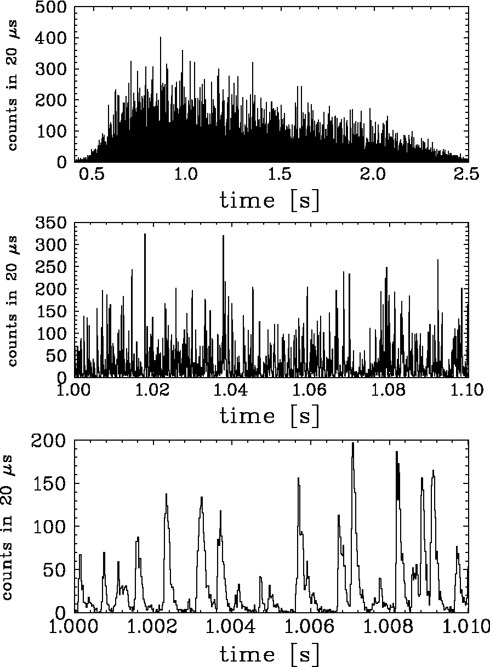


Slow Extraction: Principle and Micro-Structure
Slow extraction for t_{ex} = 1 … 10 s frequently used:
Gentle excitation of a beam third order resonance
Beam physics: Extraction as ‘slow losses’
Particle crosses
stability-boarder sequentially
Exponential amplitude growth
≈ 50 … 1000 turns
reaching septum and is extracted
Problem: Sensitivity to any
unintended resonance condition, e.g.:
Change of tune:
unintended quadrupole current ripples
Stored beam phase space at electrostatic septum
x’
shrinkage of $A_{stable}$
by tune scan
Q_{m} (t) → n ± 1/3
$ε_{Q}(t)$→ 0
ele.-stat. septum
thickness
$$A_{stable}∝{\left(\frac{Q_{m}−Q_{res}}{S}\right)}^{2}$$
$∝{\left(\frac{ε_{Q}}{S}\right)}^{2}$
extr.
channel
x
unintended quadrupole current ripple
⇒ tune ripple
⇒ bursts extracted
transit time T_{transit}
last spiral step x_{step}
after 3 turns
Sextupoles: non-linear fields
Ion’s amplitude growth per turn
⇔ T_{transit} & x_{step}
Example: C⁶⁺ at 300 MeV/u at GSI
2 s extraction
called ‘spill’
10 ms time window
Spiky structure is one major problem for users as it increases the detector dead time

Slide 13
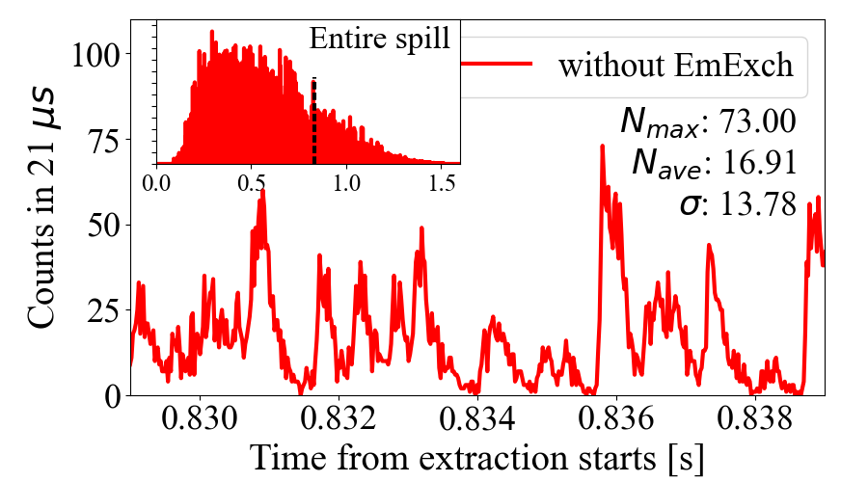
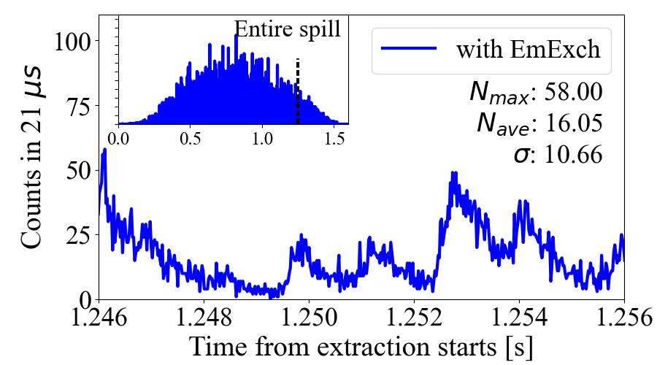
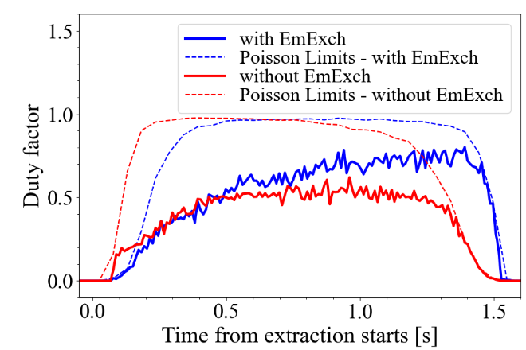
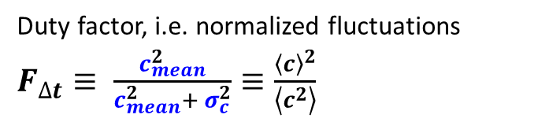
Slow Extraction: Micro-Structure Improvement
Possible mitigation:
Smaller horizontal emittance by crossing
shortly a coupling resonance Q_{x}= Q_{y}+1
⇒ Significant improvement
Other methods also tested related to
linear and non-linear beam dynamics
10 ms
window
10 ms time window
Duty factor, i.e. normalized fluctuations
$F_{∆t}≡ \frac{c_{mean}^{2}}{c_{mean}^{2}+ σ_{c}^{2}}≡\frac{{\left\langle c\right\rangle }^{2}}{\left\langle c^{2}\right\rangle }$
Part of EU-project IFAST-REX with
Collaboration: CERN, GSI, Medical Ion Therapy Centers

Slide 14
The GSI Accelerator Facility: Storage Rings
SIS: E_{max}=2 GeV/u
⇔ β=95%
Ion sources
Fragment
Separator
UNILAC: E_{max}=12 MeV/u ⇔β=16%
Fix-
target Exp.
Storage rings:
ESR
CRYRING

Slide 15
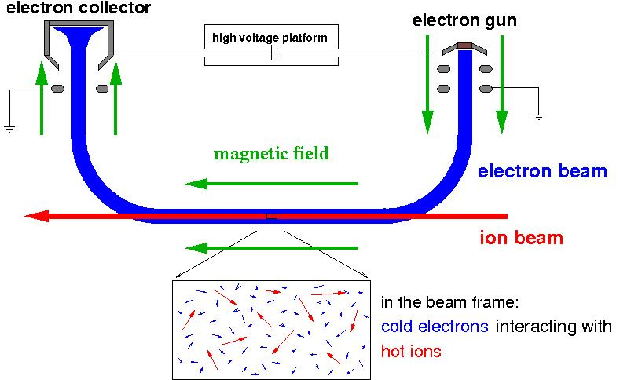
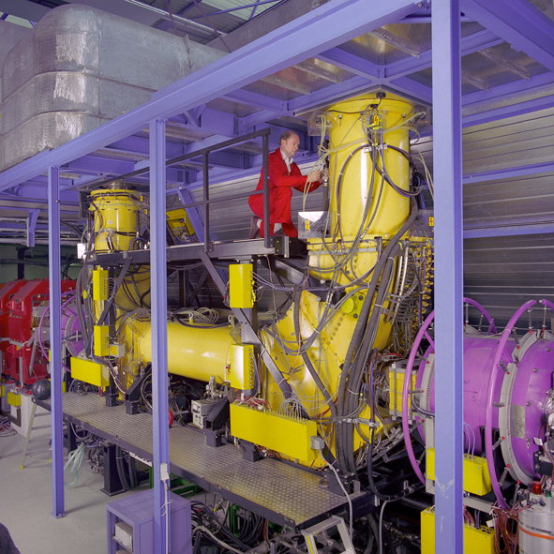
Electron Cooling: Improvement of Beam Quality
Electron cooling: Superposition ion and cold electron beams with the same velocity
Example:
Electron cooler at ESR U_{max} = 300 kV
e.g.: 220 keV electrons
cool 400 MeV/u ions
electron
temperature
k_{B}T⊥ ≈ 0.1 eV
k_{B}T║ ≈ 0.1 - 1 meV
Physics:
Momentum transfer by Coulomb collisions
Cooling force results from energy loss in the cold, co-moving electron beam
Cooling time: 0.1 s for low energy highly charged ions, 1000 s for high energy protons
Also Stochastic Cooling available at ESR

Slide 16
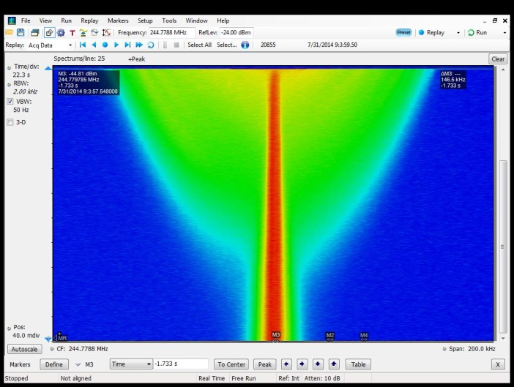
Electron Cooling: Improvement of Beam Quality
Electron cooling: Superposition ion and cold electron beams with the same velocity
Example:
Electron cooling at ESR: 10⁸ proton
at 400 MeV
e.g.: 220 keV electrons
cool 400 MeV/u ions
Δp/p₀
= 4⋅10 ⁻⁴
electron
temperature
k_{B}T⊥ ≈ 0.1 eV
k_{B}T║ ≈ 0.1 - 1 meV
t = 650 s
Δp/p₀ = 3⋅10 ⁻⁵
Physics:
Momentum transfer by Coulomb collisions
Cooling force results from energy loss in the cold, co-moving electron beam
Cooling time: 0.1 s for low energy highly charged ions, 1000 s for high energy protons
Also Stochastic Cooling available at ESR

Slide 17
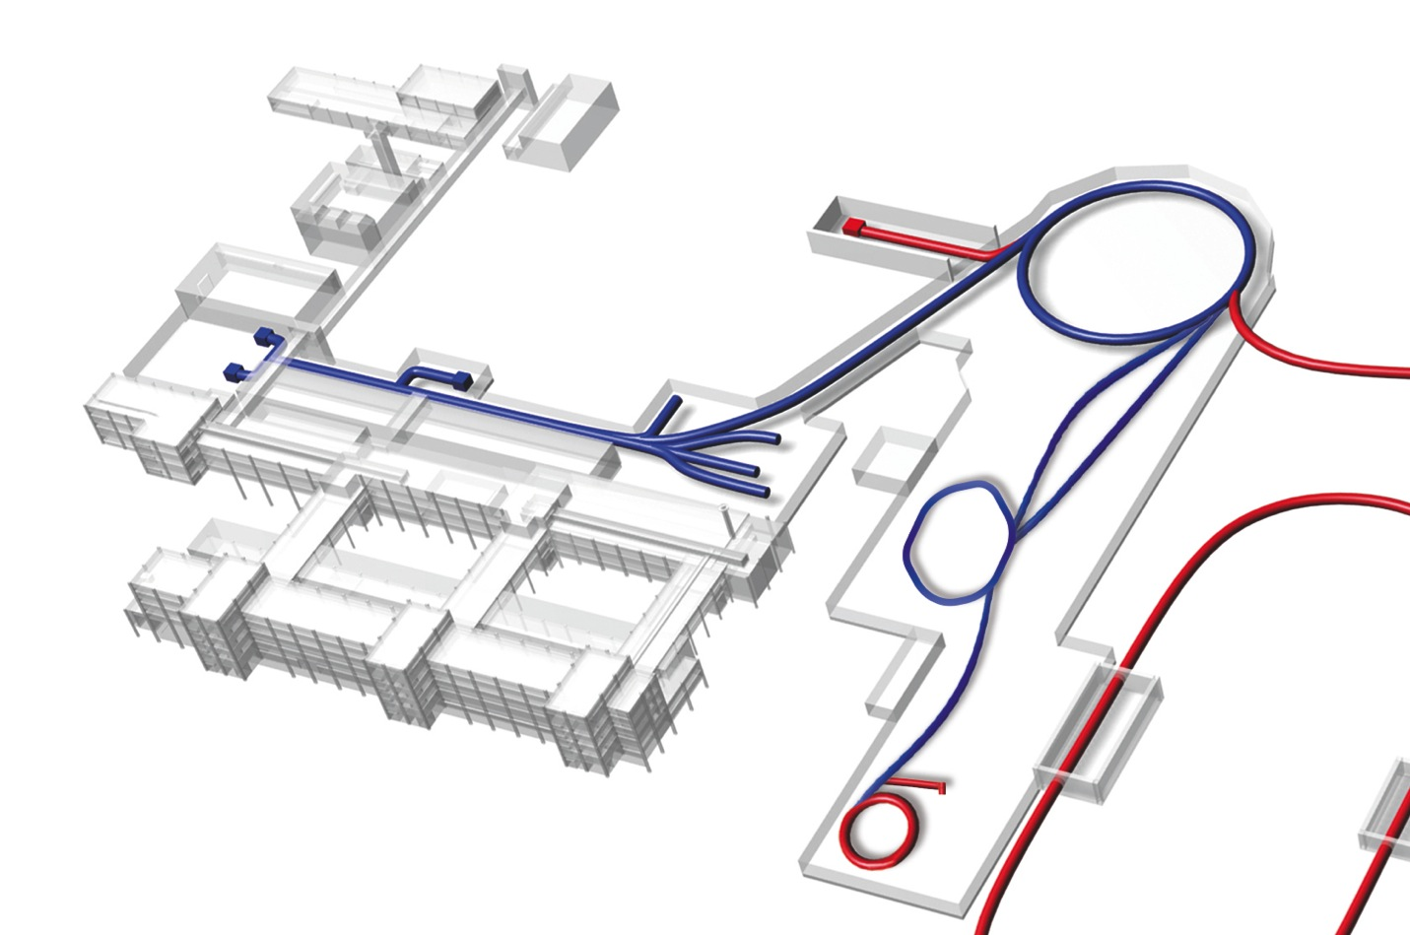
Deceleration of Highly Charged Ions
11.4 MeV/u
400 MeV/u
400–X MeV/u
UNILAC
Slow, highly charged ions
Stripping at high energy
to provide sufficient collisional energy
Deceleration: Emittance increase
(Ideally: Conservation of normalized ε_{norm})
Cooling required
Atomic physics: Ion far away from charge equilibrium
SIS
stripper/
production target
FRS
ESR
linear decelerator
4 MeV/u
HITRAP
SIS
Injection to trap → cooling to 4 K
UNILAC
ring decelerator
HITRAP
4-10 MeV/u
FRS
CRYRING@ESR
ESR
4 MeV/u … 100 keV/u
Slow ions are stored and well controlled
Energy range 10 MeV/u to sub eV/ion
10⁵ to 10⁷ highly charged ions. e.g. U⁹¹⁺
CRYRING@ESR

Slide 18
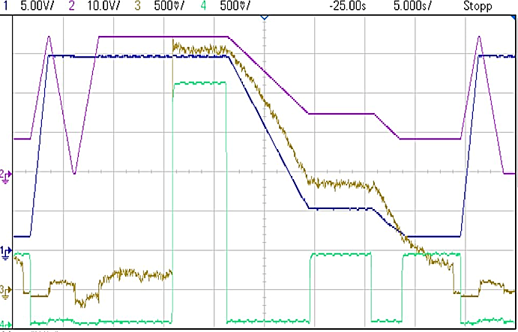
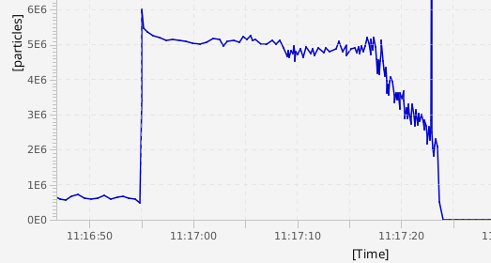
ESR Deceleration Cycle 2022
Deceleration: Au⁷⁸⁺: 145 → 30 → 10 MeV/u followed b fast transfer to CRYRING
28 s
high voltage of electron cooler (electron energy)
electron cooling is applied at all three plateaus
dipole field strength
beam current
electron current (300/100 mA)
⏐ → ⏐ 30 ⏐→⏐10 MeV/u
Achievements:
Optimization of complex beam manipulation
Intensity below 10⁷
Particle loss less than 20 % from 145 to 10 MeV/u
Challenges:
Beam instabilities by large space charge
Lifetime limit by residual gas coll. (p=10⁻¹¹ mbar)
beam current
28 s

Slide 19
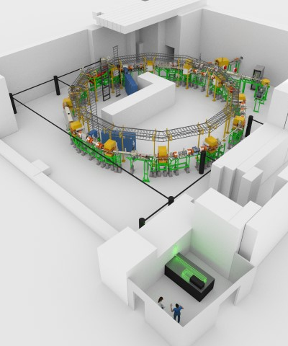
The low Energy Storage Ring CRYRING
CRYRING: Significant improved ring from University Stockholm
Injection from ESR or local source, acceleration and deceleration, electron cooling
Parameter | Value
Circumference | 54.17 m (ESR/2)
Vacuum pressure | 10⁻¹¹-10⁻¹² mbar
Ion energy | < 300 keV/u - 14 MeV/u
Rigidity for ions | 0.054 - 1.44 Tm
Magnet ramping | 1 T/s (4 T/s, 7 T/s)
Stand-alone operation | local ion beam (300 keV/u, q/A > 0.25)
Beam injection | multiturn and fast
Beam extraction | slow and fast
17 m
Beam time 2022:
Beams from ESR
Beam from local source
Atomic physics and material investigations
Extracted beams
Talk by Lorenzo Crescimbeni:
Extreme sensitive current measurement

Slide 20
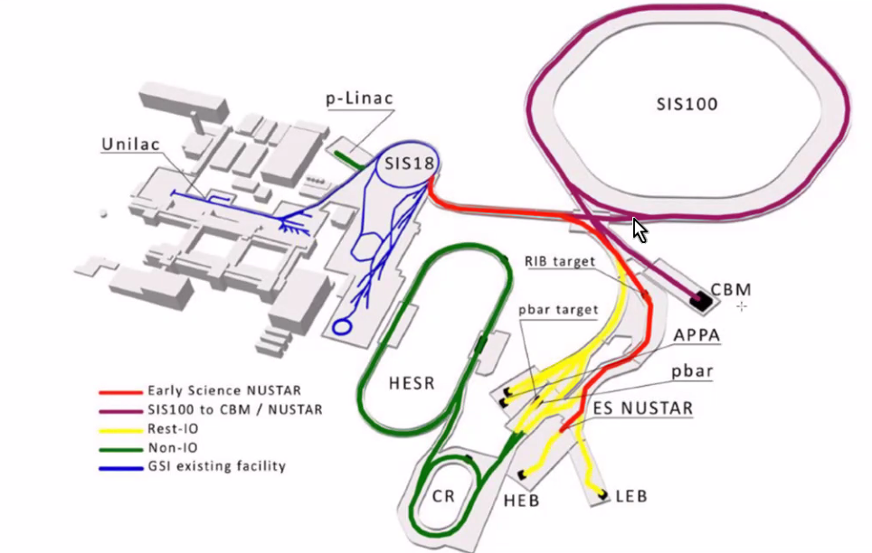
The FAIR Facility
Future Facility for Anti-proton and Ion Research FAIR:
Brilliant future as Brillance = Beam Current / Emittance
SIS100:
Low charge states e.g. U²⁸⁺
⇒ factor 10 more ions
High energies e.g. for U⁹²⁺
Radioactive beam production:
100-fold better trans.& separation
Anti-proton production & cooling
Novel investigation for up to 30 GeV
Fix targets:
Nuclear-, atomic-, plasma-,
bio-physics & & material science

Slide 21
The FAIR Facility
Future Facility for Anti-proton and Ion Research FAIR:
Brilliant future as Brillance = Beam Current / Emittance
Problems due to sanctions
against Russia
(financial and in-kind)
Significant delays expected
(under considerations….)
2028
2026
approx. 2030
after 2030

Slide 22
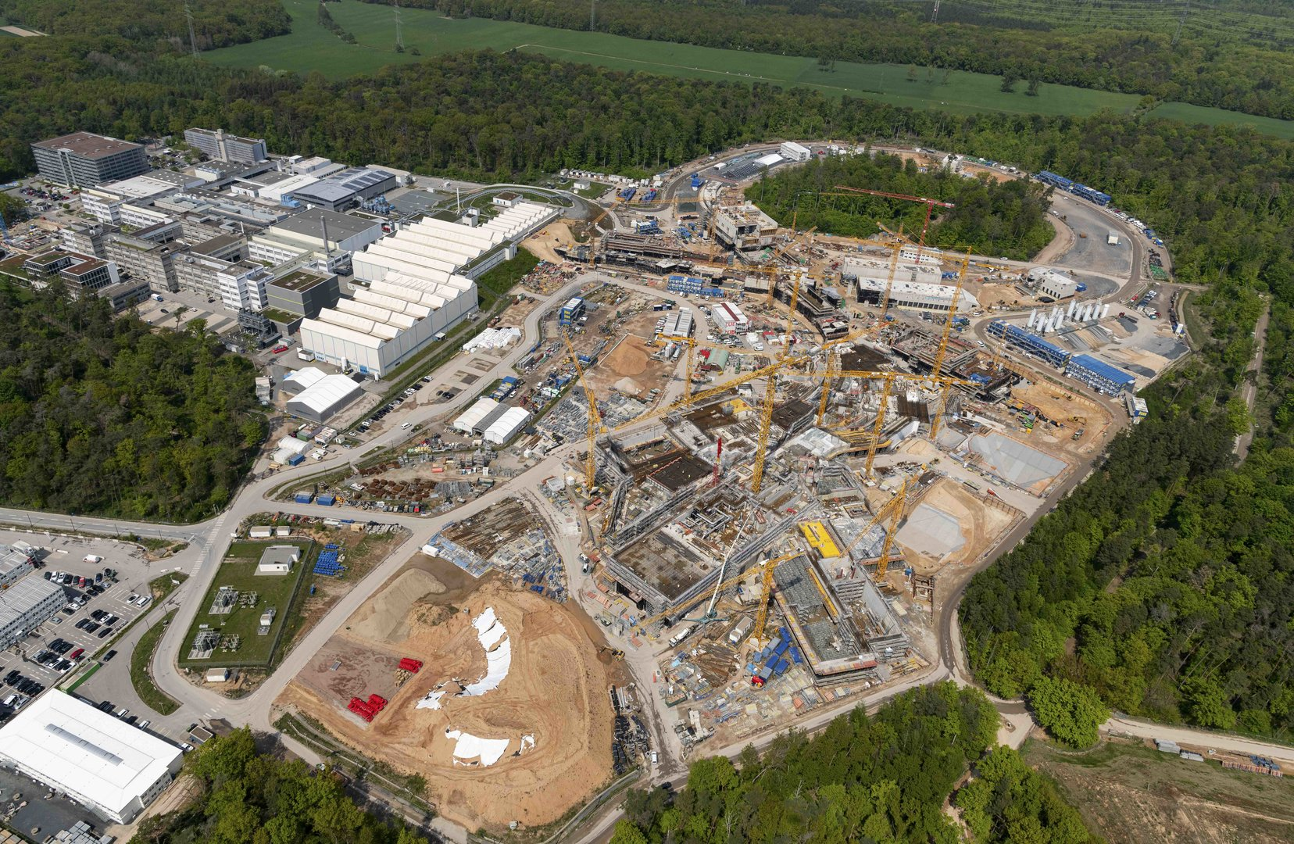
The FAIR Facility: Present Status
Status May 2022
Conclusion:
GSI: One of the most versatile accelerator facilities in the world
Challenging operation with interesting accelerator physics and technologies
FAIR as a ‘natural’ extension in progress
Thank you for your attention! Do you have questions?

