Slide 1
Adaptive Computing Accelerator Platform (ACAP) first experience and Vitis AI toolchain.
08.09.2022
Ahmad Al-Zoubi, Gianluca Martino, Fin H. Bahnsen, Jun Zhu, Holger Schlarb, Goerschwin Fey

Slide 2
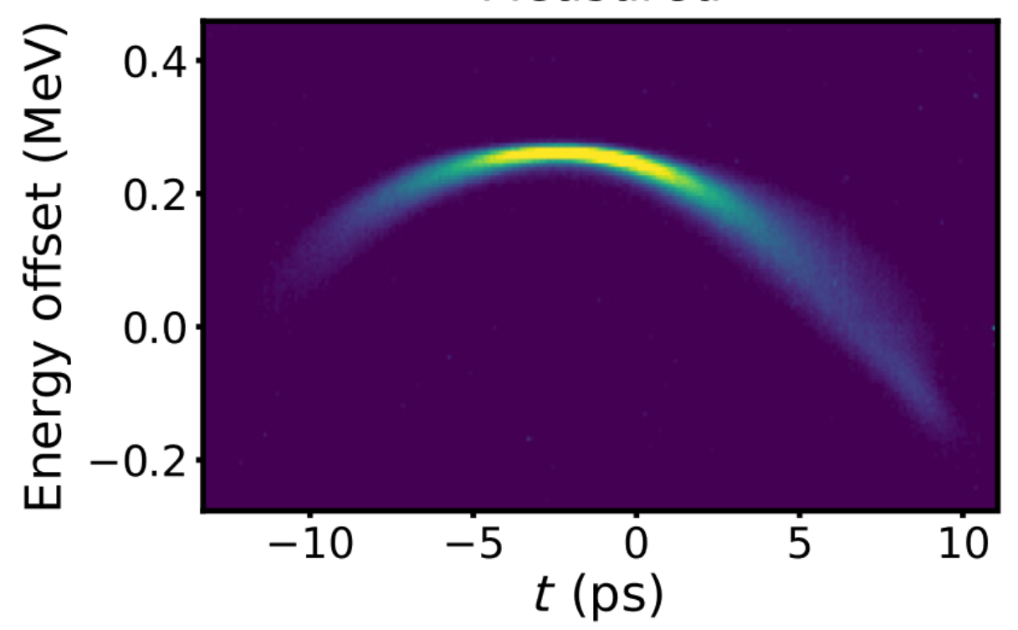
Motivation
Application
Longitudinal phase-space image at the European XFEL photoinjector
Notes:
TDS: transverse deflecting structure

Slide 3
Motivation
Application
Prediction of RF phase at:
RF gun
A1
AH1
Longitudinal phase-space image at the European XFEL photoinjector
Notes:
TDS: transverse deflecting structure

Slide 4
Motivation
Application
Prediction of RF phase at:
RF gun
A1
AH1
Longitudinal phase-space image at the European XFEL photoinjector
Notes:
TDS: transverse deflecting structure

Slide 5
Motivation
Application
Prediction of RF phase at:
RF gun
A1
AH1
Longitudinal phase-space image at the European XFEL photoinjector
Notes:
TDS: transverse deflecting structure

Slide 6
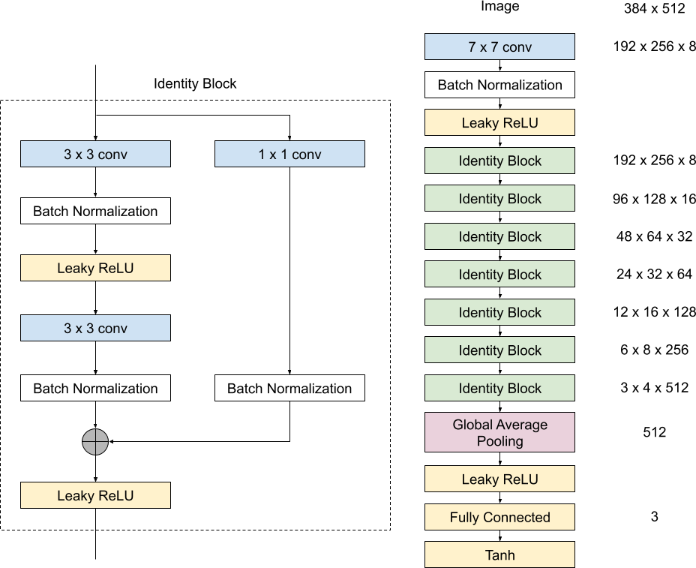
Motivation
Target network
[RF gun phase, A1 phase, AH1 phase]

Slide 7
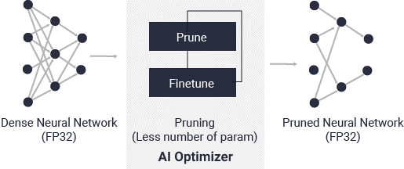
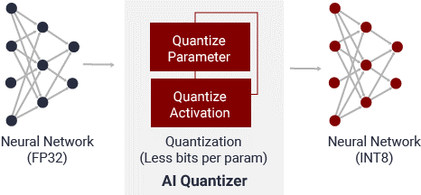
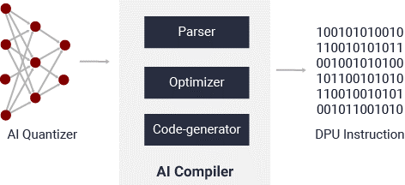
Introduction
Vitis AI

Slide 8
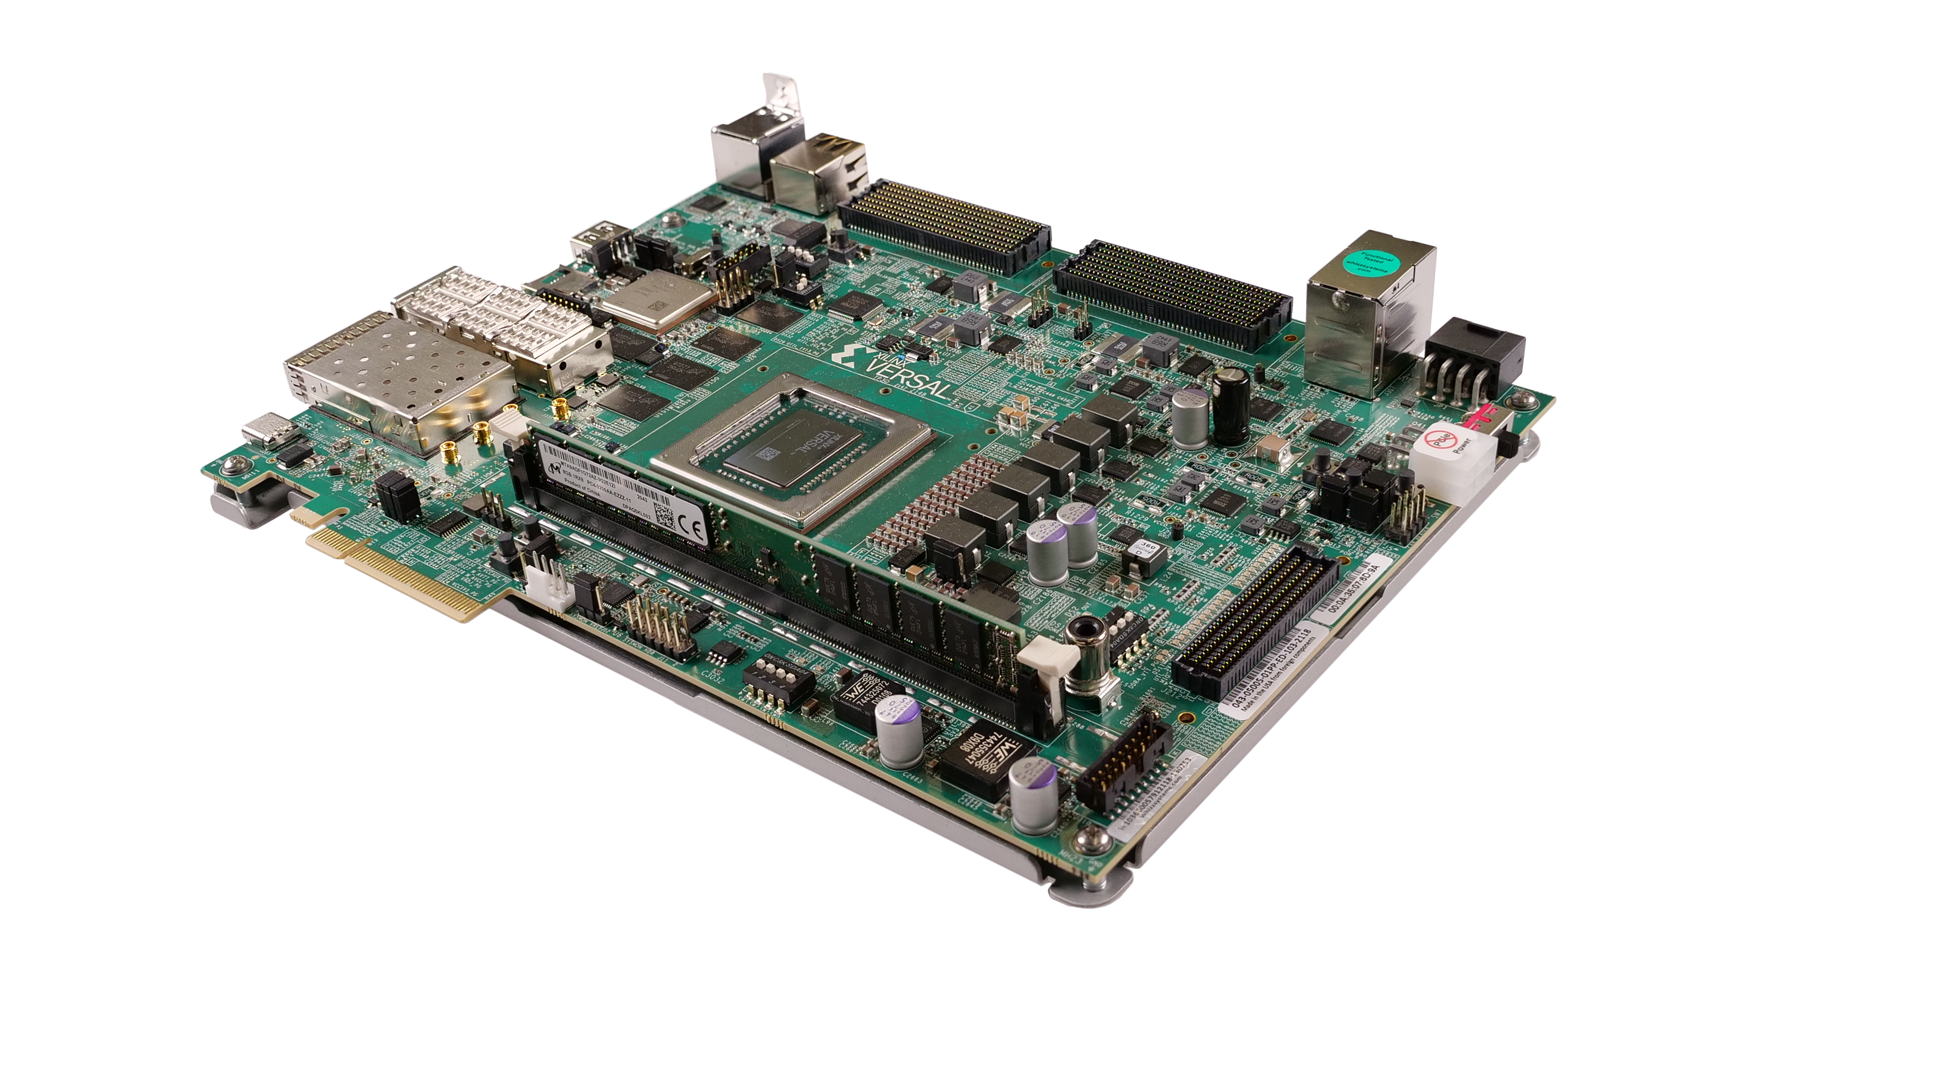
Introduction
Versal ACAP VCK 190

Slide 9
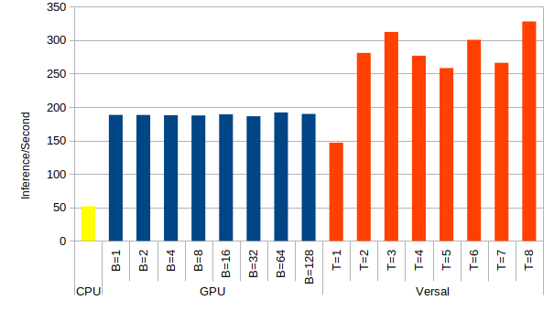
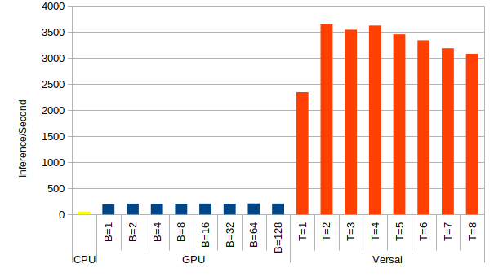
Results
Configurations | Device Latency (ms)
 | CPU | GPU | B4096 | C32B3
Partial Support | 51.40 | 55.68 | 53.04 | 24.01
Full Support | 50.8 | 54.30 | 4.60 | 2.98

Slide 10
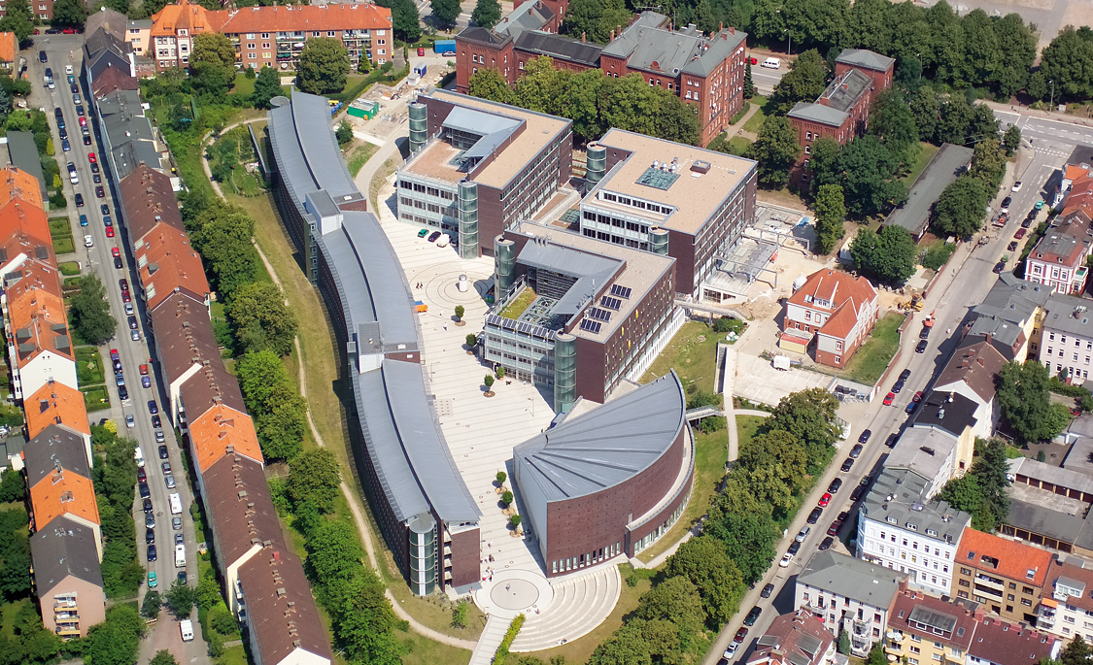
Thanks for your attention!
ACAP first experience and Vitis AI toolchain | Gianluca Martino, 08.09.2022

