Slide 1
Ocean wave impacting arrival time stability at EuXFEL.
10th MT ARD ST3 Meeting
M.K. Czwalinna*, J. Kral, B. Lautenschlager, J. Müller, H. Schlarb, S. Schulz, M. Schütte, B. Steffen, Deutsches Elektronen-Synchrotron DESY, Germany
September 7th to 9th 2022, Berlin

Slide 2
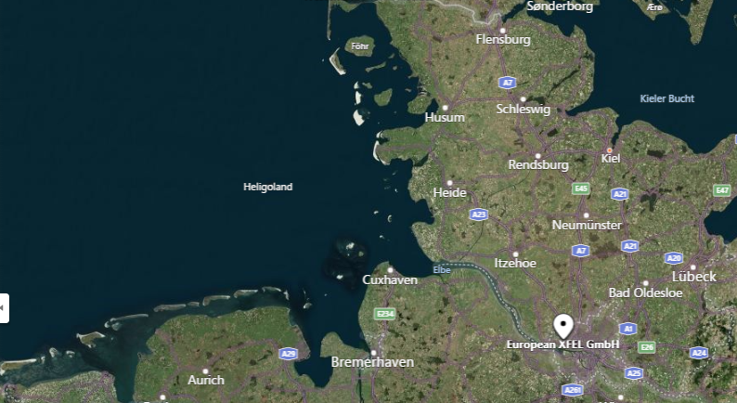
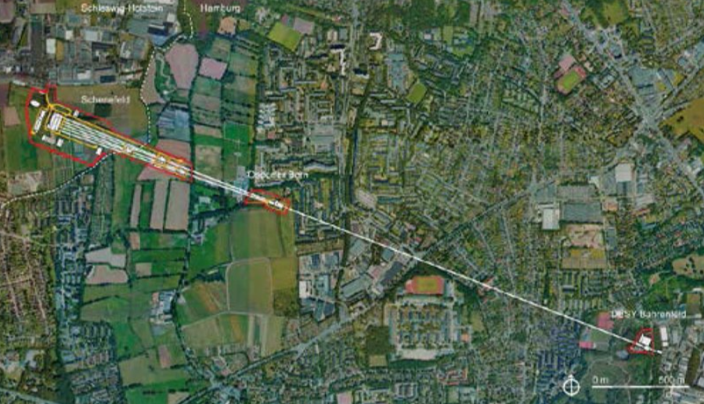
Geographical location of EuXFEL
3.5km

Slide 3
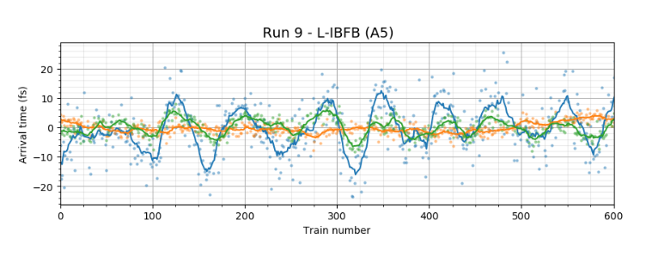
Observation : oscillations in arrival time
Main Optical Clock
Stabilized fiber links
Remote clocks
Main RF Clock
MO
RF
RF
RF
RF
RF
1500m
~1500m
e-Bunch Arrival Monitors (BAM)
X-ray Photon Arrival Monitor (PAM)
Origin of oscillations in BAM and PAM signal (~0.2Hz) ??
Romain Letrun, Tokushi Sato, Henry Kirkwood, Jayanath Koliyadu SPB/SFX Instrument, European XFEL Oct.2020 – Mar. 2021

Slide 4
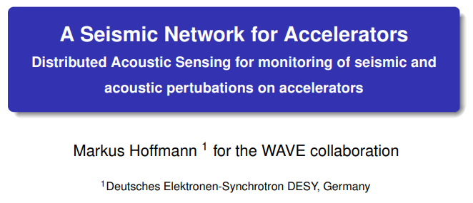
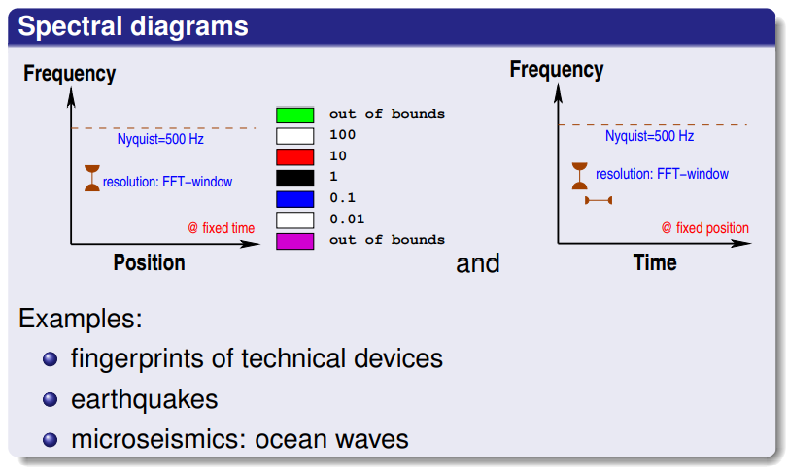
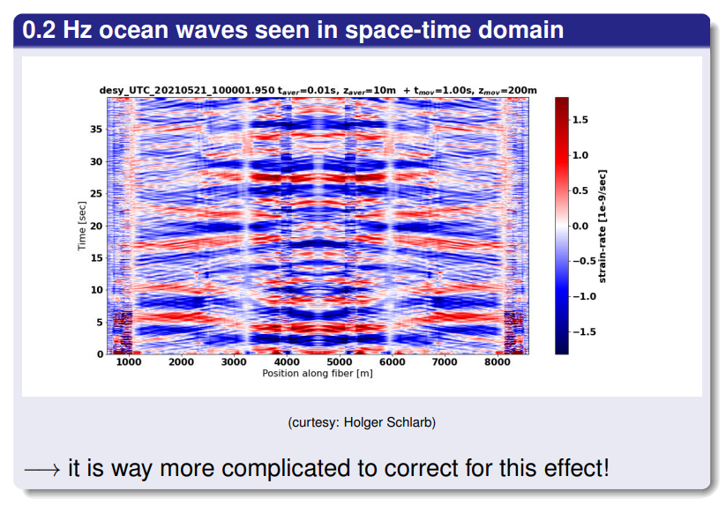
→ Insights from seismic network

