Slide 1
1st Annual Meeting
Welcome and Overview
4 May 2022
Elke Plönjes (DESY) – Scientific Coordinator
This project has received funding from the European Union´s Horizon 2020 research and innovation programme under grant agreement No. 101004728

Slide 2
Agenda
News from the coordinator
Activities of RI Co-Innovation Platform
Upcoming calls
Innovation Advisory Board IAB
Periodic report

Slide 3
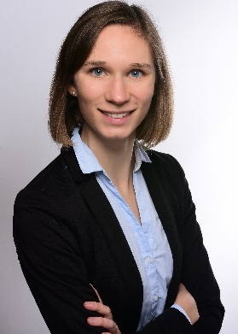
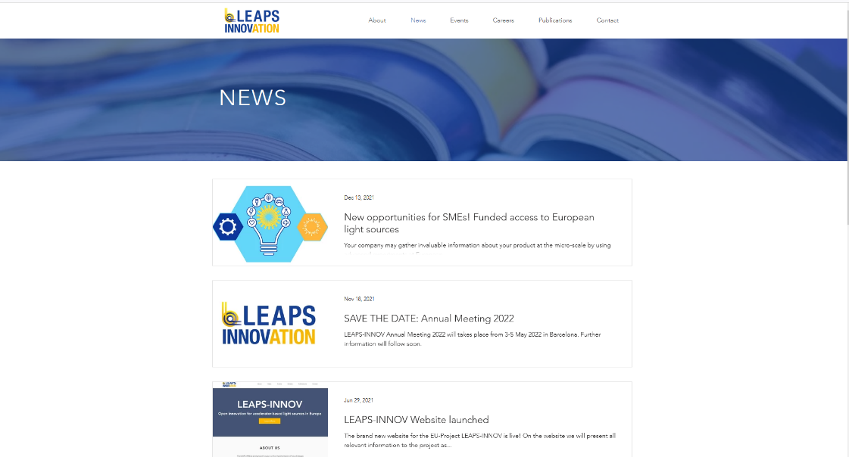
News
New Faces:
Elena Hengstmann Tom Minniberger (annual meeting preparation)
LEAPS-INNOV website: http://www.leaps-innov.eu → Elena Hengstmann

Slide 4
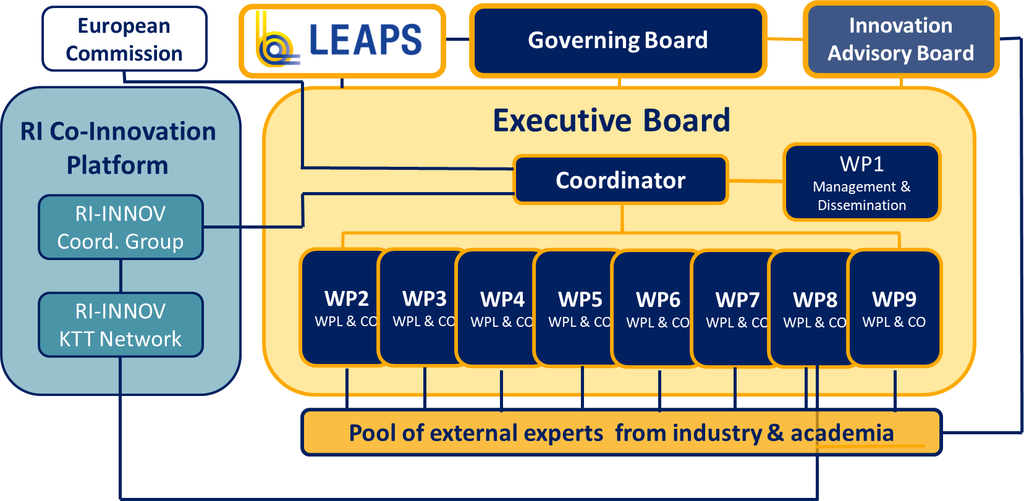
LEAPS-INNOV governance

Slide 5
RI Co-Innovation Platform
RI-INNOV Coordination Group
Members: 3 coordinators and deputies, chair of KTT network, one further representative from each project
Define a common strategy for scientific areas which are at the boundaries of the innovation pilots, avoid duplication of work
Exchange information on follow-ups of the pilot projects and on any future initiatives launched by the communities
Identify areas of cooperation and launch common initiatives (workshops, studies, documentation, etc.)
RI-INNOV KTT Network
Members: Knowledge (KT) and technology transfer (TT) experts of consortia beneficiaries (WP8)
Exchange knowledge and experience relating to collaboration with industry, , to manage interfaces and overlaps
Discuss common strategies of communication with industry, standardisation and training
Support coordination group in implementing joint activities in KT and TT
Joint Recommendations on
Innovation Strategy for RIs (D1.5 M46)

Slide 6
INFRA-INNOV RI platform - activities of 1st year
INFRA-INNOV MoU signed by consortium partners
Several meetings of RI-INNOV coordination group
First discussions together with RI-INNOV KTT experts (WP8)
Joint statement (March 2022) “Feedback to EC concerning INFRA-INNOV pilots”: Lessons learned from proposal phase and project start
Invited to “EC-ESFRI Workshop: R&I needs of Research Infrastructures”, March 30/31, 2022
Presentation of projects at the respective annual meetings
→ Notify about upcoming workshops and activities – industry and technology related (IPR workshops, BSBF, technical workshops ….)
→ Lobby for follow-up EC projects in 2024 (submission)
→ Identify overlaps and gaps (electron and photon diagnostics, ….)

Slide 7
HORIZON-INFRA-2022-TECH-01-01 call deadline 20 April 2022
Submitted Proposals:
Weare coordinated by ELETTRA 12 M€
Wave-mixing Experimental Advanced Setups for users Research in Europe 9 Partners
SMART-FIT coordinated by SOLEIL 8.8 M€
Smart Future Imaging Toolbox 9 Partners
AI4SI coordinated by ILL 11.3 M€
Artificial Intelligence for Science and Innovation 21 Partners

Slide 8
HORIZON-INFRA WP2023-2024 draft March 2022 calls in 2023
15 March
2023
HORIZON-INFRA-2023-DEV-01-05: Preparation of common strategies for future development of RI technologies and services within broad RI communities
1.5-2.5 M€ per project. To define common roadmaps for future RI technology and services.
HORIZON-INFRA-2023-EOSC-01-01: Build on the science cluster approach to ensure the uptake of EOSC by research infrastructures and research communities.
24 M€ per project (18 M€ for third parties). Cascading grant mechanism: 100-250 K€ for 12-18 months.
HORIZON-INFRA-2023-SERV-01-01: Research infrastructure services to enable R&I addressing main challenges and EU priorities
8-14.5 M€ per project. Providing trans-national access and customised RI services for challenge-driven research : linking environmental factors to human health; improving clinical research in the pediatric field; climate-change risks; sustainable Arctic/Polar regions; healthy ocean, seas and rivers; sustainable aquaculture, fisheries and blue economy; renewable energy and smart grids; for innovative applications of nanoscience and nanotechnology; enhance the EU capacity for the development of semiconductors; for shaping the future generation society.
HORIZON-INFRA-2023-SERV-01-03: Research infrastructure services advancing frontier knowledge: co-fund pilots with pan-European RIs and/or national RIs
2-5(10) M€ per project. Providing trans-national access to enable curiosity-driven interdisciplinary research.

Slide 9
HORIZON-INFRA WP2023-2024 draft March 2022 calls in 2024
20 March 2024
HORIZON-INFRA-2024-DEV-01-01: Research infrastructure concept development
1-3 M€ per project. Major upgrades of existing infrastructures may also be considered.
HORIZON-INFRA-2024-TECH-01-01: R&D for the next generation of scientific instrumentation, tools, methods, solutions for RI upgrade
5-10 M€ per project. To deliver innovative scientific instrumentation, tools, methods and solutions which advance the state-of-art of European RIs.
Lobby for a specific topic on Innovation Pilot II

Slide 10
EIC Pathfinder Open calls every year deadline ~ May
Future and Emerging Technologies
Budget up to 3M€
Consortium small 3-7 incl. industry TRL 1-4
1. Radical Vision
Radically new, unsubstantiated approach, questioning current paradigms
Further development of already researched ideas
2. Breakthrough technological goal
Ambitious research into a groundbreaking new technology (proof of concept)
No funding for “only” risky research
3. Ambitious interdisciplinary research
Research that breaks new ground
No funding for interdisciplinary research that only promises to improve an approach that has already been tried and tested
Sucsessful projects in H2020/HE:
https://www.femtochip.eu/ (Laser)
MHz Tomoscopy ( MHz rate multiple projection Xray Microscopy; European XFEL)
TWAC (THz wave accelerating cavity for ultrafast science)
….

Slide 11
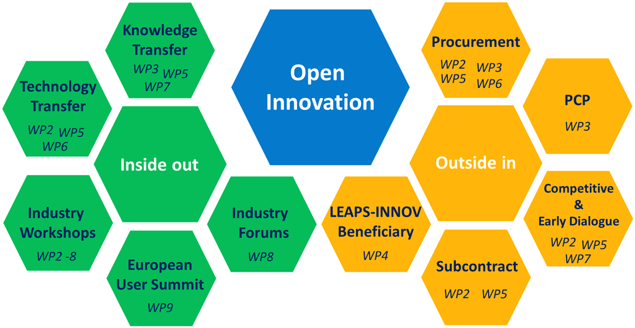
Foster technological development through open innovation
represented in
LEAPS approach to involve industry in the innovation of SR & FELs in Europe in three capacities
Industry as supplier
Industry as user
Industry as trigger of science in European Partnerships
reflect
advise
co-design
Tools

Slide 12
IAB members
Peter Anastasi
Guillaume Dovillaire
Michael Henning
Christoph Quitmann
Nikolaj Zangenberg

Slide 13
Periodic Report (PR)
Reporting period 1: 1 Apr. 2021 – 30 Sep. 2022
Submit to EC: 30. Nov. 2022
EC review: Mid December 2022 with all WP leaders
PR consists of two parts
Reporting period 2: 1 Oct. 2022 – 31 Mar. 2023
Final report: 1 Apr. 2023 – 31 Mar. 2024
Financial Report
Technical Report
WP1 talk Tom Minniberger
Financial workshop – June 2022

Slide 14
Technical Report (coordination by Elena Hengstmann)
Part A (All beneficiaries) | Part B (Work packages)
Detailed information on: Gender Publications Events (meetings, conferences, etc.) Press releases Social Media Communication efforts Questionnaire provided by the Coordinator Timeline: Tasks by: Beneficiary Coordinator | Progress of M1-M18 on LEAPS-INNOV project (each work package) Template provided by the Coordinator Coordinator will submit Part B to EC Timeline: Tasks by: Work package Coordinator
Completion of
the template
Review by
coordinator
Submit
to EC
Review
2022
Completion of
the questionnaire
Dec.
June
July
Aug.
Sep.
Oct.
Nov.
2022
Sept.
Oct.
Nov.
Send out
template
Submission to
coordinator
Finalising
Technical Report
Send out questionnaire
Submission to coordinator

Slide 15
Outlook
Please, report all industry-related activities:
Report form
Website news
Next annual meeting:
Virtual meeting May 2-5, 2023 and one extra day at LEAPS meeting in autumn 2023 or
Onsite meeting May 2-5,2023 not as hybrid!! → feedback questionnaire

Slide 16
Tak
Tack
Thanks
“ Foster open innovation for accelerator-based lightsources in Europe”
Bedankt
Dziękuję
Danke
Merci
Grazie
Gracias
https://leaps-initiative.eu
This project has received funding from the European Union´s Horizon 2020 research and innovation programme under grant agreement No. 101004728
شك

