Slide 1
Strategy & priorities 2022: key activities
Ana VALCARCEL ORTI (CB Chair, SOLEIL)
LEAPS-INNOV PLENARY MEETING
May 4th, 2022

Slide 2
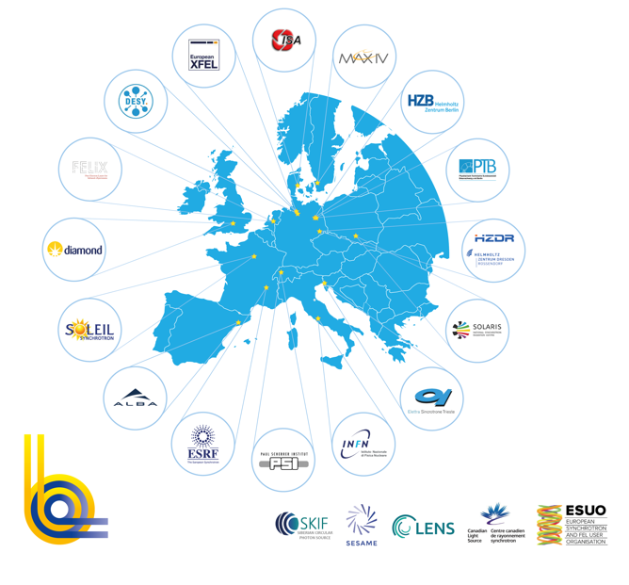
LEAPS is the largest consortium of analytical facilities world-wide and further expanding its service to an interdisciplinary European user community
19 facilities - 16 institutions - 10 countries
> 300 operating End Stations
> 1.000.000 h beamtime /year
> 5.000 publications/year
> 15 spin off companies
> 35.000 users from all EU & beyond
researchers from all research areas
Construction and Operation (~ 800ME/year) through national funding

Slide 3
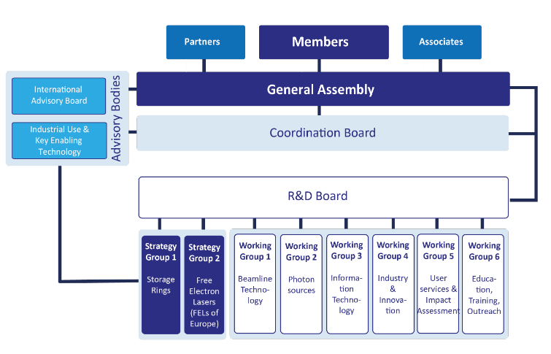
LEAPS Organisation
LEAPS Chairs
General Assembly
Present chair: Lenny Rivkin (PSI)
Past chair: Caterina Biscari (ALBA) Incoming chair: Jean Daillant (SOLEIL)
Coordination Board
Rafael Abela (PSI)
Alejandro Sanchez (ALBA)
Ana Valcarcel Orti (SOLEIL)
Task Forces
IDEA, ERA, Internal Projects funding, Strategic Access
Notes:
I will not go into detail about the activities of the TF
To give you some exemples the TF Internal funding works on a fremwork agreement to make internal project funding easier, Era is working on how to establish efficient links with the EU Partners and launched reflections on LEPS becoming a legal entity

Slide 4
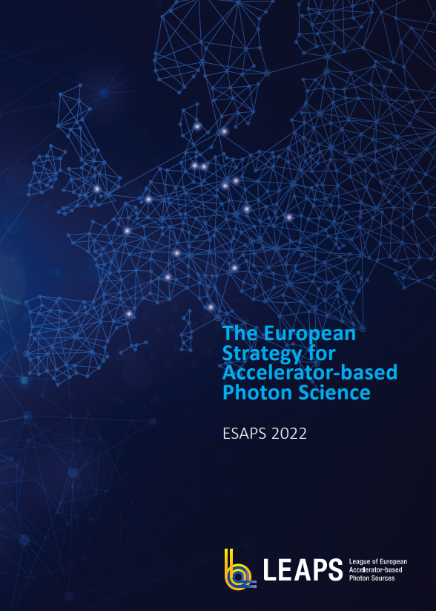
The European Strategy for Accelerator-based Photon Science
ESAPS 2022
1. Accelerator-Based Photon Science: Status and Developments
Strategic relevance, service provision, infrastructure/technology roadmap
2. ESAPS 2022 for Future Service Provision
Future schemes, pilots of strategic partnerships (targeted challenge driven service provision)
3. ESAPS 2022 for Facility Upgrades
Facility upgrades, Green LEAPS, Key enabling Technologies, Smart Specialisation, Open Innovation&Cooperation with Industry
4. ESAPS 2022 for the Digital and Green Transformation of the Operation of European User Facilities
Existing projects, DIGITAL LEAPS, Open Science
5. Transversal Priority Action Items
Training, IDEA, Synergies with neighboring RIs
… to be published very soon
Notes:
How LEAPS facilities contribute to find solution to Grand Challenges of our society
user access for challenge-driven research
transnational user access for discovery-driven research
development of novel sustainable technologies
an action plan towards open science and innovation
the strategy supporting the European Green Deal
LEAPS collaboration with neighboring analytical facilities in Europe (ARIE
Development of the LEAPS facilities
Technology Roadmap
Landscape Analysis and its future
High Priority Items
Smart specialization and European cohesion
Impact on a global scale: cooperation with industry
DIGITAL transformation of LEAPS facilities
Societal impact of ESAPS

Slide 5
Accelerator-based photon science strategy, prospects and roadmap in Europe: a forward view to 2030
Editors:
Rafael Abela (PSI), Thomas Tschentscher (EuXFEL) , Jean Susini (SOLEIL) , Gastón García (CMAM)
This collection of papers aims at providing a global view of the European photon science landscape and give insight in which are the main trends and prospects, with a long-term (towards 2030) view
All 16 European accelerator-based photon science facilities open to users, plus one associate, will be invited to contribute a paper
In addition, 2 papers will be invited to deal with the global perspective in terms scientific trends and overall strategy, and the critical aspect of data
Notes:
Synchrotron light sources and free electron lasers have gone through an impressive transformation over the last decade, where Europe is a leading actor in a rapidly changing global scenario.
This collection of papers, supported by the LEAPS network (https://leaps-initiative.eu), aims at providing a global view of the European photon science landscape and give insight in which are the main trends and prospects, with a long-term (towards 2030) view.
To that end all 16 European accelerator-based photon science facilities open to users, plus one associate, will be invited to contribute a paper.
In addition two papers will be invited to deal with the global perspective in terms scientific trends and overall strategy, and the critical aspect of data. For these two papers suitable authors will be identified and invited, by using the LEAPS network organization.
Accelerator-based photon sources are a crucial element of the European research infrastructure landscape, serving a very wide scientific and industrial user community across many different areas of science, and pushing technologies to the limit for ultimate insight into the microscopic properties of matter, at multiple time and space scales, down to atomic dimensions and dynamics.

Slide 6
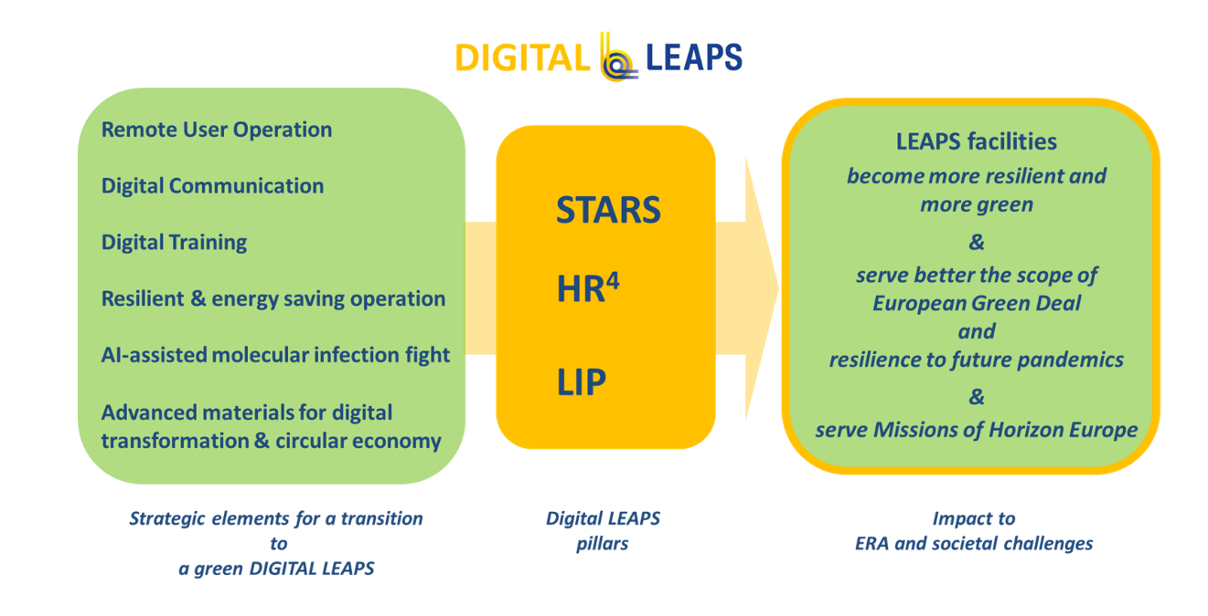
DIGITAL LEAPS is on its way
The DIGITAL LEAPS project has now started the executive phase:
During the first year, the focus of the three pillars will be on networking activities, with one pilot project for each pillar
Connection with the proposals submitted to the Horizon Europe calls
Notes:
The DIGITAL LEAPS initiative was triggered in 2020 as a response of LEAPS to the COVID-19pandemic, with the aim of increasing together, on a European level, the resilience of LEAPS facilities to times of crisis, where massive constraints on operations and mobility are taking place.
A preliminary analysis was presented at the 2020 LEAPS Plenary Meeting and it sparked a very positive feedback from both the General Assemble and members at the single facilities.
The preparation phase has started right afterwards, including from the very beginning some green aspects, which involve another strategic challenge nowadays where LEAPS contribution can be significant.
DIGITAL LEAPS structure involve three homogenous pillars, STARS, HR⁴ and LIP, each one focusing on one specific aspect.
During the preparation phase, a fertile exchange of ideas at the level of the Research and Development Board (R&D Board) allowed to find inspiration from the three pillars for project proposals, which were submitted to the Horizon Europe call INFRA-2021-TECH-01-01 in September 2021. The proposal eRImote was since then approved and has reached the stage of Grant Agreement preparation.
After approval by the LEAPS General Assembly, the DIGITAL LEAPS project proposal has now started the executive phase.
During the first year, the focus of the three pillars will be on networking activities, with one pilot project for each pillar.
The first phase takes into account both the connection with the proposals submitted to the Horizon Europe calls in September and the information collected during the preparation phase contacting the LEAPS facilities. The pilot projects will allow to complete an overview of the different actions undergoing at the LEAPS facilities to become more resilient, to explore the opportunities to create green facilities including circular economy aspects and interactions with industry, and to foster, in such a way, future common initiatives. The latter may seed both topics and proposals for Horizon Europe calls in the future RI work programs, i.e. 2023 onwards.
- Starts KO done ready to start sending questionnaires
- HR4: building the network
- LIP :seminar on android/robotic approaches

Slide 7
Feedback on the Horizon Europe calls
LEAPS Projects in Grant Agreement preparation phase:
• ReMade@ARI (HORIZON-INFRA-2021-SERV-01-04, HZDR)
• eRImote (HORIZON-INFRA-2021-DEV-01-03, DESY)
LEAPS proposals submitted to the INFRA-TECH-2022-01-01 call:
• WEARE (ELETTRA)
• SMART-FIT (Imaging TOOLBOX, SOLEIL)
• AI4SI (ILL/ESRF
Notes:
Projects initiated and supported by LEAPS:
HORIZON-INFRA-2021-SERV-01-04: ReMade@ARI, Recyclable materials development at analytical research infrastructures
To pioneer a support hub for materials research supporting the transition to the Circular Economy by offering coordinated access to Europe´s accelerator-based photon sources and to more than 50 European analytical research infrastructures (LEAPS RIs and other facilities in the ARIE network)
Grant Agreement under preparation
HORIZON-INFRA-2021-DEV-01-03: eRImote, Pathways to Improved Resilience through Remote/Digital Access for European Research Infrastructures
To explore digital and remote service provisions across analytical RIs taking beyond the state-of-the-art for concrete solutions. 11 Beneficiaries, from all 4 ESFRI domains; DESY represents: LEAPS, ARIE and APPEC
Grant Agreement under preparation
HORIZON-INFRA-2022-TECH-01-01: 3 proposals submitted on the 20th of April 2022. Diverse subjects for different apects (AI together with LENS, tools for new user communities of FELs and Lasers, Innovative Imaging Toolbox)

Slide 9
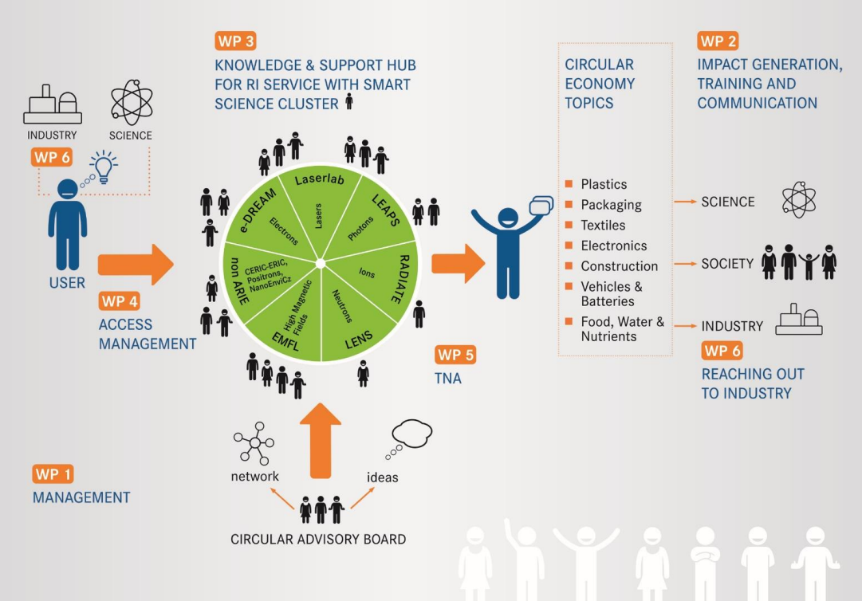
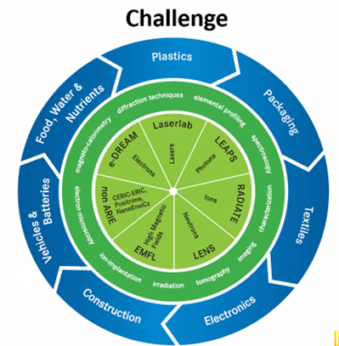
ReMade@ARI
Recyclable materials development at analytical research infrastructures
Budget: 13,6 M€
Bénéficiaires: 46 participants (LEAPS RIs and other facilities in the ARIE network)
Duration: 48 months
Possible start: 1. September 2022
end: 31. August 2026
Coordinator: HZDR

Slide 10
LEAPS relations with the European Comission and ESFRI
19 Jan. 2022
Meeting with A. Karamali – Head of Unit, Academic R&I, DG RTD
21 Mar. 2022
Meeting with P. Postigo McLaughlin and D. Sobczak – DG RTD
24 Mar. 2022
Panelist at the High-Level Launch of the ESFRI Stakeholder Forum
31 Mar. 2022
Panelist (on behalf of ARIE) at the EC - ESFRI Workshop on the WP 2023-2024
28 Apr. 2022
Participation to the ESFRI RIs Landscape analysis
LEAPS relations with the European Commission and ESFRI
… forthcoming events in May - June 2022
Notes:
ERA action 8. Strengthen sustainability, accessibility and resilience of research infrastructures in the ERA
LEAPS exchange with the EC, A. Karamali (19th of January)
o LEAPS is now recognised by the EC as a “powerful unit”; o Ms. Karamali asked for feedback/information on: - past&current call texts - HE WP 2023/24 - key scientific topics to be addressed by LEAPS) - Scientific Roadmap (collection of papers as a Focus Point Issue at EPJplus)
o EC acknowledges that becoming a legal entity would benefit LEAPS - SWOT analysis on legal entity by the TF on ERA (later by Britta)
o ESAPS document needs to be presented to the EC by the LEAPS chairs by the beginning of April (date tbc) (working meeting with P. Postigo-McLaughlin and D. Sobczak on 21st of March)
Forthcoming opinions/positions ESFRI (by June):
Charter on access to RIs
Synergies of RI funding
ESFRI stakeholder engagement strategy
LEAPS
enthusiastically welcomes the launch of the ESFRI stakeholder forum;
is expecting a closer strategic integration with ESFRI as a network;
is willing to expand its service for a higher impact on the grand challenges of today and tomorrow by establishing pilot partnerships with key stakeholders and adapting its service provision.

Slide 11
LEAPS relations with the European Parliament
Organization of a LEAPS event at the European Parliament hosted by Lina Galvez - MEP and ITRE vice-chair (May 31, 2022)
Notes:
Chairperson: Leonid Rivkin
Moderator: Mirjam van Daalen

Slide 12
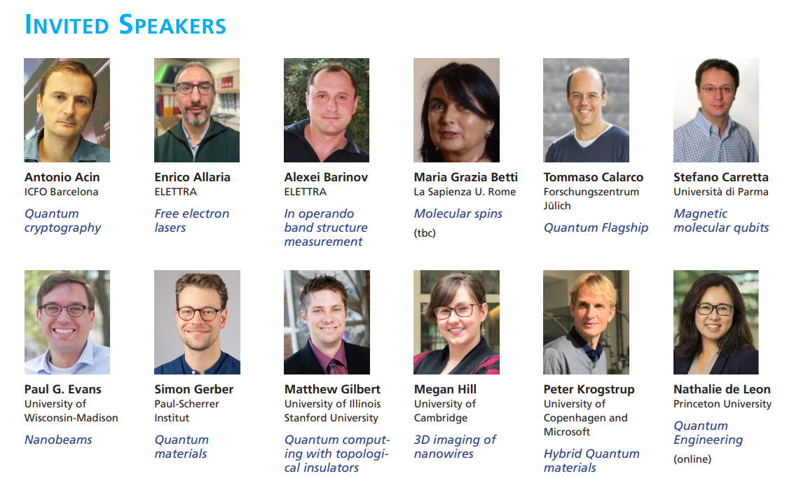
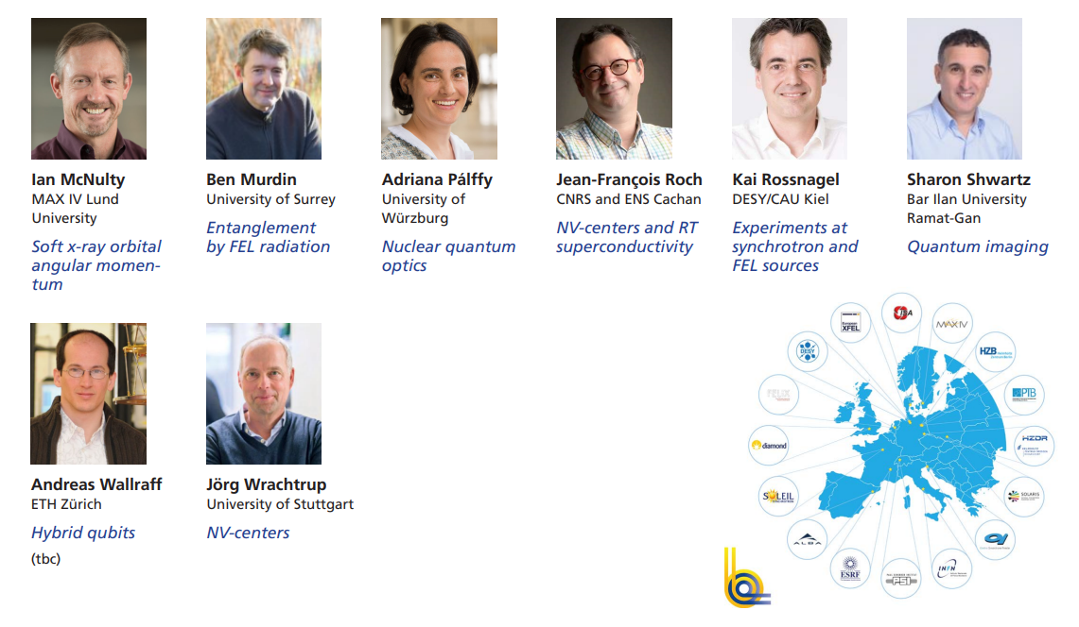
Some of the LEAPS international networking opportunities in 2022
LEAPS meets Quantum Technology – Conference
May 16 - May 20, 2022
Hotel Hermitage
La Biodola Bay 57037 Portoferraio (LI) Isola d’Elba, Italy

Slide 13
Some of the LEAPS international networking opportunities in 2022
Conference on Industrial Technologies IndTech2022
June 27 – June 29, 2022
Grenoble, France
EuroScience Open Forum 2022
July 13 - July 15, 2022
Leiden, The Netherlands
Big Science Business Forum 2022
October 4 - October 7, 2022
Granada, Spain
International Conference on research Infrastructures – ICRI 2022
October 19 - October 21, 2022
Brno, Czech Republic
Notes:
Participation to the Round table organised by the ExPaNDs and Panosc projets et the ESOF. Open Data for healthier societies: a virtuous cycle?
LEAPS has 3 talks and a booth. Big Science Business Forum 2022 | CDTI (bsbf2020.org)

Slide 14
5th LEAPS Plenary Meeting
Paul Scherrer Institut Villigen, AG
Save the Date for the 2022 LEAPS Plenary Meeting to be held at the Paul Scherrer Institut in Switzerland

Slide 15
Tack
Tak
“The strength of LEAPS lies
in its staff and users,
hailing from all European countries,
beyond those which host the facilities. Member States and facilities
should optimize
the funding instruments under
Horizon Europe
for the benefit of researchers and innovators across all Europe”
Thanks
Bedankt
Dziękuję
Danke
Merci
Grazie
Gracias
كش
17

