Slide 1


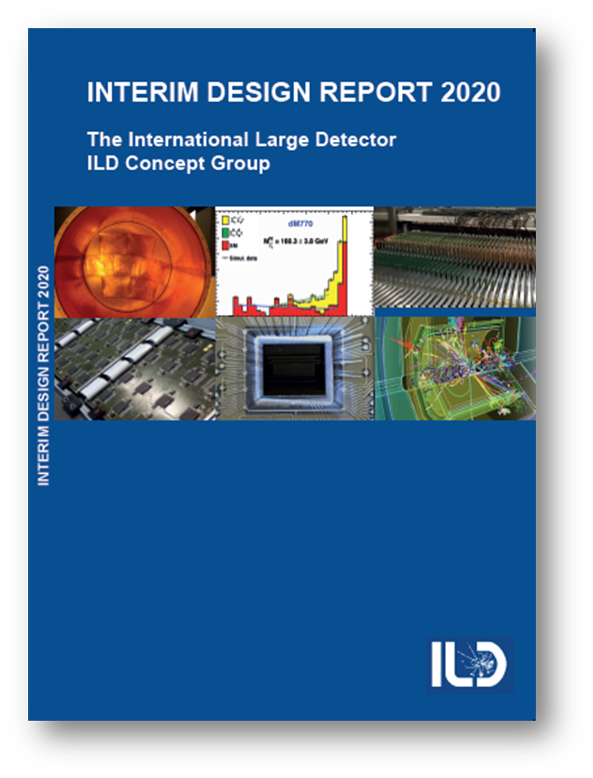
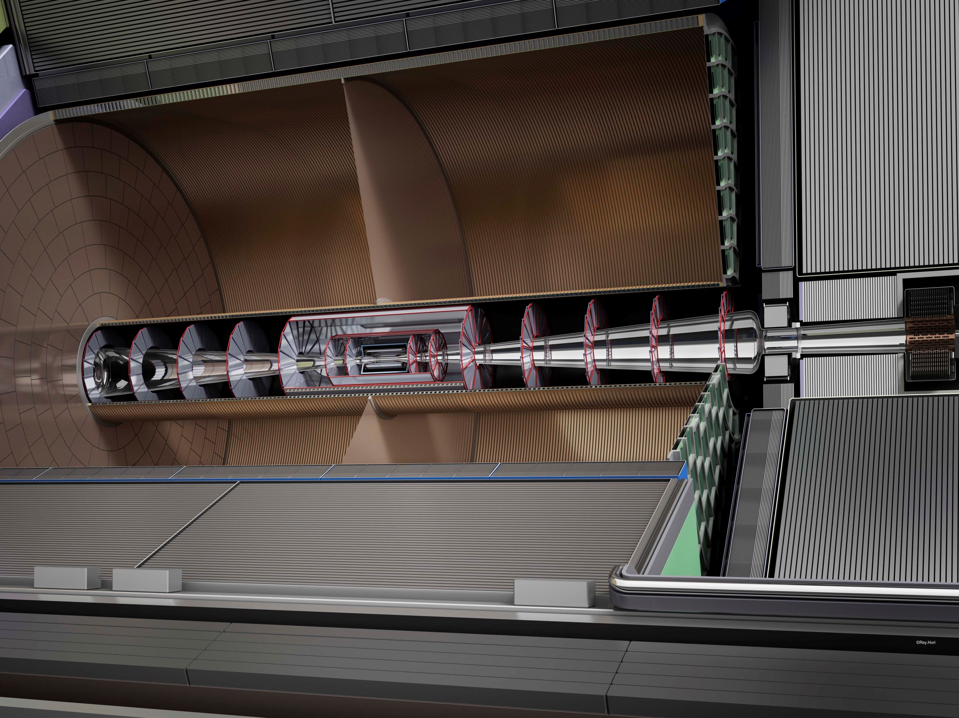
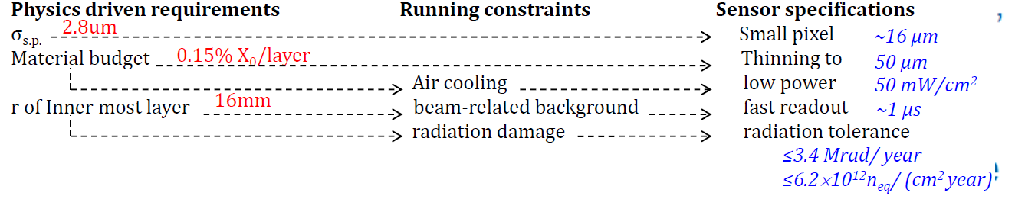
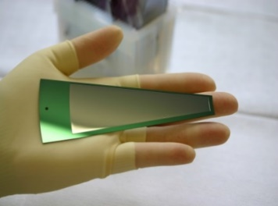
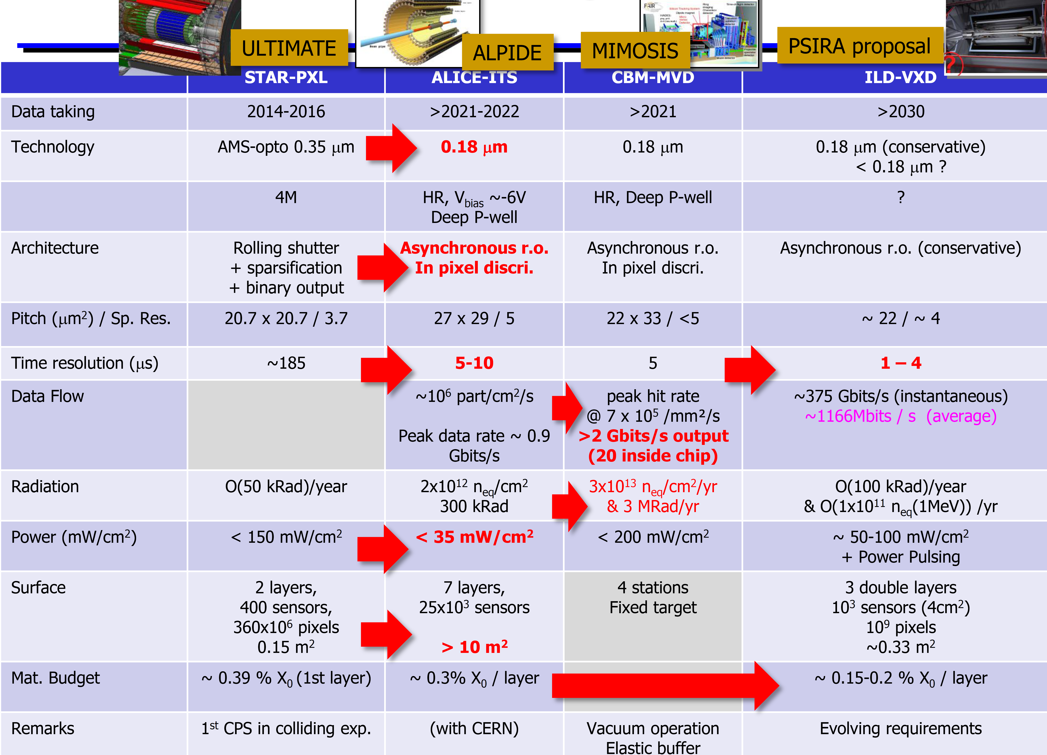
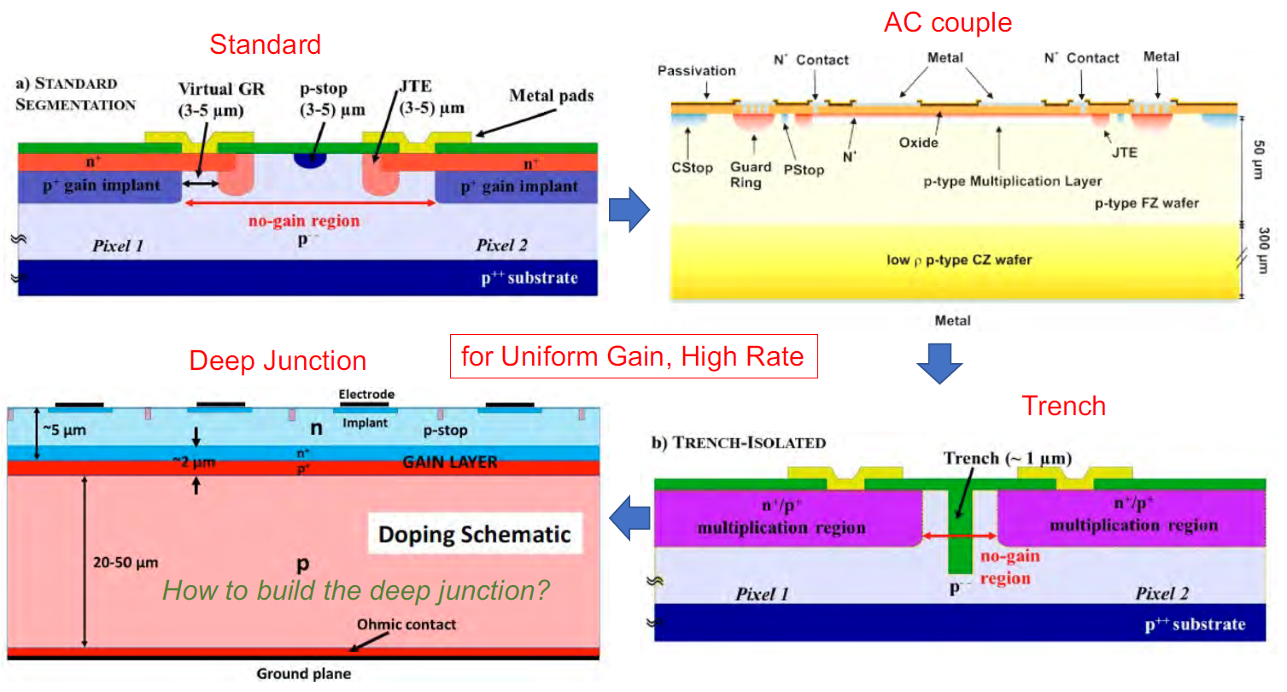
The International Large Detector: Tracking System
Paul Colas and Maxim Titov, CEA Saclay, Irfu, France (on behalf of the ILD tracking groups)
ILD (Silicon + Gas) Tracking Concept:
Vertex: Barrel of 3 double layers of Si-pixels
(e.g. CMOS MAPS, DEPFET, CCD, SoI, …)
Intermediate Si-tracker (SIT, SET, FTD)
- SIT/FTD: silicon pixel sensors (e.g. CMOS)
- SET: silicon strip sensors
Time Projection Chamber with MPGDs
- High hit redundancy (200 hits / track)
→ 3D tracking / pattern recognition;
→ dE/dx (dN/dx) information for PID
Most recent paper on ILD:
ILD interim design report
arXiv: 2003.01116
ILD Vertex Technologies:
Exploiting the ILC low duty cycle 0(10⁻³): triggerless readout, power-pulsing
Readout strategies:
→ continuous during the train with power cycling → mechanic. stress from Lorentz forces in B-field
→ delayed after the train → either ~5μm pitch for occupancy or in-pixel time-stamping
CMOS (CPS): continuous
readout, stiching (STAR))
DEPFET: continuous readout,
75 / 50 um thick (Belle II)
Fine pixel CCD: delayed readout,
5 um pitch, 50 um thickness
SOI: delayed / continuous
readout; suited for 3D integration
DuTiP SoI
(Belle II upg.)
SoI-based 3D integration: rely on high-density in-pixel circuitry, with double-tier “3D” in CMOS TJ 180nm process
Examples of recent CMOS – MAPS developments:
ALICE-ITS3 upgrade drives important R&Ds:
Bending thin (50 um)
Si-layers (MAPS): truly cylindrical, supportless CPS (65 nm)
Industrial stitching & large surfaces for low-mass detectors
TPC (10 m² endcaps) with MPGD Readout:
Ionization for PID and continuous tracking
nicolas duval-destin <nicolasduvaldestin@gmail.com>; kathleen.rougier@gmail.com
Baseline technologies: GEMs, Micromegas, GridPix
Intermediate Silicon Tracker:
Not much dedicated development work recently on Silicon tracking technologies
Baseline solution: silicon-microstrip tracker; also some enabling
technologies (e.g. based on LGAD concept)
Timing Detectors open
up 4D (and 5D) tracking:
Large area detectors
High-precision tracking
→ a few um per layer
High-precision timing
→ tens of ps per layer
Optimal geometrical
acc. (large fill-factor).
Low material (50 μm
thickness per plane).
Micromegas
GEM
GridPix
Target requirement of a spatial resolution of 100 μm in transverse plane and dE/dxresolution < 5% have been reached with all technologies (GEM, Micromegas and GridPix))
STRATEGICAL ISSUES related to adaptation of ILD to other colliders than ILC. Work plan:
Optimize acceptance in the forward region, taking into account specific background conditions
Bunch and train time structure : revise power management and heat removal to adapt to almost continuous beams
Explore how an ILD-like TPC can perform under these high-ionization and high space charge conditions.
Adapt calibration and alignment strategies to these conditions

