Slide 1
Various approaches to ODEs and PDEs
Marcin Chrząszcz
Cracow University of Technology

Slide 2
What are ODEs and PDEs ?
Let y be an unknown function
and F is given:
then an equation of the form
is called ordinary differential equation. If y is a vector function:
and
Then 1 is called system of ordinary differential equations of dimension m
(1)

Slide 3
What are ODEs and PDEs ?
A partial differential equation (PDE) for the function u(x₁,...x_{n}) is of the form:
What do we need to solve them?
Initial conditions

Slide 4
ODEs
All differential equations all usuelly tuff to solve „on paper”.
But numerically their are not so hard to solve.

Slide 5
ODEs methods
Euler method:
BUT BE CAREFULL WITH THIS METHOD!!!!!!

Slide 6
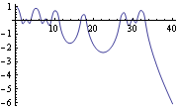
Euler method
In[1] := eqn = z''[t] == -z[t]/(z[t]^2 + ((1 + Sin[2 \[Pi] t]/2)/2)^2)^(3/2);
In[2]:= Plot[Evaluate[ z[t] /. NDSolve[{eqn, z[0] == 1, z'[0] == 0}, z, {t, 0, 40}]], {t, 0, 40}]

Slide 7
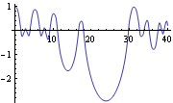
Euler method
In[3] := Plot[Evaluate[ z[t] /. NDSolve[{eqn, z[0] == 1, z'[0] == 0}, z, {t, 0, 40},
AccuracyGoal -> 10, PrecisionGoal -> 10]], {t, 0, 40}]
You can see a small diference ☺

Slide 8
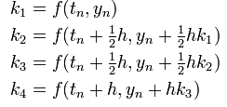
Runge–Kutta methods
Runge-Kutta method 4:
Runge-Kutta are a groupe of methods but RK4 is one of the most popular one.

Slide 9
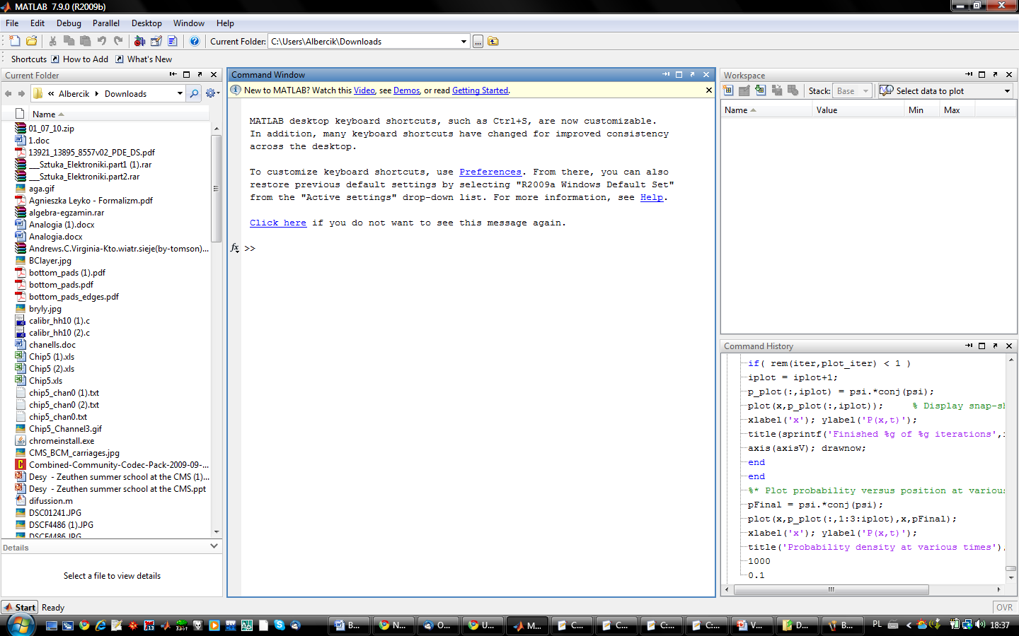
Matlab – THE PERFECT TOOL☺

Slide 10
RK2

Slide 11
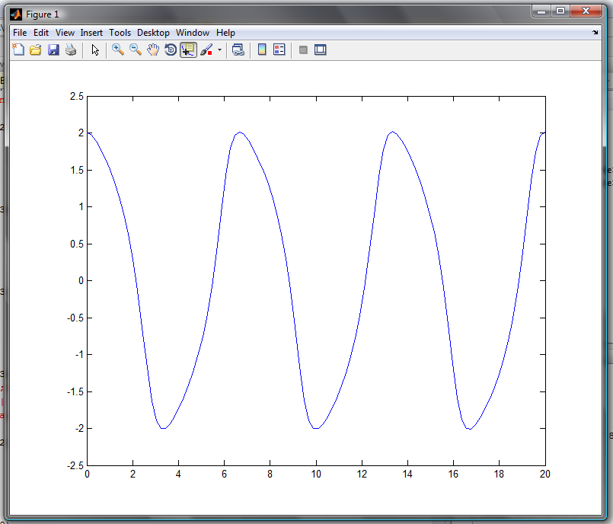
Examples in MATLab
sol = ode45(@vdp1,[0 20],[2 0]);
x = linspace(0,20,100);
y = deval(sol,x,1); plot(x,y);
plot(x,y);
Van der Pol oscillator

Slide 12
Examples in MATLab
function dydt = fl(t,y)
dydt=[10*y(2)-10*y(1); -y(1)*y(3)+99.96*y(1)-y(2); y(1)*y(2)-(8/3)*y(3)];
tspan=[0 3];
y0=[3;1;1]
ode23(@fl,tspan,y0);

Slide 13
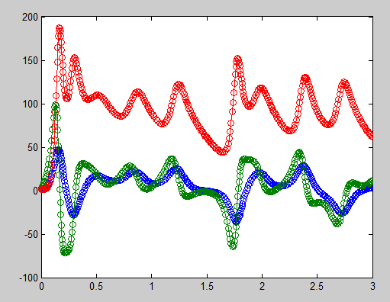
Look out for chaos!!!!!!!!
tspan=[0 3];
y0=[3;1;1]
ode45(@fl,tspan,y0);

Slide 14
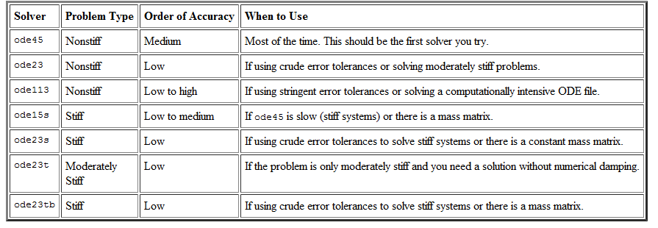
„You simply the best (MatLab)”
You don’t have to implement any algorithms!! All is there

Slide 15
PDEs methods
When it come to PDEs you have to work much harder
Number of methods is large(don’t know every one)
Here will be only about finite difference method

Slide 16
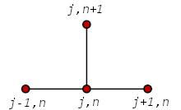
Common methods
Explicit method
There are two explicit methods. One of them has been shown previous week.
Other one is basically very similar. Only difference is that you use backward difference

Slide 17
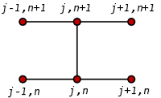
Crank–Nicolson method- state of the art

Slide 18
Example of CN
Diffusion equation
Triangle matrix problem!!! There is a well know algorithm for it

Slide 19
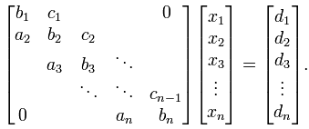
Triangle matrix algortihm
Don’t use Gaussian elemination!!!!!!!!
Great trick method !!!!!!!!
Solution:

Slide 20
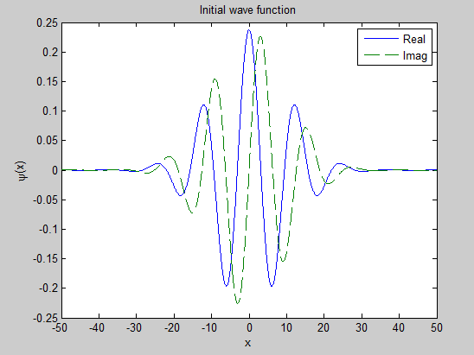
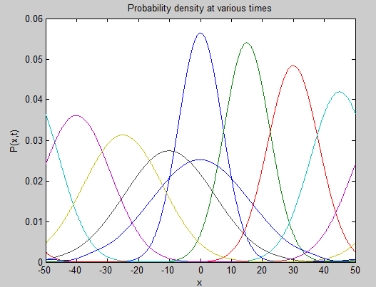
Special case of diffusion equation

Slide 21
Thank you for your attention

