Slide 1
TB21 data analysis MPV distribution for “Anton 1” sensor
Veta Ghenescu, Alina Neagu, Mihai Potlog
Institute of Space Science, Bucharest

Slide 2
“Anton 1” - GaAs sensor – runs for scan position, LSB ~ 1.2
Crt. | Info type | Additional comment | EUDAQ |  | Beam information |  | Pad position |  | LUXE_ECAL - Stack description |  | Non-empty events
 |  |  | Run number | Events | Rate [kHz] | Energy [GeV] | X_pos, [mm] | Y_pos, [mm] | nb of W plates | GaAs w/ traces | Plane 0 | Plane 1 | Plane 2 | Plane 0 - %
1 | run |  | 21 | 1109852 | 0.5 | 5 | 0 | 5 | 0 | anton1 | 32835 | 33 | 231 | 3%
2 | run |  | 22 | 1005386 | 0.5 | 5 | 5 | 5 | 0 | anton1 | 33700 | 32 | 151 | 3%
3 | run |  | 23 | 1036839 | 0.5 | 5 | 10 | 5 | 0 | anton1 | 34929 | 50 | 149 | 3%
4 | run |  | 24 | 1008398 | 0.5 | 5 | 15 | 5 | 0 | anton1 | 34887 | 57 | 175 | 3%
5 | run |  | 25 | 1131320 | 0.5 | 5 | 20 | 5 | 0 | anton1 | 36815 | 49 | 224 | 3%
6 | run |  | 26 | 1040800 | 0.5 | 5 | 25 | 5 | 0 | anton1 | 32379 | 54 | 219 | 3%
7 | run |  | 27 | 1006905 | 0.5 | 5 | 25 | 10 | 0 | anton1 | 31869 | 47 | 162 | 3%
8 | run |  | 28 | 1029338 | 0.5 | 5 | 25 | -10 | 0 | anton1 | 30162 | 44 | 194 | 3%
9 | run |  | 29 | 1157375 | 0.5 | 5 | 25 | -30 | 0 | anton1 | 29514 | 47 | 179 | 3%
10 | run |  | 30 | 1016584 | 0.5 | 5 | 20 | -30 | 0 | anton1 | 26241 | 51 | 177 | 3%
11 | run |  | 31 | 1013236 | 0.5 | 5 | 15 | -30 | 0 | anton1 | 26146 | 49 | 181 | 3%
12 | run |  | 32 | 1057989 | 0.5 | 5 | 10 | -30 | 0 | anton1 | 27207 | 48 | 251 | 3%
13 | run |  | 33 | 1041100 | 0.5 | 5 | 5 | -30 | 0 | anton1 | 28971 | 42 | 282 | 3%
14 | run |  | 34 | 1059252 | 0.5 | 5 | 0 | -30 | 0 | anton1 | 29438 | 52 | 285 | 3%
15 | run |  | 35 | 1033126 | 0.5 | 5 | -5 | -30 | 0 | anton1 | 28776 | 40 | 319 | 3%
16 | run |  | 36 | 1116483 | 0.5 | 5 | -10 | -30 | 0 | anton1 | 29440 | 36 | 372 | 3%
17 | run |  | 37 | 1036401 | 0.5 | 5 | -15 | -30 | 0 | anton1 | 26564 | 36 | 283 | 3%
18 | run |  | 38 | 2022866 | 0.5 | 5 | -20 | -30 | 0 | anton1 | 54700 | 80 | 495 | 3%
19 | run | noise level 1.2 | 650 | 1025613 | 0.5 | 5 | 0 | 0 | 0 | anton1 | 27909 | 47 | 78 | 2%
20 | run |  | 652 | 1390730 | 0.5 | 5 | 0 | -10 | 0 | anton1 | 38005 | 70 | 118 | 3%
21 | run |  | 653 | 1009584 | 0.5 | 5 | 0 | -15 | 0 | anton1 | 28330 | 35 | 194 | 3%
22 | run |  | 654 | 1010424 | 0.5 | 5 | 0 | -20 | 0 | anton1 | 29965 | 42 | 167 | 3%
23 | run |  | 651 | 1018356 | 0.5 | 5 | 0 | -5 | 0 | anton1 | 28754 | 40 | 81 | 3%
24 | run |  | 655 | 1008564 | 0.5 | 5 | 0 | 0 | 0 | anton1 | 20948 | 0 | 0 | 2%
25 | run |  | 81 | 1253282 | 0.5 | 5 | 0 | 0 | 0 | anton1 | 78275 | 0 | 0 | 6%
26 | run | large statistics | 684 | 10676465 | 0.5 | 5 | -7.1 | -14 | 0 | anton1 | 454285 | 1 | 1114 | 39%

Slide 3
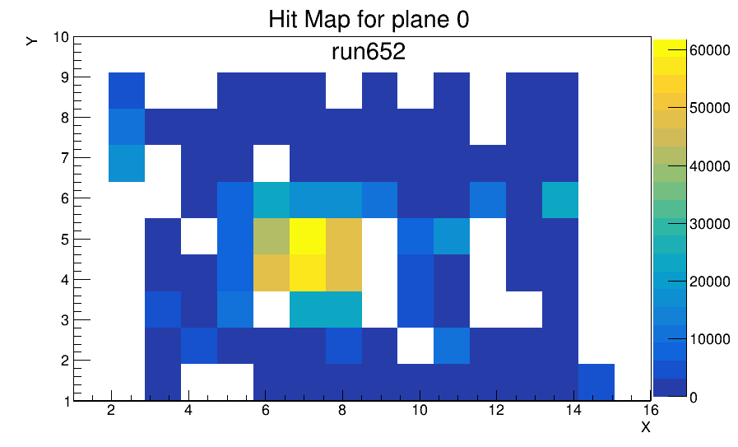
 | 7 | 27 | 47 | 8 | 28 | 48 | 68 | 88 | 108 | 63 | 83 | 103 | 123
 | 5 | 25 | 45 | 6 | 26 | 46 | 66 | 86 | 106 | 61 | 81 | 101 | 121
 | 3 | 23 | 43 | 4 | 24 | 44 | 64 | 84 | 104 | 59 | 79 | 99 | 119
 | 1 | 21 | 41 | 2 | 22 | 42 | 62 | 82 | 102 | 122 | 77 | 97 | 117
 |  | 19 | 39 | 0 | 20 | 40 | 60 | 80 | 100 | 120 | 75 | 95 | 115
 |  | 17 | 37 | 57 | 18 | 38 | 58 | 78 | 98 | 118 | 73 | 93 | 113
 |  | 15 | 35 | 55 | 16 | 36 | 56 | 76 | 96 | 116 | 71 | 91 | 111
 |  | 13 | 33 | 53 | 14 | 34 | 54 | 74 | 94 | 114 | 69 | 89 | 109
 |  | 11 | 31 | 51 | 12 | 32 | 52 | 72 | 92 | 112 | 67 | 87 | 107 | 124
 |  | 9 | 29 | 49 | 10 | 30 | 50 | 70 | 90 | 110 | 65 | 85 | 105 | 125

Slide 4
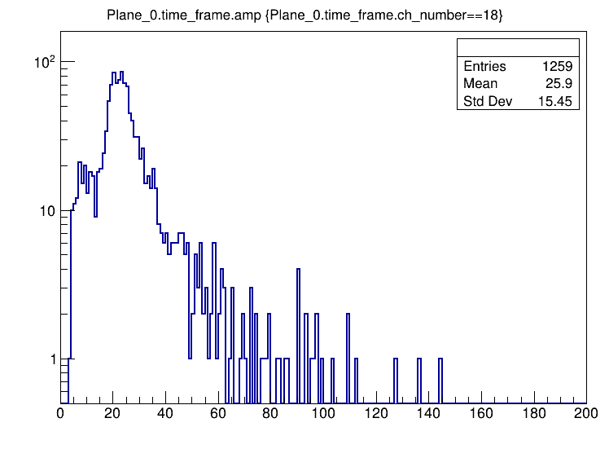
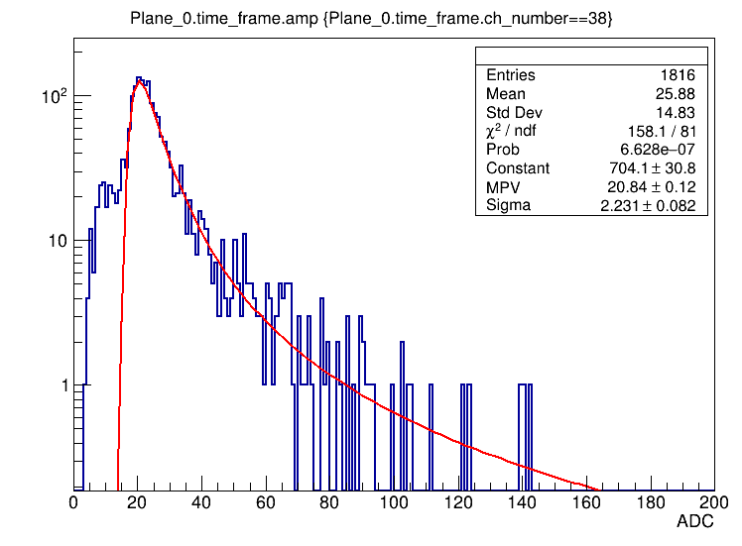
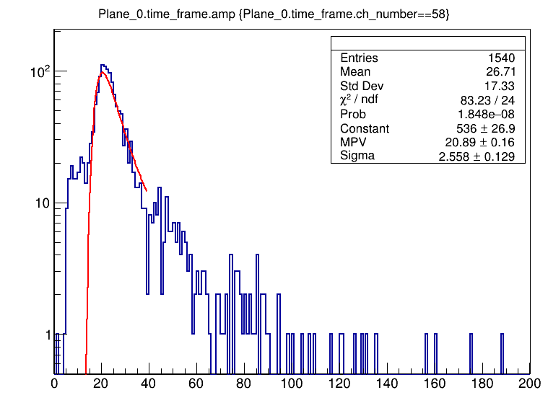
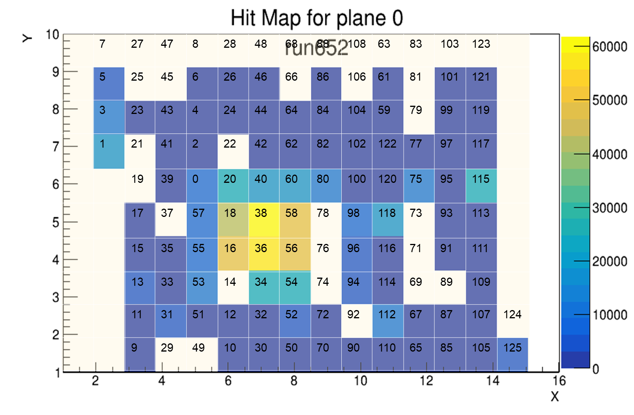
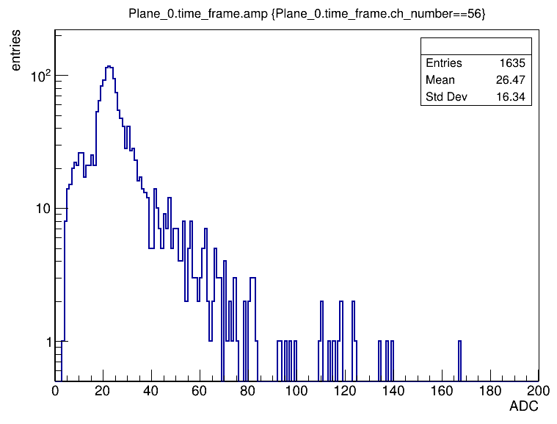
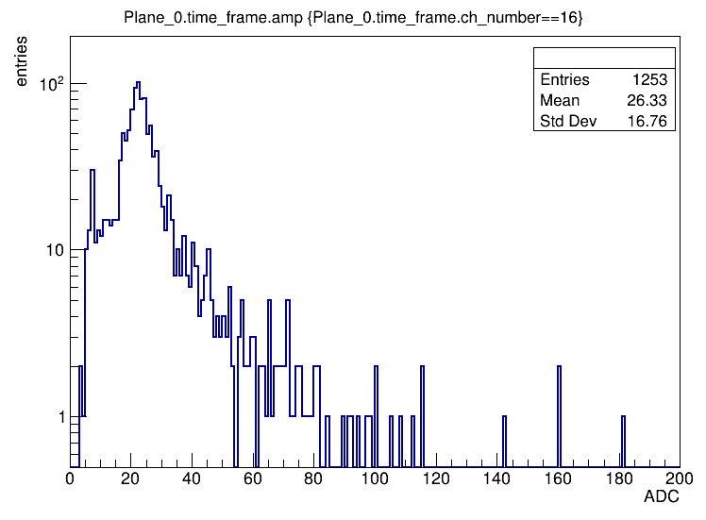
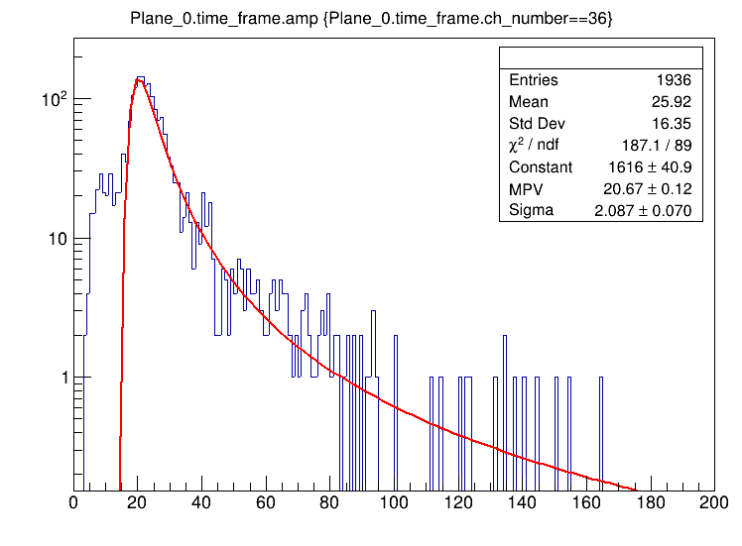

Slide 5
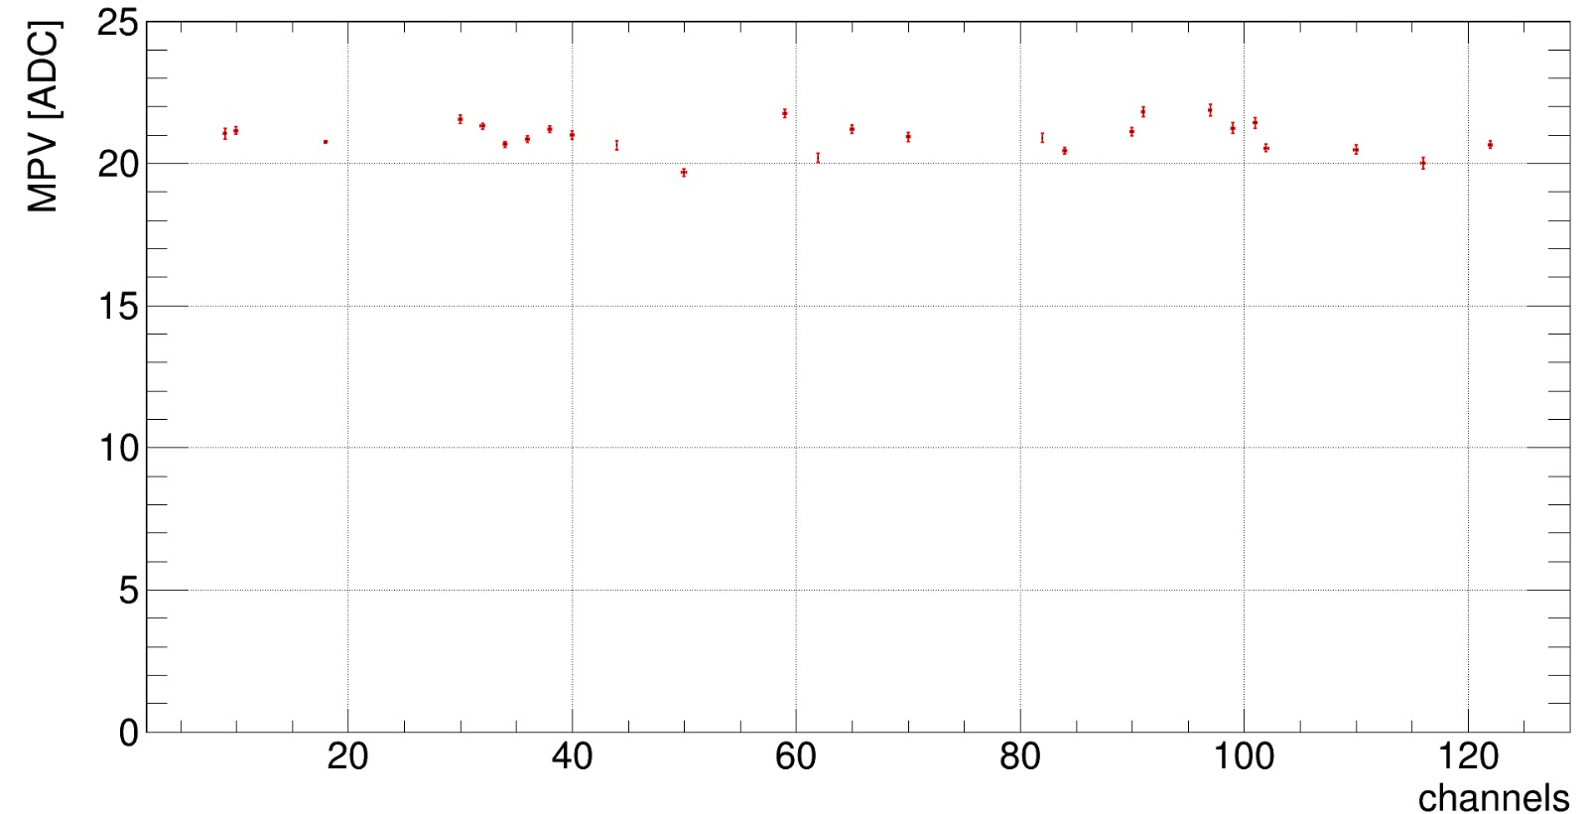
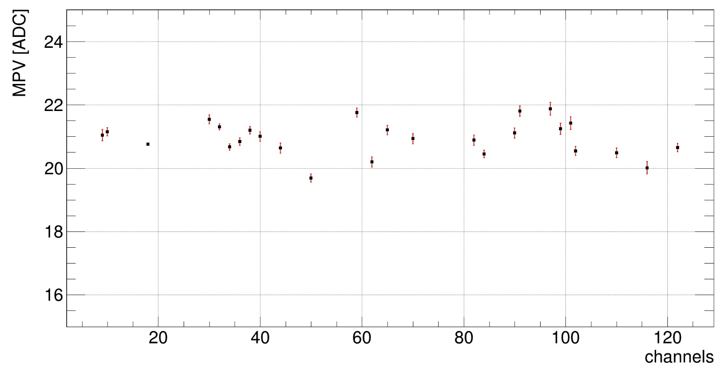
MPV of signal distribution for 26 channels from GaAs sensor – “Anton 1”. All runs without W plate in front of the sensor.

Slide 6
