Slide 1
Gamma Group Meeting
News
Introduction Jowita, Vanessa
CTA MST South pathfinder plan
If time remains then we will do a social fade-out in breakout rooms
17 March 2022

Slide 2
Dates 2022
12.-13.05, APC 7 (Zeuthen) – new date!
25.05. Colloquium Iftach Sadeh
9.-10.06, APPEC Town Meeting (Berlin, Brewdog)
22.06., DESY Sommerfest
15.-16.11, APC 8
Big conferences coming up:
  EAS, COSPAR, Gamma
Anything else?

Slide 3
General news
Ongoing ESA M7 call (see spare slides for more details)
  Developing DESY proposal for contribution to ASTROGAM
  THESEUS probably not…
  If anyone interested in contributing come and talk to me…
Mobile work rules updated, announcement soon
  In post-Corona times, up to 50% working from home can be done, in communication with line manager (average time agreement would be formalized)
  Mobile work place must be in Germany
  For us: there are of course very convenient aspects of working at home, but then communication, networking, working on Campus at the institute are also essential
  This is in particular true for students and postdocs, please keep this in mind
  My feeling is that soon we should all move to a work mode again that is mostly on site (e.g. I’m present 3 to 4 days a week at DESY or HU Berlin…)

Slide 4
Office Roulette
Confluence page: https://confluence.desy.de/display/DESYAstroparticle/Gamma+Group+Office+Roulette
  Linked from main starting page of DESY AP Confluence space
Reserve office whenever you want to come
Be prepared that others sit at your desk sometimes (key permissions for all of us to all of our offices)
CTAO SDMC may also access our offices and desks from now on

Slide 5
Ukraine
Measures following the war in Ukraine…
  DESY Scientific Committee meeting tomorrow (Sylvia and myself are members…)
  All collaborations with Russian institutes suspended (not stopped for good), this ranges from suspending high-profile projects (eROSITA, XFEL) to freezing ongoing publications
Guests from the Ukraine are hosted currently in our Hostels (Zeuthen and Hamburg) and various support programmes for scientists and students affected by this war exist

Slide 6
Science news
O4 schedule update:
  https://www.ligo.org/scientists/GWEMalerts.php
  Seminar with further details about plans end of April
  Engineering run from mid November 2022, alerts may be released, science run mid December 2022 onwards
Snowmass paper gamma rays (MeV to EeV): https://arxiv.org/pdf/2203.07360.pdf
RS Oph paper published: https://www.desy.de/news/news_search/index_eng.html?openDirectAnchor=2249&two_columns=0

Slide 7
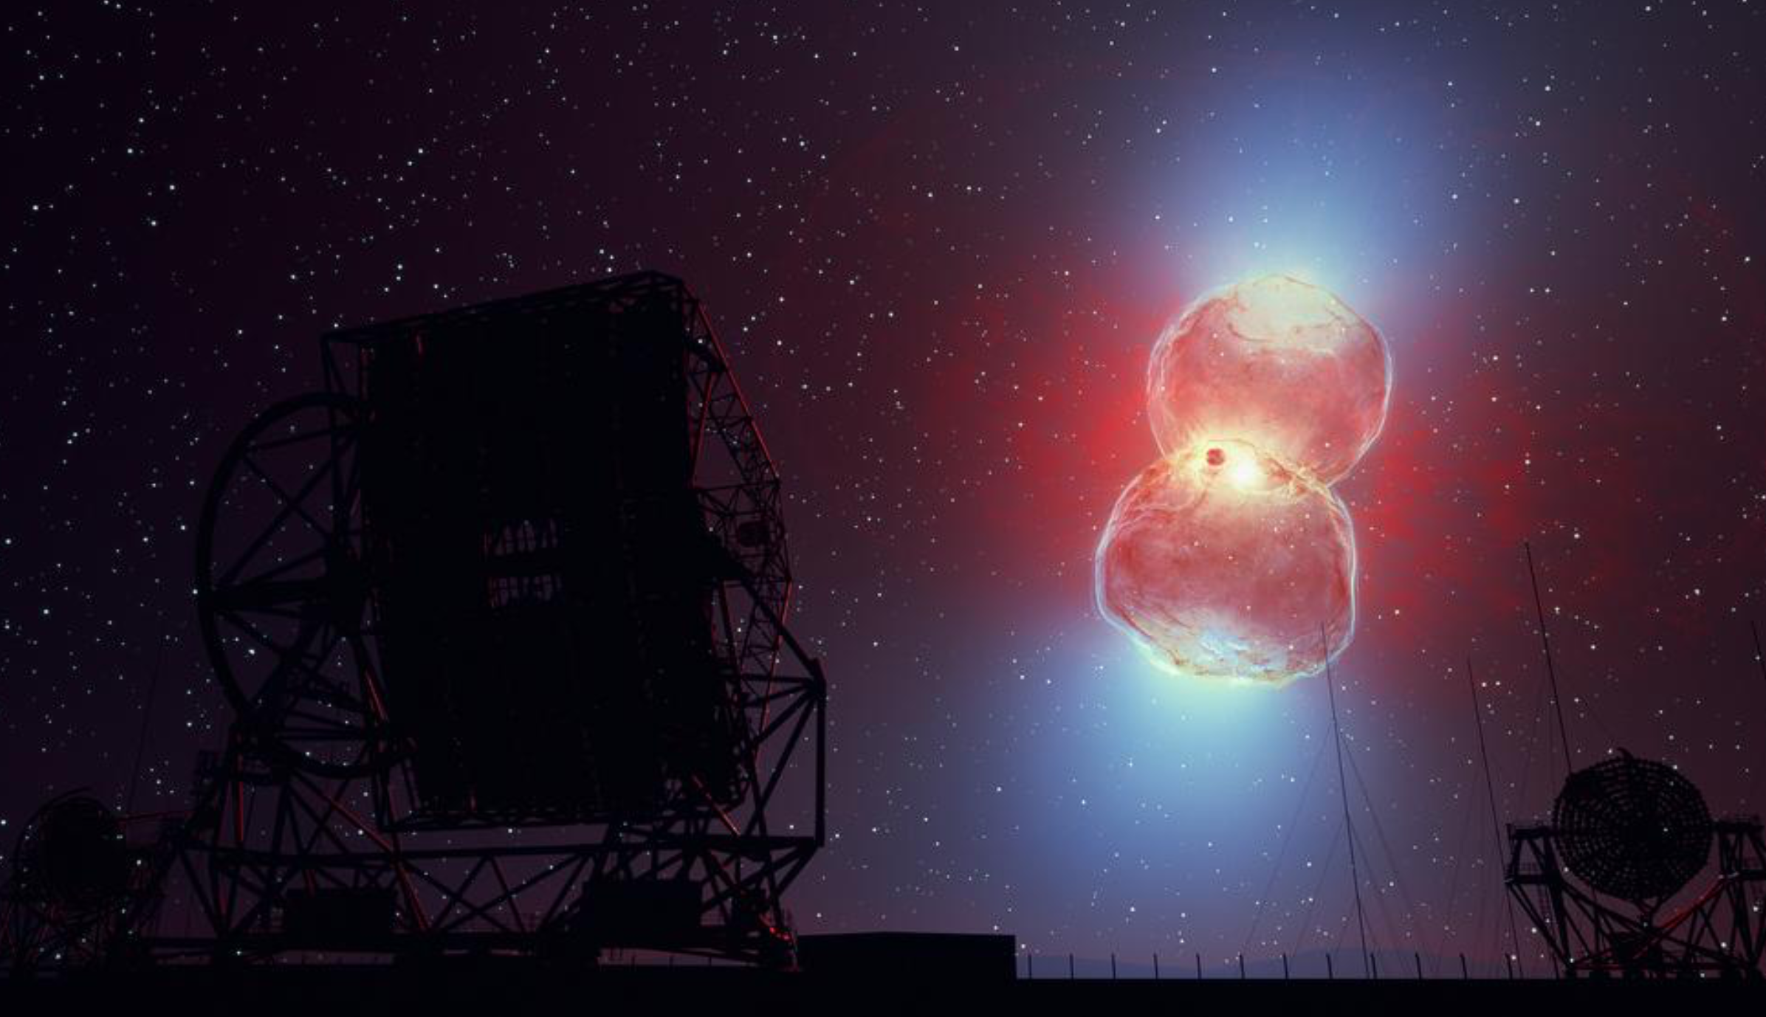
Congratulations to everyone involved!

Slide 8
Introduction
Jowita Borowska
Vanessa Montes

Slide 9
CTAO Council Meeting and MST Pathfinder
Biggest news: construction started in Chile (next slide shown by Project Manager Wolfgang Wild)
Founding of Observatory (as an ERIC): commitment letters Spain and Germany (after change of government) still missing ☹

Slide 10
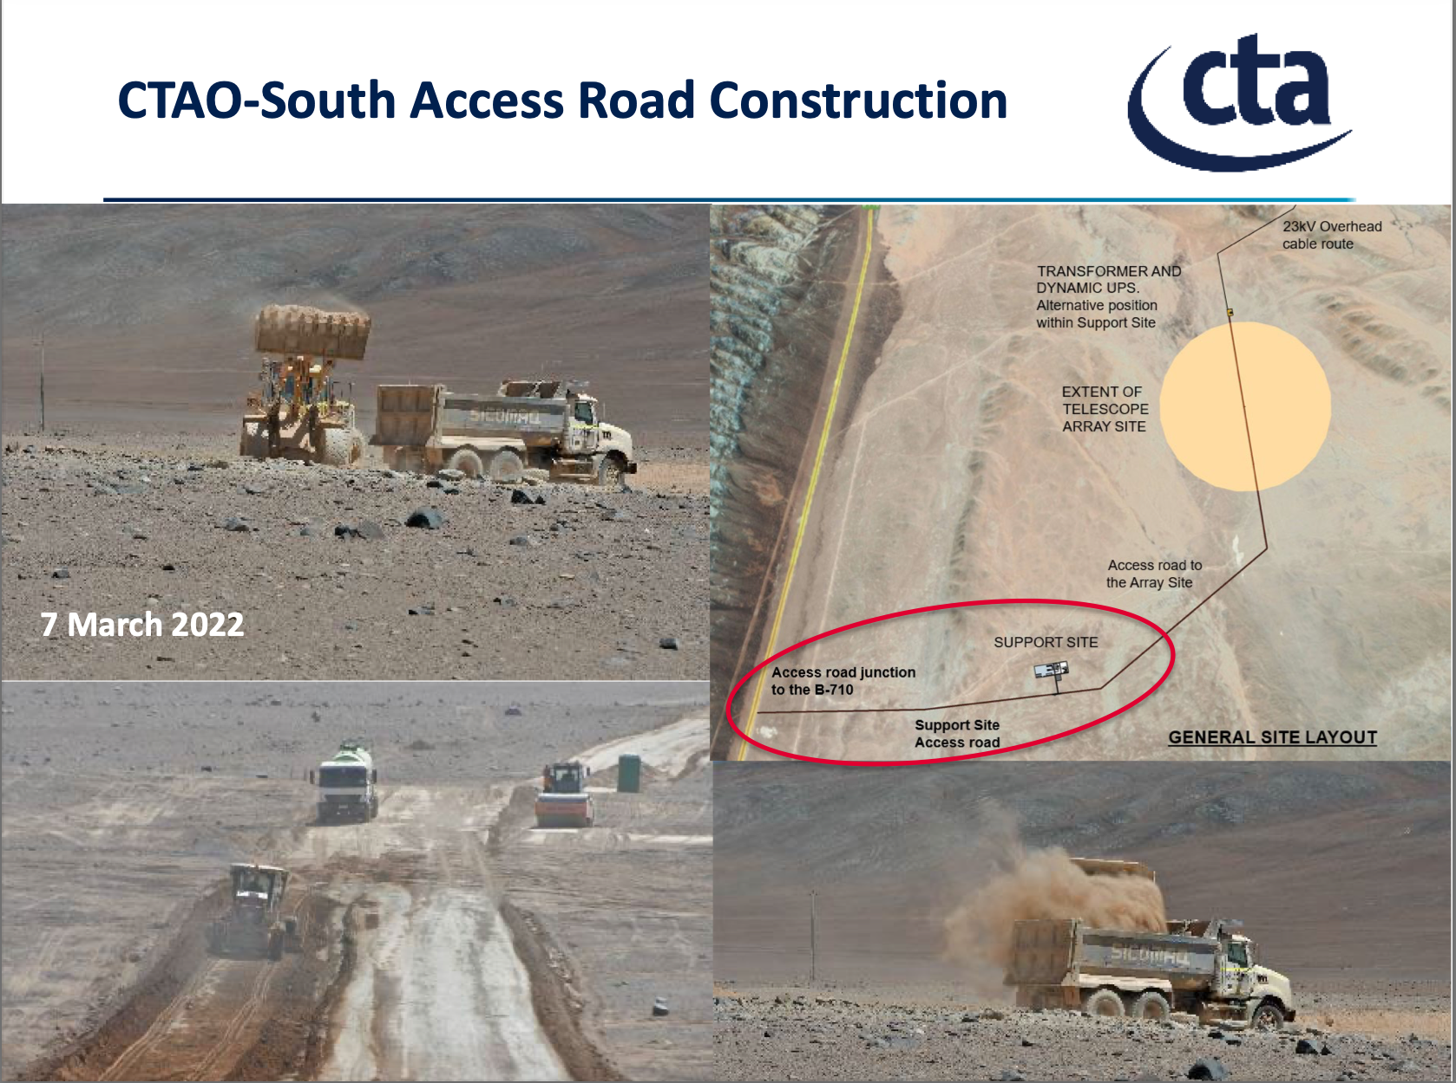
CTAO Council Meeting and MST Pathfinder
Biggest news: construction started in Chile:

Slide 11
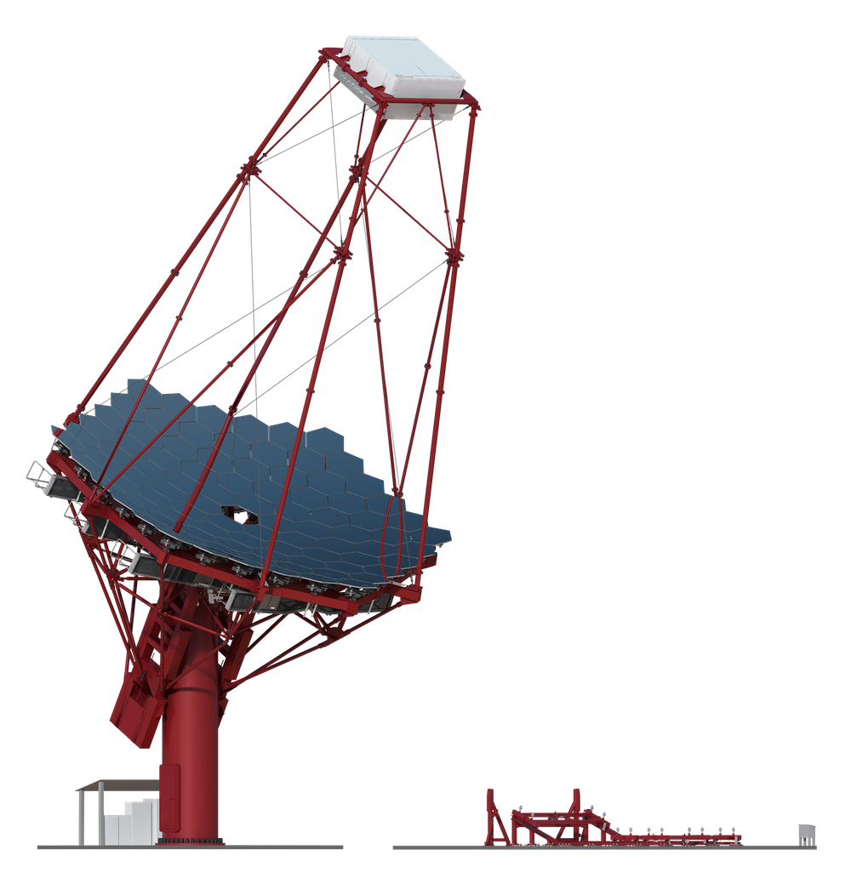
MST South Pathfinder Proposal
D.Berge (DESY), Jim Hinton (MPIK), Jean-François Glicenstein (CEA)
on behalf of the MST partners

Slide 12
MST Pathfinders/Pre-production Telescopes
A key part of our strategy for the MST is to first gain on-site experience with pre-production/pathfinder telescopes before moving to mass production
Final costs and risk of project are thereby reduced significantly
Benefits of a pre-production – gap – production approach:
  Collect experience with site-specific challenges
  Exercise construction and assembly including logistics, administrative aspects, local companies
  Provide time for a lessons learnt cycle → lower total costs!
  The actual construction will be quicker and hence reduce costs further
After initial interactions with and positive reactions by CTAO and ESO we propose to construct 1 early MST in Chile at a temporary site
  The telescope will be moved to the final site once that’s ready

Slide 13
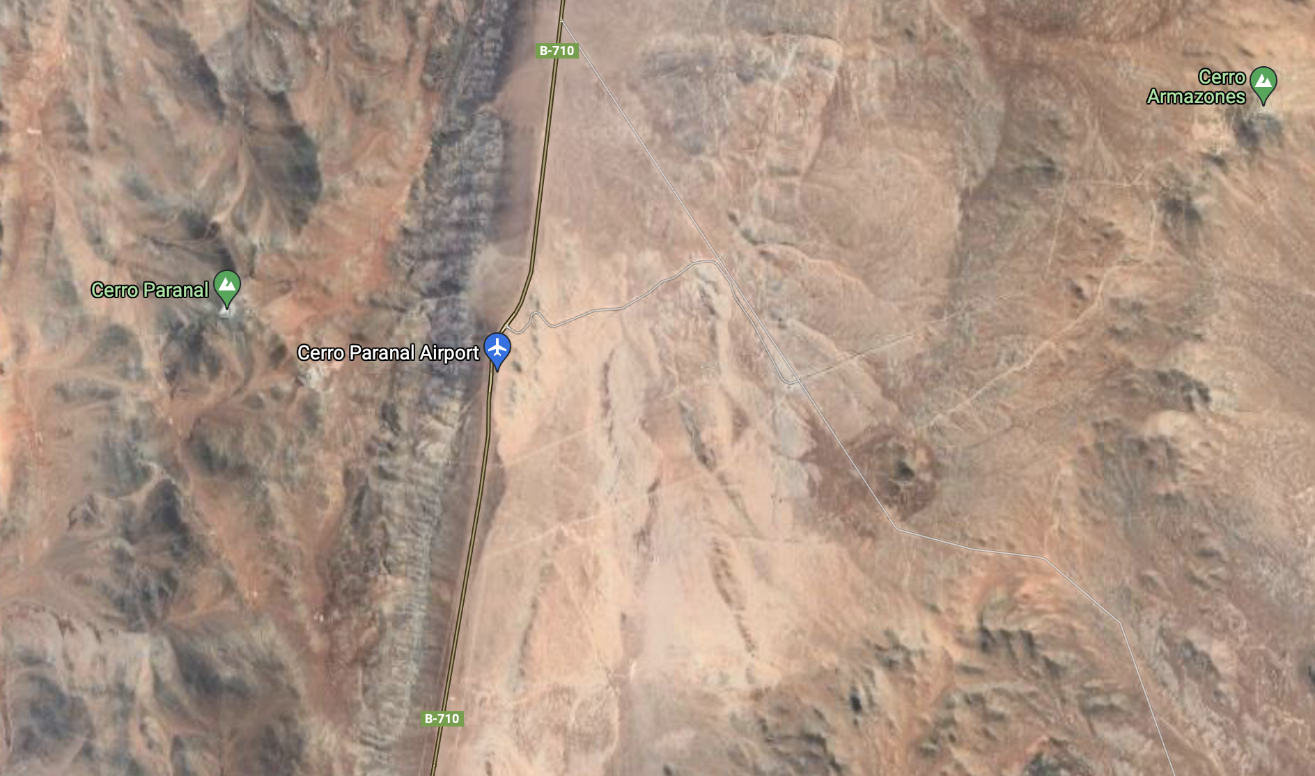
Potential site
Pathfinder site on ESO premises, exact location TBD
Final site (not ready before 2025)
~ 10 km
google

Slide 14
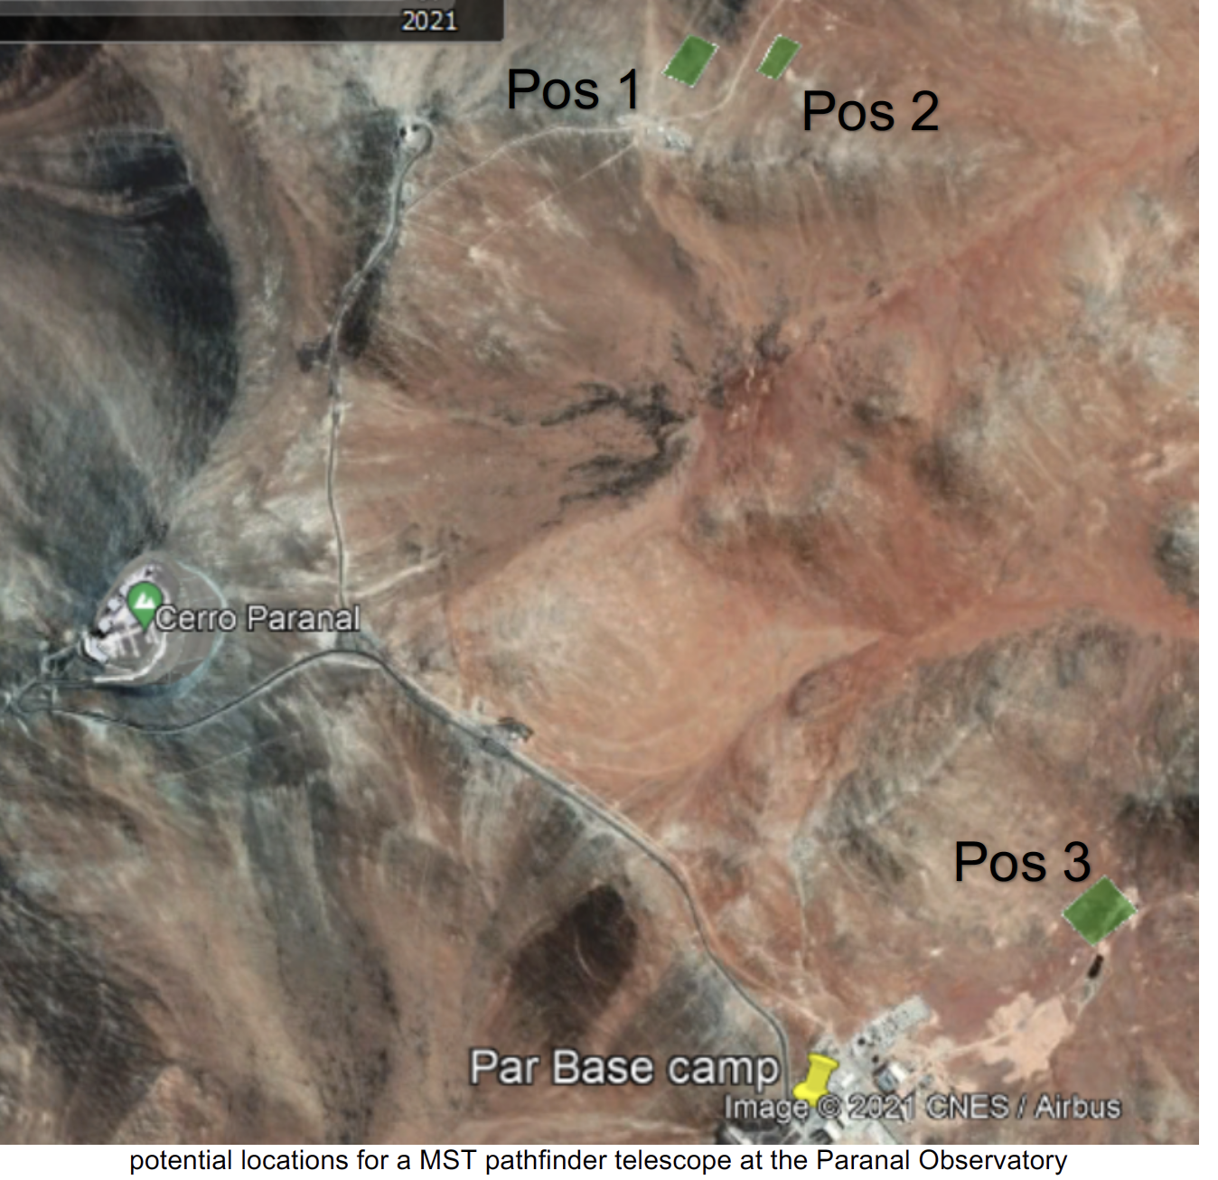
Potential Site
Pos 1 & 2 near operating ESO telescopes
  Choose location after geotechnical study
Pos 3 at ESO Paranal base camp
  Disfavoured due to potential light pollution and interference with ELT construction activities
Material provided by CTAO

Slide 15
MST South Pathfinder Cost Overview
Partners

Slide 16
MST South Pathfinder Indicative Schedule

Slide 17
MST South Pathfinder Next Steps
Request for Council approval today
  See more detailled plans in Council document linked to the agenda page
Discussions between MST partners – CTAO – ESO to finalise the pathfinder plan and setup agreements needed
Conduct relevant reviews to approve final designs (preparations in progress)
Commence tendering of telescope structure components

Slide 18
Summary
The MST Partners propose the construction of 1 MST Pathfinder telescope near the CTAO South site
The telescope and camera design are mature and to the best of our current knowledge final
The telescope will be transferred to the final site later
The telescope assembly is anticipated for Q3 – Q4 2023
We see a large number of benefits (costs, schedule, risk)
We are enthusiastic to commence CTAO telescope construction in Chile before long

Slide 19
Spare slides

Slide 20
ASTROGAM Proposal ESA M7 Call
ESA M7 call for F (“Fast”) and M (“Medium”) mission proposals
  https://www.cosmos.esa.int/web/call-for-missions-2021
Letter of Intent type of proposal (phase-1 prop.) due today
Feasibility selection and invitation for full (phase-2) proposal mid April for submission 15 July 2022
Selection of three proposals for implementation study phase November 2022
M mission:
  Implementation study 2023 to 2026, mission selection 2026, mission adoption 2029, launch 2037
  ESA cost cap 550 M€, payload typically on top
  Payload mass limit 1500 kg, Vega C or Ariane launch, 3 year mission phase
F mission:

Slide 21
ASTROGAM Proposal ESA M7 Call
F mission:
  Mission selection (including backup candidates) for implementation study 2023 to 2026, mission adoption Q1 2026, launch ~ 2030
  ESA cost cap 175 M€, payload typically on top
  Spacecraft mass limit 450 kg, payload typically 100 kg, Vega C launch, 2 year mission phase
Two M class proposals of interest for us:
  THESEUS, GRB monitor, large FoV, soft keV monitor plus keV to 10 MeV spectrometer (was finalist of M5 phase A, where Venus orbiter EnVision was selected)
    https://link.springer.com/journal/10686/volumes-and-issues/52-3
    So far German contribution only IAAT Tübingen, further support under discussion
  ASTROGAM, gamma ray survey instrument, Si tracker plus calorimeter, 1e5 to 1e9 eV, third attempt (M4, M5)
    https://arxiv.org/abs/2102.02460
  Expect only one of the two, or none, will be chosen in November

Slide 22
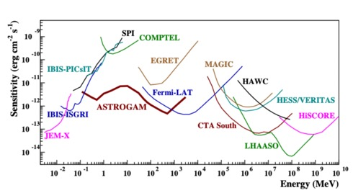
ASTROGAM plans
Point source sensitivity 2 years, preliminary
Significant German contribution planned (DLR funding plus institutes)
  Provisional agreement that Germany leads the Si tracker development and construction
German groups interested in instrument contributions: DESY, Erlangen, Mainz, Tübingen, Würzburg
Discussions German community and within DESY now to July 2022

