Slide 1
High Speed Direct Sampling Analog to Digital Converters Oblique answers to a number of hypothetical questions that I presume would be of interest to a certain percentage of those involved in particle physics
Derek Redmayne
Linear Technology

Slide 2
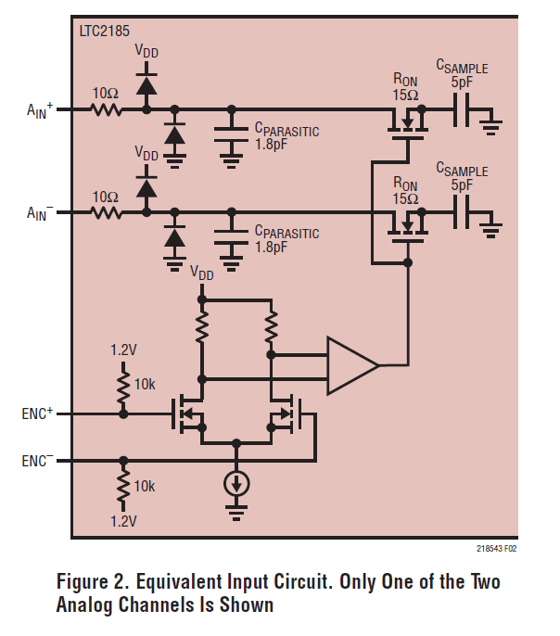
Assume the ADC is a Passive Mixer
The Same mixing products,
Sum and difference products N*fs +/- fin
Result of the commutation of the sample capacitors
Multiplies all spectral content on clock with all content on analog input, aliased into DC-Nyquist
Analog Input BW 500MHz to 1.2GHz
Clock Input BW = 2 to 3 GHz
Phase noise on clock (LO) produces phase noise on every carrier (blocking noise figure)
Phase noise multiplied by under-sampling ratio
Output of the ADC sampler is not selectively band limited, does not integrate,
ENC an be more demanding than the LO of a mixer
Discrete time, not essentially continuous like a mixer.

Slide 3
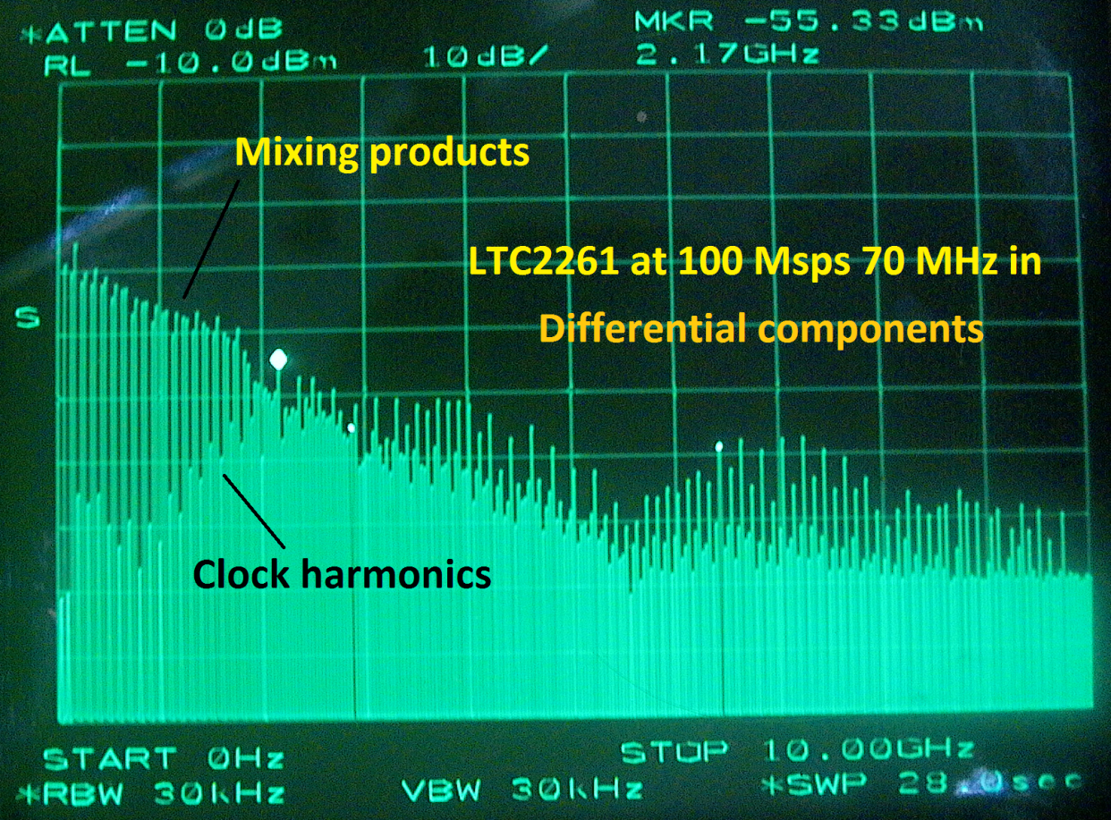
Spectral power distribution of mixing products from direct sampling

Slide 4
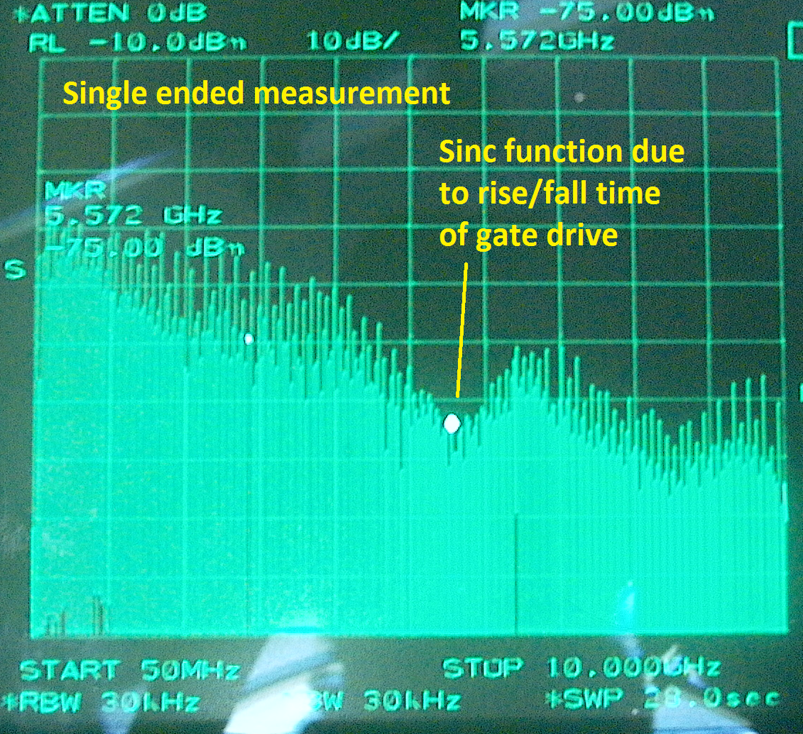
Common mode clock products

Slide 5
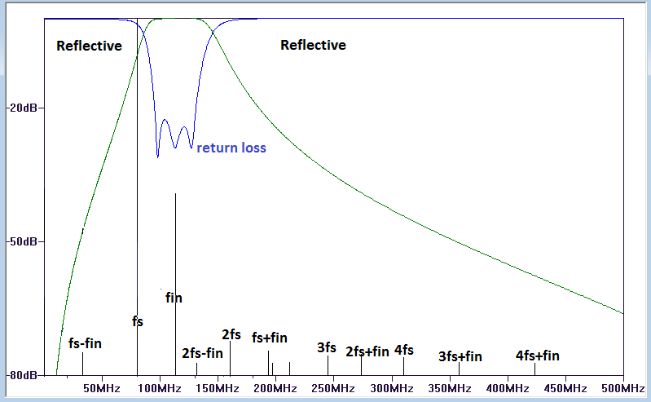
Reflective Filters and Mixing Products
Looking back into a filter...If regions of the spectrum with poor return loss coincide with the frequencies of mixing products, the ADC may see a loss of SFDR.
Transmission line lengths, Impedance, settling times of amplifiers, even dvdt of clock drive play into this game

Slide 6
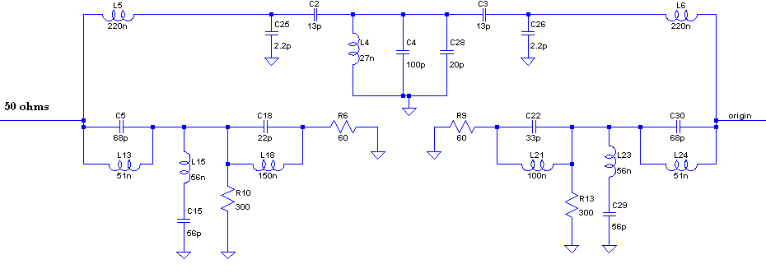
Absorptive filters and diplexers
An absorptive band-pass filter will absorb most of the out of band mixing products

Slide 7
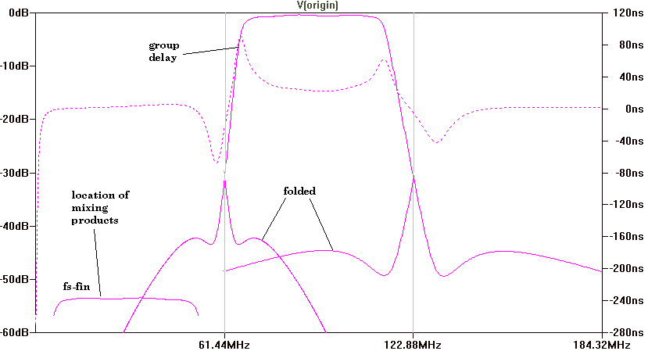
Absorptive filter S21
Pass-band , group delay and illustration of aliasing of 1st and 3rd Nyquist zones

Slide 8
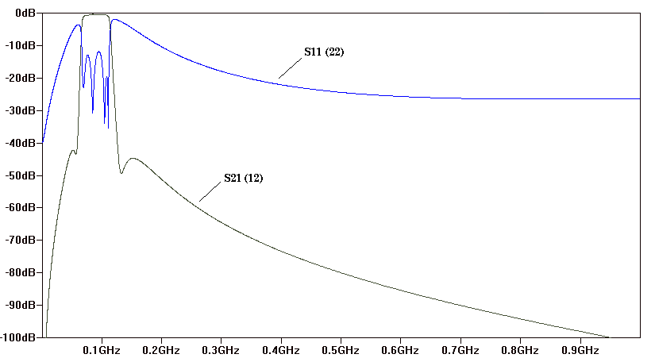
Return loss (S22 and S22)
Resulting in more consistent SFDR with changes in sample rate (6 dB is generally good enough)

Slide 9
Other absorptive mechanisms
A Diplexer with a dummy load on the high-pass port can produce nearly the same benefit as an absorptive filter, even though it absorbs only higher frequency mixing products.
An Isolator, or a Circulator with dummy load can produce good results at considerable expense.
A 1 dB pad can produce 5dB improvement in SFDR if recursive absorption can occur

Slide 10
Implications of Asymmetry
Non-linear common mode components will be returned to ADC in differential form by any asymmetry in the input network.
There is always ground bounce present on silicon devices, as they are only grounded through bond wires
Asymmetry produces loss of CMRR on differential ports

Slide 11
Long differential pairs feeding the analog input can produce RFI.
Mann muss:
Suppress the 1-5 GHz components near the ADC
(To reduce antenna efficiency as a radiator)
Bury an extended differential pair between copper planes
Create separate compartments for this network, (possibly including the ADC) and the RF front end.
Reduce VSWR (in even mode)
Even though the input pair is routed as a differential pair, If on the surface, over some distance, it will radiate common mode clock harmonics. These will be received by an RF front end (mixer) in the same enclosure.

Slide 12
Variations in Approach
Some series of ADCs benefit from critical common mode damping . (LTC2208 family no center-tap)
Generally, correct termination, for all transmission lines involved, for both odd mode, and even mode is advised.
However, 1.8V parts perform better with low common mode impedance (center-tap)
Distance plays a part (e.g. center-tap can be at wrong distance)
End termination after the ADC seems best for 1.8V parts (maybe all parts)

Slide 13
The implication of Distances to impedance discontinuities
75-100 psec may be the wrong distance at which to place an impedance discontinuity.
Returns an echo of initial disturbance conducted into the channel, non-linear charge injection, from sample gate drive
1/2 clock period is also the wrong distance
Returns non-linear disturbance from reconnection of previous sample
Commutation in the presence of protection diodes is the cause in latter case

Slide 14
Impedance Matching for track mode!?
Only for very wide band, fast settling networks, not with aggressive high Q filters
May be OK for high frequency, and wide Band-pass filters
Must settle completely in less than ½ clock cycle

Slide 15
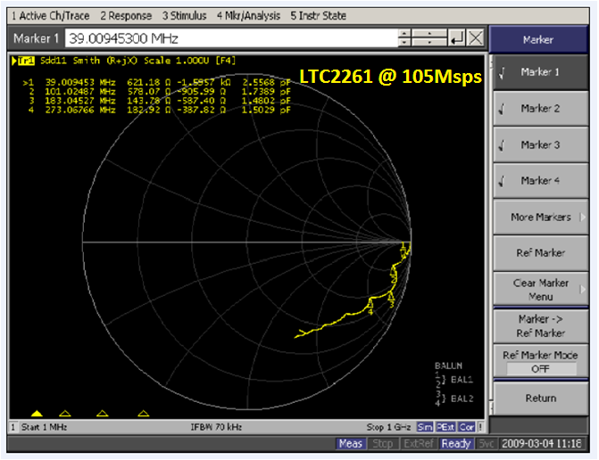
Smith Chart
Commutation between the two states, track and hold, causes dissipation (loss) in the sample switches, the effect of which is integrated by any filter, even simple RC low-pass.
Chart shows one input of two, reference plane at the pin
Interaction between two ports about -50dB
Independent, Zin=2X single port
Location of the jogs toward 50 ohm center will change with sample rate
Impedance varies in regular sinusoidal pattern with frequency, dropping with input frequency

Slide 16
Complex impedance of direct sampling
Sample capacitor is not discharged
Repetitive discharge of a capacitor produces a real impedance of 1/(C*Hz)
Repetitive reconnection via this impedance to a point effectively 1/2 clock cycle earlier in time produces a rotating vector as frequency is swept through the various Nyquist zones
(not coincident with Nyquist boundaries)

Slide 17
Impedance matching for the integration of two states
It is not practical to produce efficient power transfer (conjugate Match) into the native input impedance of a direct sampling ADC.
Must be in 50-300 ohm system with end termination
50-75 ohm source termination generally OK

Slide 18
Implications of High Source Impedance
Impedance of sampling becomes significant in terms of pass-band ripple

Slide 19
High Z = Inadequate settling / storage of non-linear charge (drop in SFDR)
High Z, high sample rate, ADCs with larger sample caps = bigger problem (LTC2217)
High Z = Significant to disproportionate pass-band ripple (Very approx. ripple = 20*log(1-1/EXP(300/Z))
0.1dB in 50ohms, 1 dB in 200 ohms, 5-6dB at 400-500 ohms
High Z means Poor S11 at higher frequencies or reasonable S11 over very limited band
SFDR Varies with fin and fs
However, SNR does not change (well it does a bit)
1/sqrt(4KTBR) R cancels due to effect on BW)
SNR in ADC product of full power BW folded into one Nyquist zone
Reduced full power BW (Rated BW in 50 ohm system)

Slide 20
End termination and common mode
Termination should provide critical damping of reflected even mode as well as differential end termination.

Slide 21
Differential End termination?
Differential (only) end termination is OK for flux coupled transformers with center-tap
Not suitable for flux coupled transformer without center-tap
It is not suitable for 1:1 Guanella (partial differential end termination OK e.g. 50/50 to AC ground 100 ohms at end of 100 ohm pair)
It is not best for differential filters (no common mode damping)
Minor mismatch between legs of differential can cause severe common mode above pass-band
Common mode ringing in filters, amplifiers with low common mode BW will degrade SFDR due to taxing of the common mode input range of the ADC.
FB Amplifiers may exhibit better results if terminated to AC ground rather than see inter-dependence, and little common mode damping.

Slide 22
Differential filters with little Common mode suppression
Some amplifiers will not tolerate the high frequency common mode transients, and may produce degraded SFDR above a certain sample rate. (ADC not to blame!!) (test above intended sample rate (if ADC family allows)
Mixers, demodulators, high integration tuners on silicon will see compromised results. (They are only grounded through bond wires)
LO feed-through in mixers is often common mode
Devise common mode suppression for GHz mixing products, and for LO and RF bands

Slide 23
Baluns and Transformers
Against popular belief, Surprisingly good!
physically fragile
Inconsistent and poorly specified
Can be best way to communicate between ground planes
(Not with a split between analog and digital grounds of ADC)

Slide 24
Flux coupled baluns, amplitude and impedance imbalance
inter-winding capacitance is not symmetrical and becomes source of amplitude and phase imbalance at high frequencies.
The higher the inter-winding capacitance, the worse the results

Slide 25
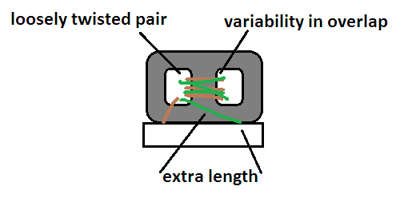
Transmission line transformer or 1:1 Guanella balun
Example MA/COM ETC1-1-13
Best 200 MHz to 500 MHz+ (roughly)
Good common mode rejection for high frequencies
Common mode length Electrically extended by Core (good)
Binocular core produces asymmetry in construction (see exposed leads)
inter-winding C at each loop-through the core
Becomes a wire below few MHz. 20 MHz OK
(3.5uH self inductance)
Coupled Electrical length about wrong length

Slide 26
Crossing gaps with a balun
Flux coupled transformer with low inter-winding capacitance best for lower frequencies
Understand that low frequency mixing products are produced even when under-sampling, and these will not be well blocked by a Guanella Balun (in isolation)

Slide 27
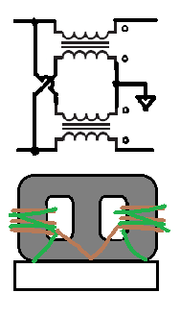
1:4 Guanella
AKA 1:4 transmission line transformer
Two separate transformers on the same core
Not well balanced when used as a balun
One side become transmission line, the other an auto-transformer
Even as a Balanced to Balanced, in combination, generally disappointing when used to drive an ADC.
OK to drive an amplifier

Slide 28
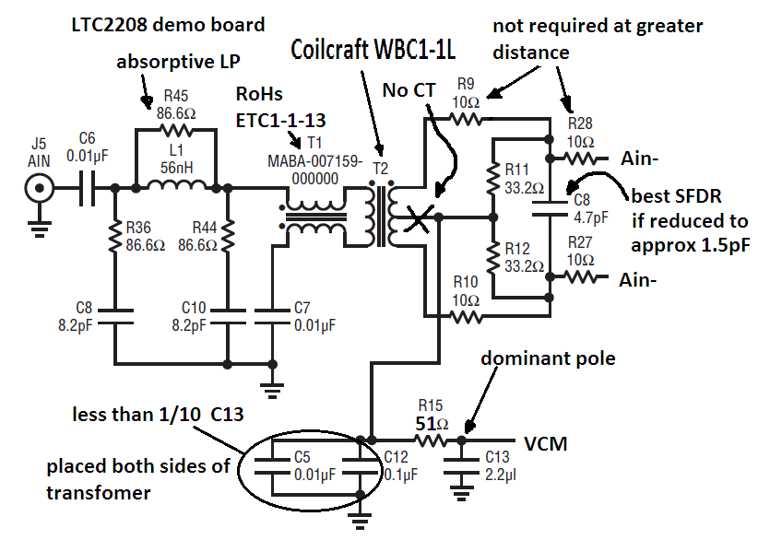
Composite Balun

Slide 29
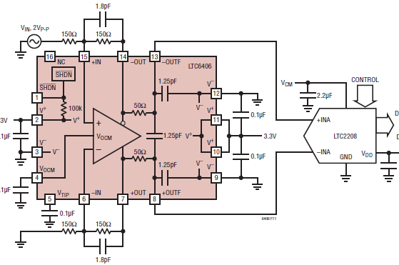
Interaction with Silicon drivers
Only grounded through bond wires Except flip chip (LTC6409)
Frequency content of sample spikes well beyond capabilities of feedback amplifiers
Output impedance of FB amplifiers rises with frequency (to some point)
Envelope detection (rectification) in input stage of amplifier unless protected from ADC
Zero caps make it worse, except you may need them to cancel pole due to pad capacitance

Slide 30
The analog input viewed as the output of the clock amplifier
High VSWR on both analog input and clock can produce instability, like any RF amplifier
Don’t run analog input next to clock
(both positive feedback, and negative FB bad)
Analog input power will phase modulate the clock producing 2nd.

Slide 31
Interaction with High Integration Mixers, Tuners, Demodulators
Common mode transients conducted through differential filters (without common mode suppression) will cause ground bounce in the tuner. (This is a common error)
Resulting ground bounce Will not be rejected by Pseudo-differential inputs on LNA, LO, REF frequency, VCO ports
Especially if you don’t use those ports properly (e.g. returning them to a poorly grounded paddle)

Slide 32
The “anti-aliasing” filter
True anti-aliasing must suppress content beyond 1 or 2* Nyquist zones to the point of insignificance
May mean over 100 dB in scenario with flat spectral power distribution
More if out of band power is higher
Significantly relaxed if there is no out of band power May only require 12-15 dB noise limiting to preserve SNR
May be required to protect amplifier
*2 Zones if image rejection processing in use

Slide 33
Design of the drive network as influenced by physical extent
If a filter with a shunt resonator were at <50psec from the ADC, 5-10 ohm series resistors, to recursively (reiteratively) absorb non-linear charge… produce good results
At 150 psec, final elements should be source termination resistors, or the filter must be absorptive
At 500 psec-2nsec, a filter with a diplexer is fine
If driver is FB amplifier, long transmission lines may not be possible, as it will not tolerate either the load of the transmission lines, the end termination, double termination or high VSWR.

Slide 34
Differential feedback amplifiers as drivers
Usually need BW limiting to one Nyquist zone
(high GBWP for low distortion means much bandwidth)
High order Differential filters difficult above 140 MHz
Need protection from products beyond their capabilities, both on input and output
Low supplies mean little headroom for insertion loss

Slide 35
MESFETS
High frequency content of glitches usually within their capability
Require BP filters to suppress 2nd and 3rd
Poor reverse isolation causes issues
High dynamic range RF power detector prior to RF gain block will see power from sampling
Products passed through into RF section
Variable
However: Best results above 300 MHz
Plug LTC6430

Slide 36
Higher frequency BP filters
Better single ended
Avoid passing recirculation current through ground plane, through vias, through antenna structures
Think about mutual inductance between inductor
Shunt or series inductors at ADC end
No shunt capacitors at ADC end unless very low impedance
Thick traces, same width as pads if possible

Slide 37
Final Filters for out-of-band power
Presence of significant out of band power in final driver alters filter requirements
High Z (reflective, open) out of band with Gain blocks, RF transistors, LTC6430, will cause loss of IP3 due to large excursions developed
Absorptive filters allow excursion to be developed due to out of band power
Sudden appearance of out of band power not initially suppressed by elliptical sections
RF amplifier Shunt resonator at amplifier, with diplexer section at ADC
FB amplifier series resonant input, with features to reduce Q

Slide 38
Filters for band limited power
If band limited prior to final drive, Absorptive best
For differential FB amplifiers, only need some 12-15 dB suppression in neighboring bands
If very flat pass-band required, symmetrical (mirror image) filters best

Slide 39
SAW FILTERS
Yes it has been done
Direct connection
With High FT discrete transistors (emitter followers)
LTC6417 (emitter followers in a BOX)
Watch out for temperature effects on delay

Slide 40
Clock jitter issues
The input frequency determines sensitivity to jitter (not the ADC)
All ADCs nearly the same, ENC input BW may vary
The ADC will translate thermal noise to jitter
Lower dvdt in the threshold region, possibly due to reflections, will cause more internal jitter
Lower power parts will add internal jitter due to reduced power budget for clock receivers
Clock receiver in the LTC2208 consumes more than the entire LTC2145

Slide 41
Clock Architecture Suggestions for under-sampling high frequencies?
It depends

Slide 42
CML
CML appears to me to be the best signaling for demanding architectures and input conditions
Double terminated for both even and odd modes (if routed properly)
PECL only end terminated (source near short)
LVDS only end terminated, and only for odd mode (source open, nearly, sometimes)
CMOS only suitable for source termination, causes ground currents
CML High dvdt without excessive excursion
CML Low additive jitter in fan-out devices
CML High power and high cost

Slide 43
MESFETs and PHempts SiGE InPh HBTs as clock amplifiers
Requires splitters of sorts, and some band limiting (multiport filters)
Can use lower IP3 than input drive amplifiers as distortion does not matter (much)
Reverse isolation not very good
If driving nasty loads, (FPGAs) add buffer to provide reverse isolation into the splitter
Don’t drive hard into compression as they become mixers and will translate high frequency products to baseband

Slide 44
Things not to do with the encode clock
Run it beside the data bus
Even some distance away without barriers
Run it near apertures
Run it through an FPGA
Run it across a gap (except maybe with a transformer, followed by a BP filter)
Use a splitter (0 degree, 90 degree, 180 degree) to drive an ADC and an FPGA
“square it up” after receiving from a back-plane

Slide 45
Other Truths
Logic has noise margin, the clock input does not.
Digital interface can induce Ground bounce and asymmetry in input networks can exaggerate digital feedback.
Poor grounding and bypass exaggerate digital feedback by reducing reverse isolation

Slide 46
Multichannel ADCs to reduce the complexity of clock circuitry
4 channel ADC e.g. LTC2175, has internal clock fan out buffer.
First stage (common) produces approx 50%-60% internal jitter, seemingly bulk of close in jitter contribution is common to all channels
Has higher power budget for the clock receiver than singles or duals

Slide 47
Multichannel ADCs as combiners for feedback amplifiers
Consider a multichannel ADC as a combiner for FB amplifiers
(e.g. DC to daylight, very wide band with sub 50 MHz cut off frequencies and other scenarios where otherwise difficult to achieve very high dynamic range)
Solution or other problematic scenarios (multiple bands, channel for maintaining operation in extreme overload, antenna diversity, directionality, or for phase noise characterization and cancelation.

