Slide 1
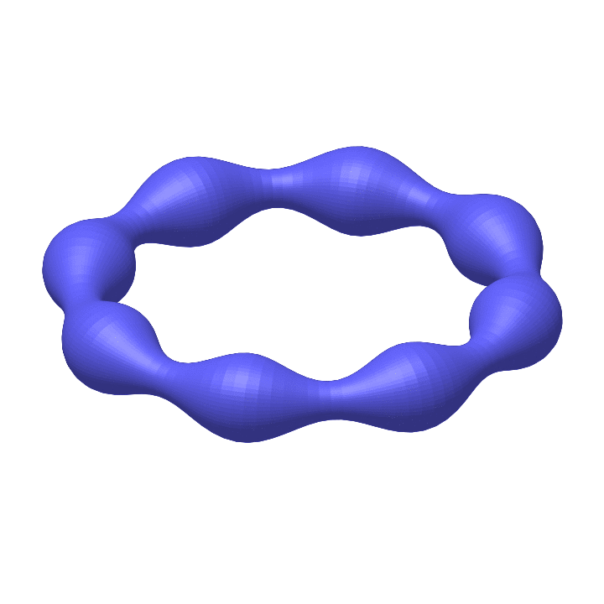
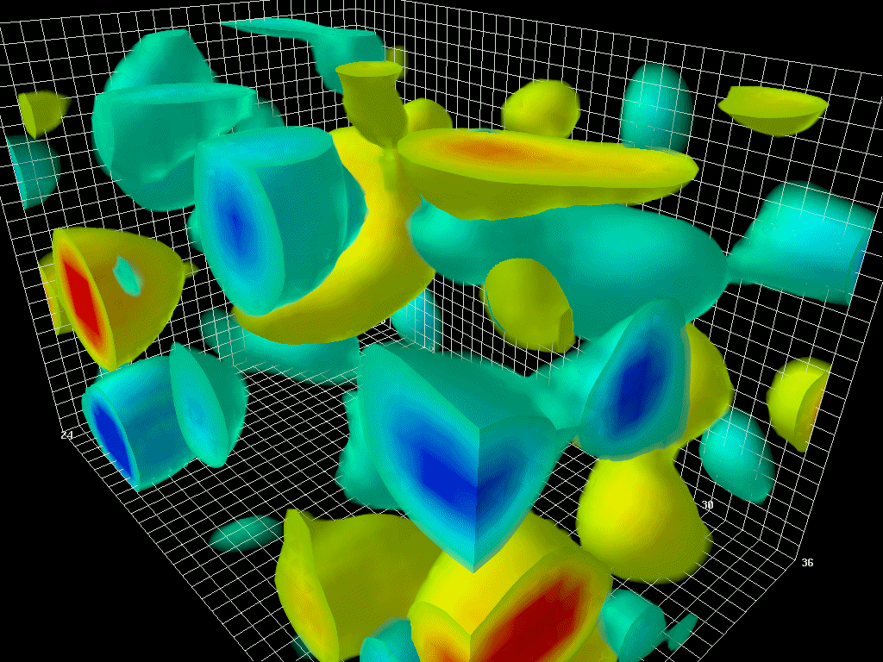
Strings and glueballs in 4D SU(N) gauge theories
HU Berlin/NIC DESY Zeuthen joint lattice seminar
27th – June 2022
Andreas Athenodorou
The Cyprus Institute
Courtesy to D. Leinweber
Work in collaboration with Michael Teper, based on arXiv:2205.03642 & 2112.11213

Slide 2
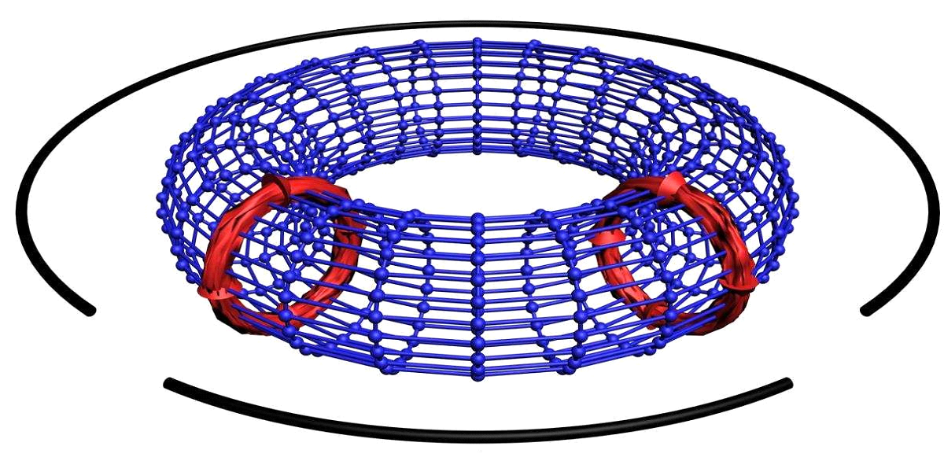
Confining Strings and the worldsheet axion
Part 1.

Slide 3
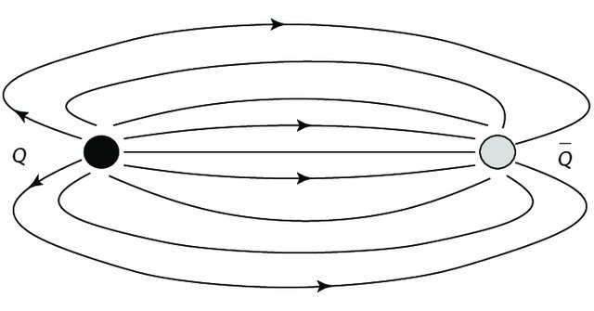
1. Generalities
In QCD quarks are confined in bound states by forming flux-tubes of chromo-magnetic and chromo-electric flux..
Long flux-tubes behave pretty much like strings.
At some point they break (string breaking).
Of course we need fermions (QCD) for string breaking.
We work in pure gauge theory.
$V≈σr, \sqrt{σ}≈440$ MeV
There are $D −2$ obvious massless Goldstone modes arising from the broken translation invariance in the $D−2$ directions transverse to the ﬂux tube.
There should be a Low Energy Effective String Theory model describing
the energy spectrum of the flux tube.
In addition to string modes are there other kind of (massive) excitations? $(\sim M_{G}≈1.6 MeV)$

Slide 4
1. Generalities
Is there a theoretical description for the conﬁning ﬂux-tube in (dis)agreement with Lattice data?
Conﬁning ﬂux-tube:
Open Flux-Tube
Closed Flux-Tube (Torelon)
$$\overline{q}$$
Compactify
$$q$$
Pure gauge phenomena are also present such as:
Glueball – Flux-Tube mixing
Flux-tube – anti-Flux-Tube mixing
Possible low-energy eﬀective string theoretical description?
Cannot capture pure gauge phenomena!
Might be possible in the Large-$N$ limit!
Investigate the spectrum of Closed Flux tubes in the Large-$N$ limit
So far: AA, B. Bringoltz and M. Teper, JHEP 1102:030,2011 [arXiv:1007.4720]
AA and M. Teper, PLB 771 (2017) 408 – 414 [arXiv:1702.03717]
AA and M. Teper, [arXiv:2112.1121], AA, [2205.03642 ]

Slide 5
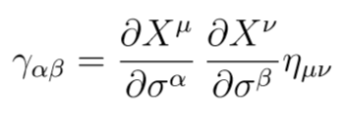
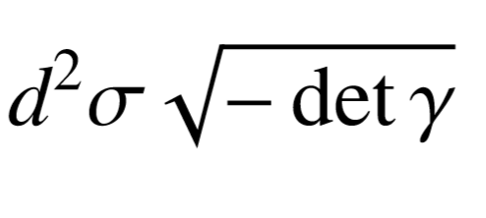
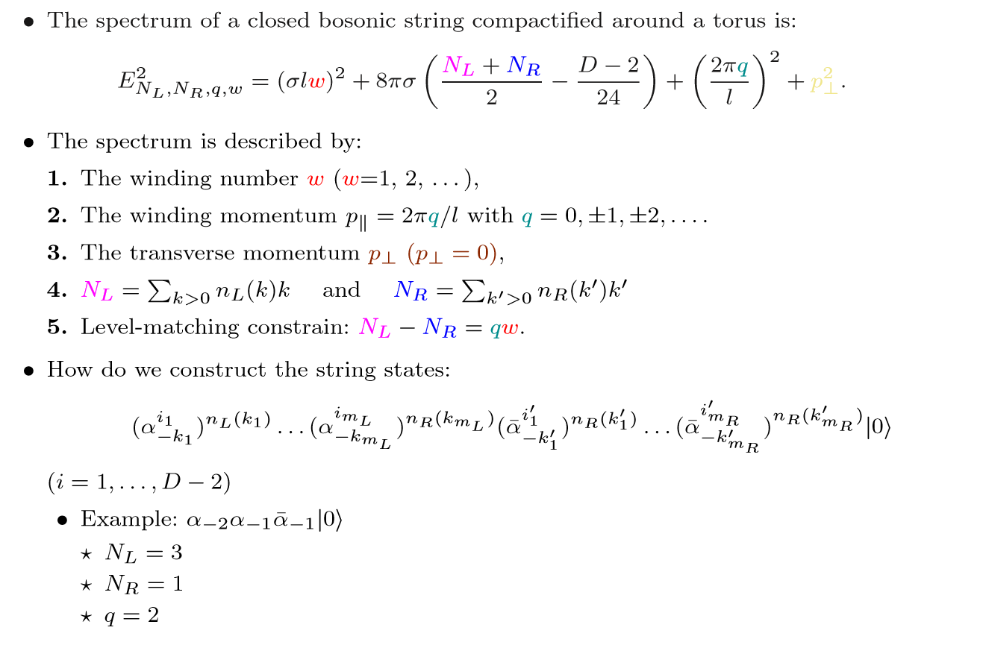
2. Theoretical Expectations: Goddard-Goldstone-Rebbi-Thorn
Contributions by
M. Lüscher ’81, J. Polchinski & A. Strominger ‘90, M. Lüscher & P. Weisz ’04, O. Aharony et al ’07 – 11, S. Dubovsky et al ’12 – 19
Quantize the Bosonic String (Nambu-Goto String):
For D =3

Slide 6
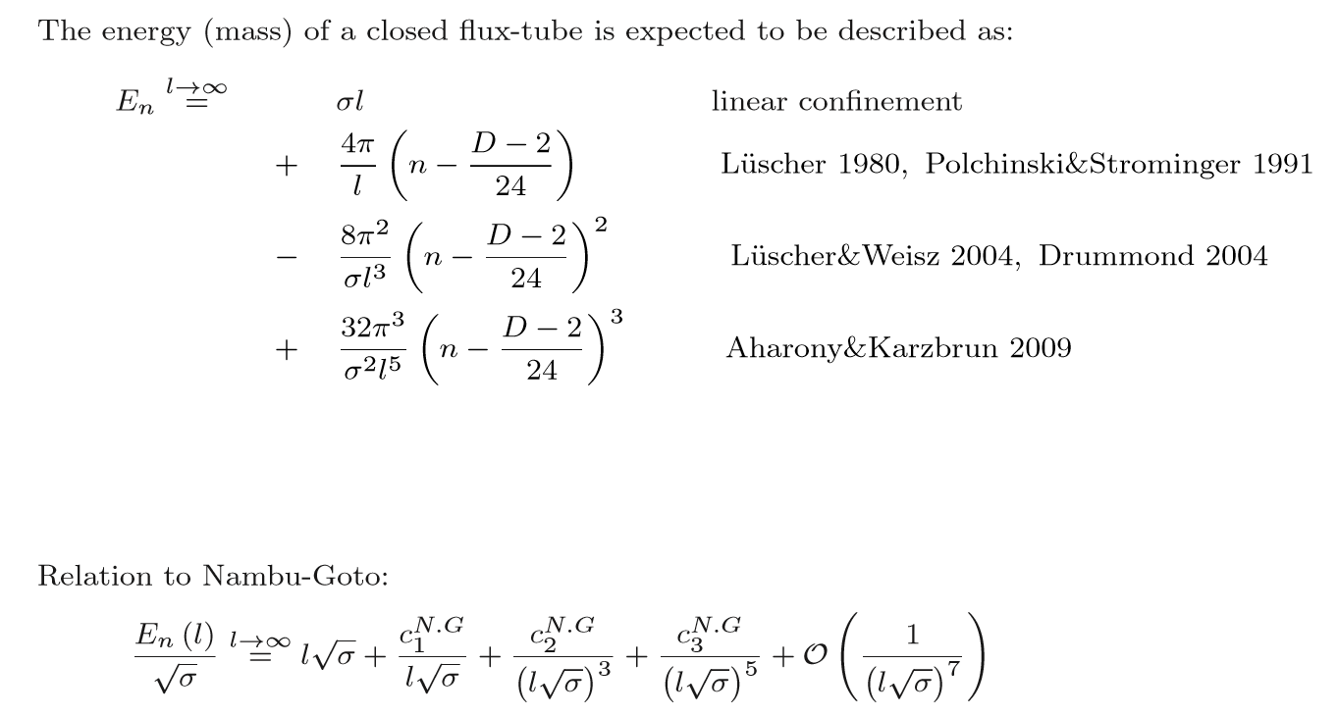
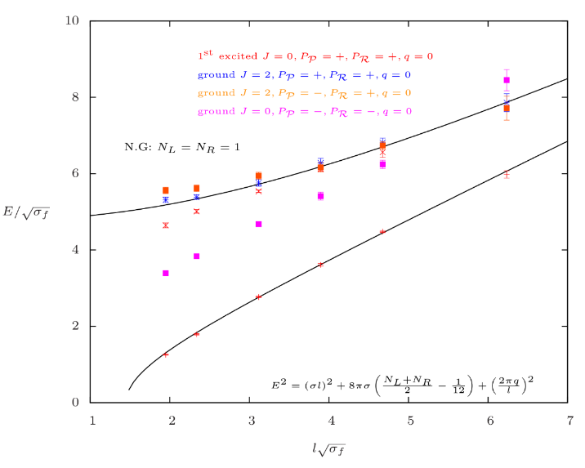
2. Theoretical Expectations: Eﬀective String Theory
Contributions by
M. Lüscher ’81, J. Polchinski & A. Strominger ‘90, M. Lüscher & P. Weisz ’04, O. Aharony et al ’07 – 11, S. Dubovsky et al ’12 – 19
AA, Bringoltz and Teper, JHEP 1102:030,2011
Sergei Dubovsky, Raphael Flauger, Victor Gorbenko’ 13, Phys. Rev. Lett. 111, 062006
By calculating the energy shifts due to phonon collissions, using approximate integrability and TBA, provided predictions for
Short flux tubes
Explain the deviations of $0^{− −}$ ground state by introducing a world-sheet axion.

Slide 7
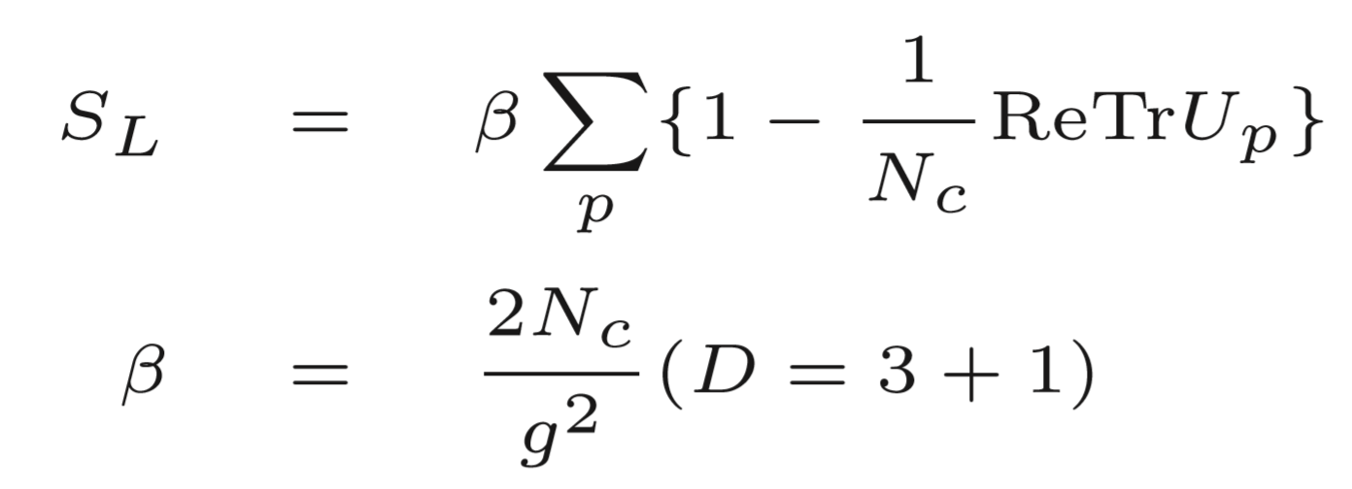
3. Lattice Calculation: Lattice Set up
Deﬁne the gauge theory on a $D = 4$discretized periodic Euclidean space-time with sites
We use the standard Wilson Action:
$$a$$
$$U_{μ}\left( \vec{x}\right)=e^{iA_{μ}(\vec{x})}∈SU(N)$$
Energies can be calculated using the correlation functions of speciﬁc operators:

Slide 8
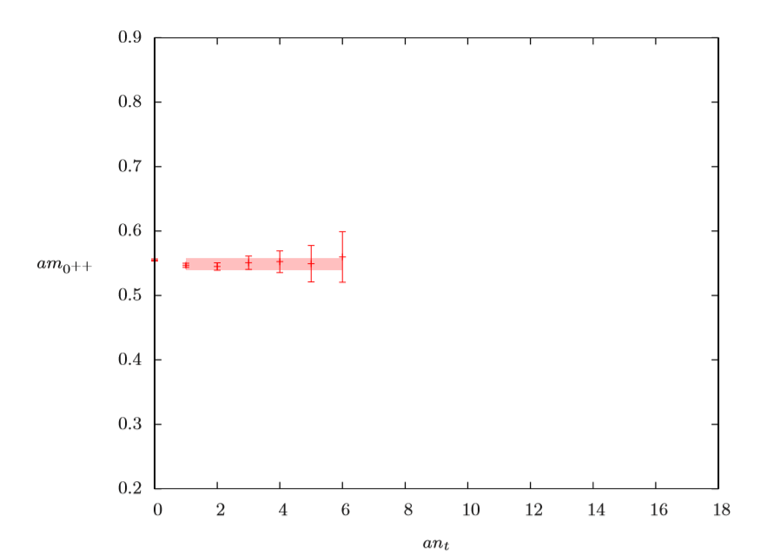
3. Lattice Calculation: Correlation Function
$$T−t$$
$$t$$
We calculate the eﬀective energy:
Example of effective mass
This provides only the Ground State

Slide 9
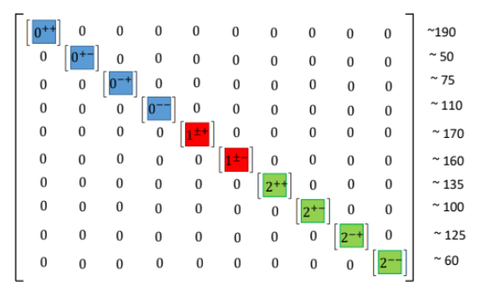
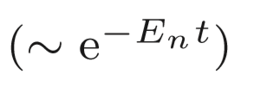
3. Lattice Calculation: Extraction of the Excitation Spectrum
Construct a large basis of Operators with RIGHT QUANTUM NUMBERS
Calculate the correlation function (Matrix)
Diagonalize the matrix
Extract the eigenvectors
Extract the correlator for each state
By ﬁtting the results, we extract the mass (energy) for each state
This is the so called Generalized Eigenvalue Problem (GEVP)
M. Lüscher and U. Wolff, Nucl. Phys. B339 (1990) 222–252..

Slide 10
3. Lattice Calculation: Operators Building
We build the path order product of links along the spatial direction → Polyakov Loop
$$T$$
Polyakov Loop
$$L$$
What Quantum Numbers characterize our states and operators?

Slide 11
4. Operator Construction: Quantum Numbers
Quantum numbers
Spin $J:$
Parity:
Example:
Example:
We project onto 5 irreducible representations $×2$ ( $=±$ )
Examples

Slide 12
4. Operator Construction: Lattice Operators
Notes:
Stays

Slide 13
3. Lattice Calculation: Strategy
Simulations
$$SU\left(3\right), β=6.0625,$$
$$l\sqrt{σ}=1.9 −7$$
13 different flux tube lengths
$$SU\left(3\right), β=6.3380,$$
$$l\sqrt{σ}=1.6 −5$$
14 different flux tube lengths
$$SU\left(5\right), β=17.630,$$
$$l\sqrt{σ}=1.9 −4.8$$
8 different flux tube lengths
$$SU\left(5\right), β=18.375,$$
$$l\sqrt{σ}=1.9 −4.8$$
5 different flux tube lengths
$$SU\left(6\right), β=25.550,$$
$$l\sqrt{σ}=1.9 −4.8$$
8 different flux tube lengths
$$SU(6), β=25.55$$
$SU(5)$, $β=17.63$
$$SU\left(3\right), β=6.0625$$
$a\sim$0.09 fm
$SU(5)$, $β=18.375$
$$SU\left(3\right), β=6.338$$
+ k = 2 flux tubes
Notes:
Stays

Slide 14
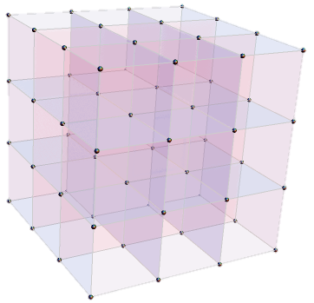
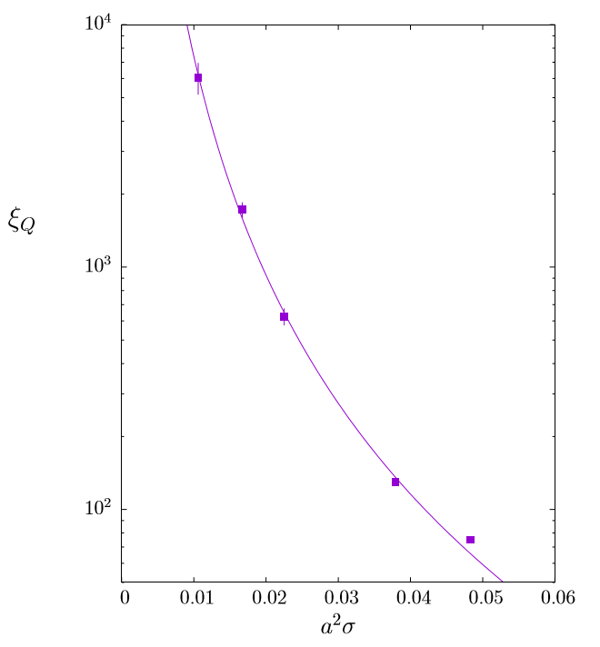
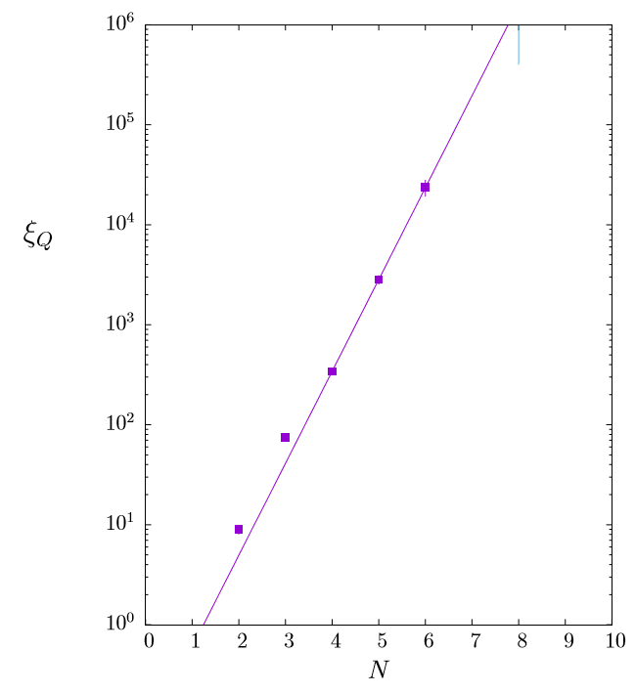
3. Lattice Calculation: Strategy – Constraints
For a computer large-$N$ limit is actually finite
Increasing the number of colour - $N$ matrix multiplications scale as $N^{3}$
This means to move from $N=3$ to $N=6$ it is 8 times slower
Moving closer to the continuum limit ($a→0$) computational time increases
To keep the flux-tube length fixed one has to scale ALL the lattice extents.
i.e. $L_{1}a_{1}\sqrt{σ}=L_{2}a_{2}\sqrt{σ}$
This means to move from $a_{1}$ to $a_{1}/2$ it is 16 times slower.
Topological Freezing – loosing ergodicity
$$L_{t}$$
$$L_{y}$$
$$L_{x}$$
Moving towards to the: Continuum Limit
Large-$N$ Limit
Correlation Length:
AA and M. Teper, arXiv:2007.06422
AA and M. Teper, arXiv:2106.00364
Notes:
Stays

Slide 15
5. Results in $D=2+1$

Slide 16
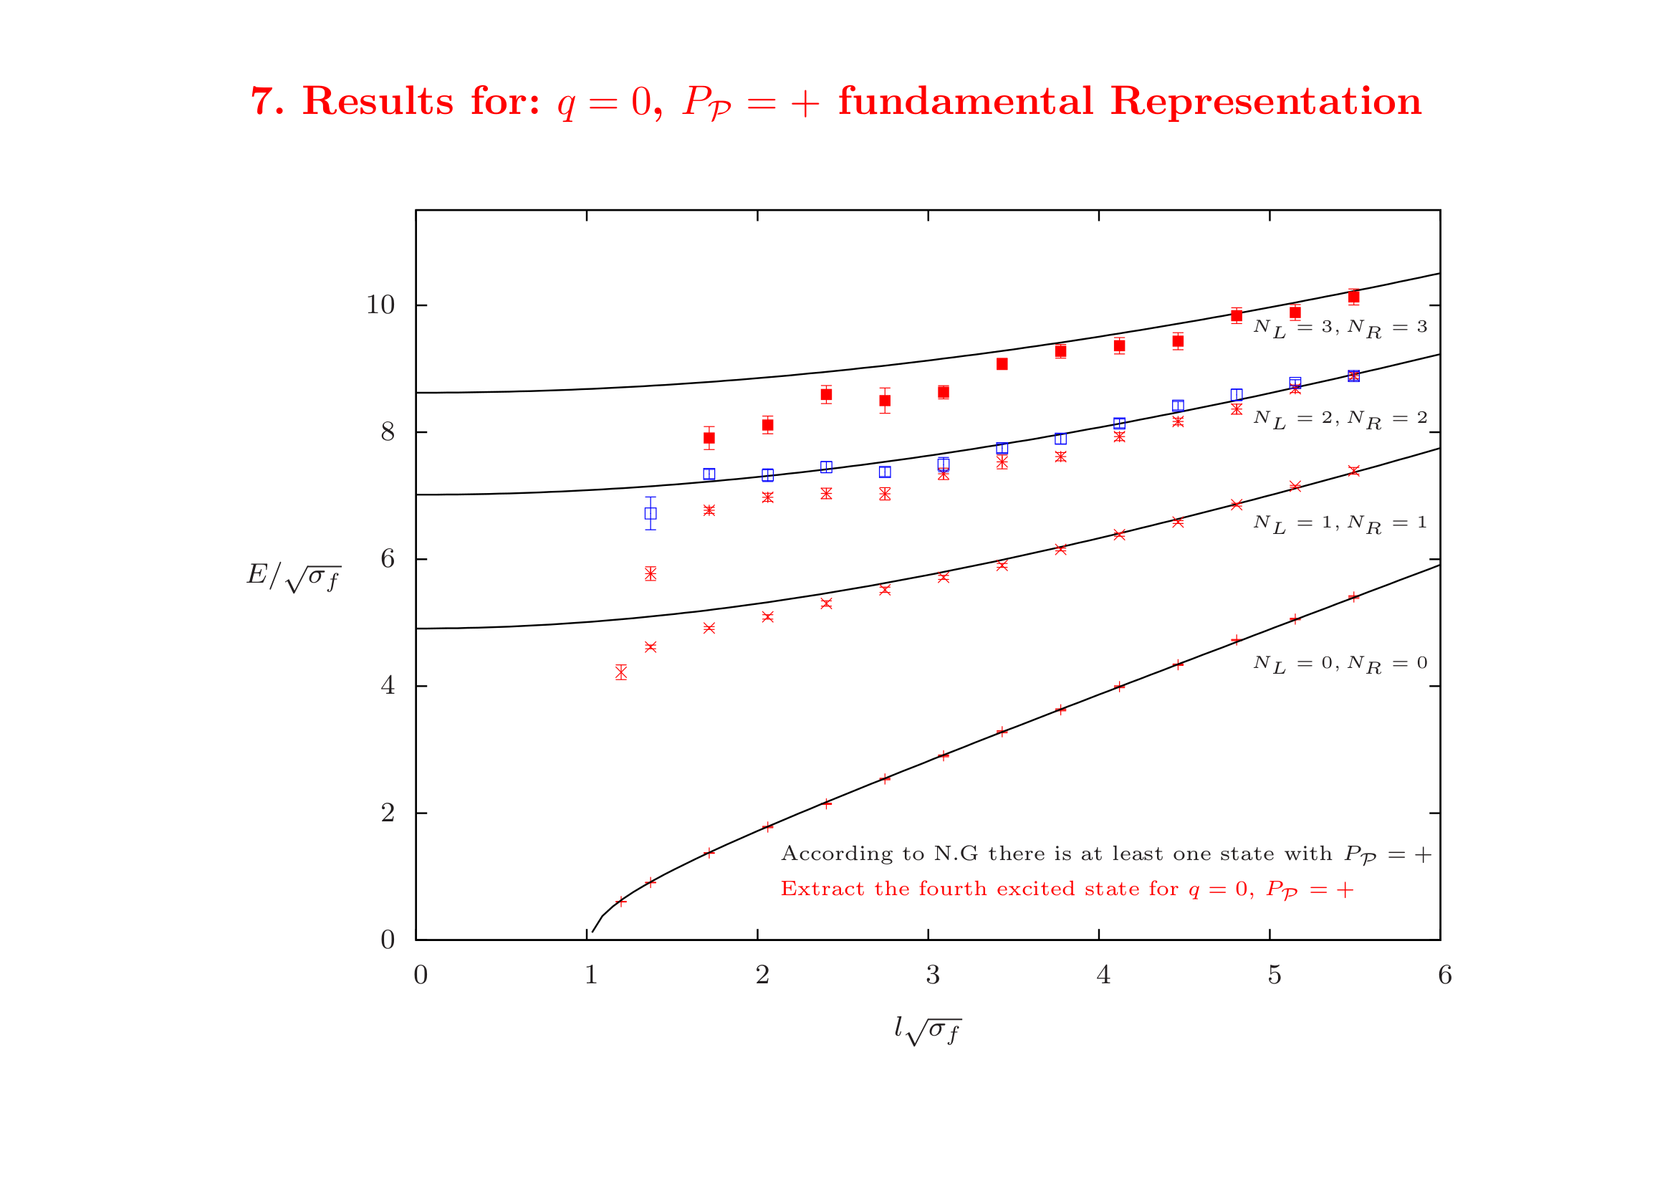
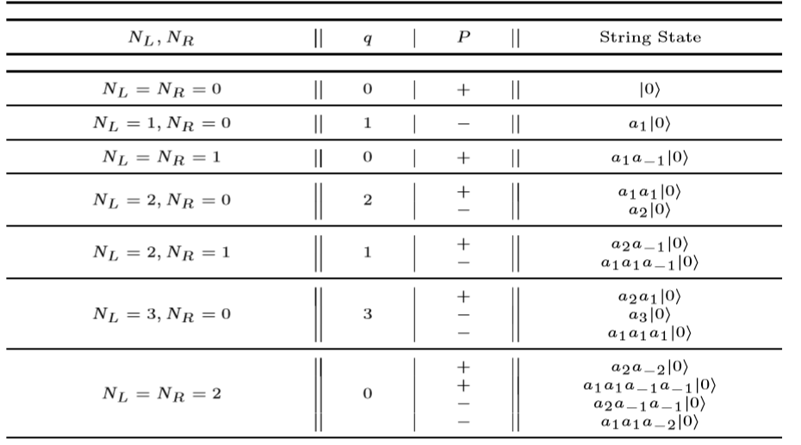
5. Results: the $D=2+1$ case
String States & Quantum Numbers
Results for SU(6), $a\sqrt{σ}\sim 0.08582(5)$
Positive Parity, $q=0$
Lattice Channels:
Quantum numbers | Ground state | 1st excited state | 2nd excited state | 3rd excited state | 4th excited state
= +, $q=0$ | ● | ● | ● | ● | ●
= - , $q=0$

Slide 17
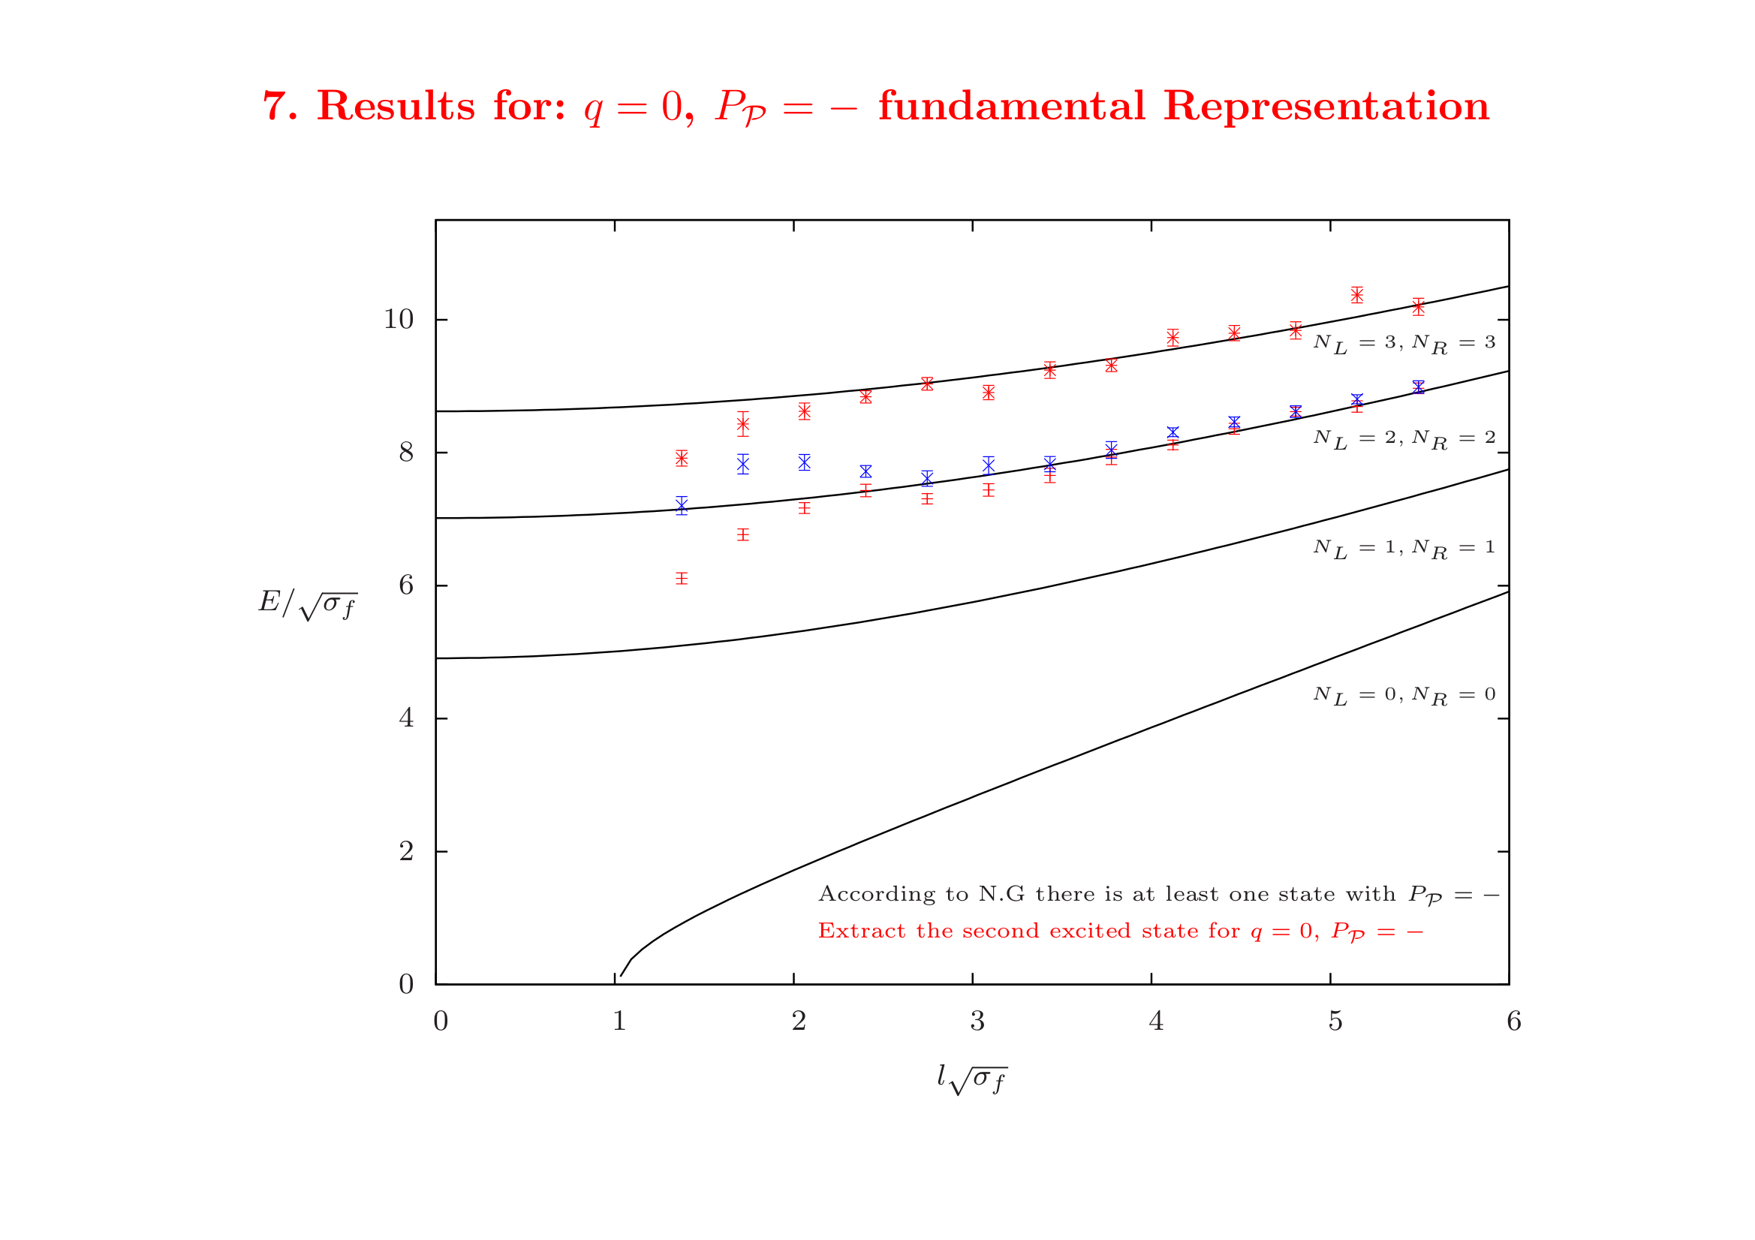
5. Results: the $D=2+1$ case
String States & Quantum Numbers
Results for SU(6), $a\sqrt{σ}\sim 0.08582(5)$
Negative Parity, $q=0$
Lattice Channels:
Quantum numbers | Ground state | 1st excited state | 2nd excited state | 3rd excited state | 4th excited state
= +, $q=0$ | ● | ● | ● | ● | ●
= - , $q=0$ | ● | ● | ●

Slide 18
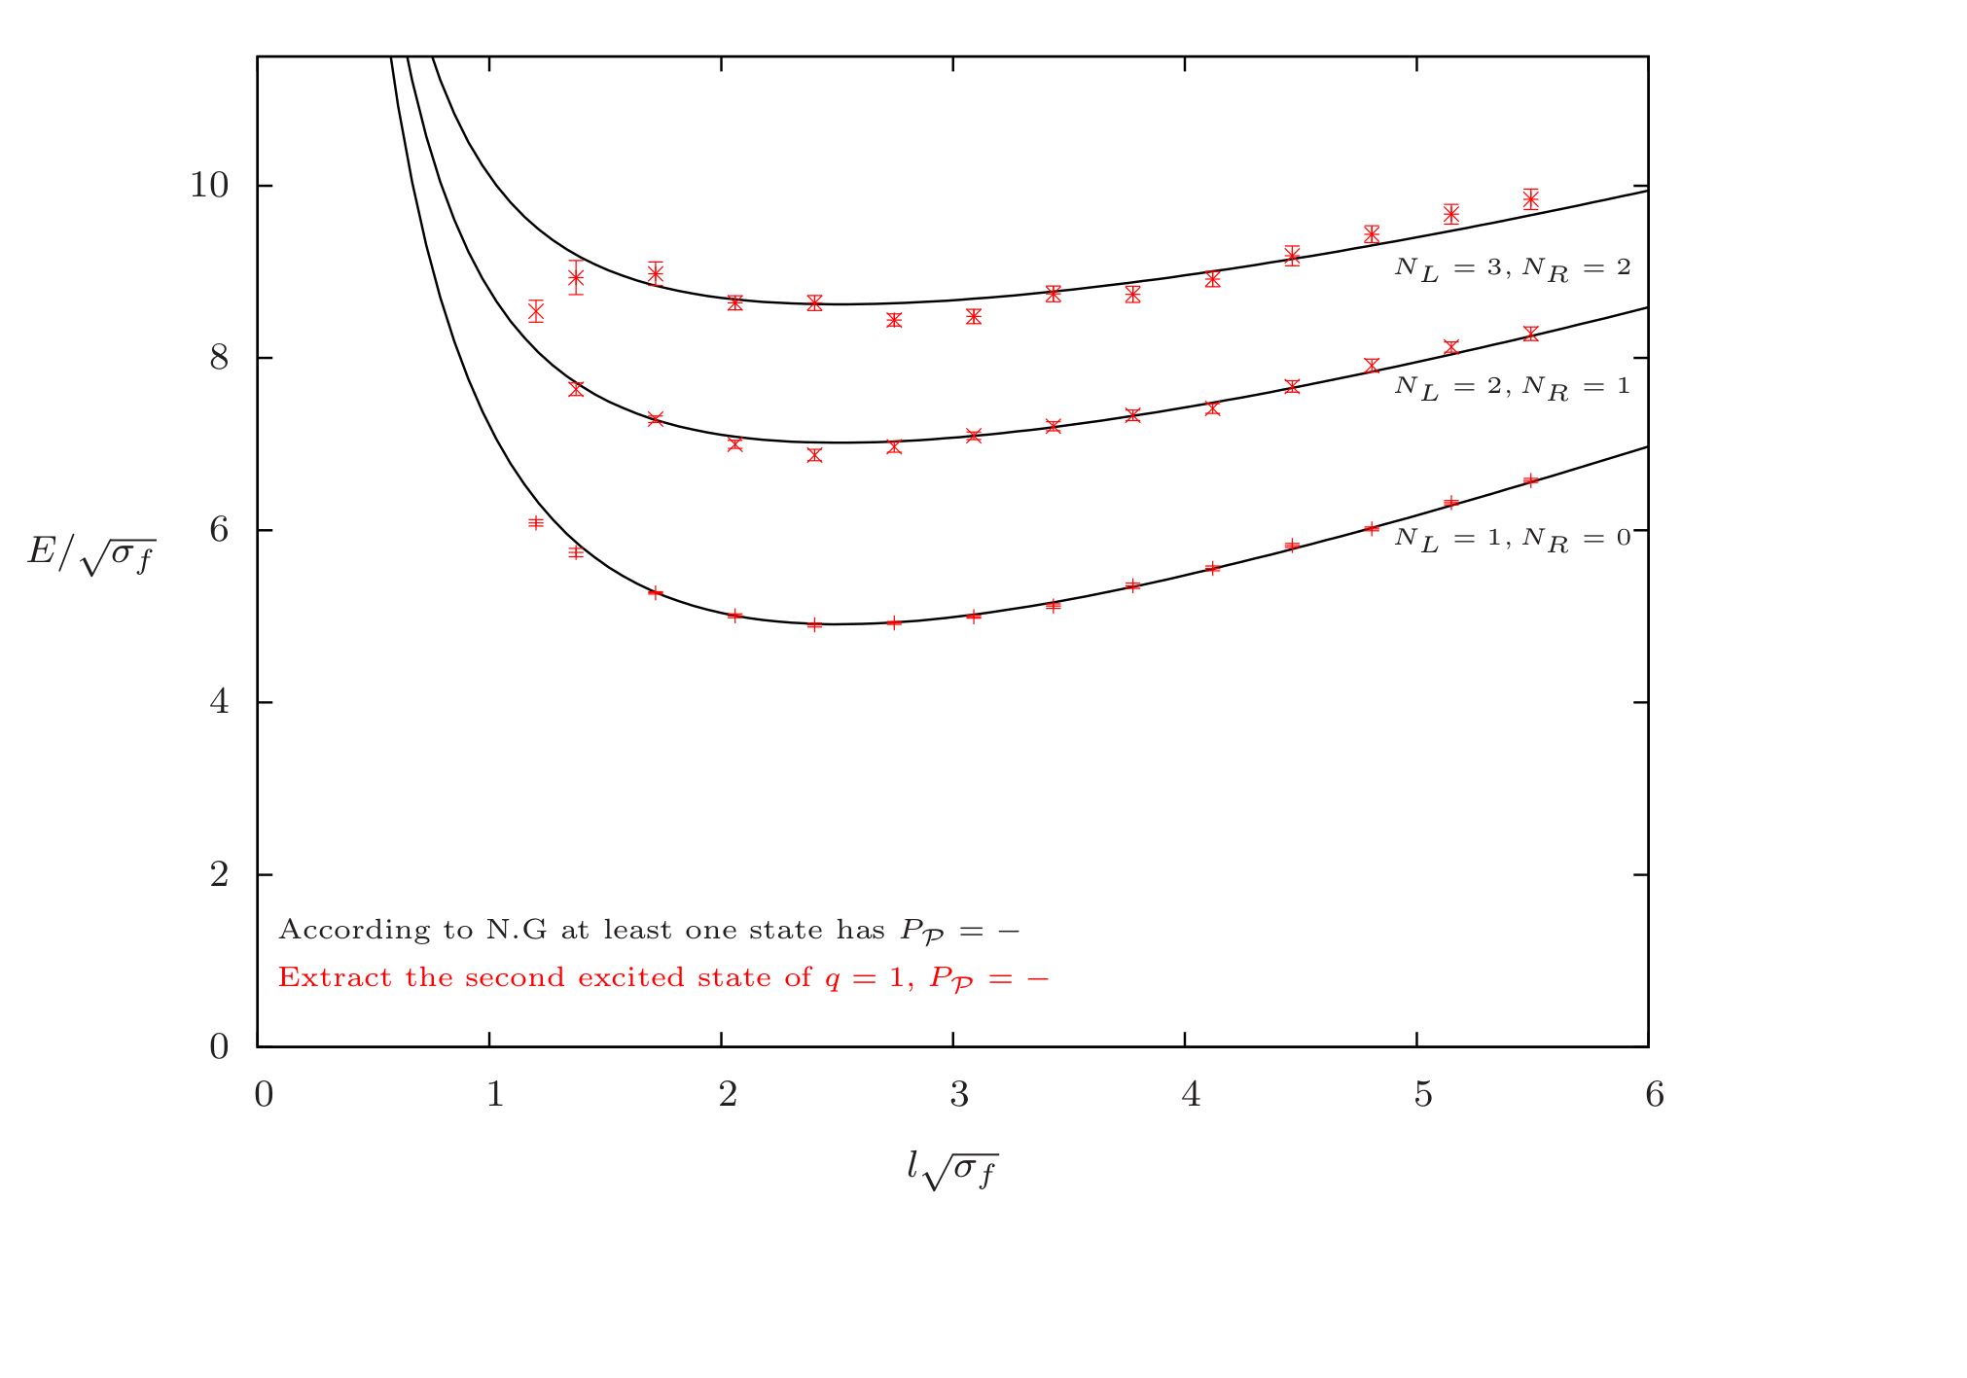
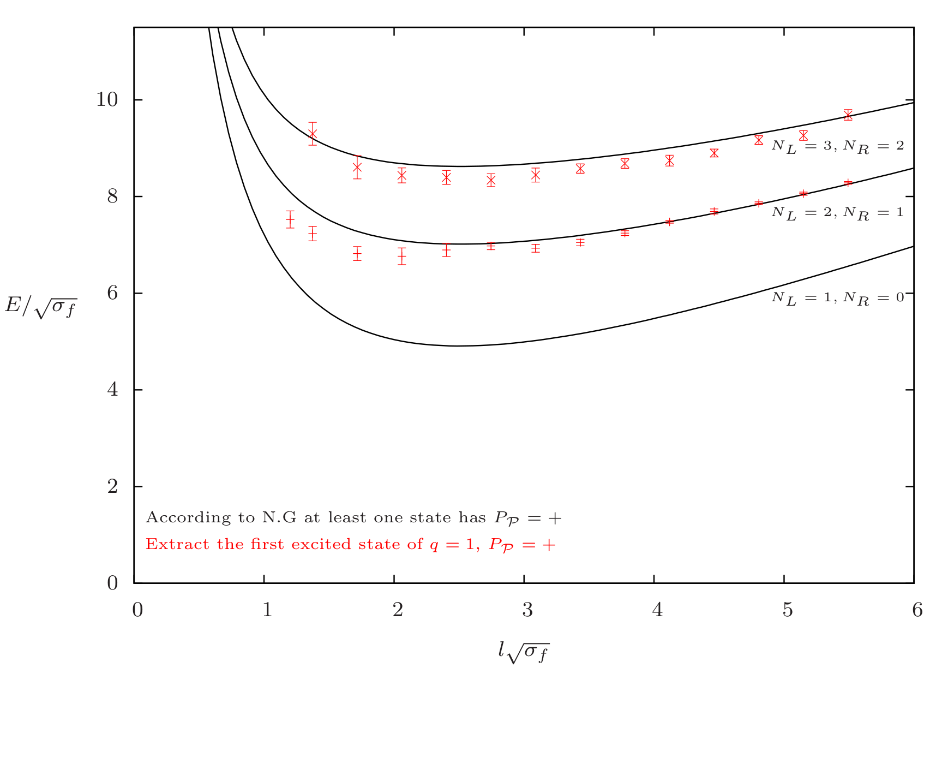
5. Results: the $D=2+1$ case
Results for SU(6), $a\sqrt{σ}\sim 0.08582(5)$
Negative Parity, $q=1$
Positive Parity, $q=1$

Slide 19
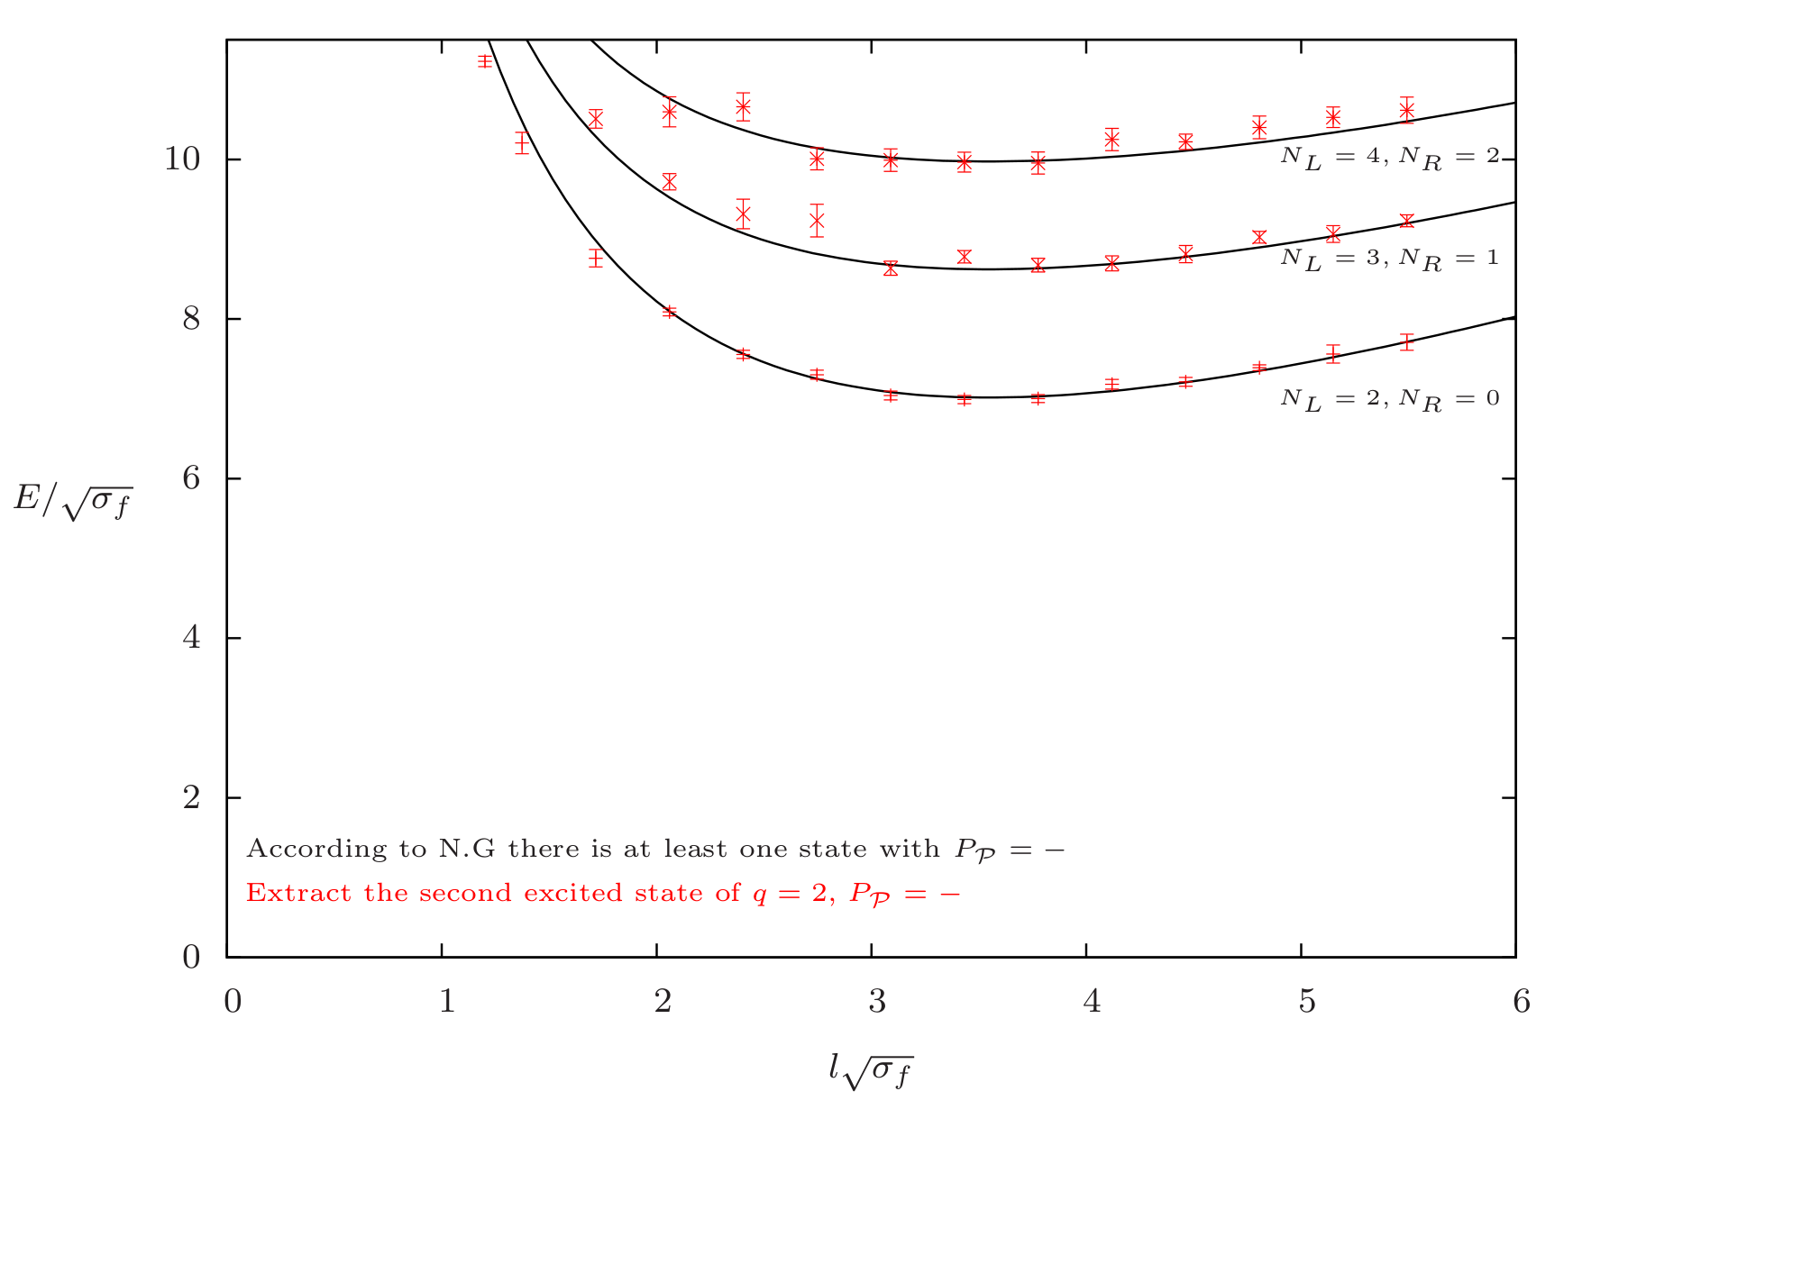
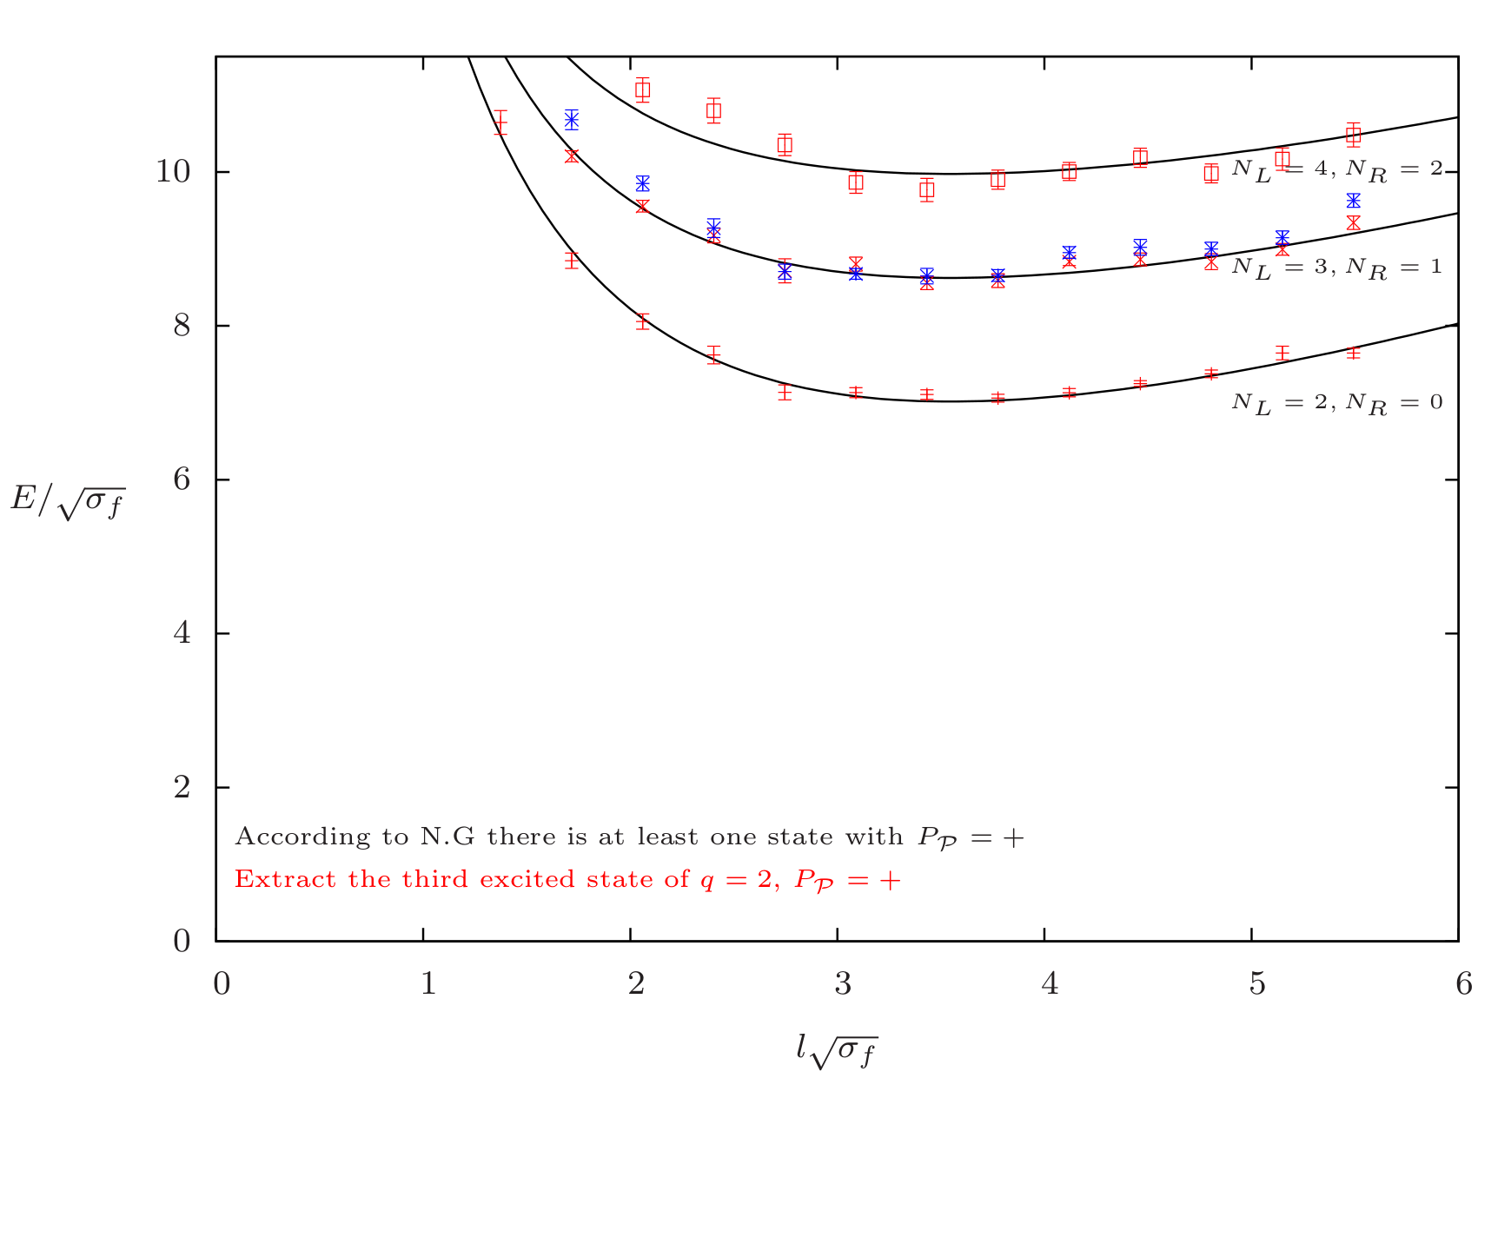
5. Results: the $D=2+1$ case
Results for SU(6), $a\sqrt{σ}\sim 0.08582(5)$
Negative Parity, $q=2$
Positive Parity, $q=2$

Slide 20
6. Results in $D=3+1$

Slide 21
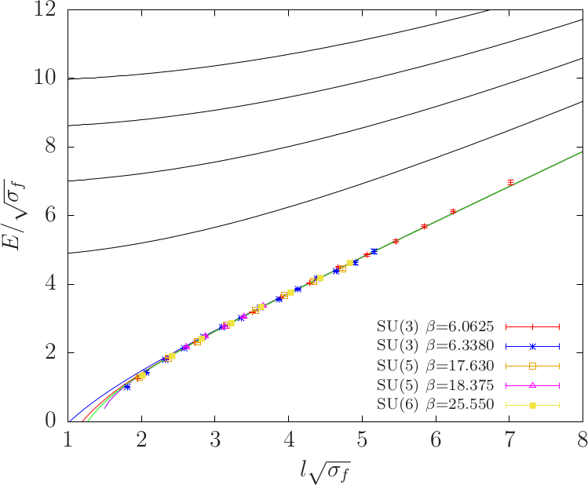
6. Results: $D=3+1$ case
String States & Quantum Numbers
Results for the absolute ground state $0^{+ +}$ for all the ensembles
$$N_{L}=N_{R}=3$$
$$N_{L}=N_{R}=2$$
$$N_{L}=N_{R}=1$$
$$N_{L}=N_{R}=0$$
N.N.L.O
N.L.O
L.O

Slide 22
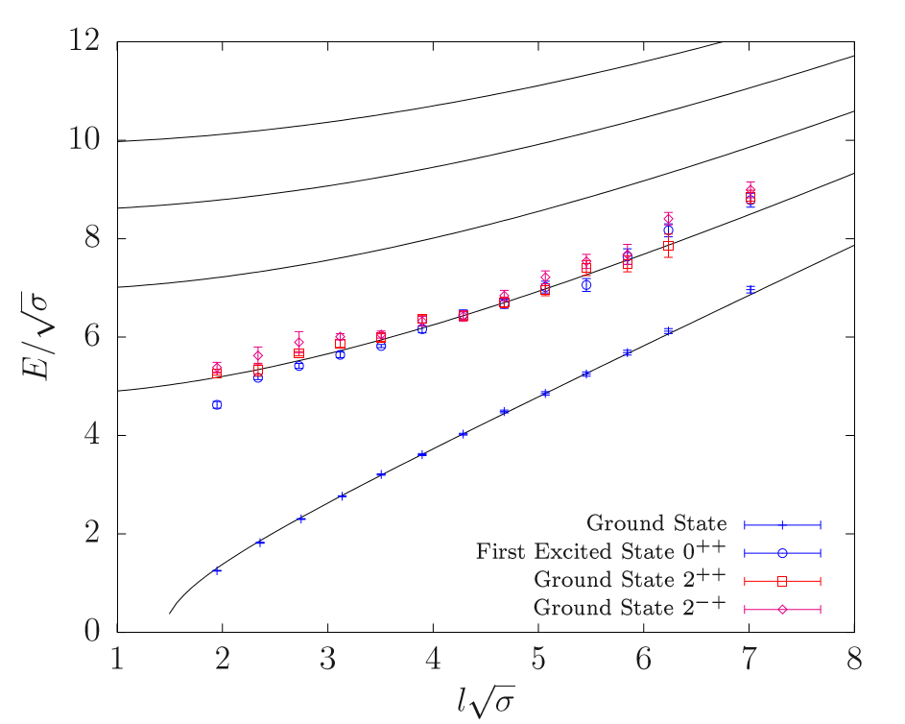
6. Results: $D=3+1$- first excited state $N_{L}=N_{R}=1$
String States & Quantum Numbers
Results for the first excited state
Example for SU(3) and $β=6.0625$
$$N_{L}=N_{R}=3$$
$$N_{L}=N_{R}=2$$
$$N_{L}=N_{R}=1$$
$$N_{L}=N_{R}=0$$

Slide 23
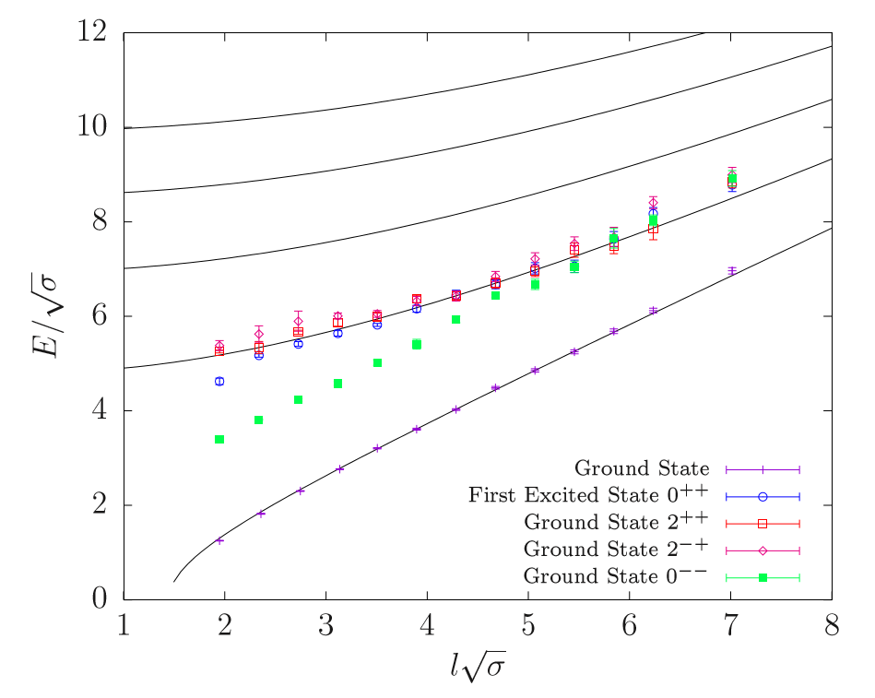
6. Results: $D=3+1$- first excited state $N_{L}=N_{R}=1$
String States & Quantum Numbers
Results for the absolute ground state $0^{− −}$
Example for SU(3) and $β=6.0625$
$$N_{L}=N_{R}=3$$
$$N_{L}=N_{R}=2$$
$$N_{L}=N_{R}=1$$
$$N_{L}=N_{R}=0$$
$$∆E\sim const.$$

Slide 24
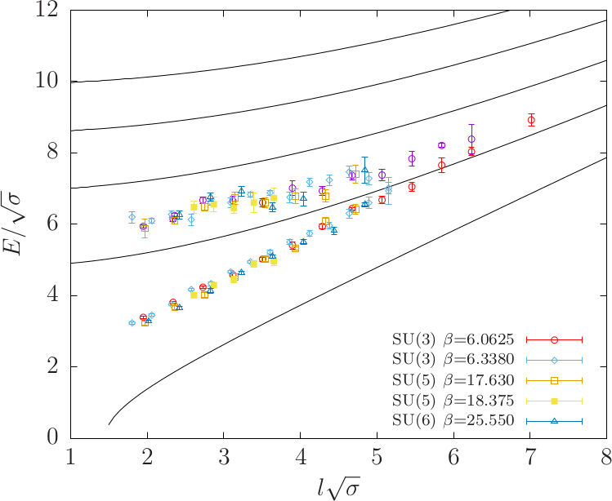
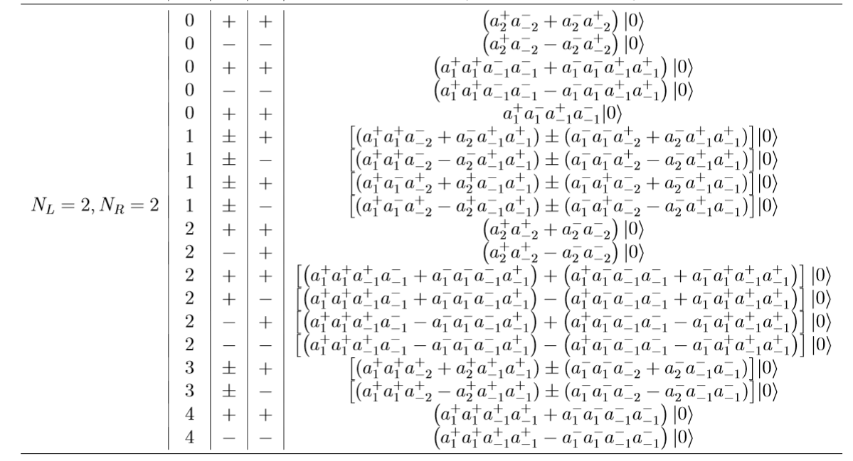
6. Results: $D=3+1$– the state $0^{− −}$
String States & Quantum Numbers
Results for the ground and first excited state $0^{− −}$
For all ensembles
$$N_{L}=N_{R}=3$$
$$N_{L}=N_{R}=2$$
$$N_{L}=N_{R}=1$$
F$irst Excited 0^{− −}$
$$N_{L}=N_{R}=0$$
Ground State $0^{− −}$

Slide 25
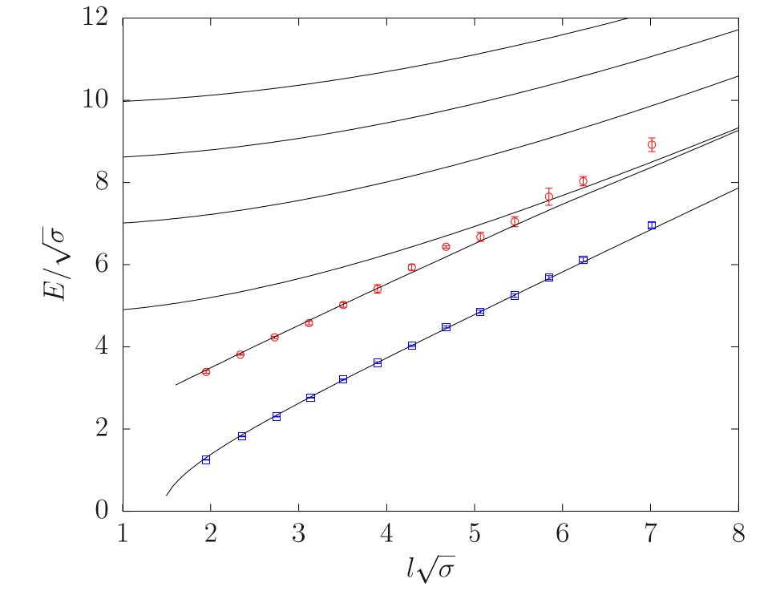
6. Results: $D=3+1$– the state $0^{− −}$
String States & Quantum Numbers
Results for the ground state $0^{− −}$
Example for SU(3) and $β=6.0625$
$$N_{L}=N_{R}=3$$
$$N_{L}=N_{R}=2$$
$$N_{L}=N_{R}=1$$
$$N_{L}=N_{R}=0$$
Including the pseudo-scalar field (axion)

Slide 26
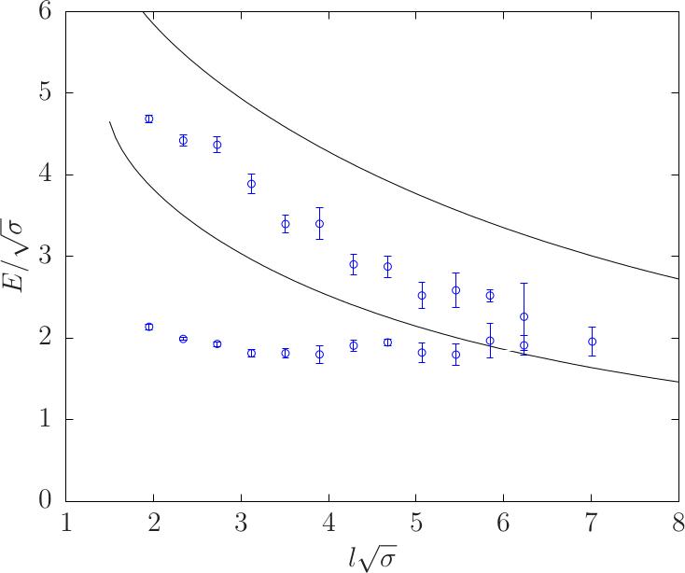
6. Results: $D=3+1$– the state $0^{− −}$
String States & Quantum Numbers
How about subtracting the absolute ground state
for the ground and first excited state $0^{− −}$
Results presented for SU(3) and $β=6.0625$
$$N_{L}=N_{R}=2$$
$$N_{L}=N_{R}=1$$

Slide 27
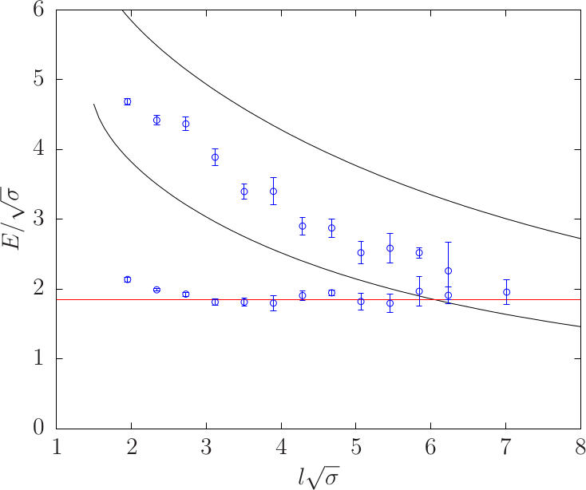
6. Results: $D=3+1$– the state $0^{− −}$
String States & Quantum Numbers
How about subtracting the absolute ground state
for the ground and first excited state $0^{− −}$
Results presented for SU(3) and $β=6.0625$
$$N_{L}=N_{R}=2$$
$$\sim 1.85$$
$$N_{L}=N_{R}=1$$

Slide 28
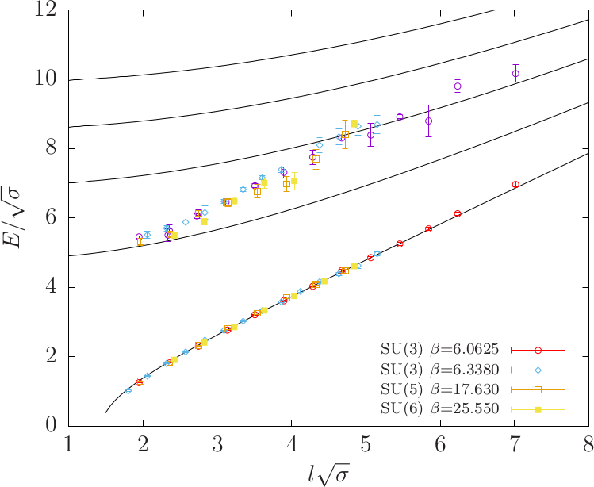
6. Results: $D=3+1$– Second Excited state $0^{+ +}$
String States & Quantum Numbers
Results for the ground and second excited state $0^{+ +}$
Results presented for SU(3) and $β=6.0625$
$$N_{L}=N_{R}=3$$
$$N_{L}=N_{R}=2$$
$$N_{L}=N_{R}=1$$
Second Excited State $0^{+ +}$
$$N_{L}=N_{R}=0$$
First Excited State $0^{+ +}$
$$∆E\sim const.$$
Ground State $0^{+ +}$
Absolute Ground State for

Slide 29
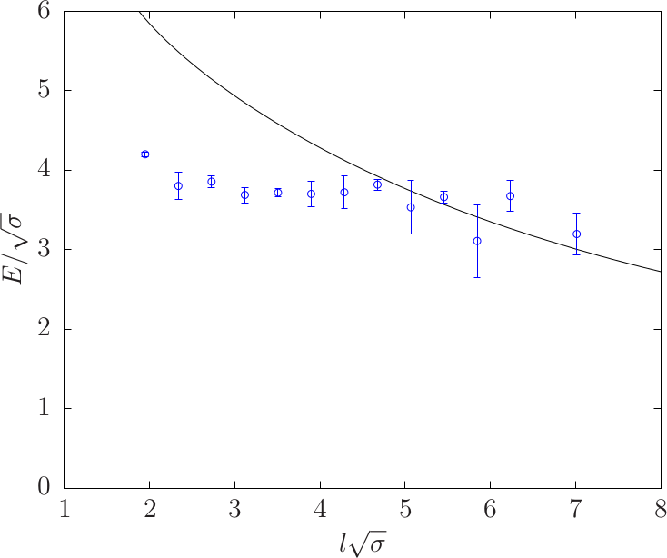
6. Results: $D=3+1$– Second Excited state $0^{+ +}$
String States & Quantum Numbers
How about subtracting the absolute ground state?
Results for the ground and second excited state $0^{+ +}.$ Results presented for SU(3) and $β=6.0625$
$$N_{L}=N_{R}=2$$
Absolute Ground State for

Slide 30
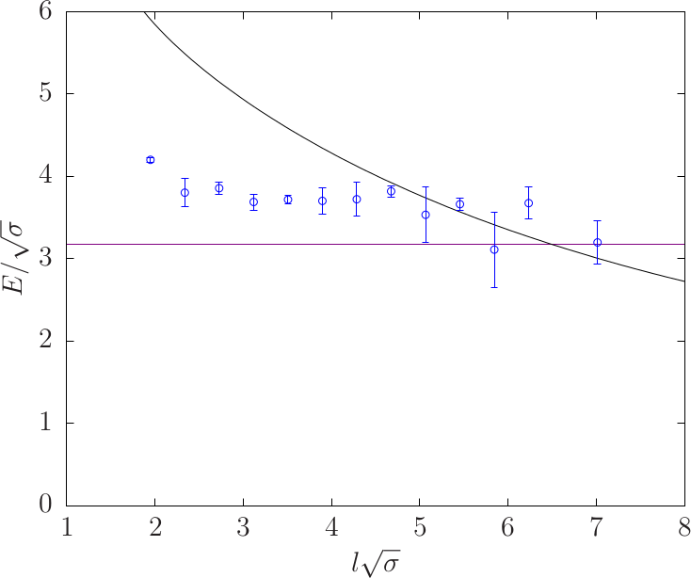
6. Results: $D=3+1$– Second Excited state $0^{+ +}$
String States & Quantum Numbers
How about subtracting the absolute ground state?
Results for the ground and second excited state $0^{+ +}.$ Results presented for SU(3) and $β=6.0625$
Glueball mass $\sim 3.10$
$$N_{L}=N_{R}=2$$
Absolute Ground State for

Slide 31
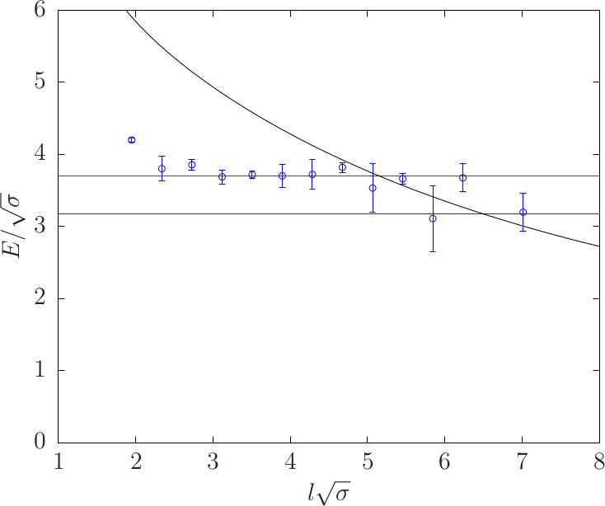
6. Results: $D=3+1$– Second Excited state $0^{+ +}$
String States & Quantum Numbers
How about subtracting the absolute ground state?
Results for the ground and second excited state $0^{+ +}.$ Results presented for SU(3) and $β=6.0625$
Twice the “axion” mass $\sim 2×1.85$
Glueball mass $\sim 3.10$
$$N_{L}=N_{R}=2$$
Absolute Ground State for

Slide 32
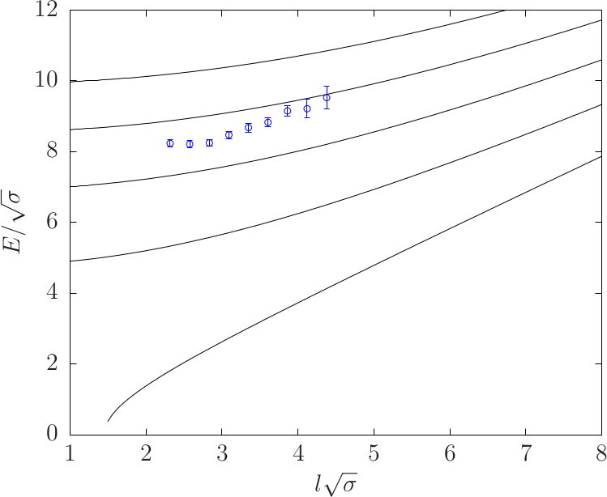
6. Results: $D=3+1$– Ground state $0^{− +}$
String States & Quantum Numbers
What is the mass of the ground state for $0^{− +}$
Results presented for SU(3) and $β=6.338$
$$N_{L}=N_{R}=3$$
$$N_{L}=N_{R}=2$$
$$N_{L}=N_{R}=1$$
$$N_{L}=N_{R}=0$$

Slide 33
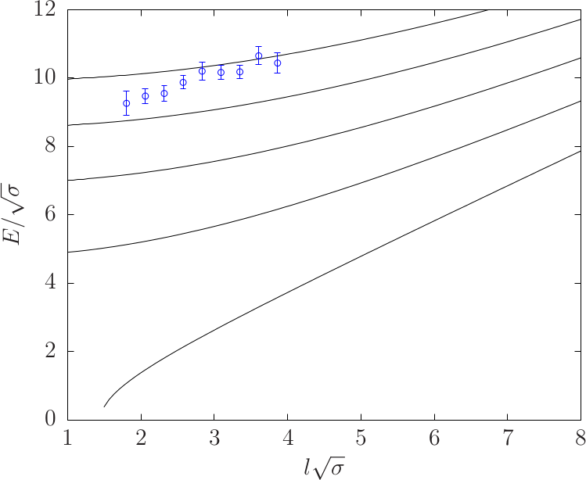
6. Results: $D=3+1$– Ground state $0^{+ −}$
String States & Quantum Numbers
What is the mass of the ground state for $0^{+ −}$
Results presented for SU(3) and $β=6.338$
$$N_{L}=N_{R}=3$$
$$N_{L}=N_{R}=2$$
$$N_{L}=N_{R}=1$$
$$N_{L}=N_{R}=0$$

Slide 34
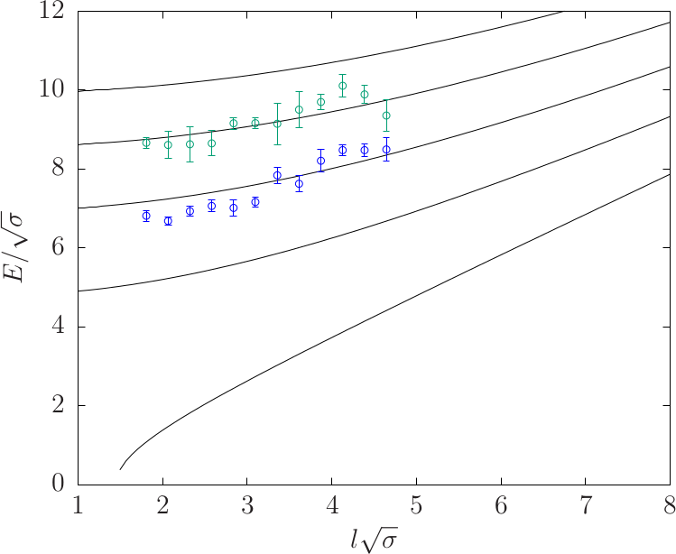
6. Results: $D=3+1$– Ground state $2^{+ −}$
String States & Quantum Numbers
What is the mass of the ground state for $2^{+ −}$
Results presented for SU(3) and $β=6.338$
$$N_{L}=N_{R}=3$$
First Excited State
$$N_{L}=N_{R}=2$$
$$N_{L}=N_{R}=1$$
Ground State
$$N_{L}=N_{R}=0$$

Slide 35
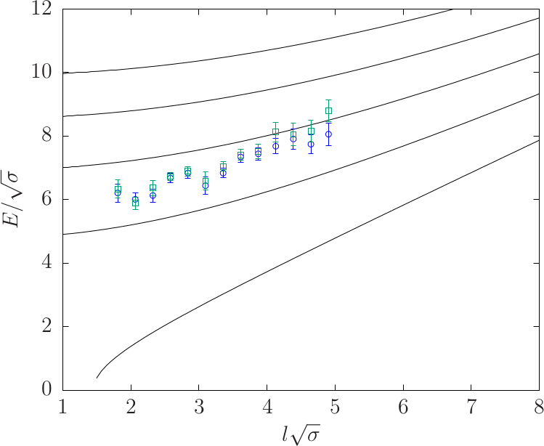
6. Results: $D=3+1$– Ground and First Excited states $1^{+}$
String States & Quantum Numbers
What is the mass of the ground state and first excited state for $1^{+}$
Results presented for SU(3) and $β=6.338$
$$N_{L}=N_{R}=3$$
$$N_{L}=N_{R}=2$$
First Excited State
$$N_{L}=N_{R}=1$$
Ground State
$$N_{L}=N_{R}=0$$

Slide 36
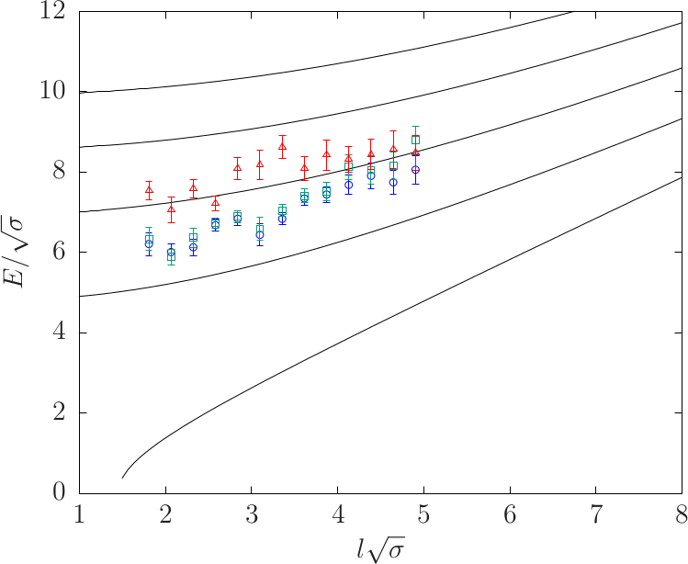
6. Results: $D=3+1$– Ground and First Excited states $1^{+}$
String States & Quantum Numbers
What is the mass of the ground state and first excited state for $1^{+}$
Results presented for SU(3) and $β=6.338$
$$N_{L}=N_{R}=3$$
$$N_{L}=N_{R}=2$$
Second Excited State
First Excited State
$$N_{L}=N_{R}=1$$
Ground State
$$N_{L}=N_{R}=0$$

Slide 37
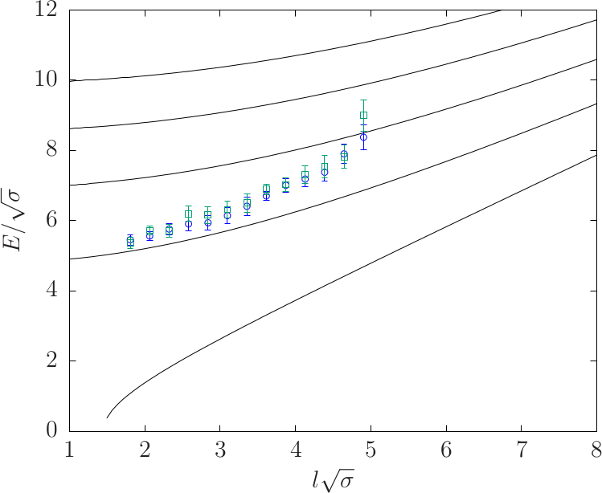
6. Results: $D=3+1$– Ground and First Excited states $1^{−}$
String States & Quantum Numbers
What is the mass of the ground state and first excited state for $1^{−}$
Results presented for SU(3) and $β=6.338$
$$N_{L}=N_{R}=3$$
$$N_{L}=N_{R}=2$$
First Excited State
$$N_{L}=N_{R}=1$$
Ground State
$$N_{L}=N_{R}=0$$

Slide 38
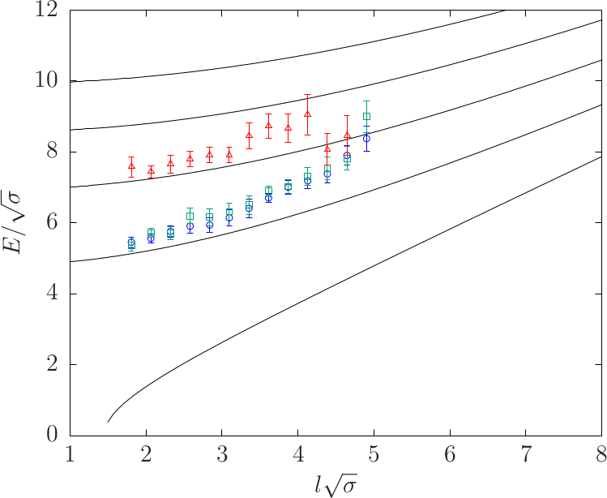
6. Results: $D=3+1$– Ground and First Excited states $1^{−}$
String States & Quantum Numbers
What is the mass of the ground state and first excited state for $1^{−}$
Results presented for SU(3) and $β=6.338$
$$N_{L}=N_{R}=3$$
Second Excited State
$$N_{L}=N_{R}=2$$
First Excited State
$$N_{L}=N_{R}=1$$
Ground State
$$N_{L}=N_{R}=0$$
$$∆E\sim const.$$
Notes:
Stays

Slide 39
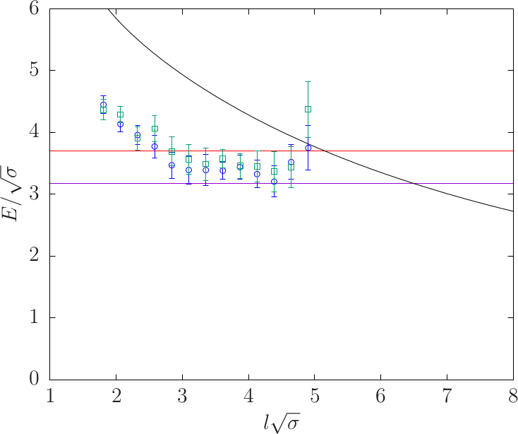
6. Results: $D=3+1$– Ground and First Excited state $1^{−}$
String States & Quantum Numbers
How about subtracting the absolute ground state?
Results for the ground and first excited state $1^{−}.$ Results presented for SU(3) and $β=6.338$
Twice the “axion” mass $\sim 2×1.85$
Glueball mass $\sim 3.10$
$$N_{L}=N_{R}=2$$
Some kind of massive mode?
Notes:
Stays

Slide 40
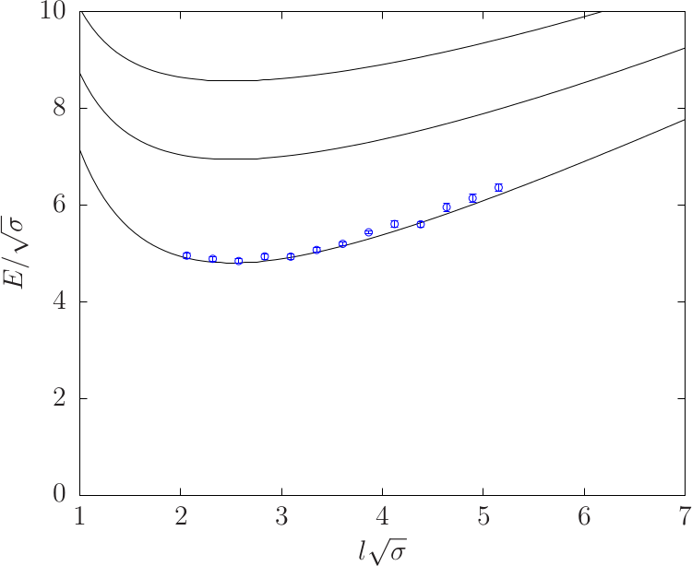
6. Results: $D=3+1$– the $Q=1$ sector
String States & Quantum Numbers
What is the mass of the ground state for $J=1$
Results presented for SU(3) and $β=6.338$?
$$N_{L}=3, N_{R}=2$$
$$N_{L}=2, N_{R}=1$$
$$N_{L}=1, N_{R}=0$$
Notes:
Stays

Slide 41
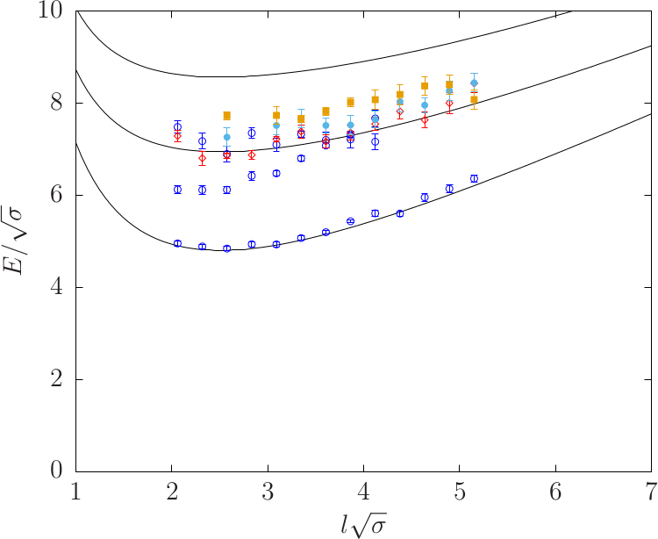
6. Results: $D=3+1$– the $Q=1$ sector
String States & Quantum Numbers
What are the states that correspond to $N_{L}=2, N_{R}=1$
Results presented for SU(3) and $β=6.338$?
$$N_{L}=3, N_{R}=2$$
$$N_{L}=2, N_{R}=1$$
$$N_{L}=1, N_{R}=0$$
?
?
?
Notes:
Stays

Slide 42
6. Results: $D=3+1$– the $Q=1$ sector
String States & Quantum Numbers
What are the states that correspond to $N_{L}=2, N_{R}=1$
State with $0^{−}$ behaves “anomalously”
Results presented for SU(3) and $β=6.338$?
$$N_{L}=3, N_{R}=2$$
$$N_{L}=2, N_{R}=1$$
$$N_{L}=1, N_{R}=0$$
?
?
?
Notes:
Stays

Slide 43
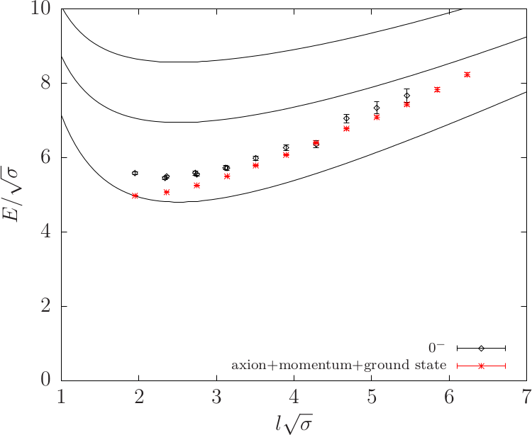
6. Results: $D=3+1$– the $Q=1$ sector
String States & Quantum Numbers
What if the state we observe is the “axion” with momentum on the ground state?
Results presented for SU(3) and $β=6.0625.$
$$N_{L}=3, N_{R}=2$$
$$N_{L}=2, N_{R}=1$$
$$N_{L}=1, N_{R}=0$$
Ground State $0^{−}$
$$\frac{E_{gs 0^{+ +}}}{\sqrt{σ}}+\sqrt{{\left(\frac{m_{ps}}{\sqrt{σ}}\right)}^{2}+{\left(\frac{2π}{l\sqrt{σ}}\right)}^{2}}$$
Notes:
Stays

Slide 44
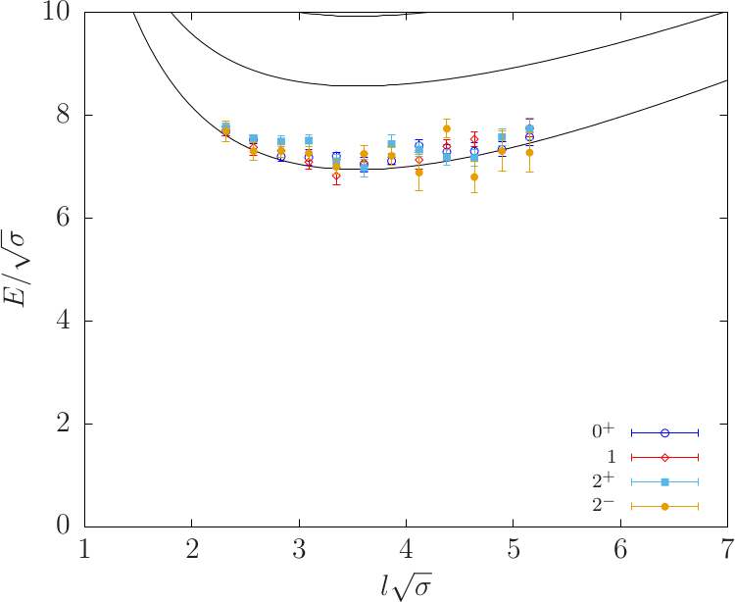
6. Results: $D=3+1$– the $Q=2$ sector
String States & Quantum Numbers
What are the states that correspond to $N_{L}=2, N_{R}=0$
Results presented for SU(3) and $β=6.338$.
$$N_{L}=3, N_{R}=1$$
$$N_{L}=2 N_{R}=0$$
Notes:
Stays

Slide 45
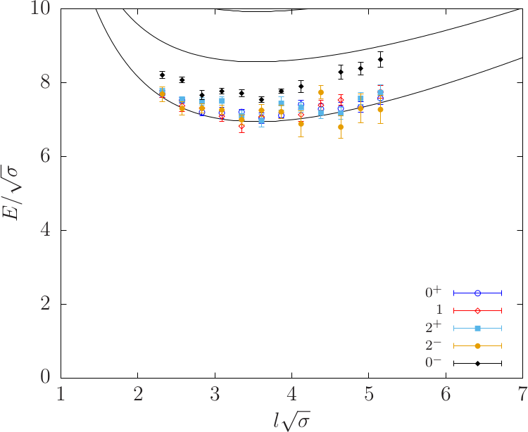
6. Results: $D=3+1$– the $Q=2$ sector
String States & Quantum Numbers
How does the ground state $0^{−}$ behave?
Results presented for SU(3) and $β=6.338$.
$$N_{L}=3, N_{R}=1$$
$$N_{L}=2 N_{R}=0$$
Notes:
Stays

Slide 46
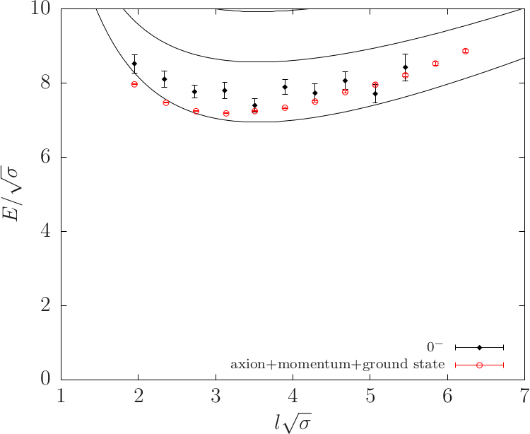
6. Results: $D=3+1$– the $Q=2$ sector
String States & Quantum Numbers
What if the state we observe is the “axion” with momentum on the ground state?
Results presented for SU(3) and $β=6.0625.$
$$N_{L}=3, N_{R}=1$$
$$N_{L}=2 N_{R}=0$$
$$\frac{E_{gs 0^{+ +}}}{\sqrt{σ}}+\sqrt{{\left(\frac{m_{ps}}{\sqrt{σ}}\right)}^{2}+{\left(\frac{4π}{l\sqrt{σ}}\right)}^{2}}$$

Slide 47
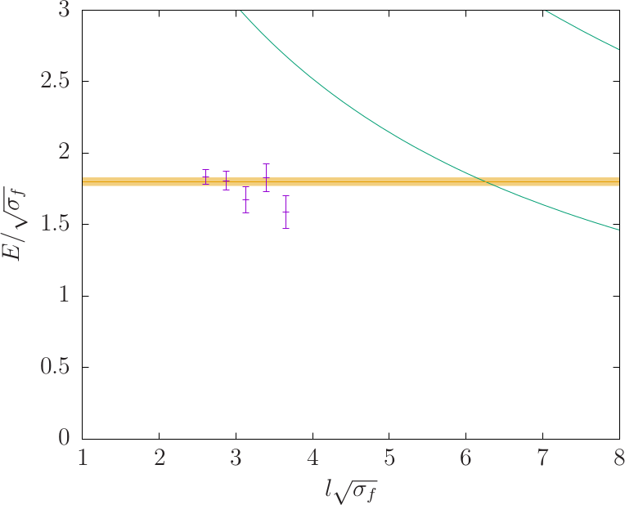
7. Results, 𝐷=3+1 – 𝒌=𝟐 string
Spectrum of flux-tubes in representations higher than the fundamental
$k=2$ antisymmetric representation for $SU\left(5\right)$
We subtracted the absolute ground state from the ground state $0^{− −}$
$$k=1$$
$k=2$ antisymmetric representation

Slide 48
8. Outline
The flux tube looks pretty much like a bosonic NG string even for short flux tubes
This is striking for $D=2+1$
Also holds for $D=3+1$, albeit with some striking differences
Τhere is a massive “axion” particle with QM $0^{− −}$ on the worldsheet of the flux tube in $D=3+1$ with mass approximately $m/\sqrt{σ}= 1.85$
Looks like there is a massive state with mass of two axions with QM $0^{+ +}$
The “axion” appears also in the spectrum of the $k=2$ string with the same mass
Universality?
Signals for more massive modes
Notes:
Keep as it is.

Slide 49
Glueballs
Part 2.
The glueball spectrum of SU(3) gauge theory in 3 + 1 dimensions, A. Athenodorou and M. Teper, JHEP 11 (2020) 172, arXiv:2007.06422
SU(N) gauge theories in 3+1 dimensions: glueball spectrum, string tensions and topology, A. Athenodorou and M. Teper,
arXiv: 2106.00364
The effect of light quarks on the glueball spectrum, A. Athenodorou, J. Finkenrath, A. Lantos and M. Teper, in preparation

Slide 50
1. Generalities
Extract the masses of lightest glueballs for all 5 irreducible reps ($A_{1}$, $A_{2}$, $E$, $T_{1}$, $T_{2}$) of cubic rotation group and $P = ±, C = ±: N ∈ [2, 12]$
For enough lattice spacings $a(β)$that we can extrapolate to the $a = 0$continuum limit
For enough $N, N ∈ [2, 12],$that we can extrapolate to the $N = ∞$limit
Accurately enough that we can identify continuum $J$ for the lightest states
Control systematic errors: multiglueball states; di-torelons; topological freezing
Investigate the effects of dynamical quarks on the spectrum

Slide 51
2. Correlation Function
……………..
$$t$$
We perform variational calculation
We calculate the eﬀective energies
We use the variational calculation to extract the excitation spectrum
Example of effective masses

Slide 52
3. Operator Construction: Lattice Operators
Notes:
Stays

Slide 53
4. Example of correlation functions
$SU(8)$, $V={20}^{3}30$, $a√σ = 0.132$5
Torelon ∗, $J^{PC}$ = $0^{++}$($A_{1}^{++}$) • ; $2^{++}$($E_{}^{++}$) ◦ ; $0^{−+}$($A_{1}^{−+}$) △ ; $1^{+ −}$($T_{1}^{+ −}$) ⬥

Slide 54
5. Continuum Limit
Continuum limit:
We calculate two energies $aM(a)$ and $aµ(a)$, then the ratio loses the units,
$aM(a)/aµ(a) = M(a)/µ(a),$and we can extrapolate to the continuum limit (at tree level):
we use the calculated string tension $σ$ for $µ$:
i.e. we calculate $M/√σ$.

Slide 55
6. Results: Continuum Limit
e.g. $SU(4):$some continuum extrapolations
$A_{1}^{++}$→ $0_{}^{++}$(•), $E_{}^{++}$→ $2_{}^{++}$ (♦) and $T_{2}^{++}$ → $2_{}^{++}$ (♢).
NOTE: doublet $E_{}^{++}$ + triplet $T_{2}^{++}$ −→ five components of $J_{}^{PC}$ = $2_{}^{++}$ glueball

Slide 56
7. Spin and cubic group
$A_{1}$, $A_{2}$, $E$, $T_{1}$, $T_{2}$ representations → $J$, (Hamermesh: Group Theory ...)

Slide 57
8. Results: Planar Limit
We extrapolate to the Large-N limit
Examples:
$J^{PC}$= $0^{++}$ ground (•) and first excited (■);
$0^{−+}$ ground (◦) and first excited (□).
With extrapolations to $N = ∞$from $N = 2 − 12$.
$J^{PC}$= $2^{++}$ground (•) and first excited (◦) tensors; $2^{−+}$ ground (■) and first excited (□) pseudotensors; lightest $2^{+−}$ (∗) and the lightest $2^{−−}$(♦).

Slide 58
8. Results: Planar Limit

Slide 59
8. Results: Planar Limit

Slide 60
9. Results: What if we include dynamical light quarks?
4
$$N_{f}=4, M_{π}≈250 MeV$$
3.5
Pure $SU(3)$
3
$$M\sqrt{t_{0}}$$
2.5
2
1.5
$${4×M}_{π}\sqrt{t_{0}}$$
1
$${2×M}_{π}\sqrt{t_{0}}$$
0.5
$$M_{π}\sqrt{t_{0}}$$
0
$$A_{1}$$
$$A_{2}$$
$$E_{}$$
$$T_{1}$$
$$T_{2}$$

Slide 61
Observations
Observations:
$N = 3$‘close to’ $N = ∞$: modest $O(1/N^{2})$correction suffices
$J^{PC}$= $0^{++}$ scalar is the lightest glueball
$J^{PC}$= $2^{++}$ next with mass $\sim 1.5 ×0^{++}$
$J^{PC}$= $0^{−+}$ mass is next, very close to $2^{++}$
$J^{PC}$= $1^{+ −}$ is next, very close to first excited $0^{++}$
Other $C=−$ states are much heavier
The effect of dynamical quarks on the spectrum appears to be negligible
However additional states appear

Slide 62
Thanks for your attention

