Slide 1
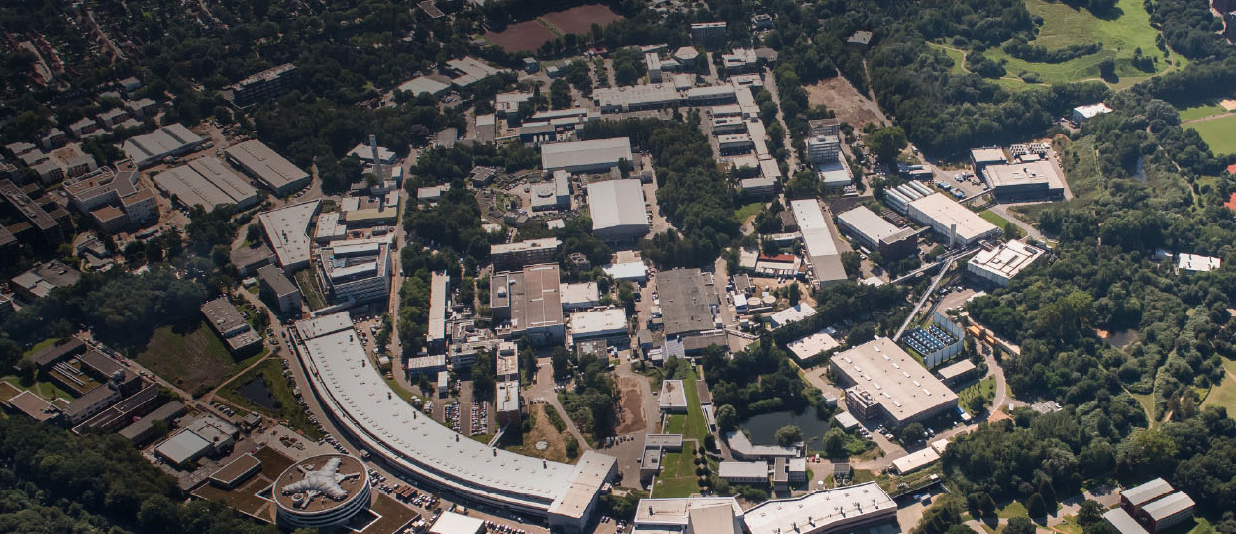
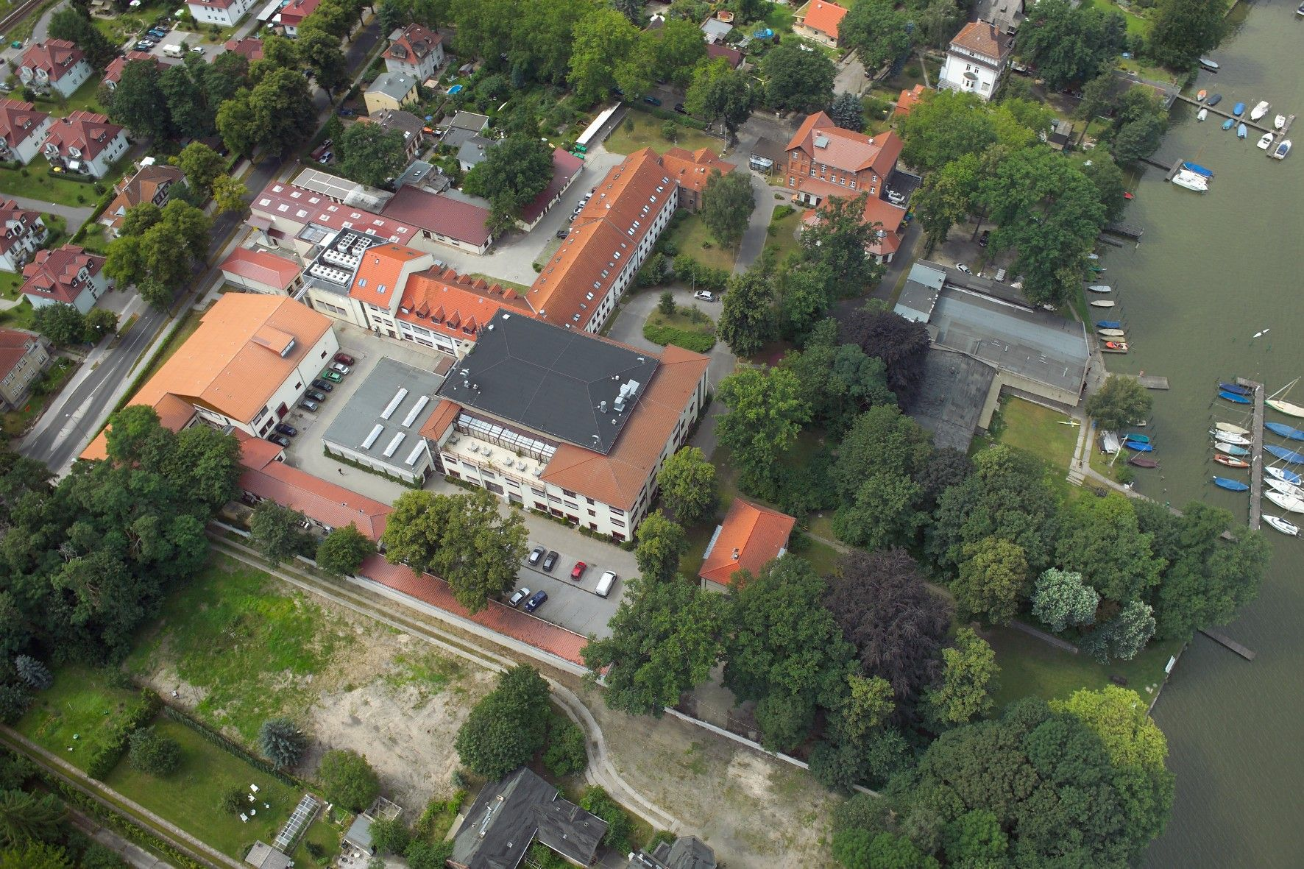
Quantum GANs at DESY.
Prof. Dr. Kerstin Borras and Dr. Dirk Krücker
Deutsches Elektronen-Synchrotron DESY and RWTH Aachen University

Slide 2
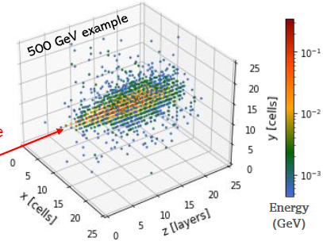
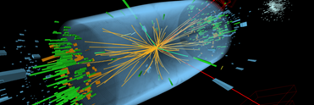
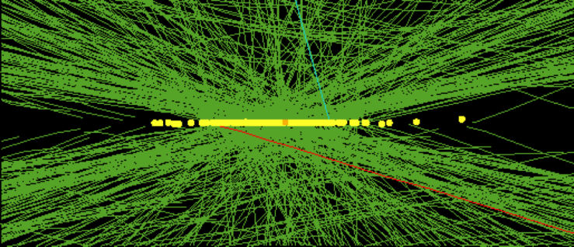


Quantum Machine Learning
Quantum Maschine Learning lies at the intersection of
Quantum Computing and Maschine Learning
High Luminosity LHC (>2029) needs vast amount of simulations with 200 pile-up events,
GRID Computing, Big Data Analysis
LHC (~20 pile-up events) LHC (~140 pile-up events)
Develop machine learning and tensor network methods for QC
Quantum GAN (Quantum Generative Adversarial Network) simulations for detectors
(CERN Openlab with joint Gentner PhD Student)
Tracking with Quantum Computers for LUXE and ATLAS
Early examples in Experimental Particle Physics

Slide 3
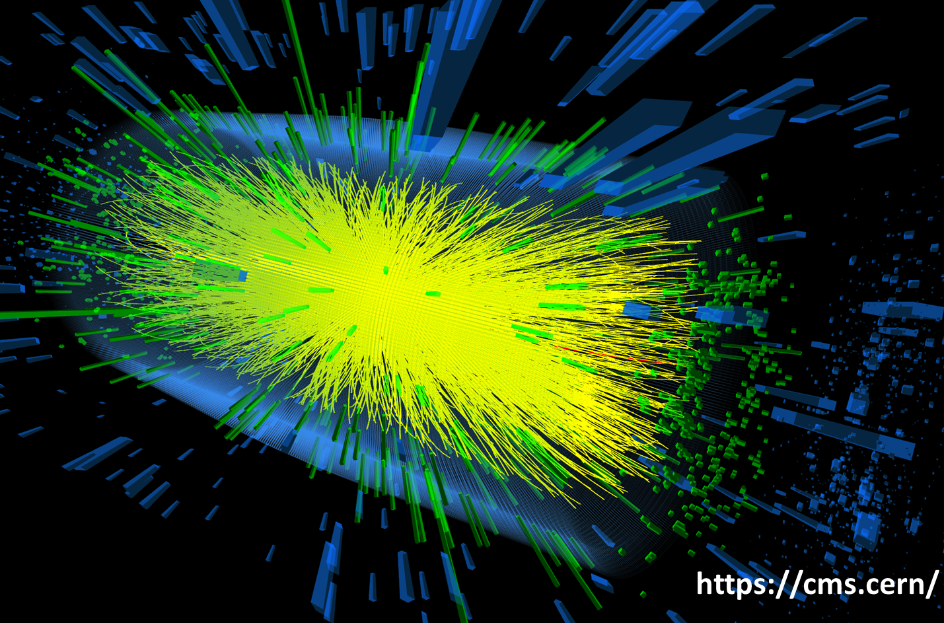

Quantum GANs in One Dimension
Down sample 3D shower image → 8 pixels → 3 qubits
8 quantum states:
|000⟩, |001⟩, |010⟩, |011⟩,
|100⟩, |101⟩, |110⟩, |111⟩
Use hybrid approach: quantum + classical
Employ a Quiskit qGAN model developed by IBM*
* https://qiskit.org/documentation/machine-learning/tutorials/04_qgans_for_loading_random_distributions.html
Quantum Generative Adversarial Network
Initial work by CERN Openlab et al:
Quantum Generative Adversarial Networks in a Continuous-Variable Architecture to Simulate High Energy Physics Detectors:
arXiv:2101.11132 [quant-ph]
Dual-Parameterized Quantum Circuit GAN Model in High Energy Physics
EPJ Web of Conferences 251, 03050 (2021)

Slide 4
Quantum GAN in One Dimension without Noise
F. Rehm, S. Vallecorsa, K. Borras, D. Krücker http://symsim.jinr.ru/grid2021/363-368-paper-67.pdf
training time ~ 1 day for 3000 epochs → speed up training
hyperparameter optimizations:
higher learning rate
implement exponential learning rate decay
different generator and discriminator learning rate
train discriminator more often than generator
Result:
10x speed up in training time → need only ~300 epochs instead of > 3000
Quantum Machine Learning
for HEP detector simulations
Proceedings of the 9th International Conference "Distributed Computing and Grid Technologies in Science and Education" (GRID'2021), Dubna, Russia, July 5-9, 2021
http://symsim.jinr.ru/grid2021/363-368-paper-67.pdf

Slide 5
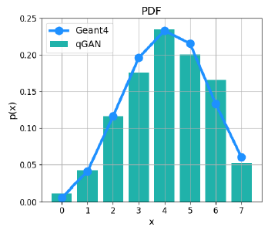
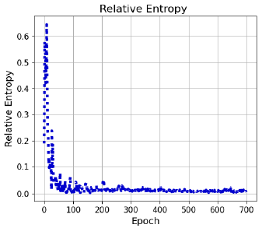
Quantum GAN in One Dimension with Noise
Apply Readout Noise (model IBMq belem)
F. Rehm, S. Vallecorsa, K. Borras, D. Krücker http://symsim.jinr.ru/grid2021/363-368-paper-67.pdf
no decrease in accuracy
fast convergence
Apply Full Noise (model IBMq manila)
no decrease in accuracy
fast convergence

Slide 6
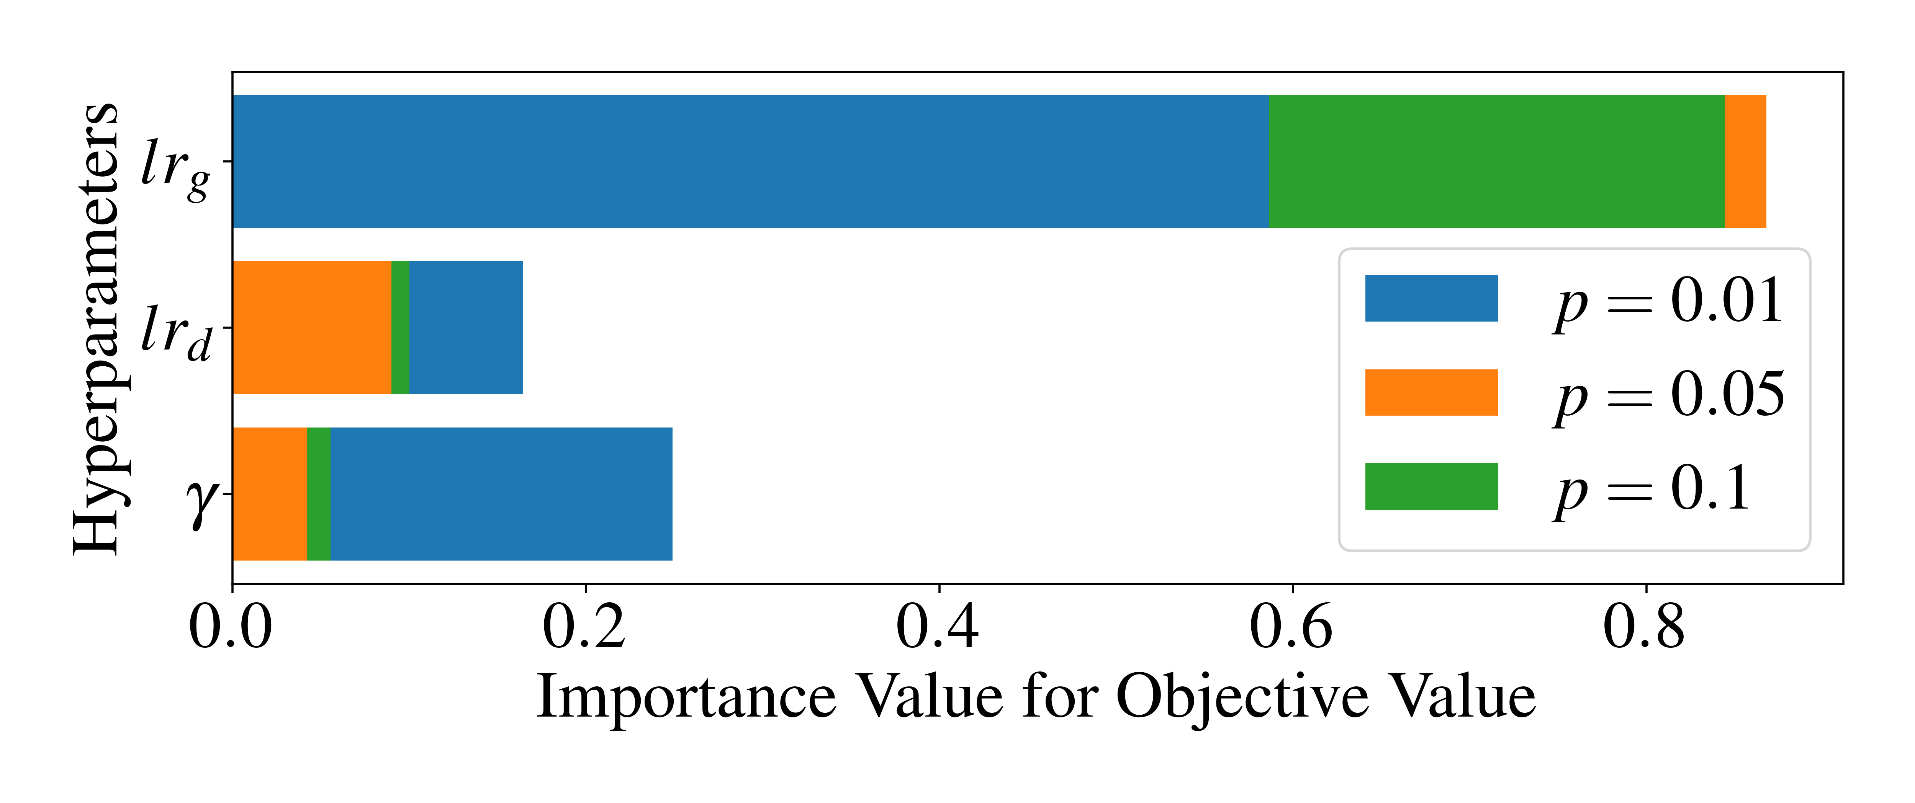
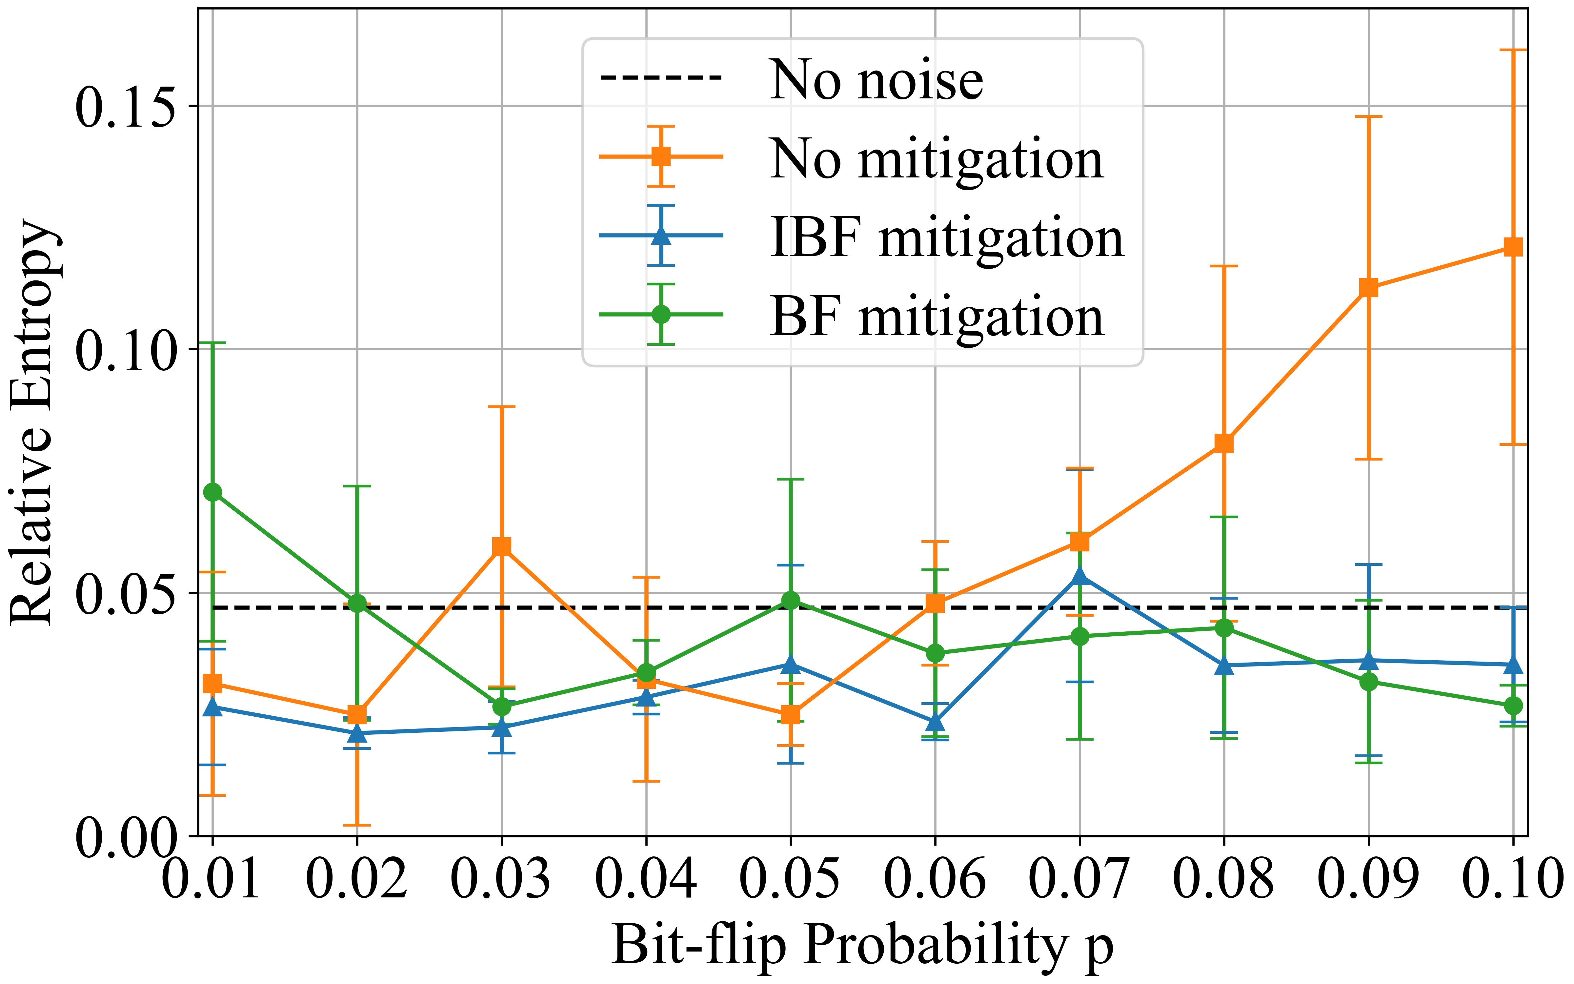
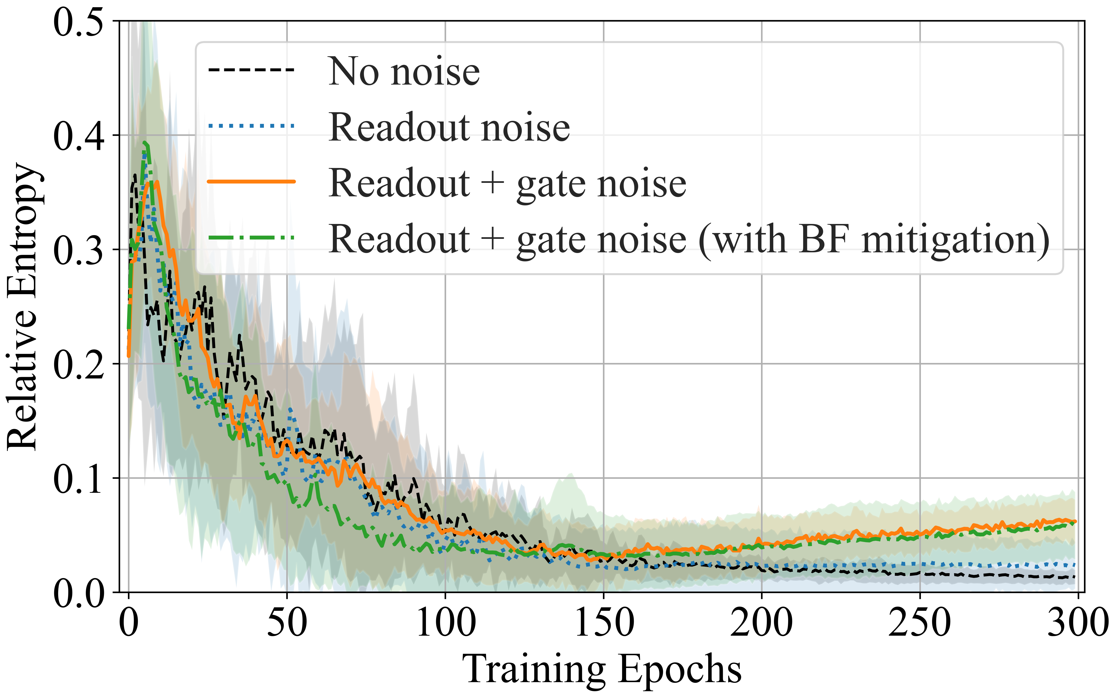
Impact of quantum noise on the training of Quantum GANs
K.Borras,S.Y.Chang,L.Funcke,M.Grossi,T.Hartung,K.Jansen, D.Kruecker,S.Kühn,F.Rehm, C.Tüysüz,S.Vallecorsa https://arxiv.org/abs/2203.01007
Detailed studies with noise and noise mitigation
Importance of hyperparameters for different
values of the bit-flip probability, p = {0.01, 0.05, 0.1}
generator learning rate lrg, discriminator learning rate lrd,
exponential decay rate γ for the learning layers
→ generator learning rate lrg has the highest impact → demonstrates the difficulty of training the quantum generator
Results without and with two different error mitigation methods
Error mitigation plays a crucial role for qGAN training in the presence of the large readout errors on current NISQ devices
Average values quickly converge in the noise-free and readout-error only cases, but do not seem to converge when including two-qubit gate errors → reveal the critical effect of two-qubit gate errors on qGAN training with current NISQ devices.

Slide 7
Quantum GAN in Two Dimensions
Early examples in Experimental Particle Physics
Down sample → 8x8 pixels → 6 qubits
Adapt Tree Tensor Network
Grant, E., Benedetti, M., Cao, S.et al.
Hierarchical quantum classifiers.
npjQuantum Inf4,65 (2018). https://doi.org/10.1038/s41534-018-0116-9

Slide 8
Work Package B - QGAN
Tasks and Milestones

