Slide 1
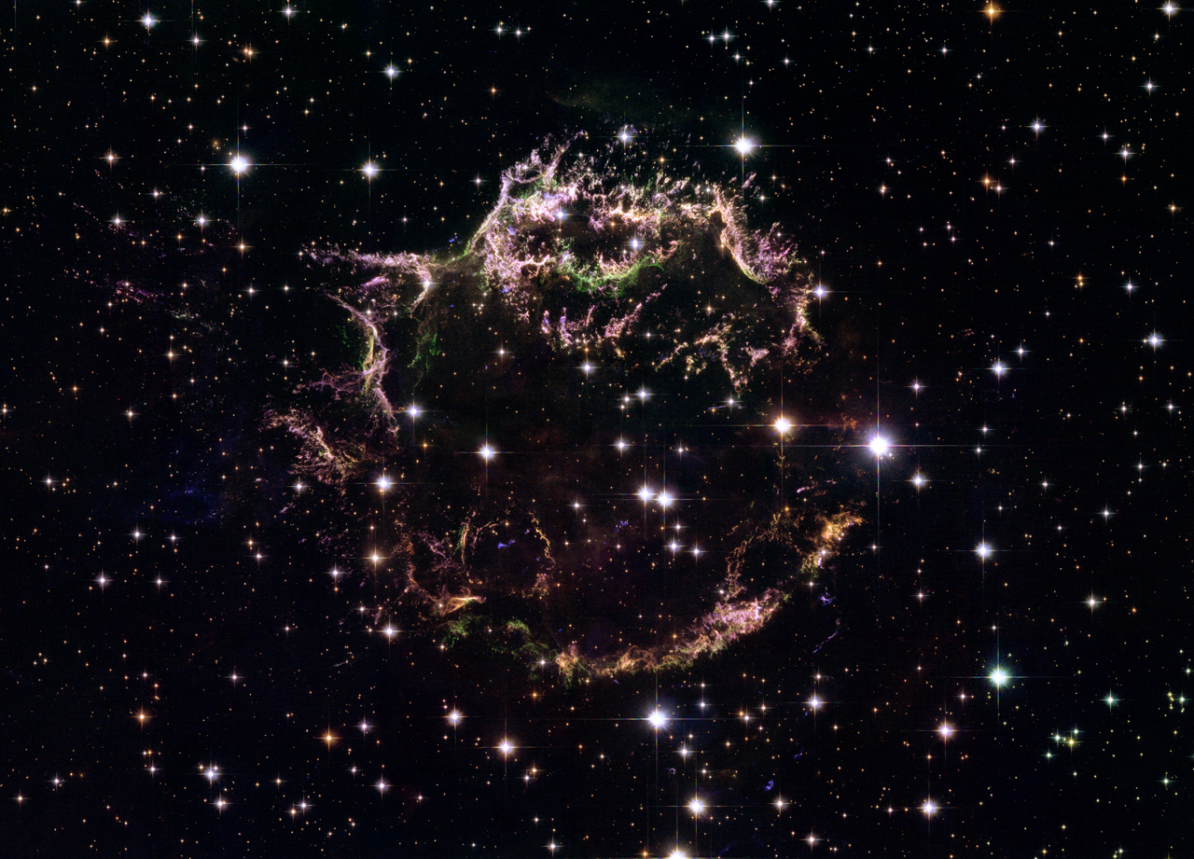



The plasma physics of shock acceleration
Tony Bell
STFC Rutherford Appleton Laboratory
and
University of Oxford
Cassiopeia A, the brightest (extra-solar) radio source in the sky
http://hubblesite.org/newscenter/archive/releases/2006/30/image/a/format/xlarge_web/

Slide 2





Diffusive shock acceleration
CR scattered by fluctuations in magnetic field
B₁
Shock velocity:
Cosmic ray density at shock:
$$u_{shock}$$
Cosmic Ray
B₂
$$N$$
shock
High velocity
plasma
Low velocity
plasma
At each shock crossing
$$\frac{∆ε}{ε}=\frac{u_{shock}}{c}$$
Fractional energy gain
Fraction of cosmic rays lost
$$\frac{∆N}{N}=−\frac{u_{shock}}{c}$$
Krimskii 1977, Axford et al 1977,
Bell 1978, Blandford & Ostriker 1978
Differential energy spectrum
$$n∝ε^{−2}$$

Slide 3
Part I: The acceleration process

Slide 4
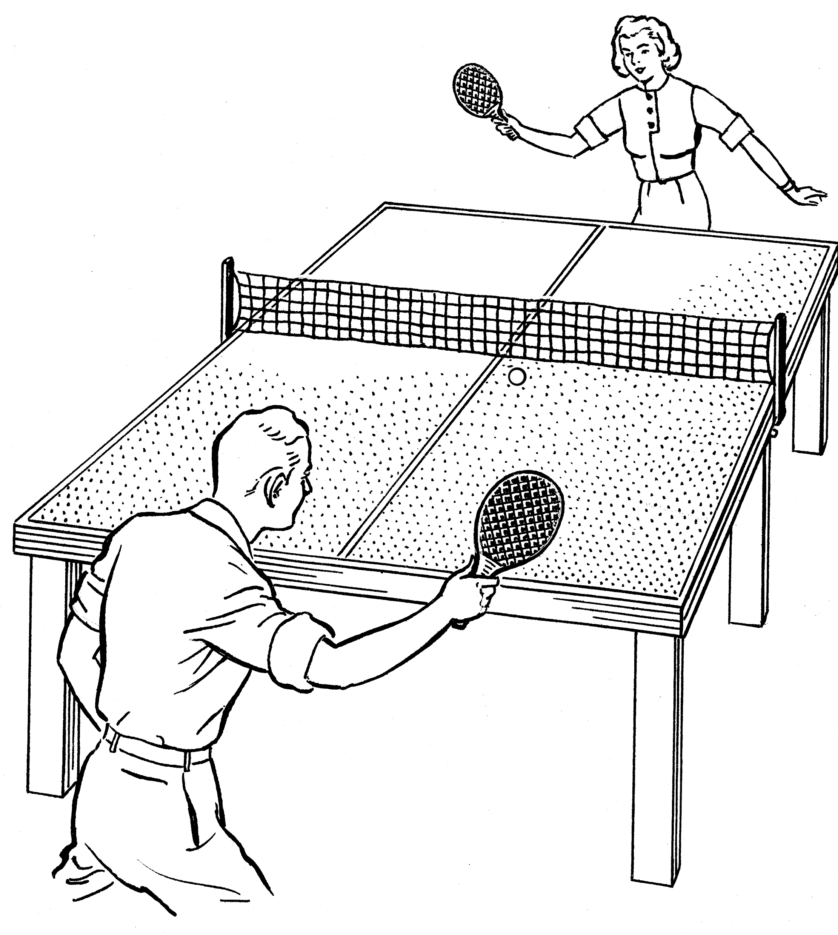


The traditional picture of shock acceleration
Analysis in rest frame of shock
Energy gain comes from up/downstream frame change
Energy comes from electric field
$$E=−u×B$$
background fluid velocity
Equations for CR energy($ε)$/momentum($p$)
eliminate
Giving
electric
magnetic
(energy in eV)
Note: independent of detailed trajectory

Slide 5
Strong shock
Derive energy gain
Flow velocity u_{s}
Flow velocity u_{s}/4
Single transit upstream (assume constant $u=u_{s}$)
One cycle, upstream + downstream transit

Slide 6
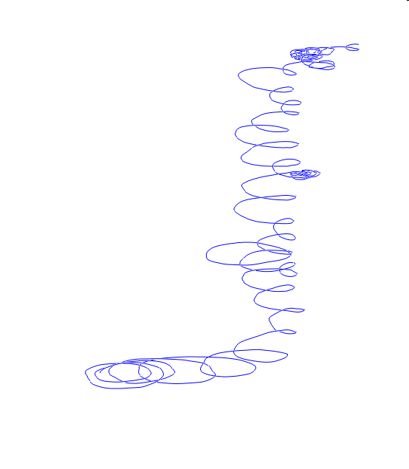
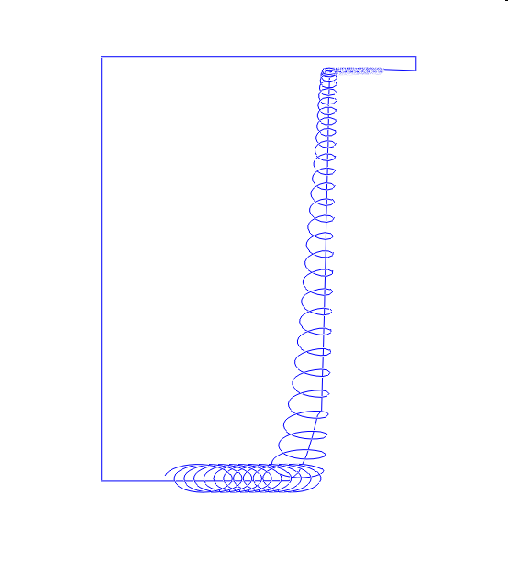
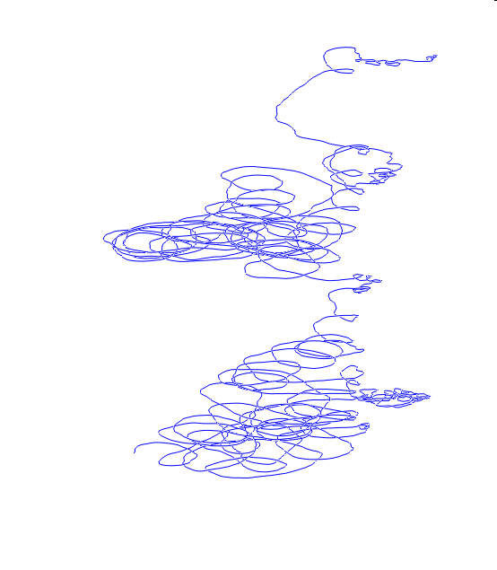
Special case: ‘perpendicular shock’
B₀
4B₀
perpendicular to shock normal
Scattering by perturbed magnetic field
No
scattering
Weak
scattering
Strong
scattering
Not to scale
B₀ into figure

Slide 7


Special case: ‘parallel shock’
B₀
$B_{0 }$parallel to shock normal and $u$
=0
CR energy gain comes from turbulent electric fields
as required
Correlation between $δz$ and $δB$

Slide 8


Maximum CR energy gain
Gain from one shock-crossing cycle
$$h$$
Average time spent upstream, from number balance,
Rate of energy gain
Characteristic time for energy gain is $4h/u_{s}$
What determines $h$?

Slide 9


What determines $h$, acceleration rate, maximum CR energy?
$h$determines acceleration rate
h
From diffusion theory with scattering mean free path
Larmor radius
In available time R/u_{s}
Hillas energy, but only provided
~
SNR as pevatrons requires (i) $B$ amplification (ii) turbulence on Larmor scale

Slide 10
Part II: Magnetic field amplification on the Larmor scale ($λ_{mfp}\sim r_{g})$

Slide 11
Non-resonant instability: CR current drives magnetic field lines into a helix
Generates amplified magnetic field on Larmor scale
CR particles coupled to MHD code
t=0
t=1.5
CR current
Lucek & Bell (2000)

Slide 12

Magnetic field amplification: how it works in a simple form
Expanding loops of magnetic field
Cosmic ray
Electric current
j x B
j x B
B
Instability grows until CR get tied to field lines: Loop size = r_{g}
Automatically saturates with
$$λ\sim r_{g}$$

Slide 13
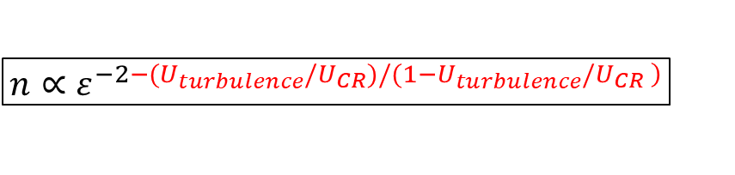


A price to pay: turbulence steepens the CR spectrum
CR scattered by fluctuations in magnetic field
B₁
Shock velocity:
Cosmic ray density at shock:
$$u_{shock}$$
Cosmic Ray
B₂
$$N$$
Now add in energy loss to
Magnetic field amplification
shock
High velocity
plasma
Low velocity
plasma
At each shock crossing
Fractional energy gain
Fraction of cosmic rays lost
$\frac{∆ε}{ε}=\frac{u_{shock}}{c}$ $\left(1−\frac{U_{turbulence}}{U_{CR}}\right)$
$$\frac{∆N}{N}=−\frac{u_{shock}}{c}$$
$$n∝ε^{−2−(U_{turbulence}/U_{CR})/(1−U_{turbulence}/U_{CR}\left. \right)}$$
Bell et al 2019

Slide 14

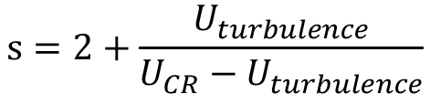



Diffusive shock acceleration: turbulence steepens the CR spectrum
$$n∝ε^{−s}$$
where
$$s=2+\frac{U_{turbulence}}{U_{CR}−U_{turbulence}}$$
$${ U}_{turbulence}∝\frac{u_{shock}^{}}{c^{}}U_{CR}$$
Non-resonant instability (consistent with observation):
SNR radio spectral index $α$ against expansion velocity
pre
$$α= \frac{s−1}{2}$$
extragalactic
galactic
from theory
$$u$$
Steepening by 0.2 in $s$(0.1 in $α$) reduces number reaching PeV by >10
This matters – see below

Slide 15
The real limit (not Hillas) on maximum CR energy
Need time to grow magnetic field on Larmor scale
CR flux relative to
background plasma
⨯
⨯
Instability growth places lower limit on CR charge escaping upstream beyond
⨯
CR must pass through or the instability would not grow to contain them

Slide 16

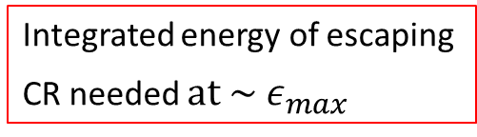
The real limit (not Hillas) on maximum CR energy
Total charge of high energy CR escaping (per unit area)
Coulomb m⁻²
Escaping CR carry away energy
Integrate over area of SNR blast wave
Integrated energy of escaping
CR needed $at {\sim ε}_{max}$
Assume 3% $(η_{CR,max})$ of$E_{SNR}$ goes into CR that drive largescale turbulence
Possibly why historical SNR are not Pevatrons (now)

Slide 17

Conclusion: no surprise that Pevatrons are problematic
Energy diverted to turbulence steepens spectrum: reduces number reaching highest energies
Hillas is a hard limit, not to be exceeded:
Hillas is an upper limit, often not reached
1) Requires Bohm diffusion
2) Takes time to amplify magnetic field
~
Note: definitely ‘ ‘ not ‘=‘
~
For more careful calculations see Zirakashvili & Ptuskin (2008); Bell, Schure, Reville & Giacinti (2013)

