Slide 1
ANGELOTTI/TOSCA STATUS UPDATE
TP 1: Energieeffiziente Nb₃Sn-Kavität auf Kupferbasis

Slide 2
Roadmap: ANGELOTTI
Nr. | Deadline (Quarter/year) | Description Milestone
1 | 04/2021 | Preconditioning of carrier material
2 | 02/2022 | Process optimization for copper
3 | 04/2022 | Coating of antenna and QPR cups
4 | 02/2023 | Construction of cavity sputtering system finished
5 | 03/2023 | Preconditioning of copper cavity
6 | 04/2023 | Coating of copper cavity
7 | 01/2024 | Evaluation of Nb₃Sn copper cavity
8 | 02/2024 | Documentation and publication of results

Slide 3
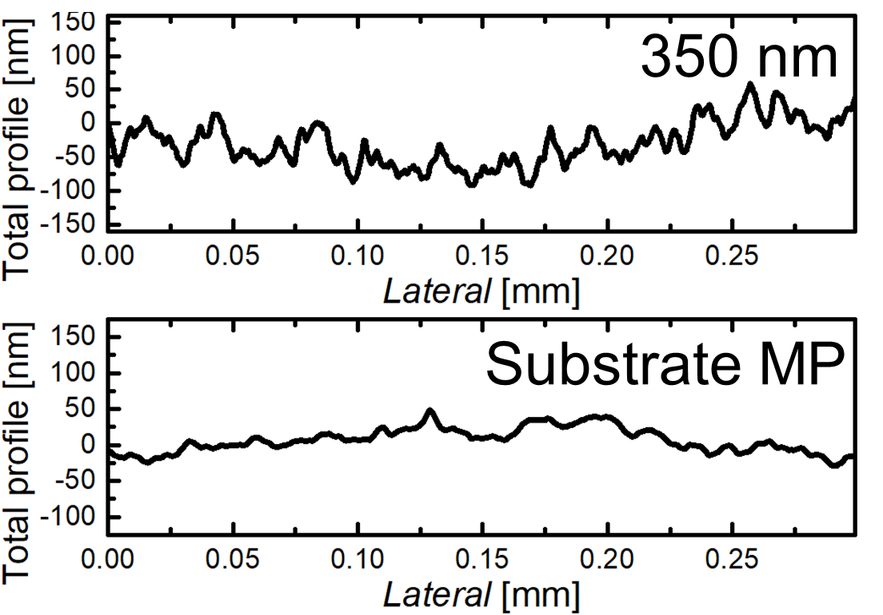
Preconditioning of carrier material

Slide 4
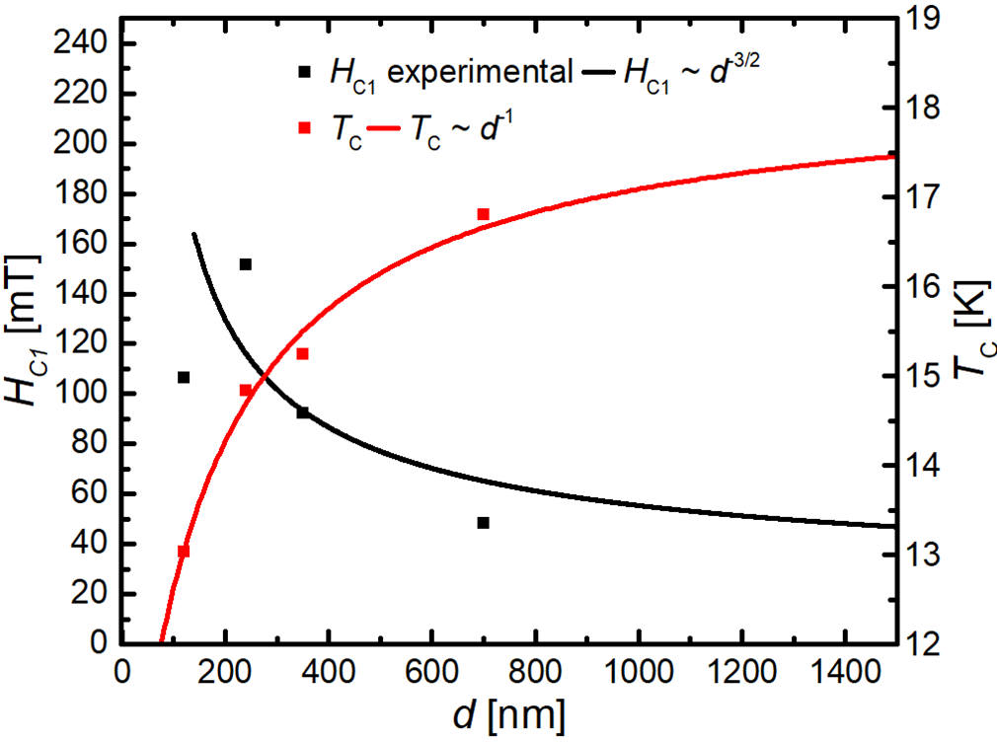
Process optimization for copper

Slide 5
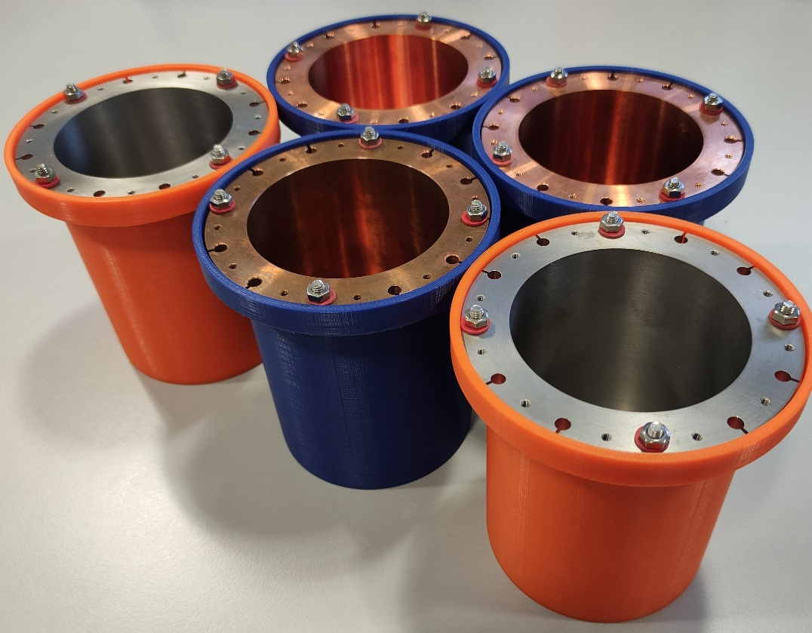
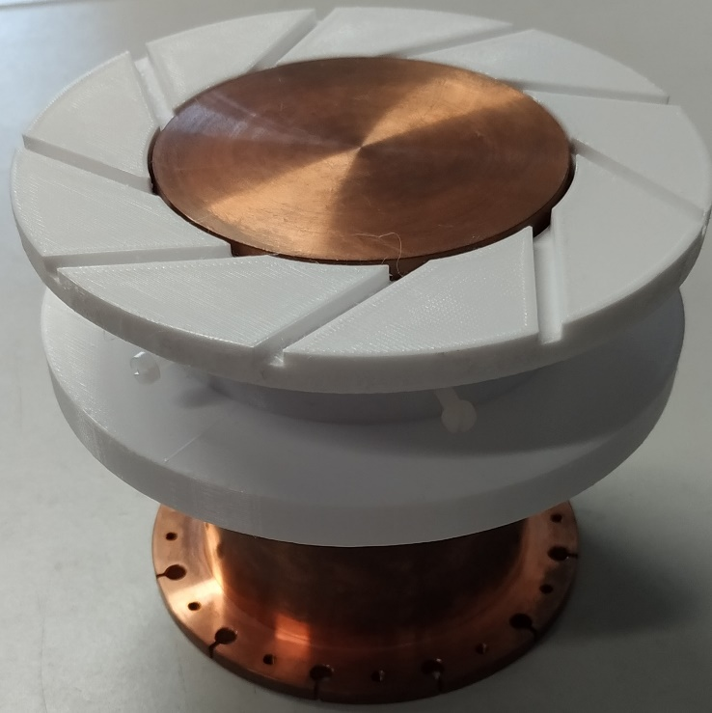
Coating of antenna and QPR cups

Slide 6
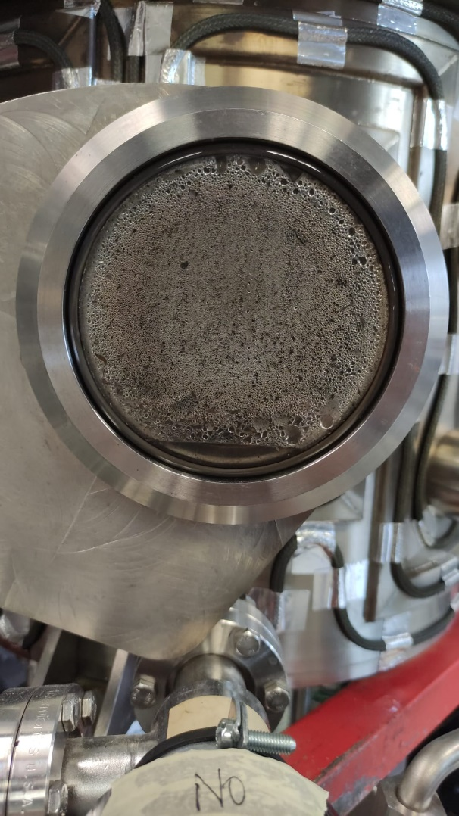
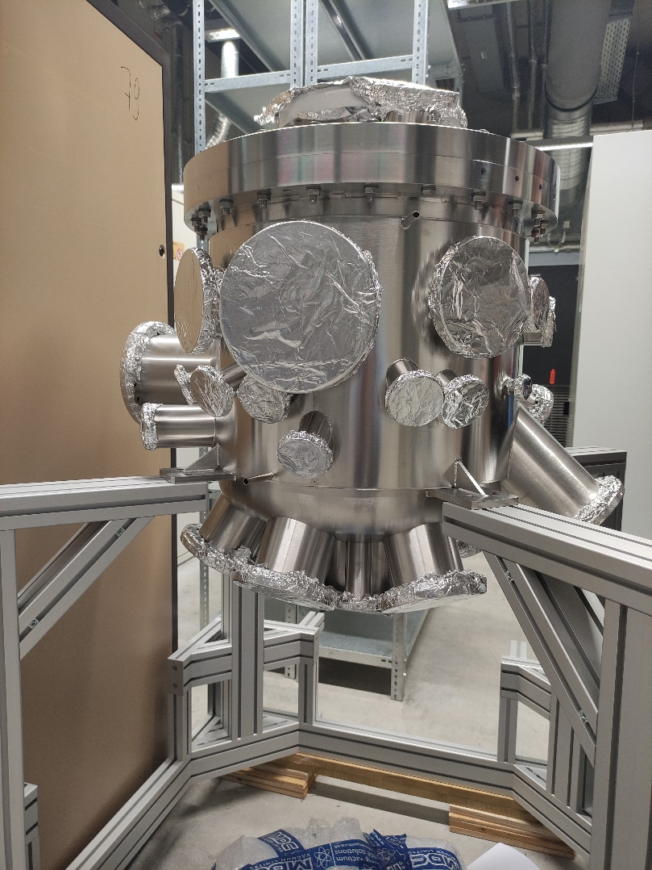
Coating of antenna and QPR cups

Slide 7
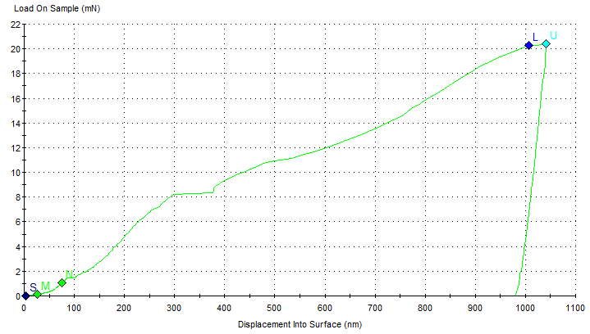
Adhesion test: nano ball indentation
Pop-In: Cracking of the layer

Slide 8
Adhesion test: scratch test

Slide 9
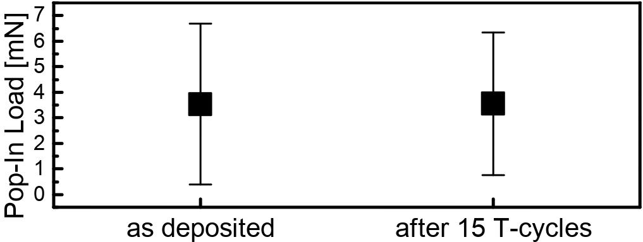
Adhesion test: T-cycling 5-300K

Slide 10
Double ring magnetron arm
Magnetron
Cavity

Slide 11
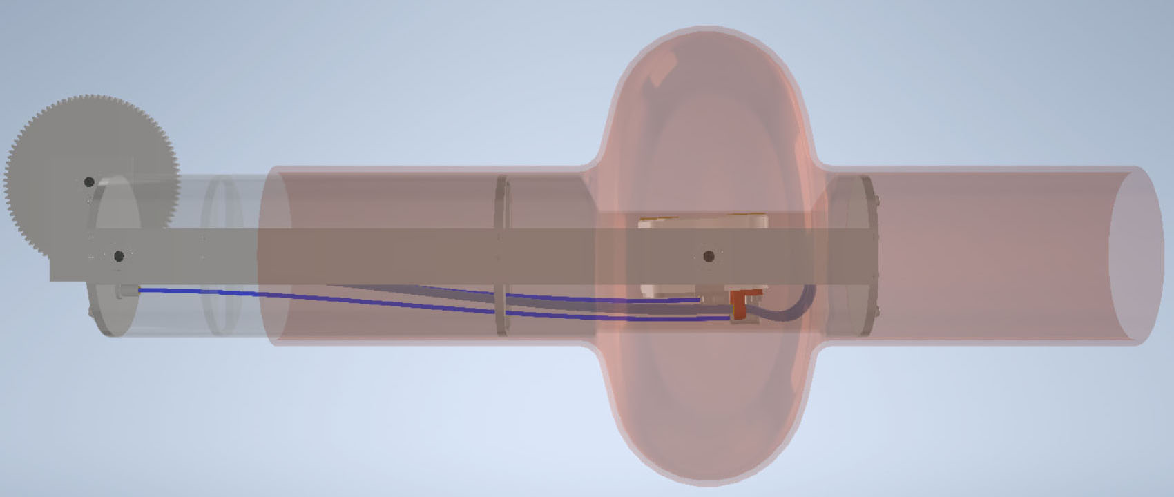
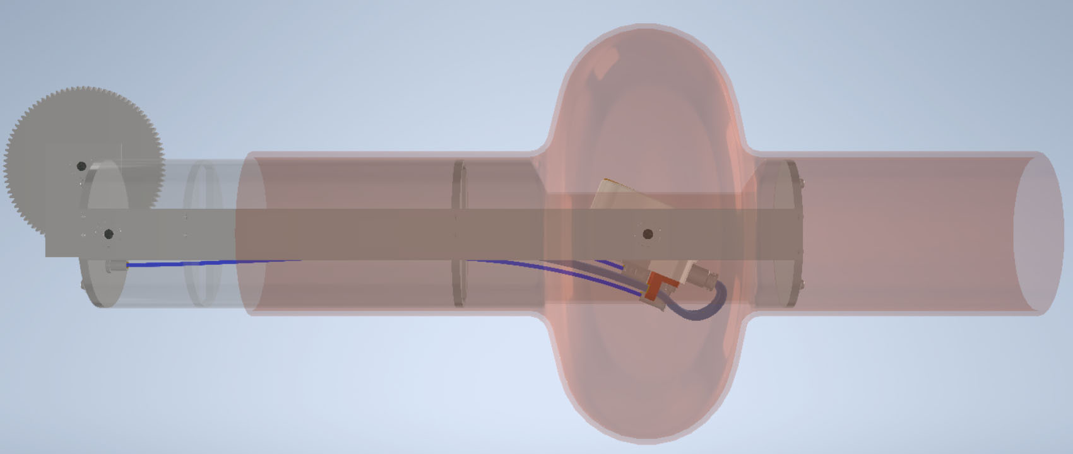
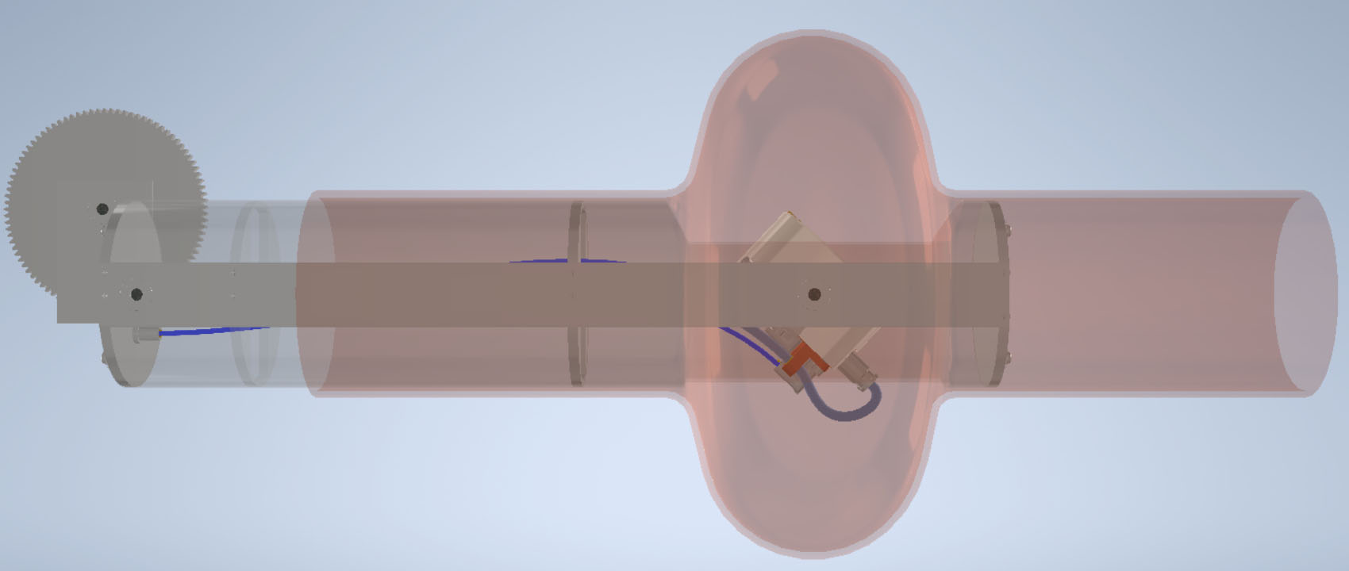
Sputtering
Sputtering spot

Slide 12
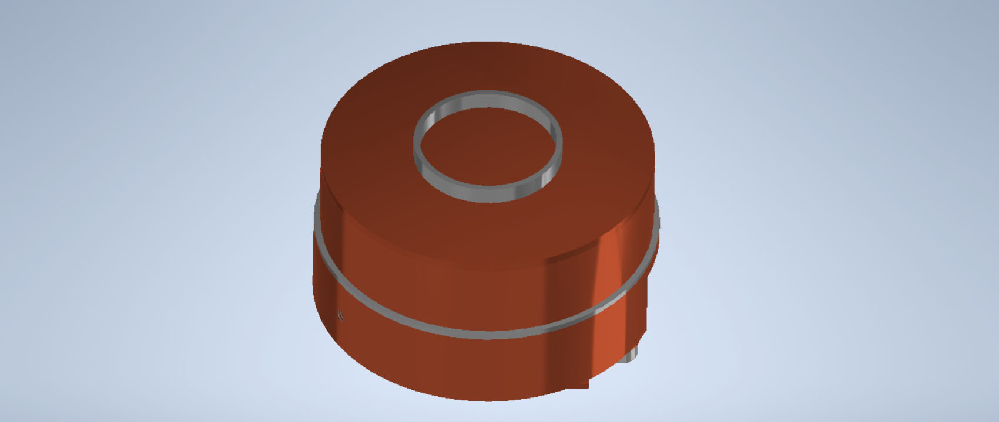
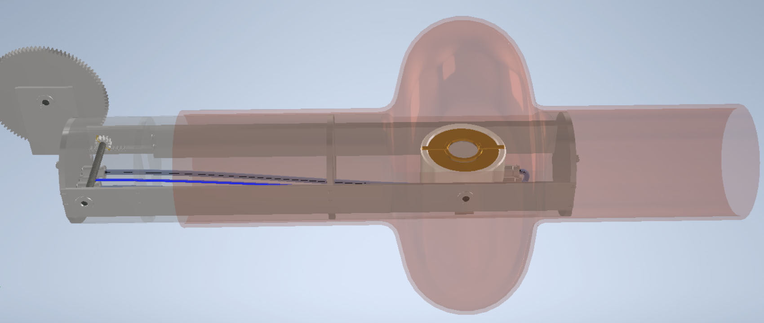
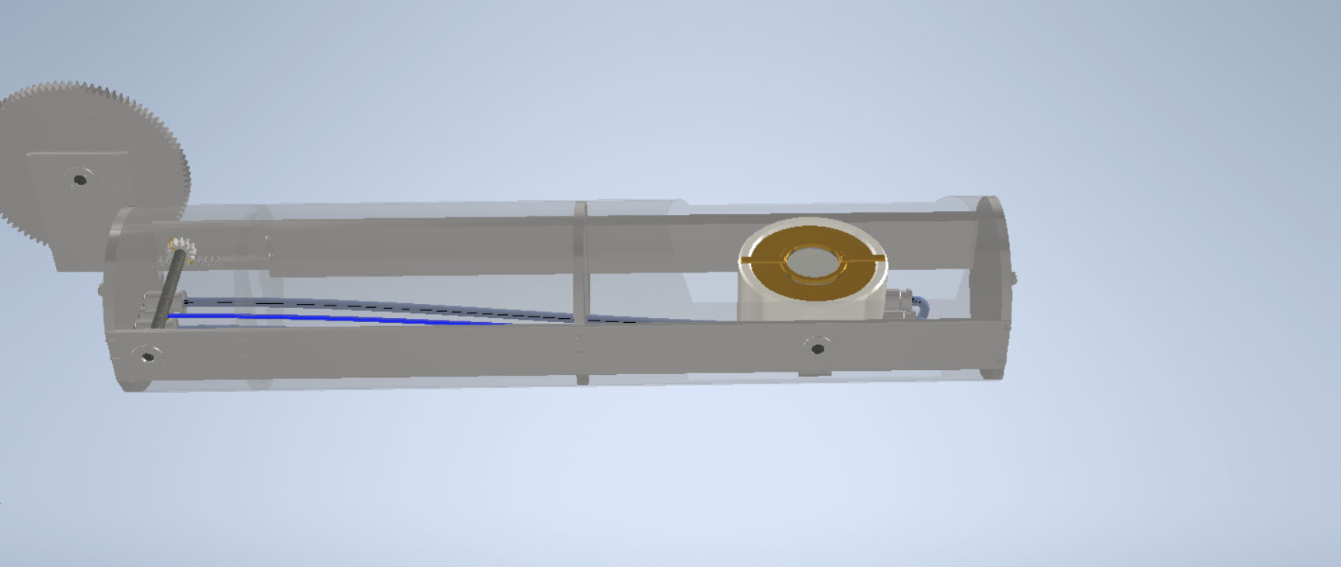
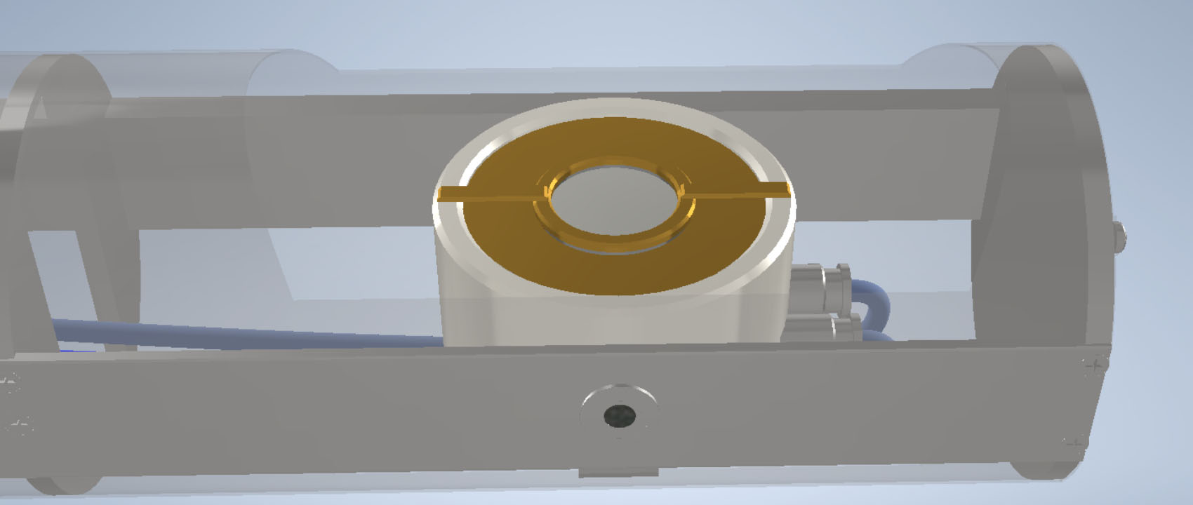
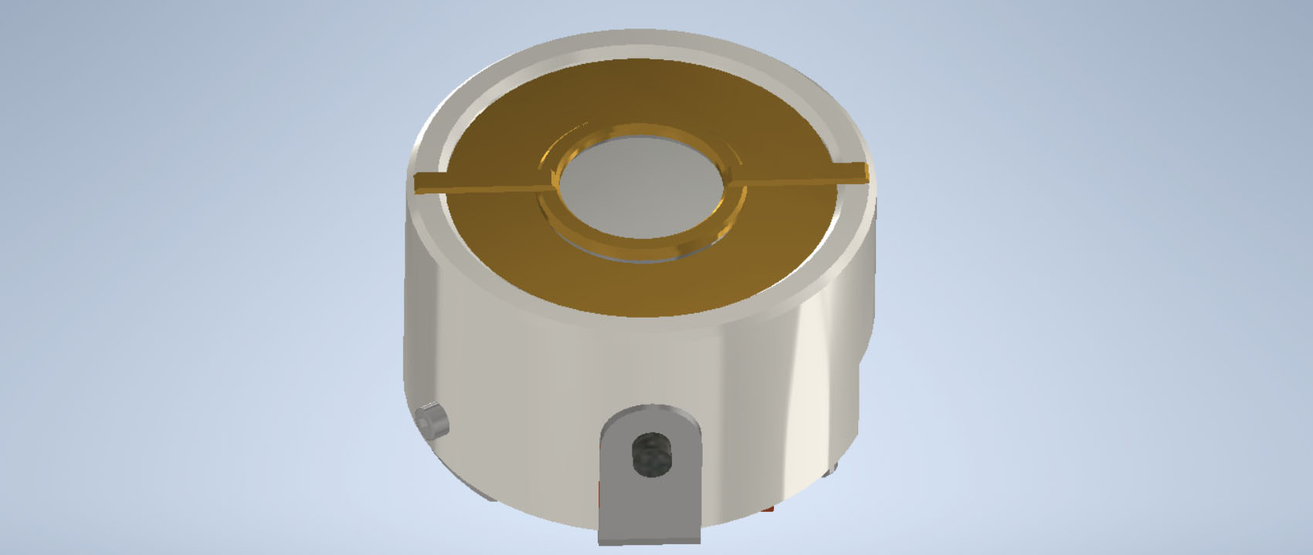
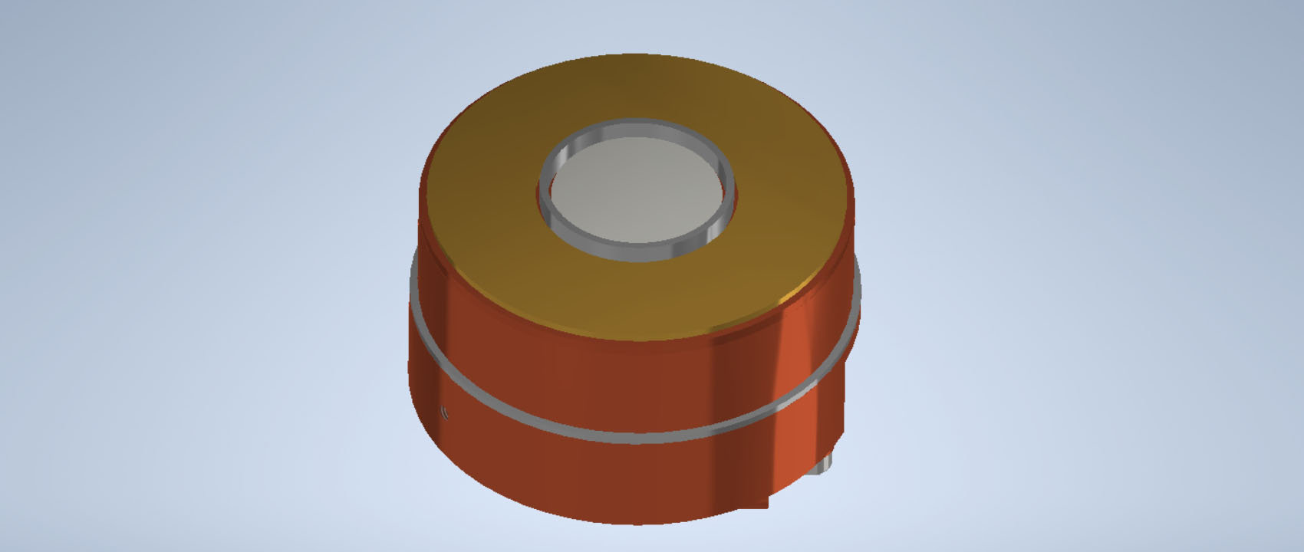
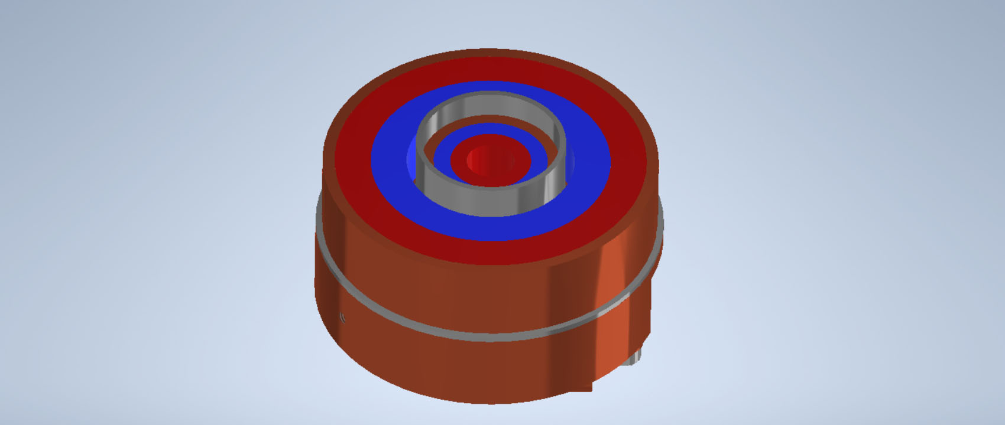
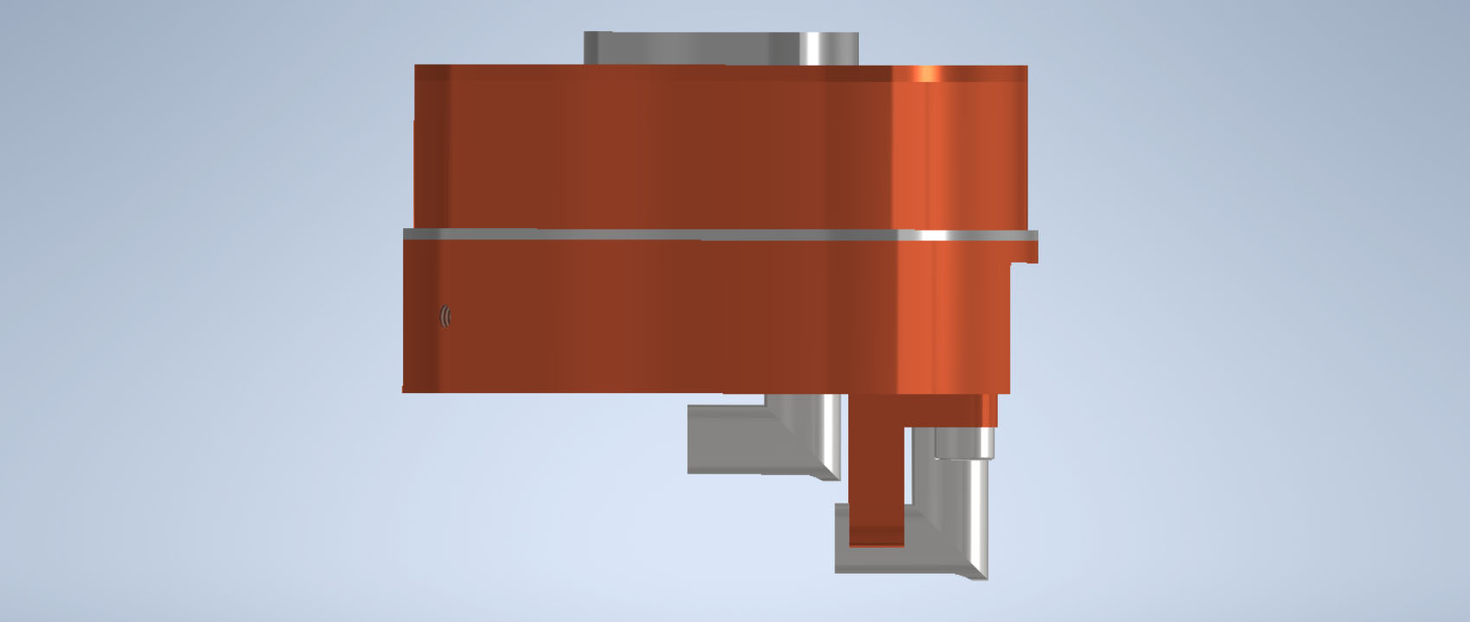
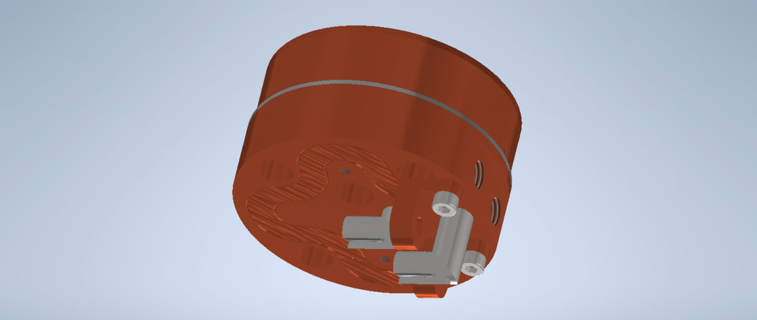
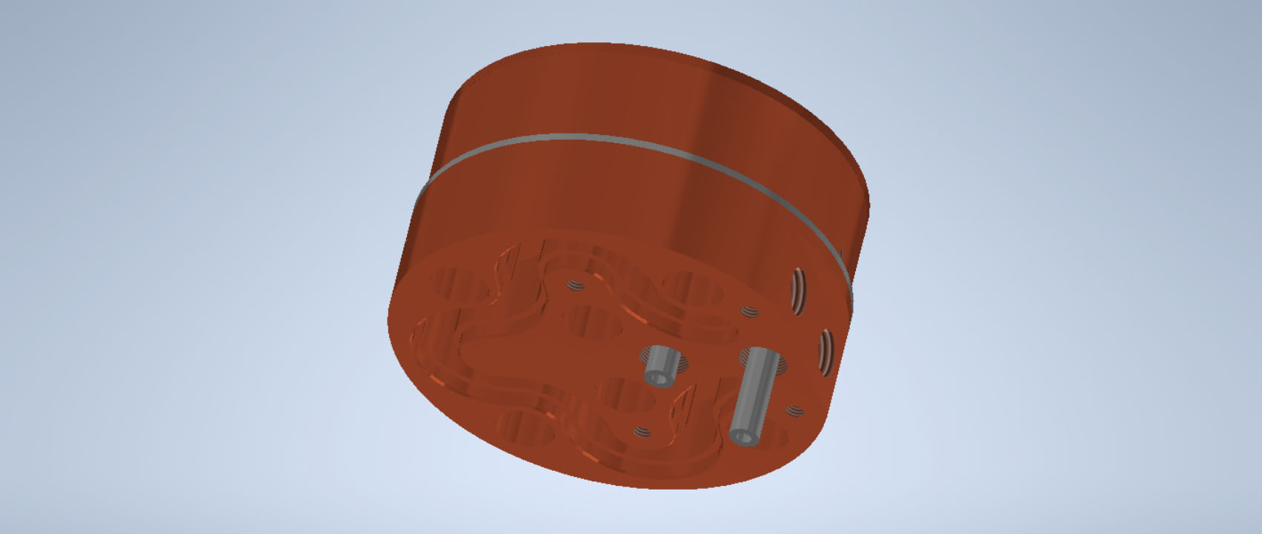
Magnetron
Sn target
Ring magnets
Nb target
Top with magnets
Ceramic insulation
Water inlets
Bottom with cooling
Water channel
Ceramic insulation
of high voltage inlets

Slide 13
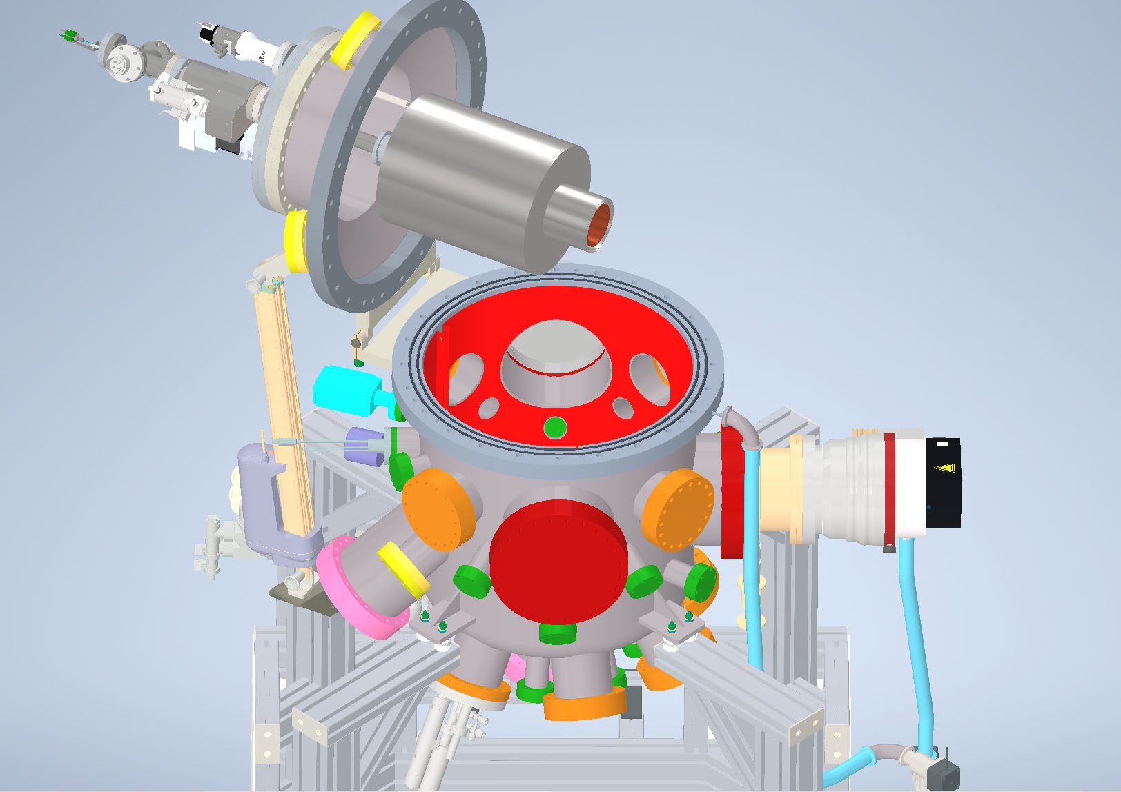
Coating of antenna and QPR cups

