Slide 1
LEAPS-INNOV WP7
Task 1 – Collaboration platform
LEAPS-Innov Annual Meeting, May 3-5 2022
David Pennicard (DESY), Darren Spruce (MAX-IV)
This project has received funding from the European Union´s Horizon 2020 research and innovation programme under grant agreement No. 101004728

Slide 2
Task 1 – Collaboration platform
What have we done so far?
Meetings
Seminars
Web space for communication between stakeholders, and sharing code and data
These fulfil the LEAPS-Innov proposal
What can we improve or add?
Some thoughts to be discussed later

Slide 3
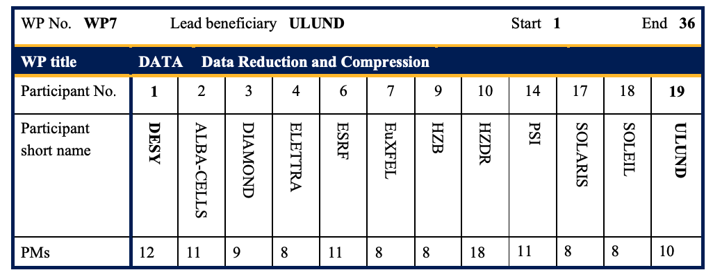
Project meetings so far
Task leader meetings – monthly or more frequently
So far, full collaboration meetings roughly every 6 months
Notes:
Do we say more about the general goals of the project? Tricky

Slide 4
Full collaboration meetings so far
April 2021 – Kickoff
Presentations of ongoing and planned work at member institutes
Followed up by survey of activities and needs at institutes
Oct 2021 – workshop (combined with first seminar)
Feedback of survey results
Presentation of first work on tomography at HZDR, call for interested collaborators
Seminar speakers – Blosc and hdf5plugin, experiments at Eu.XFEL
May 2022 – Annual LEAPS-Innov meeting (in person)
Notes:
What do we want to get out of this?
Putting things presented at seminars into action?
More collaboration between labs on specific topics?
Is the difficultly one of getting things working in practice?

Slide 5
Improving meetings?
Is the pattern of meetings OK?
Let’s see how our first face-to-face, multi-day meeting goes!
Joint activities between labs would naturally lead to more frequent meetings between the specific labs involved
Increasing industrial involvement?
Notes:
How to improve adoption of different methods?
Question

Slide 6
Seminars
Oct 2021 - Blosc and hdf5plugin, experiments at Eu.XFEL
Feb 2022 – Compression for tomography
Apr 2022 – FPGAs for compression
Planned – Compression with libAPR
Up to about 100 participants from different labs per seminar – thanks for forwarding information to your colleagues!
We would appreciate suggestions for more speakers

Slide 7
More ideas related to seminars?
More follow-up on seminars?
Try to get speakers to commit to some sort of tutorial, code sharing etc?
Tutorial or hackathon on implementation of data pipelines (suggested by HZDR)?

Slide 8
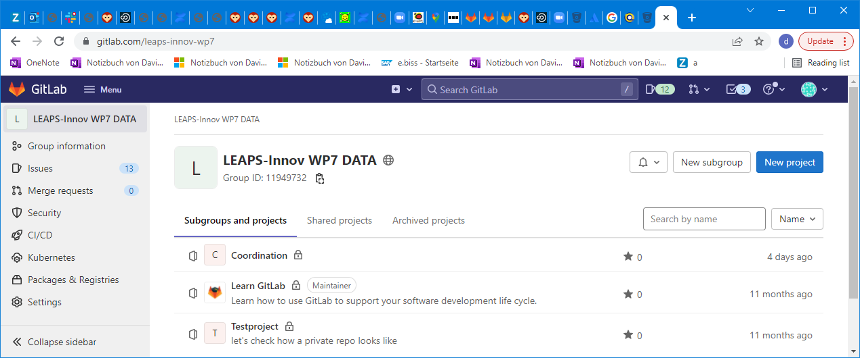
Webpages
Gitlab project:
https://gitlab.com/leaps-innov-wp7

Slide 9
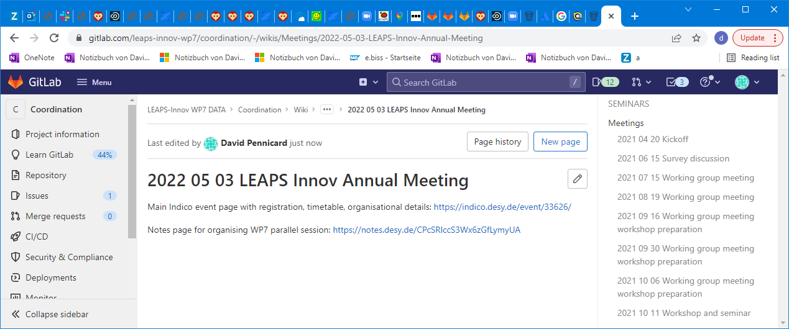
Webpages
Wiki within Gitlab project (requires membership of project)
https://gitlab.com/leaps-innov-wp7/coordination/-/wikis/home
Notes:
Notes access?

Slide 10
Webpages – note taking
We usually have a collaborative note-taking page running during meetings (linked to from Gitlab, and Indico where appropriate)

Slide 11
Future expansion of webpages
Code repositories will be added to Gitlab for code developed within project
Should we create new wikis with different access permissions for other uses?
Public information on data processing, e.g. links to repositories belonging to LEAPS labs?

Slide 12
Summary
Meetings – monthly meetings between task leaders, general meetings every 6 months so far
Seminars – have started organizing these every ~2 months
Webpage – currently use wiki for meetings and seminars, will host code in future

