Slide 1
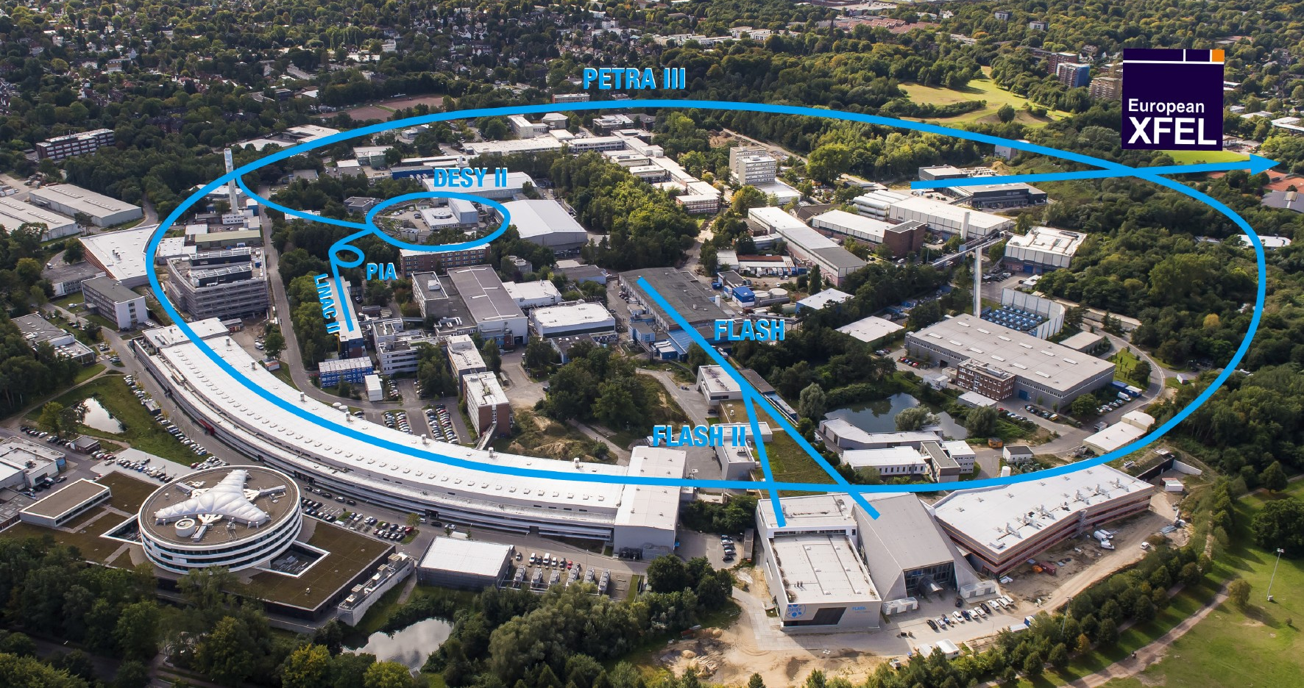
LEAPS-Innov annual meeting 2022 – DESY
David Pennicard
Notes:
Structure:
CERN – chip info etc
Photon counting vs event-by-event readout
Current uses
Eng stuff?
What about Fabian Borstal’s work? (“Getting to grips”?)

Slide 2
Areas of development
Serial crystallography
  Image compression
  Image rejection by conventional and machine learning methods
Hardware acceleration using Xilinx Alveo cards
General developments at DESY
Notes:
OWN IMPLEMENTATION

Slide 3
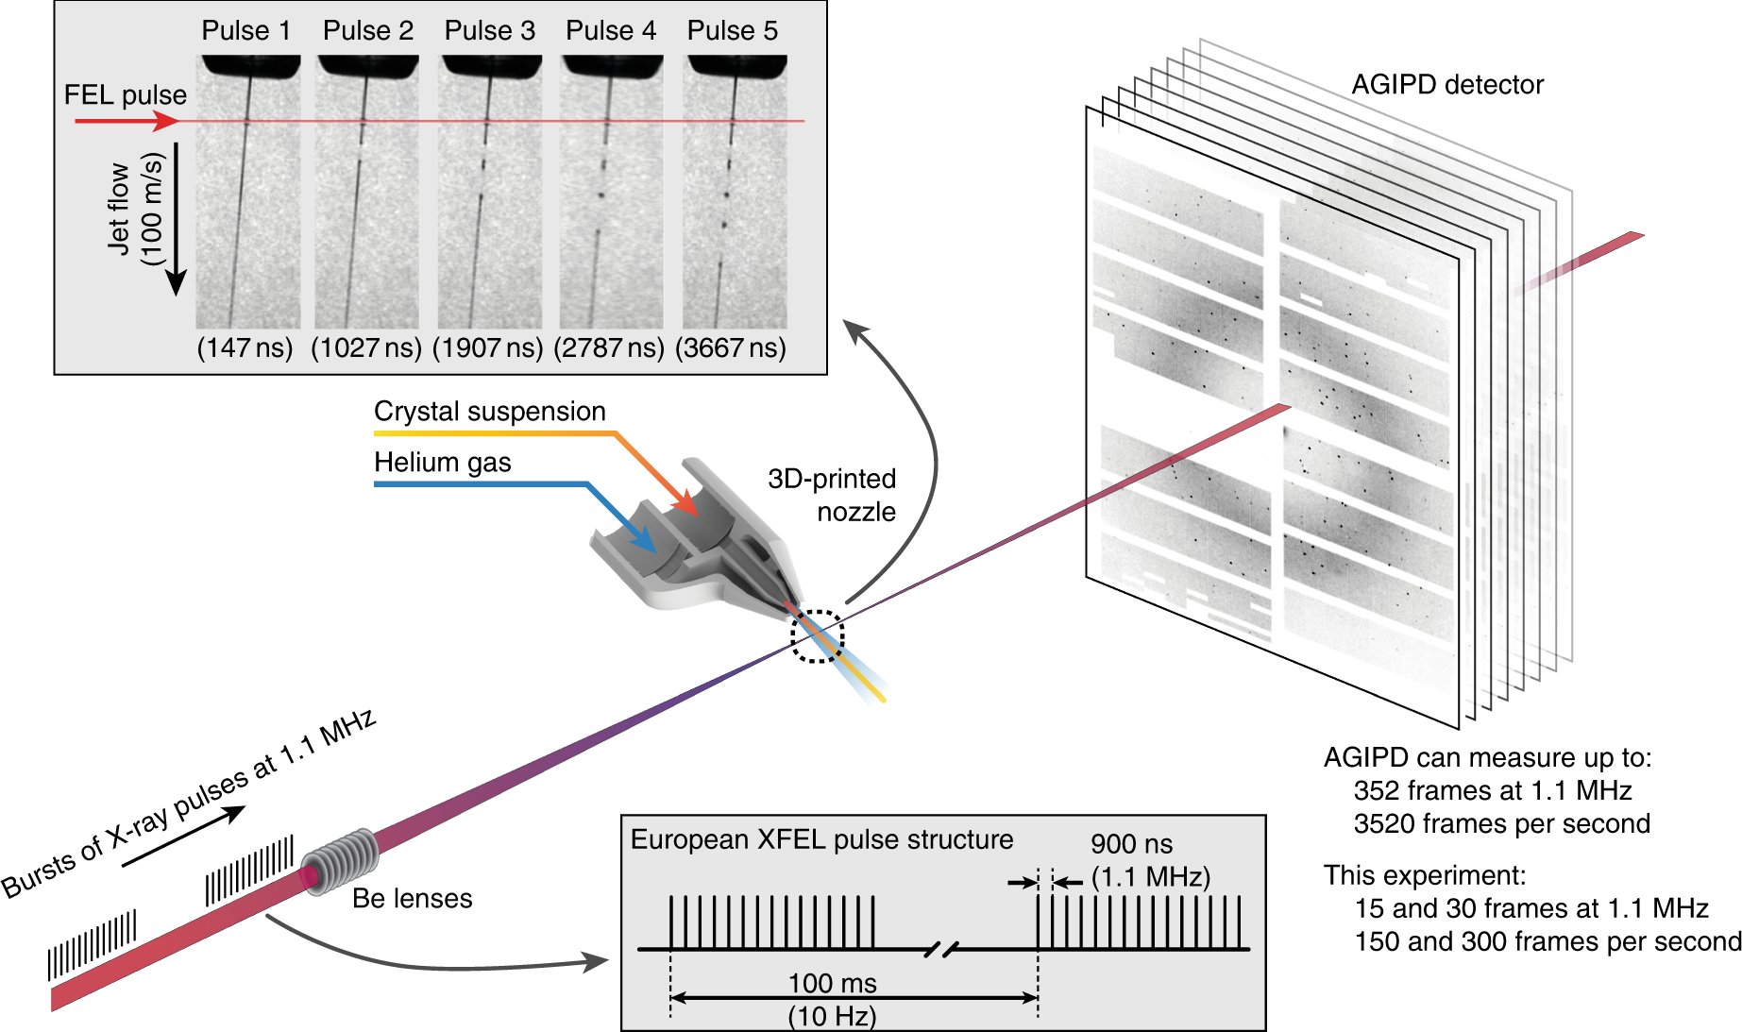
Serial crystallography

Slide 4
Serial crystallography - compression (>200 tests)
Marina Galchenkova,
Alexandra Tolstikova,
Oleksandr Yefanov
The best CR is usually Bzip2, but gzip (lev6) is a good compromise.
*bzip2 - from PyTables package
**gzip, lzf - h5py
***Blosc + {lz4, lz4hc, blosclz, snappy, zlib, zstd}; Bitshuffle with/without lz4; lz4; zstd - hdf5plugin

Slide 5
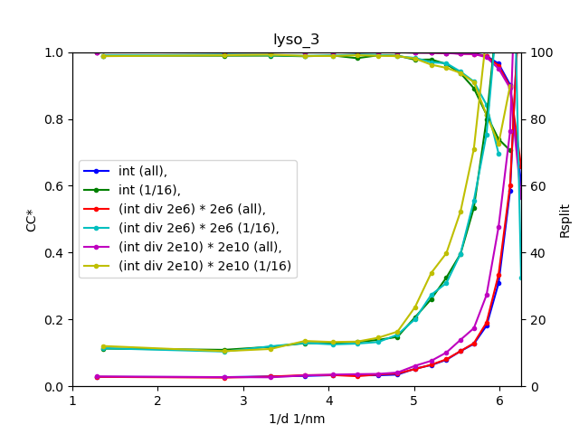
Quality check for lossy compression
Quality checks for SX/MX:
1. Data quality: Rsplit,CC*
2. Model quality: Rfree/Rwork
3. Anomalous signal (SAD/MAD)
4.* Electron density maps
Checking data quality is the key!
Currently we are tuning the parameters and checking the result for every run!
Requires automatization but not so easy to implement.
Marina Galchenkova,
Alexandra Tolstikova,
Oleksandr Yefanov
Notes:
Rsplit – symmetrical intensities in dataset, look for difference

Slide 6
Rejecting bad images
Conventional peak-counting methods in Cheetah software
  Aim – identify as many peaks as possible, with statistical modelling of background
  Some tuning of parameters by users required
Investigating machine learning methods as a fast, reliable “first pass” rejecting clearly bad data
  Use computationally cheap methods from computer vision
  Learn rejection criteria from previous experiments
Notes:
Not a replacement for conventional peak finding, but computationally cheap first pass at data

Slide 7
Rejecting bad images with machine learning
Computationally cheap ORB method finds image features
Neural network trained from sets of good and bad images (obtained by experts using conventional methods)
Vahid Rahmani, Shah Nawaz, Jaisinh Bhosale
Notes:
Also experimented with neural networks

Slide 8
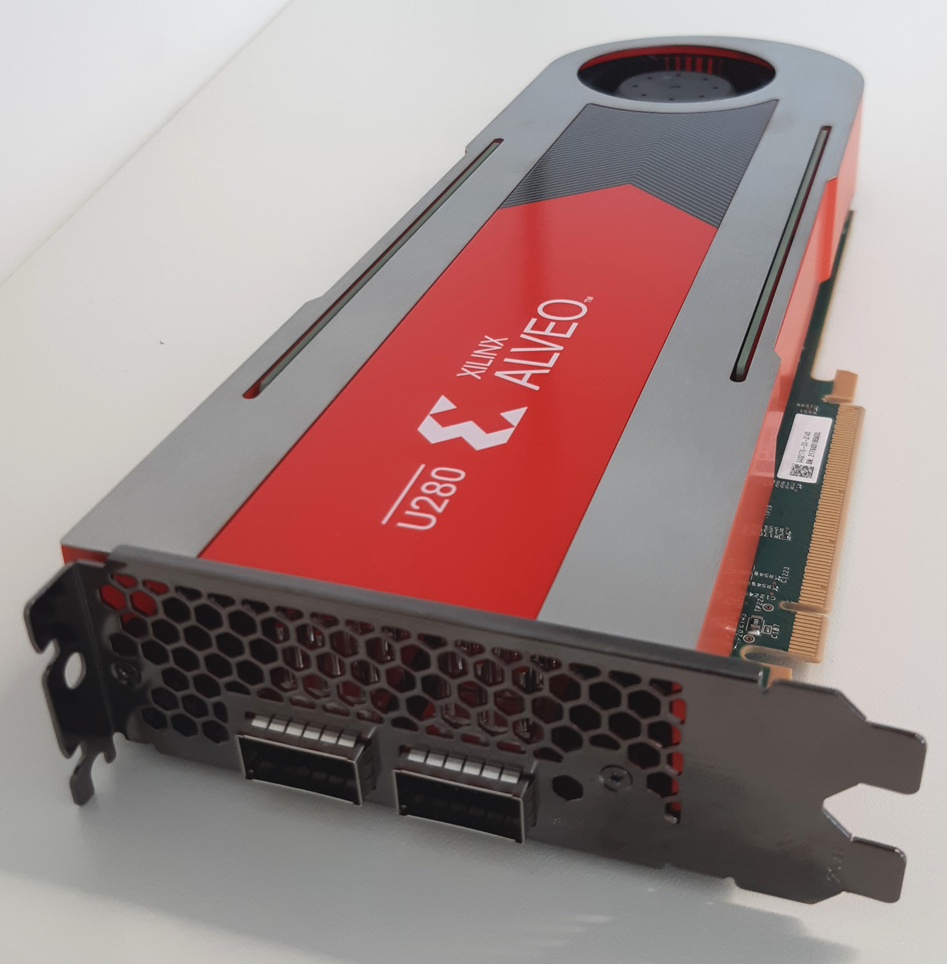
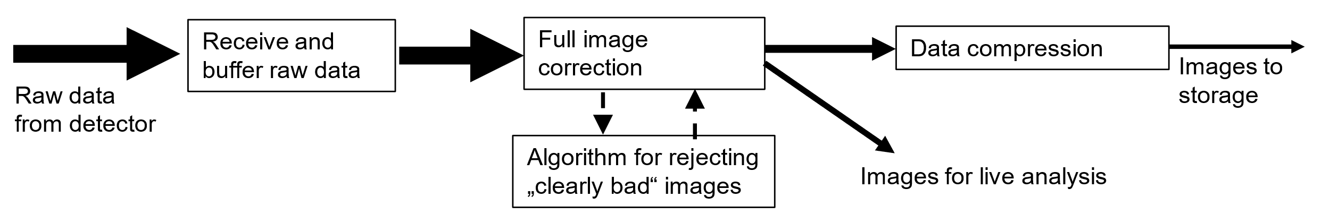
Using Xilinx Alveo FPGA accelerator cards
Features of Alveo card:
  Data reception with 2 x 100 Gigabit Ethernet
  Data processing in Ultrascale+ FPGA fabric
  High-bandwidth memory for temporary storage
  PCIe4.0 transfer to server PC
Similar to Alpha-Data 9H3 board used by PSI (Filip Leonarski) in Jungfraujoch system
Shabarish Pala Setty
Notes:
Hopefully run same kind of code
Is LZ4 basically glorified RLE?

Slide 9
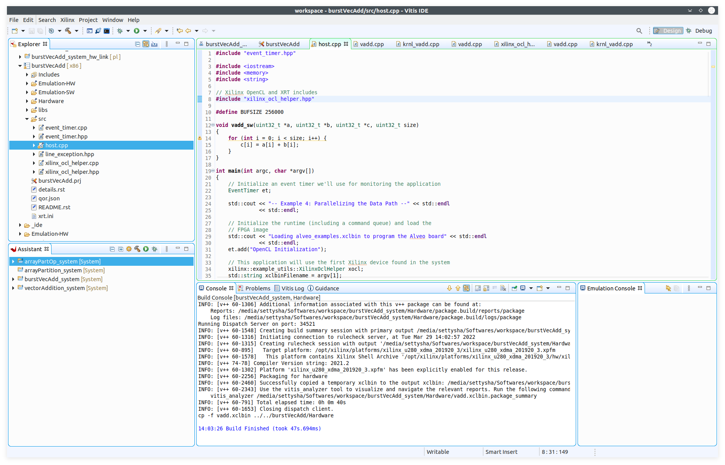
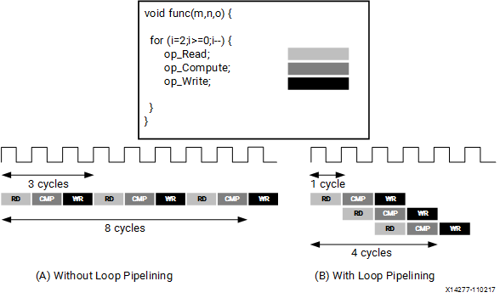
Vivado HLS development environment
Code written in sequential style based on C++
Various directives in code indicate how this can be efficiently converted to VHDL for synthesis

Slide 10
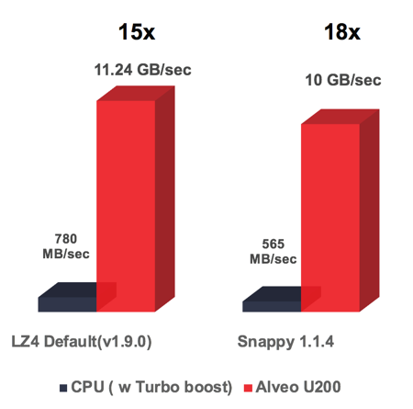
On-FPGA lossless compression
Xilinx offers compression libraries, including LZ4
However, for our applications, very basic implementations might still get good results?
44% U200 FPGA usage; perhaps 33% for U280.
https://www.xilinx.com/products/design-tools/vitis/vitis-libraries/vitis-data-compression.html
Notes:
BloscLZ
LZ4 – minimum match length of 4, so maybe have some special sequences e.g. 0 0 1 0 or similar that can match and affect compresion. But otherwise probs mostly OK. Issue is maybe 4-character sequences with a 1 in there.

Slide 11
Compression tests with LAMBDA and X-ray tube
Used Zlib algorithm on PC:
  DEFLATE stage looks for recurring series of characters (like LZ4, but no bitshuffle)
  Huffman coding stage encodes characters efficiently (like Morse code)
Simplest DEFLATE algorithm (run length encoding only) gave better results!
  Explanation – virtually all our redundancy here comes from long runs of 0s
X-ray tube flux | Standard Zlib – compression | Standard Zlib – time | Run length only – compression | Run length only – time
High | x 4.5 | 70 s | x 5.0 | 61 s
Low | x 7.5 | 51 s | x 9.5 | 49 s
Notes:
Curious to see if we can do this with LZ4.

Slide 12
General ongoing work at DESY
Some DESY central IT staffing shifting from particle physics to photon science
  DESY has a large computing facility that is part of the LHC computing grid (tier 2)
  PETRA staff organized workshops explaining PETRA science and needs, including compression
Development of ASAP::O distributed streaming system for data analysis
  Typical usage – streaming data from beamline to computer cluster and back for online analysis
  http://asapo.desy.de/
Notes:
DESY – significant central IT department, historically more focused on particle physics
Politically – more work on photon science, but under the command of a different division
- steering in the direction we want

Slide 13
Serial crystallography – real time data processing
Real time compression allowed deletion of non-useful datasets

Slide 14
Summary
Serial crystallography
  Image compression
  Image rejection by conventional and machine learning methods
Hardware acceleration using Xilinx Alveo cards
General developments at DESY
Thanks for listening

Slide 16
People involved
Anton Barty leads new scientific computing group in photon science
Experimental control: Thorsten Kracht
Central IT: Volker Gulzow
  Central scientific computing: Martin Gasthuber
David Pennicard – photon science detector group data projects
Notes:
What to say about this?

Slide 17
Data processing and reduction in serial crystallography
Coherent imaging group at CFEL (Centre for FEL science) – Henry Chapman
Developed techniques for serial crystallography at FELs and synchrotrons

Slide 18
Data processing and reduction in serial crystallography
Coherent imaging group at CFEL (Centre for FEL science) – Henry Chapman
Developed techniques for serial crystallography at FELs and synchrotrons
Cheetah: software for high throughput data reduction and analysis
  A. Barty et al., J. Appl. Crystallogr. 47, pp 1118–1131 (2014), doi:10.1107/S1600576714007626
  Performs various image corrections - e.g. background subtraction
  Evaluates image quality metrics (no of Bragg spots, maximum resolution) to allow rejection of images where crystal was missed
  Outputs selected corrected images and useful statistics (e.g. hit rate)

Slide 19
Machine learning results

Slide 20
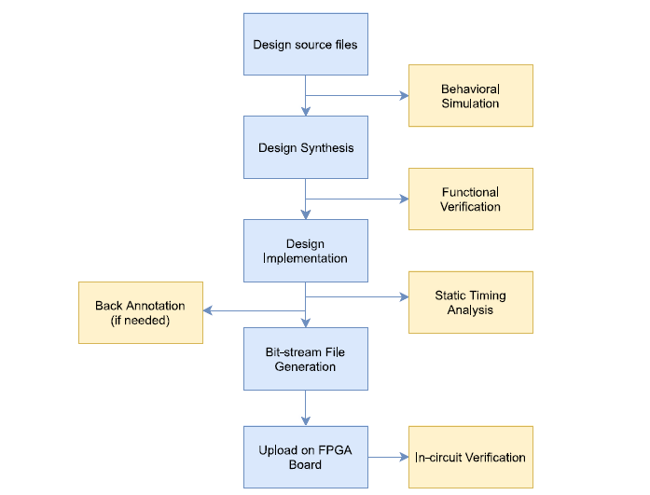
Basic FPGA design flow
VHDL(RTL)/C++
Fig 3 : FPGA Design Flow

Slide 21
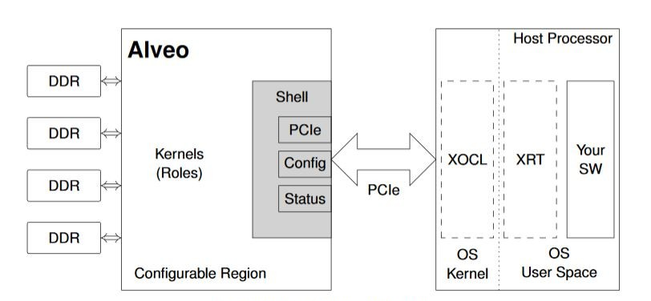
Leveraging U280 accelerator card
Designing optimal kernels to compute data correction and optimizing to the best possible result
Fig 5 : ALVEO topology

Slide 22
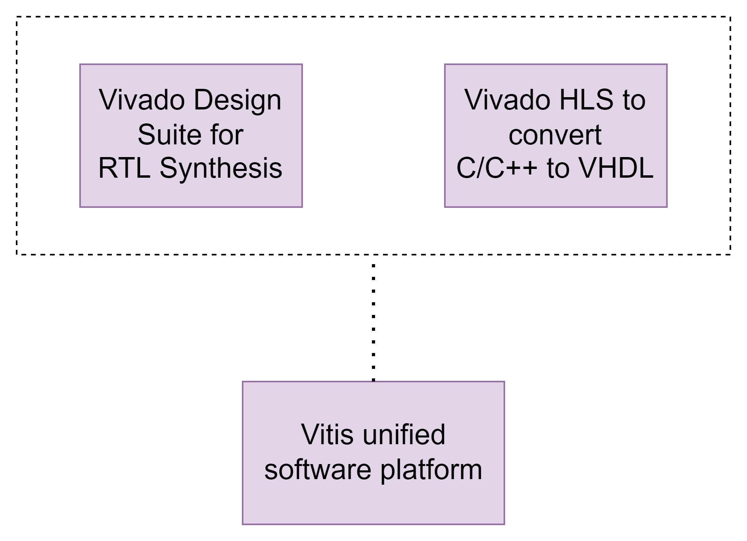
Tool chain for hardware/software development
Fig 4 : Tool chain

Slide 23
Information on storage system at PETRA-III
Beamline file system – 220 TB SSD (+ 220 TB HDD)
  Designed to cope with high instantaneous data rates
GPFS core file system: 7.2 PB total (1.5 free)
  Data kept until 180 days passed without access
dCache: Archive with 2 copies of data
NB – 3 macromolecular crystallography beamlines run by EMBL use own storage system

Slide 24
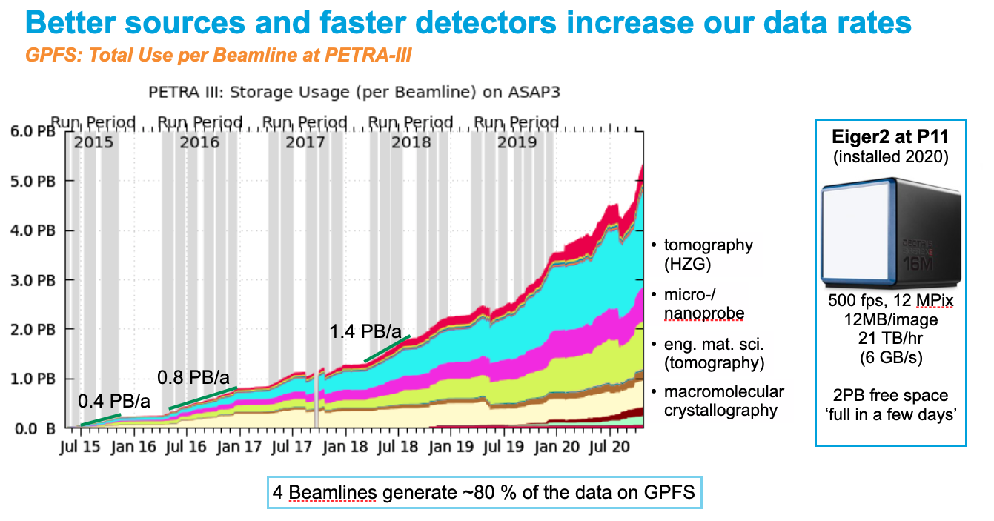
Data rates and needs
4 PB/a slope
Notes:
Data archived after 180 days without access

Slide 25
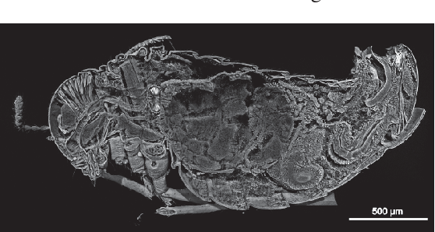
Tomography
Approx 50% of data on GPFS
Processed data (reconstructions) approximately same size as original data!
Lossless compression gives limited benefit (compared to diffraction)

Slide 26
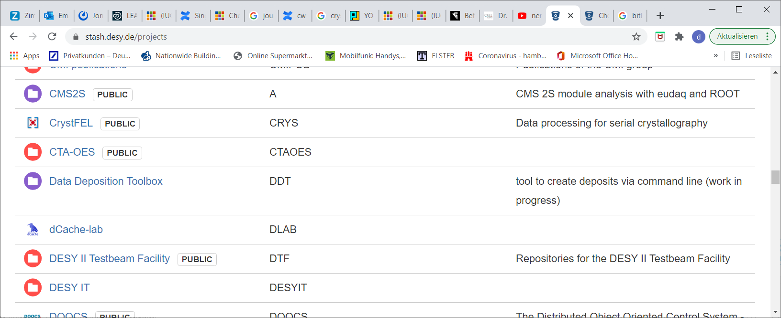
Code sharing and repositories
Bitbucket / Stash code repository – stash.desy.de
Uses „git“
Projects can be made public

Slide 27
Work in DESY IT
DESY has a large computing facility that is part of the LHC computing grid (tier 2)
DESY central IT staffing shifting from particle physics to photon science
PETRA staff organized workshops explaining PETRA science and needs, including compression
  Biggest potential for improving compression comes from tomography
  Some demand for azimuthal integration, though technically challenging
  Demand for more support with online analysis, to allow deletion of bad datasets during experiment
Notes:
DESY – significant central IT department, historically more focused on particle physics
Politically – more work on photon science, but under the command of a different division
- steering in the direction we want

