Slide 1
SciCat: History and Status
Stephan Egli:: Paul Scherrer Institut
SciCat Meeting Hamburg, July 6th 2022

Slide 2
History: continuous evolution over > 5 years
2015-12 Initial data catalog requirement definition within DaaS project
2016-08-26 Decision for new development based on prototype demo
2016-09-16 ESS-PSI contract for «Data Curation» project signed
2016-12 First Kubernetes installation
2017-06-22: First PSI-ESS meeting on “Melanie” (Mongo-Express-Loopback- Angular Integrated Enviroment)
2017-08 Initial release based on Loopback 3 and Angular 2
2017-10-06 Baptize as “SciCat”, define Logo
2017-10-08 Move code from PSI repos to GitHub
2018-01 Start of first data ingests at PSI
2018..2021 Main development period during Data Curation project
2021-04 Release with support for publication workflow and OAIPMH
2021-07 Start of evaluating nestjs as loopback 3 replacement
2021-11-26 Rename catanie to frontend and catamel to backend
2022-01 adding pyscicat and OIDC support
2022-02-14 Frontend: replace the build time configs with runtime configs
2022-09-01 Planned switch to new backend

Slide 3
Historic Slide: Architecture

Slide 4
Historic Slide: Prototype

Slide 5
Goals
Fill a very specific gap: provide a metadata catalog for scientific data to support the processes of data management (therefore supporting FAIRness rules)
For scientists
Support all scientific areas with flexible data format.
Make it easy to add data to the catalog and find data back
Support dataset lifecycle management (data handling and metadata edit history)
Support to publish and link the raw data leading to publications
Support sharing of data for multidisciplinary research
Allow users to extend the system by their own tools via well defined API
For the operators/implementers
Options to integrate with existing storage infrastructure, archive systems, digital user interface and user identity systems
Non-goals:
replace or modify existing disk storage infrastructure or archive systems
replace or modify existing proposal systems or user office systems
Make deployment easy and operation stable (micro-services)

Slide 6
Core Features (User relevant)
Long-term storage for metadata of scientific data in form of datasets with unique PID
Flexible format: allow principal investigator, beamline scientists, instrument responsible to choose the metadata they need (no developer or operator help needed)
Define raw datasets and derived datasets including their relation
Link datasets to proposals and samples
Optional adding of keywords and attachments
Query on all provided metadata fields to find the data stored in the system
Link filename lists to datasets inside datablocks (no built in size limitations)
Automated edit history, lifecycle book keeping
Automated creation of SI units from given units
Define published data including its metadata (author, abstract , title…) by combining datasets and assigning a unique DOI
Job system to interface with existing external storage infrastructure (e.g. for archive and retrieve jobs)
Allow ad-hoc sharing of data via email addresses

Slide 7
Start screen: Searchable list of datasets
Published datasets before login
Your (embargoed) datasets after login

Slide 8
Example dataset definition
Metadata is stored in human and computer readable JSON format.
Administrative and scientific metadata, see screenshots:

Slide 9
Example administrative metadata

Slide 10
Example scientific meta data

Slide 11
Lifecycle information

Slide 12
Filelisting, search for filenames

Slide 13
Publishing data

Slide 14
Publishing data continued…

Slide 15
Customizable GUI features
Allows to make GUI adjust to site specific needs:
Enable archive/retrieve workflow
Enable direct download options
Allow for editing of datasets and or sample data
Configure columns to be presented in dataset tables
dataset detail display options, display of raw json data
Etc.

Slide 16
Technical concepts
API first concept: All functionality via the SciCat API . (Multiple) graphical UIs and CLIs can be developed independently .
REST based API (currently based on Loopback 3, migration to NESTJS ongoing)
Language agnostic interfacing (Python pyscicat, JS, Go…)
Dedicated or auto-generated language specific SDKs
Storage in Document Databases (MongoDB): flexible format, full query power
User and access handling managed by linking to existing LDAP systems (AD, OpenLdap) or to identity providers (OIDC, Keycloak)
Modern web framework (Angular >=10) for GUIs
Micro-service architecture for container based deployments (Kubernetes)
SciCat Core: «passive» system: data must be pushed: task of «external» ingest tools, with various levels of automation. Therefore gain flexibility in connecting existing storage systems.

Slide 17
Technical components around SciCat API Optional Services at PSI (2021)

Slide 18
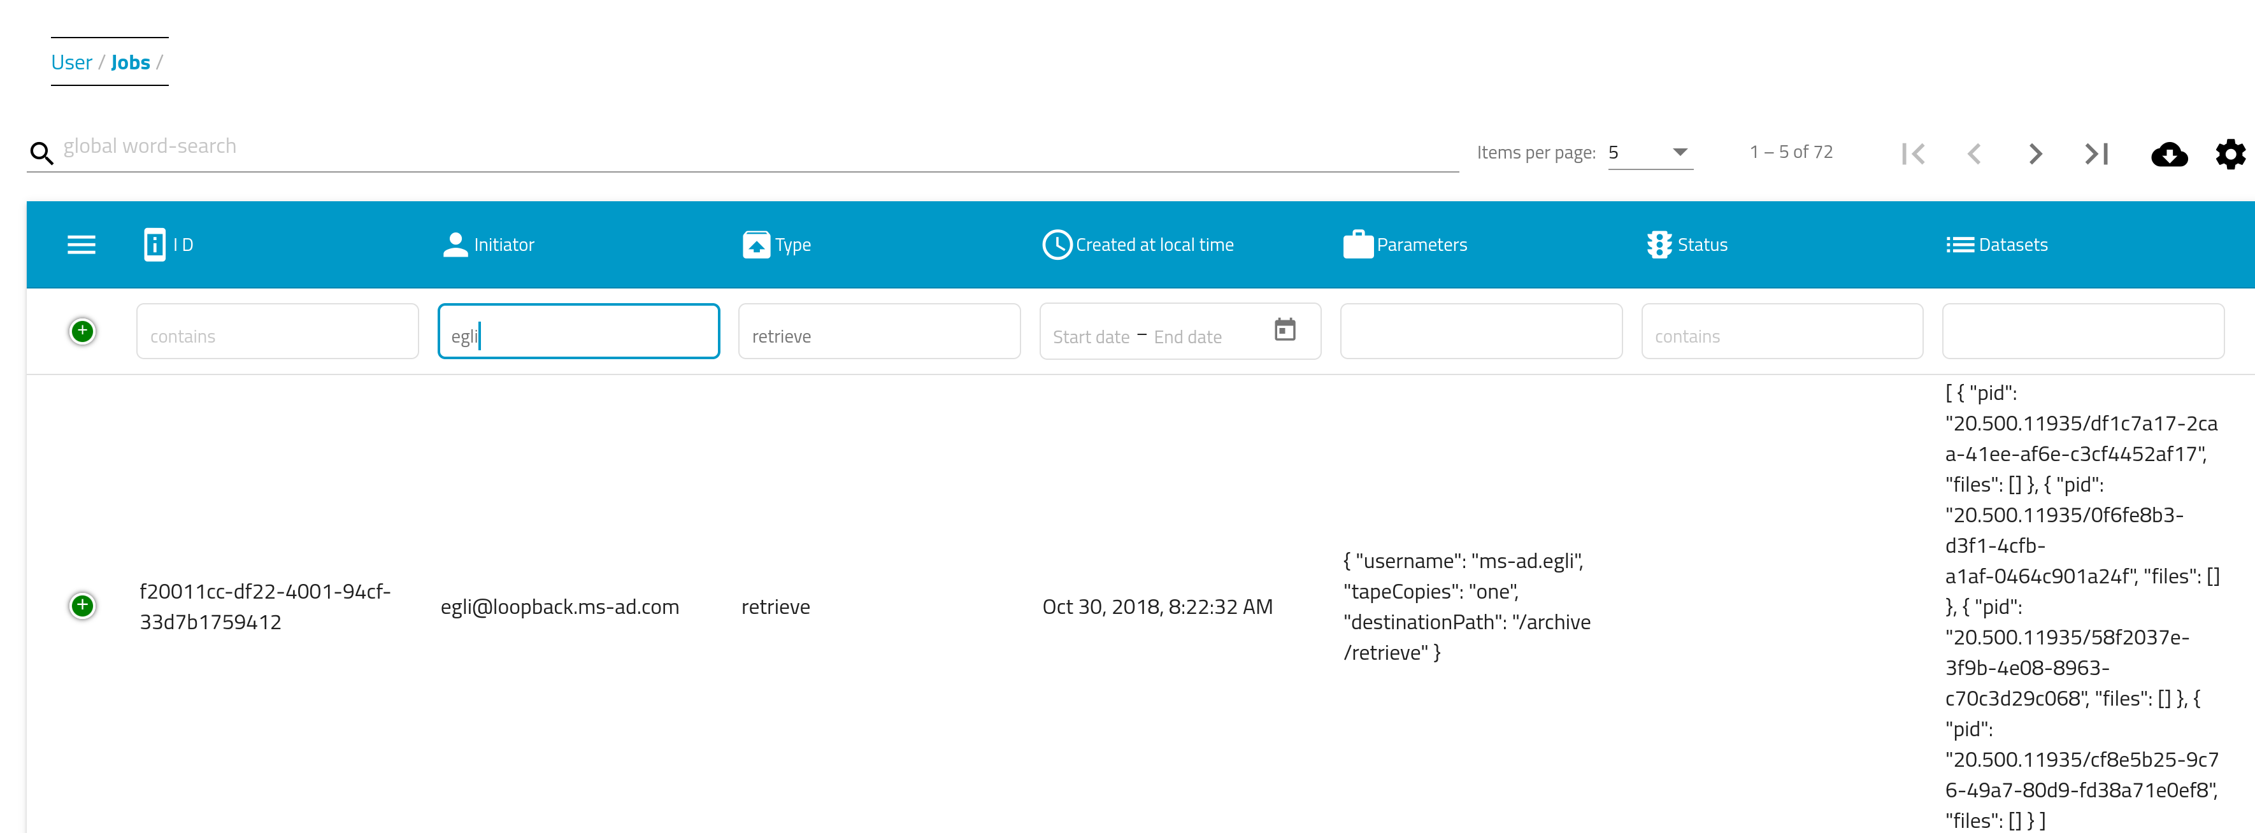
Job definition: separate “what” from “how”

Slide 19
Optional additional services
SciCat as crystallization point for ecosystem of expanding service infrastructure
Landing page server for published data
OAIPMH Server to publish data to the worldwide DOI system
File download service via zip-service
Link service to chat rooms (scichat)
Federated Search API (from PaNOSC/EXPANDS project)
Scoring service for search results
PaNET API (experiment technology ontologies) (from PaNOSC/EXPANDS project)

Slide 20
Integration of Optional Services at PSI (2021)

Slide 21
The scicatproject codebase on GitHub

Slide 22
Documentation: https://scicatproject.github.io

Slide 23
Supporting Institutions and Projects
Main contributing institutions so far
ESS
MaxIV
PSI
Supporting projects
Data analysis as a service project (swissuniversities)
PSI-ESS Data curation project
EU projects EXPANDS/PANOSC
Potential upcoming support within ETH-ORD (open research data) program

Slide 24
The people make the difference - Thanks to all contributors !
In order of “appearance”:
Tobias Richter
Frederik Bolmsten
Gareth Murphy
Chris Gwilliams
Luke Gorman
Hannes Petri
Henrik Johansson
Linh Nguyen
Marco Leorato
Laura Shemilt
Dylan McReynolds
Max Novelli
Linus Pithan
Anastasiia Pylypenko
It is a big pleasure for me to work in such a lively community !

