Slide 1
Imagine: SciCat @DESY
Frank Schluenzen, Thorsten Kracht, Jan Kotanski, Martin Gasthuber DESY / FS+IT

Slide 2
phases and events – SciCat interactions
first copy2tape
beamtime
scheduled
proposal
accepted
system setup
ACL’s, FS, …
last copy2tape
unlink beamtime
system cleanup
data taking, fast/slow copy
view, online analysis
offline analysis
proposal
submission
recall from tape
data lifetime exceeded
start_beamtime
executed – data
taking starts
stop_beamtime
executed – data
taking end

Slide 3
initial beamtime config/setup – DOOR MD ingested
first copy2tape
beamtime
scheduled
proposal
accepted
system setup
ACL’s, FS, …
last copy2tape
unlink beamtime
system cleanup
Setup Phase
data taking, fast/slow copy
view, online analysis
offline analysis
proposal
submission
recall from tape
data lifetime exceeded
start_beamtime
executed – data
taking starts
stop_beamtime
executed – data
taking end

Slide 4
Setup Phase
create SciCat proposal
setup functional accounts (if required) and PI, + from LDAP base
ingest DOOR (proposal mgmt system) metadata – copied once, no re-sync later
optionally: create initial RAW, … datasets
User (you)
login into SciCat
further extend metadata
use logbook (chat) to communicate with collaboration members
…

Slide 5
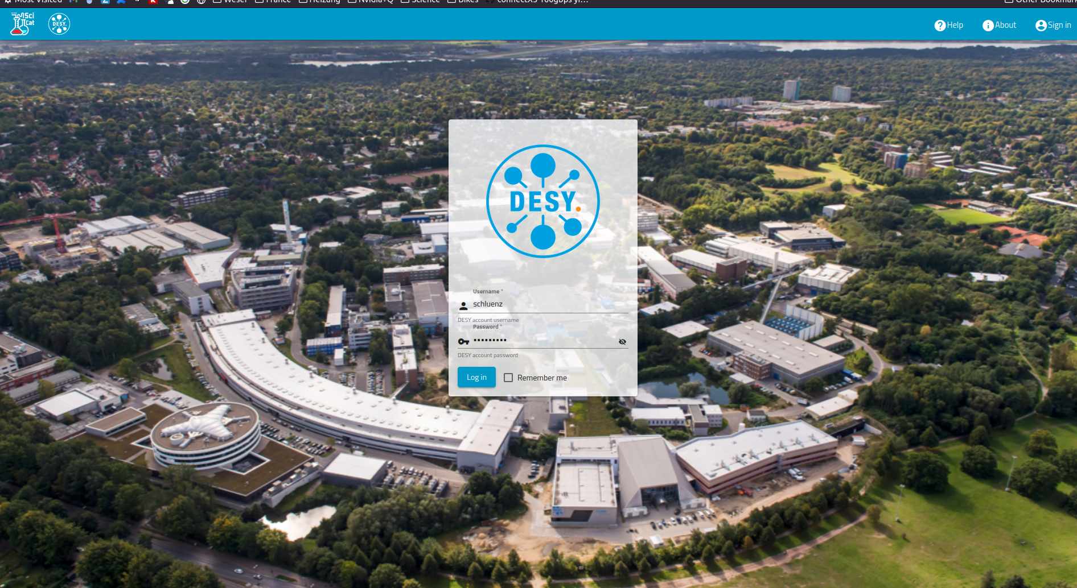

Slide 6
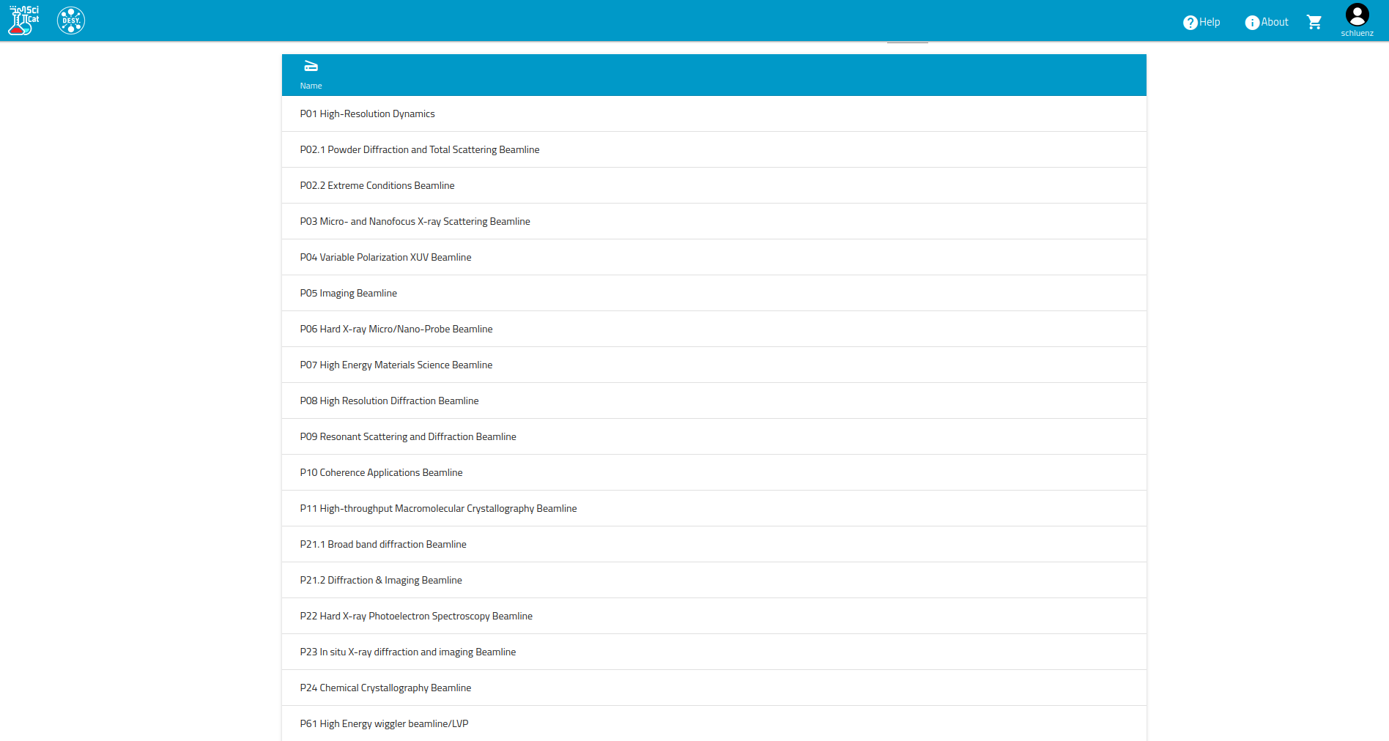

Slide 7
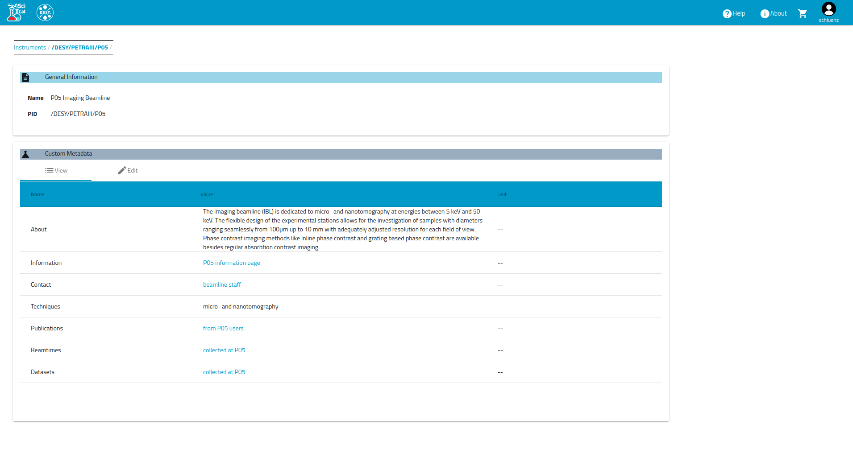

Slide 8
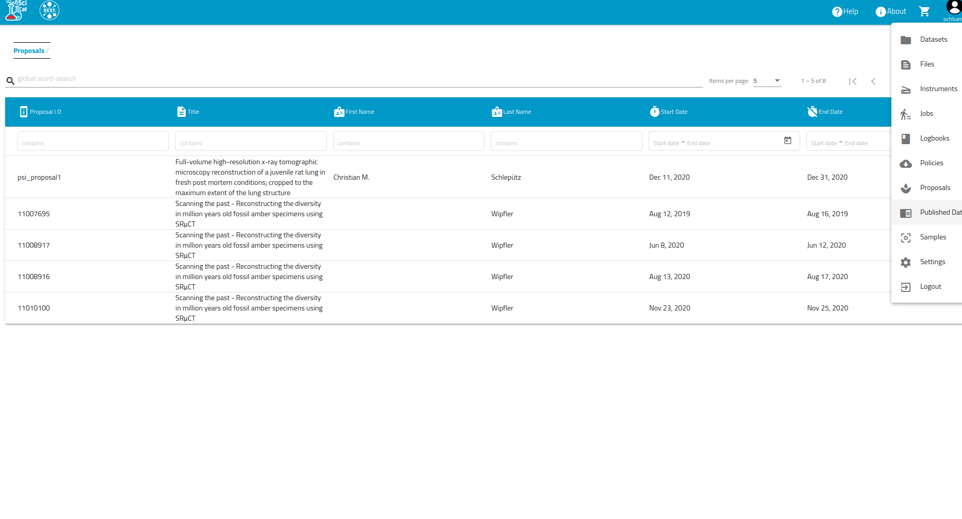

Slide 9
phases and events – SciCat interactions
first copy2tape
beamtime
scheduled
proposal
accepted
system setup
ACL’s, FS, …
last copy2tape
unlink beamtime
system cleanup
Data Taking Phase
data taking, fast/slow copy
view, online analysis
offline analysis
proposal
submission
recall from tape
data lifetime exceeded
start_beamtime
executed – data
taking starts
stop_beamtime
executed – data
taking end

Slide 10
Data Taking Phase
raw detector data (files) ingested through HiDRA (ZMQ) to Beamline-FS
raw detector data copied by ‘fast copy process’ to Core-FS – updating SciCat RAW dataset with new file metadata (pathname, etc.) – the ‘SciCat registration’ file-by-file
optionally: ingest (many) files metadata at the end of – bulk ingest of file metadata
run or scan
at ‘stop_beamtime’ – end of data taking – ‘all at once’ mode
User (you)
watch RAW dataset filling up ;-)
kick-off Jupyter notebook to view/analyse – further integration required – more on page 14
reverse mode: connect existing Jupyter instance to you SciCat proposal (DESY beamtime-id)
submit (more heavyweight analysis) as SLURM job – glue code to retrieve dataset + content from SciCat required
your code could be agnostic/independent of SciCat - use existing pipeline/code – file by file

Slide 11
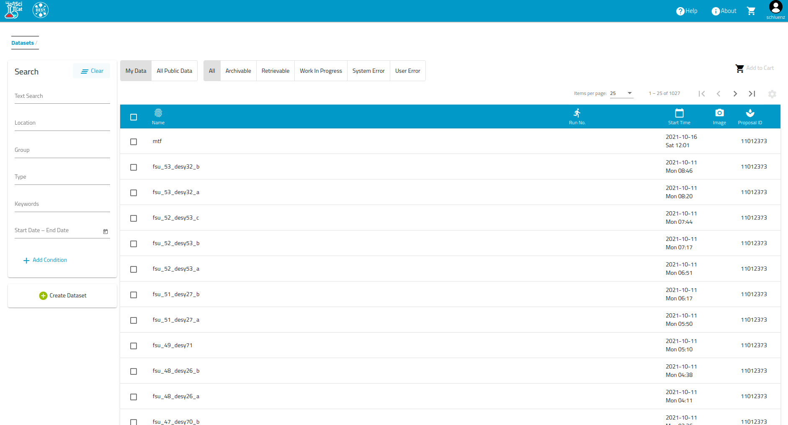

Slide 12
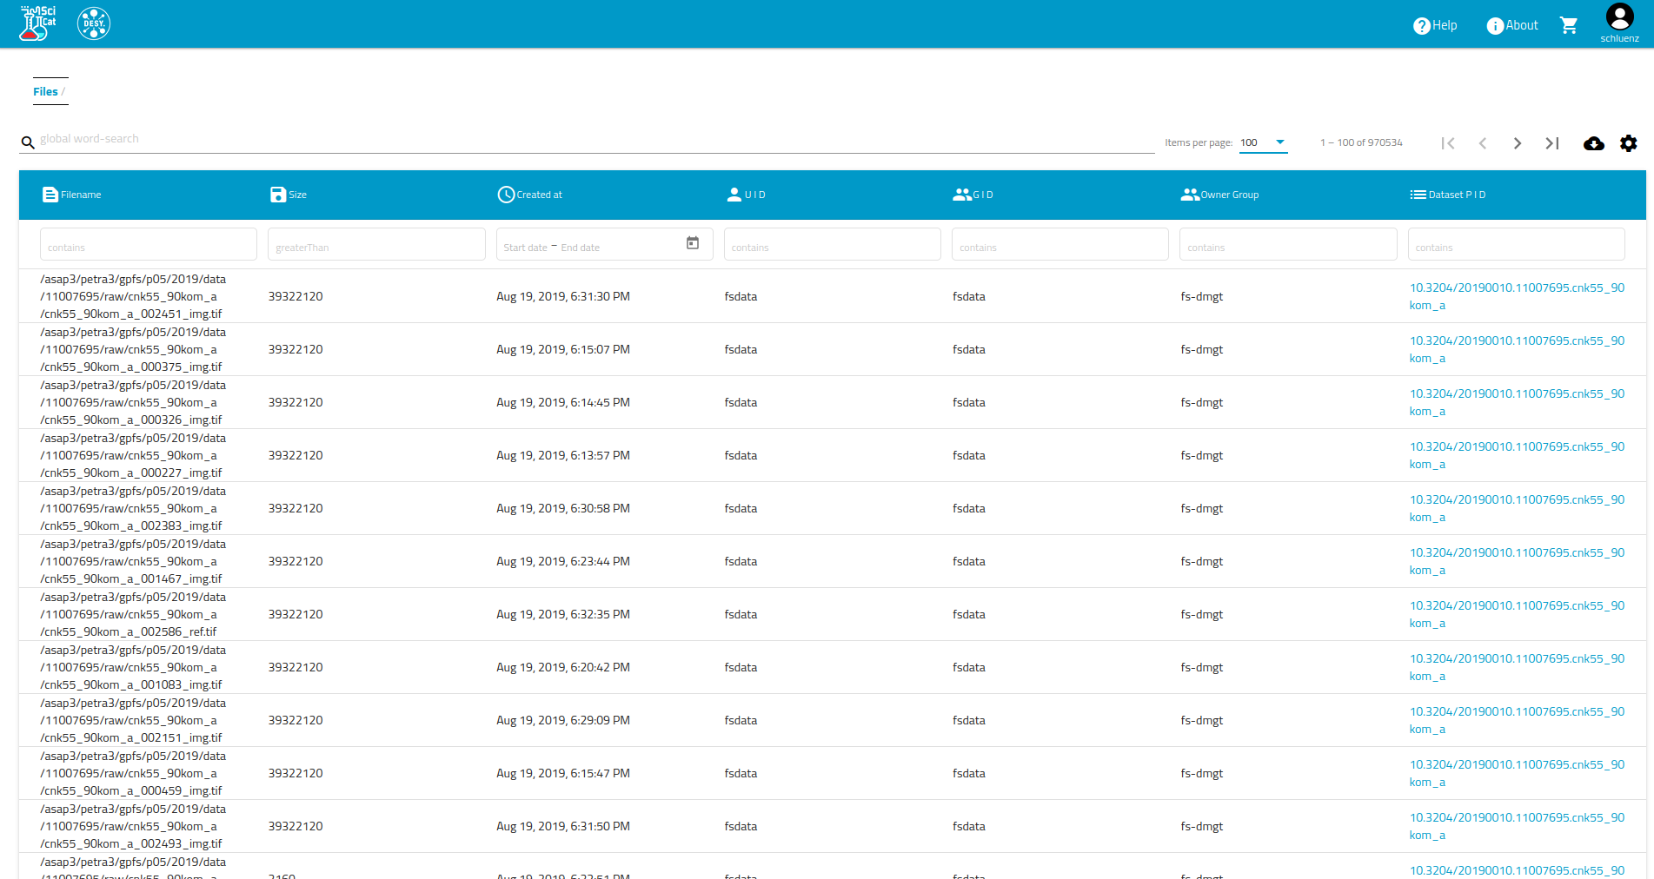

Slide 13
phases and events – SciCat interactions
first copy2tape
beamtime
scheduled
proposal
accepted
system setup
ACL’s, FS, …
last copy2tape
unlink beamtime
system cleanup
Offline Processing/Analysis
data taking, fast/slow copy
view, online analysis
offline analysis
proposal
submission
recall from tape
data lifetime exceeded
start_beamtime
executed – data
taking starts
stop_beamtime
executed – data
taking end

Slide 14
example – Jupyter
how (outlook !) this could look like
look at Dylans (ALS) short video on that topic
talk to Frank to show your plans and use-cases ! all thoughts are welcome
as a <i.e. beamline scientist> i would like to <your idea> so that <your expected result>
not limited to Jupyter case – all SciCat / metadata related are welcome
helps us to verify configuration and deployments – i.e. user – group – role - authorization
User (you)
use existing analysis pipeline prepended with (provided) SciCat glue (iterate over datasets and files in dataset)
schedule SLURM (@Maxwell) job providing SciCat proposal-id (DESY beamtime-id) / and optionally dataset-id
minor extension
your code ‘just expect pathnames’ as before – if …
extend your code to ‘generate new datasets’ + ‘register new files to dataset’ – helper tools provided / or pySciCat
just use the existing SciCat API to construct ‘DIY processing’

Slide 15
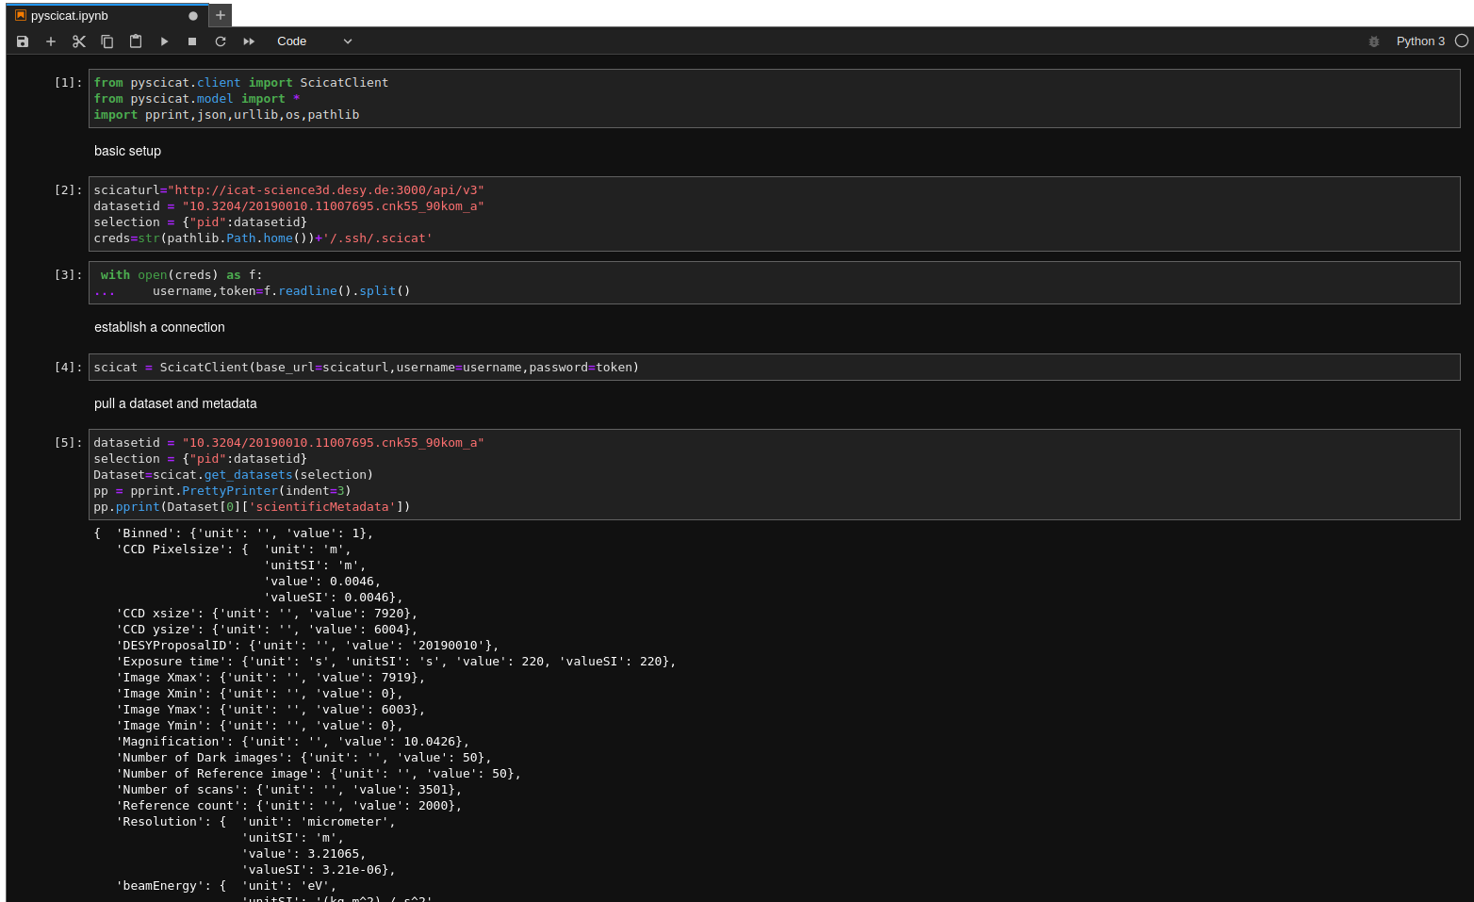

Slide 16
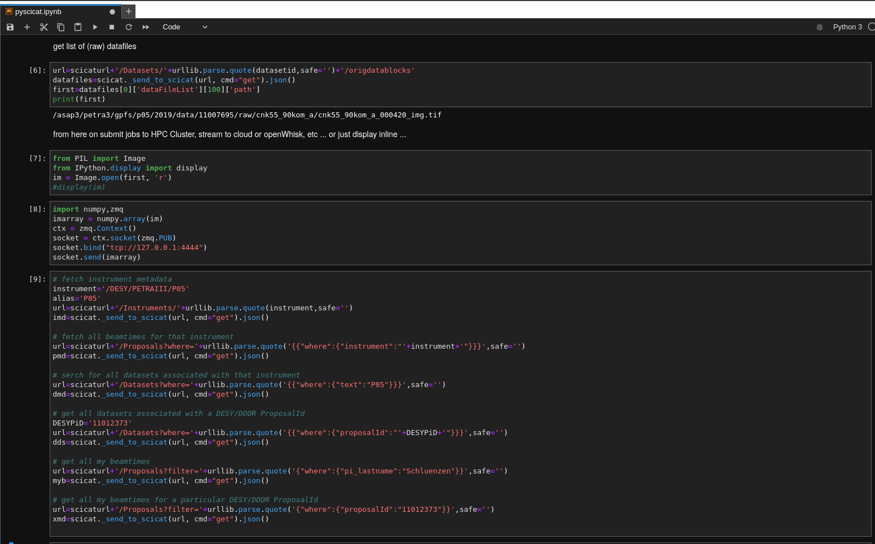

Slide 17
status & next steps
test instance created by Frank - https://www-science3d.desy.de/
job opening (nearly) for local SciCat expert – driving development and deployment – active participation in SciCat project
opening should be found at desy.de soon – stay tuned ;-)

