Slide 1
Calorimeter Optimization
30-05-2022 update
Michal elad

Slide 2
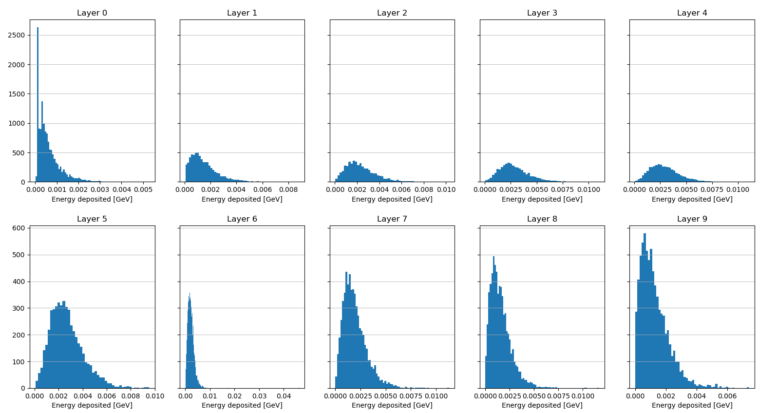
Energy distribution per layer 2 gev, layers 0-9

Slide 3
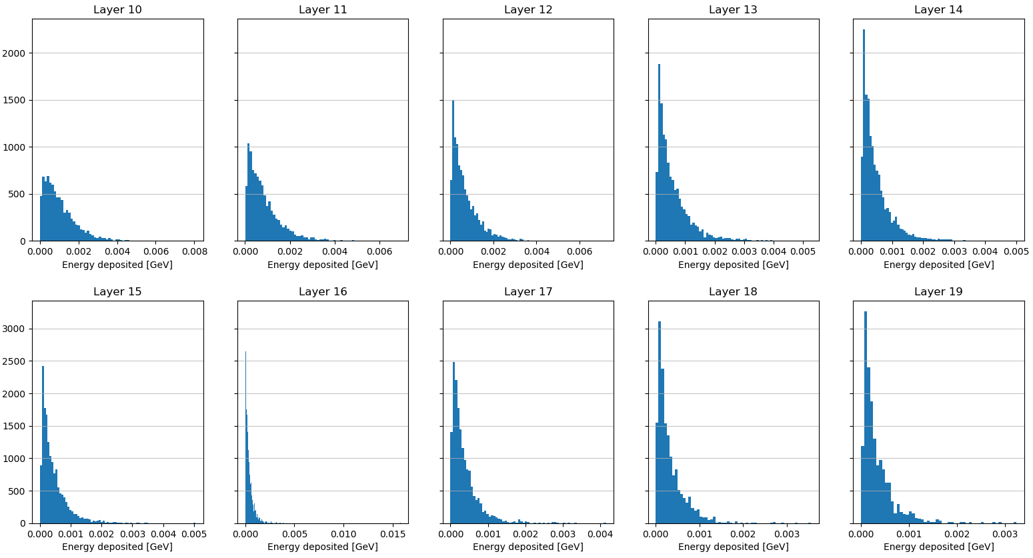
Energy distribution per layer 2 gev, layers 10-19

Slide 4
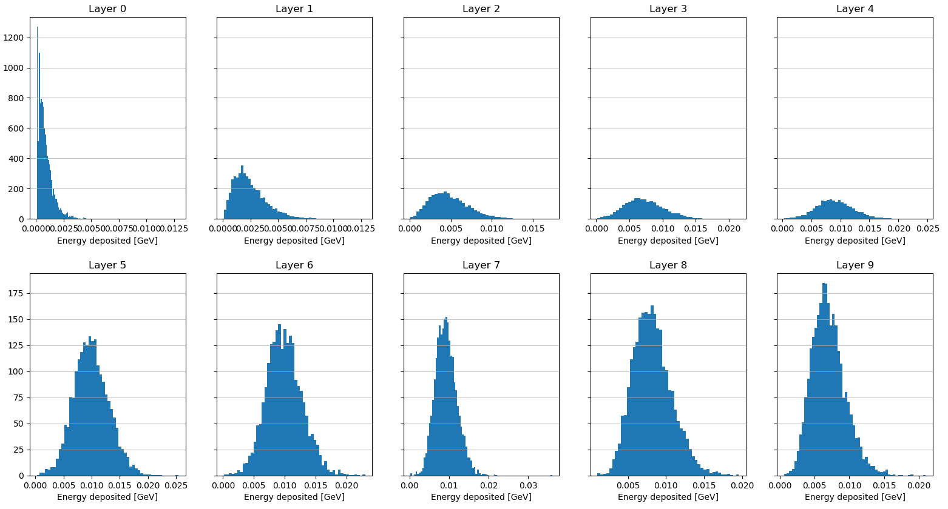
Energy distribution per layer 8 gev, layers 0-9

Slide 5
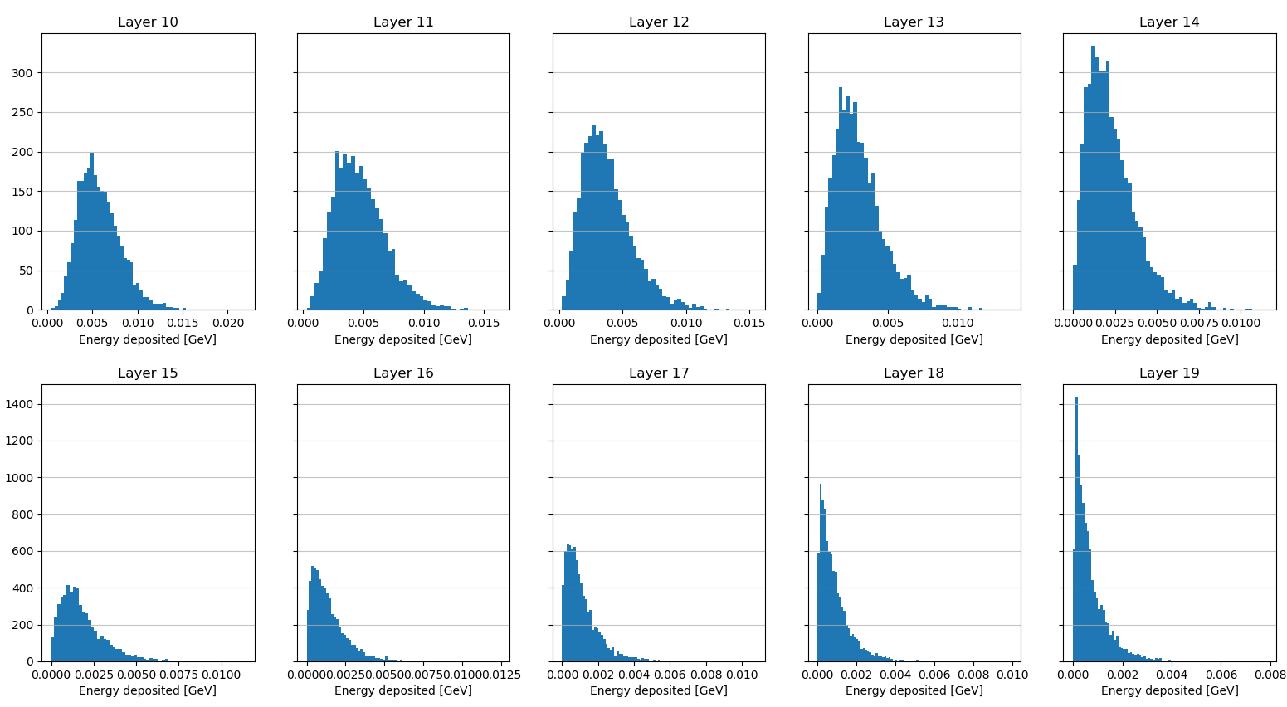
Energy distribution per layer 8 gev, layers 10-19

Slide 6
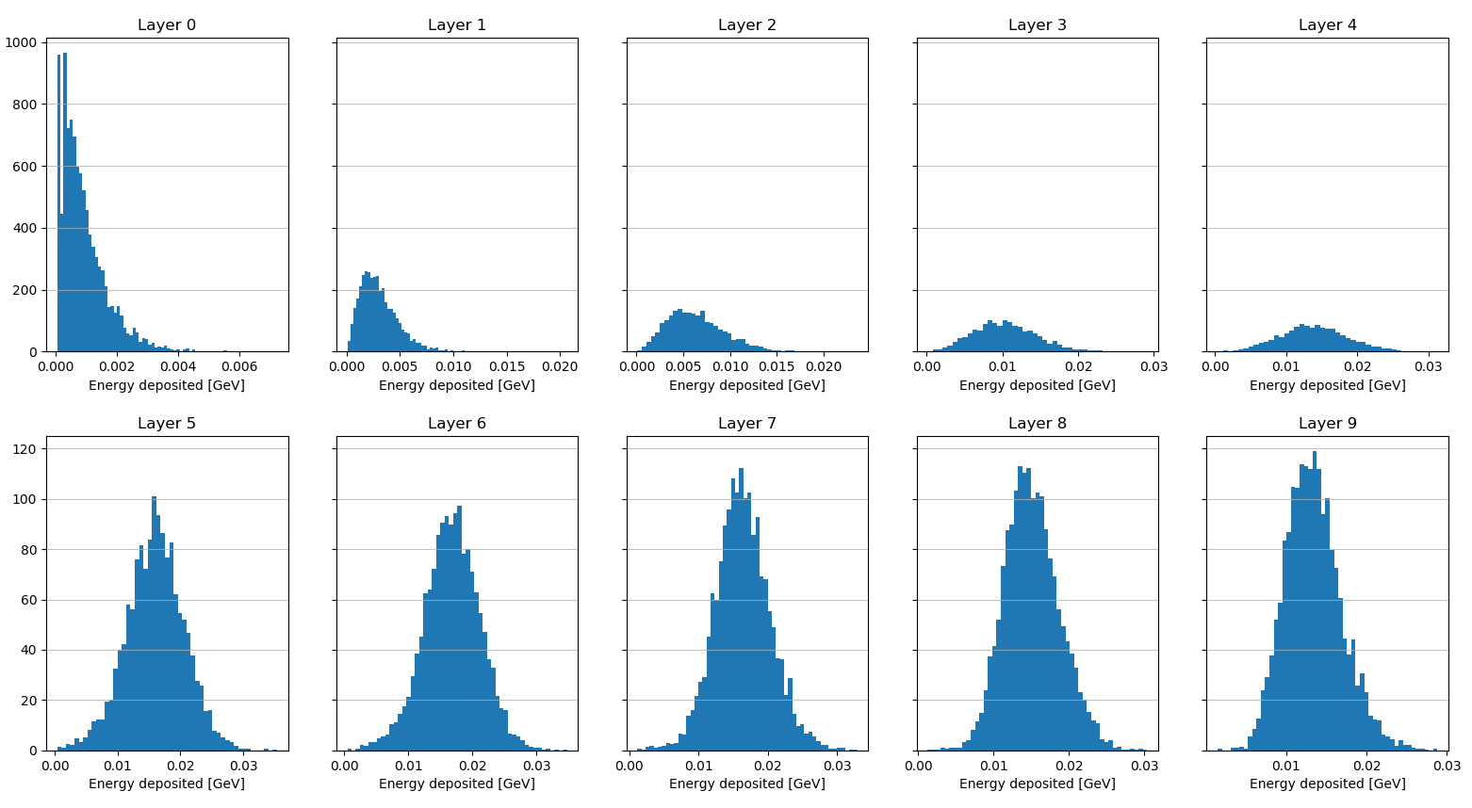
Energy distribution per layer 14 gev, layers 0-9

Slide 7
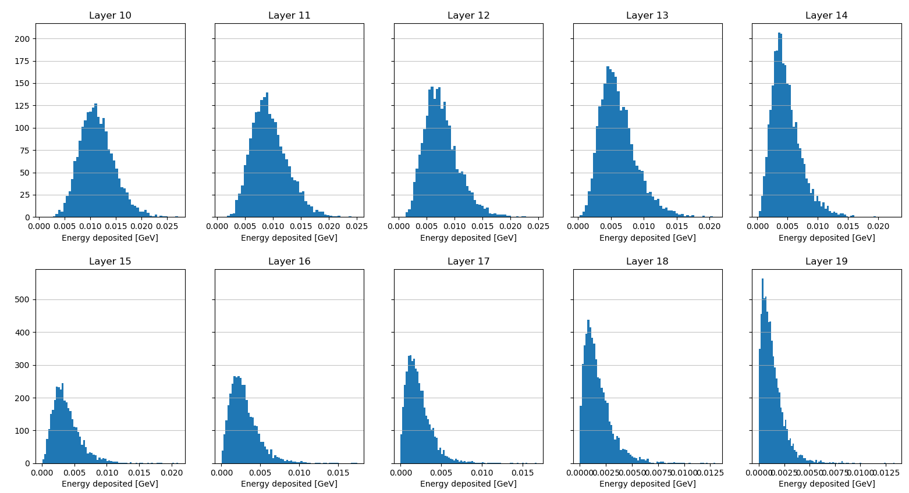
Energy distribution per layer 14 gev, layers 10-19

Slide 8
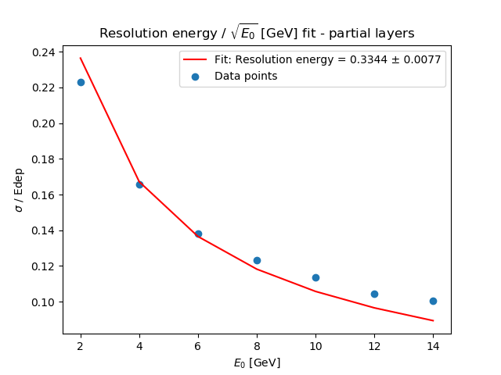
Resolution energy fit – subset of layer missing layers reconstructed with 2x_0 (or another number of x0)
Layers
0,1, 3,4,5,6,7,8, 11, 15

Slide 9
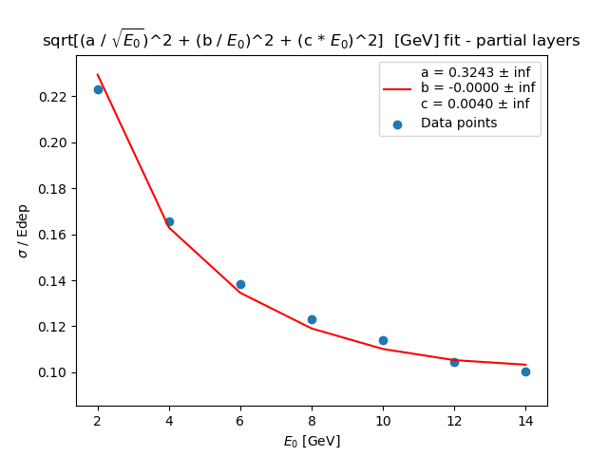
Resolution energy fit – subset of layer missing layers reconstructed with 2x_0 (or another number of x0)
Layers
0,1, 3,4,5,6,7,8, 11, 15

Slide 10
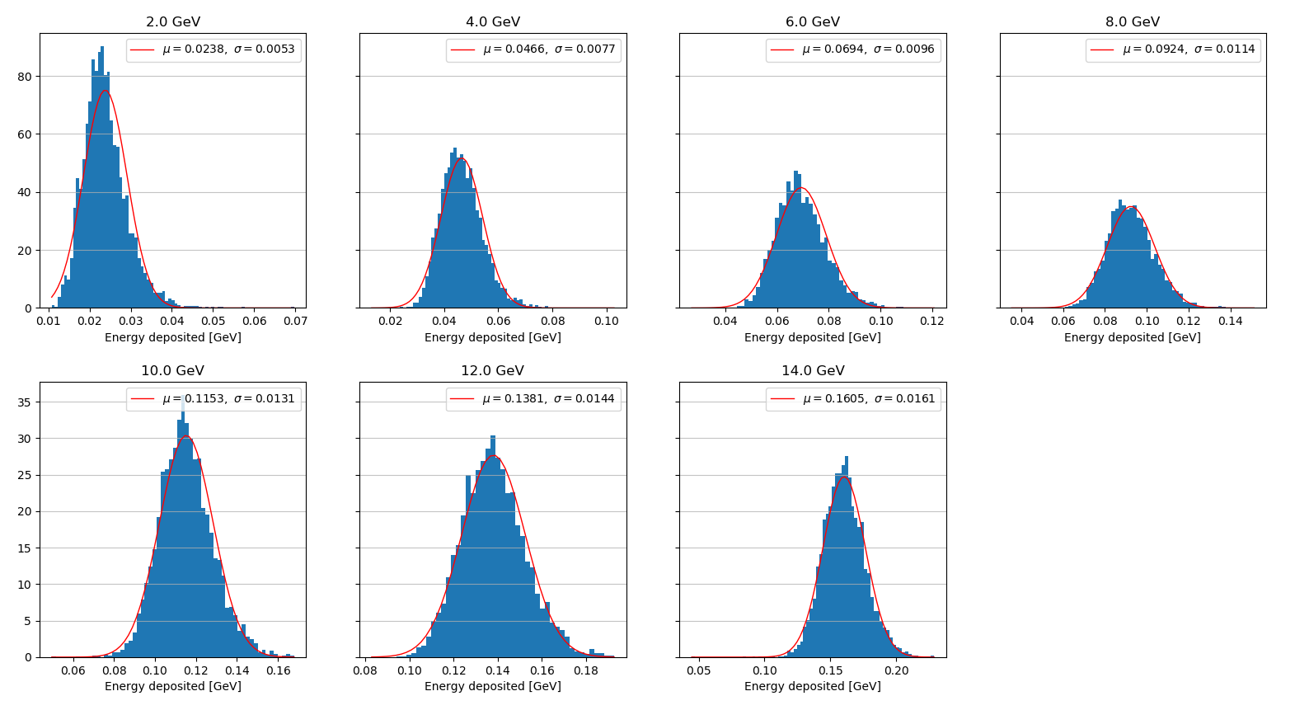
Resolution energy fit – subset of layer missing layers reconstructed with 2x_0 (or another number of x0)

Slide 11
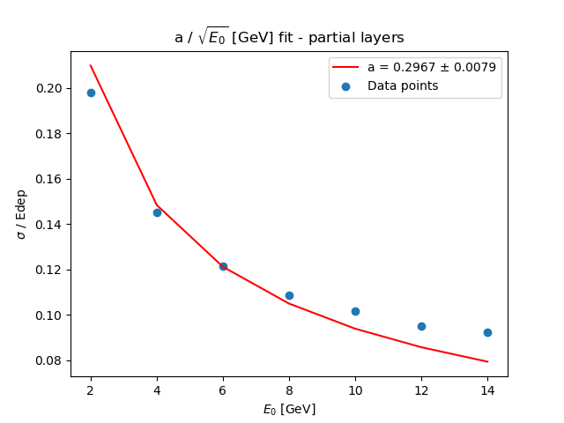
Resolution energy fit – subset of layer missing layers reconstructed with a linear assumption
Layers
0,1, 3,4,5,6,7,8, 11, 15

Slide 12
Resolution energy fit – subset of layer missing layers reconstructed with a linear assumption
Layers
0,1, 3,4,5,6,7,8, 11, 15

Slide 13
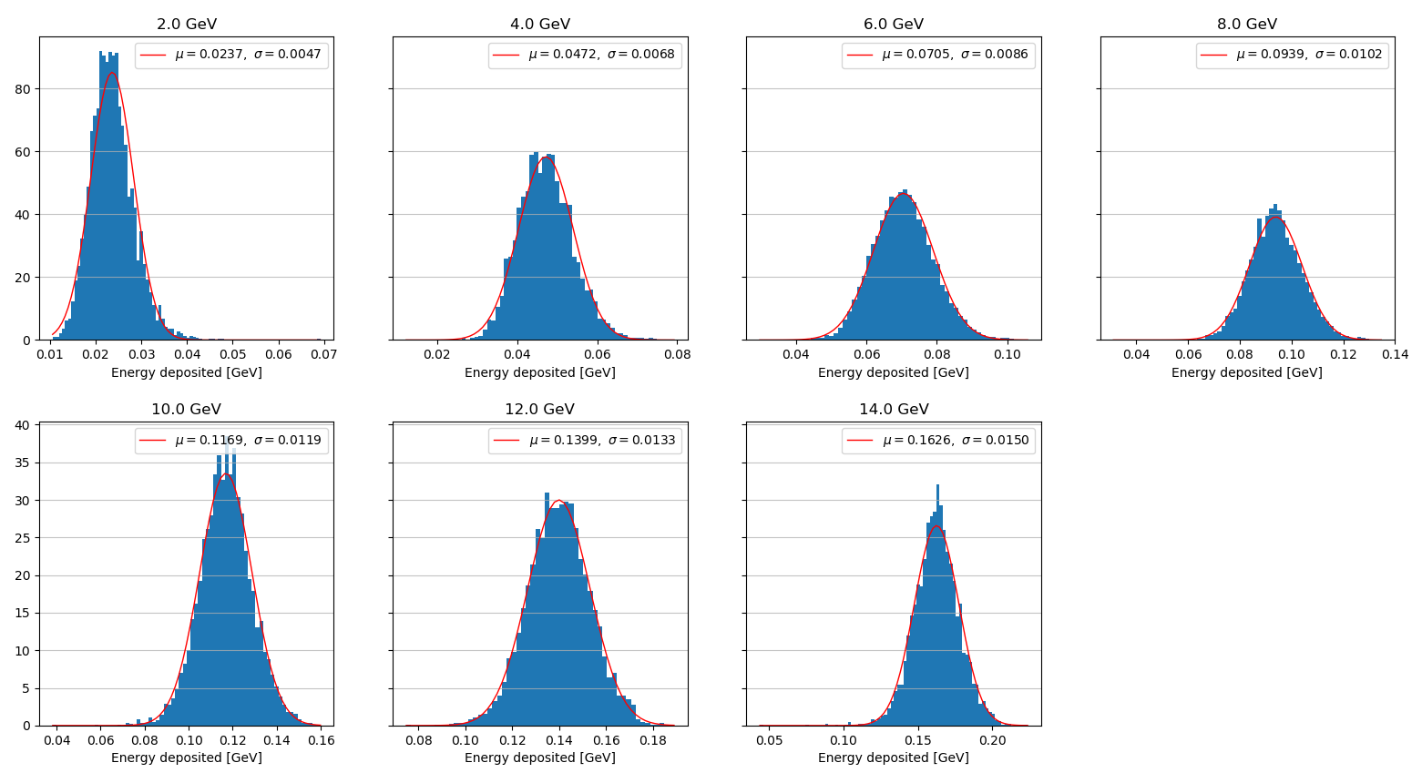
Resolution energy fit – subset of layer missing layers reconstructed with a linear assumption

