Slide 1
Introduction and performance benchmarks
Wolfgang Lohmann
BTU, DESY and RWTH

Slide 2
Scientific goal
Explore Quantum Electrodynamics at high fields
Pertubative QED predicts electromagnetic phenomena with excellent
precision, e.g. Lamb shift, anomalous magnetic moment of the electron,
Bhabha scattering
At high fields, Heisenberg and Euler predicted in Z.Phys. 98 (1936) 714-732
Title:„Folgerungen aus der Dirac`schen Theorie des Positrons“
‘electromagnetic fields can create matter if they are strong enough’
Critical field strength: = 1.32 10¹⁸ Vm⁻¹
Denoted as ‚Schwinger limit‘!

Slide 3
Scientific goal
For illustration: In a silicon sensor of 300 µm thickness and this field strength:
E_{e} = 400 TeV
t accelerates an electron over the distance of its Compton wavelength to E_{e} equal to its mass
New phenomenon: Field induced tunneling of e⁺e⁻ pairs off the vacuum,
Colloquial: ‚the vacuum starts boiling‘
Source of high electrical fields: chirped pulse amplification (CPA) laser, focal intensity 10²¹ Wcm⁻¹
_{L} = 10¹⁴ Vm⁻¹
Electron at high energy in a laser pulse: * = γ _{L} (1 + cos θ)
Example:
For E_{e} = 10 GeV, γ ≈ 10⁴ ➔ critical field strength will be reached !
γ = E_{e}/m_{e}

Slide 4
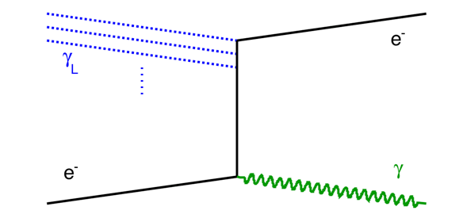
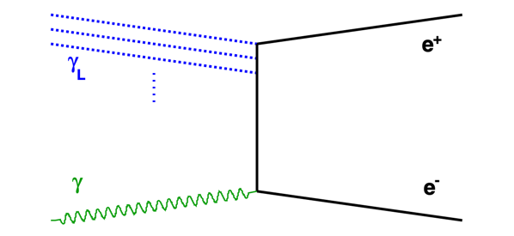
Processes
Non-linear Compton scattering
e⁻ + nγ_{L} e⁻ + γ_{C}
Breit-Wheeler process (BW)
γ + nγ_{L} e⁺ e⁻
The initial photon might be the γ_{C}
from non-linear Compton scattering (two step trident)
or a dedicated high-energy photon beam

Slide 5
Scientific goal
Essential quantities: number of electrons and positrons in the final state
Predictions:
Detector components:
Silicon pixel tracker
Highly granular and compact ECAL(s)

Slide 6
LUXE detector (gg version)
ECAL-P
ECAL-P
Detector components:
Silicon pixel tracker
Highly granular and compact ECAL(s)

Slide 7
Requirements and challenges
Goal: measure the number and energy(spectrum) of positrons
Low ξ: non, one or a few positrons
Single shower reconstruction on top of wider spread background
Small Moliere radius, compact calorimeter
High granularity sensors

Slide 8
Requirements and Challenges
High ξ: x00 – 100000 positrons per BX
Energy flow approach, single showers cannot be measured, but the deposited energy as a function of x (horizontal plane)
Expected energy due to B-field is used.
high granularity sensors
small Moliere radius
large dynamic range of the readout
(may approach saturation, in addition
non-linear sensor response, quantitatve estimate needs effort).

Slide 9
Expected performance
Example: Number of positrons

Slide 10
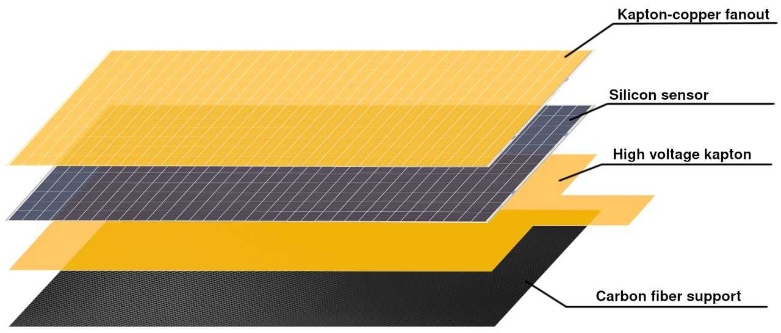
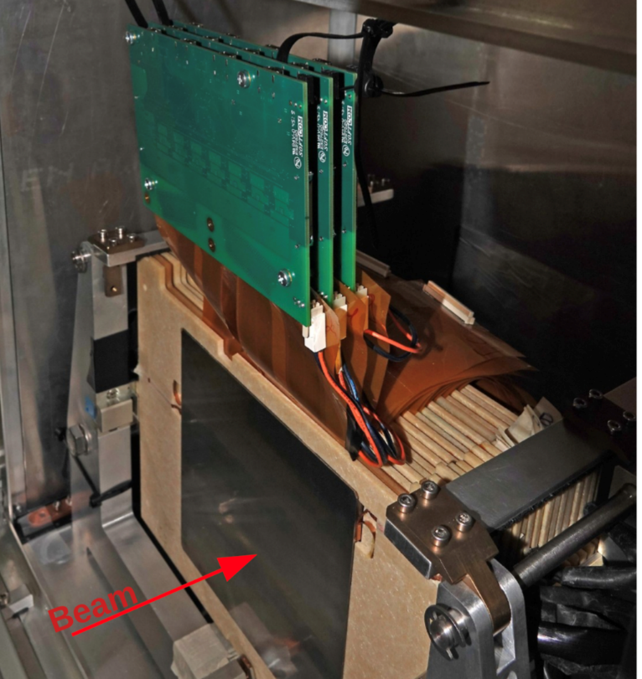
Requirements and Challenges
Use FCAL technology, as developed for e+e- linear collider: sandwich calorimeter
Thin sensor planes (< 1mm)
Tungsten absorber plates
LumiCal prototype
FCAL LumiCal in the testbeam
Effective Moliere radius: ~ 8 mm
(approaching the technological limit)
Position resolution : ~ 0.5 mm (5 GeV)
Published in: Eur.Phys.J.C 79 (2019) 7, 579

Slide 11
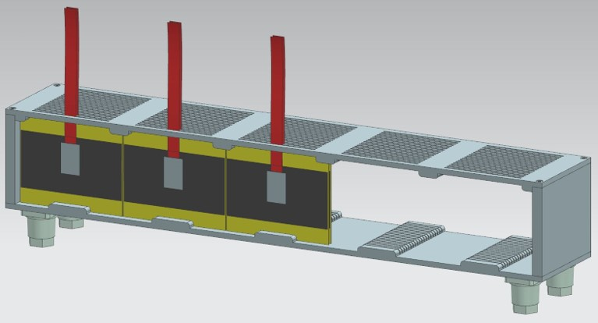
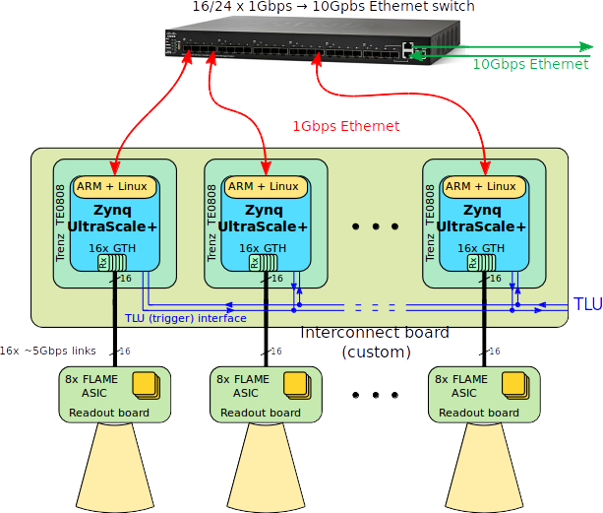
ECAL-P concept
ECAL concept
GaAs/tungsten sandwich calorimeter
Frame aluminum, fiducial volume
53x5.2x9 cm³
20 tungsten plates 1 X₀ thick
GaAs:Cr sensors 550 μm thick, 52x76 mm²
area
FE ASICs FLUXE (derived from FLAME) on top of ECAL
FPGAs for orchestrating the read out and preprocessing in a rack a few m away
TLU trigger and readout adapted to EUDAQ
To be updatedold figure,
but shows the principle

Slide 12
Purpose of this meeting
Prospects of an extended Calice prototype for LUXE
Responsibilities and schedule of construction, test and commisiioning
For ECAL-P: Due to the Russian invasion in the Ukraine we lost two collaborators, TSU and JINR
For sensors and tungsten absorbers other sources are needed, new mechanics has to be designed and build

