Slide 1
potential new ECAL-P
Wolfgang Lohmann
BTU, DESY and RWTH

Slide 2
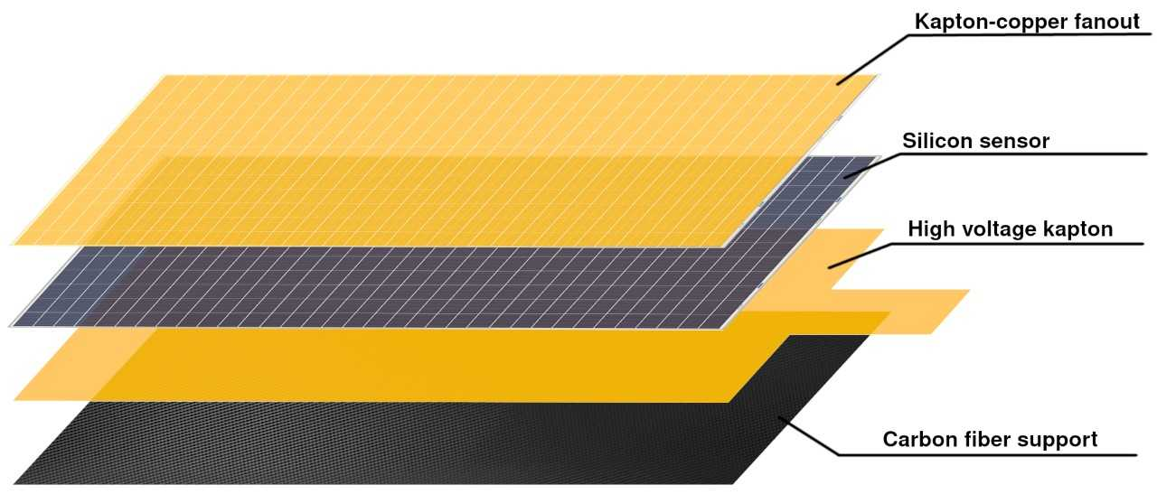
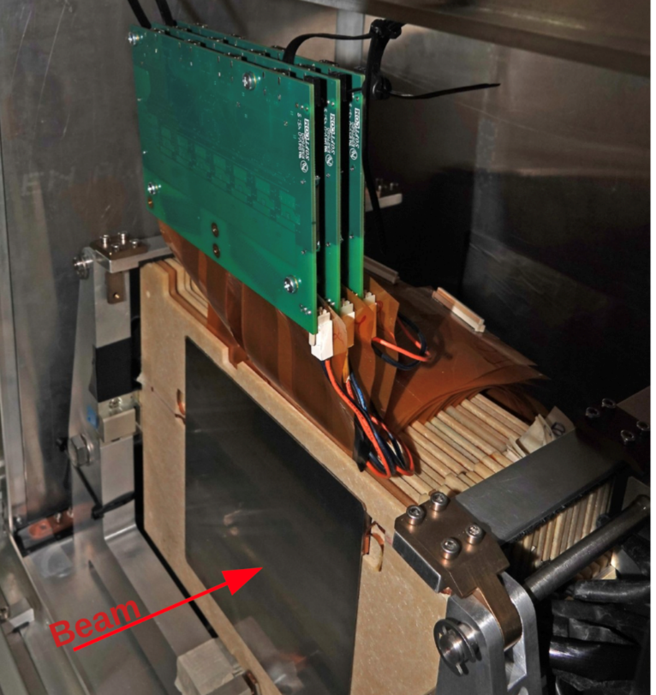
Current FCAL structure
Use FCAL technology, as developed for e+e- linear collider: sandwich calorimeter
About 30 W-absorber plates
14x14 cm²
LumiCal prototype
May be cutted to get 60 plates 7 x 14 cm₂
With 15 plates per tower 4 towers may be build, covering in (x,y) 56 x 7 cm²
60 sensor planes 9 x 9 cm² (Calice type) needed, price roghly 60 k ???
About 20 k readout channels

Slide 3
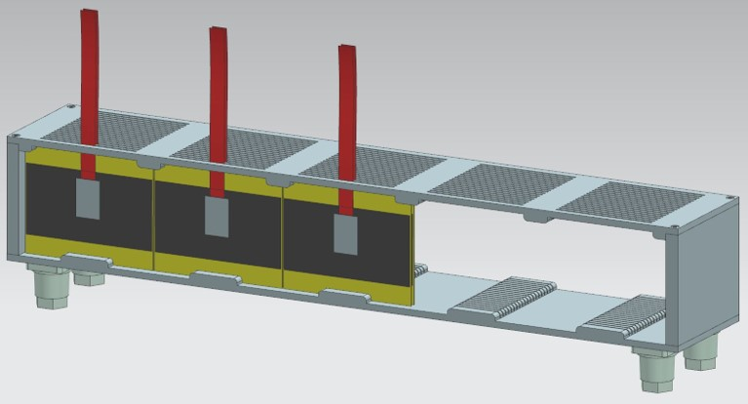
New ECAL-P concept
New ECAL-P concept
Missing components
Mechanical Frame aluminum,
fiducial volume 56 x 9 x 10 cm³
(potentially extendable to 20 layers)
Sensor plane assembly using glue tehnology
Remaining from the old concept:
FE ASICs FLUXE (derived from FLAME) on top of ECAL
FPGAs for orchestrating the read out and preprocessing in a rack a few m away
TLU trigger and readout adapted to EUDAQ

Slide 4
To be discussed
Can Calice give support for the mechanical frame ?
Who and where W-planes can be cutted?

