Slide 1
Outreach, Education and EDI
Ana Godinho (CERN)
EPS-HEP 2023 | 23.08.2023

Slide 2
Science Education, Science Outreach. What are we talking about?
Outreach
Education
Informing, communicating, engaging with audiences outside academia/research
Learning that takes place in informal, out-of-classroom contexts
(often called Public Engagement in Science)
Goals
Activities
Actors
Audiences:
All ages
Mainly young people (students) and teachers

Slide 3
Citizens’ attitudes towards S&T…and scientists
Eurobarometer (2021) - Survey on science and technology with 37 103 respondents in 38 countries, including EU Member States, EU enlargement countries, EFTA states, and the United Kingdom. Survey was conducted between 13 April and 10 May 2021, primarily through face-to face interviews.

Slide 4
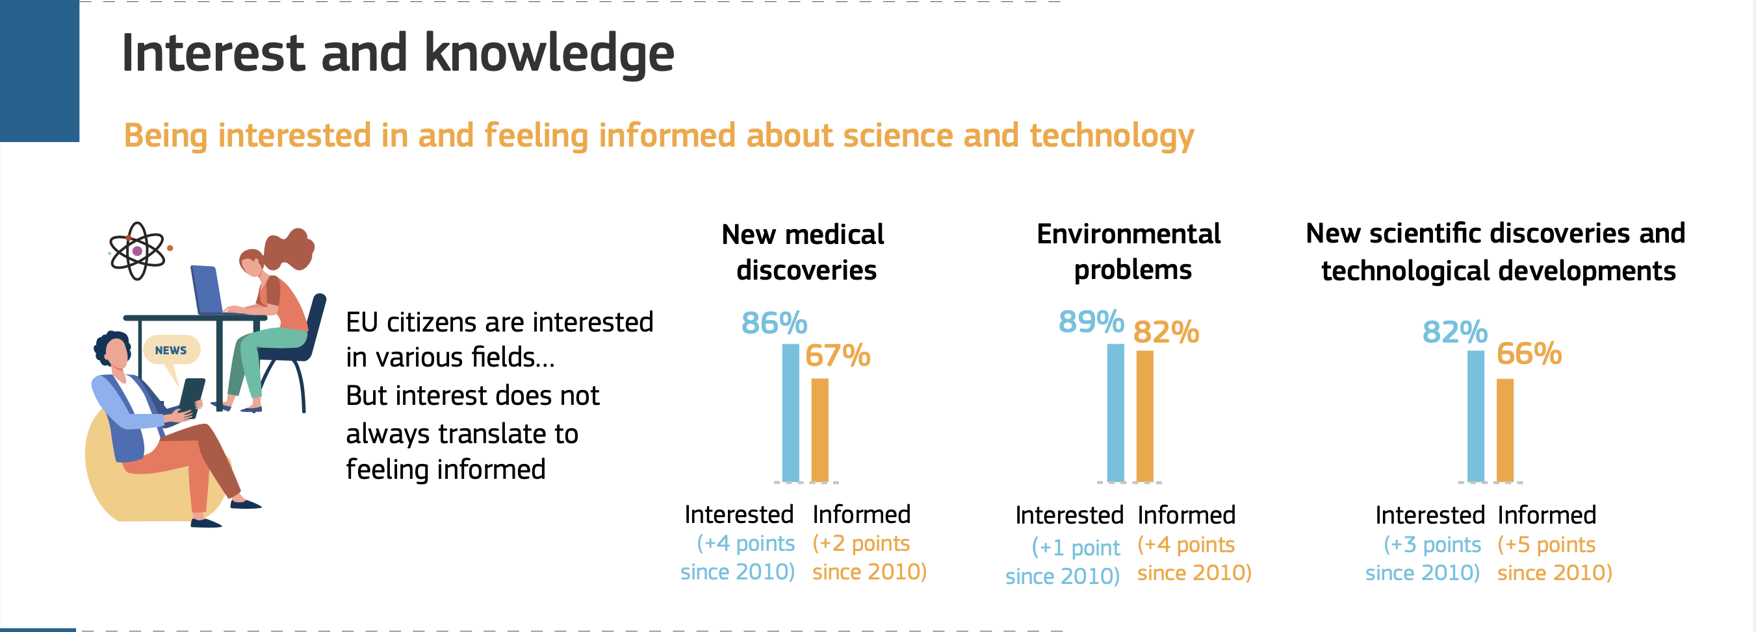
EU citizens’ interest in new scientific discoveries is high*
Others areas
Culture & Arts - 77% (66%)
Politics - 71% (75%)
Sports news - 59% (60%)
Q: In everyday life, we have to deal with many different issues, where we feel more or less interested. For each of the following, please indicate whether you are...
Eurobarometer (2021)

Slide 5
Positive about influence and benefits of science and technology
Q: Do you think that the overall influence of science and technology on society is...?
Q: How strongly do you agree or disagree with the following statement? Science and technology do not really benefit people like you (%)
Eurobarometer (2021)

Slide 6
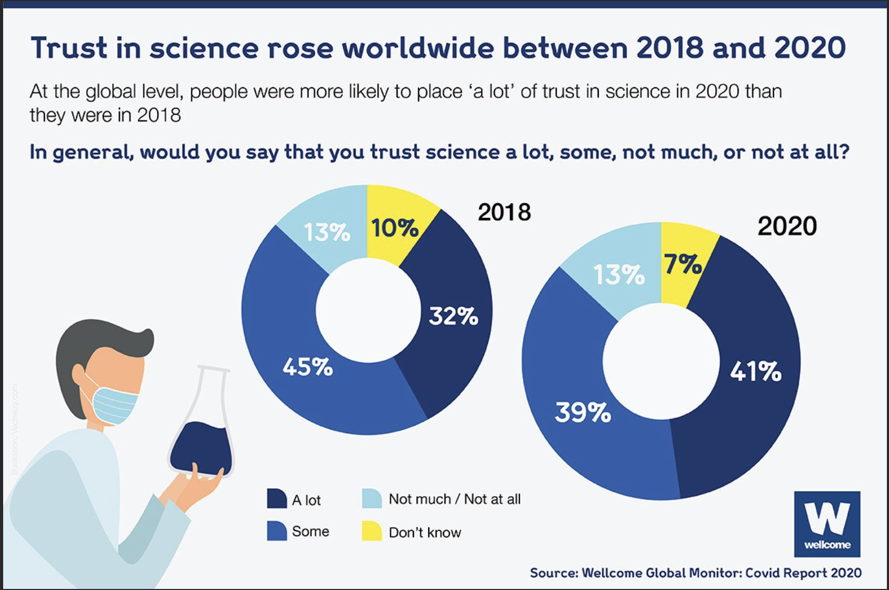
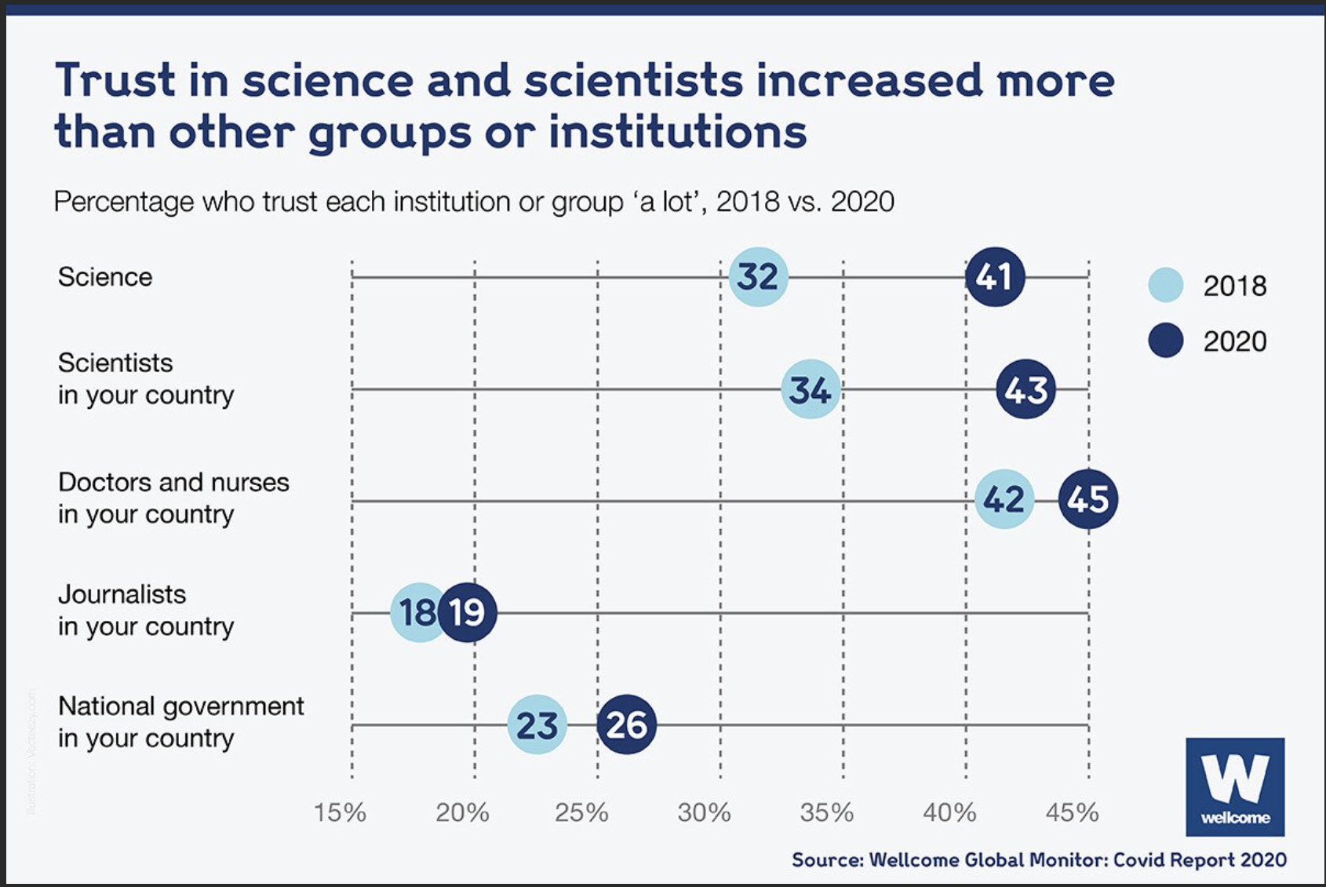
The effect of COVID: trust in science and scientists increased
Wellcome Global Monitor 2020*
Similar results in German Science barometer (2020) and 3M State of Science Index (2019 and 2020)
* Wellcome Global Monitor 2020 - conducted as part of the Gallup World Poll by the Wellcome Trust (UK). Includes results from representative surveys in 113 countries and territories carried out in 2020 and early 2021, with approximately 1 000 adults aged 15 and older interviewed per country

Slide 7
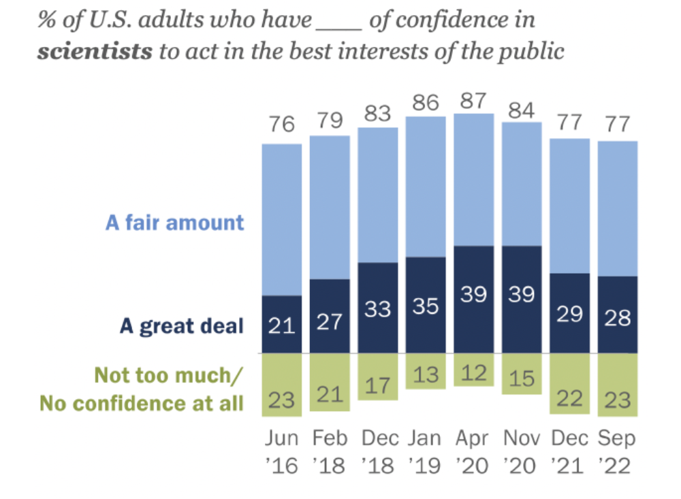
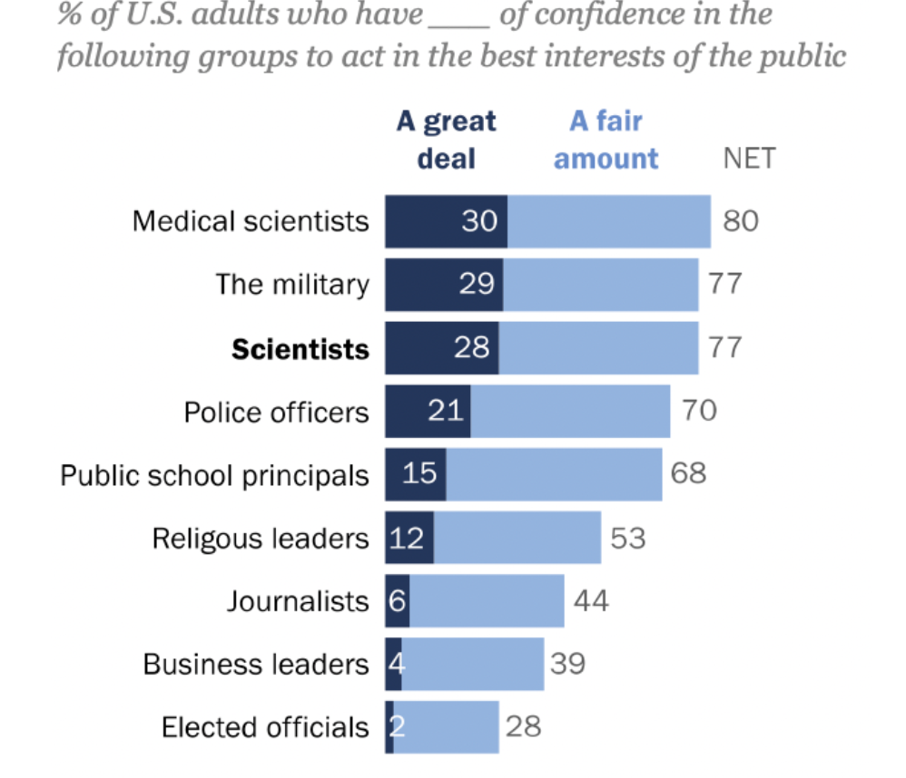
Trust in science in the US: COVID and partisanship
Pew Research Center survey of 10 588 U.S. adults from Sept. 13-18, 2022.

Slide 8
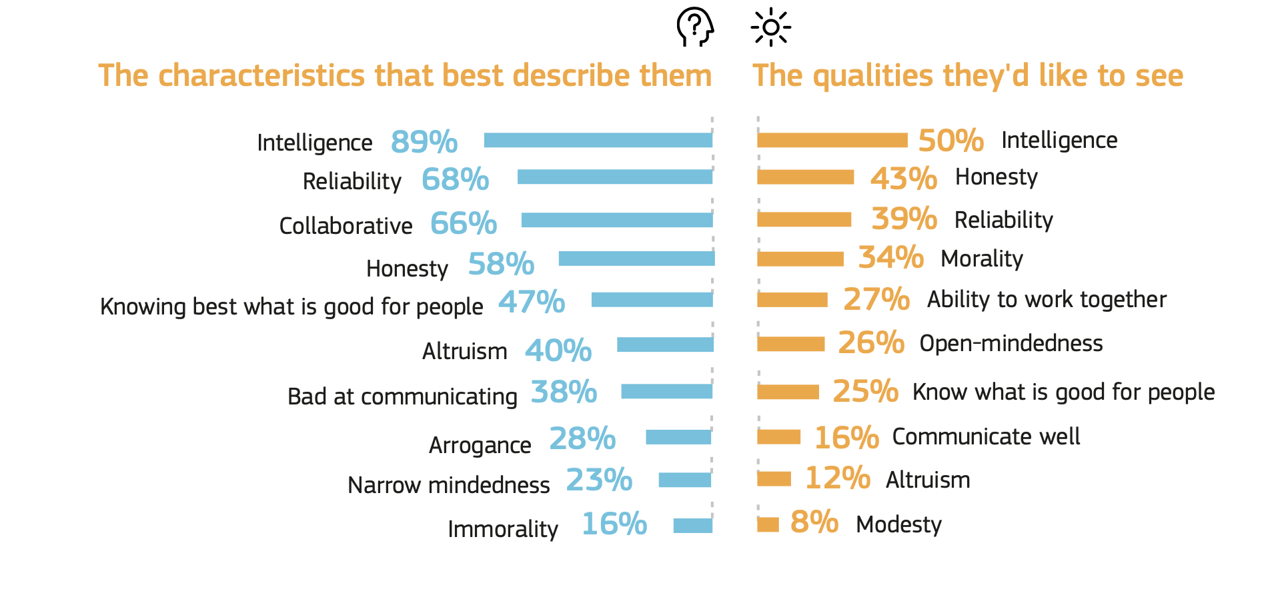
What EU citizens thinks of scientists
Q: The following is a list of characteristics that can be associated with scientists today. For each characteristic, indicate if you think it describes scientists well or describes them badly
Q: Please choose the three qualities that you think scientists should have
Eurobarometer (2021)

Slide 9
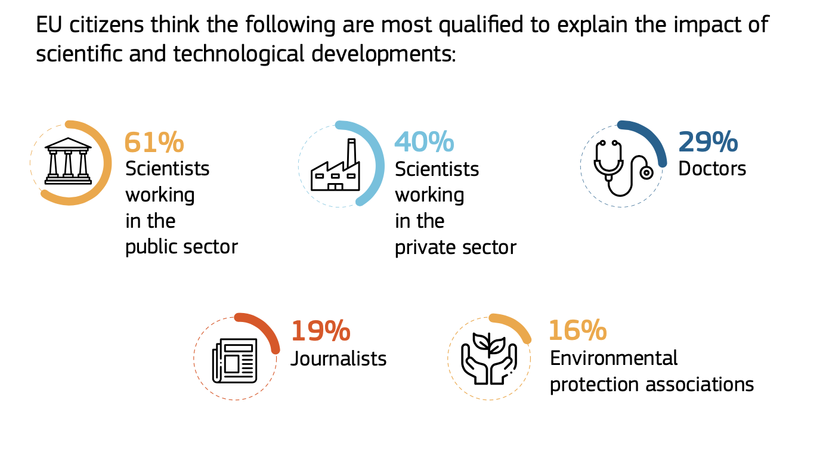
Scientists (in public sector) as more qualified to explain the impact of S&T
National governments
12%
People active on social media
/blogs
6%
Q: Among the following categories of people and organisations, which are the best qualified to explain the impact of scientific and technological developments on society?
Eurobarometer (2021)

Slide 10
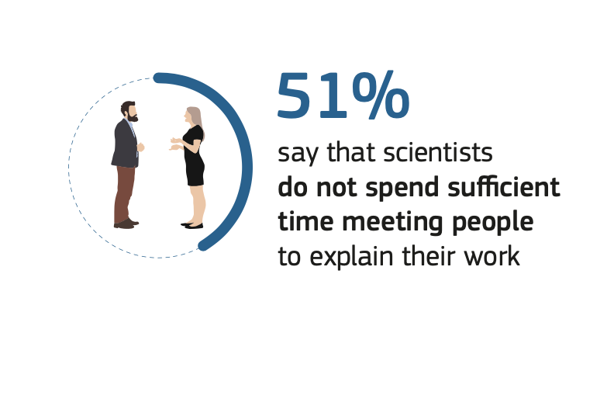
Citizens are interested in hearing directly from scientists
Wellcome Global Monitor 2020
Eurobarometer 2021
“Public interest in hearing directly from scientists about the research they were conducting jumped by nineteen percentage points (63% to 82%)”
Jensen et al (2021)
Q: Please indicate to what extent you agree or disagree:
Scientists spend sufficient time meeting people like me to explain their work

Slide 11
The role of scientists in education and outreach
Aka: why should scientists get involved in education and outreach?

Slide 12
Scientists are key “actors” in education and outreach
A non-exhaustive list of the ”actors”
Individuals
Scientists
Education & Outreach professionals
Organisations
Research labs
Funding agencies
Authors
Social media influencers
Podcasters
Science centres
Science festivals
Media (newspapers, broadcast, online)
Companies/agencies
Journalists
School clubs

Slide 13
What do we know from science communication research?
One of the values of science festivals is a unique opportunity to interact with scientists in an informal way. (Jensen & Buckley, 2014).
Casual conversations between scientists and the public in everyday settings also create high levels of engagement. (Stofer et al, 2019)
Interactions between scientists and the public lead to increasing knowledge about science and the natural world, increased engagement with science and increased understanding of the role of science in society. (Wormald, 2018)
Meeting scientists face-to-face allows school students to change their perception of scientists from ‘boring’ and ‘nerdy’ to ‘normal’ and ‘approachable’, as well as broadens their understanding of scientist careers. (Woods-Townsend et al, 2016)
Short discussions with scientists about their everyday life provide evidence of increase in students’ science career aspirations. (Hochberg & Kuhn, 2019)

Slide 14
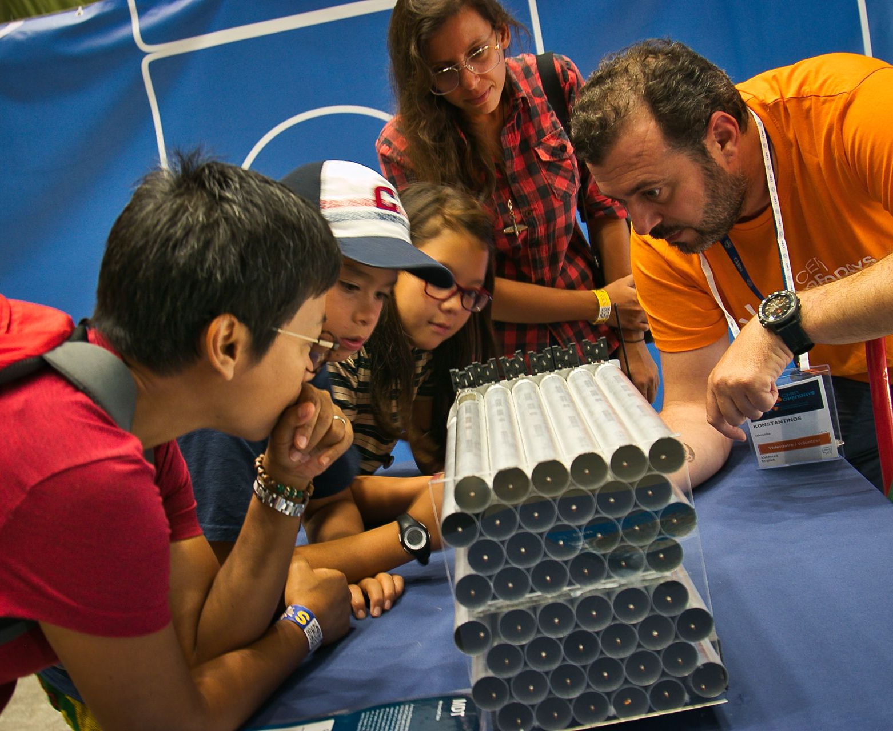
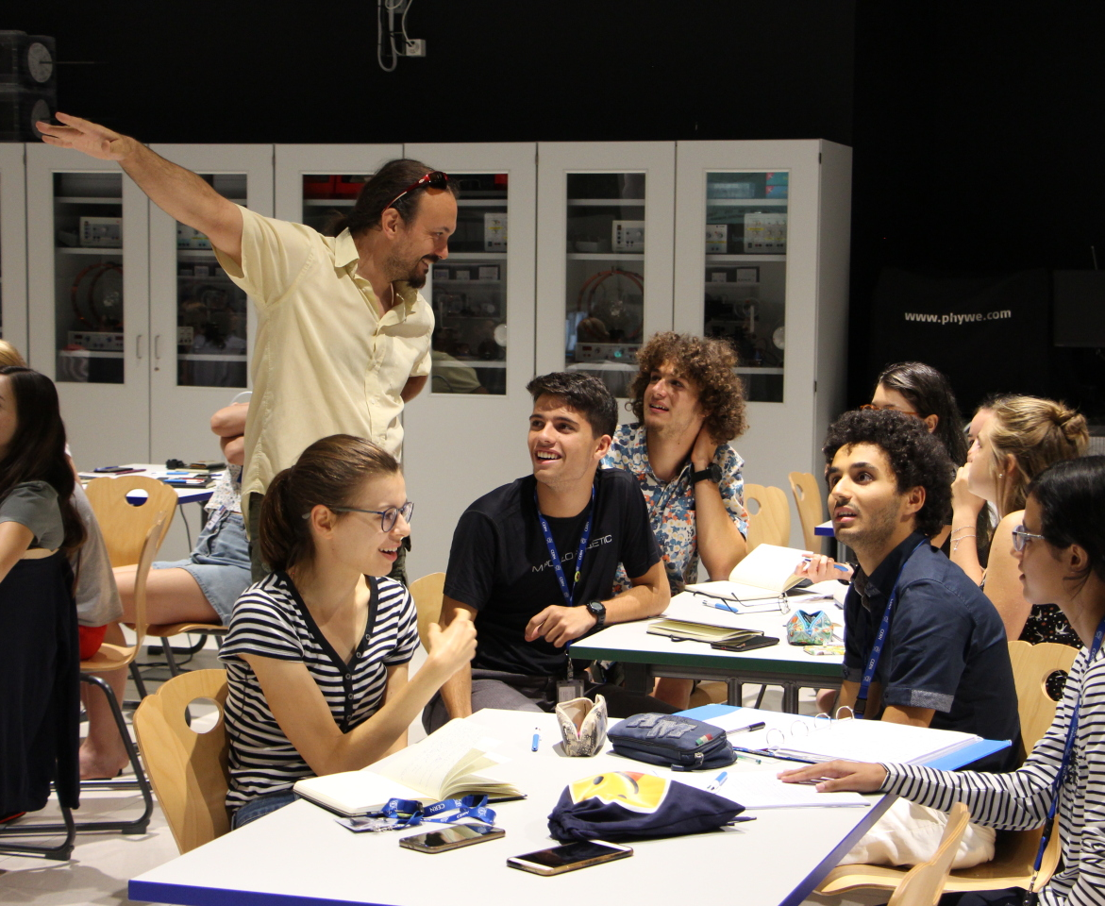
What does our own research show?
CERN Open Days 2019
CERN S’Cool LAB

Slide 15
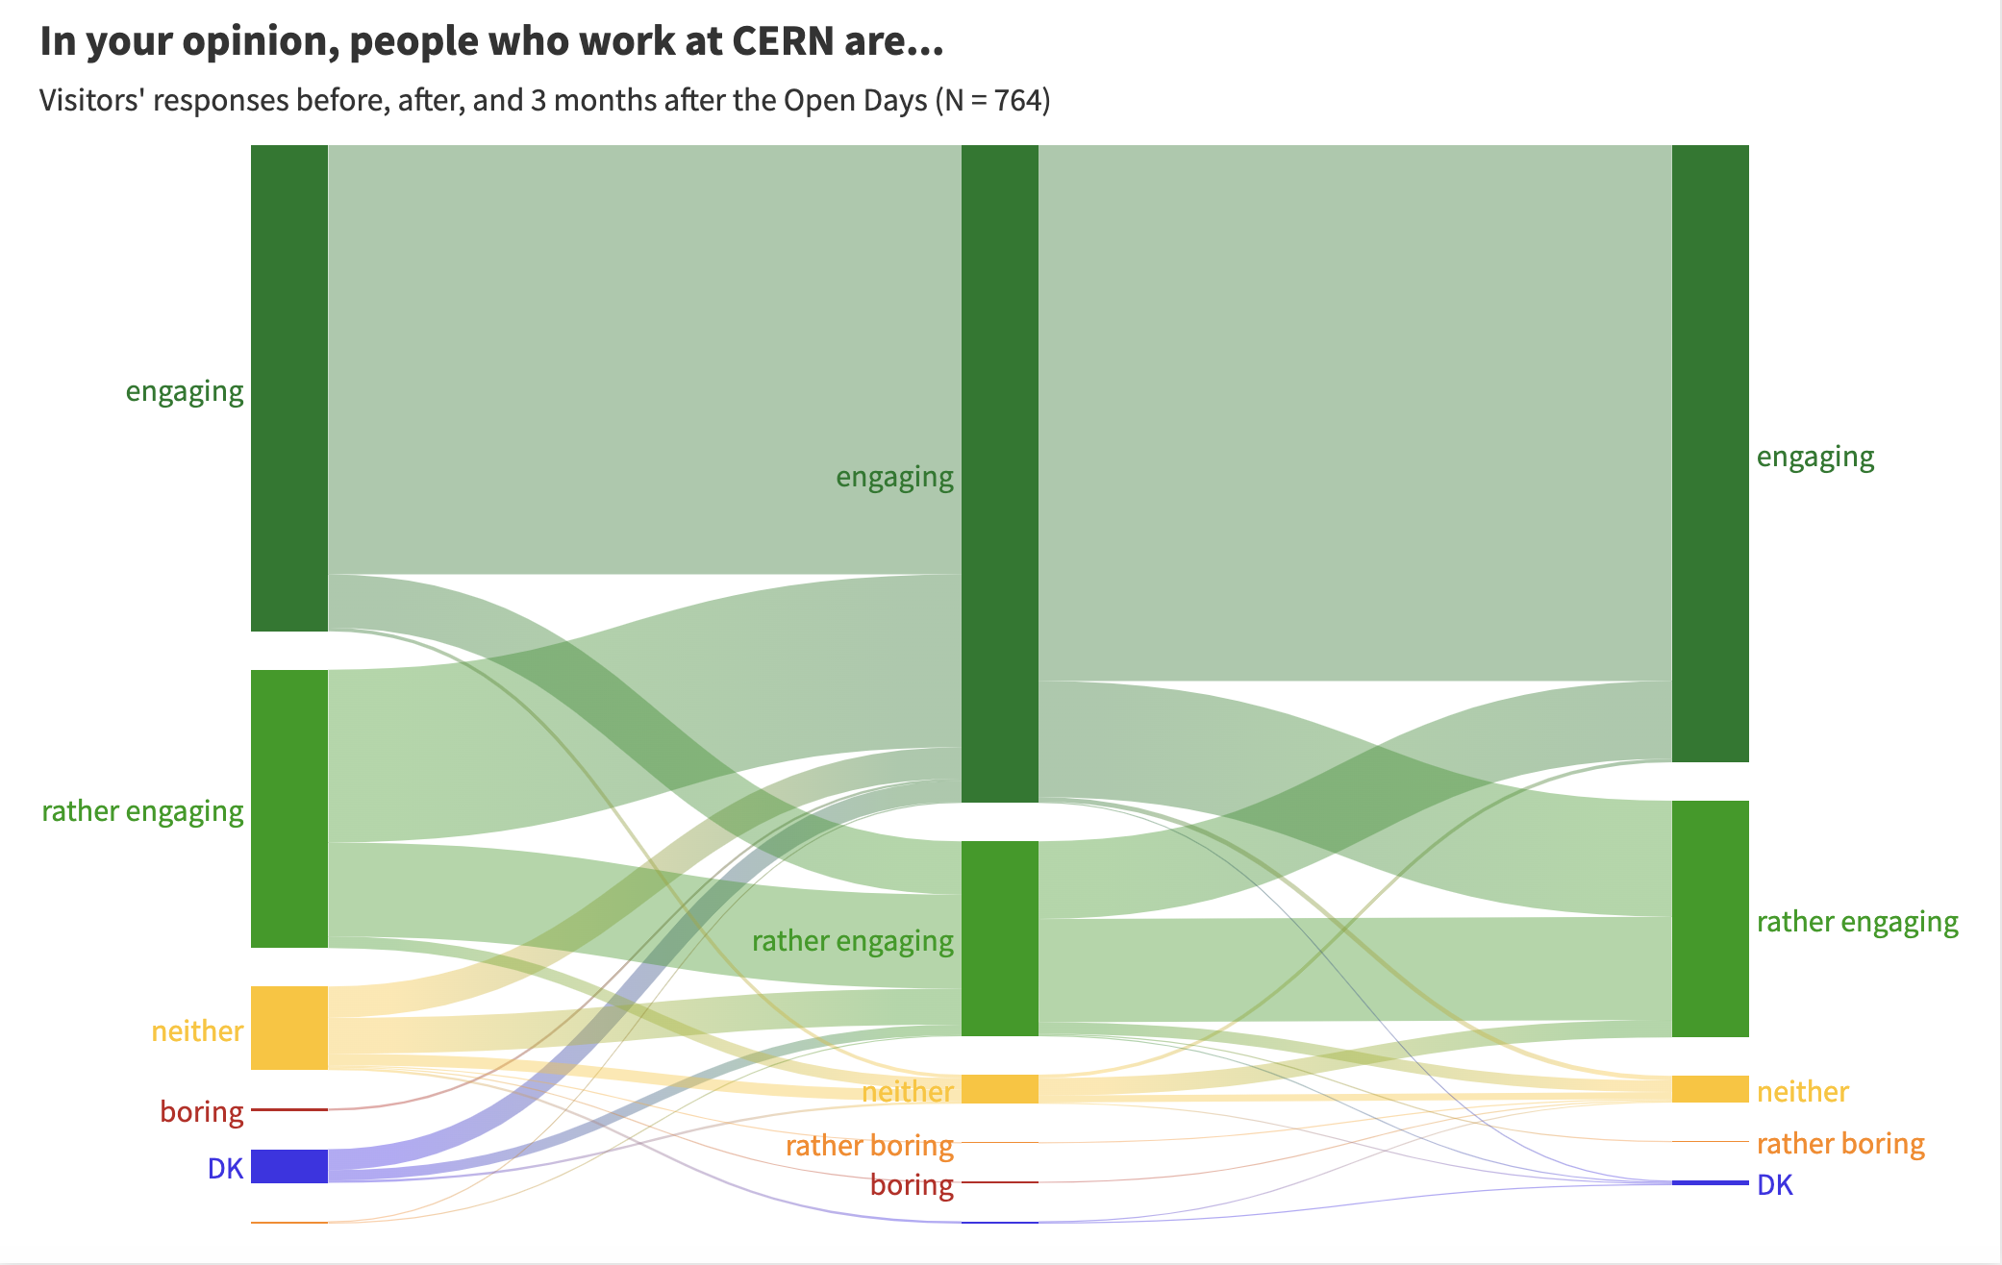
CERN Open Days 2019 (1/2)
Daria Dvorzhitskaia, U. Zurich & CERN
Pre-OD
45% (N = 1674 / 3752) - “Talking to people who work at CERN” as one of the main things they looked forward to
Post-OD
58% (N = 2327 / 3979) - “I had conversations with people from CERN” as one of the main activities they did at the Open Days

Slide 16
CERN Open Days 2019 (2/2)
Daria Dvorzhitskaia, U. Zurich & CERN
16% (N = 631 / 3979) explicitly mentioned members of CERN community when describing their take-home message / key memory from the Open Days
“More impressive than the LHC is CERN’s people.”
“People at CERN like their work and like to talk about it.”
“CERN does complicated things, but if you go there and speak with the CERN people, it isn't difficult at all to understand.”
“The guide of guides named Jacob from New Zealand […] was the absolute highlight and fulcrum of our trip […] Our experience at CERN was informed 100% by what he alone explained. […]”
Same ca. 16% in the subsample who responded immediately after (132 / 764 ) and 3 months after the Open Days (126 / 764)

Slide 17
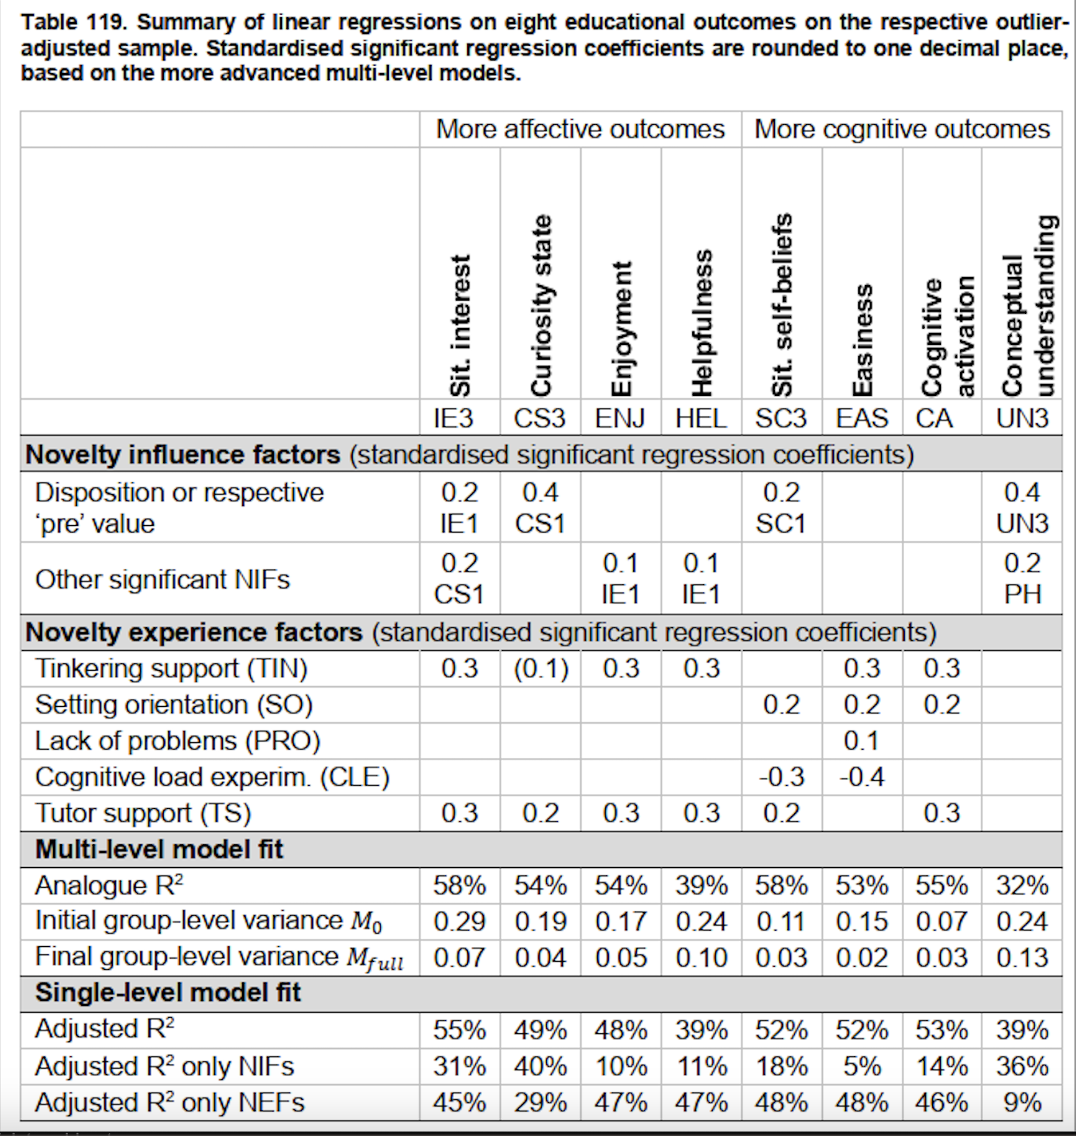
CERN S’Cool LAB
Julia Woithe, U. Kaiserslauten & CERN
Assessed range of affective and cognitive outcomes (of the students)
Study of 509 high-school students from 13 countries
took part in a half-day hands-on sessions of particle physics experiments
Guided by ”tutors” from CERN community
Findings:
Students’ perception of tutors and support provided by tutors is highly positively correlated with almost all outcomes such as interest, curiosity, enjoyment, physics self-beliefs, perceived cognitive activation.
In linear regression models, tutor support was by far the most important predictor for these outcome variables
Notes:
Tutor support (e.g. help in case of problems and display of fascination for physics)
Tinkering support (e.g., helpful instructions and easy to find materials) – positive learning environment
Setting orientation (setting familiarity due to preparation)
Cognitive load (has to do with task difficulty and the interactivity between tasks)
Cognitive activation (an active and elaborated interaction with the learning topic. E.g. contrasting students’ existing conceptions with new surprising experiences, which allow students to connect their knowledge in new ways or apply it in new contexts)
Novelty influence factors (student characteristics)
Novelty experience factors (students’ perception of laboratory characteristics)

Slide 18
Equity, Diversity and Inclusion

Slide 19
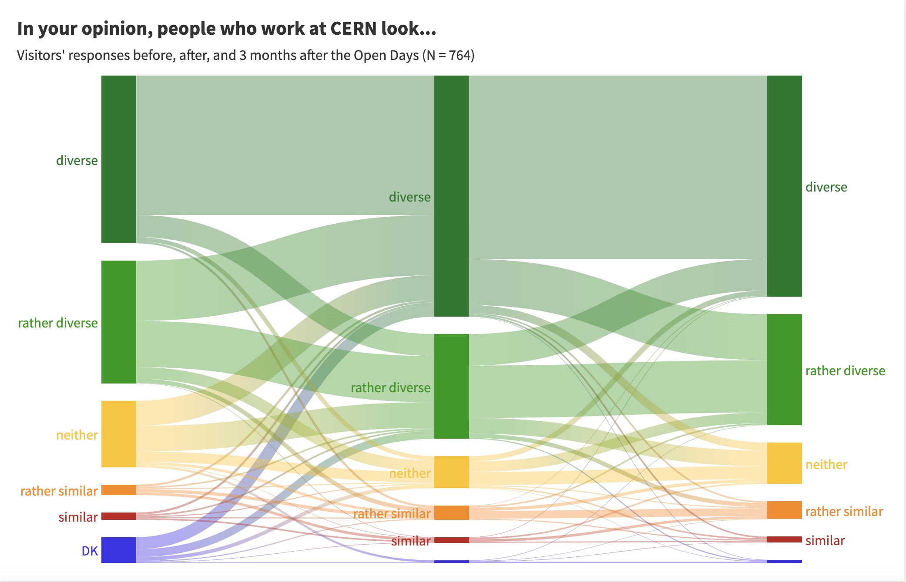
Showing diversity in HEP through outreach
Data from the
2019 CERN Open Days
Daria Dvorzhitskaia,
U. Zurich & CERN

Slide 20
Inclusive education and outreach
Inclusive education and outreach
Equitable access to and engagement with STEM
Create a sense of belonging in STEM for all
Diversity is not simply having a range of demographics
Inclusion is more than successful participation. It is ownership of that participation.
EDI in education and outreach is intentionally working with diverse, traditionally excluded communities in developing projects
Canfield et al., 2020

Slide 21
Who do we mean when we talk about diversity groups?
Girls/Women
Ethnic groups
Religious groups
Immigrants
Linguistically diverse
Persons with disabilities
Developing nations
LGBTQIA+
Indigenous people
Low socio-economic status
Good to remember:
A person may belong to more than one group ex: black single mother
It is good to interrogate how our own experiences and cultural perspectives shape our work
Education and outreach practitioners and researchers may belong to one of these groups, and so should (be empowered to) bring in their experience
Judd and McKinnon, 2021

Slide 22
The methods of inclusive education and outreach
Co-creation
Using culturally-relevant channels
Integrating lay expertise
Community-engaged research
Accept engagement on audiences' terms
Canfield et al., 2020

Slide 23
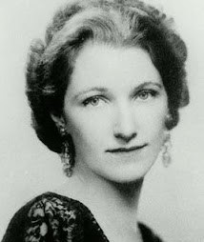
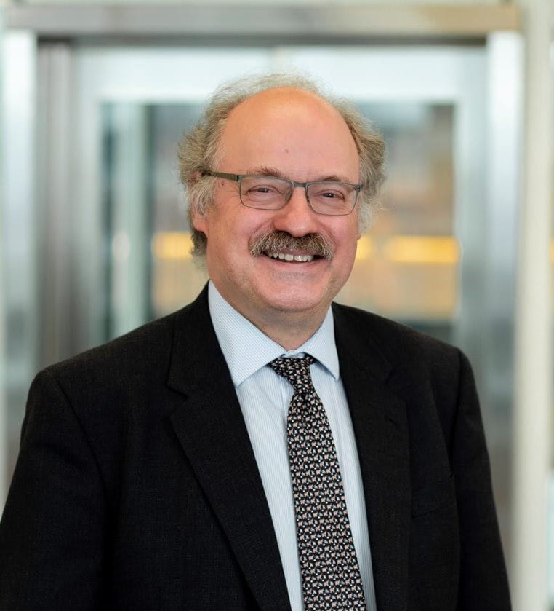
In 1952
“Nothing in science has any value to society if it is not communicated, and scientists are beginning to learn their social obligations”
Anne Roe, Clinical psychologist and researcher
In 2013
“Science isn't finished until it's communicated. The communication to wider audiences is part of the job of being a scientist, and so how you communicate is absolutely vital.”
Sir Mark Walport, Former Chief Scientific Advisor to the UK Government

