Slide 1
Measurement of 1-Jettiness* in the Breit Frame at High Q²
Henry Klest for the H1 Collaboration
EPS-HEP
August 26, 2023

Slide 2
Measurement of 1-Jettiness* in the Breit Frame at High Q²
Henry Klest for the H1 Collaboration
EPS-HEP
August 26, 2023
* + grooming!

Slide 3
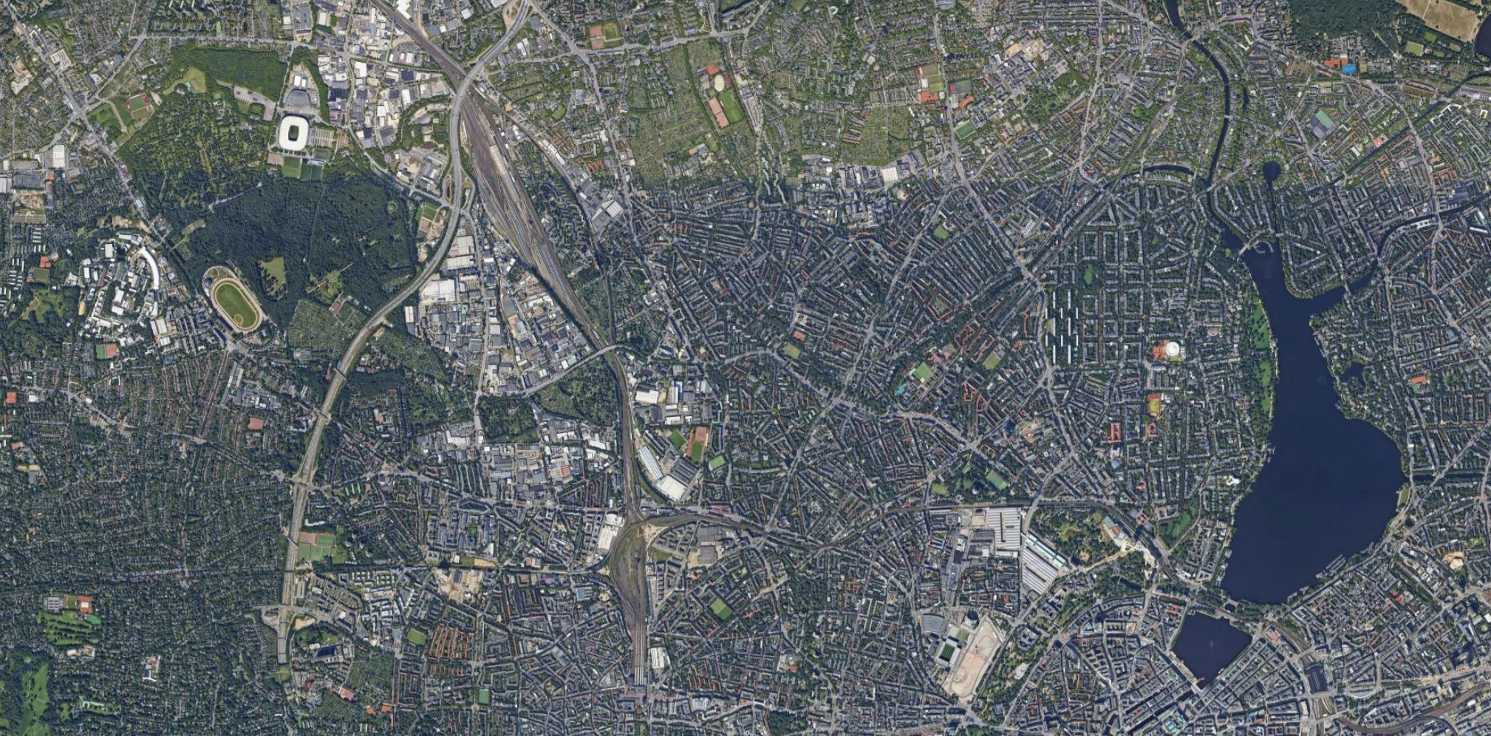

Slide 4
Wir sind hier!

Slide 5
~7 km
Wir sind hier!

Slide 6
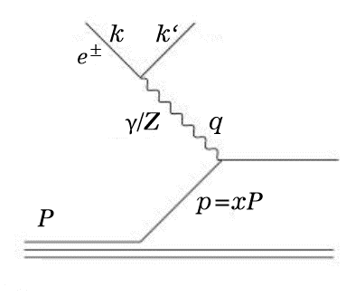
Deep inelastic scattering kinematics
Exchanged boson virtuality - Q²
Sets hard scale of process
Bjorken x
Fraction of proton’s momentum carried by struck quark*
Bounded between 0 and 1
Inelasticity – y
Fraction of electron’s energy transferred to parton in proton rest frame
The DIS kinematic variables can be measured with the scattered electron, hadronic final state, or combination of both
$$Q^{2}=sxy$$
* In the proton-infinite-momentum frame

Slide 7
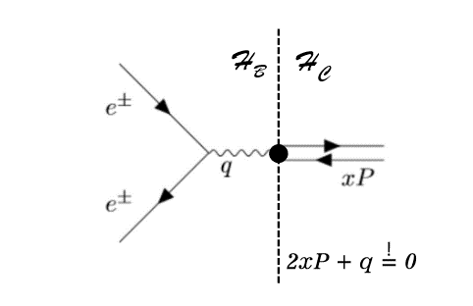
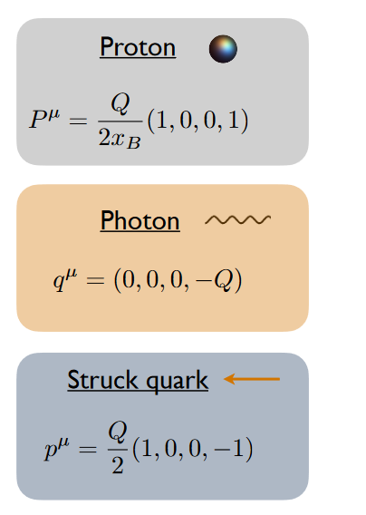
The Breit Frame
Figures from Y. Makris
Revisiting the Role of Grooming in DIS ArXiv: 2101.02708
With x_{B} and photon 4-vector measured, can Lorentz boost to Breit frame
Event is divided into two “hemispheres”
Current hemisphere H_{C} (p_{z} < 0)
Contains mostly radiation associated with struck parton
Remnant hemisphere H_{R} (p_{z} > 0)
Contains mostly radiation associated with proton remnant

Slide 8
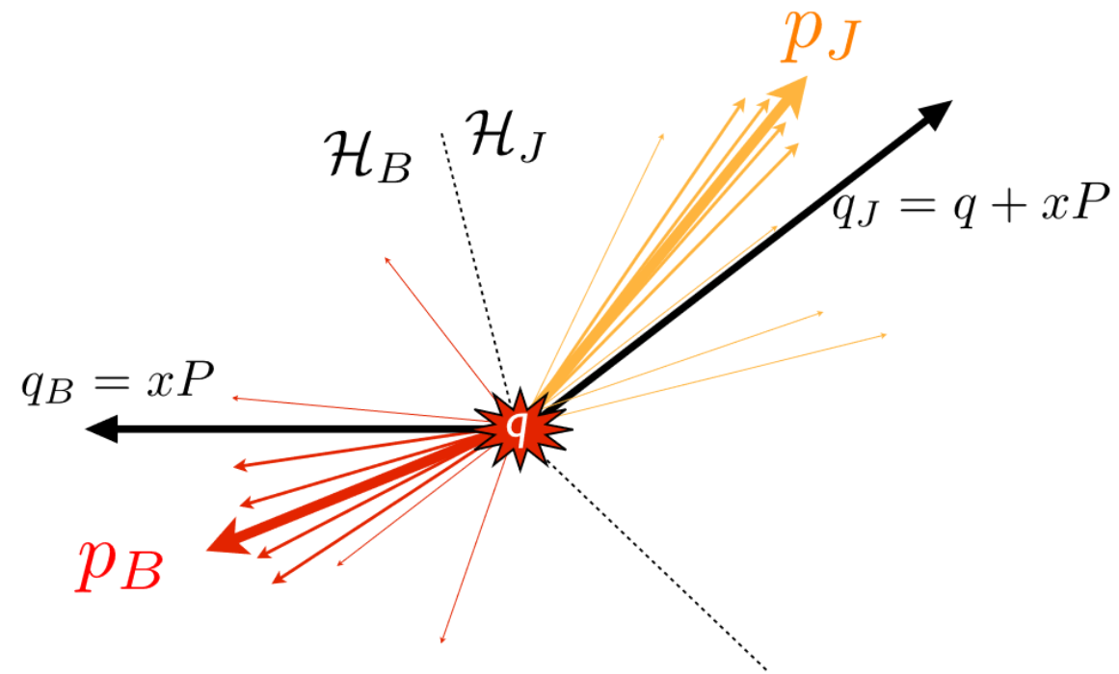
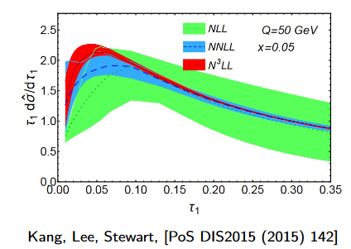
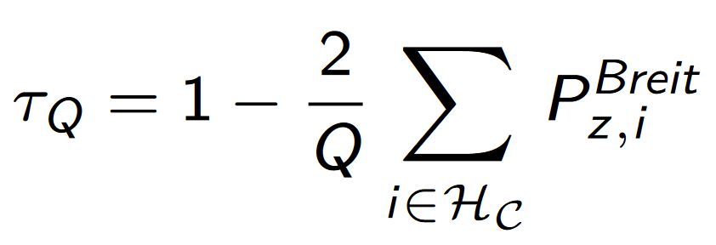
1-Jettiness Event Shape
Sum of four-vector dot product of final state particles with struck-parton axis or beam axis
IR-safe and free from non-global logarithms
Sensitive to α_{s} and PDFs
Valuable for tuning MC models
Parton shower, hadronization, etc.
Equivalent definition follows from momentum conservation
Only particles in current hemisphere contribute – experimentally favorable

Slide 9
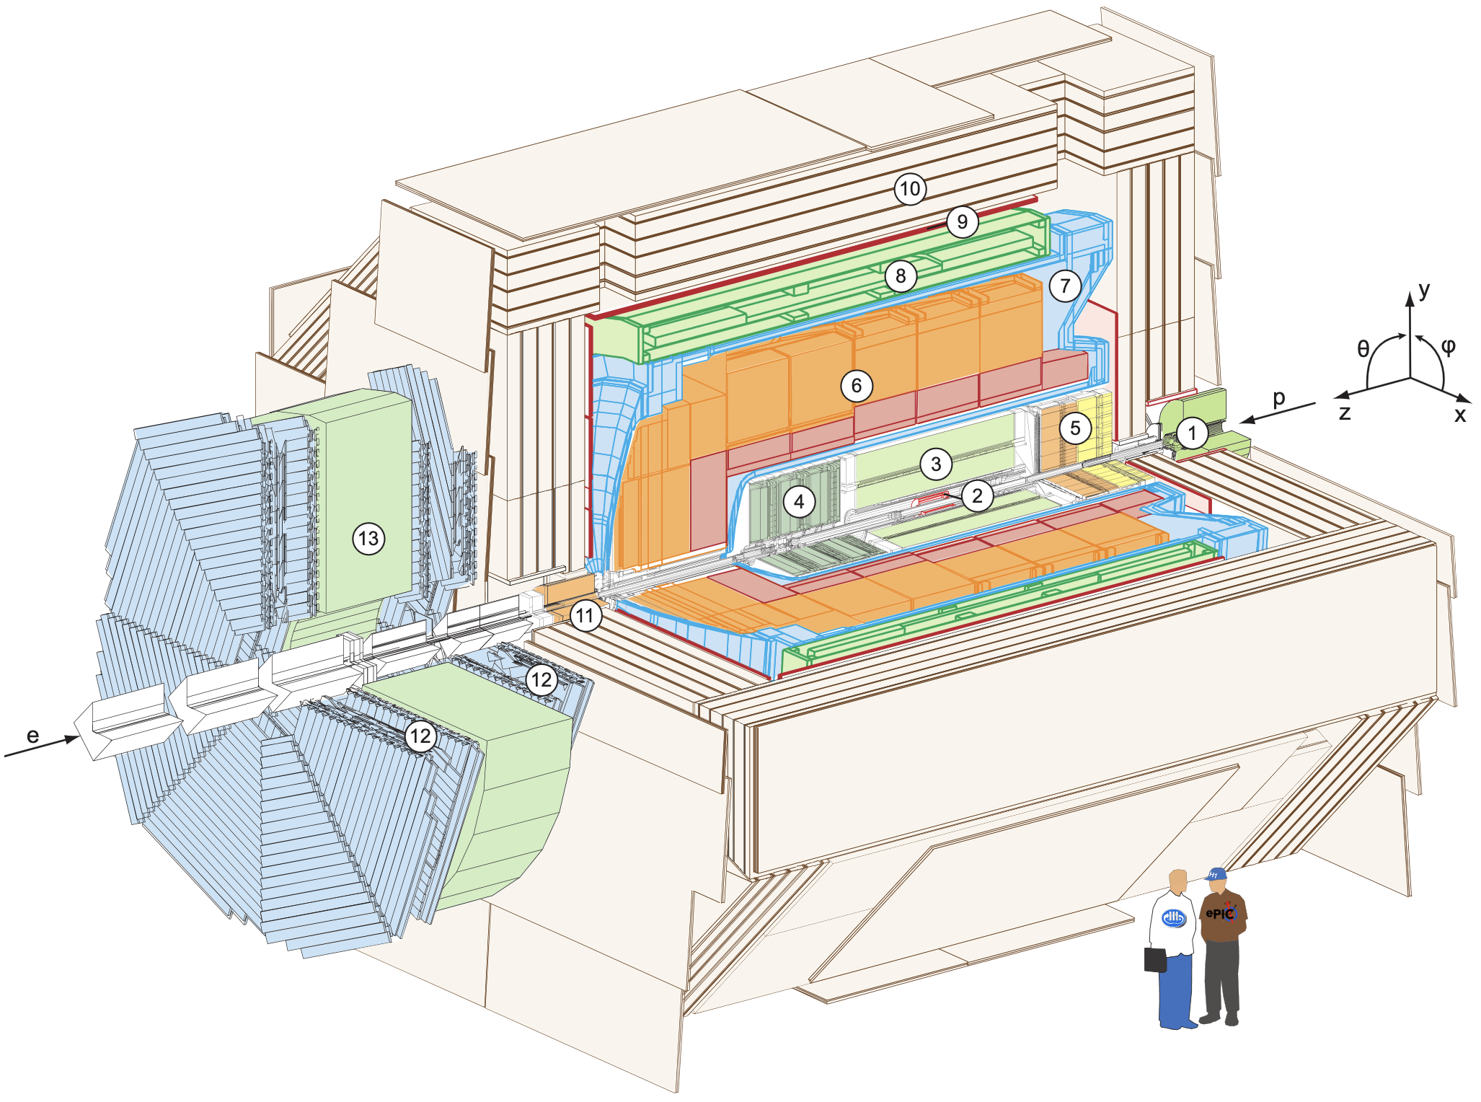
H1 at HERA
HERA
World’s only high energy electron-proton collider
H1 Detector
Asymmetric hermetic detector
Drift chamber + silicon tracking
High-resolution LAr calorimeter
Particles reconstructed with particle flow algorithm
H1 LAr Calorimeter Specifications

Slide 10
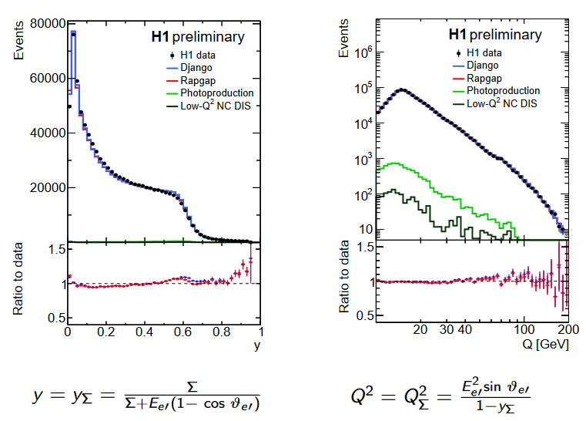
Inclusive DIS
HERA-II data
Q² > 150 GeV², 0.2 < y < 0.7
351 pb⁻¹ collected
Rapgap (ME+PS) and Djangoh (CDM) used as “signal” generators
Both are full DIS generators
Small backgrounds
Photoproduction, Low-Q NC DIS are largest sources
DIS kinematics reconstructed with IΣ method
Independent of QED ISR

Slide 11
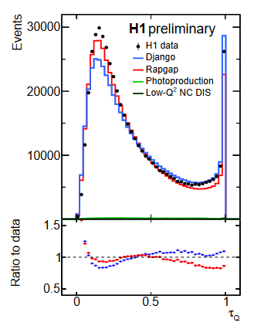
$τ_{Q}$ Measurement
$τ_{Q}$ $→$ 0: DIS 1-jet event (Born-level)
$τ_{Q}$ $→$ 1: DIS dijet event
$τ_{Q}$ $=$ 1: Dijet event with both jets in beam hemisphere
Simulation provides reasonable description of data over full range of $τ_{Q}$
Observable can clearly resolve differences in MC models

Slide 12
Observables
DIS 1-jet configuration $→$Small $τ$
Born-level, parton shower, resummation,
hadronization
Multi-jet configuration $→Large$ $τ$

Slide 13
Observables
DIS 1-jet configuration $→$Small $τ$
Higher order QCD emissions
Multi-jet configuration $→Large$ $τ$

Slide 14
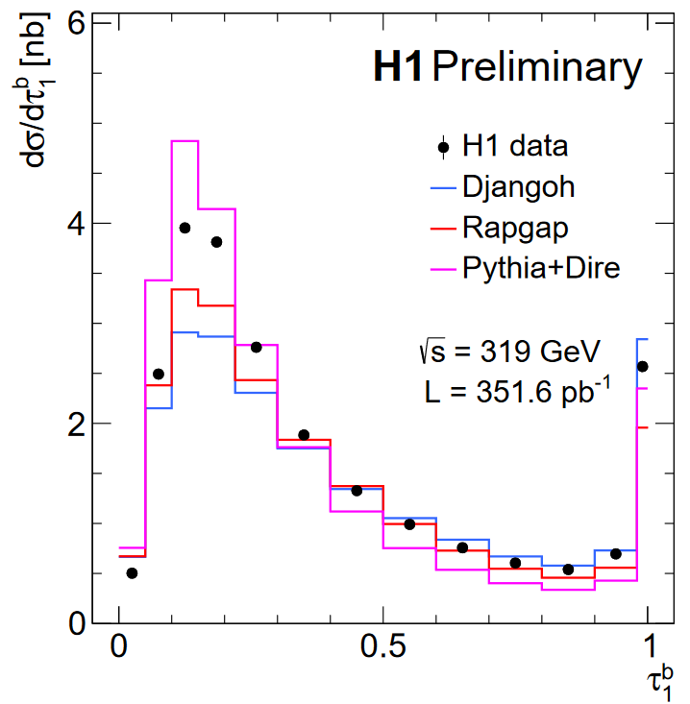
Single Differential Cross-Section
Corrected for detector and QED effects bin-by-bin
Peak (resummation) region $τ_{Q}$ $→$ 0 poorly described by all models
Rapgap/Djangoh underestimate, Pythia+Dire overestimates
Tail (fixed-order) region $τ_{Q}$ $→$ 1
Rapgap and Djangoh do well, Pythia+Dire underestimates
L = Luminosity
$∆_{τ}$ = Bin width
150 < Q² < 20000
0.2 < y < 0.7

Slide 15
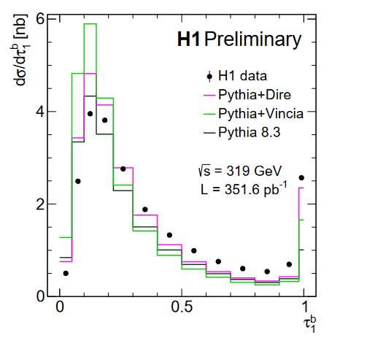
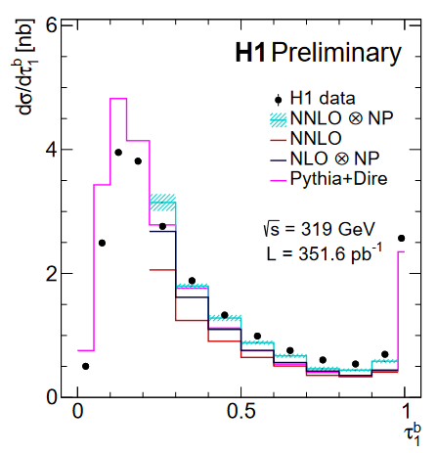
Parton shower model comparison
No fully satisfactory description in peak region
Predicted topology is more 1-jet-like than the data
$e+p→2 Jets+X$Prediction from NNLOJET
NP corrections from Pythia8.3
NP corrections large at low $τ_{1}^{b}$
NNLO provides good description of tail region, improves over NLO

Slide 16
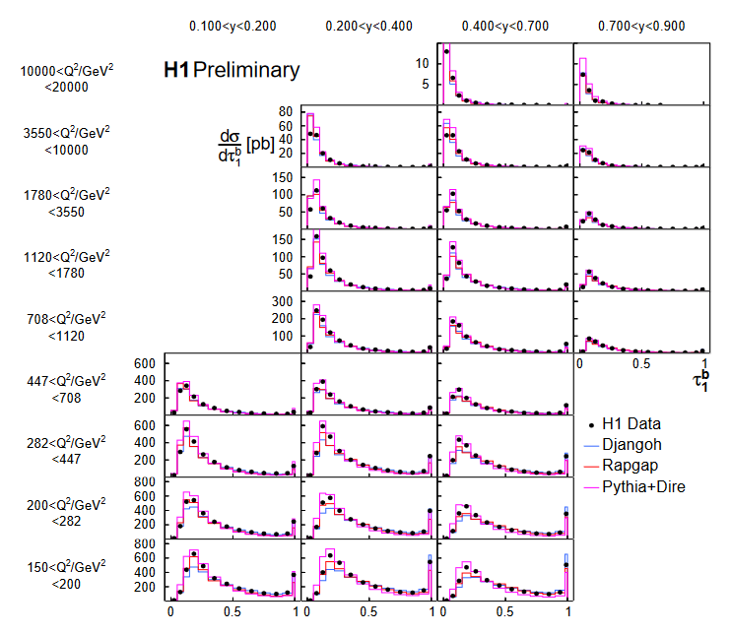
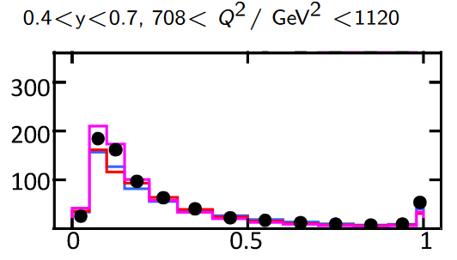
Triple-Differential Cross-Section
With increasing Q:
Total cross-section decreases
Tail region decreases
Peak moves to lower $τ$
At higher momentum transfer, jets are more collimated
With increasing y:
$τ$ = 1 is enhanced
Ratio plots & further model comparisons in backup
$$τ_{1}^{b}$$

Slide 17
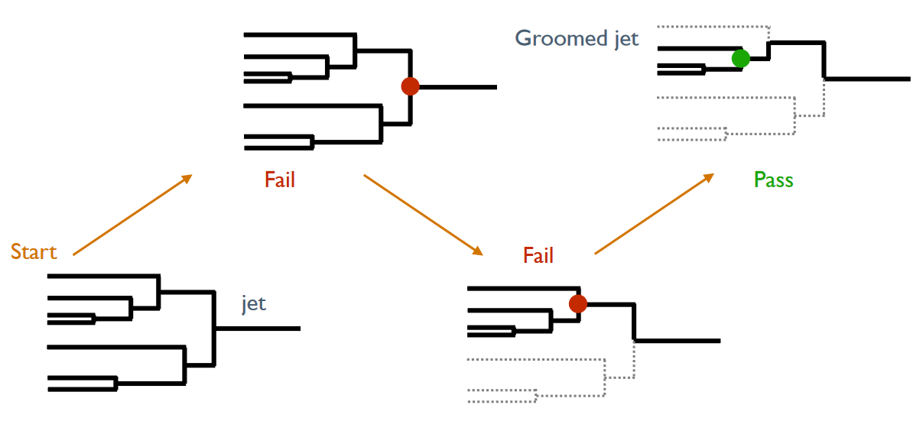
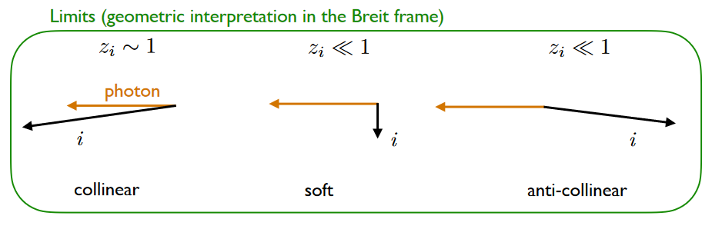
Groomed event
Event Grooming
Whole event is clustered into one “jet”
Use asymmetric Centauro jet clustering algorithm suited for asymmetric DIS
Iteratively de-cluster until grooming condition is passed
Removes particles unlikely to be associated with struck parton
Groomed e+p events are similar to groomed jets!
Does grooming improve the model description of the data?
Full event
p+p Soft Drop condition
DIS grooming condition

Slide 18
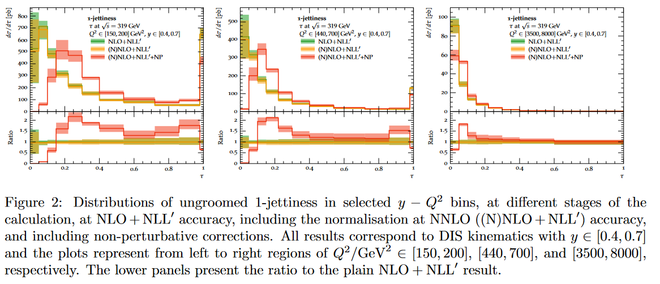
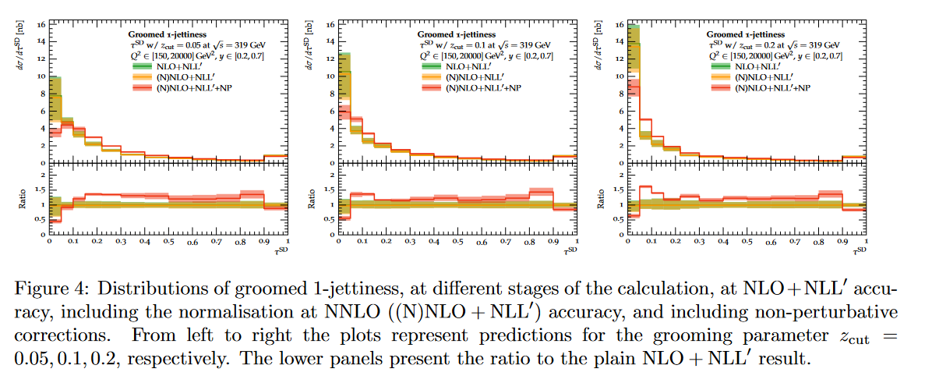

Slide 20
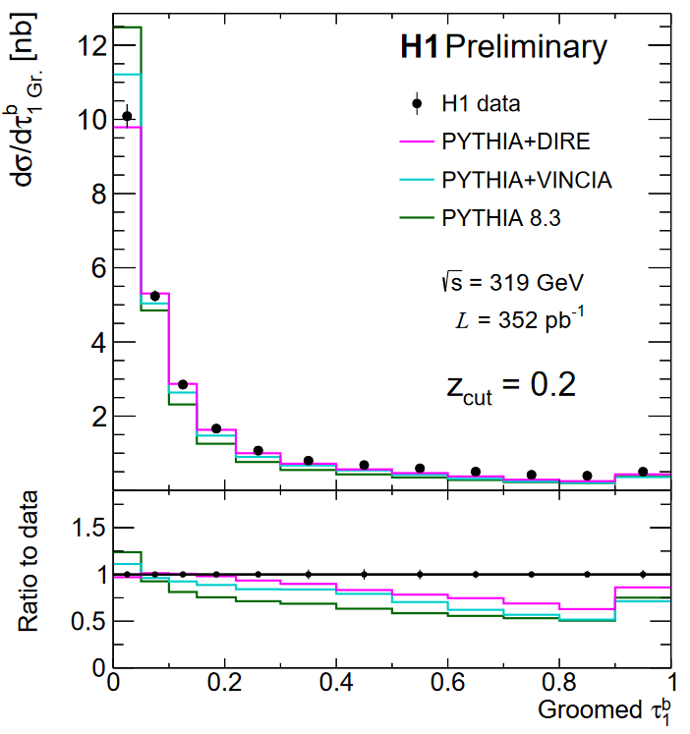
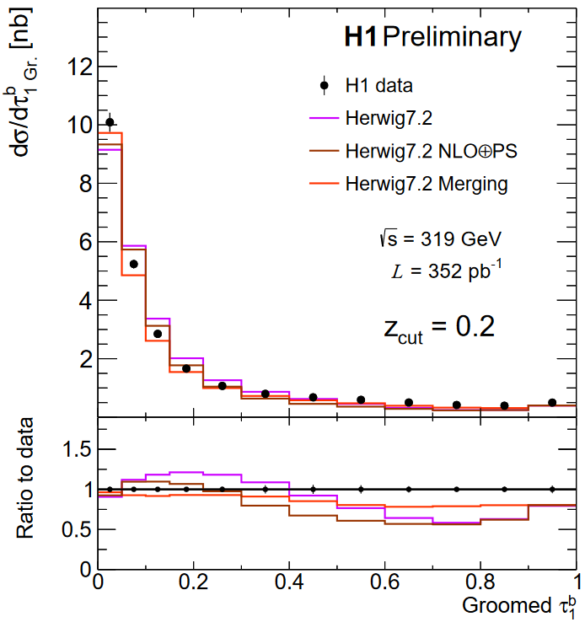
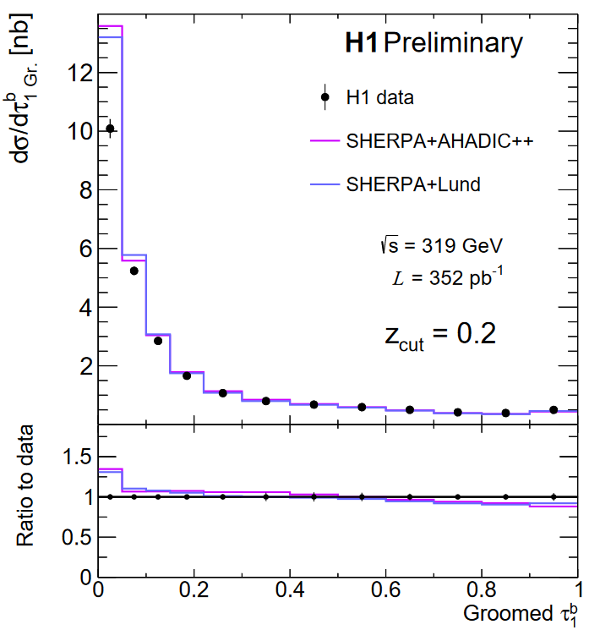
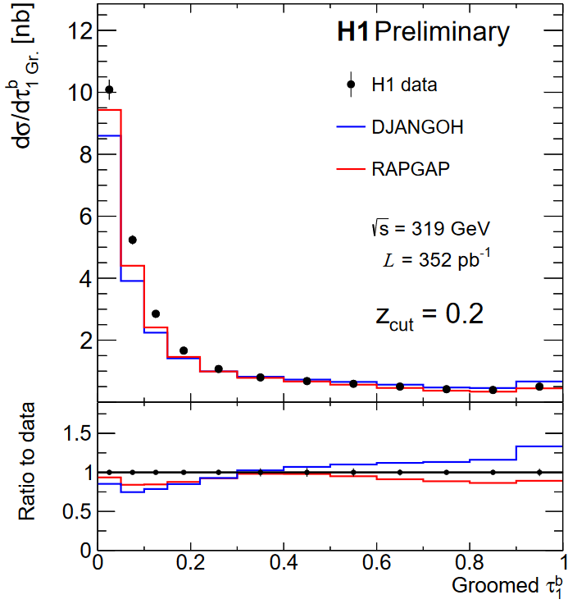
Results – Groomed 1 Jettiness
Pythia – Version 8.3
VINCIA: Antenna Shower
DIRE: Dipole shower + multi-jet merging
Herwig – Version
NLO $⊕$PS – AO Shower, subtractive matching
Merging - Dipole shower + multijet merging
SHERPA – Version 2.2.12 (MEPS@NLO)
AHADIC++ - Cluster Fragmentation
Lund – String Fragmentation
Best tail region from SHERPA, RAPGAP
Fixed-order, multijets, hard splittings
Best peak region from DIRE, Herwig Merging
Resummation, parton shower, hadronization
Notes:
The unreasonable effectiveness of SHERPA and VINCIA

Slide 21
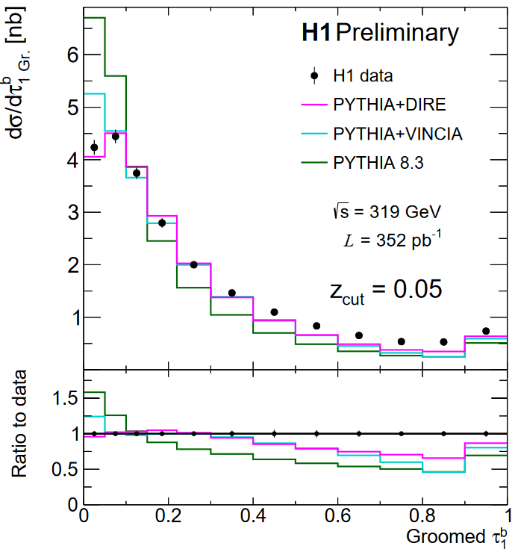
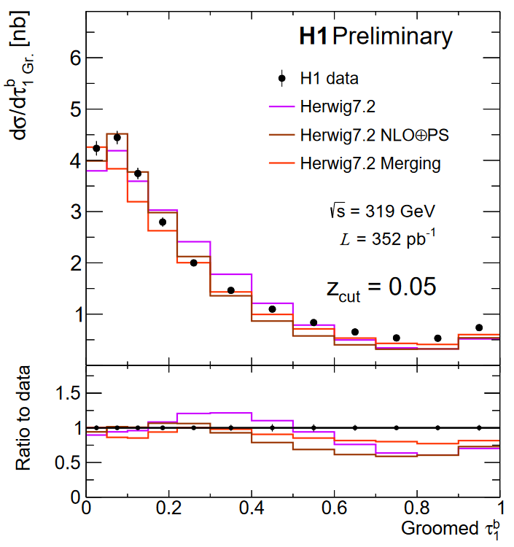
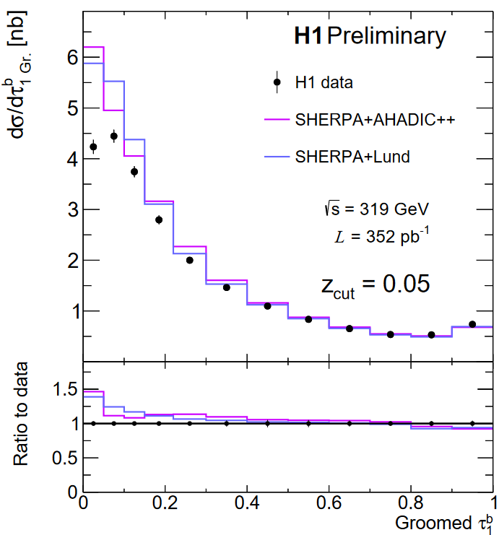
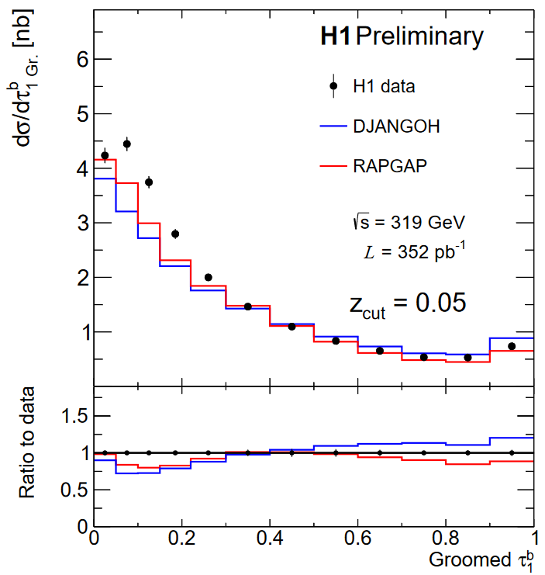
Results – Groomed 1 Jettiness
Pythia – Version 8.3
VINCIA: Antenna Shower
DIRE: Dipole shower + multi-jet merging
Herwig – Version
NLO $⊕$PS – AO Shower, subtractive matching
Merging - Dipole shower + multijet merging
SHERPA – Version 2.2.12 (MEPS@NLO)
AHADIC++ - Cluster Fragmentation
Lund – String Fragmentation
Best tail region from SHERPA, RAPGAP
Fixed-order, multijets, hard splittings
Best peak region from DIRE, Herwig Merging
Resummation, parton shower, hadronization
Notes:
The unreasonable effectiveness of SHERPA and VINCIA

Slide 22
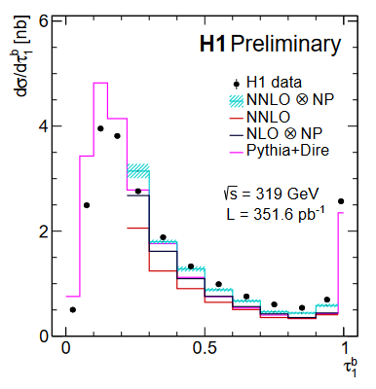
Conclusion + Outlook
First measurement of 1-Jettiness event shape in NC DIS
First application of Centauro & grooming at HERA
More results available in backup slides & H1 Preliminary database
H1prelim-22-033 and H1prelim-21-032
Data sensitive to fundamental QCD quantities
$α_{s}$, PDFs, etc.
Useful for tuning & validation of MC generators
No MC uniformly describes the data
Grooming doesn’t fix the situation
DIS MCs require tuning for Electron-Ion Collider!
Promising measurements for EIC and other future e+p colliders (LHeC, FCC-eh)
See the other H1 talks:
Multi-differential Jet Substructure Measurement in High Q2 ep collisions with HERA-II Data
Machine learning-assisted measurement azimuthal angular asymmetry of soft gluon radiation in deep-inelastic scattering with the H1 detector

Slide 23
Backup

Slide 24
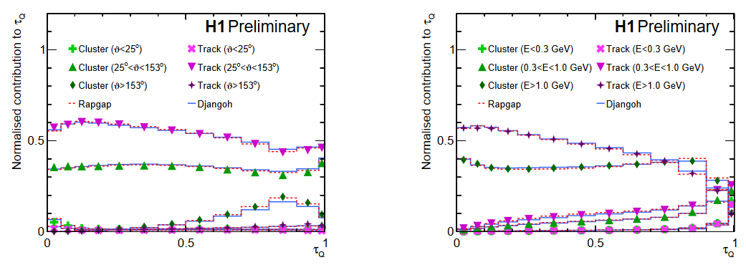
Fully inclusive observable – all events contribute
All particles in current hemisphere contribute to sum $→$
Normalized contributions to $τ_{Q}$ spectrum
0 Degrees $→$ proton-going direction, 180 degrees $→$ electron-going direction
Central, high momentum particles dominate
These are well-measured by the H1 detector!

Slide 25
Triple-Differential Cross-Section
With increasing Q:
Total cross-section decreases
Tail region decreases
Peak moves to lower $τ$
At higher momentum transfer, jets are more collimated
With increasing y:
$τ$ = 1 is enhanced

Slide 26
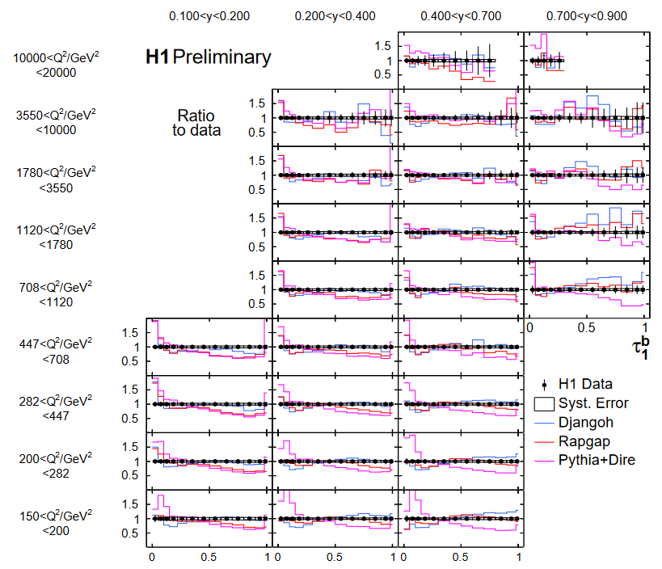
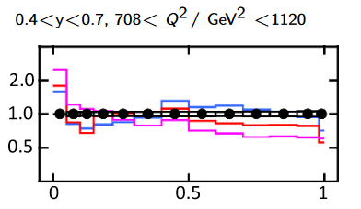
Triple-Differential Cross-Section
Ratios to data
Stat. uncertainties range from a few % to a few 10s of %
Sys. uncertainties around 5%
Djangoh and Rapgap perform reasonably well over full phase space
Pythia+Dire too large in peak region

Slide 27
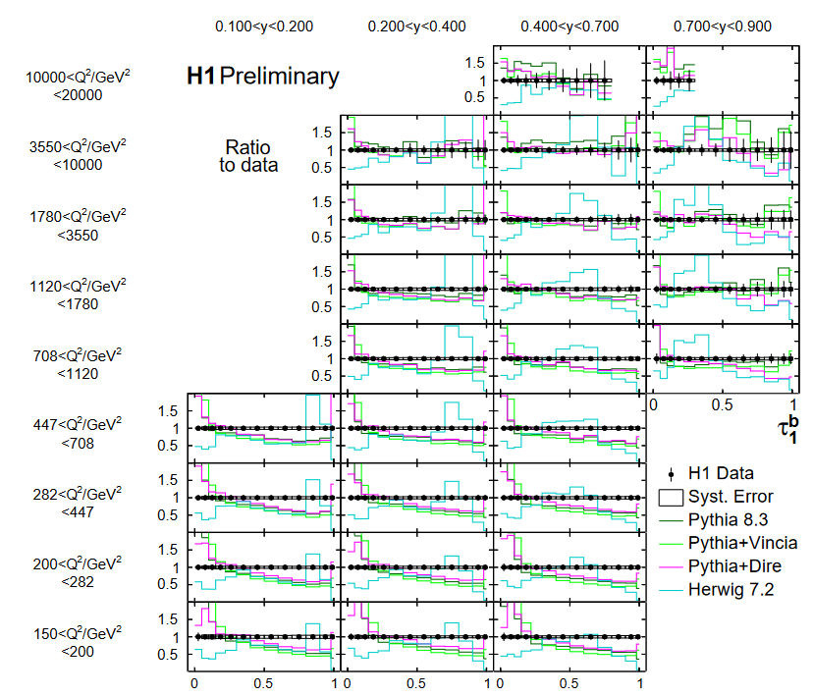
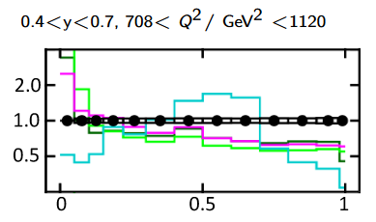
Triple-Differential Cross-Section
Further model comparison
Pythia+Default shower
Pythia+Vincia
Herwig 7.2
Herwig underestimates DIS cross-section
Bump structure visible at mid $τ$

Slide 28
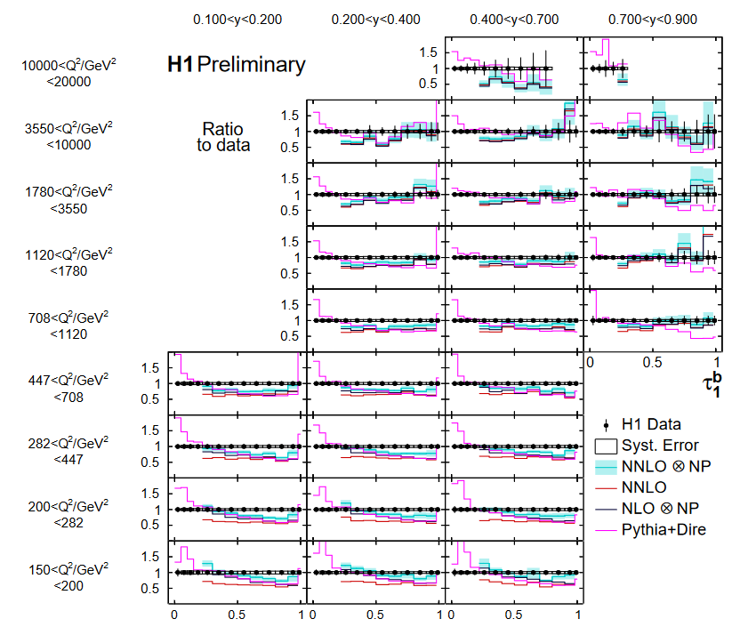
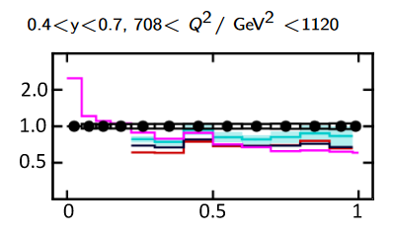
Triple-Differential Cross-Section
NNLO QCD prediction for $ep→2 Jets+X$
Reasonable description over full phase space
Scale uncertainties relatively small
NNLO improves over NLO
NP corrections are sizable

Slide 29
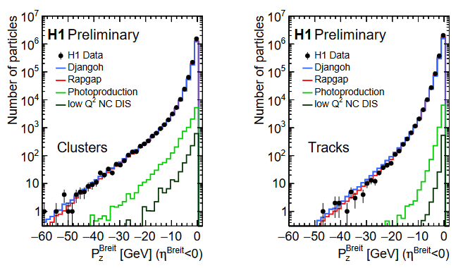
$τ_{Q}$ Measurement
Current hemisphere longitudinal momentum is well modelled by H1 detector-level simulation

Slide 30
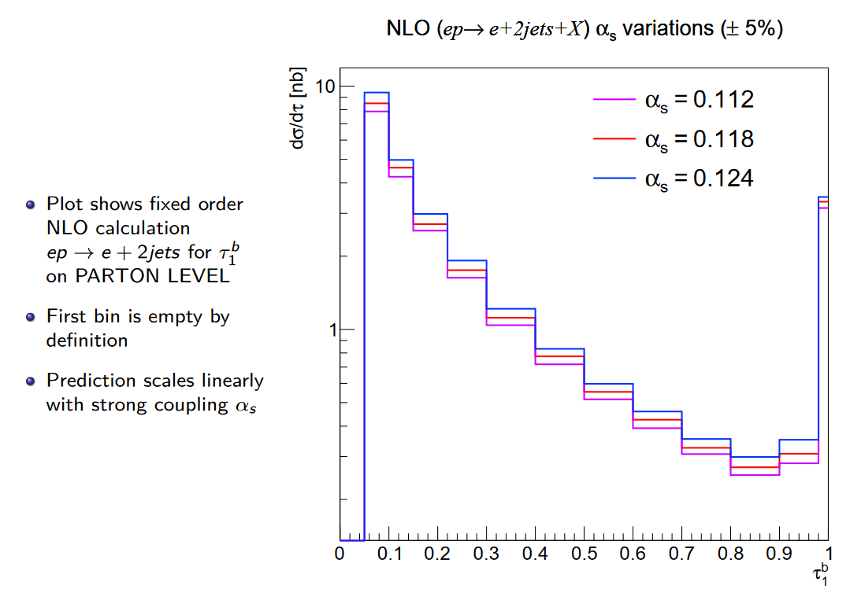

Slide 31
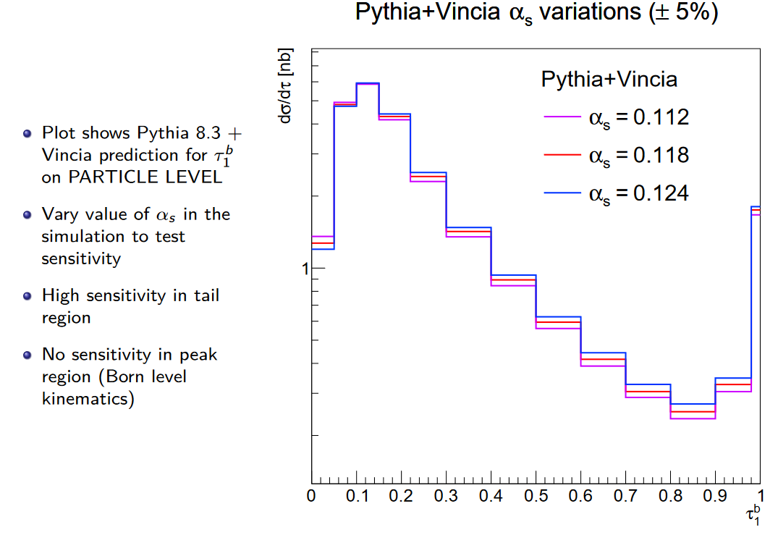

Slide 32
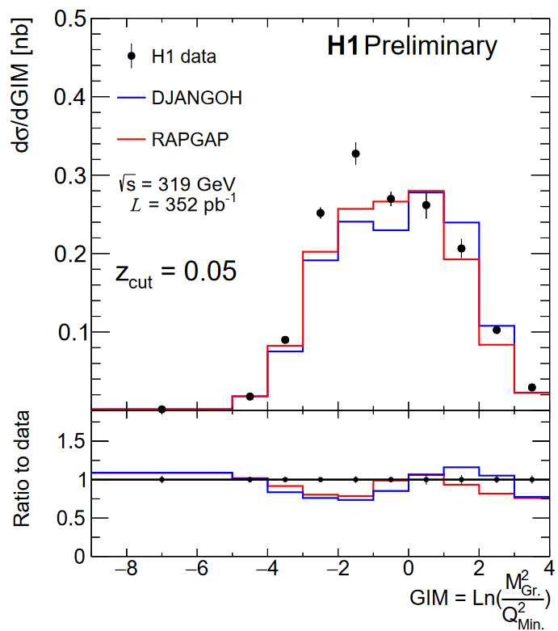
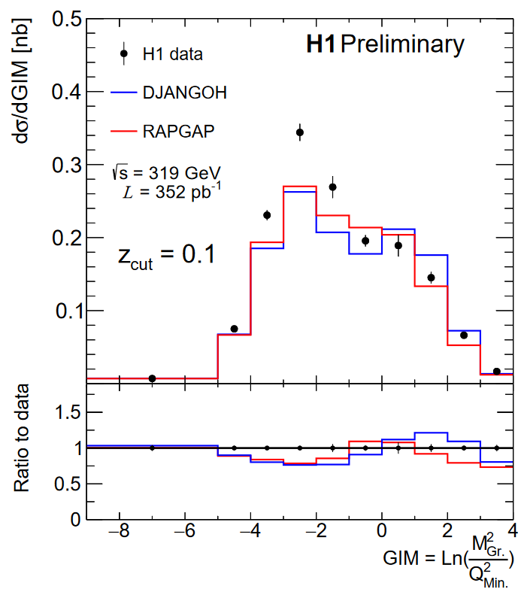
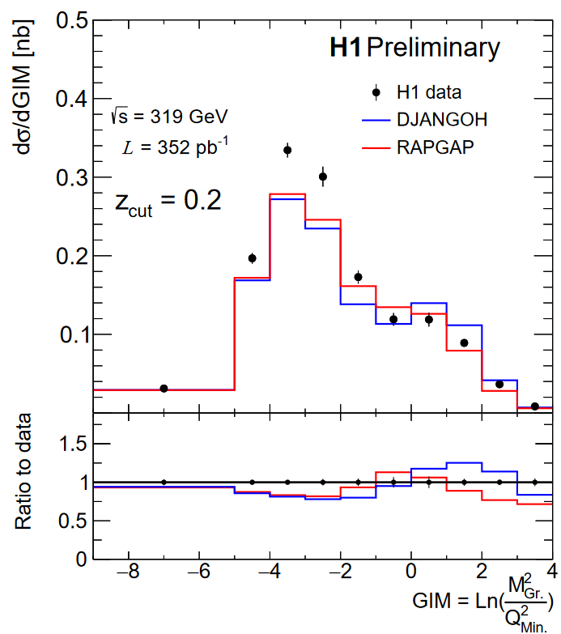
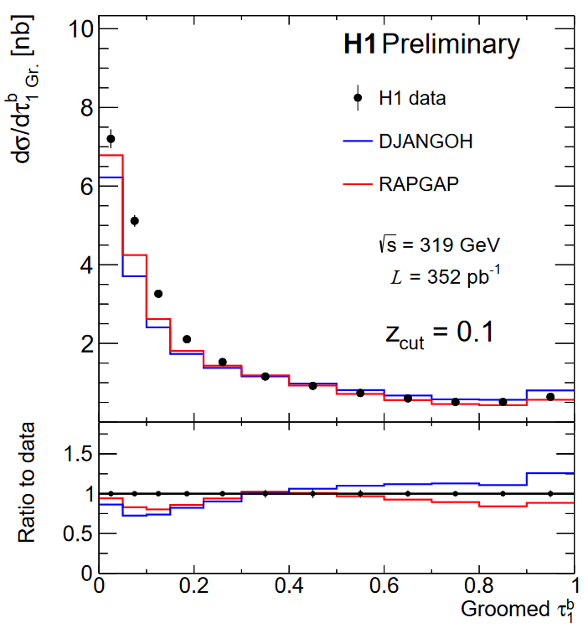
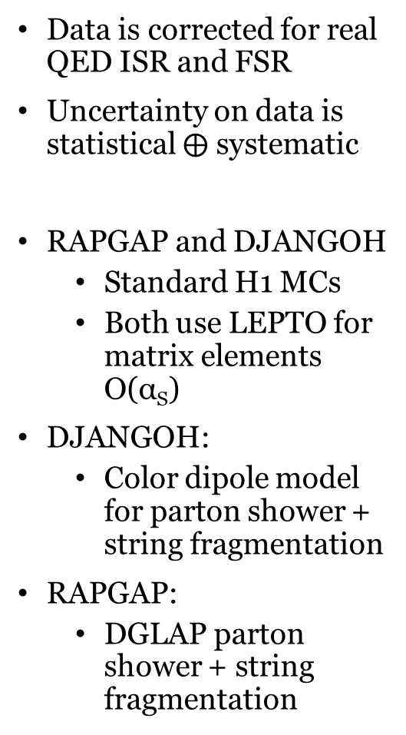
Results
Q²_{Min.}= 150 GeV²
Q²_{Min.}= 150 GeV²
Q²_{Min.}= 150 GeV²
Data is corrected for real QED ISR and FSR
Uncertainty on data is statistical $⨁$ systematic
RAPGAP and DJANGOH
Standard H1 MCs
Both use LEPTO for matrix elements O(α_{S})
DJANGOH:
Color dipole model for parton shower + string fragmentation
RAPGAP:
DGLAP parton shower + string fragmentation

Slide 33
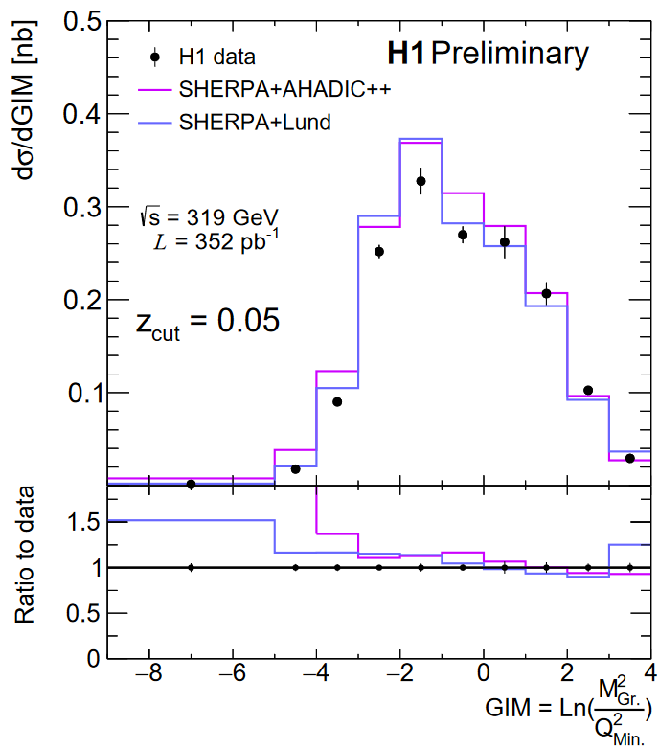
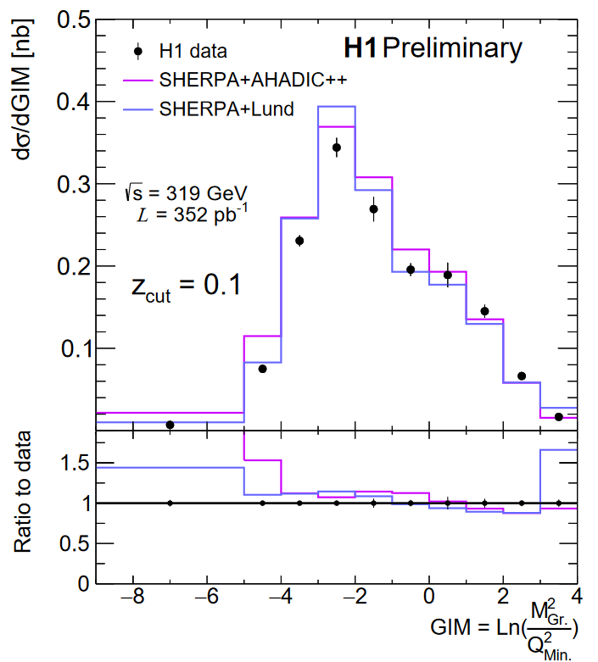
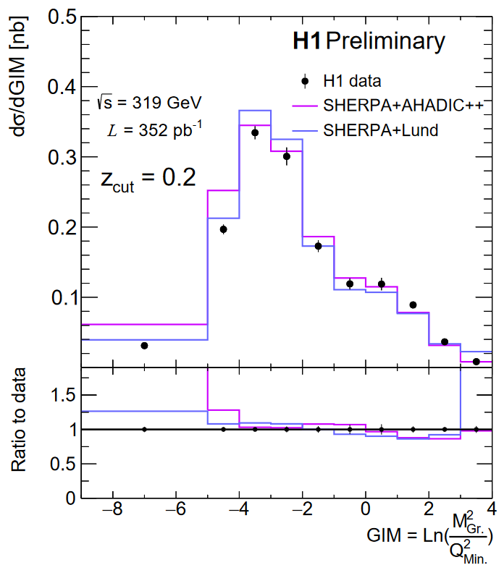
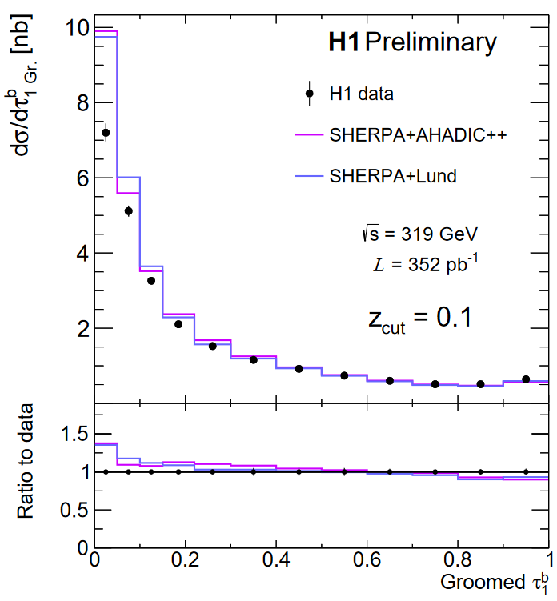
Results
SHERPA
Version 2.2.12
MEPS@NLO
AHADIC++:
SHERPA native cluster hadronization model
Lund:
Lund string model from PYTHIA
Both models provide good description of fixed-order region
Notes:
Sherpa tends to overestimate

Slide 34
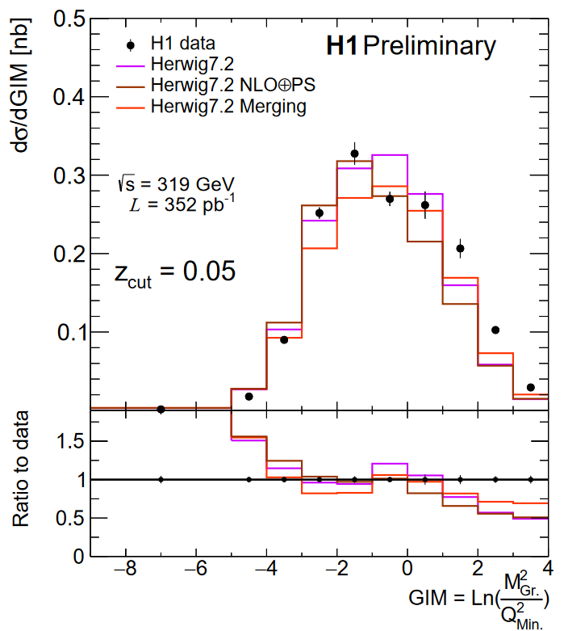
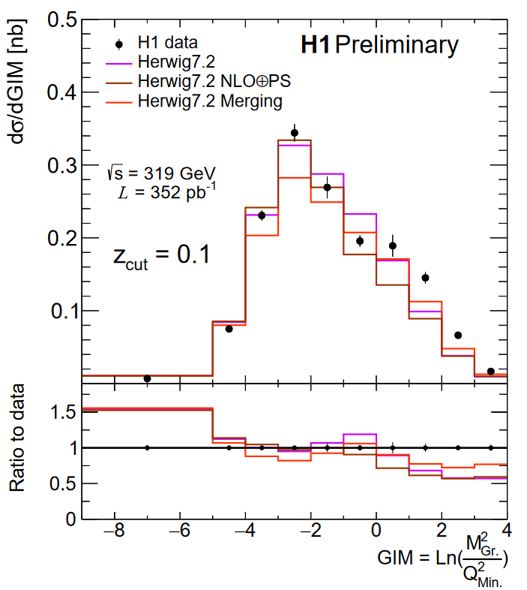
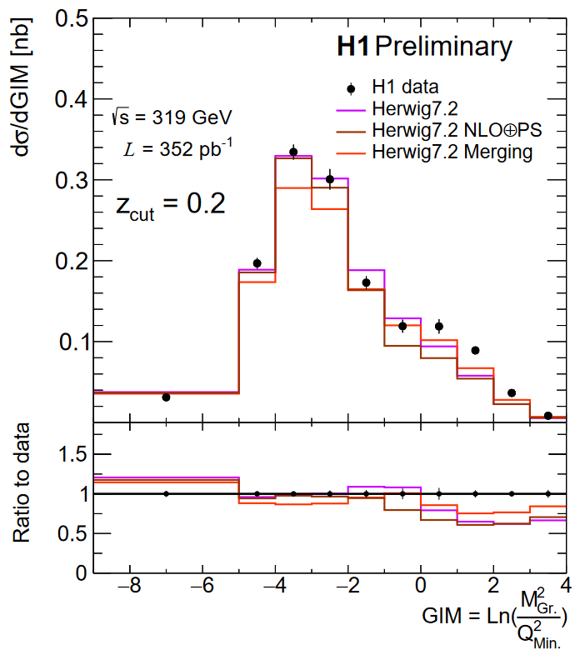
Results
Herwig
Version 7.2.2
NLO$⊕$PS:
Herwig internal implementation of MC@NLO via Matchbox
Merging:
Dipole shower with multijet merging

Slide 35
Results
PYTHIA
Version 8.3
No external matrix elements
DIRE:
Dipole resummation
Excellent description in resummation region
VINCIA:
Antenna shower

Slide 36
Results
Analytic - SCET
From Y. Makris [1]
Evaluated at two values of Ω_{NP}
Shape function mean
No fixed-order calculation yet incorporated
Agreement improves with increasing z_{cut,} Ω_{NP}
Non-perturbative effects are significant!
Factorization validity improves to higher z_{cut}

Slide 37
Centauro
vs.
vs.
Cluster at pi has low P_{T} in Breit frame, smaller d_{ij}
Doesn’t preferentially capture struck quark
Not longitudinally invariant

