Slide 1
Summary of a discussion about LUXE ECALs
Wolfgang Lohmann
BTU, DESY and RWTH

Slide 2
Meeting June 2
Present: V. Boudry (E. Polytechnique) , V. Ghenescu (ISS), M. Idzik (AGH-UST), A. Irles (IFIC), A. Levy (TAU), I. Levi (TAU) W. Lohmann, R. Poeschl (LAL), T. Suehara (Kyushu Univ)
Talks from V. Boudry, M. Idzik, A. Irles, W. Lohmann

Slide 3
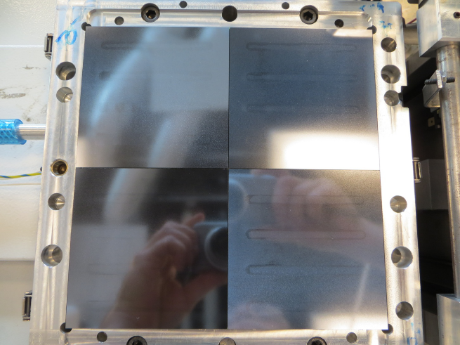
ECAL-E status
Tower size 18 x 18 cm² (4 sensors 9 x 9 cm²)
Sensors available to instrument one tower, 15 sensors
Sensors for a second tower will be ordered
16 FEVs for readout available, potentially sufficient for two towers
For a third tower sensors and FE ASICs needed
W-plates available, 2.1 mm and 4.2 mm thick, one tower 9.6 X₀
Problems appeared with the conductive glue connections. Special R&D effort planned, lead by Adrian, funding expected.
Currently distance between sensor planes 3 cm, for a compact ECAL new mechanical frame needed

Slide 4
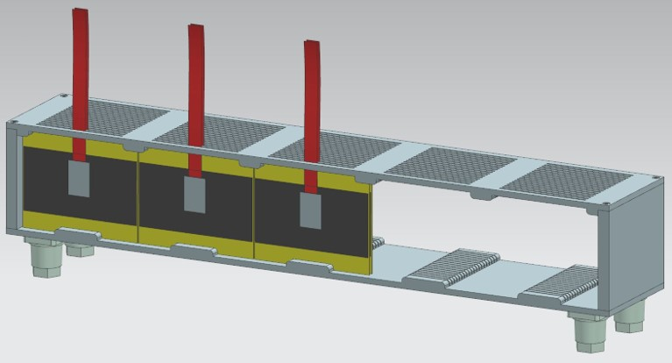
ECAL-P status
Using W-plates from FCAL 4 towers, each 14 x 7 cm2 can be build, 15 X0, horizontal coverage 56 cm, W-plates can be cut in E. Polytechnique.
New mechanical frame needed
Using Calice silicon sensors of 9 x 9 cm2, 6 sensor towers are needed to cover 54 cm,
90 new sensors needed, investment about 90 k $
Number of FLUXE channels 23k, to be covered by the grant of Marek

Slide 5
Conclusion
Design and construction of two ECALs is possible!
Major open items:
Mechanical frames
Sensors
Connectivity with conductive glue
TDR like document, with details of the design, time schedule, responsibilities urgently needed, goal for installation: 2025

