Slide 1



Measurement of laser intensity in
relativistic electron-laser collisions
Gianluca Sarri
g.sarri@qub.ac.uk
GBP working group 15/06/2022

Slide 2
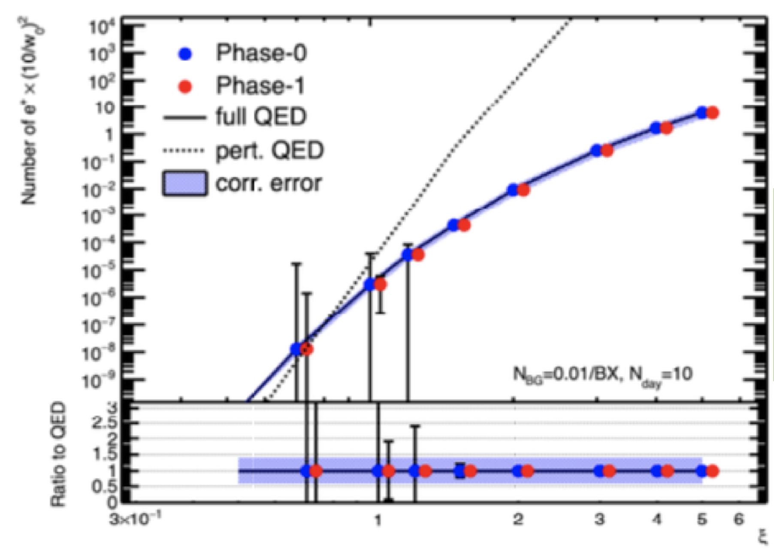
Rationale
The laser intensity at the collision point is a key parameter for the whole experiment
Pair production rate in electron-laser collisions
All the main physics phenomena to be studied have a strong dependence on intensity:
Pair production rates
Compton scattering
Quantum radiation reaction
For a quantitative test of SF-QED models
it is imperative to know the laser intensity
at the interaction point with ~few % precision
Gianluca Sarri

Slide 3
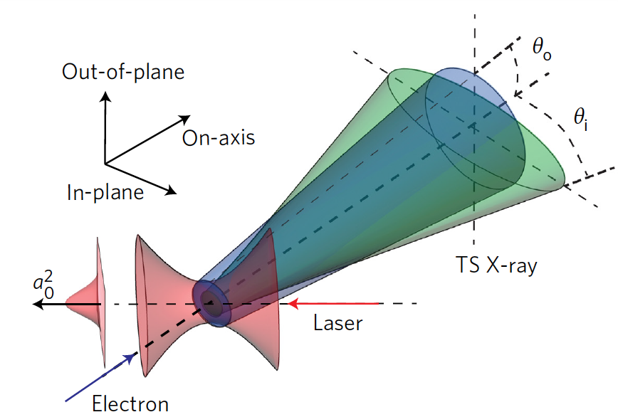
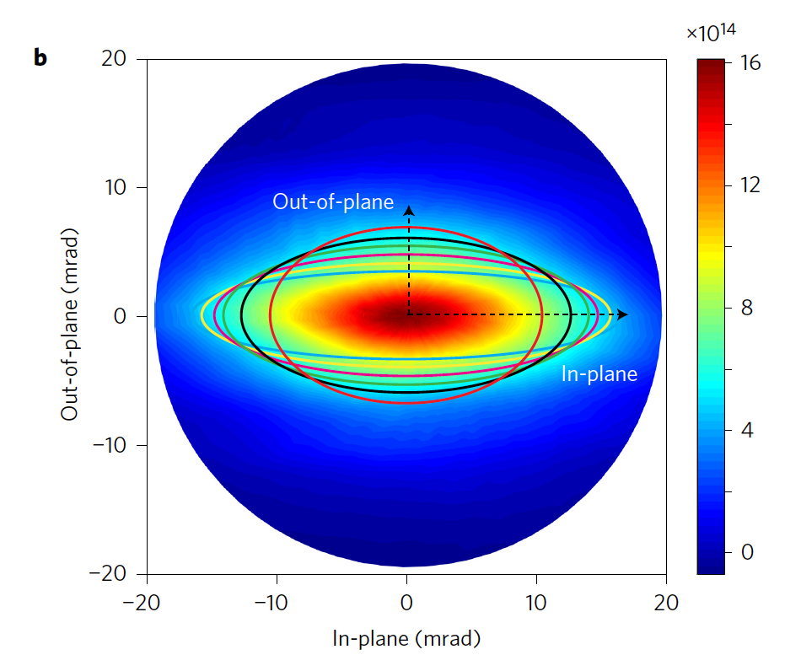
Compton-scattered photon beams
The angular distribution of Compton-scattered photon beams depends on the laser intensity
In linear polarization, the photon emission is elongated along the laser polarization axis
W. Yan et al., Nat. Phot. (2017)
T. Blackburn et al., PRAB (2020)
G. Sarri et al., Phys. Rev. Lett. (2014)
O. Har-Shemesh, and A. Di Piazza, A. Opt. Lett. (2012).
Gianluca Sarri

Slide 4

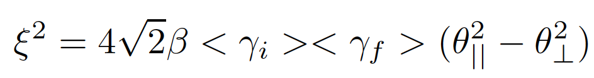
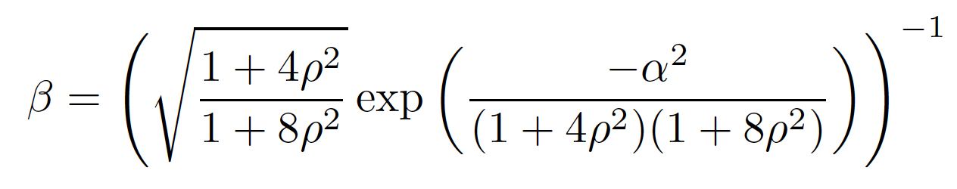
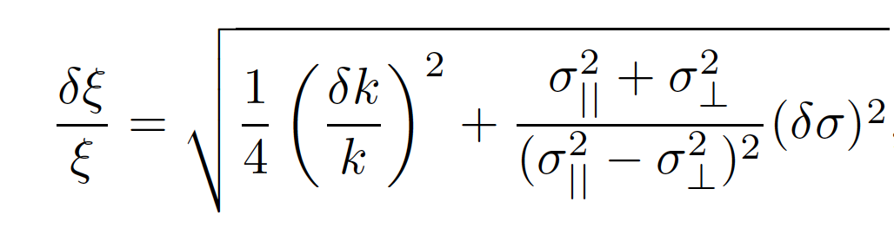

Theory
In a plane-wave, single cycle approximation, the emission angles are:
In reality, one must take into account the focussed nature of the laser field and the relatively long duration of the laser pulse (electron Lorentz factor changing during propagation in the laser field):
k
Geometrical factor
Initial Lorentz factor
Final Lorentz factor
Measurables from the profiler
$ρ=r_{b}/ω_{0}$ and $α=x_{b}/ω_{0}$
Gianluca Sarri

Slide 5
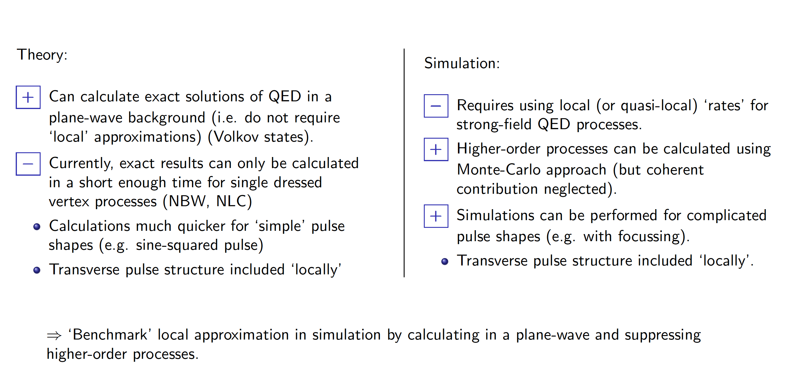
Theory
Gianluca Sarri

Slide 6
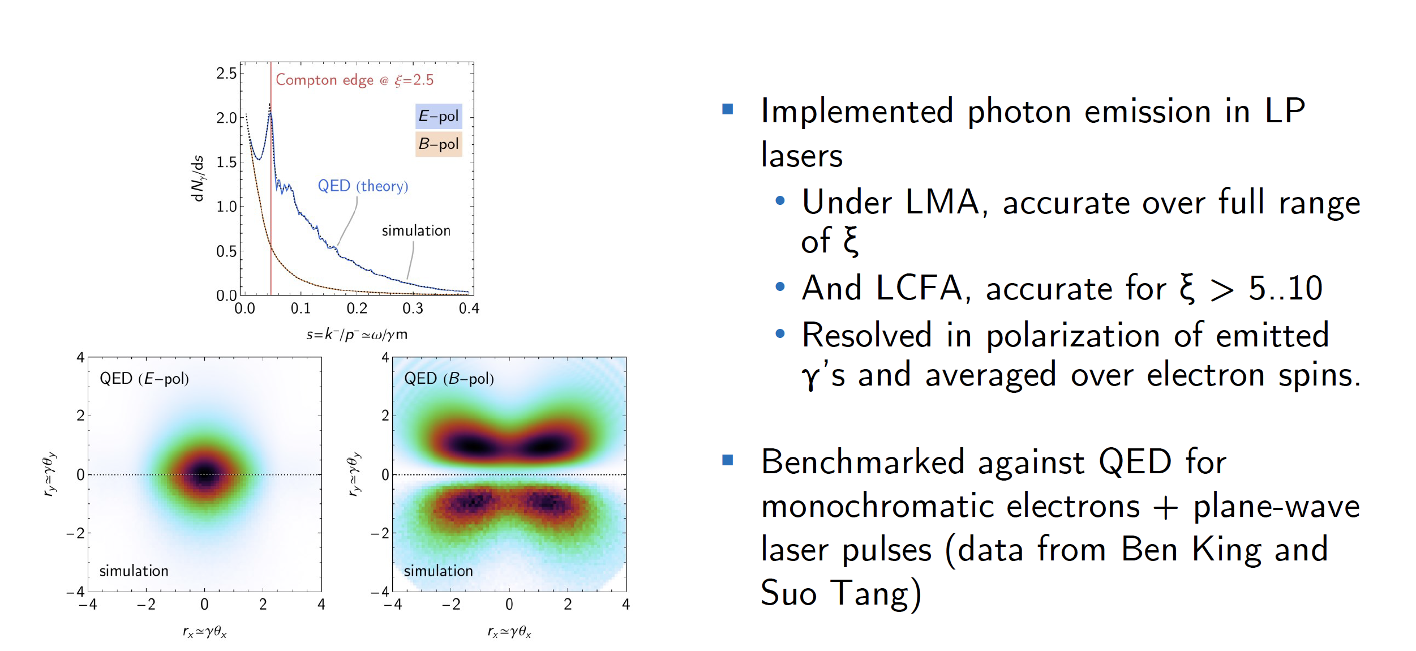
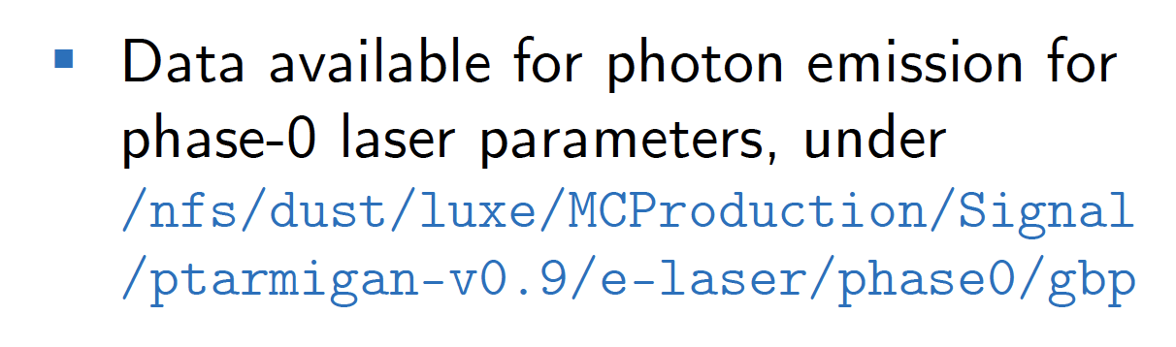
Theory
Gianluca Sarri

Slide 7
Intensity estimates
Ptarmigan simulations for the interaction so far obtained in LCFA
Monte-Carlo simulations for the photon propagation to the detector
Uncertainty in γ_{f} from the electron diagnostics in LUXE
Different laser intensities
Different laser spot sizes at fixed intensity
BUT:
LMA-based simulations now available: possibility to refine these calculations!
Gianluca Sarri

Slide 8
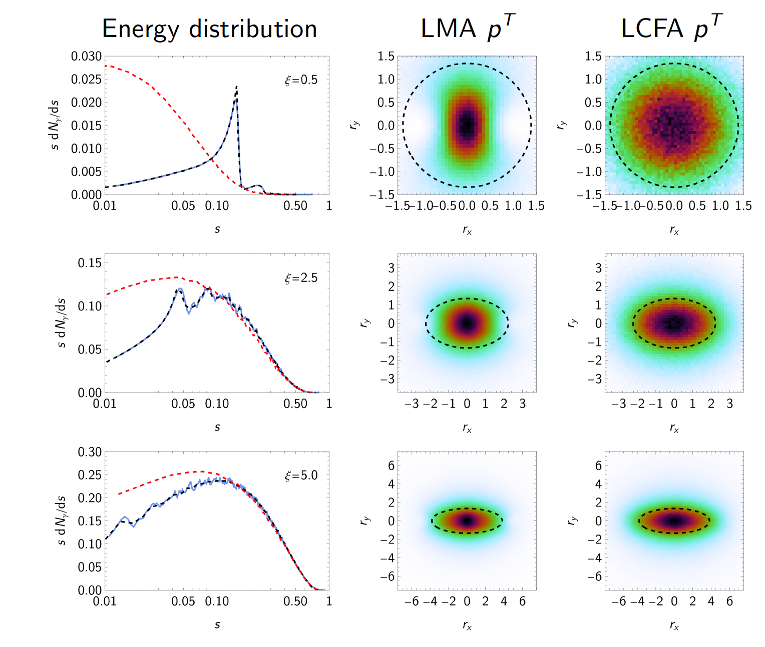
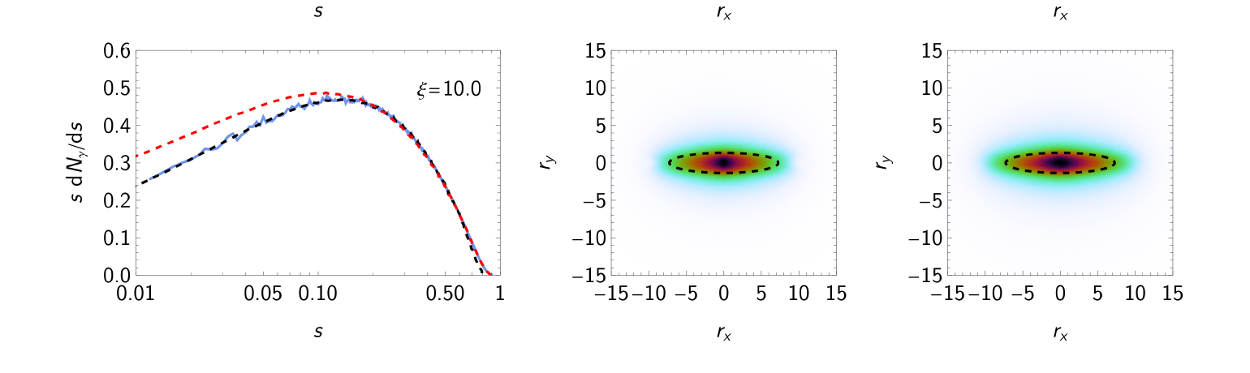
LP simulations for LUXE
For ξ < 1, dipole emission patterns dominate.
Gamma-ray distribution elongated along
axis perpendicular to polarisation
For ξ = O(1), the LCFA overestimates
the ellipticity
For ξ >>1, the LCFA reasonably
approximates the ellipticity
Gianluca Sarri

Slide 9
Thanks for your attention!
Gianluca Sarri
g.sarri@qub.ac.uk

Slide 10
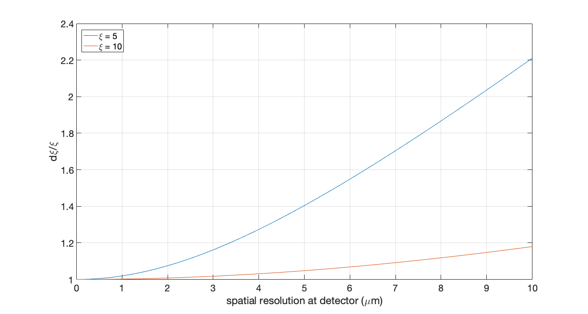
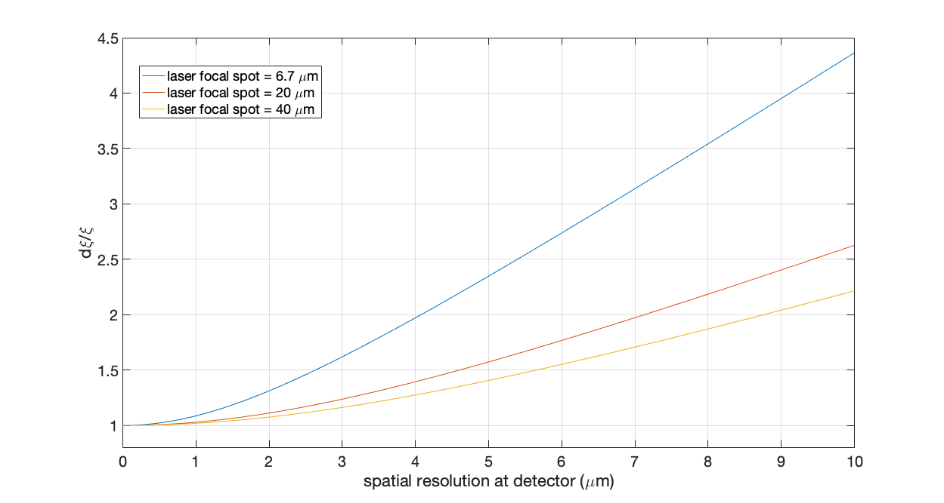
Intensity measurement uncertainty
Different laser intensities
Different laser focal spot size (same intensity ξ = 5)
~2.5% resolution in ξ achievable in all configuration but strongly dependent on the resolution of the electron detectors (assumed to be 2% here)
Lower laser intensities will be less accurate (work in progress)
Gianluca Sarri

Slide 11
Preliminary tests
Preliminary tests carried out at Astra-Gemini, with a mean electron energy of ~800 MeV electrons interacting with a focused laser pulse with a maximum a₀ of the order of 3
Gamma-rays imaged by a CsI scintillator placed 2.2 m away, with a crystal size of 1 mm and a pixel size from the imaging system of 100 micron.
The laser is polarized along the horizontal axis
1/e² contour
Collision on
Collision off
Data analysis currently ongoing…
Gianluca Sarri

