Slide 1
Schedule and Resonsibilities
Wolfgang Lohmann
BTU, DESY & RWTH

Slide 2
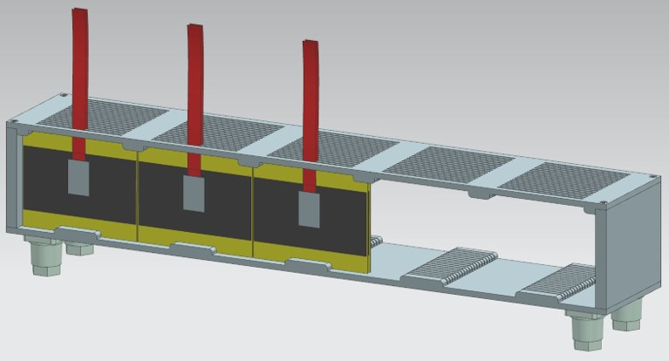
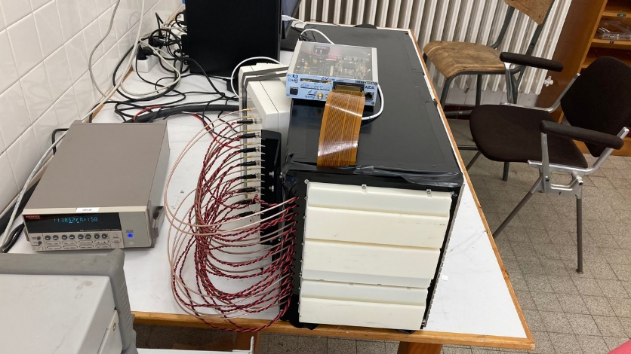
Content
Organisation
Recource requirements
Production and Installation plan
ECAL-P
ECAL-E

Slide 3
Organisation
Collaborators up to Feb. 2022
The AGH-University of Science and Technology UST, Cracow, (Prof. Marek Idzik)
The Institute for Space Research ISS, Bukharest, (Dr. Veta Ghenescu)
The Joint Institute for Nuclear Research JINR, Dubna, (Prof. Alexei Zhemchugov)
The Tel Aviv University, Tel Aviv, (Prof. Halina Abramowicz)
The Tomsk State University, Tomsk, (Dr. Anton Tyashev)
LAL (Calice demonstrator ECAL) , Orsay (Dr. Roman Pöschl)

Slide 4
Organisation
Collaborators Now
The AGH-University of Science and Technology UST, Cracow, (Prof. Marek Idzik)
The Institute for Space Research ISS, Bukharest, (Dr. Veta Ghenescu)
The Tel Aviv University, Tel Aviv, (Prof. Halina Abramowicz)
The Warsaw University ?
IFIC Valencia ?
Ecole polytechnique ?
LAL (Calice demonstrator ECAL) , Orsay (Dr. Roman Pöschl)

Slide 5
Organisation
For Understanding:
This is first of all a commitment to write together an TDR, and express interest in the LUXE ECAL.
It should be used to apply for funding
MoUs (or something like this) are an issue when the project is approved

Slide 6
Responsibilities
AGH-UST: ASIC development, Test, production, assembly, trigger, DAQ
ISS : slow control, software
JINR : mechanics, precise tungsten plates
Tau : sensor tests, assembly, of detector planes, DAQ
TSU : sensor development, production, test
LAL : CALICE demonstrator ECAL

Slide 7
Responsibilities
AGH-UST: ASIC development, Test, production, assembly, trigger, DAQ
ISS : slow control, software
?? : mechanics, precise tungsten plates
Tau : sensor tests, assembly, of detector planes, DAQ
??? : sensor development, production, test
LAL : CALICE demonstrator ECAL

Slide 8
Resource requirements, ECAL -P
Engineering personpower: 2 FTE years, 160 kEur
AGH-UST applyed successfully for funding to their FAs
This table has to be updated
A similar table we need for ECAL-E

Slide 9
Production Plan, old
Start from scatch
Stilll ongoing
To be agreed

Slide 10
Updates needed for the TDR
Detailed responsibilities and schedule for ECAL-E (Labs, Personpower)
The role of (potential) new partners in ECAL-P
More practical:
Who volonteers to write text, finetune schedules and responsibilities.

Slide 11
backup

Slide 12
Resource requirements, detailed
LUXE calorimeter
Mechanics
 | number | price | total
tungsten plates | 20 | 340 | 6800
support frame | 1 | 1000 | 1000
sensor support structures (carbon etc) | 100 | 300 | 30000
sum |  |  | 37800
Connectivity
fan out Kapton HV | 100 | 60 | 6000
fan out Kapton, signal | 100 | 60 | 6000
sum |  |  | 12000
Silicon sensors | 160 | 1000 | 160000
Front-end ASICs
prototyping, ASICs | 50 | 1000 | 50000
channels | 24000 | 2,6 | 62400
probecard for tests | 1 | 20000 | 20000
sum |  |  | 132400
front-end electronics
PCB and assemply | 100 | 100 | 10000
auxiliary components |  |  | 15000
sum |  |  | 25000
Power supplies
HV |  |  | 10000
LV |  |  | 10000
cables and connectors, patch panels |  |  | 15000
sum |  |  | 35000
Data acquisition
Receiver cards (FPGA based) | 100 | 500 | 50000
crates | 5 | 1000 | 5000
crate computer | 5 | 1000 | 5000
racks | 1 | 2000 | 2000
sum |  |  | 62000
Tooling |  |  | 30000
sum |  |  | 494200
Engineering Personpower, 2 FTE years |  |  | 160000
total |  |  | 654200

