Slide 1
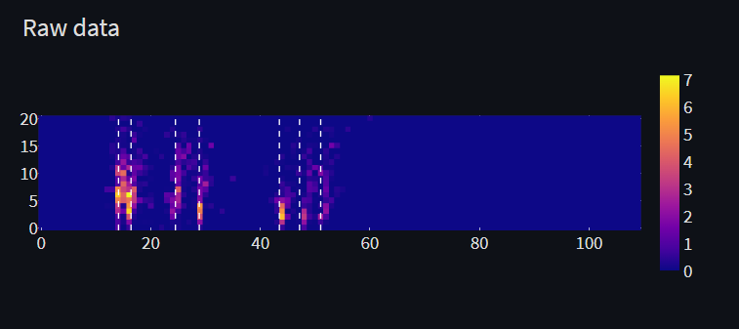
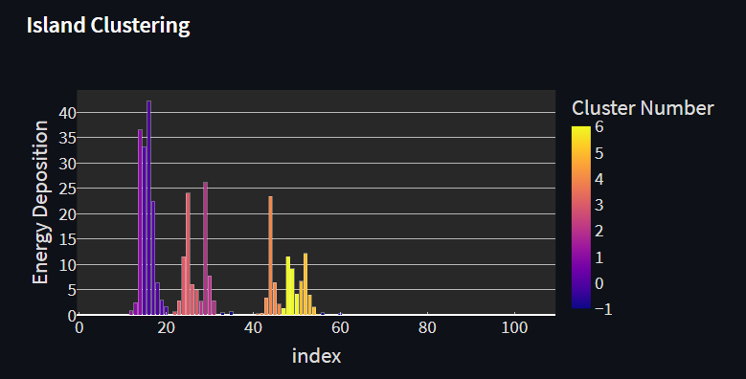
Take raw 2D data, sum over Z
Use “Islands” clustering
Find maximum tower, assign to new cluster, remove from list.
Find new maximum tower.
If new is adjacent to cluster – add to cluster.
Else, assign to new cluster.
Sum energy deposition per cluster
Filter clusters below 15 MeV (uncalibrated)
Count estimated multiplicity per cluster.
Find estimated energy for cluster center of mass
Divide Deposited energy by estimated to find multiplicity
Final energies for event will be a list of calibrated energy per cluster, times the estimated multiplicity
Example – 7 well separated particles and 7 clusters, 1 particle per cluster.

Slide 2
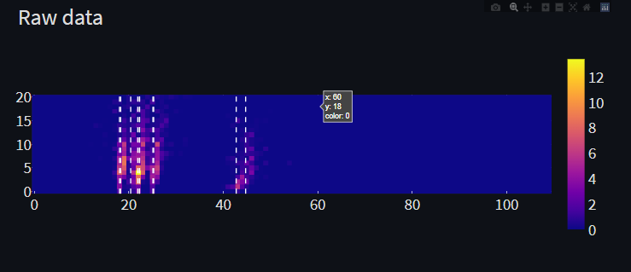
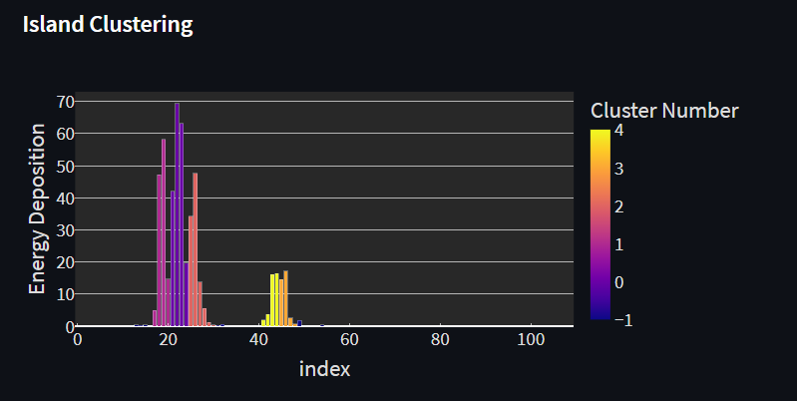
Take raw 2D data, sum over Z
Use “Islands” clustering
Find maximum tower, assign to new cluster, remove from list.
Find new maximum tower.
If new is adjacent to cluster – add to cluster.
Else, assign to new cluster.
Sum energy deposition per cluster
Filter clusters below 15 MeV (uncalibrated)
Count estimated multiplicity per cluster.
Find estimated energy for cluster center of mass
Divide Deposited energy by estimated to find multiplicity
Final energies for event will be a list of calibrated energy per cluster, times the estimated multiplicity
Example – 10 particles, some overlap.
5 clusters with multiplicities [4,2,2,1,1] resulting with 10 predicted particles.

Slide 3
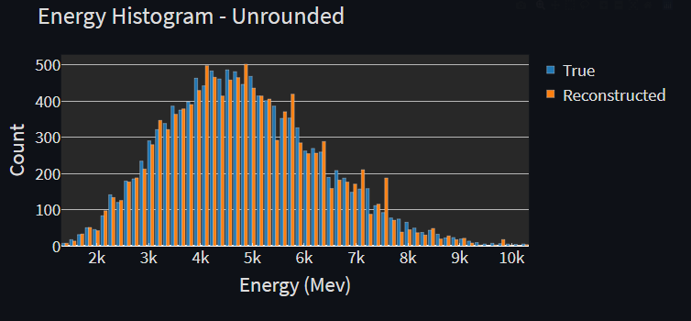
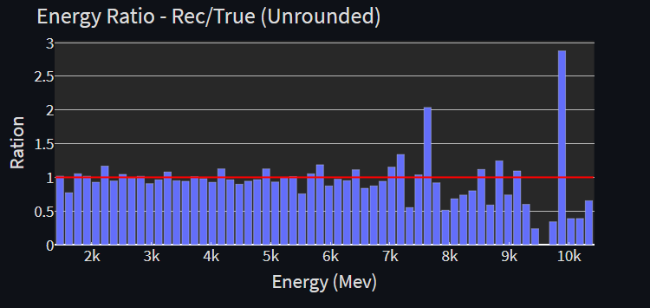
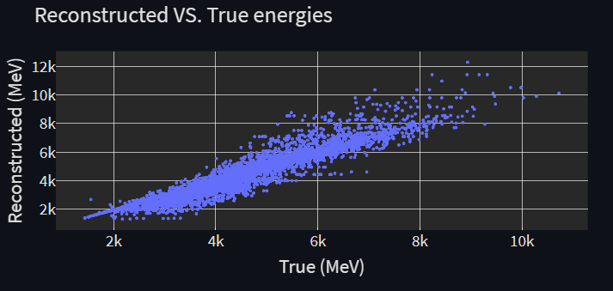
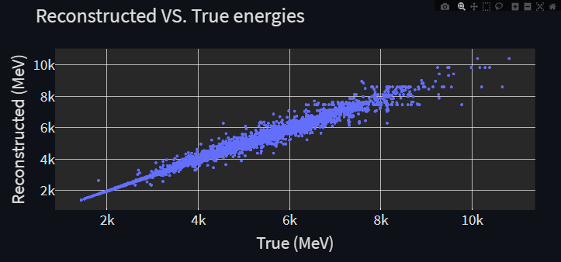
Following graphs show results before and after new improvement implementation:
For “Per cluster position reconstruction” – instead of calculating the center of mass of each cluster we use weights that are linear with position

Slide 4
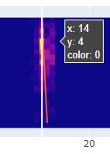
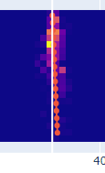
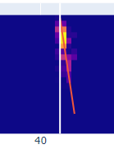
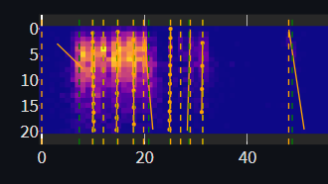
Angle Reconstruction
White line – Estimated X
Orange line – Fit
For each cluster, find a line that minimizes sum of distance from all pixels, with energy deposition as weighting.
N=63
Needs debugging

Slide 5
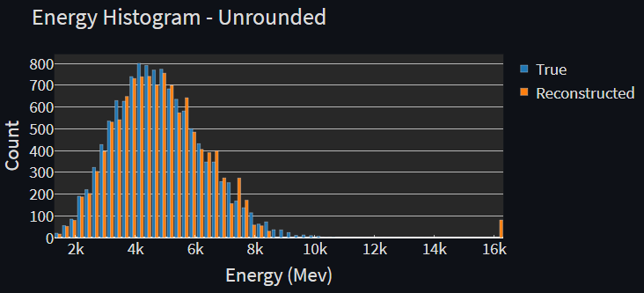
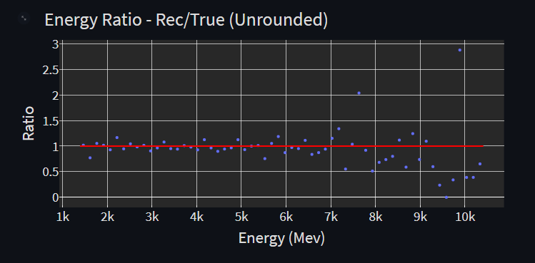
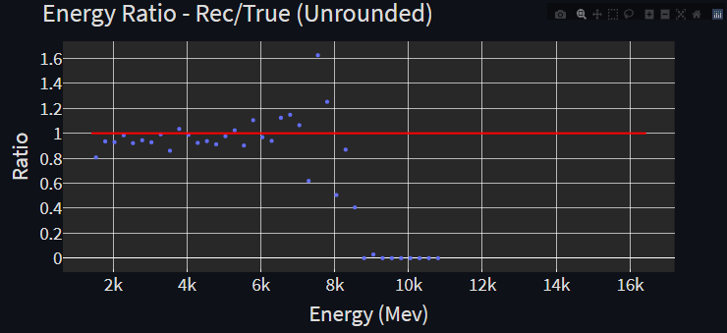
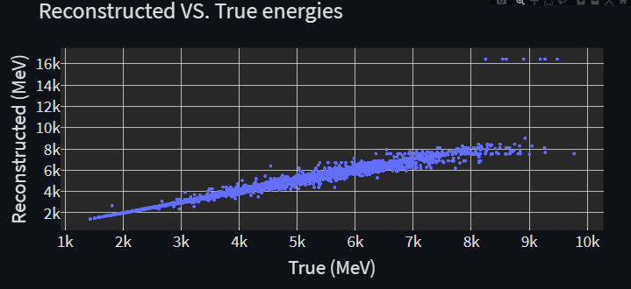
Cluster COM with shift
Entry angle Reconstruction
Comparison between old and new position reconstruction methods.

