Slide 1
Gamma ray spectrometer @ LUXE
DAQ requirements
Gianluca Sarri, Kyle Fleck, Niall Cavanagh, Matthew Streeter
School of Mathematics and Physics, Queen’s University Belfast, UK
g.sarri@qub.ac.uk
Gianluca Sarri

Slide 2
System overview
Main components
10 μm tungsten target
Shielding + beam dump
50cm Pb collimator
1.6 m vacuum chamber
Dipole: 1.4 T, 120 cm
2 LANEX scintillators
2 i-CCD cameras
γ-ray profiler (separate)
DAQ requirements
All the DAQ requirements are centered on the 2 i-CCD cameras required to image the LANEX scintillation screens. Preferred option: Andor iStar
Due to the long scintillation time of the LANEX, we would need to trigger them approximately 1 μs after the laser.
Assumption of 2 16-bit cameras with 2048 x 512 pixels operating at 10 Hz (1 Hz for data taking, other frames for background readings).
Expected 40 MB/s of data.
Gianluca Sarri

Slide 3
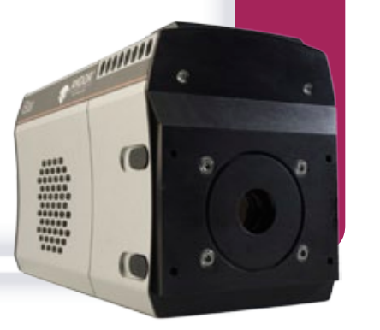
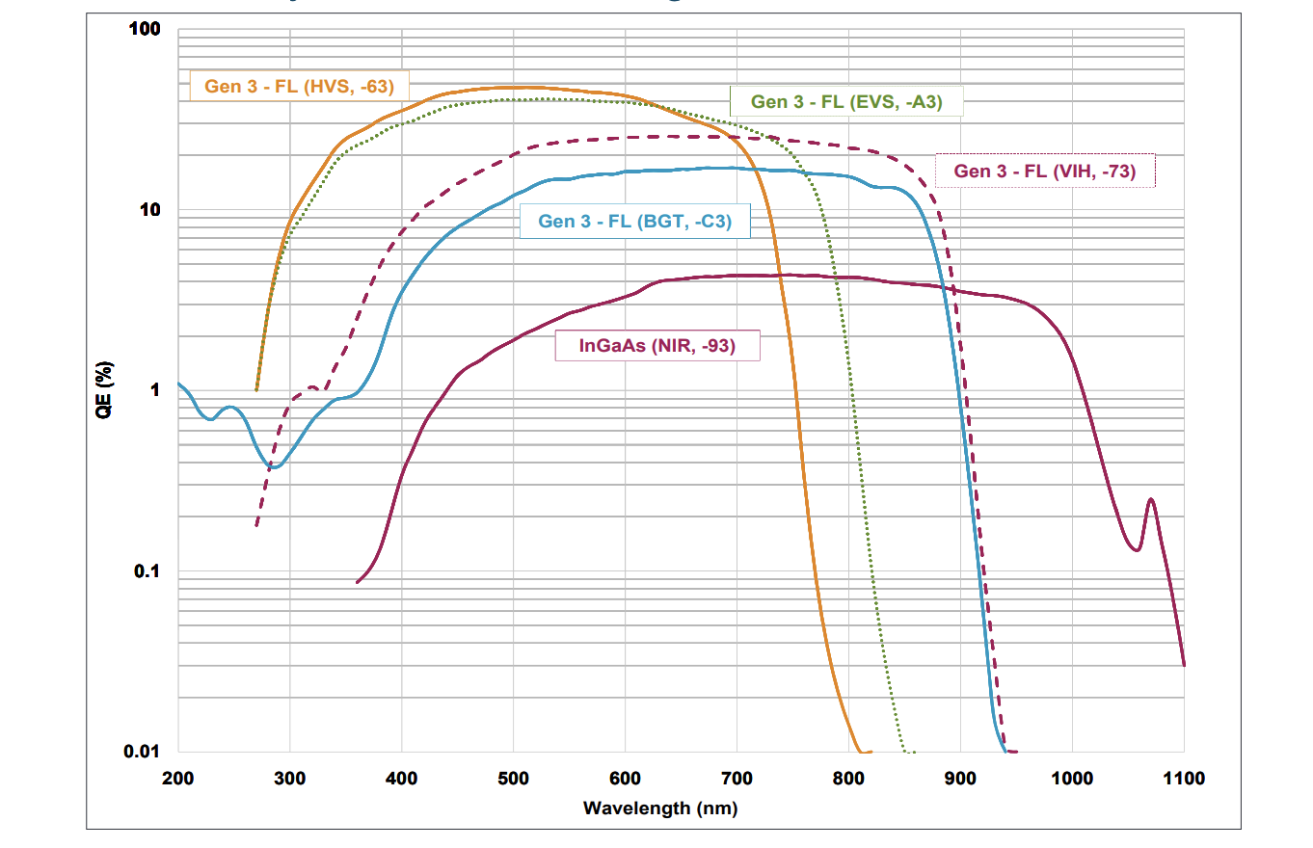
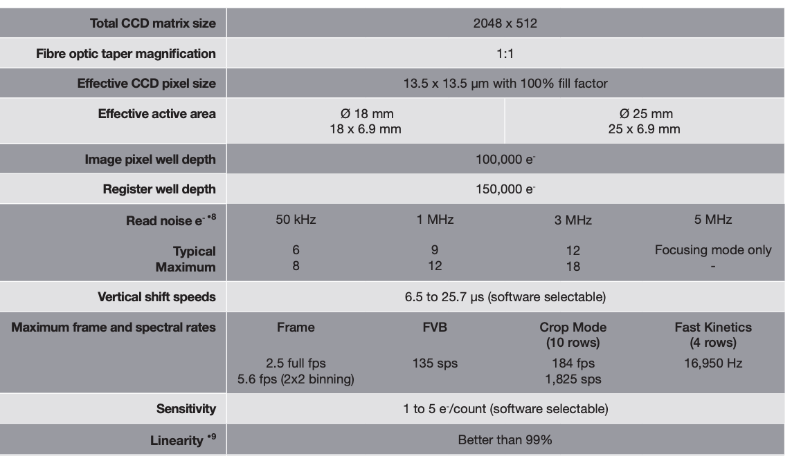
Andor iStar
Gianluca Sarri

