Slide 1
CERN
Medium and Long Term Strategy
KET Perspektiv-Workshop
25/10/2010
Rolf Heuer

Slide 2
Opening the door…
Council opened the door to greater integration in particle physics by unanimously adopting in June the recommendations to examine the role of CERN in the light of increasing globalization in particle physics.
  Particle physics is becoming increasingly integrated at the global level.
  Council’s decision contributes to creating the conditions that will enable CERN to play a full role in any future facility wherever in the world it might be.
The key points agreed by Council include:
  All states shall be eligible for Membership, irrespective of their geographical location;
  A new Associate Membership status is to be introduced to allow non-Member States to establish or intensify their institutional links with CERN;
  Participation of CERN in global projects wherever sited.
Applications for Membership from Cyprus, Israel, Serbia, Slovenia and Turkey have already been received by the CERN Council, and are undergoing technical verification. Romania already in accession to membership.

Slide 3
Scientific Strategy
Full exploitation of LHC physics potential
  Reliable operation (including consolidation and LINAC 4)
  Remove bottlenecks to benefit from nominal luminosity for both machine and detectors
  Focused R&D and prototyping for High-Luminosity LHC
  Re-establish standards for technical and general infrastructure
Preparation for the long-term future (>2015)
  Energy frontier
    CLIC/ILC collaboration and R&D (for detectors and machine)
    Generic R&D for High-Energy LHC (i.e. high field magnets)
  R&D for high-power proton sources (HP-SPL) e.g for ν-physics
World-class fixed-target physics programme

Slide 4
Full exploitation of the LHC physics potential
LHC operation until around 2030, aim at ∫Ldt ≈ 3000/fb
→ first decade 2010-2020
up to 14 TeV, up to around design luminosity
→ reliable operation of the whole accelerator complex
(consolidation needs independent of decision on SPL/PS2)
→ shutdown around 2020 for luminosity and detector upgrade
→ second decade 2020-2030
up to 14 TeV, luminosity around 5x10³⁴, luminosity leveling
(HL-LHC)

Slide 5
Baseline Schedule

Slide 6
Full exploitation of the LHC physics potential
LHC operation until around 2030, aim at ∫Ldt ≈ 3000/fb
→ two/three-year running scenario
→ run 2010/11 at 7 TeV cms energy, aim 1/fb
→ refurbish copper stabilizers in 2012
→ run 2013/14/15 at maximum cms energy
→ 2016 connect LINAC4, detector improvements
→ 2020/21 long shutdown for LHC-upgrades (e.g.
inner triplets) and detector upgrades

Slide 7
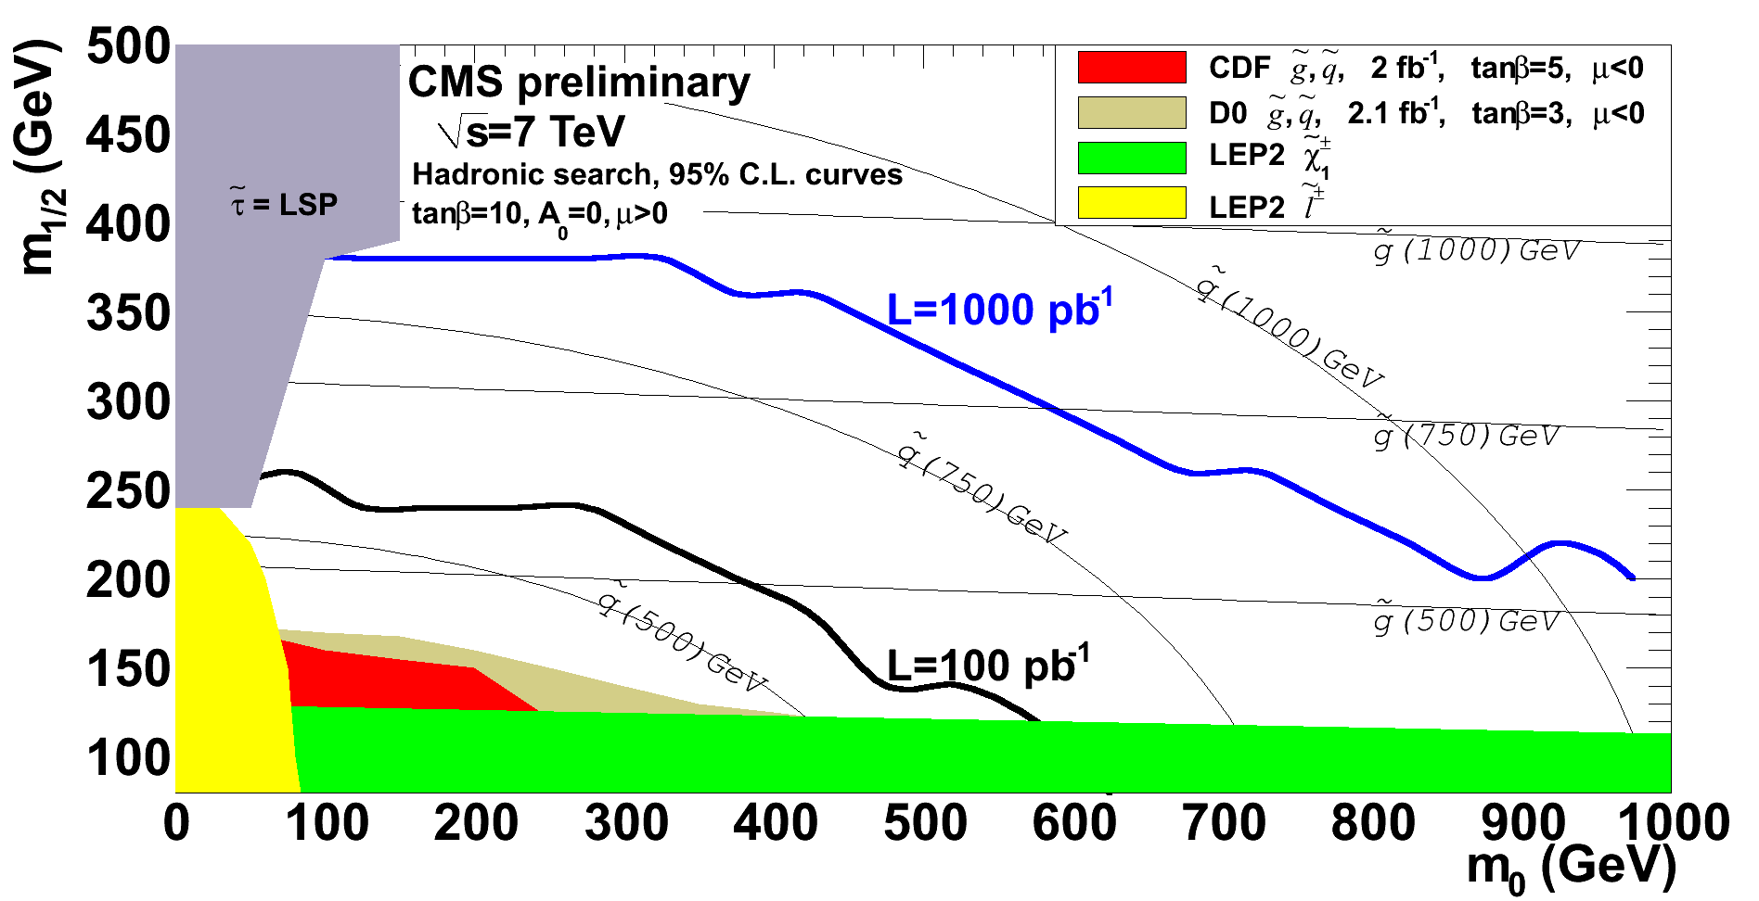
What can we expect from LHC for 2012
SUSY
Tevatron exclusion
reach: ~ 450 GeV
LHC discovery reach for pair production, 1 experiment
M (TeV) 1 fb⁻¹ 2 fb⁻¹ 5 fb⁻¹
√s=7 TeV 0.7 0.8 1
√s=8 TeV 0.8 0.9 1.1

Slide 8
What can we expect from LHC and Tevatron
Assume continued excellent performance of Tevatron and continued excellent progress of LHC machine (≥1/fb in 2011) and experiments
expected mass ranges
95% cl exclusion between 114 and ~600 GeV
3σ evidence between ~125 and ~500 GeV
Higgs
Keep fexibility concerning shutdown 2012

Slide 9
Comparison of scenarios for upgrades of the accelerator chain during this decade:
Scenario with
SPL/PS2 construction
Scenario without
SPL/PS2 construction
Start of LP SPL and PS2
Not ready < 2020
Cumulative budget deficit increases
Upgrade PSB
Ready by ~2015
Cumulative budget deficit continues to reduce
=> not affordable, and not the baseline scenario

Slide 10
CERN as laboratory at the energy frontier
CLIC/ILC collaboration
→ CLIC CDR 2011, ILC TDR 2012
→ LC detector R&D
→ increase efforts after CDR/TDR accepted and if budget allows
- R&D for high-field magnets (HE-LHC)
Focused R&D for Neutrino Physics
R&D on high power proton sources
Fixed target physics
CERN share of HIE-Isolde infrastructure (high priority in NuPECC)
CNGS, NA62, Cloud, n-TOF, Compass, ……
New initiatives need extra resources

Slide 11
The next years
Important steps in the coming years
CDR for CLIC 2011
TDR for ILC 2012
ICFA Seminar at CERN 3-6 October 2011
use this occasion to
- layout exciting future prospects in particle physics
- synchronize regional strategies/roadmaps
Update of European strategy for particle physics start: EPS 2011, finalize Sept. 2012
IEEE 2012 special event to promote LC

