Slide 1
EuXFEL Beam Regions
Operator training
Bolko Beutner and Matthias Scholz
July 19, 2022

Slide 2
Why Beam Regions
The Beam Regions will replace the RF flattops as we used them so far.
The advantage of the BRs is that we can not only add slopes on the RF amplitudes and/or phases but basically any “continuous” function (within limits, of course).
That allows us to compensate e.g. energy or compression variations over a bunch train even then when they are not linear.
The good thing is: From the operation point of view, not much will change, as we will see in the following slides.
The BRs are in use for A1, AH1 and A2-A5

Slide 3
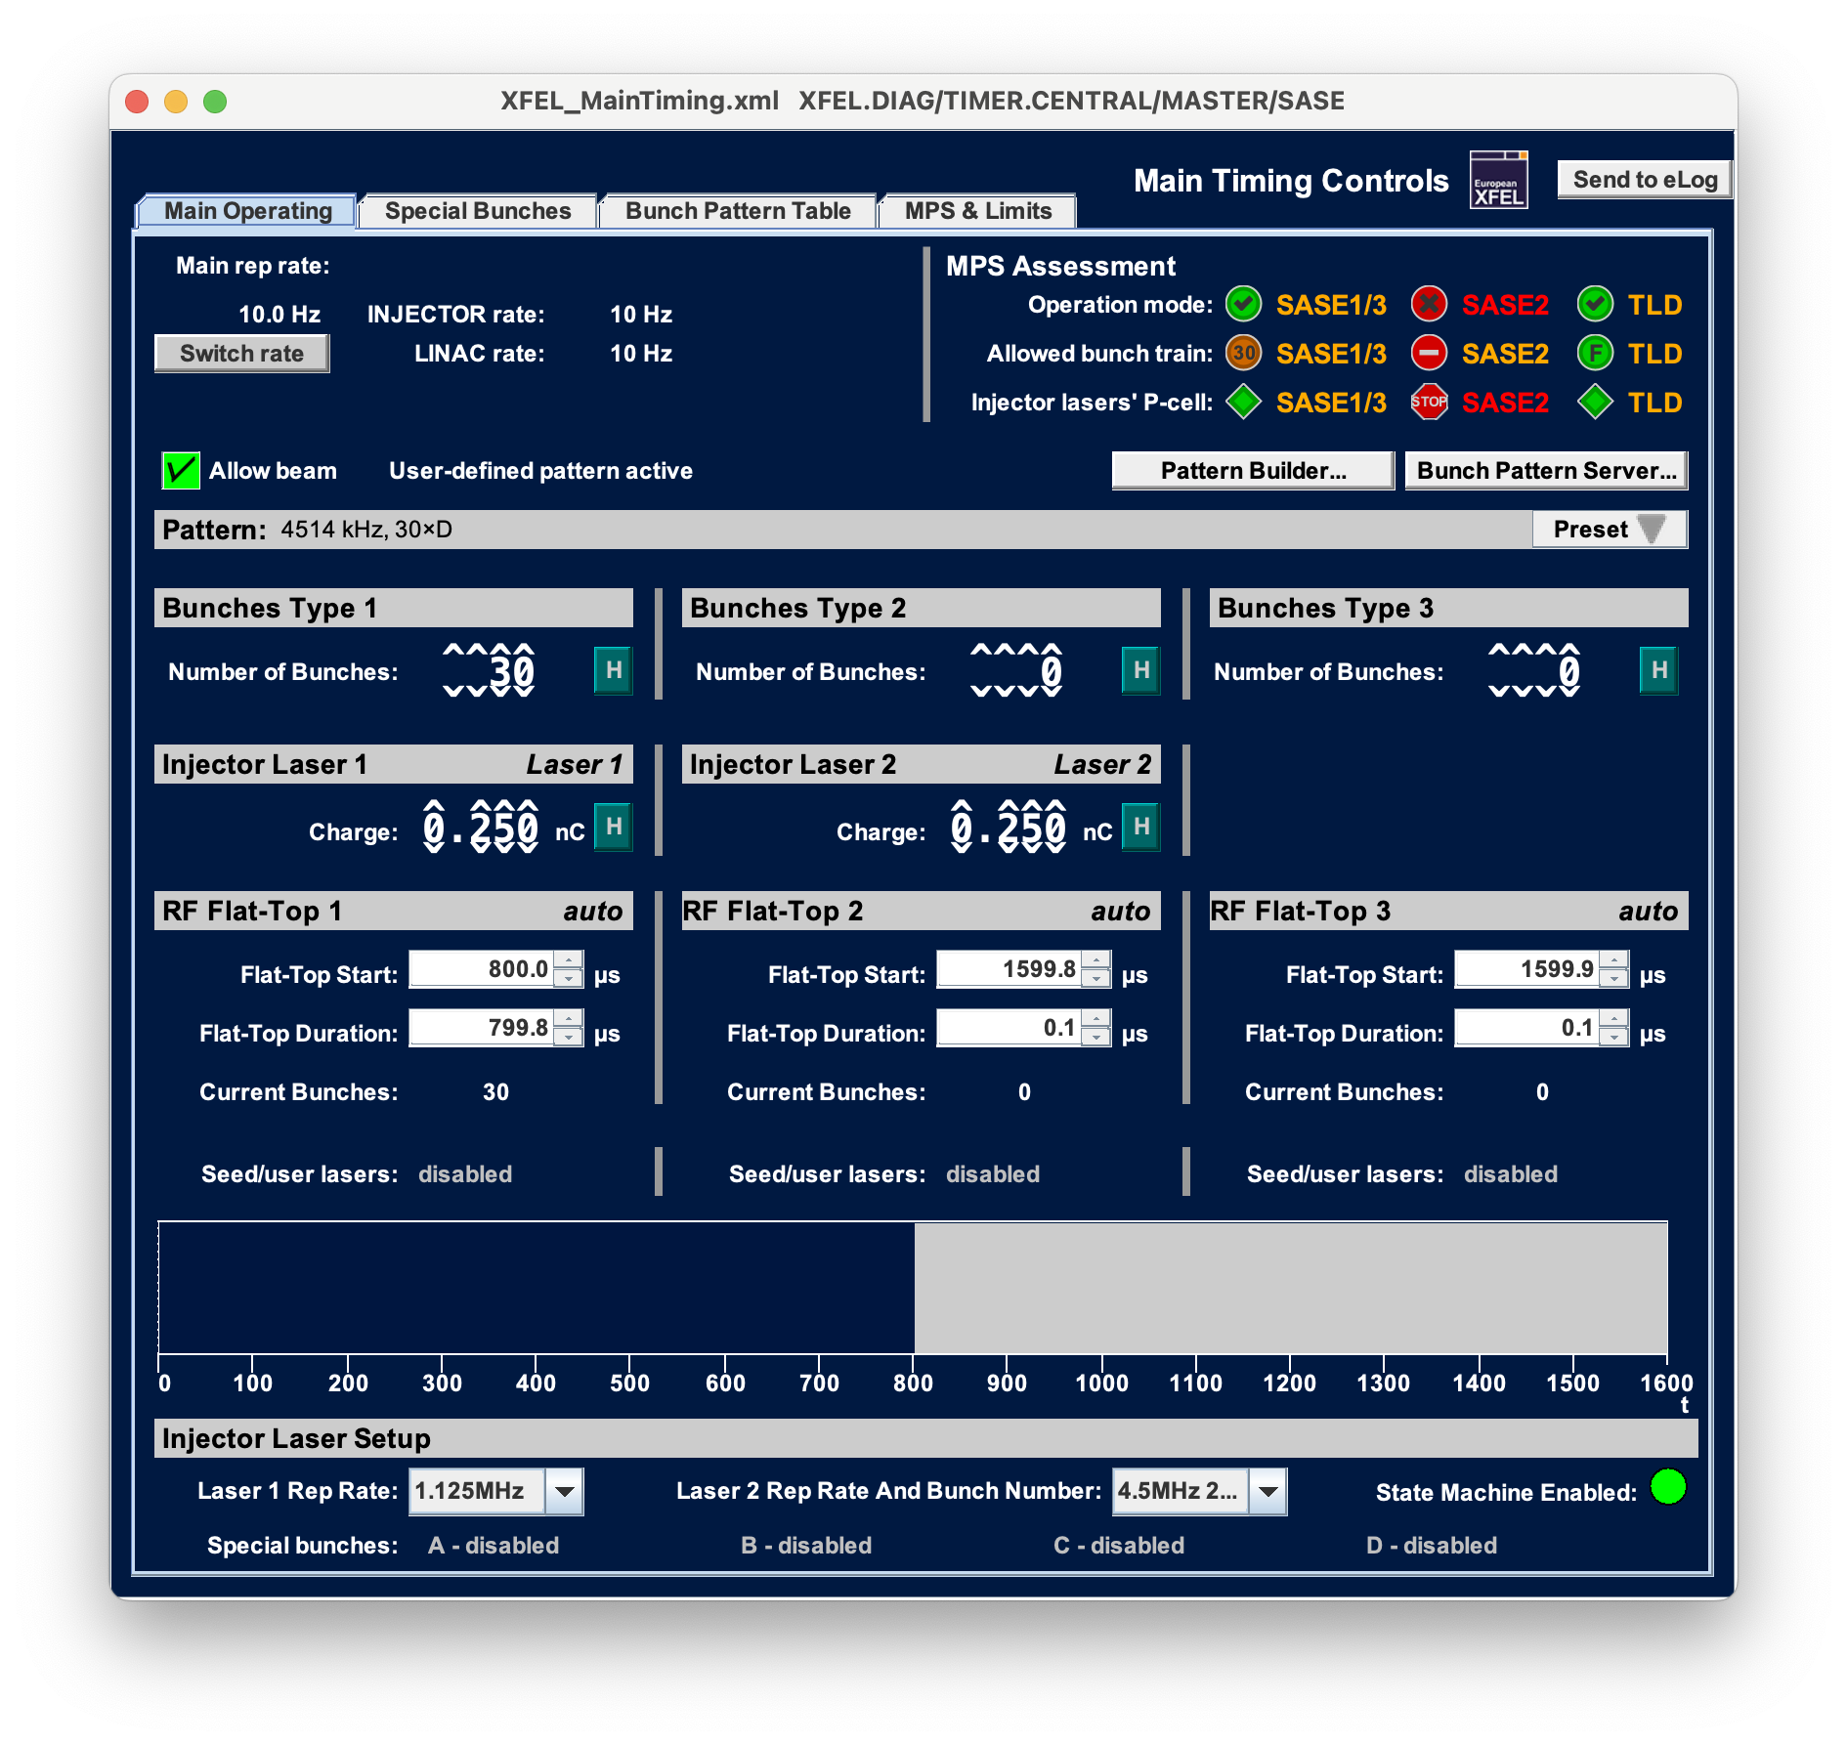
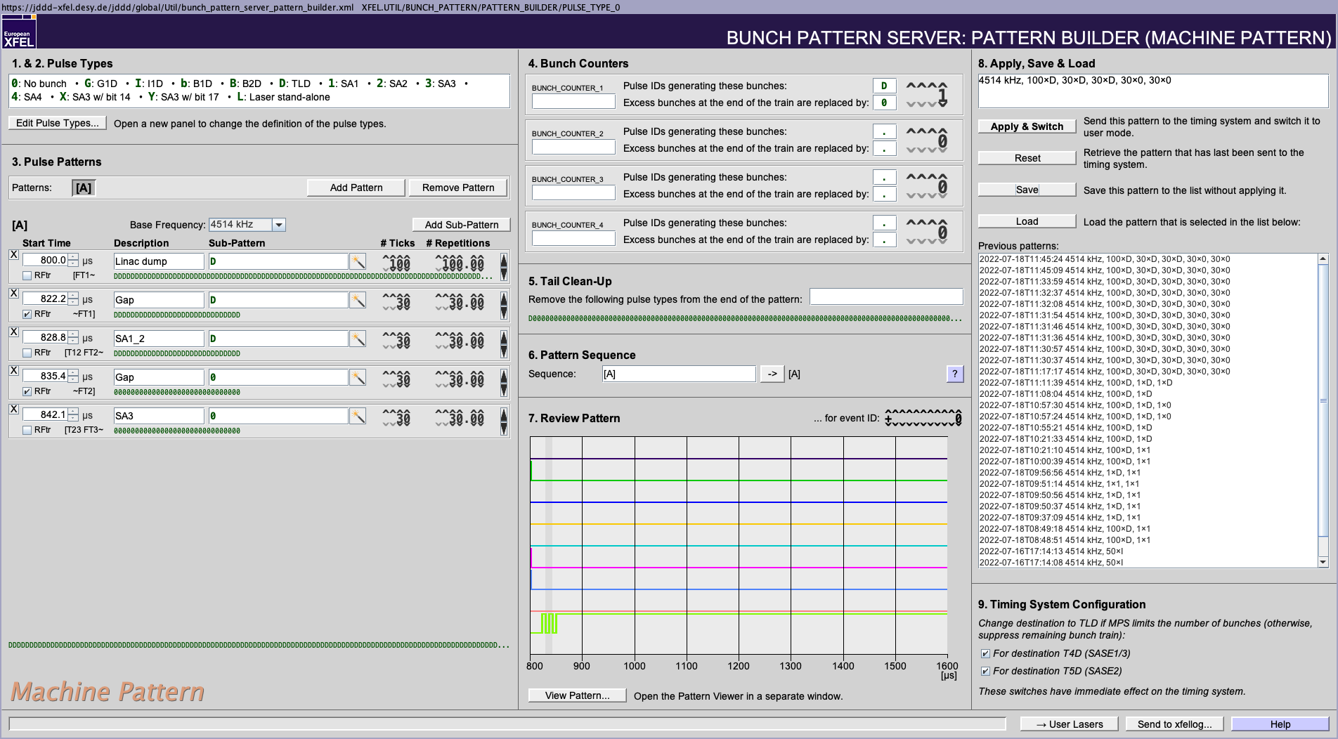
How to define BR
The BRs will be used by default for the RF stations A1, AH1 and A2-A5.
They are defined via the bunch pattern builder.
A BR is always behind a transition time, which is defined (as in the past) by the respective checkboxes.
The maximum number of Beam Regions is 16.
Pre-bunches
D
SASE2
2
D
SASE1/3
13

Slide 4
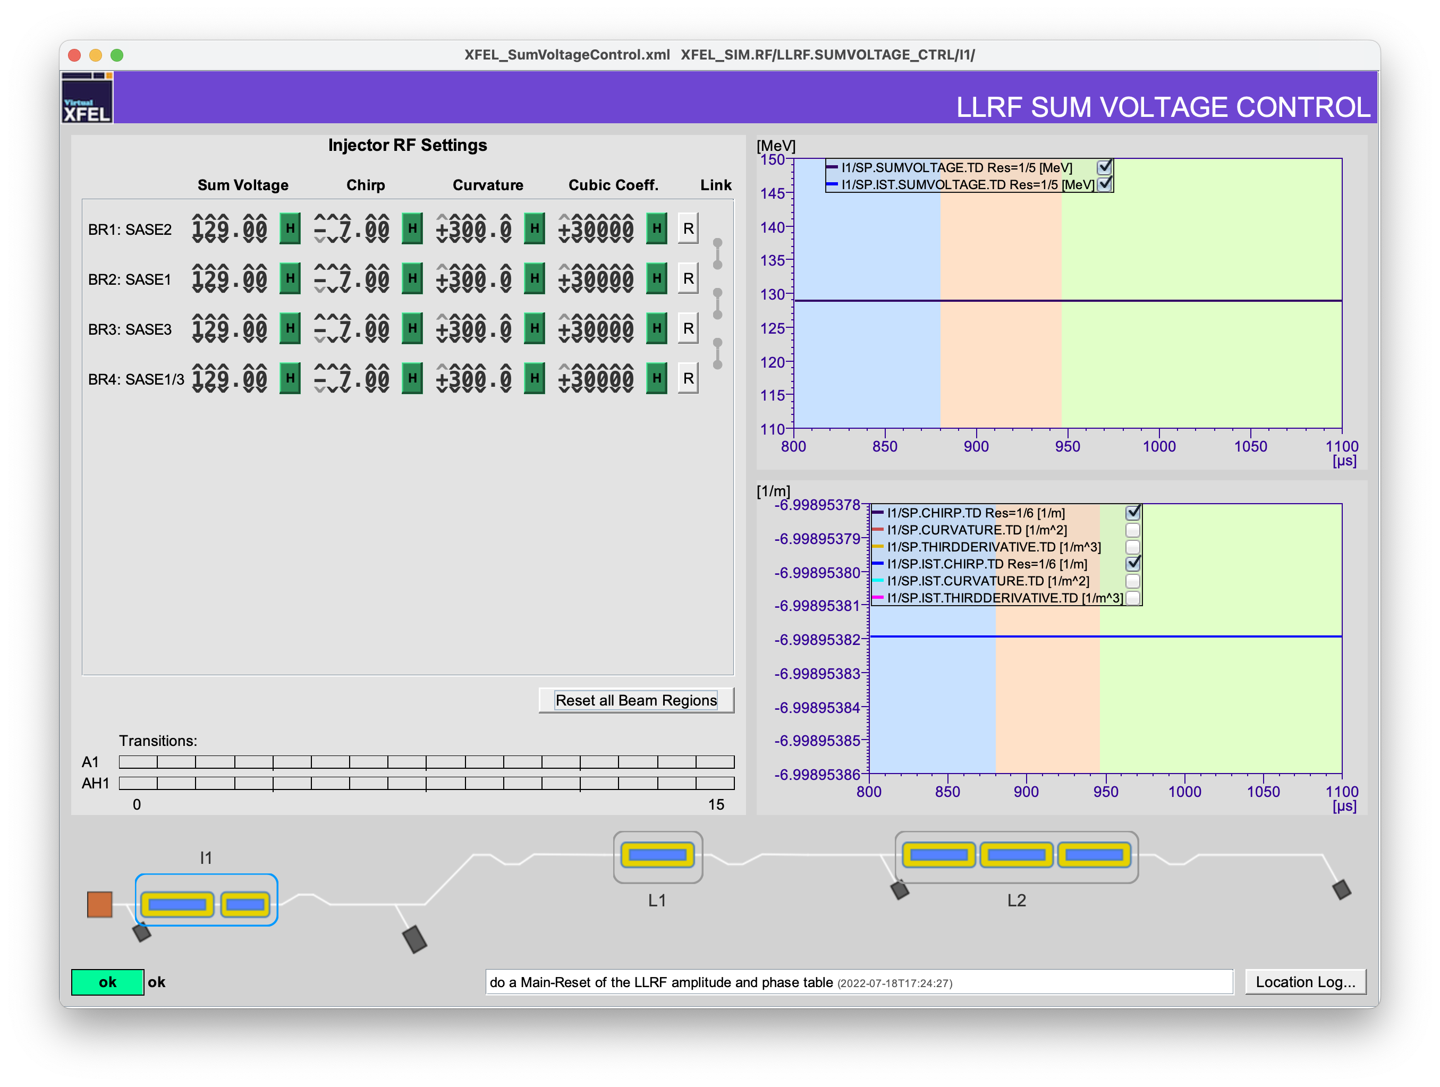
Operation of Beam Regions
Like for the RF steps, we have individual parameters for sum voltage and chirp in I1, L1 and L2. In the injector, we have, of course, also curvature and cub. coefficient.
These parameters can be found in the new Sum Voltage Server panel as shown on the left hand side.
They will also be available again on the SASE tuning panels as before.
All BR have the same parameters in the case shown here. More complexity will follow ☺
Sum voltage and chirp etc. for 4 Beam Regions in I1

Slide 5
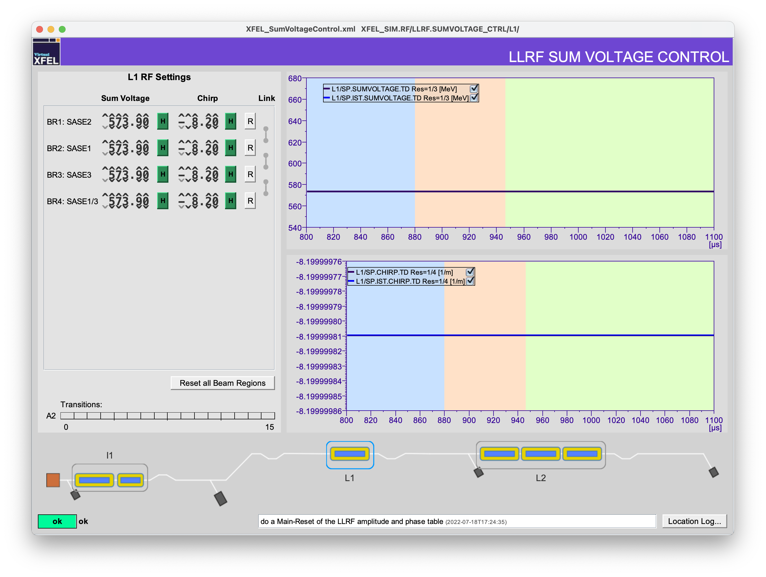
Operation of Beam Regions
Like for the RF steps, we have individual parameters for sum voltage and chirp in I1, L1 and L2. In the injector, we have, of course, also curvature and cub. coefficient.
These parameters can be found in the new Sum Voltage Server panel as shown on the left hand side.
They will also be available again on the SASE tuning panels as before.
All BR have the same parameters in the case shown here. More complexity will follow ☺
Sum voltage and chirp for 4 Beam Regions in L1

Slide 6
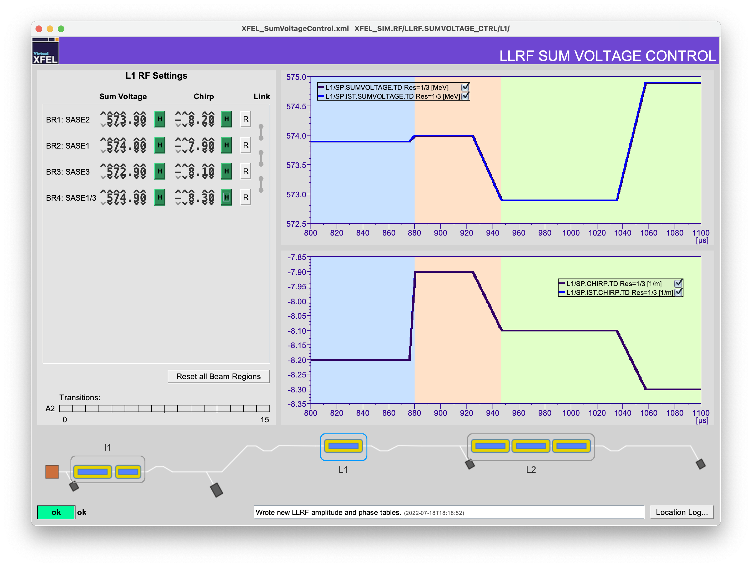
Operation of Beam Regions
Now with different sum voltages and chirps for all Beam Regions in L1.

Slide 7
Operation of Beam Regions
Now with different sum voltages and chirps for all Beam Regions in L1.
It is possible to link BRs to each other. After that, they will change sum voltage and chirp synchronously if one of the regions’ parameter is changed.
Link between two Beam Regions

Slide 8
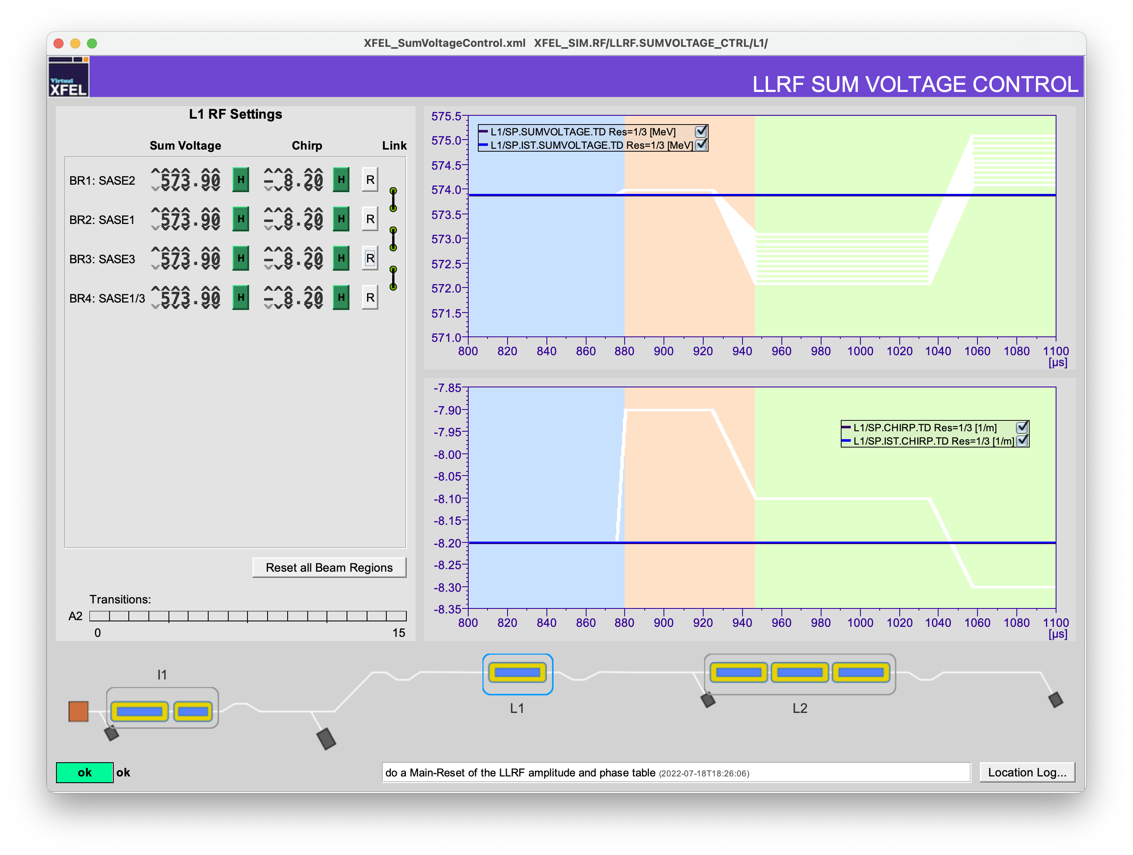
Operation of Beam Regions
Now with different sum voltages and chirps for all Beam Regions in L1.
It is possible to link BRs to each other. After that, they will change sum voltage and chirp synchronously if one of the regions’ parameter is changed.
In case you have several bunch trains defined for SA1-SA3 but all of them should have the same RF parameters, use the “Reset all Beam Regions” button and link the regions.
This reset button sets the parameters for all bunches to the same value that was applied to the first bunch so far.
Resets all

Slide 9
Operation of Beam Regions
If you now also link all Beam Regions to each other, you can operate the RF like before with only one RF step.
That is handy for setup etc.
Link between all Beam Regions

Slide 10
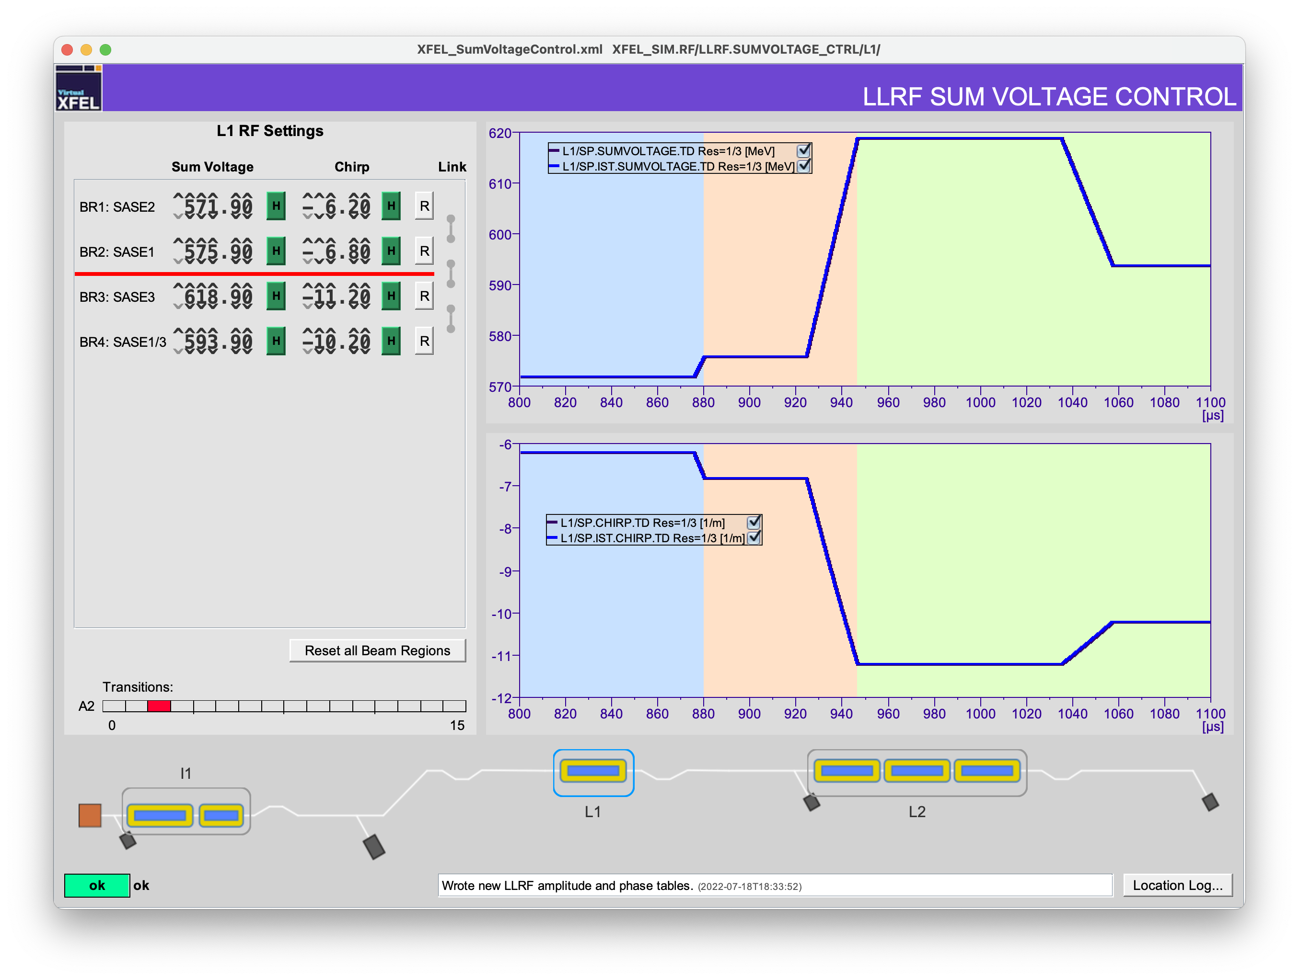
Operation of Beam Regions
In case the requested change of parameters from one BR to the next can not be realised in the given transition, this will be indicated in the panel.
The changes will not be applied in such a case.
One transition can not be realised

Slide 11
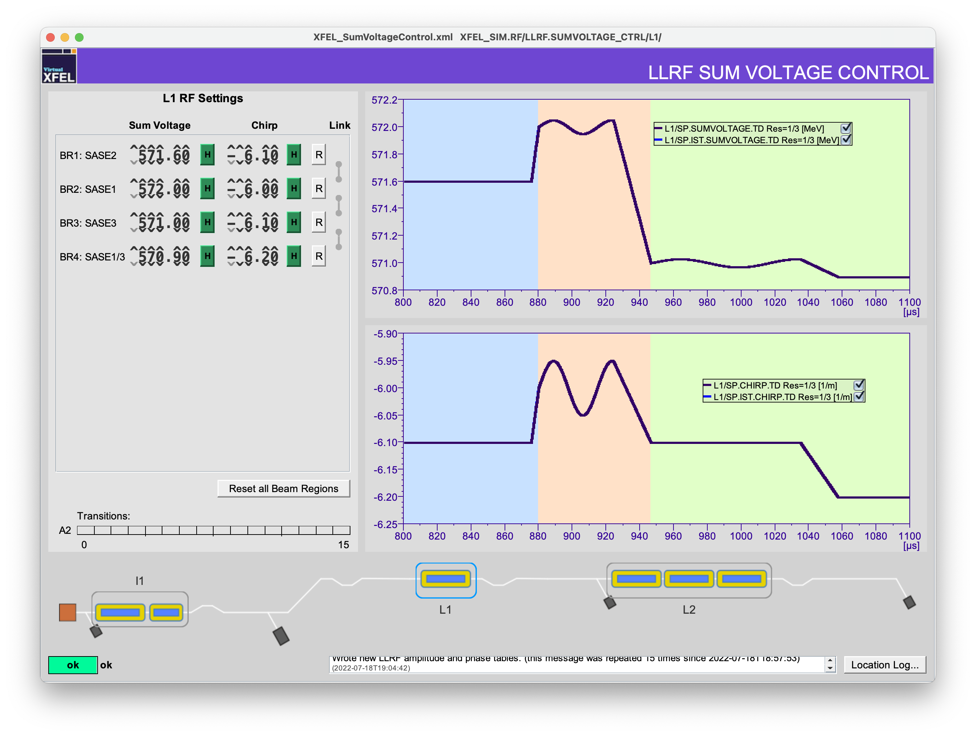
Operation of Beam Regions
As said before, the BR provide more flexibility than the old RF flattops.
You can add additional functions to the individual Beam Regions in order to compensate e.g. different compressions along the bunch train. Those values are stored in tables of the RF system.
Here we see additional sin-functions in BR2 and 3.
BR1 and BR4 did not change at all.
These functions can be applied via doocs channels. In most cases, that will be a functionality of a slow FB that takes care of e.g. compression along the bunch train.

Slide 12
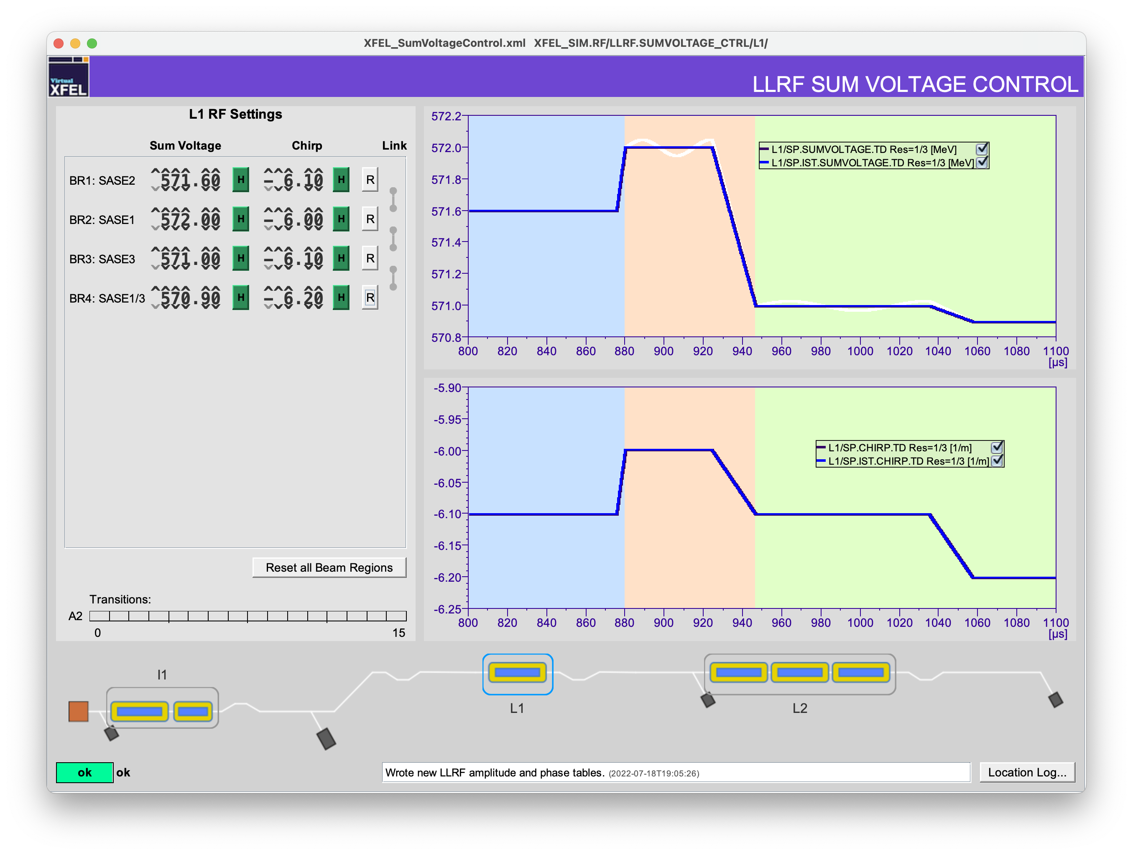
Operation of Beam Regions
There is the possibility to reset the individual Beam Regions.
In this case all positions in the BR will be set to the same value that was at the first position of the respective BR before.

Slide 13
Operation of Beam Regions
There is the possibility to reset the individual Beam Regions.
In this case all positions in the BR will be set to the same value that was at the first position of the respective BR before.

Slide 14
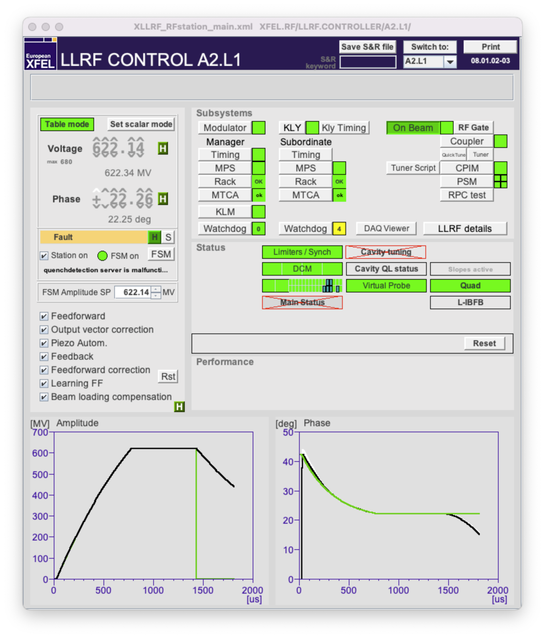
The two operation modes of the RF stations
The table mode
Default during operation
Enables the discussed flexibility
No direct operation of phases and amplitudes
The scalar mode
One setting over the complete flattop.
Only for the gun, L3, LLRF experts, FSM during ramp up and during on-crest phase measurements.

Slide 15
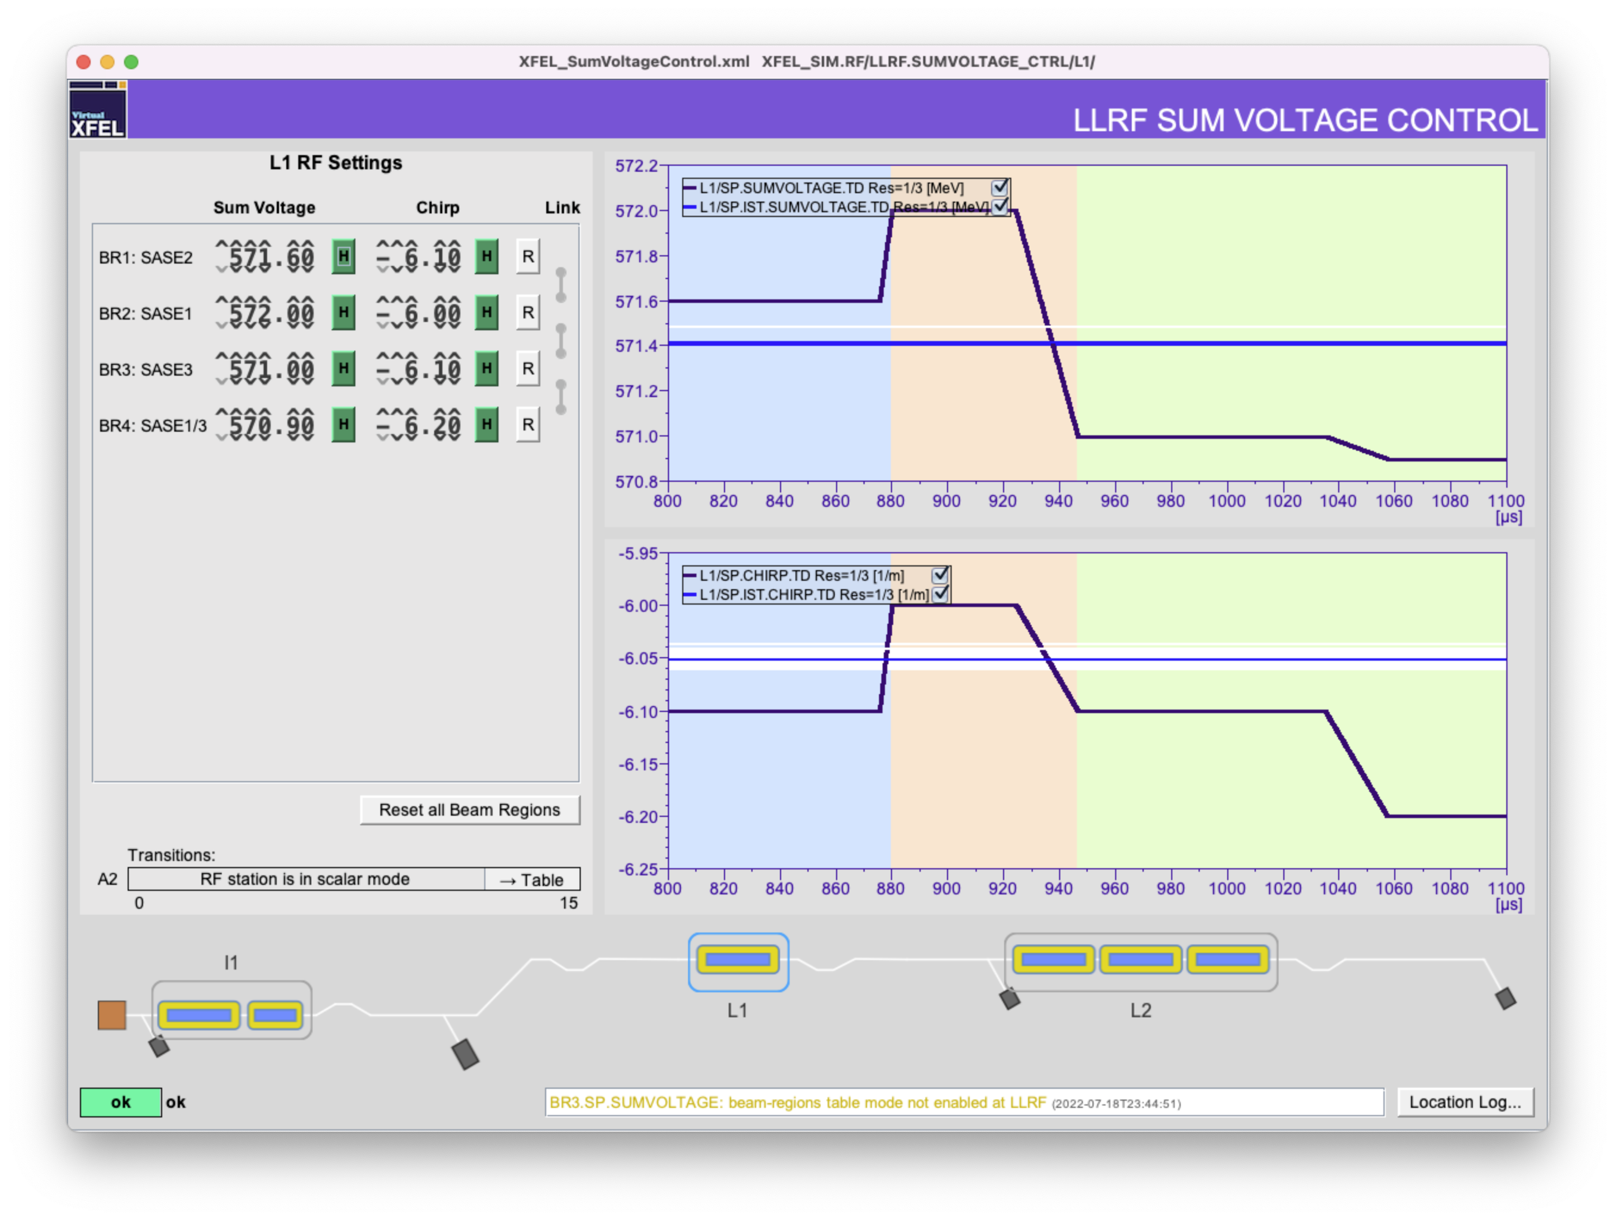
How to switch between the two modes
Switching via the Sum Voltage Server panel
It is best practice to use this panel.
You can find a button in the bottom left part of the panel that is only there if you are in scalar mode and that switches the named station to table mode.
This works only if the requested setup can be achieved. Otherwise it helps to reset the BR settings first.
Switching individual stations via the LLRF-panel
There is a button available that allows to switch between both modes. Button-text changes if you do so.
In Scalar mode it says ”Set Table mode” and vice versa.

Slide 16
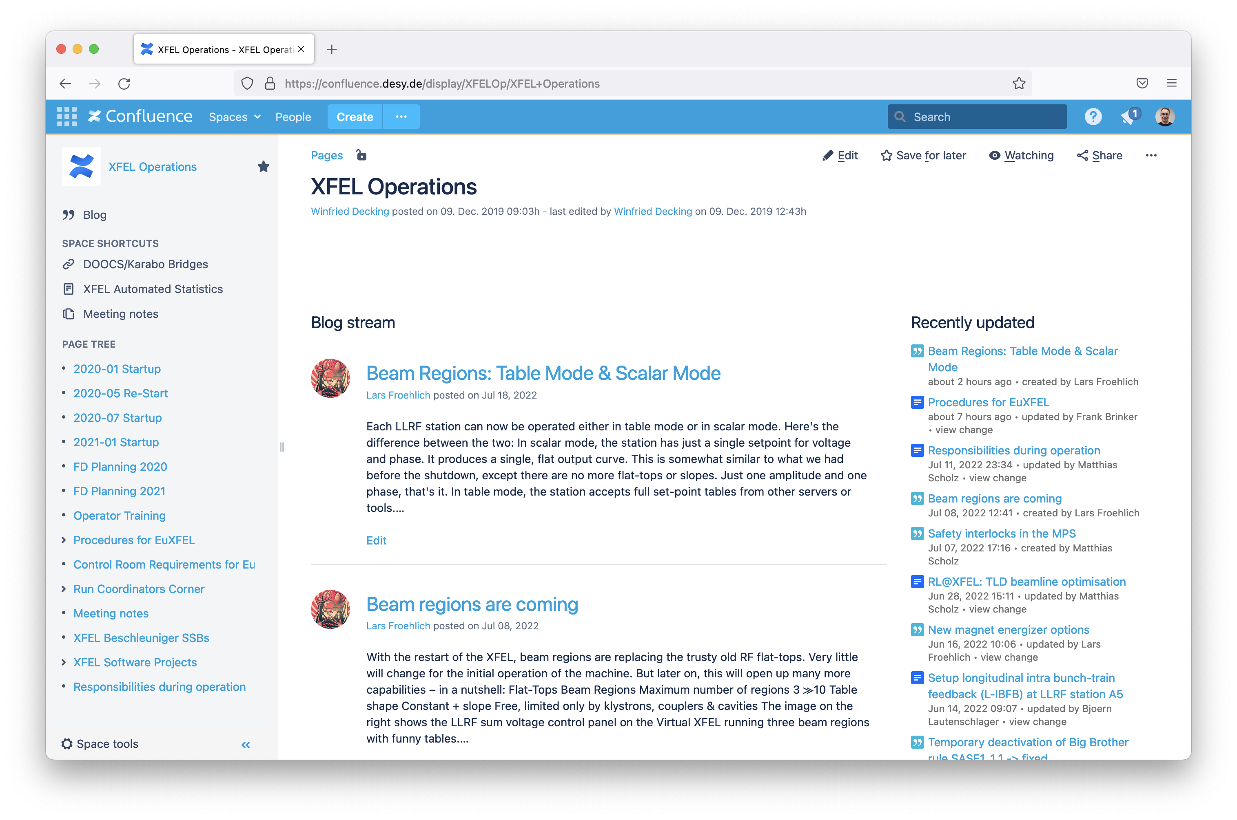
Please do not forget:
News are usually announced in the Operations Blog!
XFEL Operations on Confluence

