Slide 1
ARES operation meeting, Monday 18th July
by the ARES shift crew

Slide 2
Summary of KW 28
 | Monday 11th July | Tuesday 12th July | Wednesday 13th July | Thursday 14th July | Friday 15th July
Achievements | * Tunnel open for maintenance day | * Putting ARES back on track (see below) * AA shift: work on quadrupoles misalignment, agent-based beam optimization (centering/focusing), automated beam/quad alignment | * Dispersion measurement along the beamline for dispersion closure in the BC * EAQZM3 readback deviation fixed by MPC * Gun solenoid can cycle again (accuracy adjusted) | * AA shift: Measuring quadrupoles misalignments, testing agent user interface * Position feedback studies on SH.E2 | * Comparison momentum measurement LE dipole vs PCB steerers * Trying a momentum measurement comparison PDE dipole vs PCB steerer * Taking one last point for TWS1 compression curve
Perturbating events | * High voltage event in the power distribution | * DIO.0 cannot be switched on * PHAROS off with errors * Power supply of EAQZM1 needed to be exchanged | - | * Automated beam/quad alignment crashed over lunch | * LI.R3 camera is unstable (crashed several times when using it alone) * Discrepancy ASTRA/experiment for off-crest momentum
Notes | - | - | - | * MEA work brought improvement for quad alignment | * Might look at LI.R1 calibration

Slide 3
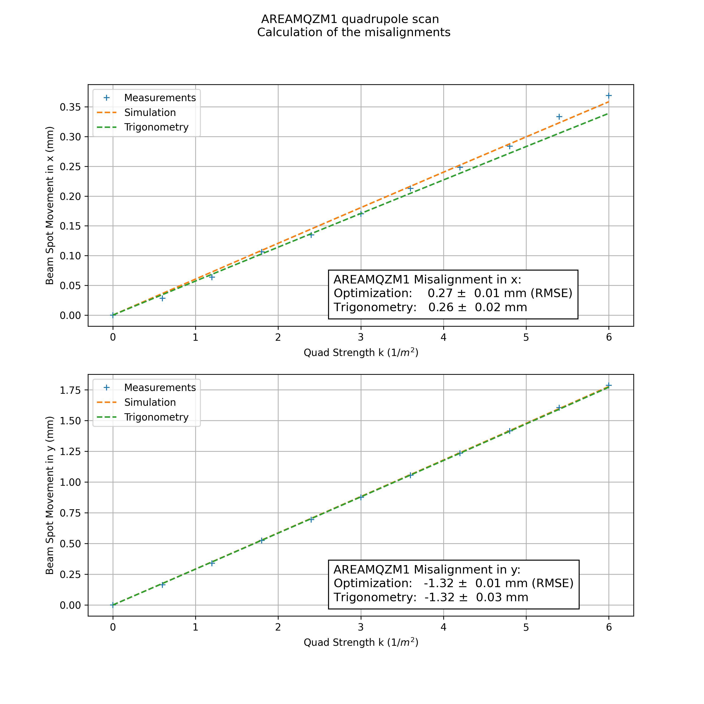
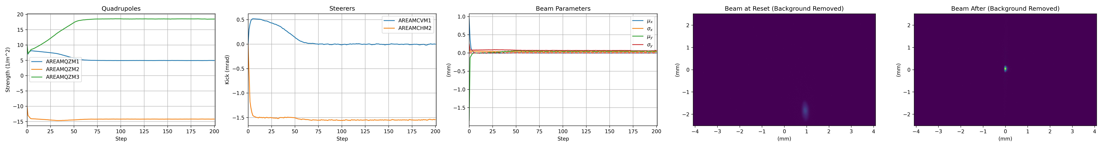
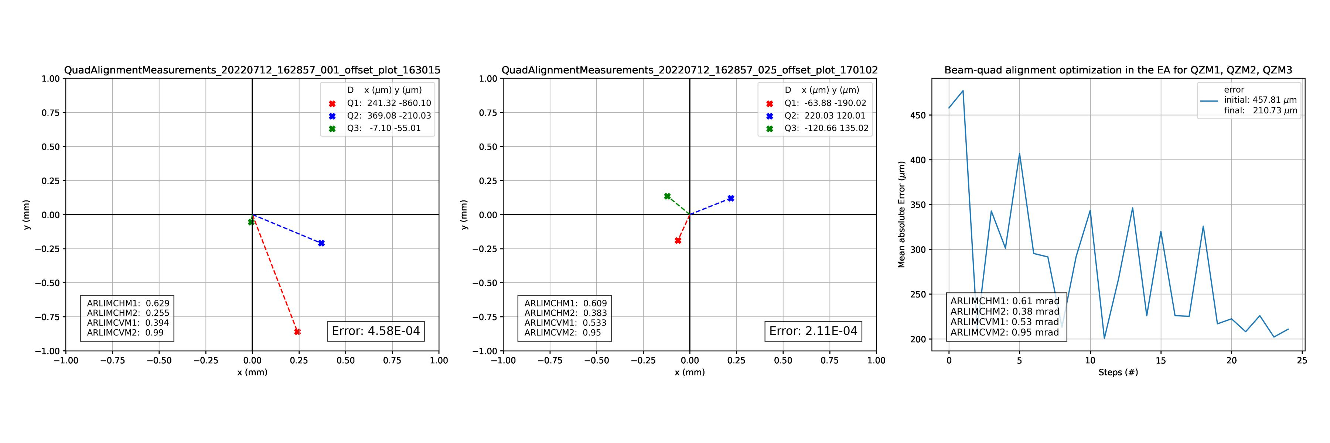
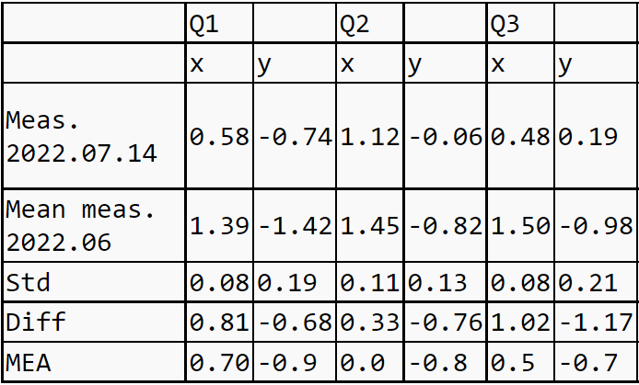
AA shifts

Slide 4
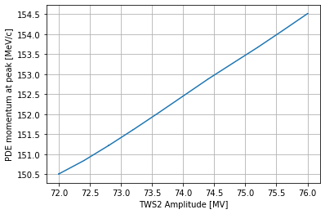
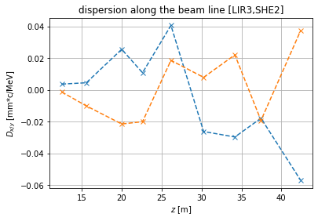
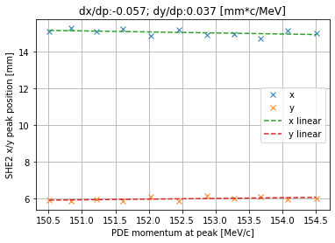
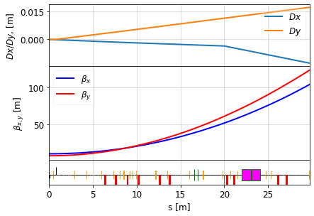
Dispersion studies

Slide 5
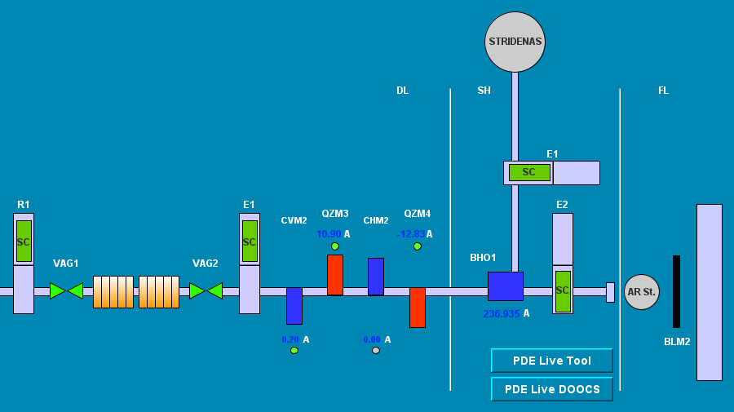
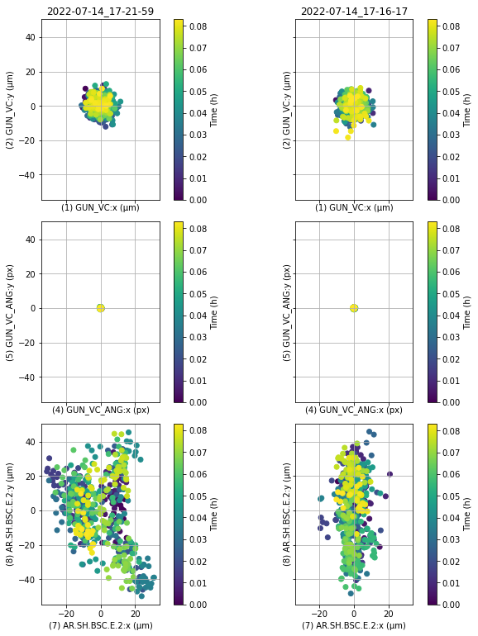
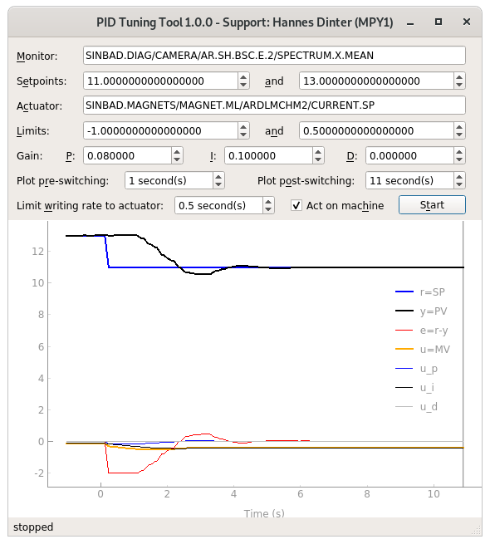
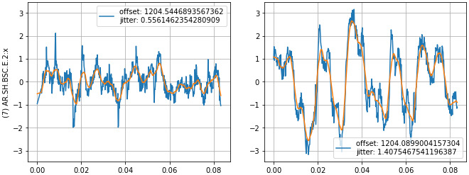
Discrete horizontal position feedback on SH.E2
Using ARDLMCHM2 as actuator (5 minute datasets)
Feedback off
Feedback on
GUN_VC:
x vs. y (µm)
as reference
Measure beam position on screen, correct with upstream steerer
Tried only horizontal direction so far
rms position jitter reduced from 13.88 µm (1.41 px)
to 5.48 µm (0.56 px)
→ factor 2.5 improvement
rms laser position jitter on virtual cathode: 4 µm (7 px)
SH.E2:
x vs. y (µm)
PID parameter
tuning tool
SH.E2:
x vs. time (px)

Slide 6
Dipole/steerer momentum measurement
LE dipole momentum measurement: 3.8513 +/- 0.0002 MeV/c
Slight discrepancy when measuring on LI.R1 → Might be worth to check again calibration (when time allows it)
Momentum discrepancy (around 3-2.5 MeV/c at max.) observed between ASTRA predictions and experimental measurements for off-crest settings in TWS (namely anything different from triple on-crest).
Might be due to TWS field incorrect modeling in ASTRA input or not yet understood PDE features → Try to investigate the latter one with comparison PDE/steerer for momentum measurement.
Conclusion not possible because errorbars are of 3-4 MeV/c with the PCB steerer measurement.
 | LI.X1 | LI.R1 | LI.R2
CVG1 | 3.825 +/- 0.050 | 3.915 +/- 0.051 | 3.88 +/- 0.23

Slide 7
Schedule
Week 29
Date | Shift leader
18.7. | Florian (Tunnel open)
19.7. | Hannes/Willi
20.7. | Willi
21.7. | Hannes
22.7. | Thomas
If you want to learn or join the shift: please give the shift leader a call (BKR 2840 / SINBAD Box 2454)

