Slide 1
ARES Operation Meeting
Summary of week 29 / 2022
Hannes Dinter, on behalf of the ARES crew

Slide 2
Summary of week 29
 | Mon. 18th July | Tue. 19th July | Wed. 20th July | Thu. 21st July | Fri. 22nd July
Achievements | (Tunnel open) | Start up Operator training Dispersion measurement | Dispersion measurement including BC Automating dispersion measurement Checking quadrupole settings vs. ocelot simulation | Autonomous ARES Test quad misalignment measurement notebook beam-to-quads auto-alignment Tunnel open for visit & quadrupole position measurement Operator training during start-up Over night: stability measurement on LI.R1 including Gun OVC | Trying geometrical alignment with TWS1 Velocity bunching measurements Over weekend: detailed charge map
Difficulties |  | Power glitch (restarting TWS RF stations was necessary) | Camera SL.S1 not reachable, restarted server, serials were scrambled (fixed by expert) Screen station MR.R3 calibration coefficients were off (missing a zero), corrected now | Rightmost Linux console frozen (not even pingable), restarted without problems | No signal on BPM for this low charge Saturday: card in MPS SPS crashed

Slide 3
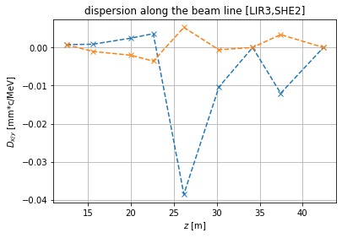
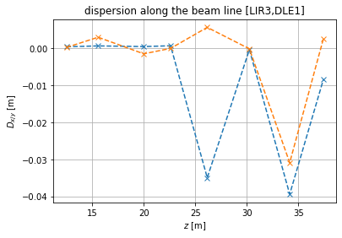
Dispersion measurements
2022-07-19
2022-07-20

Slide 4
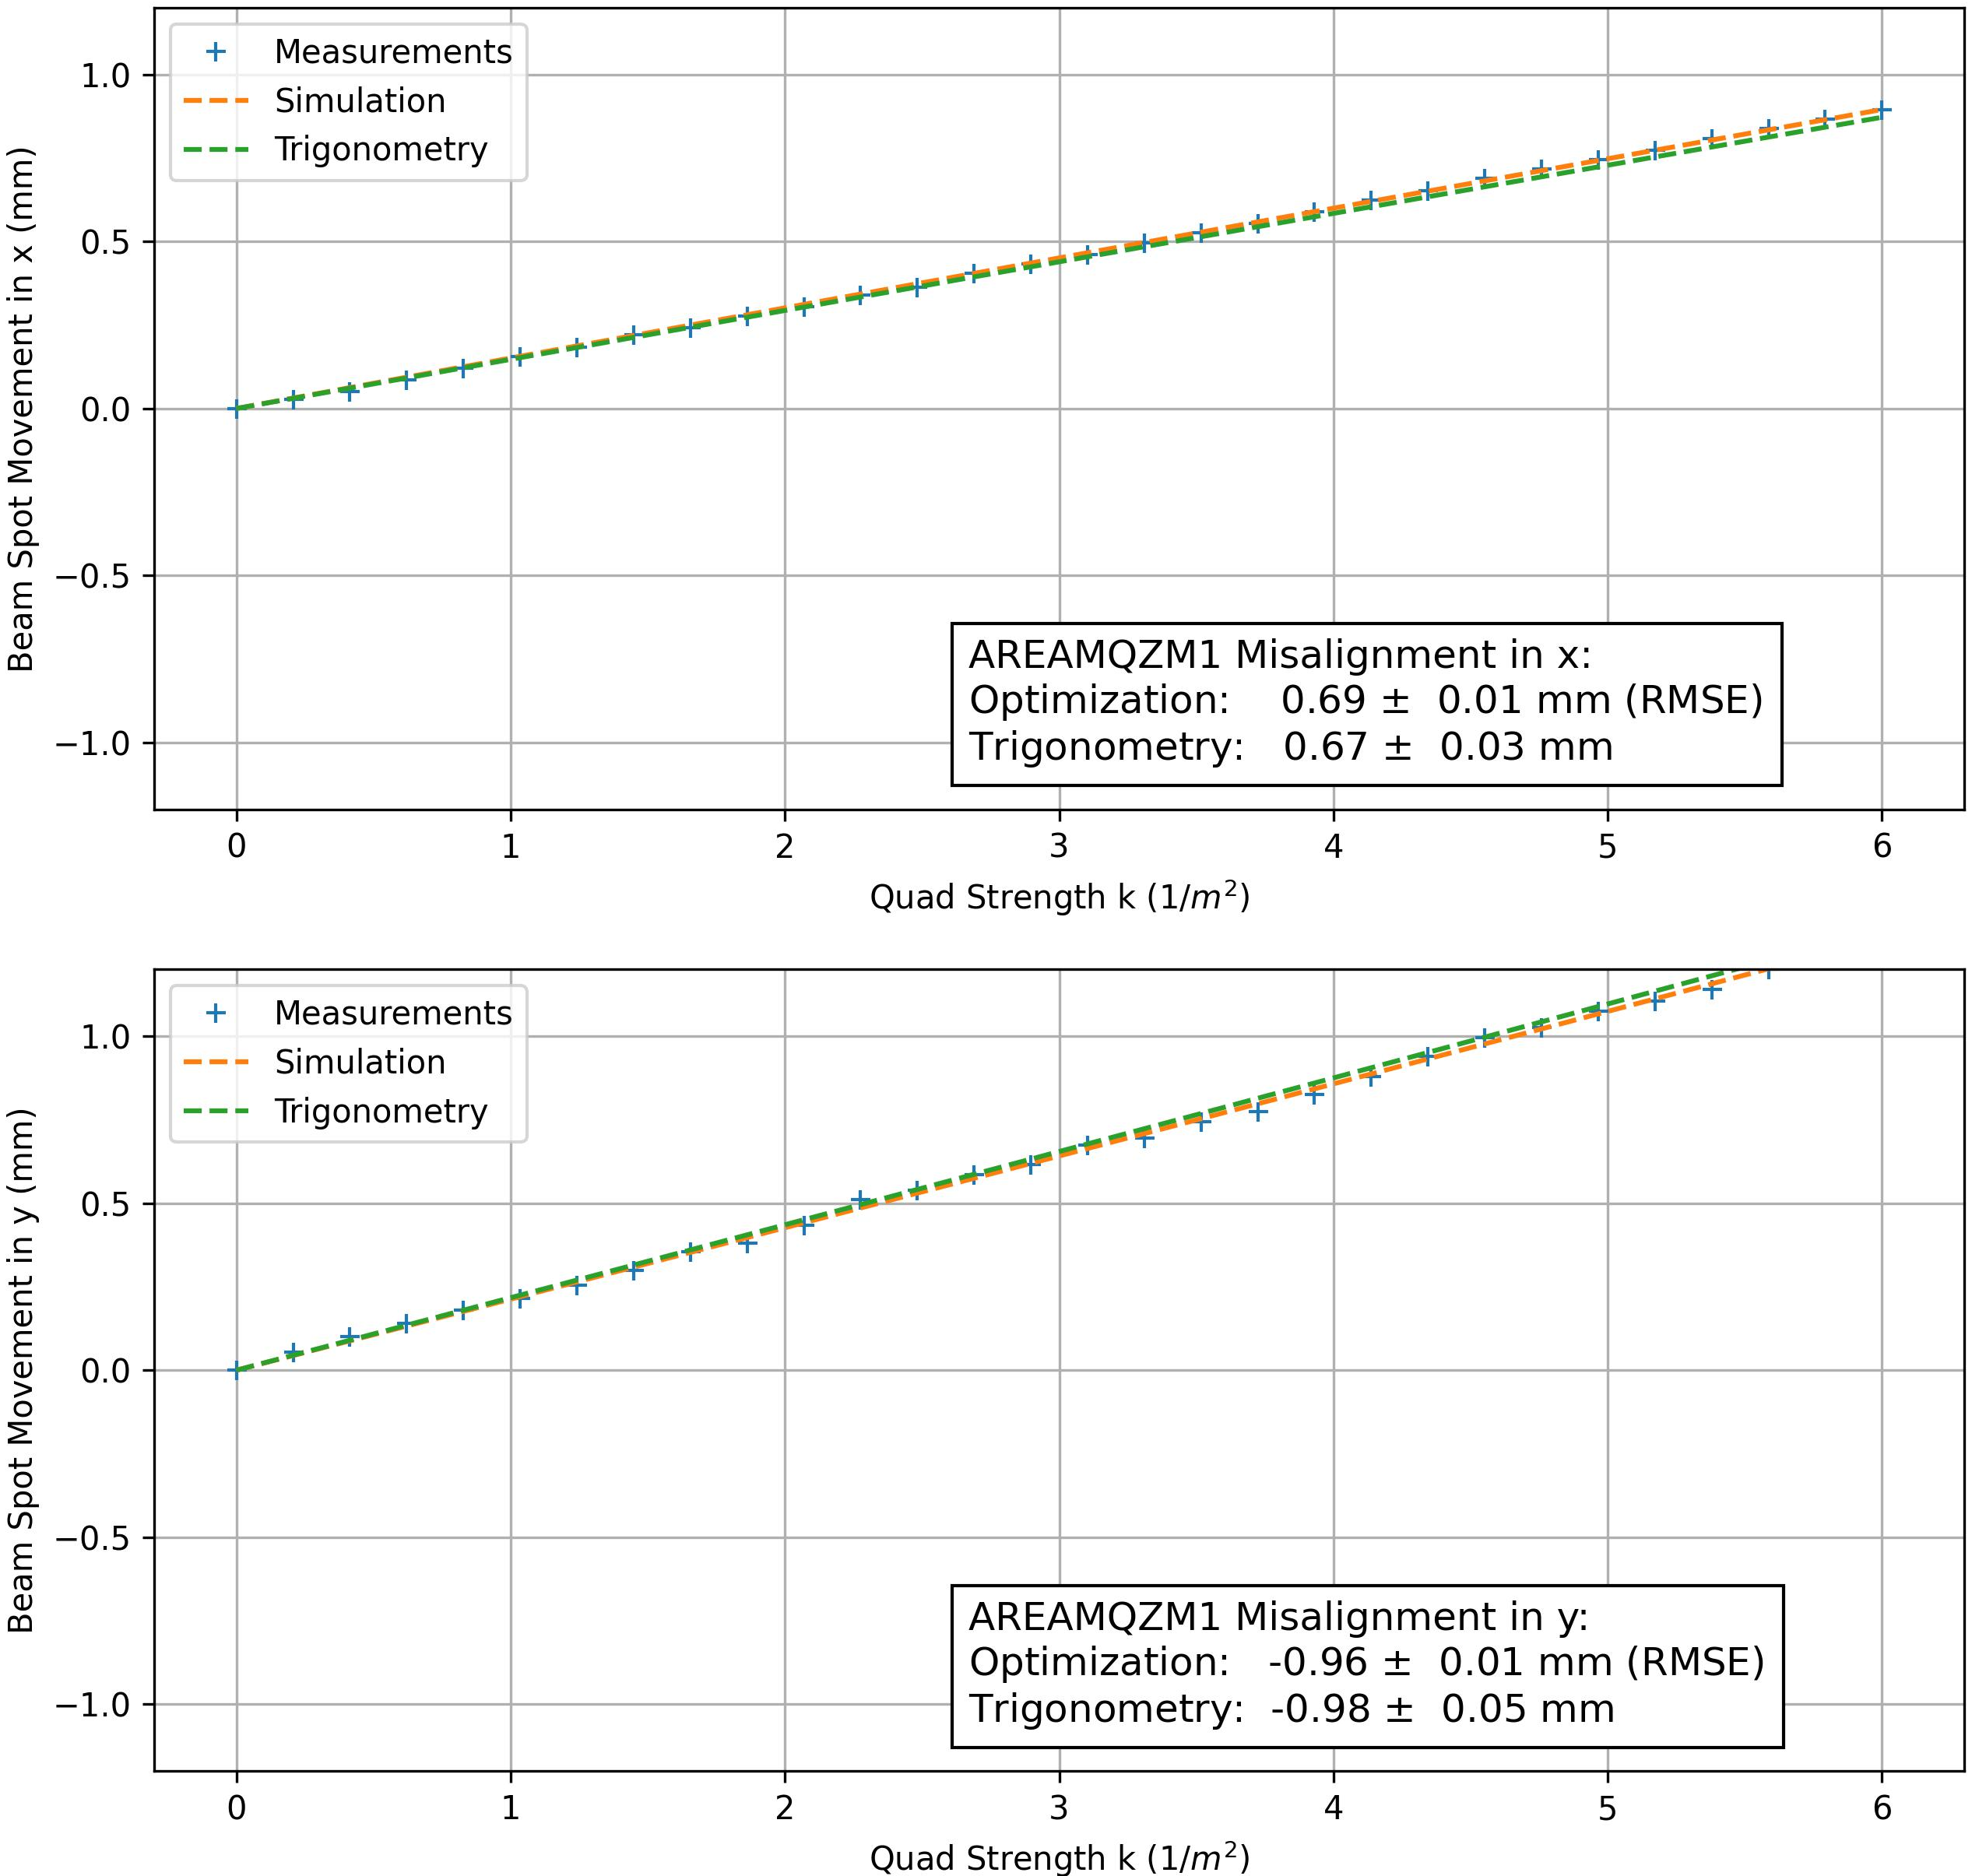
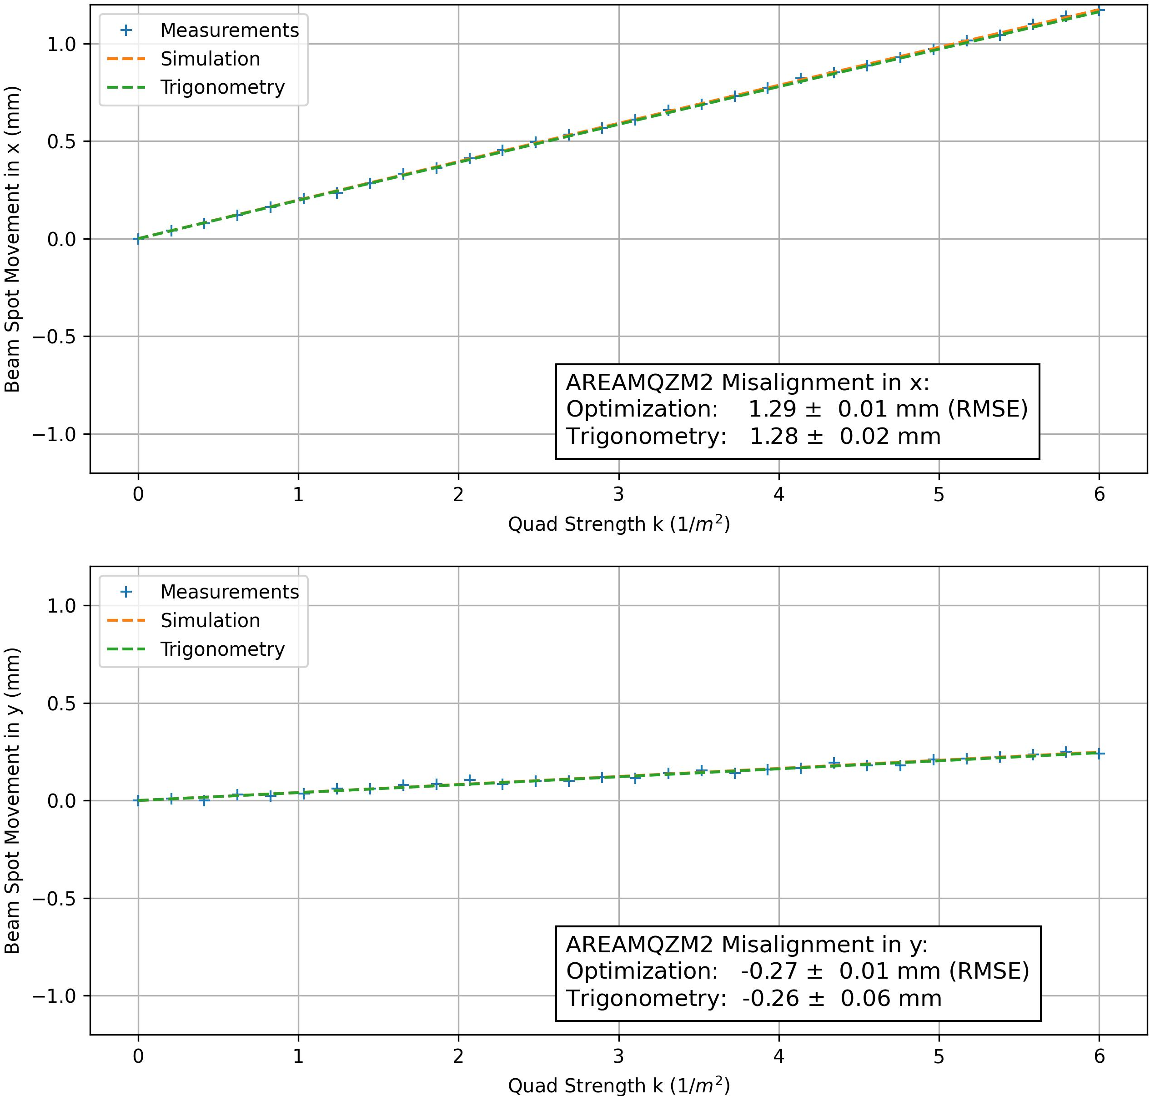
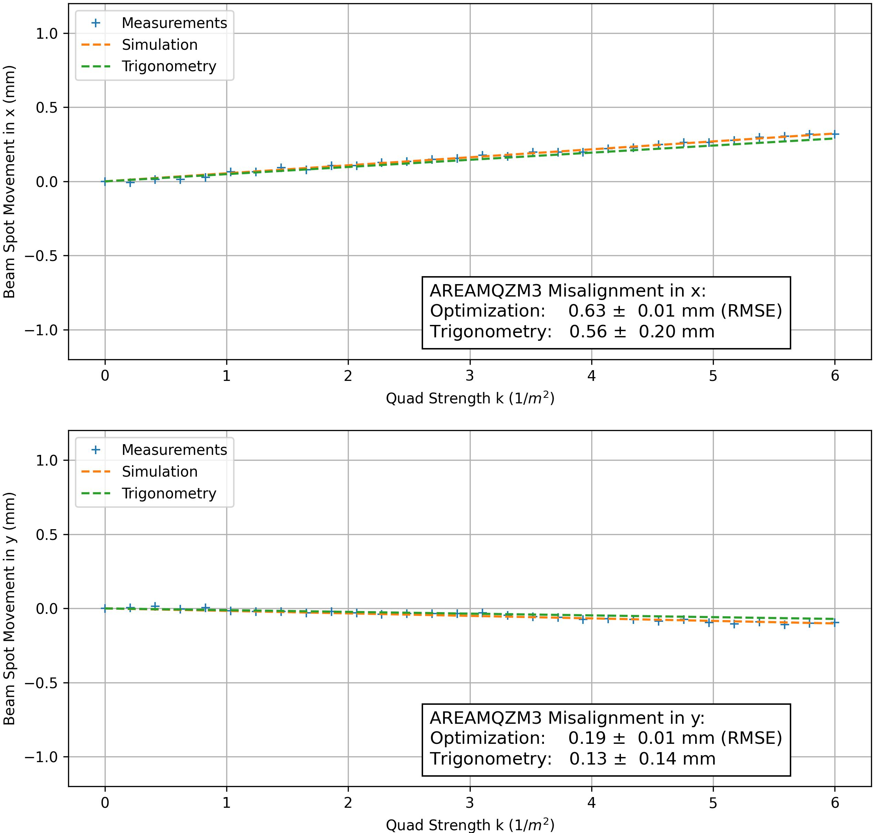
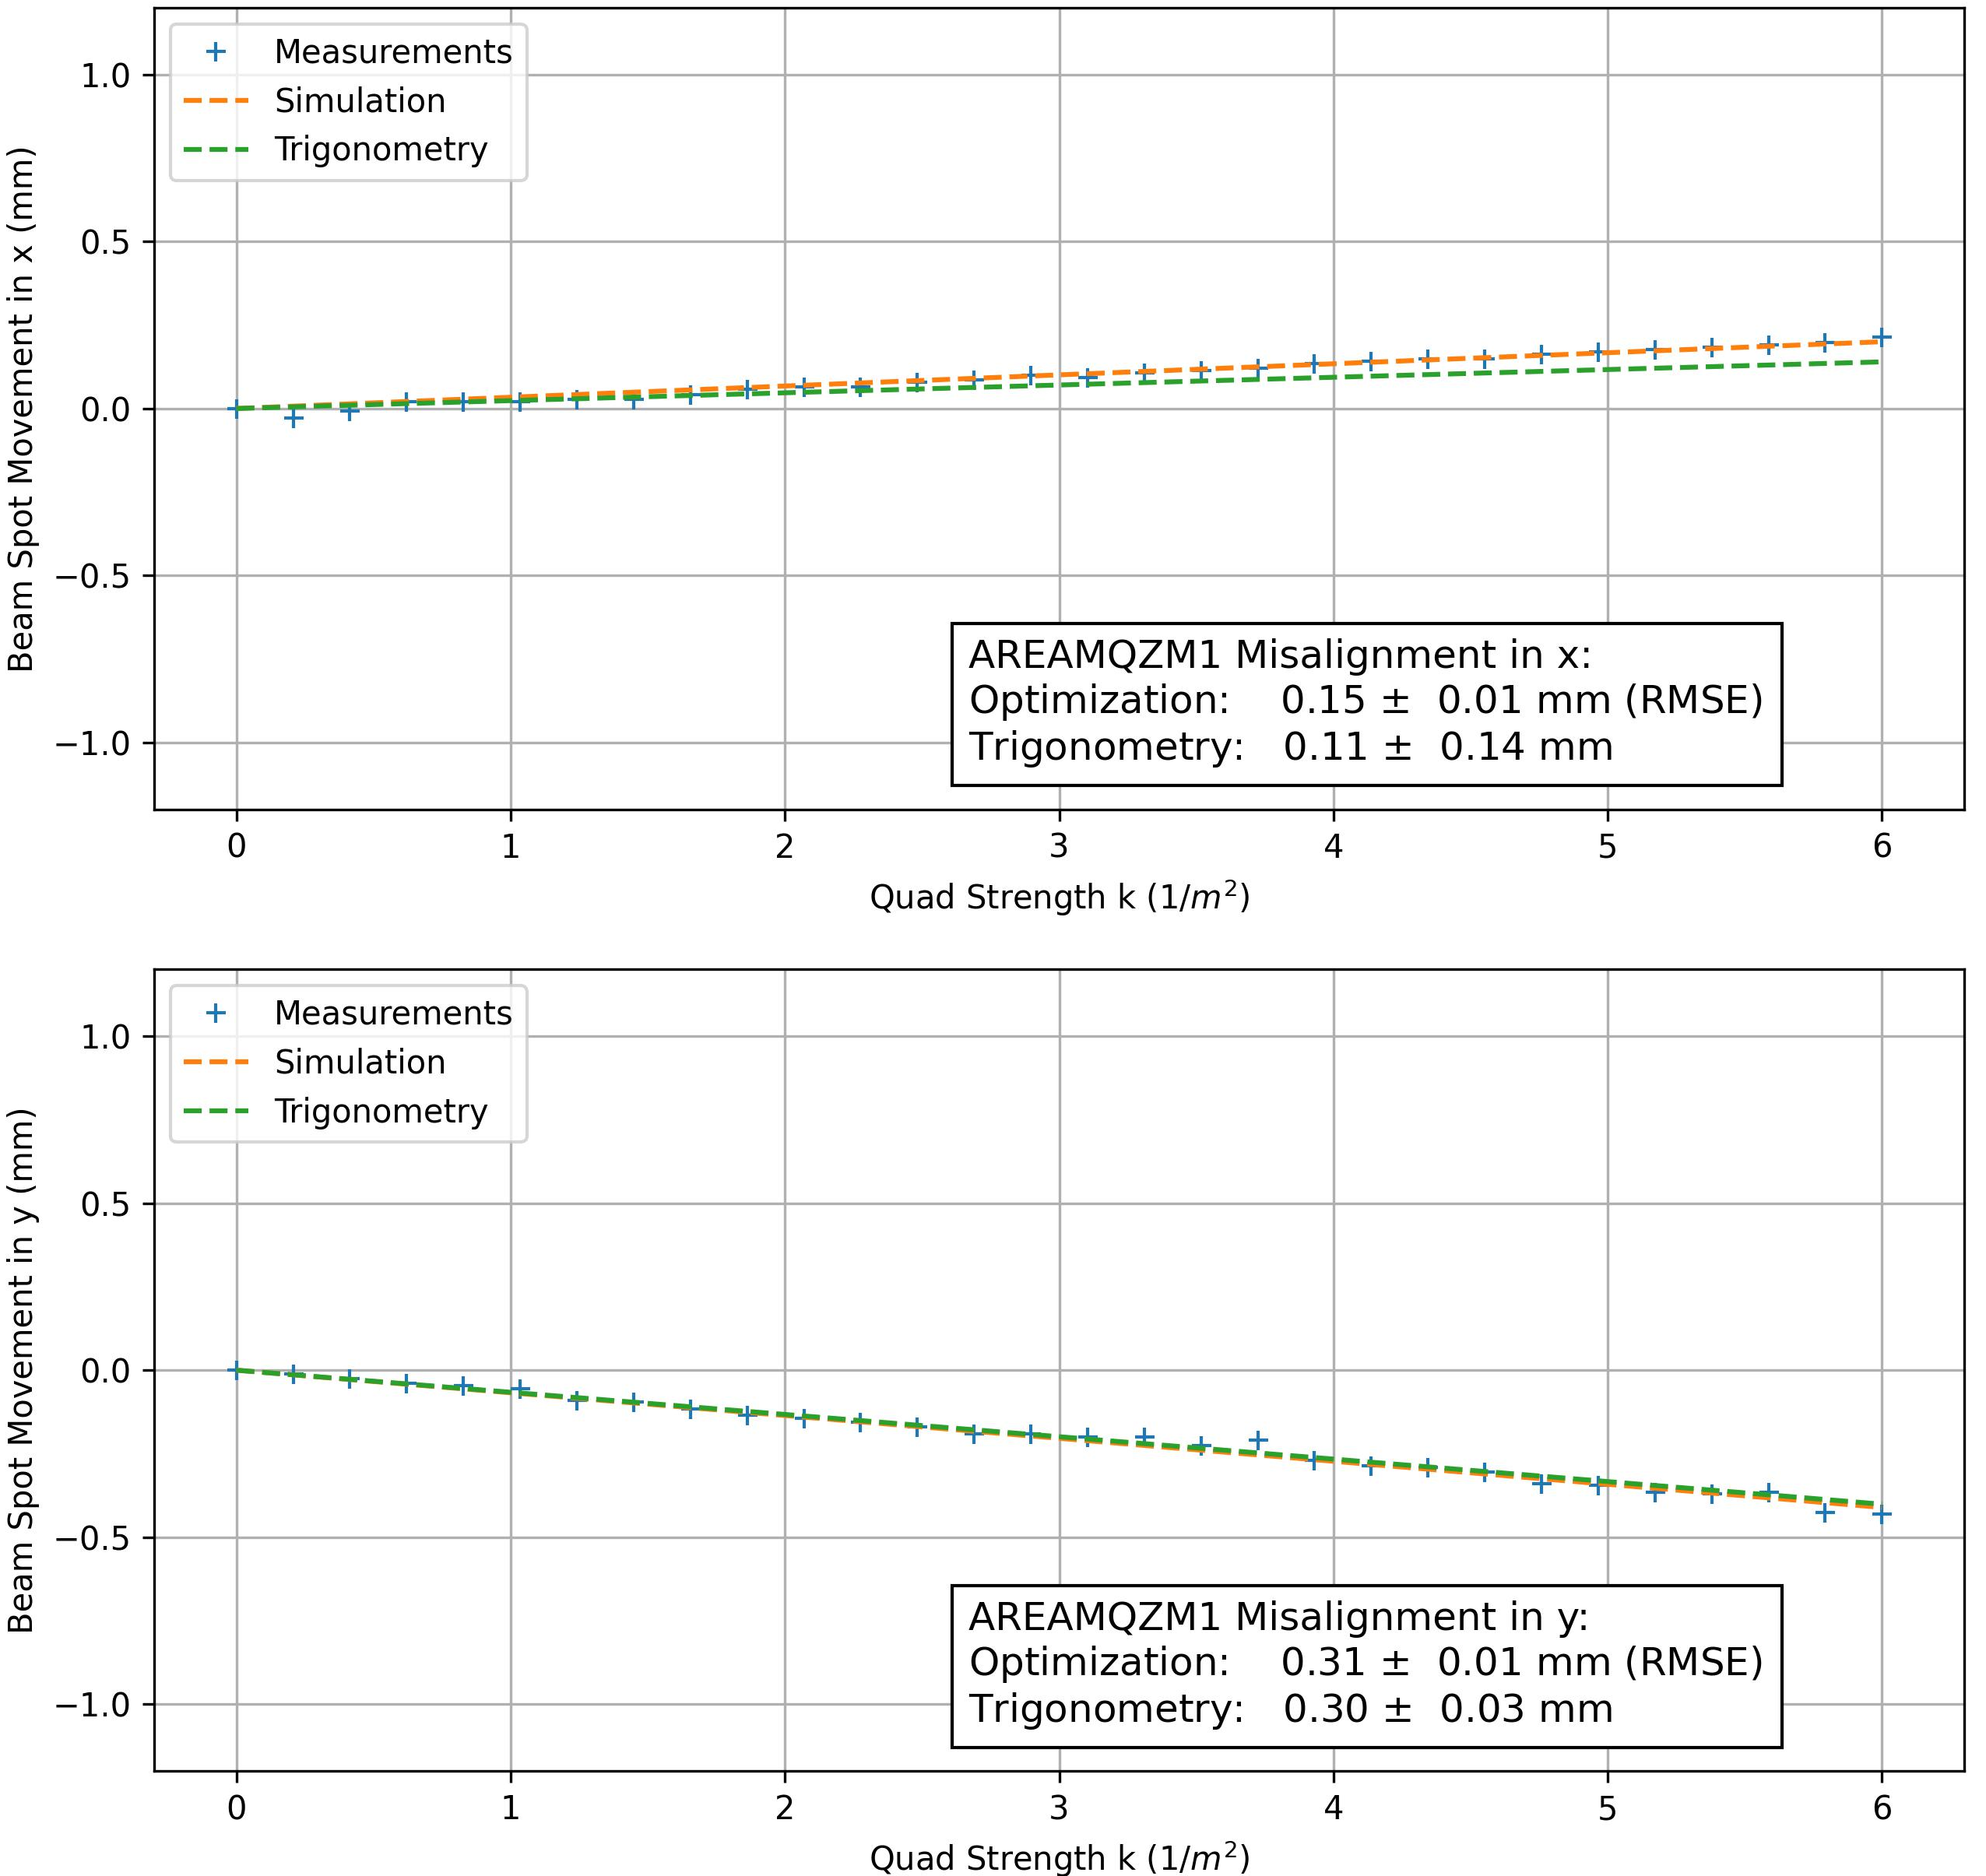
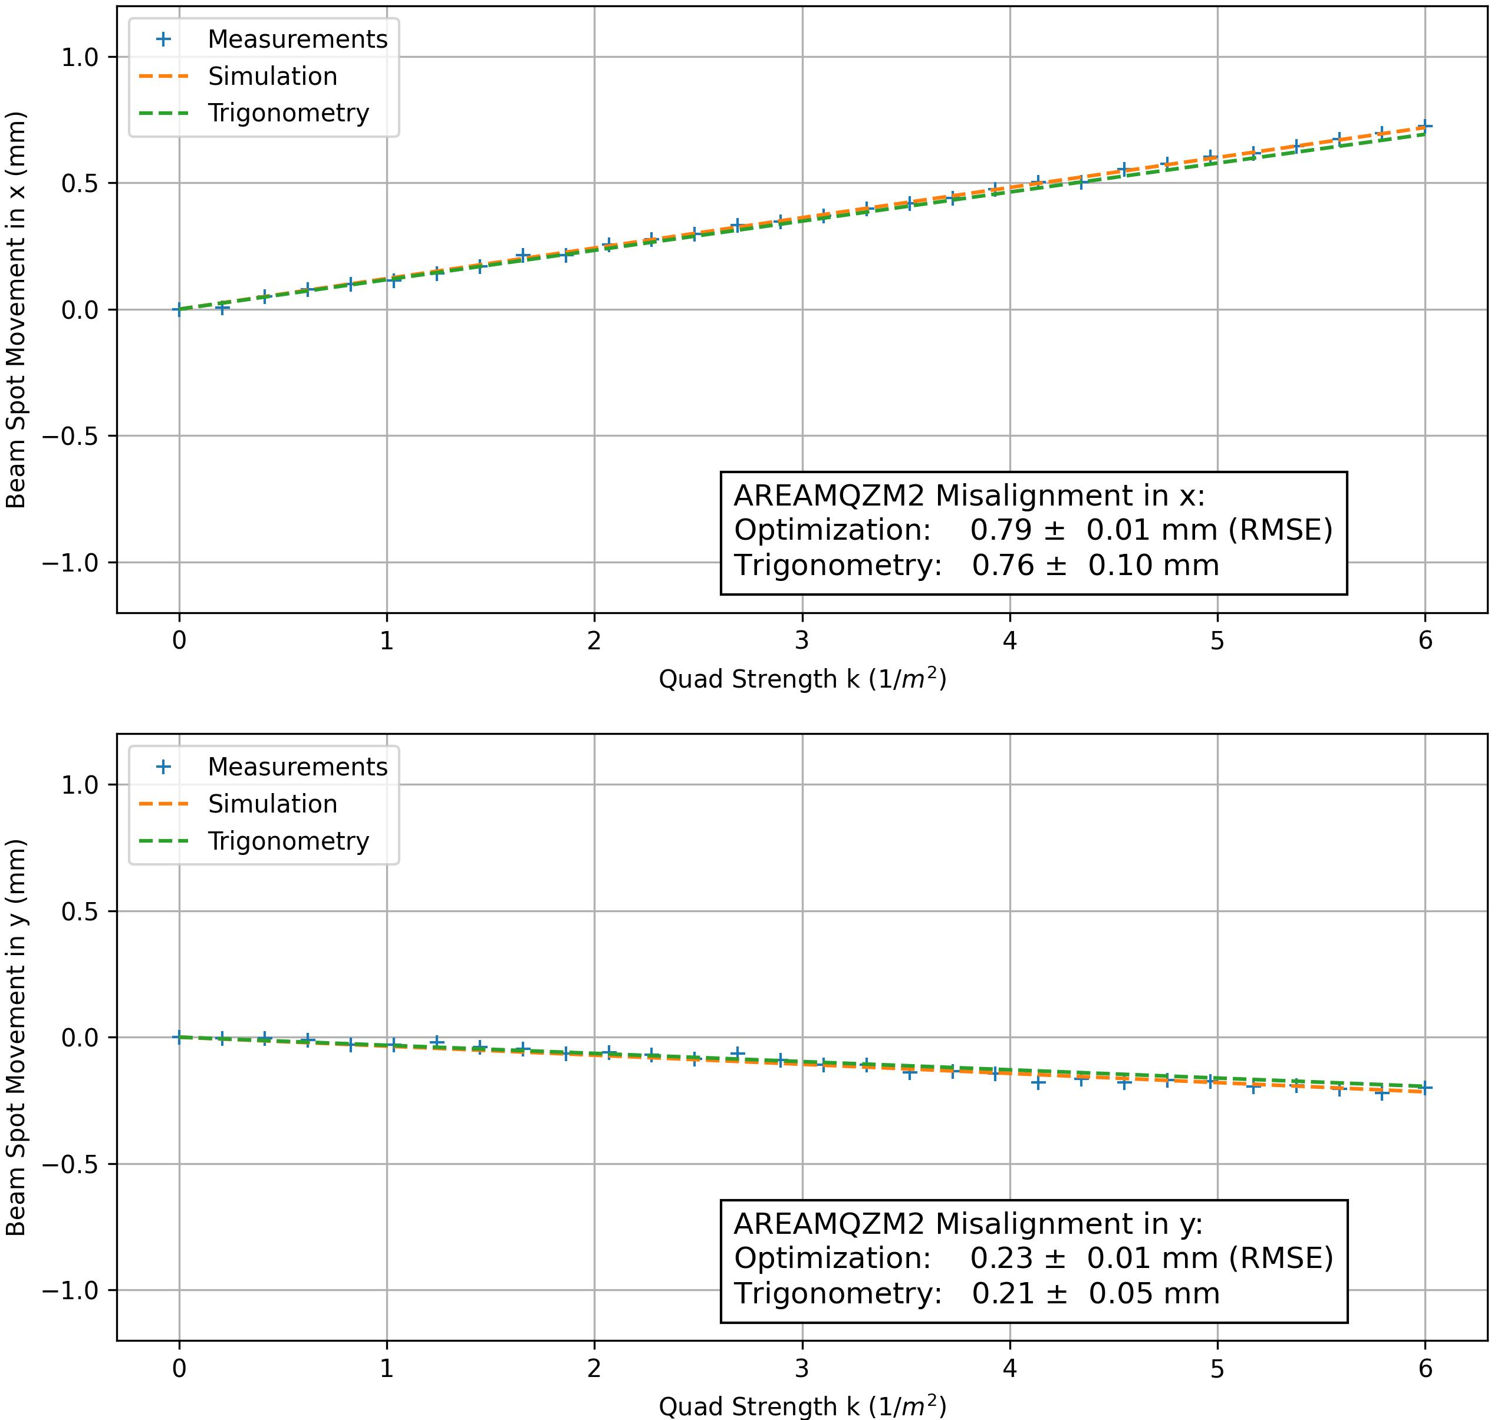
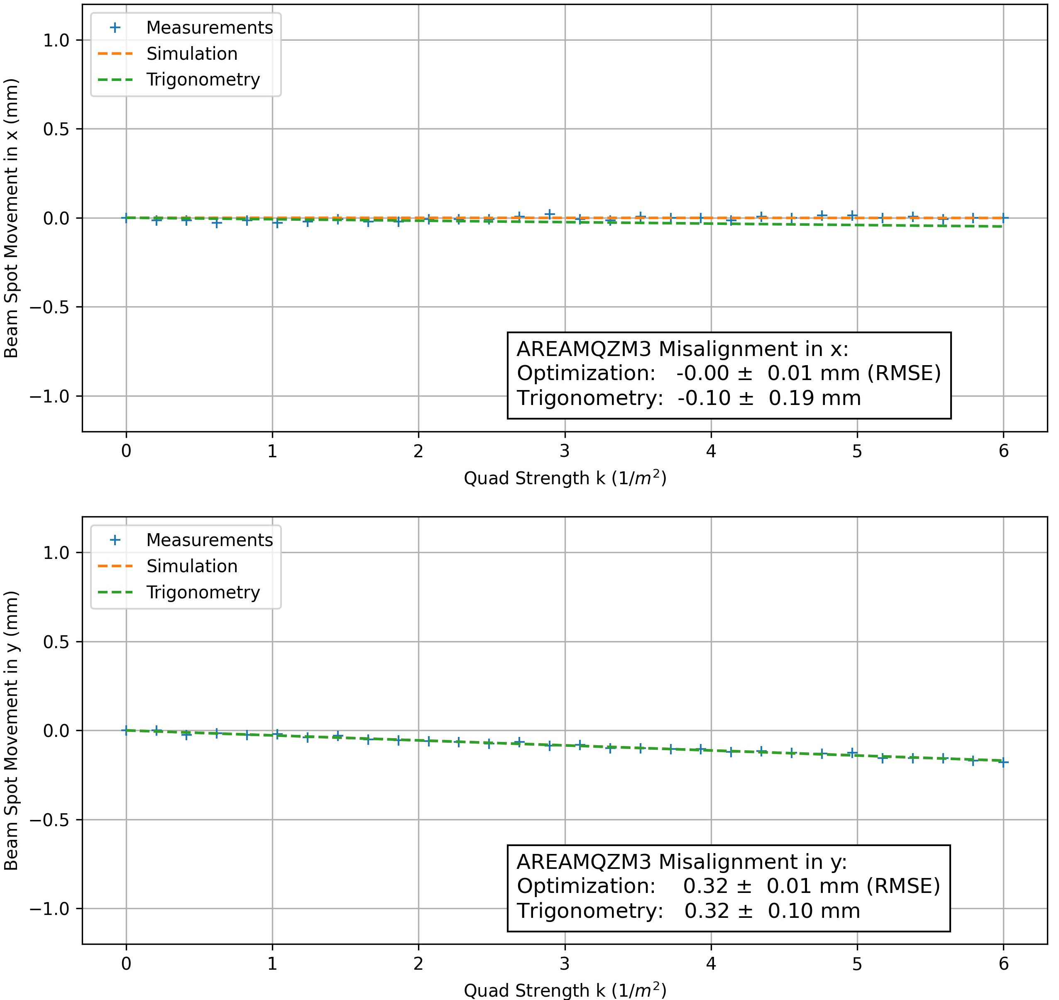
Automated beam quadrupole alignment
AREAMQZM1
AREAMQZM2
AREAMQZM3
Before:
x:
y:
After:
x:
y:

Slide 5
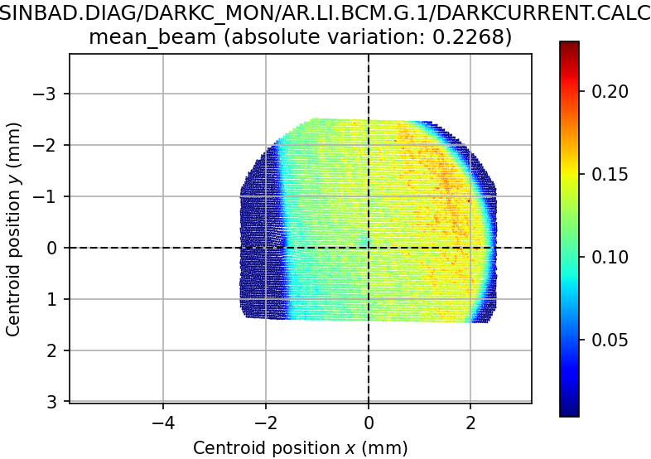
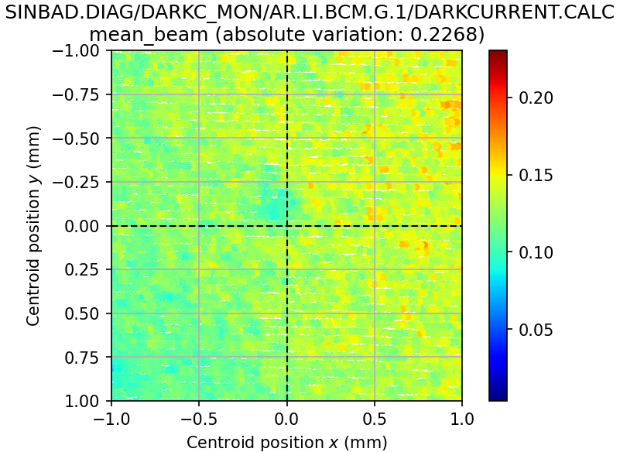
Charge map using 50µm aperture
(incomplete due to MPS SPS failure on Saturday)

Slide 6
Schedule
Week 30
Date | Schedule
25.07. | Tunnel open
26.07. | Thomas
27.07. | Willi
28.07. | Hannes
29.07. | Frank
If you want to learn or join the shift: please give the shift leader a call (BKR 2840 / SINBAD Box 2454)

