Slide 1
Calorimeter Optimization
26-07-2022 mini update
Michal elad

Slide 2
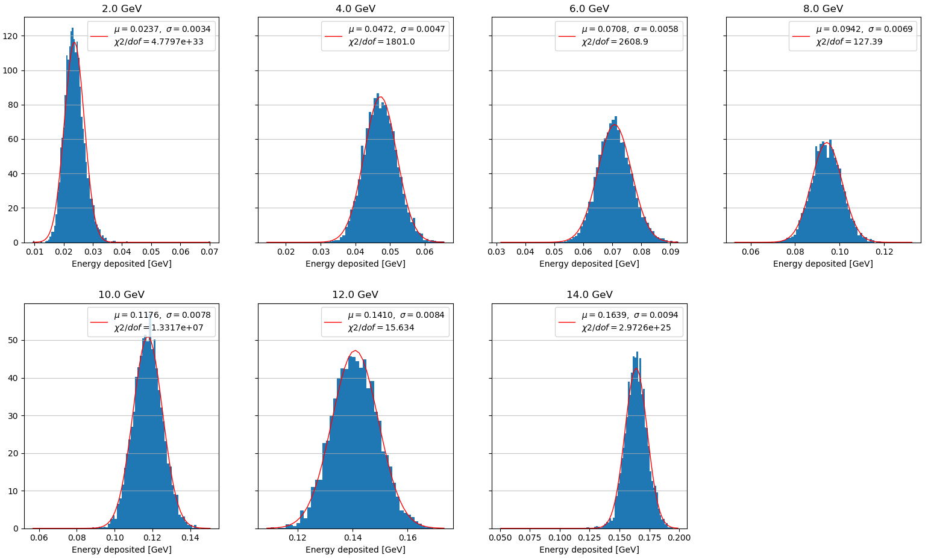
Gaussian fit – all layers

Slide 3
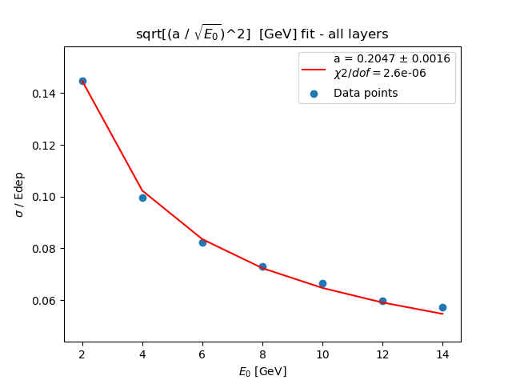
Resolution energy fit – all layers

Slide 4
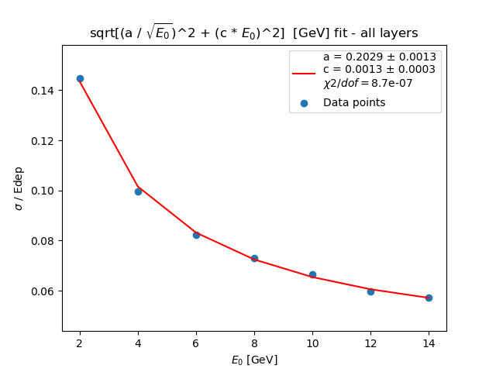
Resolution energy fit – all layers

Slide 5
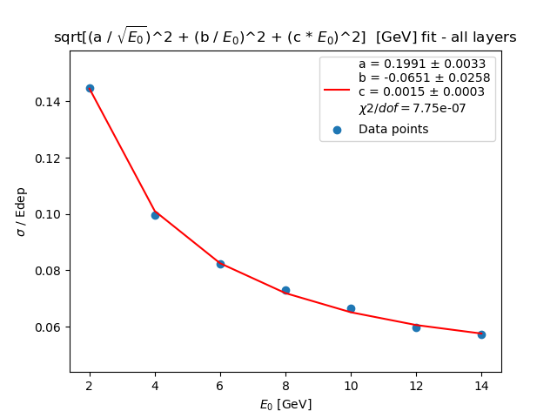
Resolution energy fit – all layers

Slide 6
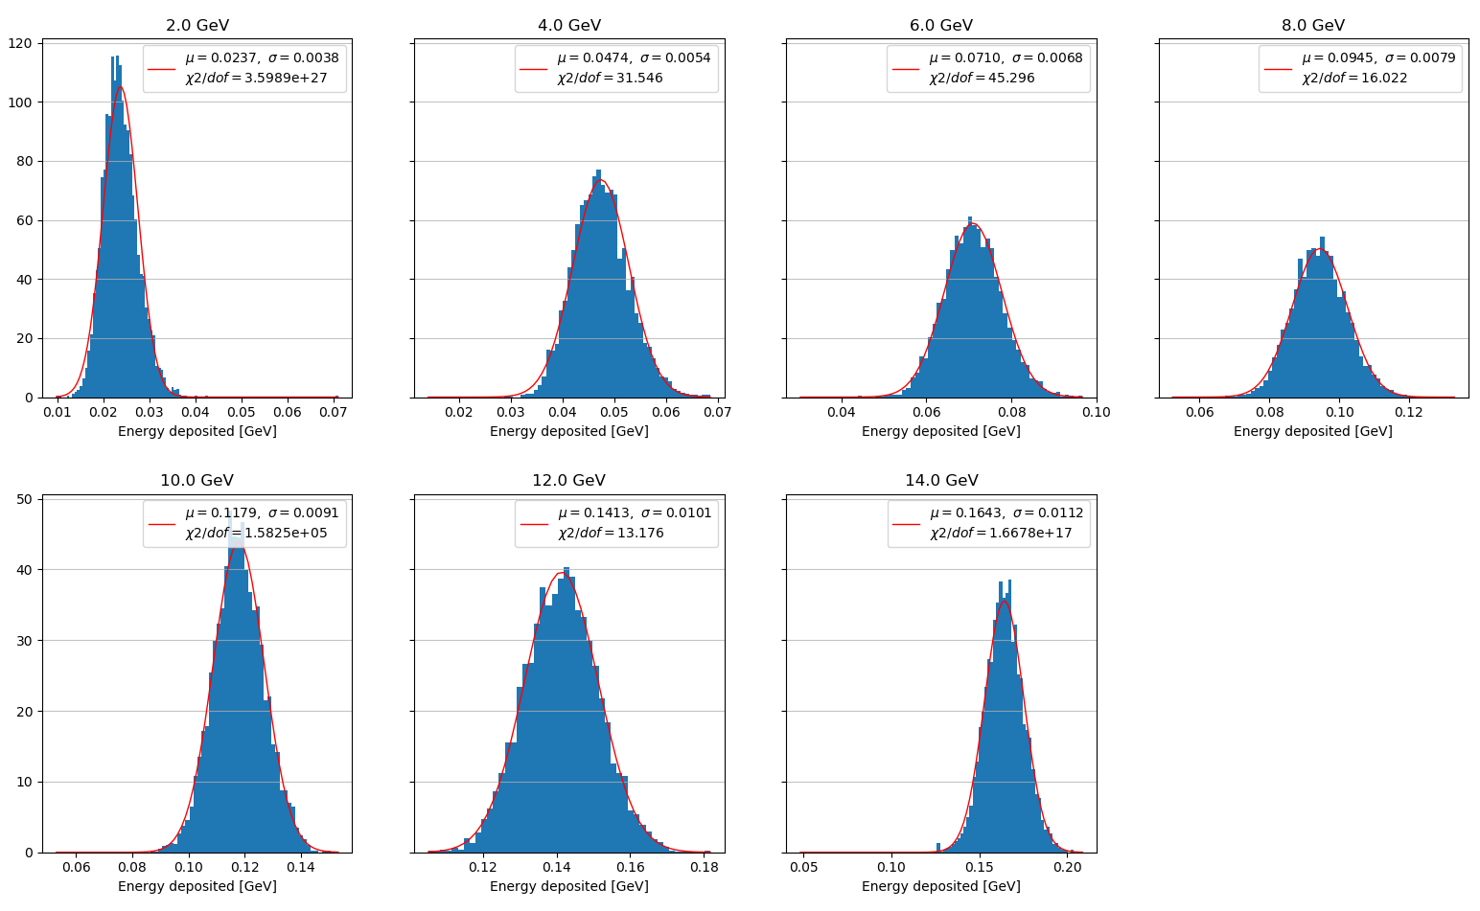
Resolution energy fit – 15 layers missing layers reconstructed with a linear assumption

Slide 7
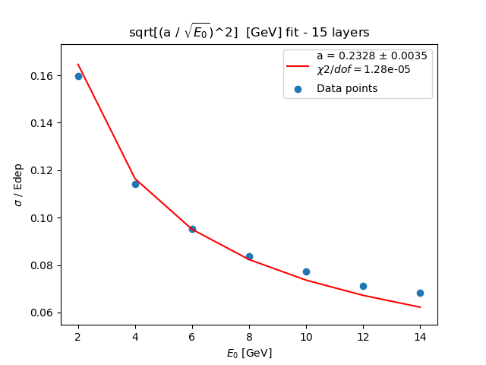
Resolution energy fit – 15 layers missing layers reconstructed with a linear assumption

Slide 8
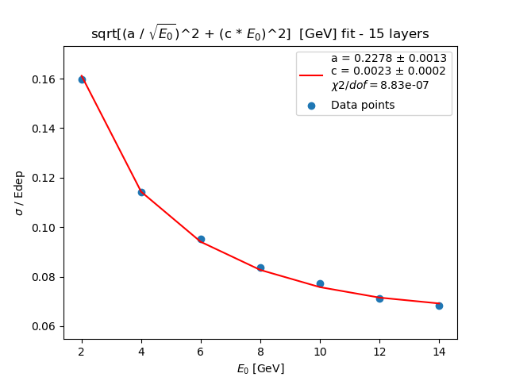
Resolution energy fit – 15 layers missing layers reconstructed with a linear assumption

Slide 9
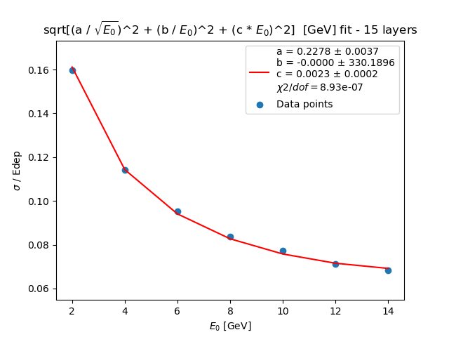
Resolution energy fit – 15 layers missing layers reconstructed with a linear assumption

Slide 10
notes
Uncertainties for the data points in the fit are to be added
Limits to the range of the gaussian fit are needed

