Slide 1
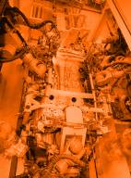
MTCA for Industrial applications

Slide 2
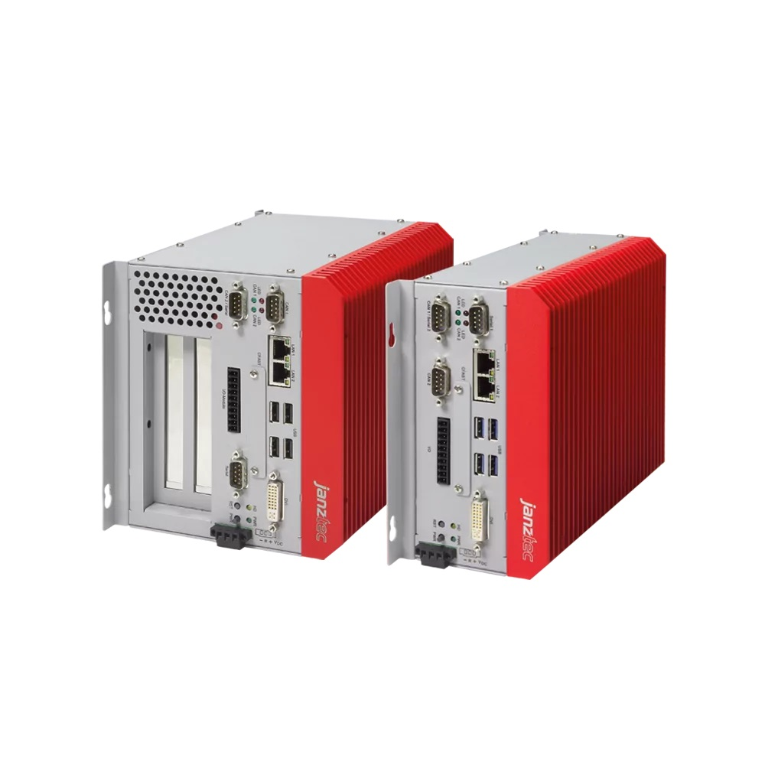
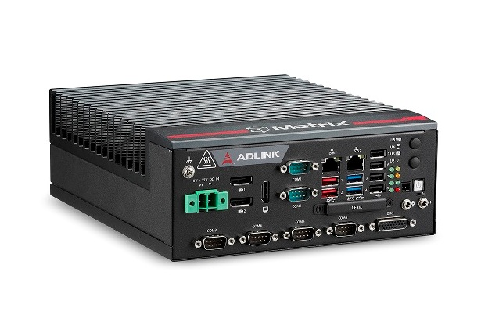
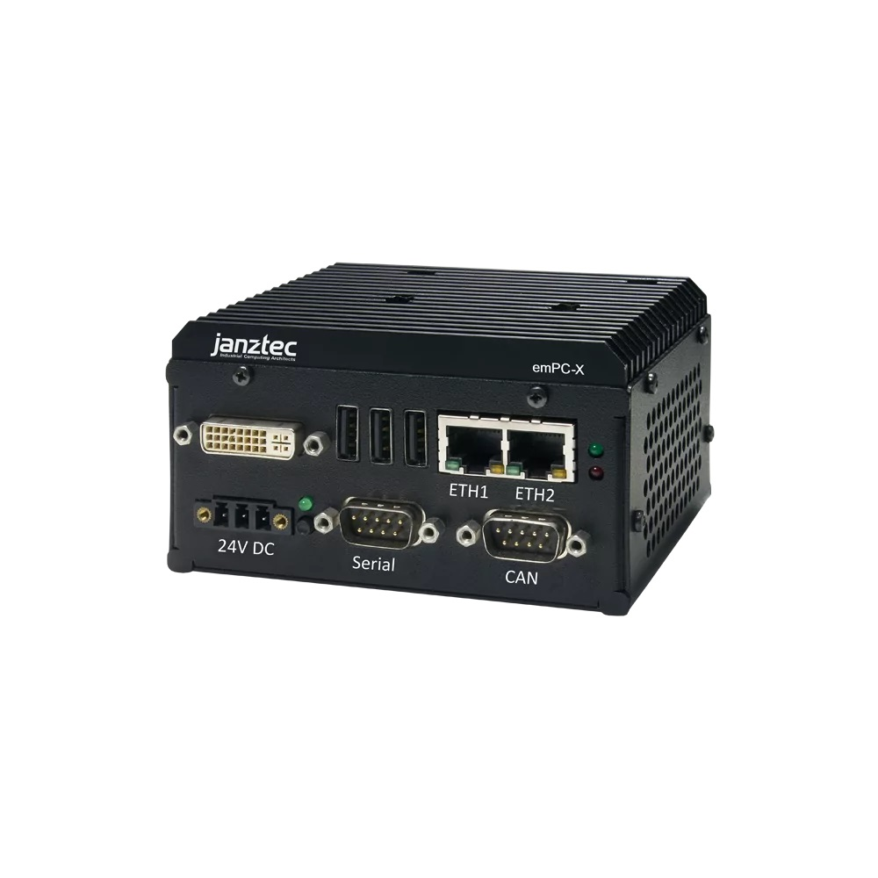
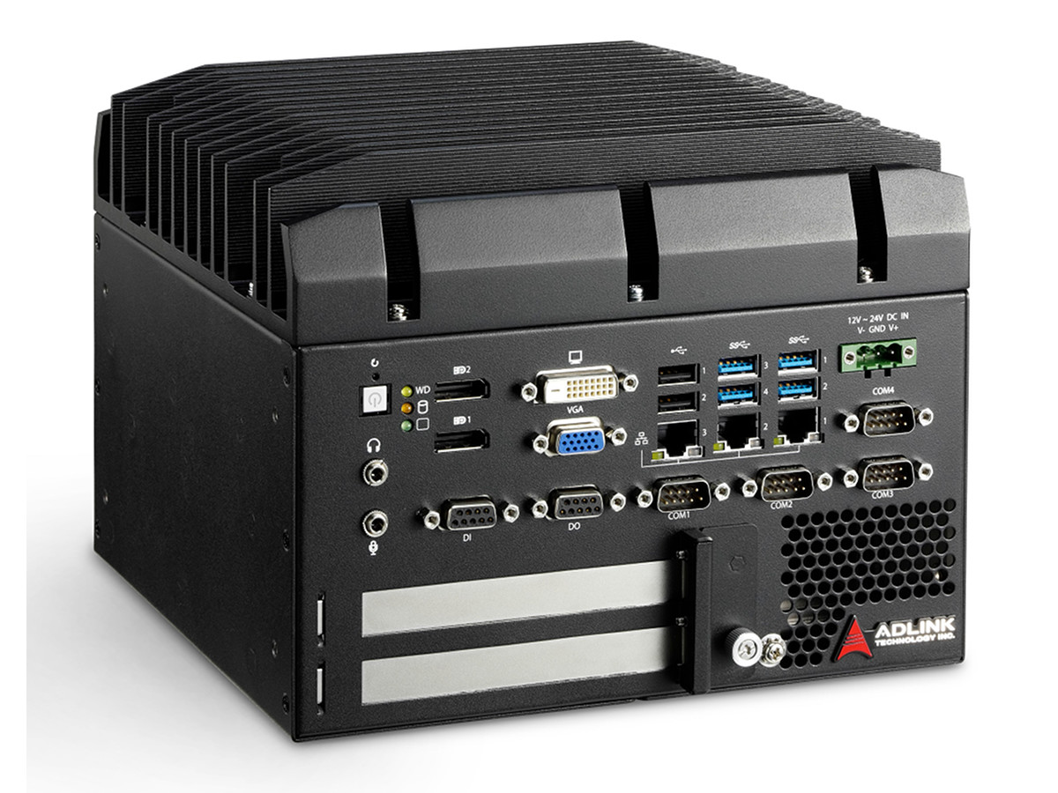
Industry requirements
Industrial PC are used all over for de-centralized data processing/acquisition in factory automation
They need to be:
simple to operate
easy to manage
robust
reliable
long-term availibility
cost effective
small

Slide 3
Industry reality
Industrial PC lack of the following features
They are not easy to operate
They do not have any management
They are not easy to maintain or manage
They are very limited to expand beyond
Max. 3 PCI slots (if any)
Components are not easily exchangeable

Slide 4
A simplified MTCA system
A simplified MTCA system is:
Simple to operate
Has got easy management
Support for 6 AMC modules
PCIe links to each AMC (x4 is enough)

Slide 5
A simplified MTCA system
A simplified MTCA system is:
Simple to operate
Has got easy management
Support for 6 AMC modules
PCIe links to each AMC (x4 is enough)
A simplified MCH
eMCH
backplane integrated
as backplane add-on

Slide 6
A simplified MTCA system
A simplified MTCA system is:
Simple to operate
Has got easy management
Support for 6 AMC modules
PCIe links to each AMC (x4 is enough)
A simplified MCH
eMCH
backplane integrated
as backplane add-on
Cost reduction expected compared to a full feature MTCA system
Microchip PM8532 (181,00 EUR; 26.9.2022)
Broadcom PM40028B1-F3EI (190,01,00 EUR; 26.9.2022)
Supports up to 6 AMC Slots with PCIe x4

Slide 7
Industry requirements
Small system (either 19“ or wall mount)
Flexible
Expandable
Simple to operate
No redundancy needed
Easy management
Cost effective
Not neccessarily 12 expansion slots slots
Maybe 6 slots will be enough

Slide 8
Industry requirements
No need for high-end solutions
Open frame AC power supply
DC optional
Max. 6 slots
PCIe as fabric
x4 lanes to every AMC may be enough
Few variants

Slide 9
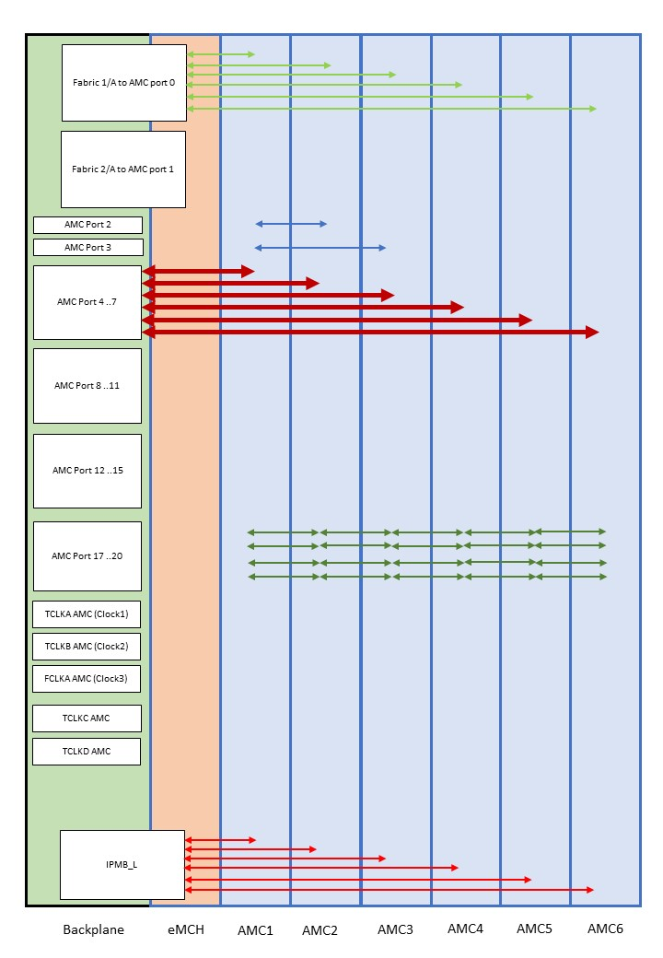
Requirement for a simple MTCA system
GbE to every AMC slot
Dedicated CPU Slot (AMC1)
PCIe x4 on AMC Ports 4..7
SATA links between AMC1 and AMC2/3
Daisy chain between AMC1 to AMC6
Clock 3 to all slots
Custom backplanes optional
for AMC port 8..11, AMC port 12..15

Slide 10
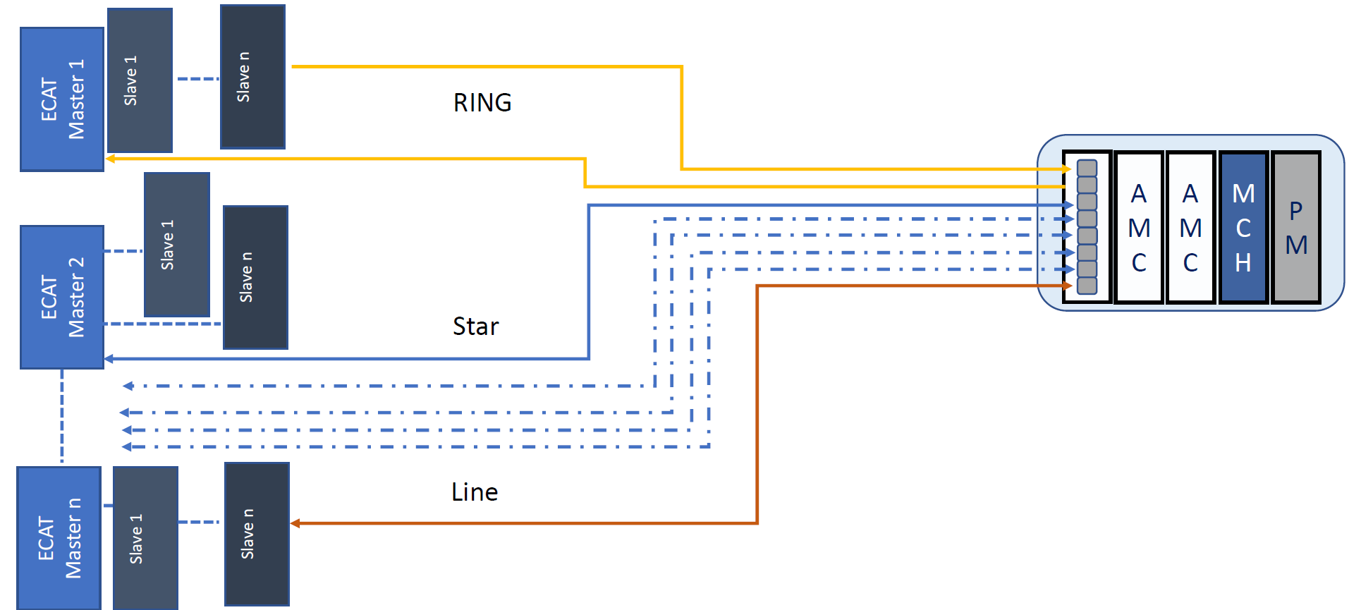
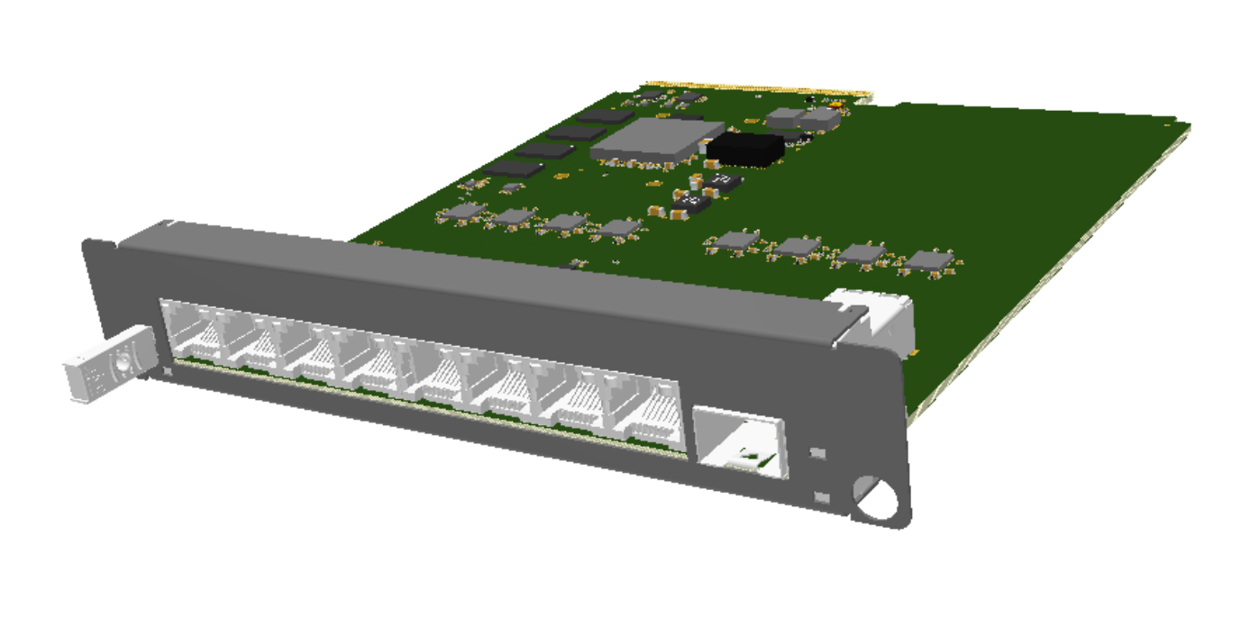
EtherCAT with NAT-AMC-ZYNQUP-ECAT

Slide 11
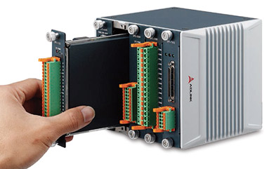
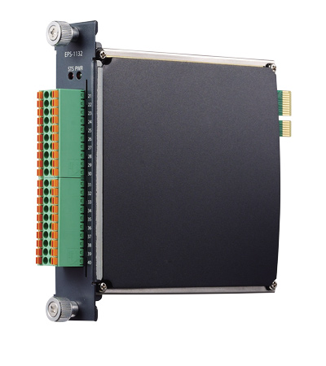
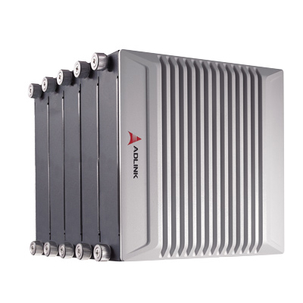
Fieldbus EtherCAT
EtherCAT Slave modules
EPS-9905 6-slot DIN rail mount with EPS-6000 EtherCAT bus coupler
EPS-1132 digital input 32 channel with SPI interface (sinking type)
EPS-2032 digital output 32 channel with SPI interface (sourcing type)
EPS-2308 relay output 8 channel and 8 digital input with SPI interface
EPS-3032 analogue input 32 channel (+/-10V) with SPI interface
EPS-3216 analogue input 16 channel (0~20mA) with SPI interface
EPS-3504 RTD input thermal 4 channel with SPI interface
EPS-4008 analogue output 8 channel with SPI interface
EPS-7002 pulse output motion controller 2 channel with SPI interface

Slide 12
MTCA in Industry
MTCA system (EtherCAT Master) controls Adlink EtherCAT slave (shown at DESY workshop in 2013)
MTCA system can support multiple camera for visual inspection (shown at various DESY MTCA workshops since 2014)
MTCA system can share data among different other systems (DDS) (MTCA workshop 2020 demo)
MTCA system can support GPGPU (powerBridge table top exhibition)
MTCA system acts as a dual rackmount PC for HIL testing (different root complexes)
MTCA system acts as a data logger in automotive (different root complexes)
MTCA system controls and monitors traffic crossing (monitors contact loops)
MTCA system is used in particle therapy systems

Slide 13
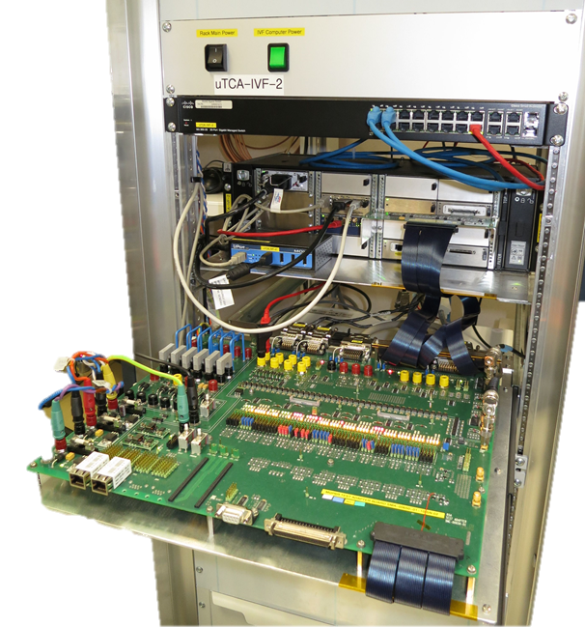
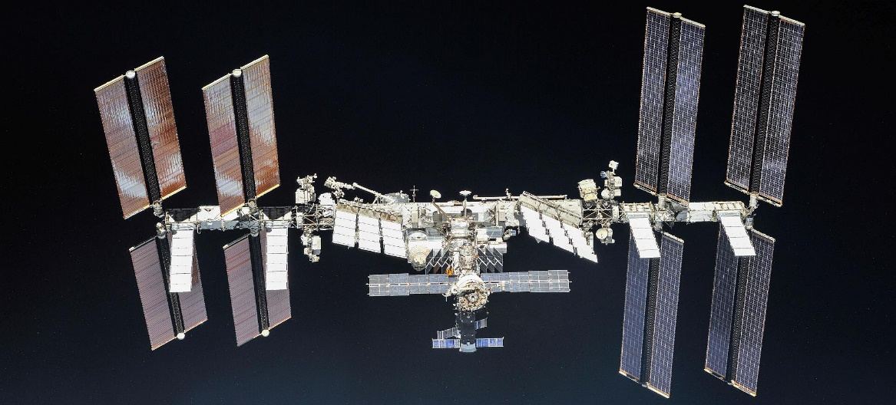
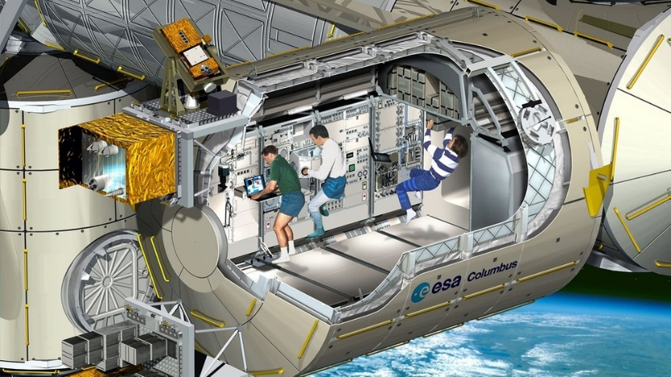
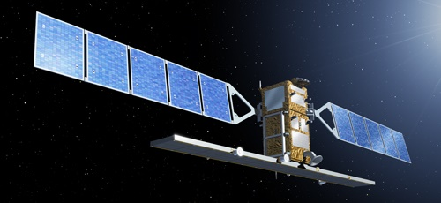
AeroSpace

Slide 14
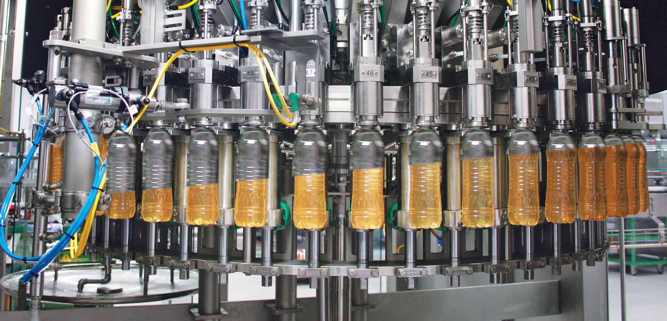
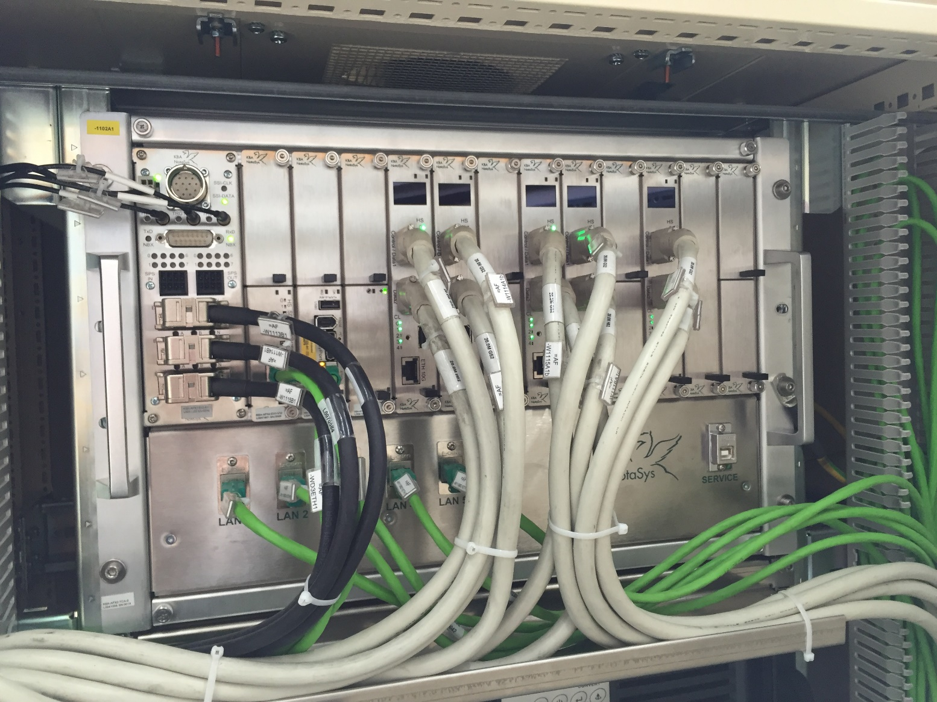
Industrial Automation

Slide 15
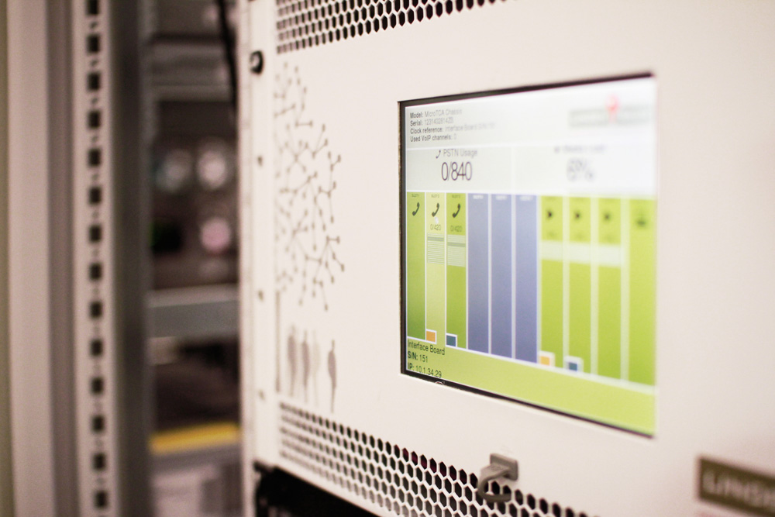
IT / Communication

Slide 16
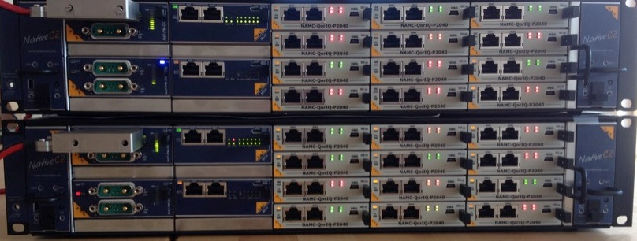
Transportation

Slide 17
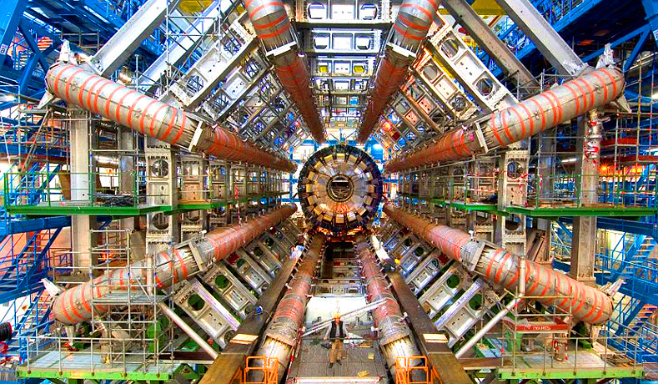
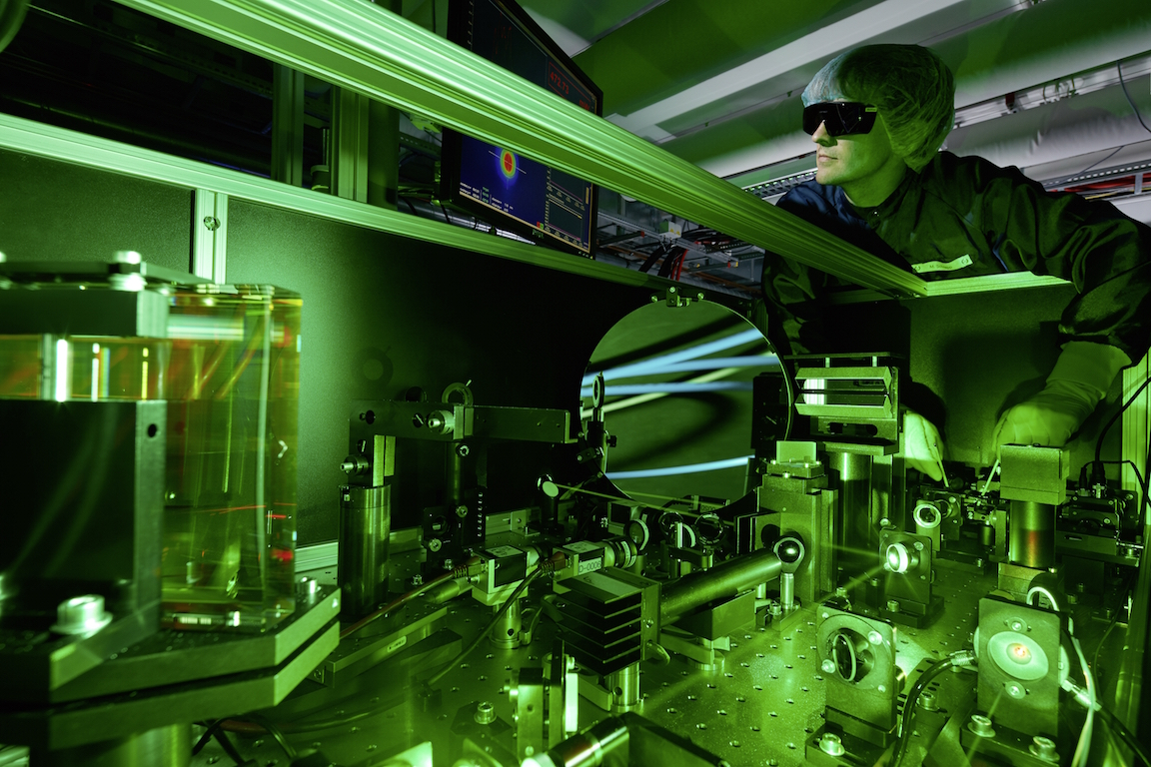
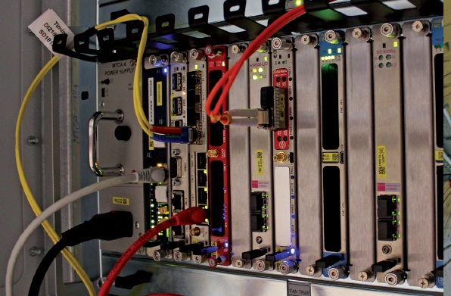
Research

Slide 18
Missing AMC products
XMC carrier (single and double)
M.2 carrier (up to 2 M.2,
2 x PCIe x4 oder 1 x PCIe x8, or maybe RAID?
Multiserial AMC module (RS232/422/485)
4/8/16 ports
A/D converter AMC cards +/-10V; 0-10V, Isolated
12-bit, 14-bit, 16-bit
Low cost FPGA AMC with adoption slot
Other fieldbusses?
USB?

Slide 19
Thank you
Thomas Holzapfel
Thomas.Holzapfel@powerbridge.de
Tel: +49-5139-9980-21
powerBridge Computer Vertriebs GmbH
Ehlbeek 15a
30938 Burgwedel, Germany
www.powerbridge.de

