Slide 1


µTCA Uplink Options

Slide 2
History: µTCA uplink concept 2006
In 2006 interconnect was defined around Telco Market requirements
  CPU centric design concept
  1 GbE up to 10 GbE/XAUI to external telco Server
Previous solution
  1 GbE via Base MCH
  10 GbE via Fat Pipe switch (MCH)
  1GbE/10GbE via CPU card
  Other uplink options via dedicated AMC’s / RTM’s/ NIC
Science, industry and Com Market have additional requirements
  More speed/bandwidth
  More protocols
  Trigger and timing requirements
Systems on Module (SoM) was a major game changer
Notes:
When we speak about the requirements for uplink option for MTCA systems to external system we have to review how everything began.
MTCA during the specification process before 2006 was defined around Telco application.
In this was also the interconnect between a MTCA system and the Telco Network was defined around the typical Telco Protocols.
TDMA mainly for Input and GbE ,XAUI / 10 GbE as uplink to Telco Network based on ATCA or Telco server.
At that time most application worked with dump I/O cards a CPU board for processing and than uplink via ETH to the network.
However the world has changed. MTCA has to serve beside Telco/Com Market also the industrial and Science market. With additional and different requirements.
Beside the need for more bandwidth different protocols the impact of intelligent I/O cards / system on Chip/ system on Module have been a major game changer for the requirements.

Slide 3
Current Status: µTCA uplink option today
General:
  Today MTCA is mainly used as data aggregator
    Uplink pre-processed data to server/Cloud etc.
      Time sensitive data transmissions are getting higher priority
    Uplink raw data
      In most cases not time sensitive
  1 GbE via base MCH
  10 GbE via fat pipe switch (MCH fat pipe)
  1GbE/10GbE via CPU or NIC card
  Uplink via PCIe
  Other uplink options via dedicated AMC’s / RTM’s
Notes:
General speaking, independent if we talk k about Science-, Industry- or Com- market. MTCA has its main home in data aggregation.
Analog Data in, pre-processing on AMC cards ( FPGA etc.) typical SoC/SoM concept.
For the CPU board we see :
- CPU used just for Control
- CPU for further processing
- No CPU at all ( ARM CPU on FPGA can handle the process
For timing ( here just timing for Data processing ) we can see
- real time processing and uplink
- store and forward (not time critical)

Slide 4
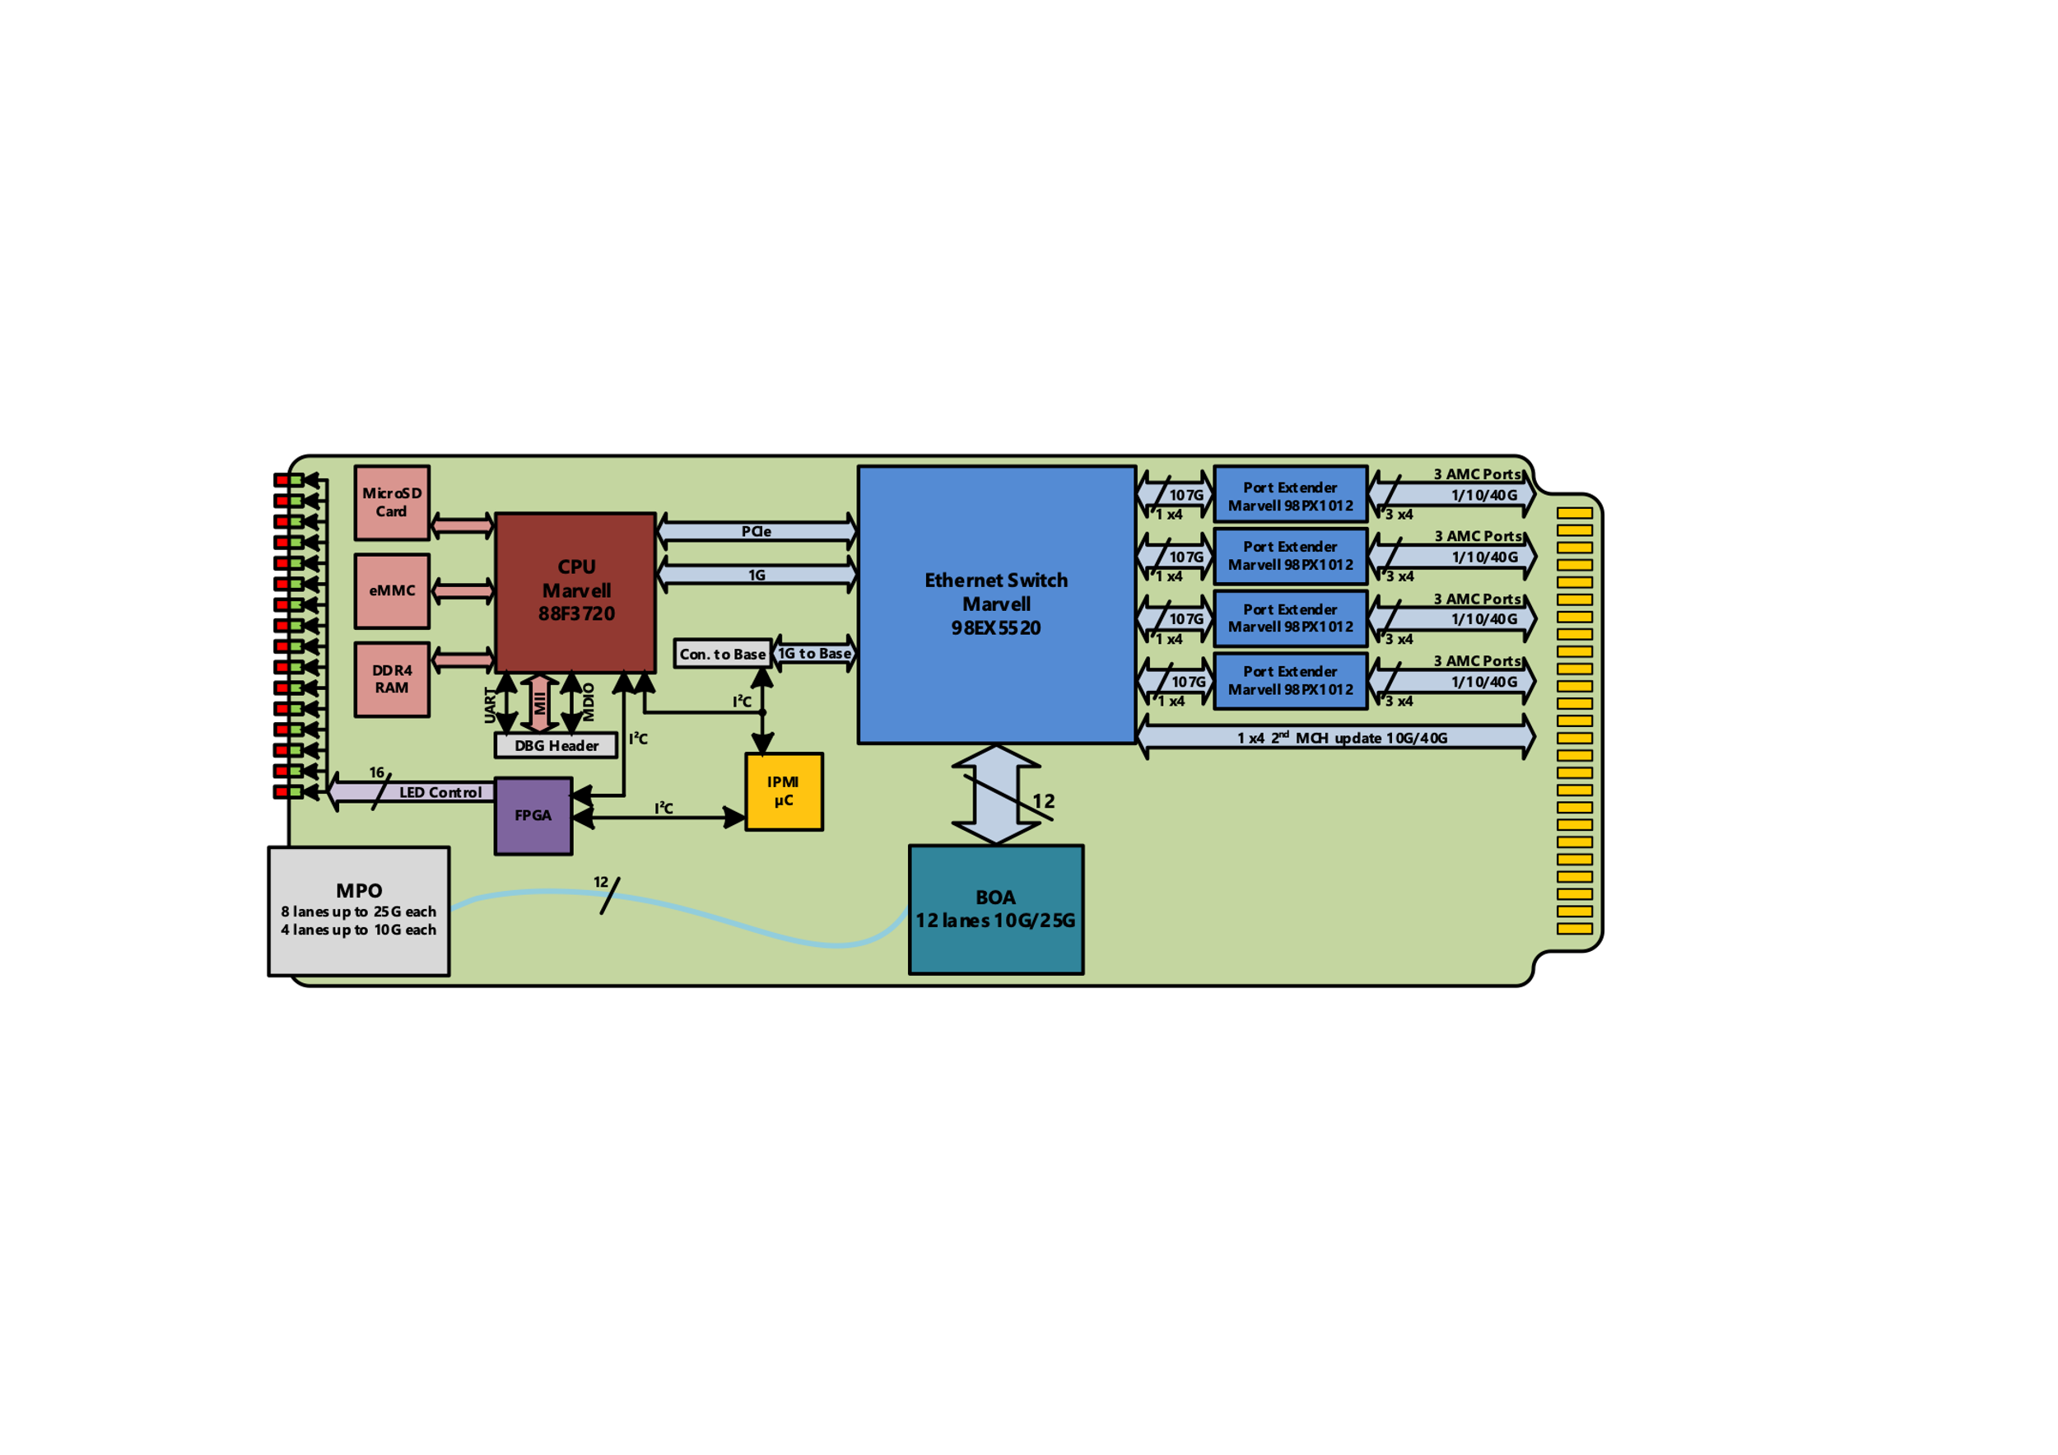
Uplink Ethernet via MCH
  Data aggregation from several AMC’s
    Typical SoM* setup with n* AMC’s in 1 Chassis
      Dedicated CPU card not required
      Or CPU for control path only
  10/40/100 GbE uplink
    1/10/40 GbE to backplane
    Old XAUI AMC
  Non time critical application
  Or real time ETH (TSN)
    Future IEEE1588 support
* System on Module

Slide 5




Uplink PCIe via MCH
Schematics
Different PCIe uplink options
MTCA seen as server extension
Transfer from / to
  Memory via DMA
  GPU memory via xDMA (DMA direct)
  NVMe via xDMA (DMA direct)
1 MCH to 1 PCIe card (1*x16)
1 MCH to 2 PCIe cards (2*x8)
2 MCH to 1 PCIe card (2*x8)
  Today PCIe Gen3 (16*8Gb = 128Gb)
  Future PCIe Gen 4-5 (256Gb-512Gb)
    2*16, lanes under evaluation for NG-MTCA
CPU
Memory
PCIe
NPCIe-Uplink-O
NVMe
GPU
External Server
https://nateurope.com/product/npcie-uplink-o/
Notes:
As soon as DMA is required to Server Memory, Grafik card Memory or a NVMe storage device is required this is a adequate solution.
Using already Fibre for the 2*x8 or 1*x16 connection makes this solution flexible in terms of distance.
Future option with PCIe uplink are under validation
- more lanes to support High end server
- versions with PCIe Gen 4 and 5 to allow up to 256 or 512 Gb per PEG port
- uplink function via a PCIe I/O card
Current limit are the max x4/x8 PCIe lanes via backplane FPGA-MCH (32Gb / 64 Gb) however here we will get more flexibility with NG-MTCA

Slide 6
Uplink Ethernet via CPU cards
Today
  CPU card used for processing/ pre-processing
    Limited processing power 24/40/60W TDP due to AMC power envelope
    Uplink option via 1 or 10 GbE
    ➔limited processing power combined with limited uplink speed
Future
  Server class CPU AMC used for Processing
  CPU up to 200 W (Server class) NG-MTCA
  24/32+ PCIe lanes available (Gen3-5)
  Min x8 PCIe usable for Uplink via ETH Controller
    64 Gb based on PCIe Gen 3 x8
    128 Gb based on PCIe Gen 4 x8
    256 Gb based on PCIe Gen 5 x8
    Option for RTM (storage or other I/O functions)
NAT-AMC-COMex-V2
Notes:
Uplink via a CPU card is required and usefull when the CPU is used for Processing / preprocessing inside the MTCA system
current limitation is the available TDP power budget due to current MTCA spec.
CPU in is max 32 -64 Gb via backplane therefore the realistic uplink is limited to 1/ 10 GbE
In the future this situation will change.
we will see in MTCA –CPU cards from 20W via 80W up to 200 W TDP This means server class CPU’S
this means we can use x8 PCIe Lanes for uplink to external server
Ratio up to 16 lanes in via backplane and up to 8 lanes for upstream
16 Lanes to backplane are important for smaller systems with eg. 2 FPGA cards connected directly to CPU card.
Typical application are here SDR and Vision systems

Slide 7
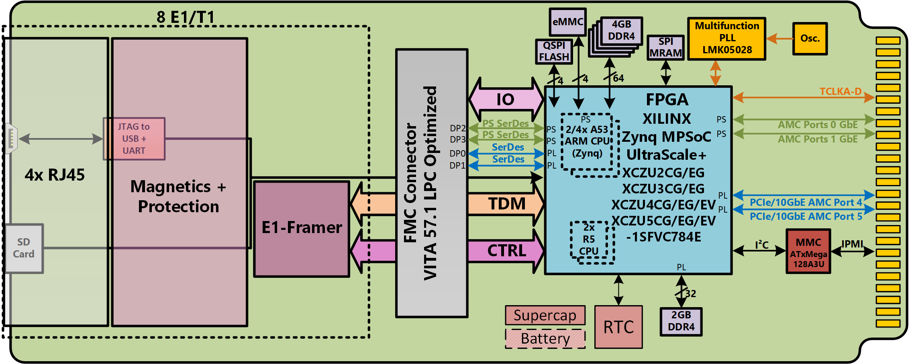
Uplink Ethernet via NIC/FPGA Card
under development
2023 release
Uplink FMC

Slide 8
Summary Uplink Options
Uplink 2* (10/25/40/100/ ff. ) Ethernet via MCH
  Data aggregation from several cards
  Typical SoM (System on Module) setup
  No (x) DMA required
Uplink PCIe x8/x16 PCIe via MCH
  Data aggregation from several cards
  (x)DMA required
Uplink (1/10/25/40/100)GbE via CPU card
  CPU for pre-processing is required anyway
  CPU as standalone AMC or RTM to MCH
Uplink via NIC cards (10/40/100) GbE
  When only x1 -x8 PCIe on backplane required
FMC
Notes:
So far we discussed uplink to server in the second part of this presentation Thursday morning we will cover the requirements for deterministic and reliable Networks
Which means clock, timing

Slide 9
Thank you very much!
Herbert Erd
Strategic Business Development Manager
herbert.erd@nateurope.com
Tel: +49 228 965 864-42
Mob: +49 172 521 6162
or
Heiko Koerte
VP Sales & Marketing
Heiko Koerte@nateurope.com
Tel: +49 172 245 2022
N.A.T. GmbH
Konrad-Zuse-Platz 9
53227 Bonn
Germany
www.nateurope.com

