Slide 1
Beam Position Monitoring using MicroTCA for Diamond-II
MTCAWS – DESY, Hamburg
Laurence Stant
December 7th, 2022

Slide 2
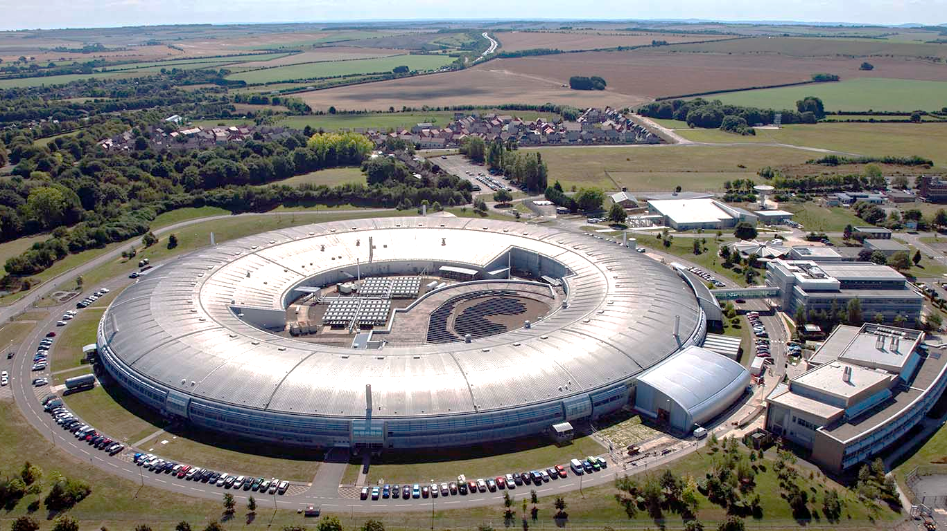
Agenda
Diamond-II Upgrade
BPM System Requirements
BPM Cell Overview
EBPM Design
XBPM Design
Communication Architecture
Supporting Work
Conclusion

Slide 3
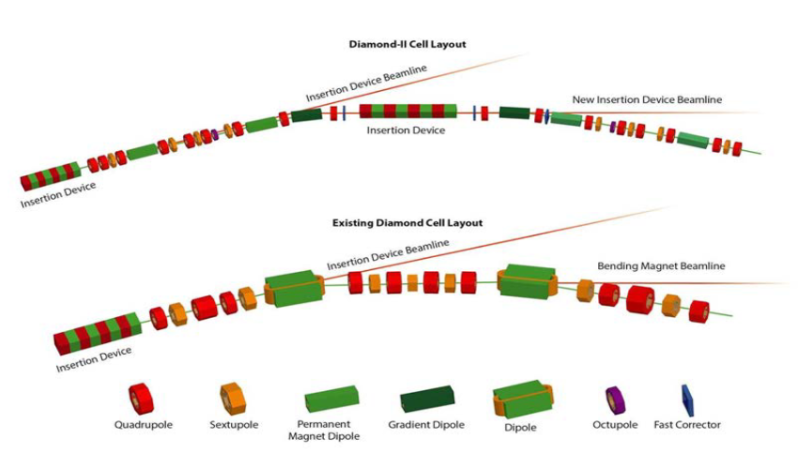
Diamond-II Upgrade to 4th Gen. Light Source
DBA:
Replacing entire machine at Diamond Light Source.
Energy increased from 3 to 3.5 GeV.
Horizontal emittance reduced from 2700 to 160 pm rad.
RF @ 499.499 MHz
Double Triple Bend Achromat cells.
24 new “mid-straights” available for ID positions: 5 new beamlines and upgrades to bending magnet beamlines.
M-H6BA (DTBA):

Slide 4


BPM System Requirements
https://www.diamond.ac.uk/dam/jcr:ec67b7e1-fb91-4a65-b1ce-f646490b564d/Diamond-II%20Conceptual%20Design%20Report.pdf
Lower emittance requires improved FOFB.
EBPMs and XBPMs included in FOFB.
Data rate must increase from 10 to 100 kHz.
252 SR EBPMs (11/12 per cell).
60 XBPMs.
Short-term motion (<1 second):
  Commissioning (0.3 mA): <130 nm/√Hz
  User beam (300 mA): <2 nm/√Hz
Long-term motion (<1 wk): <1 µm pk—pk
In-house design chosen due to sufficient technical resource and concern over legacy COTS capability (in 2020) with new data rate requirement.
MicroTCA chosen for integrated gigabit backplane, COTS availability and longevity (15 years support from 2027).
https://dlsltd.sharepoint.com/:b:/s/DiamondCommunications/EeZYURxeZQ9BsjSXqsWGd7kBbDWvOjFNAhjiD1mK-N7KIg?e=D9coh2

Slide 5
BPM Cell Overview
electrons
Storage Ring
Frontend Support
Primary
EBPM
Standard
EBPM
Dipole
Beamline
x-rays
Power Supplies
electrons
Pilot Tone Generator
ID
4
XBPMs
Girder
(Part)
MicroTCA Crate
Pilot tone
AFE
AFE
AFE
64ch of
EBPM ADC
(16 EBPMs)
Floor
Machine Timing
EVR
24ch of
XBPM ADC
(6 XBPMs)
EPICS Network
FOFB Network
Control & Instrumentation Area (CIA)
Inside the Vault

Slide 6
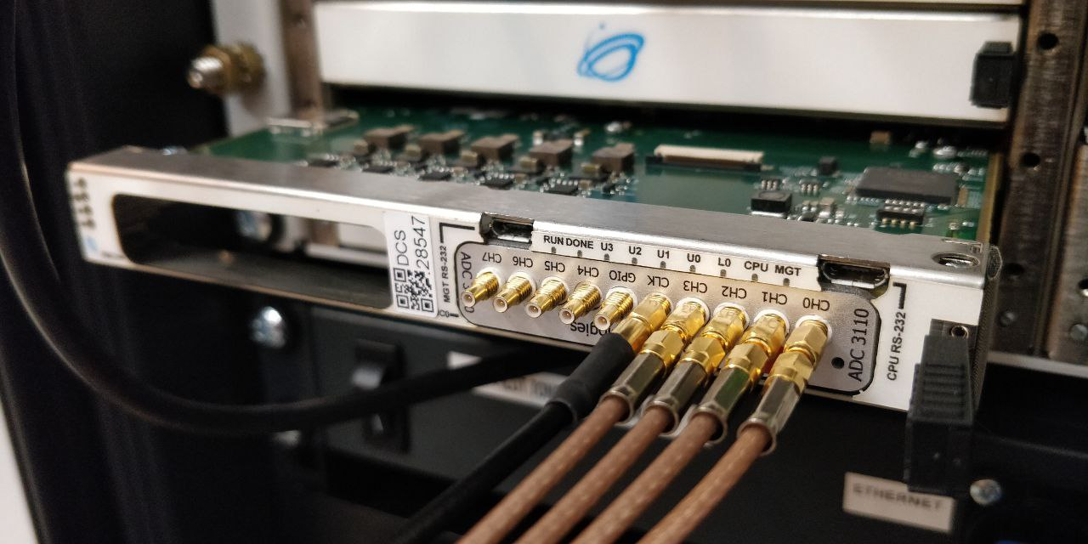
EBPM Design
Button pickups in the storage ring generate 500 MHz waveforms which are amplified and filtered by an analogue front end and then digitised on FMC modules hosted on an AMC carrier.
The front end also injects a pilot tone signal at a close frequency and this compensates out system gain and phase variations. This is extracted in the digital processing.
We have planned to use IOxOS ADC3110 8ch 16-bit/250 Msps FMCs on a suitable dual AMC carrier.
We are currently testing on a Vadatech AMC561 with a Virtex 7 690T carrier.
We will be testing on a prototype IOxOS IFC_1412 carrier with Ultrascale+ FPGA.
The high density of fast ADCs (8 per AMC) is sensitive to the carrier’s power implementation.

Slide 7
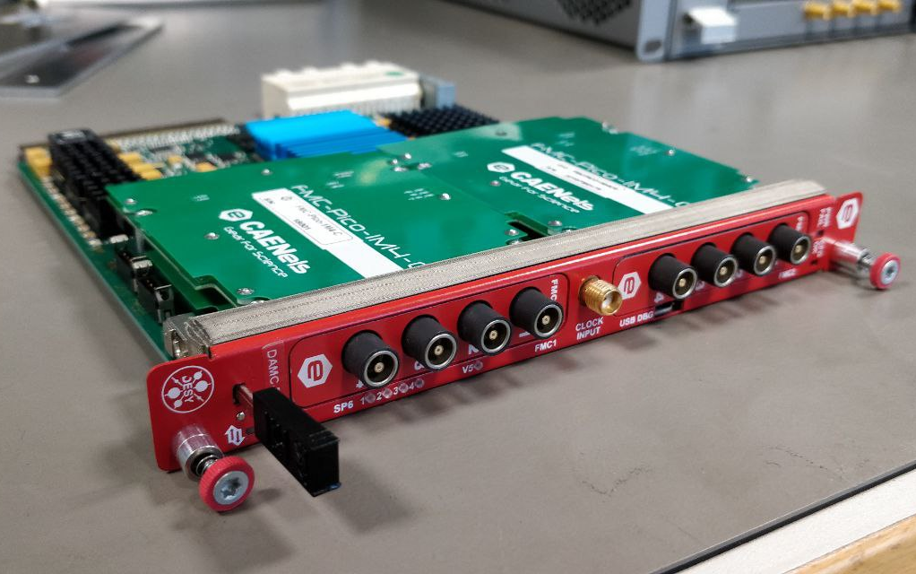
XBPM Design
Electrical currents are induced in metallic blades placed close to the x-ray beam. These are connected to specialised digitizer FMCs and are hosted on an AMC carrier.
We have planned to use CAENels FMC-PICO-1M4-C6 4-ch 20-bit 1 MSPS pico-ammeter FMCs.
We are currently testing on a CAENels DAMC-FMC25 AMC carrier.
We will be testing with the same IOxOS prototype carrier as the EBPMs for standardisation.

Slide 8
Communication Architecture - MicroTCA
A single 12-slot crate handles an entire cell of EBPM and XBPM diagnostics.
Four EBPM dual-FMC carrier cards.
Up to three XBPM dual FMC carrier cards.
Dual MCH: One for PCIe, one for FOFB GbE.
Event receiver card, CPU card.
Machine protection from custom Rear Transition Module (RTM).

Slide 9
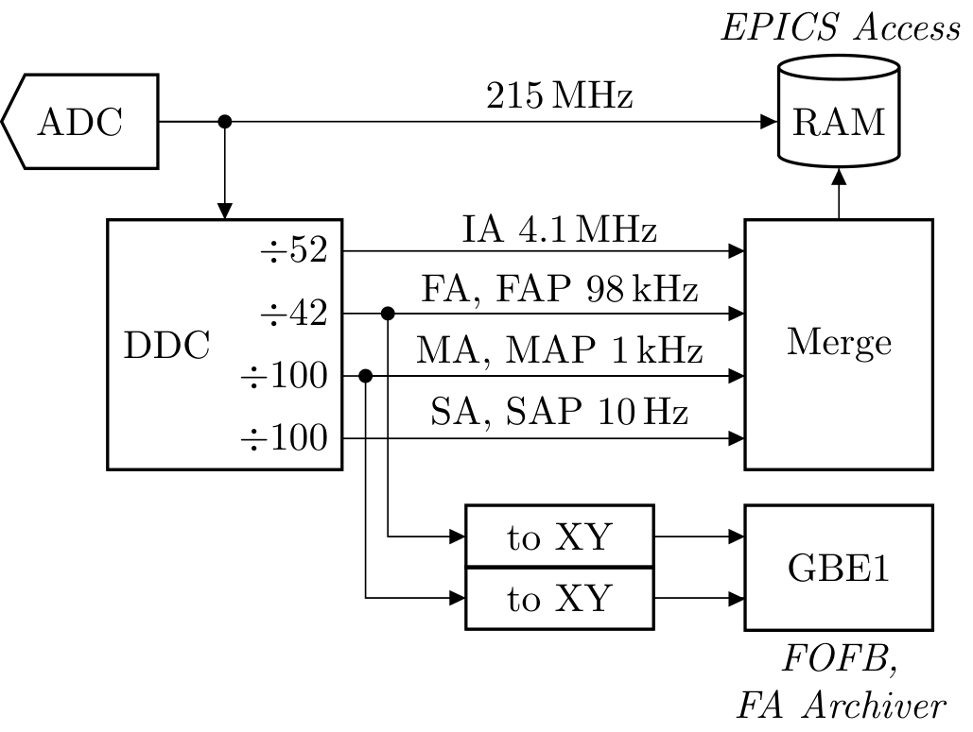
Communication Architecture - Streams
215 Msps ADC streamed to RAM.
Downconverted with 70 MHz IF and then downsampled into streams:
  4.1 MHz intermediate acquisition
  98 kHz fast acquisition (+ pilot)
  Used for FOFB and fast archiver
  1 kHz medium acquisition (+ pilot)
  Used as a new archiver source
  10 Hz slow acquisition (+ pilot)

Slide 10
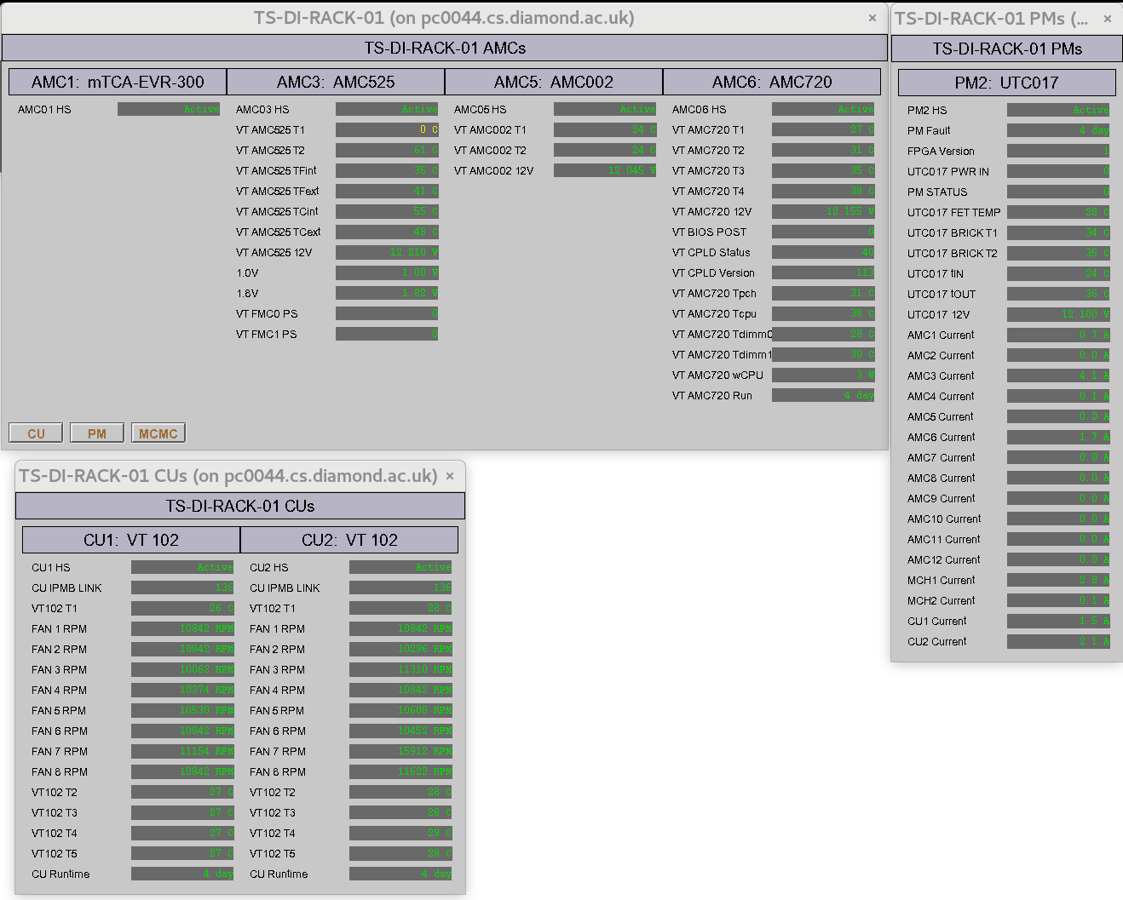
Supporting Work – EPICS MTCA Management
We have developed IOC code to enumerate and poll FRU data via python-softioc and python-ipmi.
Auto generates EDM screens (could extend for CSS).
Easy to use, just give it an MCH IP address.
This is available as a Github repository at: https://github.com/EmilioPeJu/epicsmonmtca

Slide 11
Supporting Work – OpenMMC STM32 Port
For Diamond AMC capability we have been refactoring and adding to the CERN OpenMMC STM32 porting effort from Adam Wujek and Tomasz Wlostowksi.
We have a release soon to be added as a branch of the upstream.
We developed a Python MCMC (MCH) simulator which connects to an MMC under test via an Arduino for USB <> IPMB-L and hardware-in-the-loop simulation for regression testing of IO and interrupt/event handling.
Code at: https://github.com/EmilioPeJu/MMCTester
Use latest python-ipmi as we had to submit some fixes for better support!

Slide 12
Conclusion
The Diamond-II upgrade involves a largely in-house BPM platform, both for EBPM and XBPMs.
The MicroTCA platform has been chosen for data acquisition and processing due to the extensive COTS availability, established community and experience of good reliability from previous projects.
Full cell deployment is now being tested for reliability and interoperability.
More details in IBIC 22 paper: https://ibic2022.vrws.de/papers/mo3c2.pdf

Slide 13
Thanks
With thanks to my co-authors:
Michael Abbott, Chris Bloomer, Lorraine Bobb, Emilio Juarez-Perez, and Austin Rose.
We would like to thank Dr. Guenther Rehm of Helmholtz-Zentrum Berlin for initial development work on this project.
…and thank you for your attention!

