Slide 1
Basic-AMC – A Cost-Effective Module for Divertor Bolometer Diagnostics

Slide 2
What is the „Basic-AMC”
(and why you
might want it)
A double-width AMC module with PCI Express x2
Low dependency on special components
A minimal hardware platform for „simple” FPGA designs
RTM support, front-panel GPIO
Easily upgradeable FPGA
MMC and board features customized for your application, e.g.:
Low-noise power supply for RTM
http://thedoghousediaries.com/5627

Slide 3
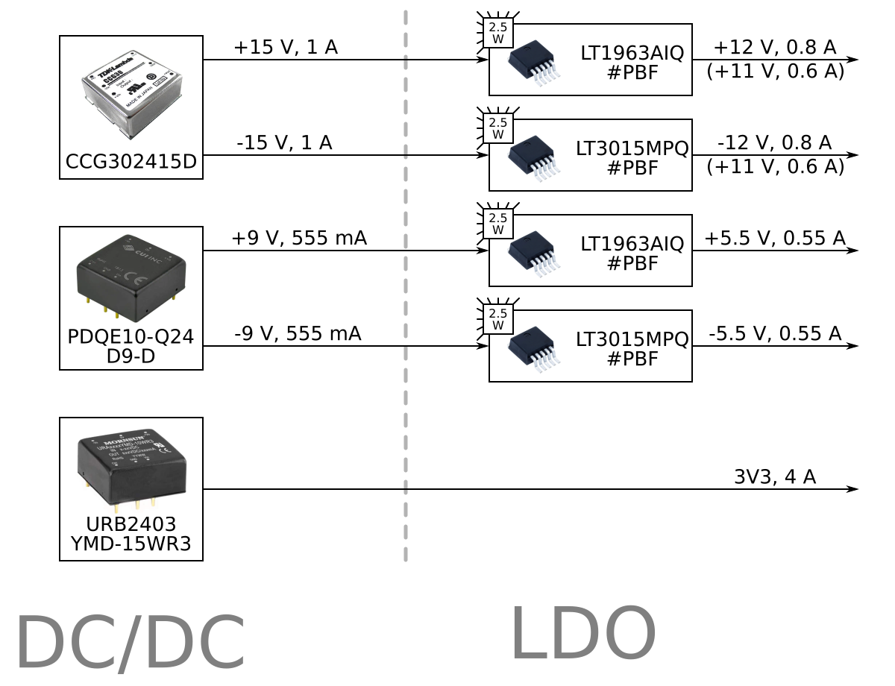
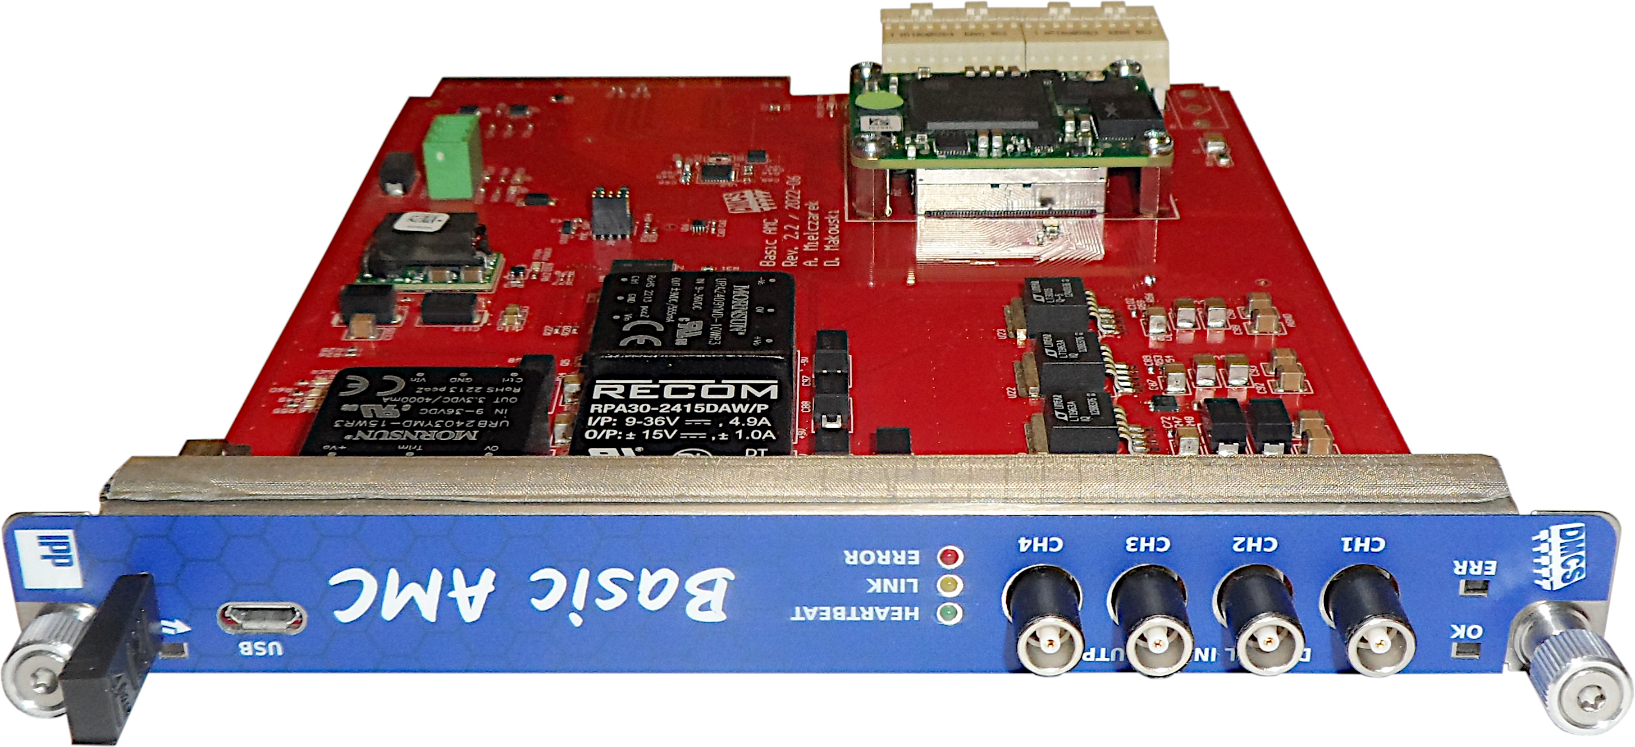
The Module Overview
Edge connector
System area
User area
Debug UART over USB
LVCMOS I/O

Slide 4
Hosted FPGA Modules
Feature | Basic-AMC (2020) | Basic-AMC V2 (2022)
FPGA module standard | TRENZ 3x4 (200 pins) | TRENZ 4x5 (260 pins)
Selected module and its features | TE0714 (104 EUR) XC7A50T QSPI FLASH | TE0712 (280 EUR) XC7A100T QSPI FLASH 1 GB DDR Memory SI5338 PLL Ethernet PHY 1-Wire EEPROM
FPGA migration options | Only migration to XC7A35T | 12 alternative modules available

Slide 5
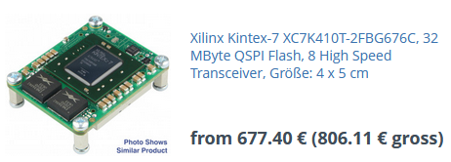
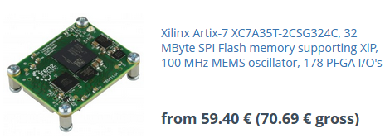
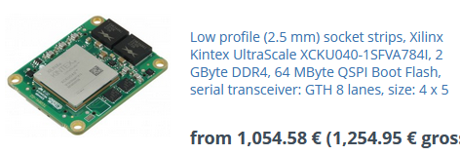
TRENZ FPGA Modules

Slide 6
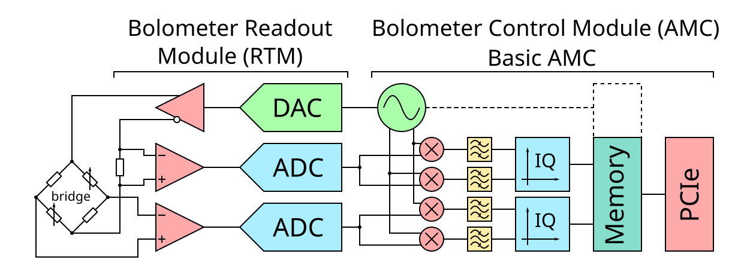
The Divertor Bolometer Use Case

Slide 7
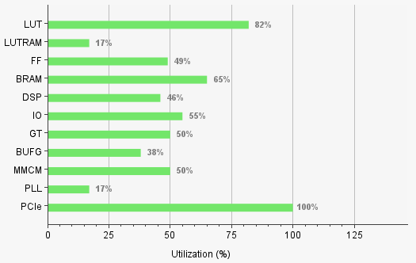
FPGA Firmware for Divertor Bolometer
PCIe gen.2 x2 (3x DMA)
DDR3 memory interface
4 CORDIC computers
4 arbitrary function generators
16 quadrature modulators
32 FIR filters of 480 taps each
Many diagnostic features
Firmware upgrade

Slide 8
Basic-AMCv2 now support Firmware Update via IPMI

Slide 9
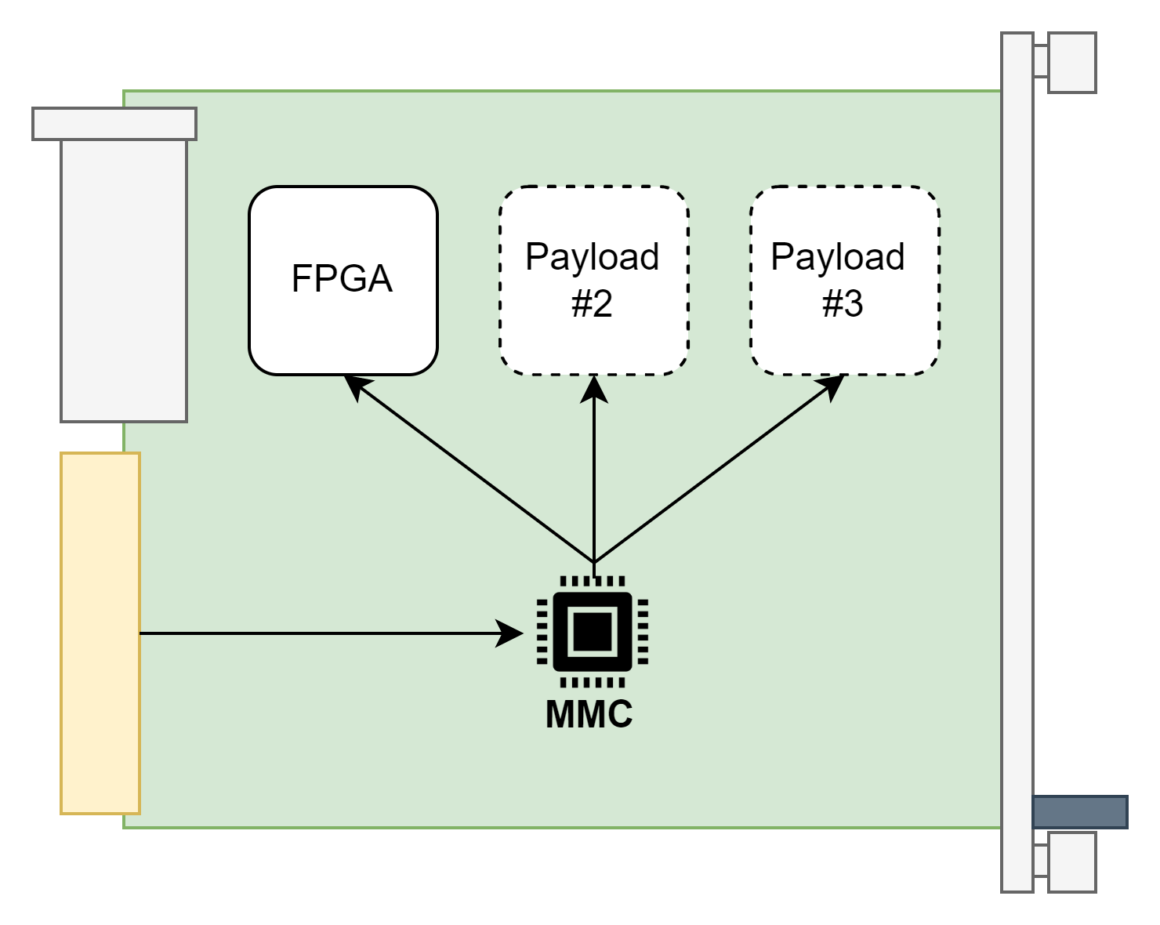
Firmware Update Process
Firmware on the AMC board can be updated remotely without any programmer connected to the PC
MCH
Update over IPMI
Remote PC

Slide 10
HPM.1 Support
Ask for a payloads that can be upgraded
Control of the upgrade process
Firmware activation, test and rollback

Slide 11
Basic-AMCv2 MMC Memory Structure
Cold Reset
BOOTLOADER
BOOTLOADER
Start the application
#1 Firmware
(Active)
#1 Firmware
(Active)
#2 Firmware
(Empty space)
#2 Firmware
(Empty space)

Slide 12
MMC Update Process
BOOTLOADER
#1 Firmware
(Active)
Firmware update request
IPMI
HPM.1
Upload and store new firmware
Remote PC with access to the MCH
#2 Firmware
Storing a new program…

Slide 13
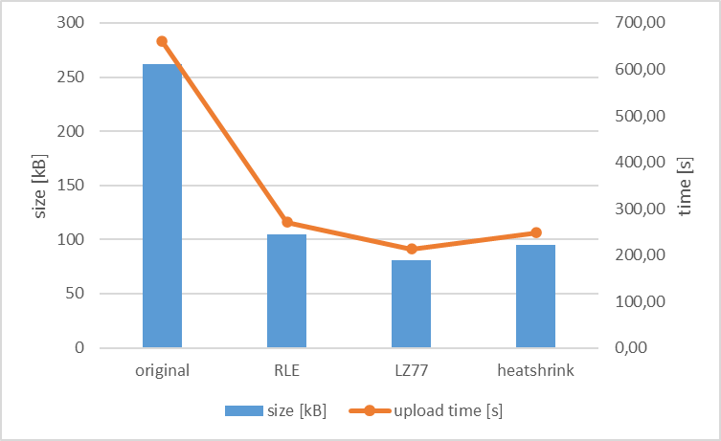
MMC Firmware Compression
LZ77 algorithm was chosen for firmware compression
73%
This yields a
shorter update process

Slide 14
MMC Update Process
BOOTLOADER
BOOTLOADER
Upload process finished
#1 Firmware
(Currently active application)
#1 Firmware
(Inactive application)
Switch application and restart
#2 Firmware
Just received firmware
#2 Firmware
(Currently active application)

Slide 15
MMC Firmware Rollback
BOOTLOADER
BOOTLOADER
BOOTLOADER
Upload process finished
#1 Firmware
Inactive
#1 Firmware
Inactive
#1 Firmware
Active
#2 Firmware
Faulty firmware
#2 Firmware
Faulty firmware
#2 Firmware
Faulty firmware

Slide 16
AMC Payload Firmware Update via HPM.1
Request to update FPGA firmware
MMC
With
HPM.1 support
Program FPGA memory via SPI
Remote PC with access to the MCH
FPGA

Slide 17
Conclusion
If there's something weird And it don't look good Who you gonna call? (Ghostbusters)
When in need of platform for:
Cost-effective RTM carrier
Unusual data concentrator
Process control over PCIe
Timing, event or all-purpose IO
New modules are under design
Contact us
We will customize the Basic-AMC for you
Department of Microelectronics
and Computer Science (DMCS)
+48 42 631 27 20
secretary@dmcs.pl
Lodz
University
of
Technology

