Slide 1


Timer & Timing for MTCA
Notes:
In my first presentation we spoke about inteconnect between MTCA ad the external world using ETH and in some cases PCIe.
ETH is the main protocol between systems and that is what we will support today and even more in the future.
But even more important
➔ Deterministic and reliable ETH Networks are the key requirements for the future. ⬅
Content:
Timing aspects such as precision, synchronization and distribution are more and more getting critical, not only for applications in science but also for those in industry. Beside application specific precision timing modules the global approach through IEEE1588 is getting more and or attention.
The presentation will highlight the clocking options for a new (NG-MTCA ready) MCH Clock module providing IEEE1588 support and will compare these to dedicated precision timer modules. Also aspects such as the requirements for the connected AMCs and the different options for external clocks and triggers are covered.
Summary:
Precise and distributable timing is important for many applications in science and industry.
The presentation will provide a brief comparison of the timing options available for different requirements and precision.
Content:
Timing aspects such as precision, synchronization and distribution are more and more getting critical, not only for applications in science but also for those in industry. Beside application specific precision timing modules the global approach through IEEE1588 is getting more and or attention.
The presentation will highlight the clocking options for a new (NG-MTCA ready) MCH Clock module providing IEEE1588 support and will compare these to dedicated precision timer modules. Also aspects such as the requirements for the connected AMCs and the different options for external clocks and triggers are covered.
Summary:
Precise and distribtable timing is important for many applications in science and industry.
The presentation will provide a brief comparison of the timing options available for different requirements and precision.
Content:
Timing aspects such as precision, synchronization and distribution are more and more getting critical, not only for applications in science but also for those in industry. Beside application specific precision timing modules the global approach through IEEE1588 is getting more and or attention.
The presentation will highlight the clocking options for a new (NG-MTCA ready) MCH Clock module providing IEEE1588 support and will compare these to dedicated precision timer modules. Also aspects such as the requirements for the connected AMCs and the different options for external clocks and triggers are covered.
Summary:
Precise and distribtable timing is important for many applications in science and industry.
The presentation will provide a brief comparison of the timing options available for different requirements and precision.

Slide 2
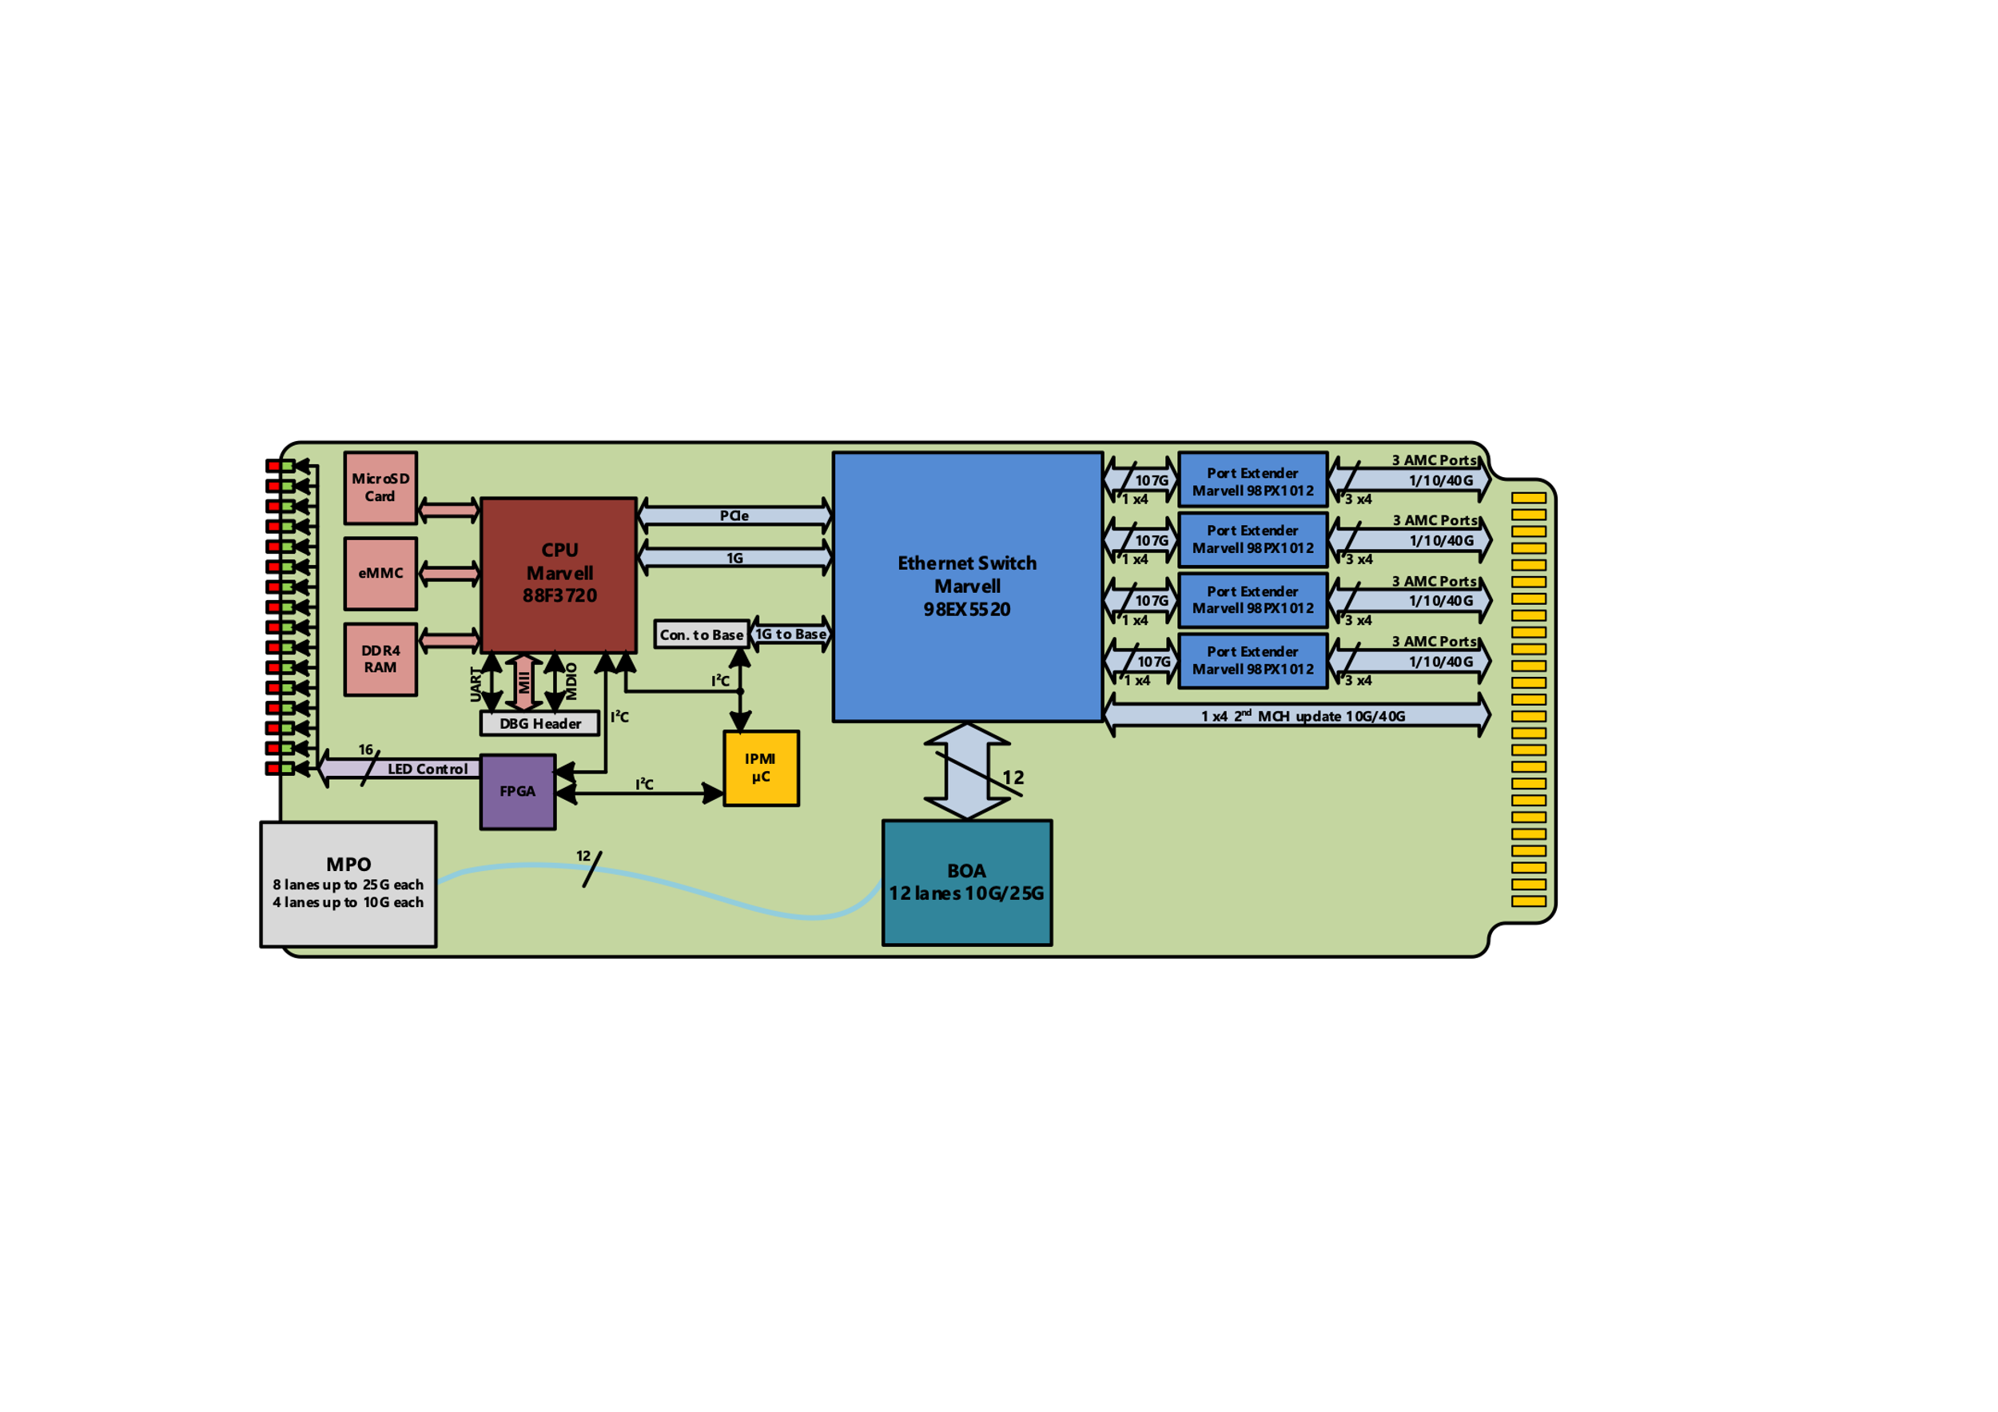

Summary Uplink Options
Uplink 2* (10/25/40/100/ ff. ) Ethernet via MCH
  Data aggregation from several cards
  Typical SoM (System on Module) setup
  No (x) DMA required
Uplink PCIe x8/x16 PCIe via MCH
  Data aggregation from several cards
  (x)DMA required
Uplink (1/10/25/40/100)GbE via CPU card
  CPU for pre-processing is required anyway
  CPU as standalone AMC or RTM to MCH
Uplink via NIC cards (10/40/100) GbE
  When only x1 -x8 PCIe on backplane required
FMC
Notes:
So far we discussed uplink to server in the second part of this presentation Thursday morning we will cover the requirements for deterministic and reliable Networks
Which means clock, timing

Slide 3
Comparison of sync. requirements
Protocol | Sync Accuracy | Interconnect | Clock Requirements
NTP | 1 ms – 10 ms | ETH, LAN or WAN | HW/SW for server and client
IRIG | 1 µs – 10µs | Coax Cable | HW Master & slave
IEEE1588 | 20 ns – 100 ns | ETH, LAN | HW Master & slaves
WR | < 1 ns | ETH, LAN | HW
Exp: 100 m fibre cable my have 20 ns delta between RX and TX
IEEE1588 Rev 2 from 2019 has incorporated WR requirements
Notes:
The White Rabbit Network is based on existing IEEE standards while extending these standards in a backward-compatible way if needed to meet sience requirement.
Today timing requirements are in the range of nano- or even pico-sec
MTCA has also support application from mil-sec down to pico-sec
PTP implementation is requires special hardware
Close to PHY ( between MAC and PHY)
ged Local Area Network with VLANs (IEEE 802.1Q) that uses Ethernet (IEEE 802.3) to interconnect switches and nodes, and the Precision Time Protocol (PTP, IEEE 1588-2008) to synchronise them.

Slide 4
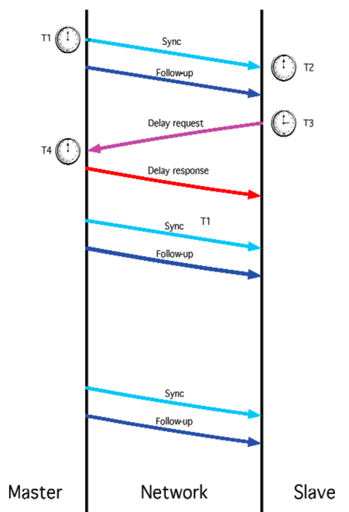
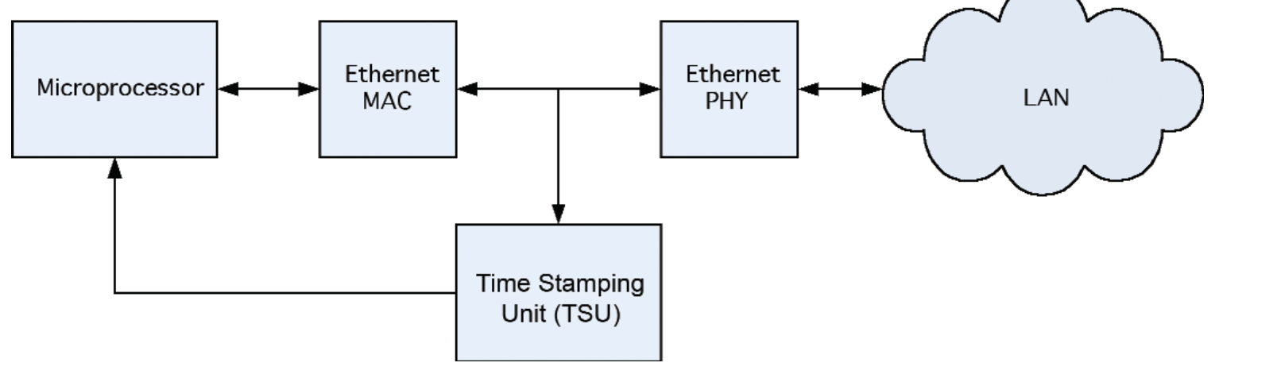
HW requirements for PTProtocol stamping
Notes:
In Industry and Telco we are relative save with IEEE1588
1,5 µs was the requirement for 4G networks
20 ns is the current requirements for 5 G networks
ITU-T G8271.1 we have now a requirements for a 21 node network with a max sync requirement of 420 ns
In this respect: when it comes to time sync, the science word is at the fore front. And even with IEEE1588 R2 the WR requirements are integrated.
The good news this requirement for Time stamp intrusion is ready standard for available chips in industrial/embedded systems.
The price tag critical in the past has disappeared
For us as a embedded Solution provider we have to ensure that step by step on all new products at least IEEE1588 and or WR has to be supported.

Slide 5
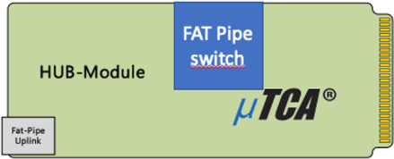
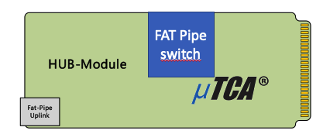
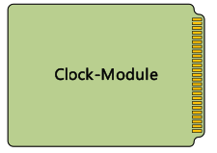
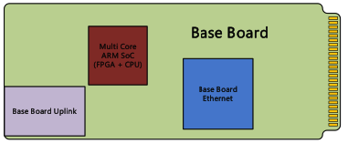
NAT-MCH-G4 - building blocks
Fat-Pipe HUB Modules
  1/10/40 GbE
  PCIe Gen 3-5
  Fat-Pipe Uplink options 40/100GbE
Clock-Module
  IEEE 1588 support
  Optional OXCO
Base Board
    Multi Core ARM SoC
    Base Board ETH 10GbE
    Base Board Uplink 10/40 GbE

Slide 6
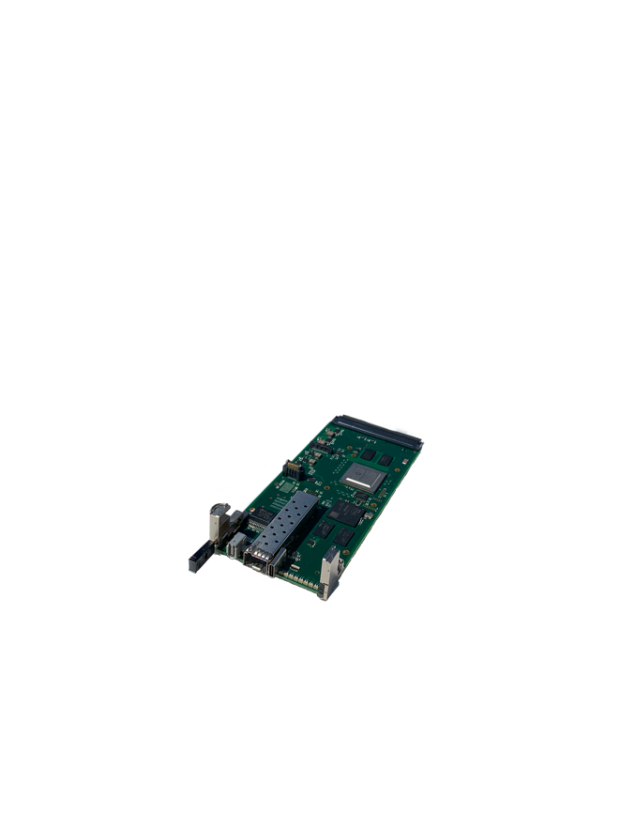
NAT-MCH-G4 – new base board (with IEEE1588 support)
Notes:
Same concept as you have seen with the CPU board, support 1, 2.5, 10 GbE on port 1&2 or Fabric A
Uplink with 25 GbE to the HUB modules with the fat pipe switches
Small FPGA with embedded ARM cores as the management engine
Space for an OXCO in combination with clock module
Front
with Clk interface
Same PCB but different stuffing options for uplink to external systems

Slide 7
NAT-MCH-G4 – new base board (clock requirements)
3 uplink options
  #1: SFP(-DD)
    1-25G
    Optical / Copper via SFP
  #2: ix
    1-10G (10GBASE-T)
    Copper
  #3: RJ45
    1-10G (10GBASE-T)
    Copper

Slide 8
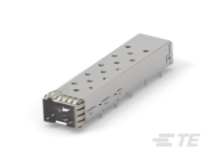
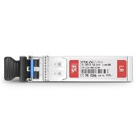
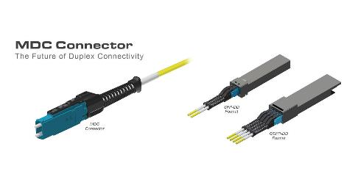
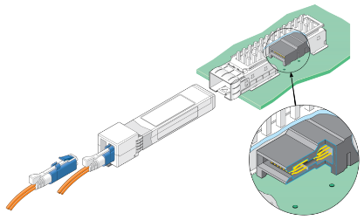
NAT-MCH-G4 – new base board
#1
Uplink option #1: SFP-DD
  Data rates up to 200 Gbps via two channels
  Backward compatibility to existing SFP receptacles
  Large variety of existent transceivers
  Issue:
    No SFP(+) with PTP support
    PTP in Switch implemented)
Notes:
Double Densitiy = two rows of electrical pins

Slide 9
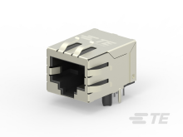
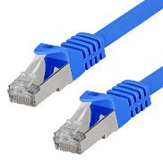
NAT-MCH-G4 – new base board
Uplink option #3: RJ45
  Well established interface standard
  Data rates up to 10G (same as ix)
  Optional: One iX or RJ45 is used for Clock I/O
#3

Slide 10
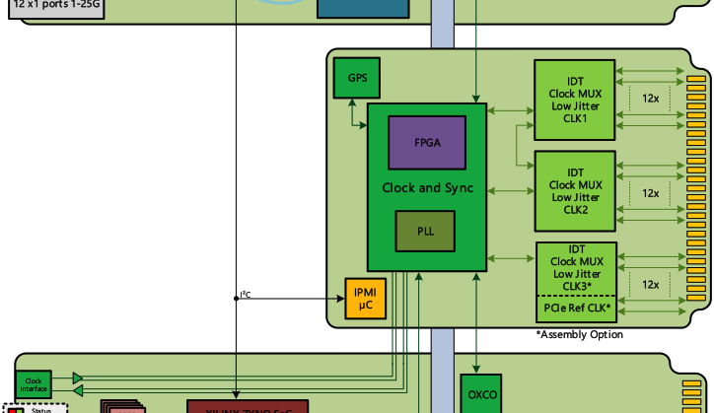
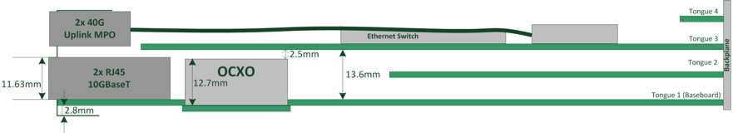
NAT-MCH-G4 – Clock Module
PLL synthesizer and dedicated FPGA
  several options of switching
  Several option for clock manipulation
    IEEE 1588 Support
    Synchronous Ethernet Support
    2 low-Jitter clock mux: CLK1 and CLK2 to each AMC
    2 low-Jitter clock mux: CLK3 or FCLK
    Optional GPS via front SMA connector
    Optional OCXO on base board

Slide 11
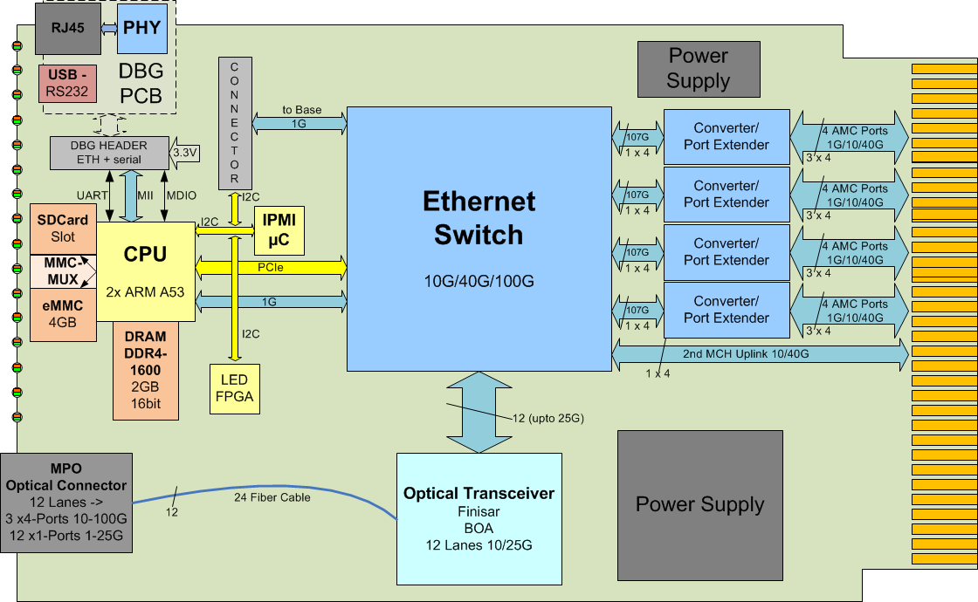
NAT-MCH-G4 – 40GbE/XAUI fat pipe hub/switch

Slide 12
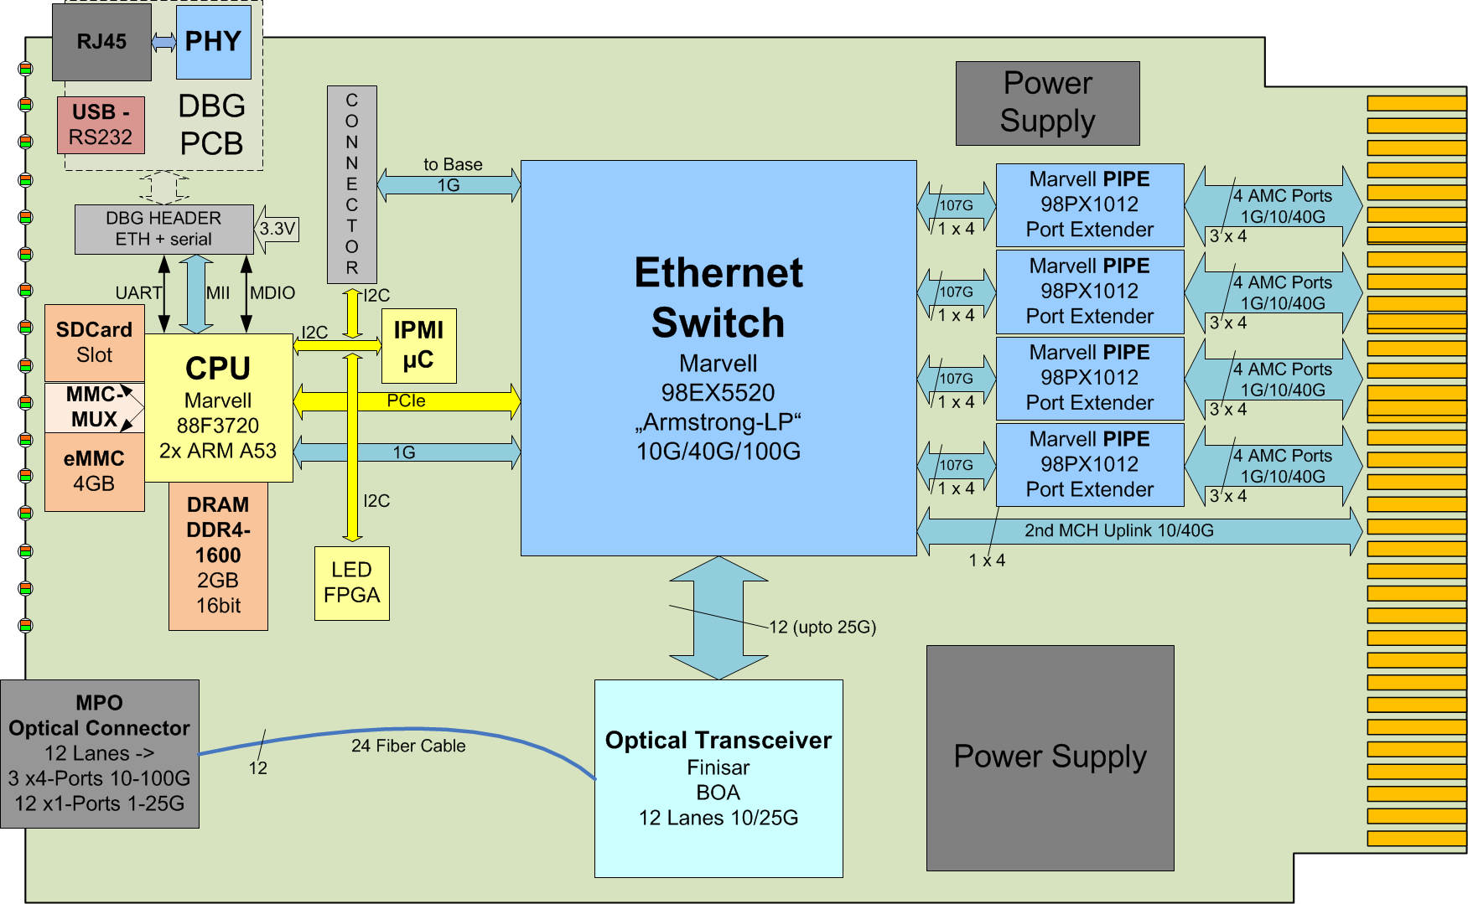
Uplink GbE via MCH
  Data aggregation from several AMC’s
    Typical SoM setup
      Dedicated CPU card not required
      Or CPU for control path only
  Issue:
  - No SFP(+) with IEEE1588 support
  - PTP stamping in Switch
  - wire prep. for SFP cage
  - BOA alternative under eval.

Slide 13
Uplink Ethernet via CPU cards
CPU clocking
  CPU board already IEEE1588 support
  No SFP(+) with IEEE1588 support
    Wire prepared
    Interim ETH controller for stamping
NAT-AMC-COMex-V2
Notes:
Uplink via a CPU card is required and usefull when the CPU is used for Processing / preprocessing inside the MTCA system
current limitation is the available TDP power budget due to current MTCA spec.
CPU in is max 32 -64 Gb via backplane therefore the realistic uplink is limited to 1/ 10 GbE
In the future this situation will change.
we will see in MTCA –CPU cards from 20W via 80W up to 200 W TDP This means server class CPU’S
this means we can use x8 PCIe Lanes for uplink to external server
Ratio up to 16 lanes in via backplane and up to 8 lanes for upstream
16 Lanes to backplane are important for smaller systems with eg. 2 FPGA cards connected directly to CPU card.
Typical application are here SDR and Vision systems

Slide 14
Summary Clock & Timing
Clock module with IEEE1588 coming soon
Base MCH ( IEEE 1588 ready)
  SFP support for IEEE 1588 open issue
  RJ45 and IX connector working
Fat pipe Switch ( IEEE 1588 ready)
  SFP support for IEEE 1588 open issue
NAT-AMC-COMex (IEEE 1588 ready)
  SFP support for IEEE 1588 open issue
Other NAT-AMC… (IEEE 1588 step by step)
Notes:
So far we discussed uplink to server in the second part of this presentation Thursday morning we will cover the requirements for deterministic and reliable Networks
Which means clock, timing

Slide 15
Thank you very much!
Herbert Erd
Strategic Business Development Manager
herbert.erd@nateurope.com
Tel: +49 228 965 864-42
Mob: +49 172 521 6162
or
Heiko Koerte
Head Sales & Marketing
Heiko Koerte@nateurope.com
Tel: +49 172 245 2022
N.A.T. GmbH
Konrad-Zuse-Platz 9
53227 Bonn
Germany
www.nateurope.com

