Slide 1
DESY MMC Solutions
New Features and more Modularity for an optimal AMC Management
Sven Stubbe, Patrick Huesmann, Carsten Dülsen
Hamburg, 8th December, 2022

Slide 2
DESY MMC Solutions
New Features and more Modularity for an optimal AMC Management
Overview
MMC Mailbox
Implementation in MMC Firmware
Implementation in SoC Firmware
UART Forwarding to IPMB-L
Conclusion

Slide 3
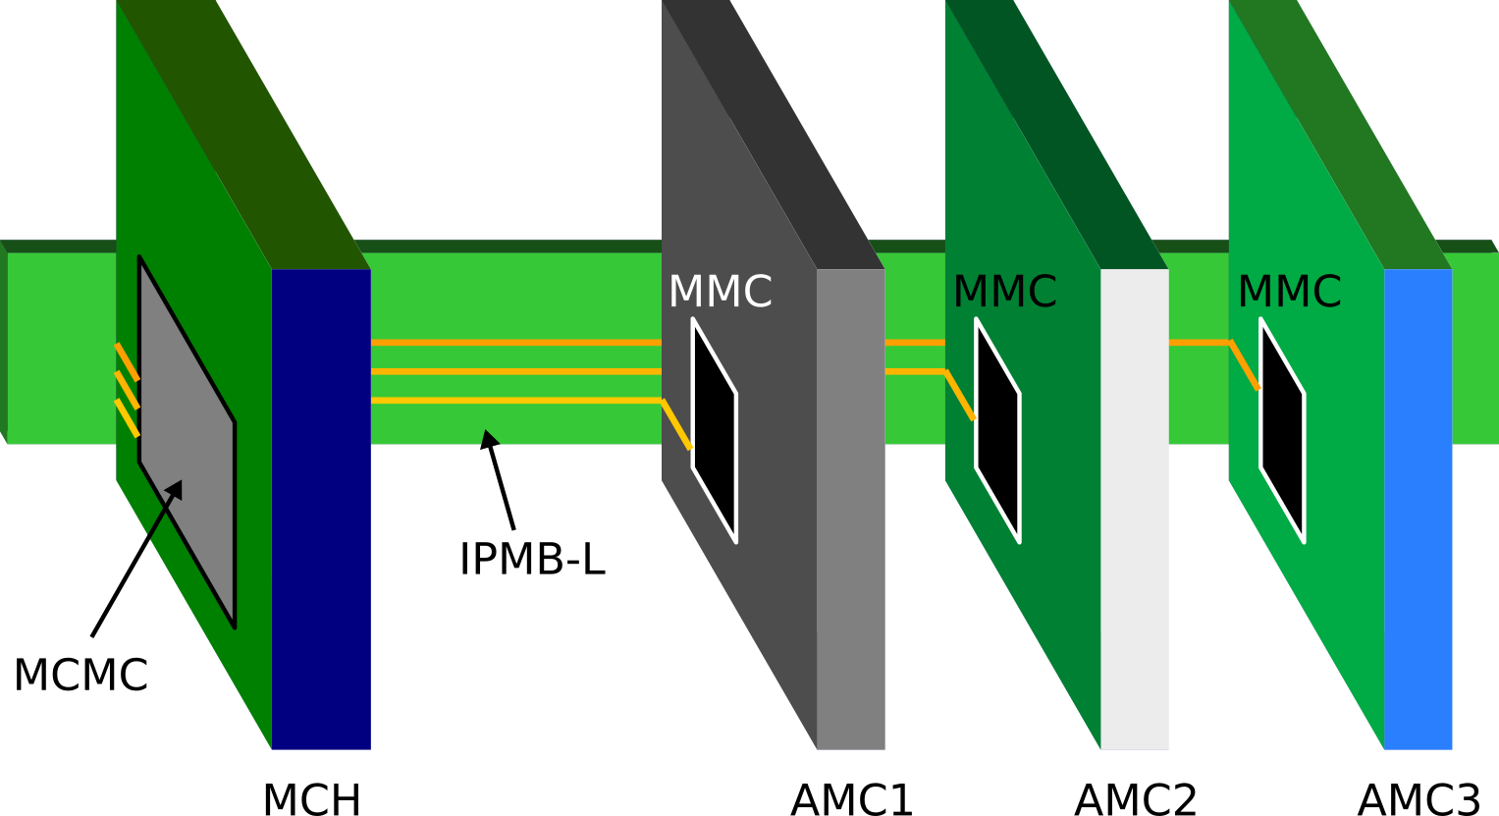
Overview
DMMC-STAMP System on a Module
Management in MicroTCA
System perspective
MicroTCA Carrier Management Controller (MCMC)
Enhanced Module Management Controllers (eMMCs)
(interfaced via IPMB-0: IPMB-A, IPMB-B)
Module Management Controller (MMC) (interfaced via IPMB-L)
AMC perspective
IPMI parsing / message generation
Provide FRU information
Event handling: sensors, thresholds, alerts
RTM control
Payload management (e.g. FPGAs/SoCs, FMCs)
DMMC-STAMP: drop-in solution for AMC MMC
Manufactured and provided by DESY

Slide 4
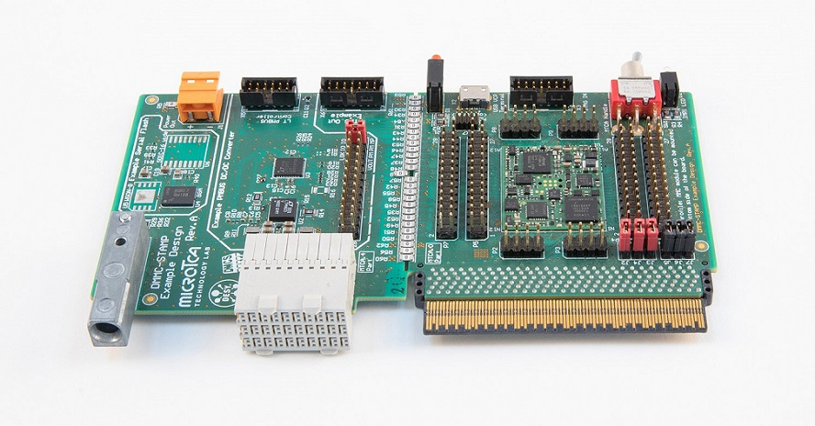
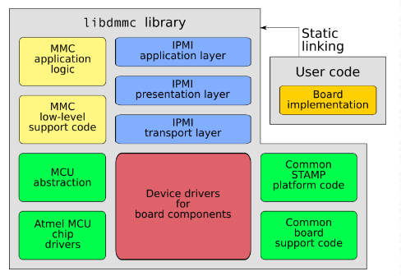
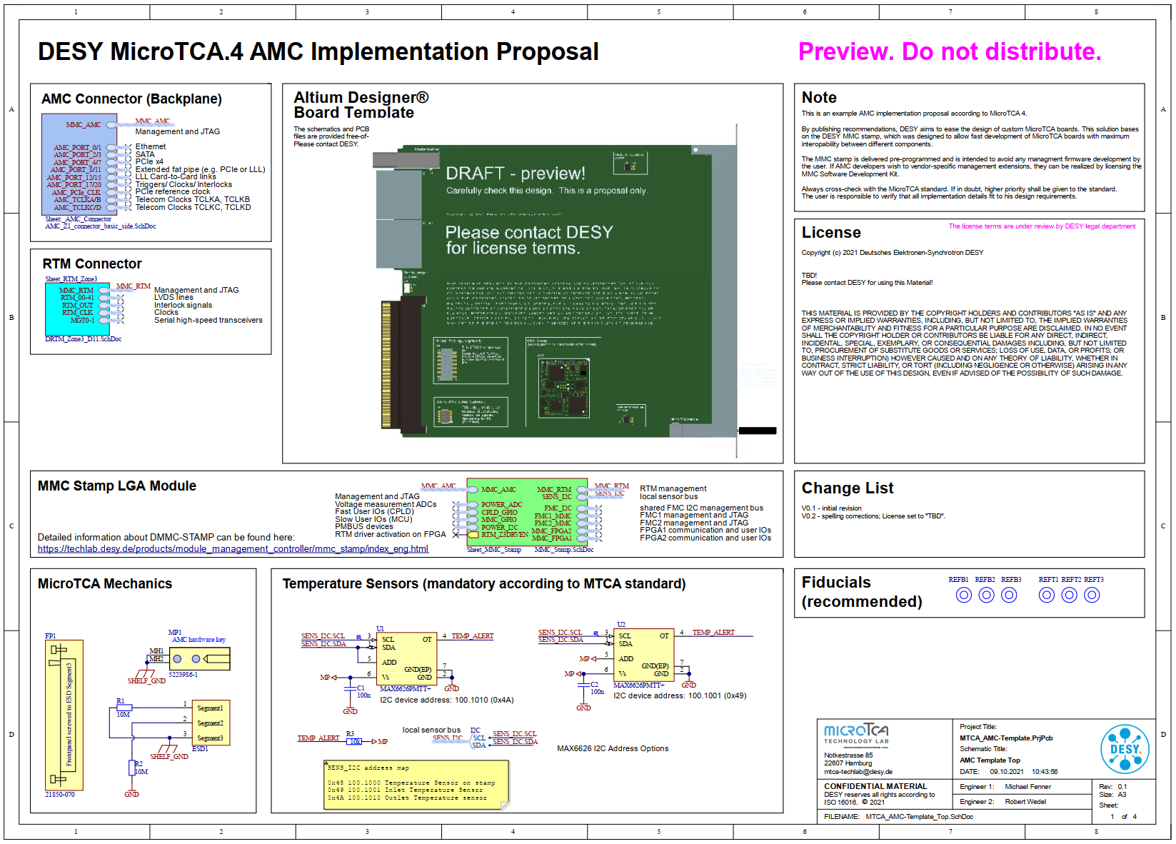
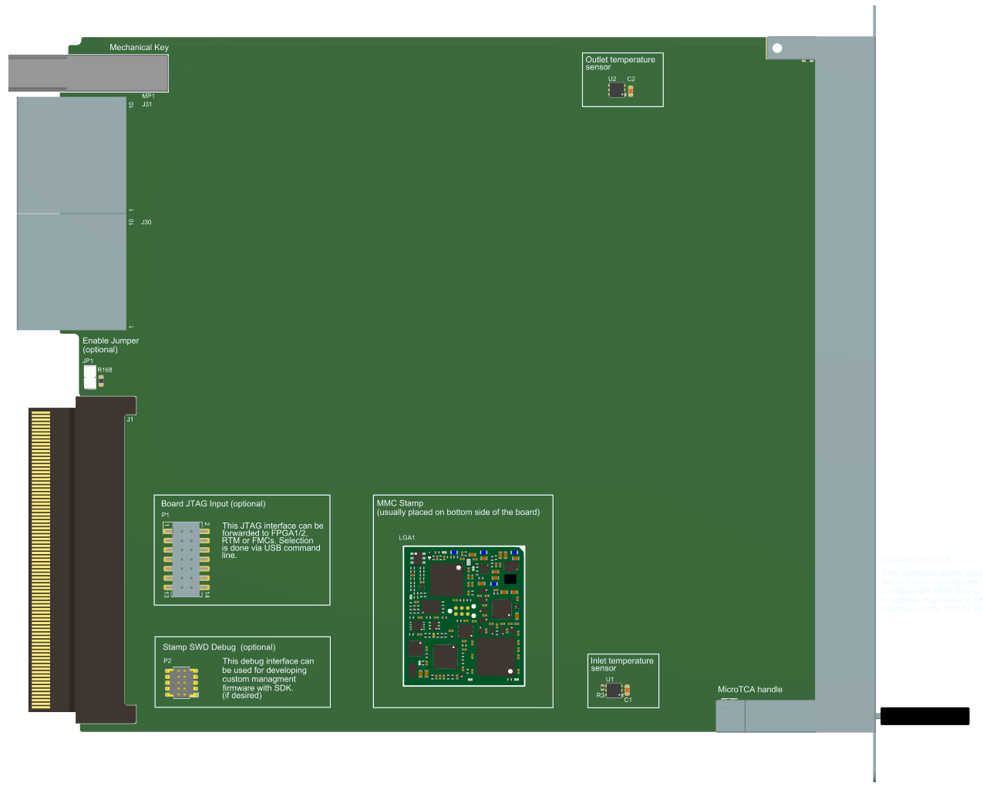
Overview
DESY MMC Solutions
DMMC-STAMP SoM
Pre-programmed firmware
Tiny: 25.5 x 29.5 x 2.3 mm
DMMC-SDK
MMC firmware customization
DESY MMC Software Library
Example implementations (e.g. DAMC-FMC2ZUP)
Open Source Tools and Templates
AMC and RTM Altium Designer Templates
mmcterm: serial over IPMB
bin2hpm: convert bitfiles for IPMI upgrade
frugy: generating FRUs
IPMI tools (e.g. in-system firmware update)
DMMC-STAMP
DMMC-STAMP-BoB
DMMC-SDK
Altium Design Templates (incl. DMMC-STAMP)
Useful tools on GitHub

Slide 5
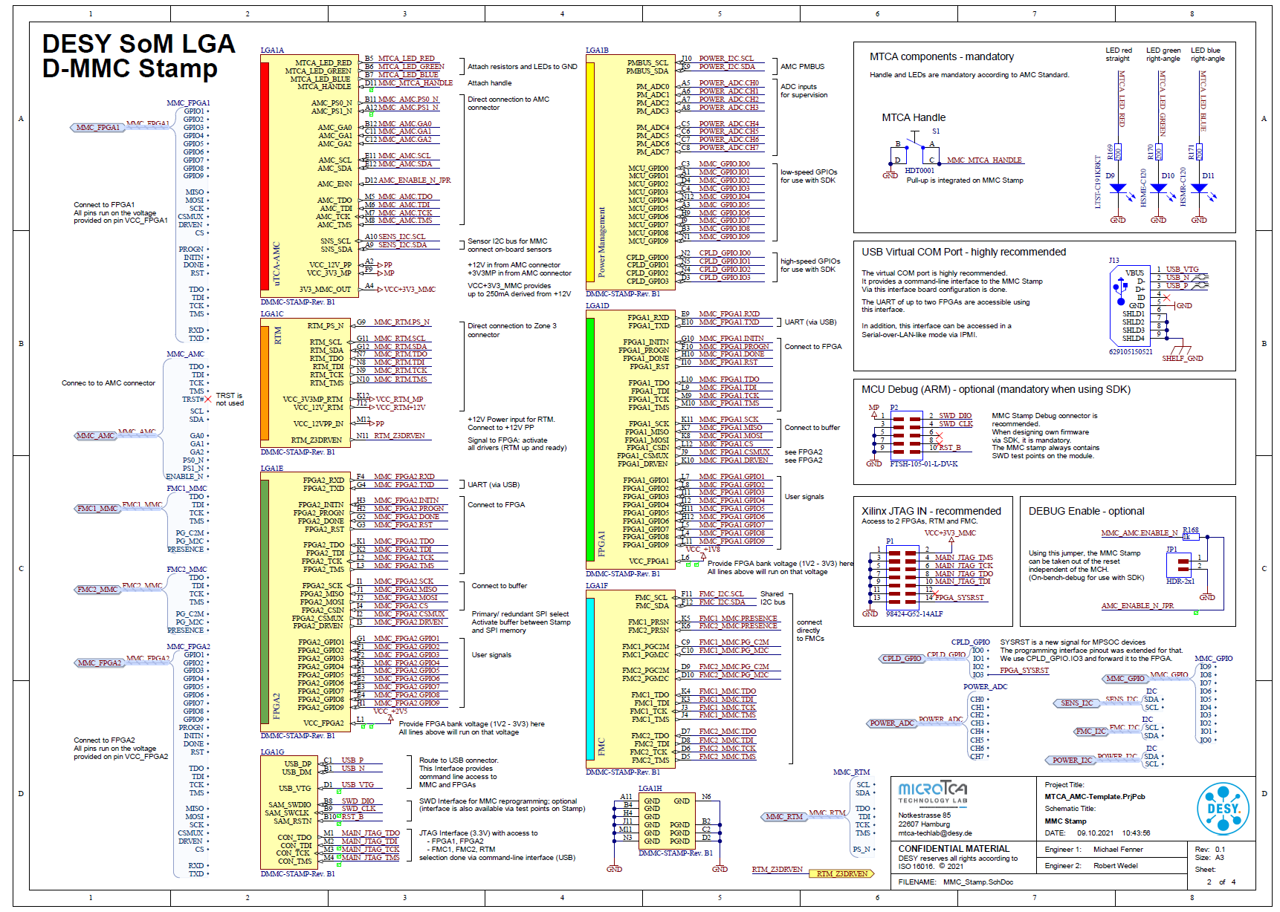
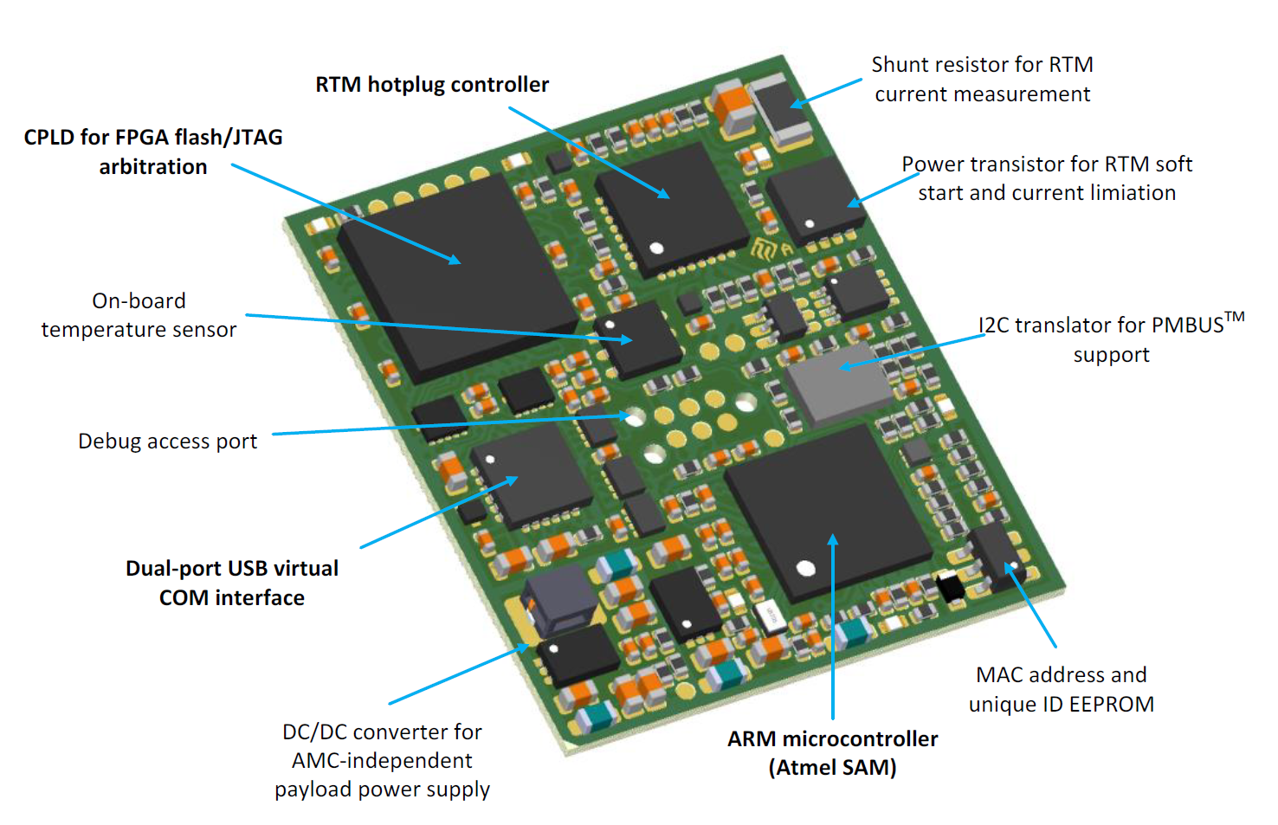
Overview
RTM
CPLD GPIO
MCU GPIO
FPGA1
DMMC-STAMP System on a Module
Programmable building blocks:
ARM Microcontroller
Lattice CPLD
Features for payload SoC interfacing by using customized firmware
FPGA2
FMC

Slide 6
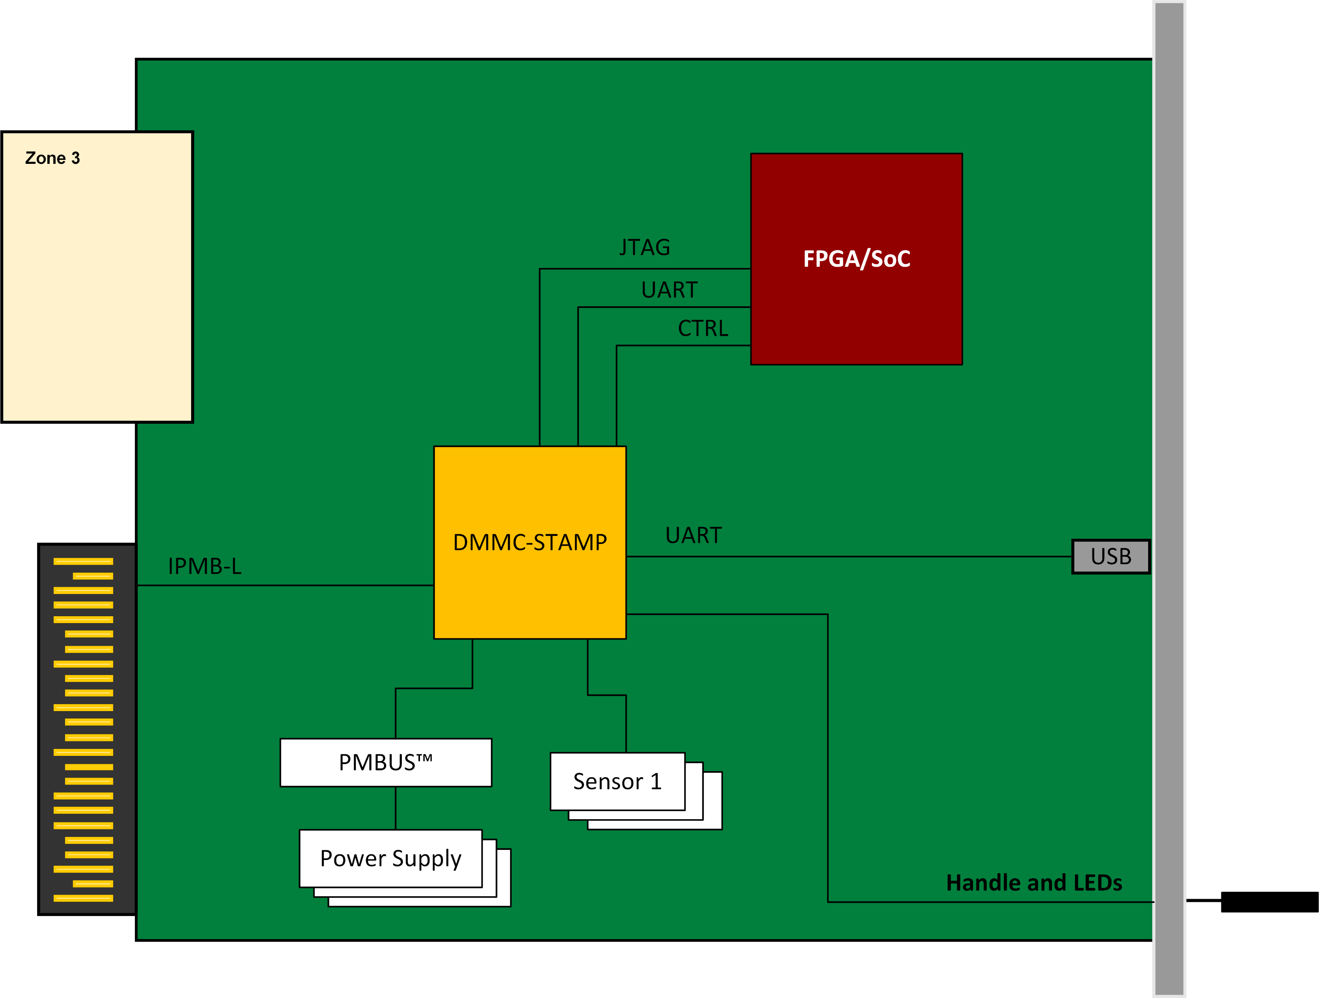
MMC Mailbox
Information Exchange between SoC OS and MMC
Communication channel between AMC Management and SoC Processing System (Application)
Monitor system health information
Use on-board sensor data in application (e.g. for ADC/DAC calibration)
Use DMMC-STAMP unique ID as MAC address
Use connected FRU data in application
Application shutdown before turning off the payload power
User specific functionality
{…}
Additional Communication

Slide 7
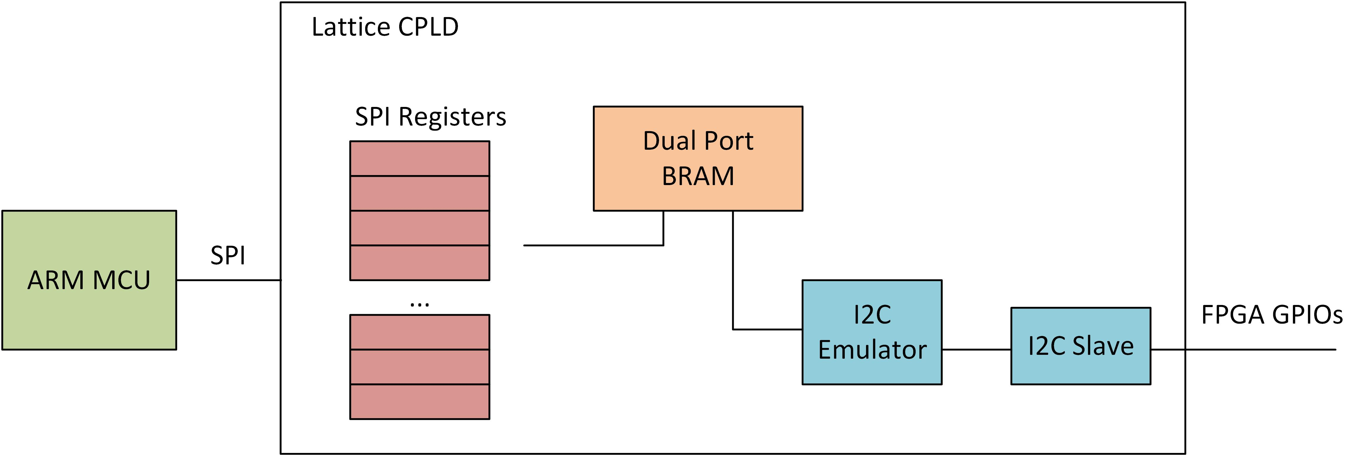
MMC Mailbox
Implementation on DMMC-STAMP Side
Introduce 2-KB CPLD BRAM as „MMC Mailbox“
Access from MCU via SPI register space
Access from SoC via I2C
Defined register space
EEPROM Emulation
Interface the CPLD BRAM
Emulate a Microchip 24C02 EEPROM
Define a locking mechanism to avoid a competing register access
Registerflag
Add software functionality to DMMC-STAMP MCU
Continuous upgrade of mmc information to mailbox
Handling of payload shutdown sequence

Slide 8
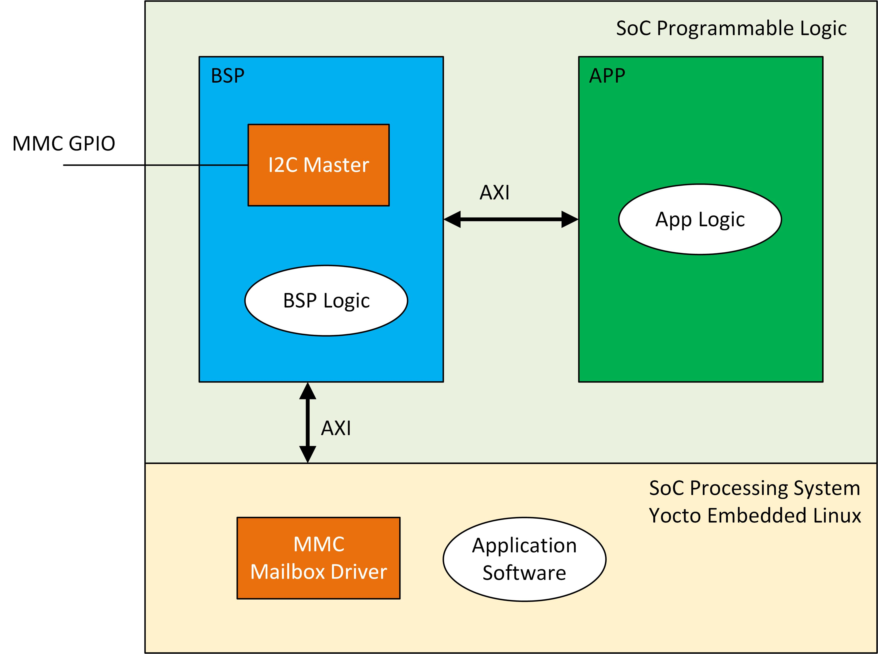
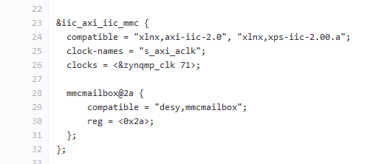
MMC Mailbox
Implementation on SoC Side
Add I2C master to PL BSP section
Modify device tree to support the „mmcmailbox“ driver
Add mailbox driver and mailbox software to meta-techlab-bsp layer
Read MMC information from mailbox on request
Provide high-level API to be interfaced by user application
Poll mailbox register to get noticed about a Hot-Swap handle event

Slide 9
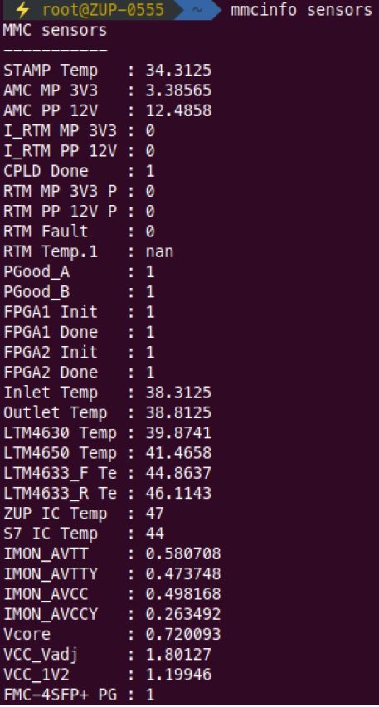
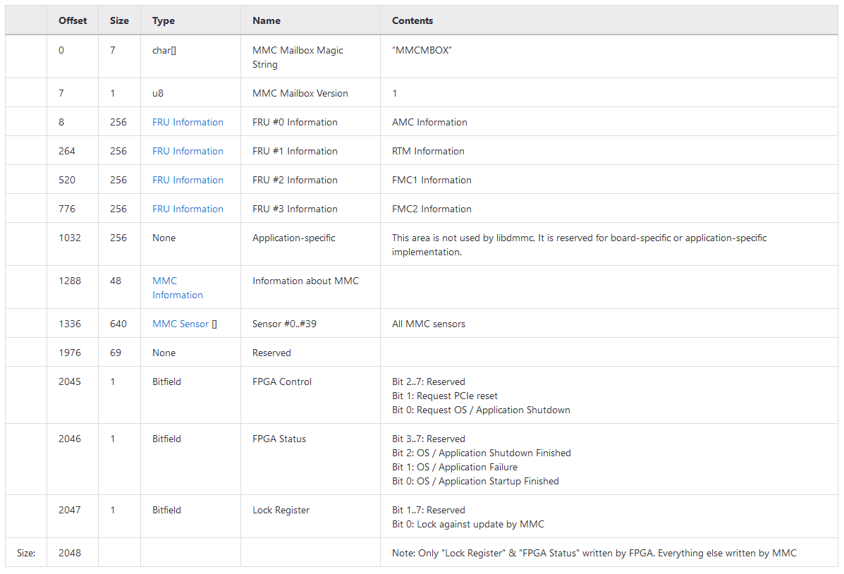
MMC Mailbox
Memory Layout

Slide 10
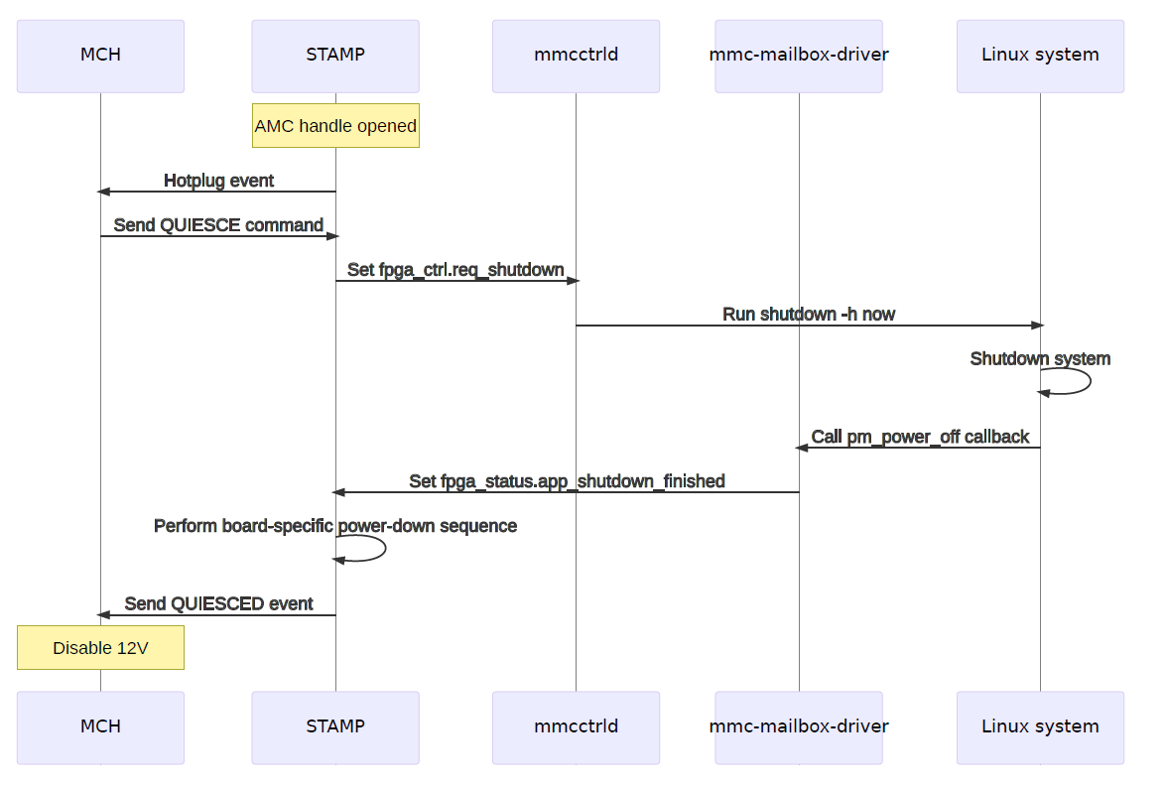
MMC Mailbox
Embedded Linux Shutdown Sequence
,
see talk by Patrick Huesmann today, 12:00 am

Slide 11
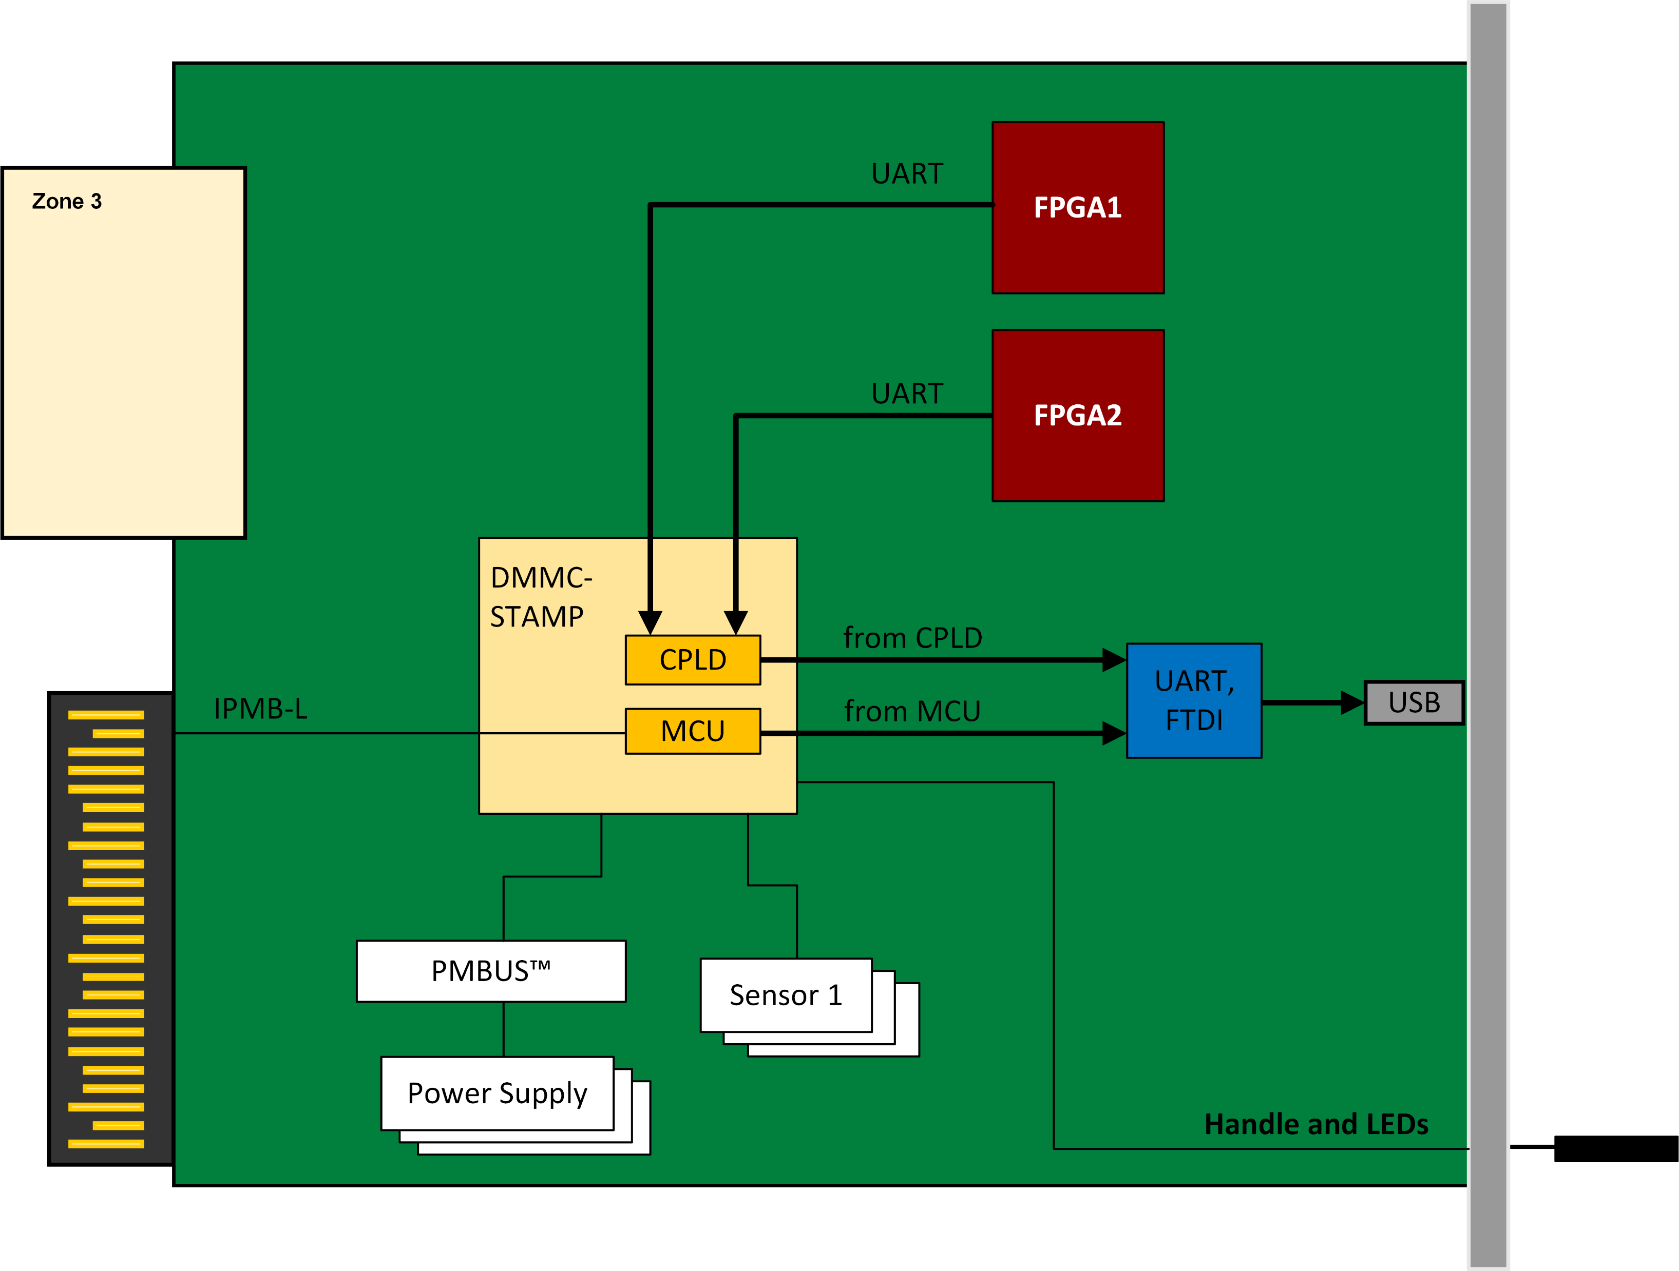
UART Forwarding to IPMB-L
Remote Access of the PS
Improve UART multiplexing to remote access the PS by using mmcterm
System recovery in case of failure (e.g. network issues and ssh does not work anymore)
No need for USB cables anymore

Slide 12
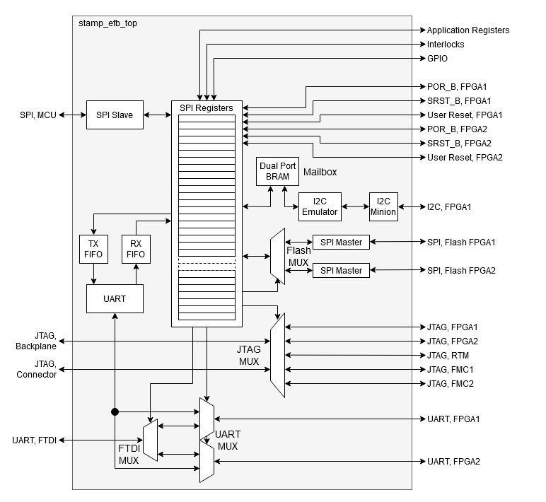
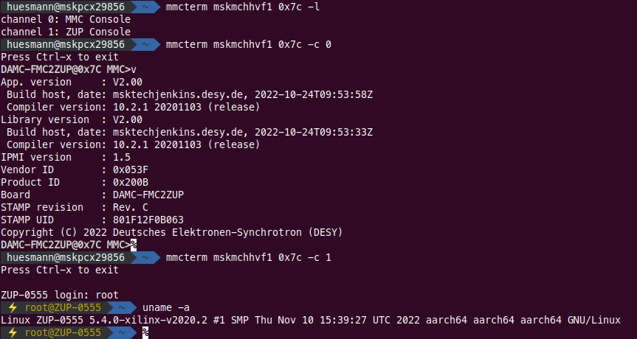
UART Forwarding to IPMB-L
SoC PS implementation
Use Cases
Remote Access
System Recovery

Slide 13
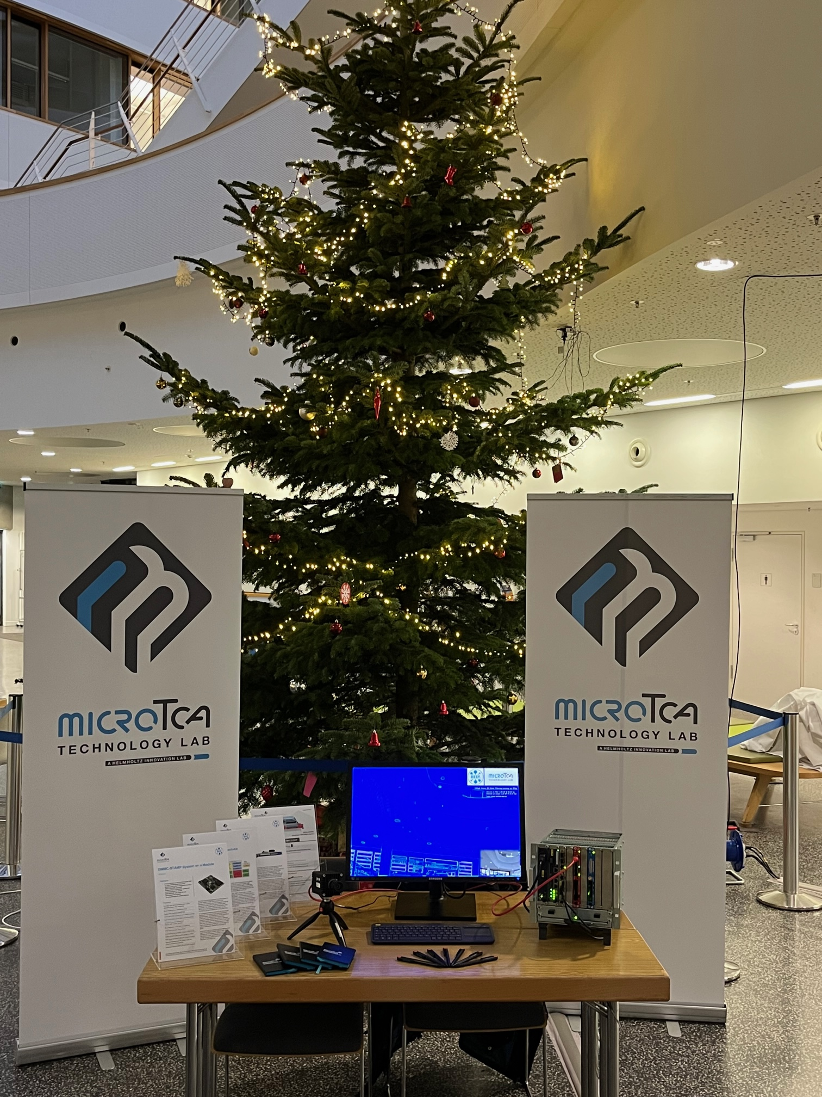
Conclusion
New Features and more Modularity
Mailbox feature for communication between MMC and SoC
Deploy (critical) system information
Graceful shutdown of Linux OS
Application specific need
PS UART forwarding to IPMB-L
Additional PS access channel (next to Ethernet and USB)
Very useful for remote access in case of a system failure
Modular firmware/software implementation
Library based approach
Fully integrated with the DMMC-SDK
Clear separation to custom application part

Slide 14
Thank You!
Sven Stubbe
Head of MicroTCA Technology Lab
+49 (0)40 8998-1870
sven.stubbe@desy.de
Deutsches Elektronen-Synchrotron DESY
MicroTCA Technology Lab
Notkestraße 85
22607 Hamburg

