Slide 1
MYRRHA - MINERVA accelerator project status and MicroTCA.4 developments
11th MicroTCA Workshop for Industry and Research - 06/12/2022

Slide 2
Contributors
SCK CEN
Anton Tanquintic
Erik Verhagen
Jan Geerts
Koen Geerts
Philippe Della Faille
Sofiane Boussa
Stijn Van Malderen
Ulrich Dorda
Wouter De Cock
ICJLAB
Christophe Joly
Jean-François Yaniche
Julien Rozé
Nicolas Gandolfo
Sylvain Berthelot

Slide 3
SCK CEN
MYRRHA
MINERVA
MTCA4
4
8
13
16

Slide 4
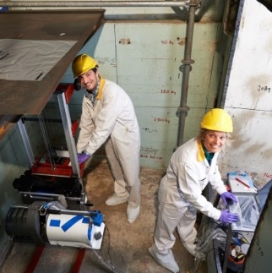
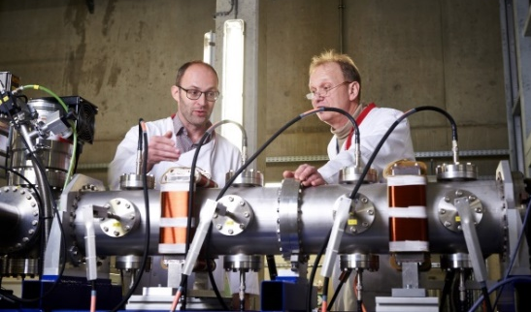
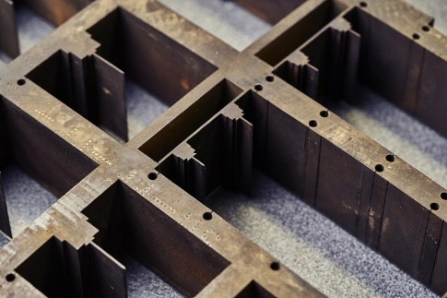
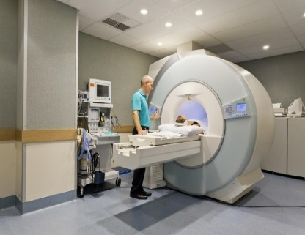
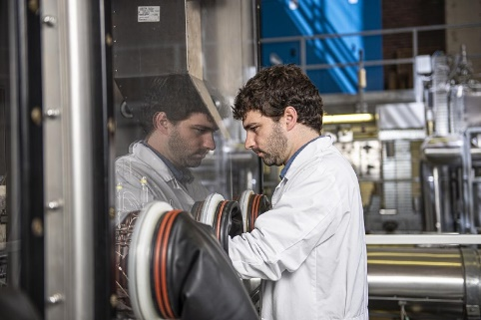
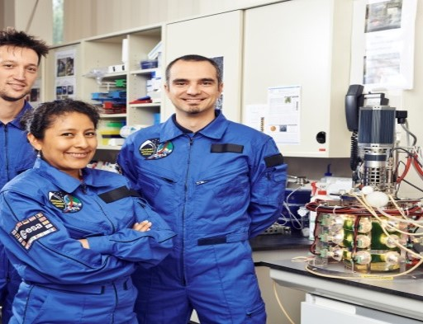
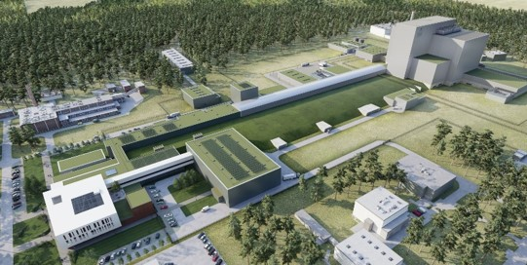
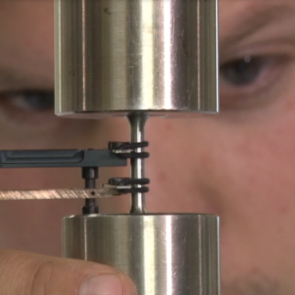
SCK CEN
The Belgian Nuclear Research Center
Staff of more than 900
  39% with an academic degree
  43 nationalities
  90 PhD students in different disciplines
Main expertise / Institutes
  Health, Environment and Society
  Materials, Technology and Safety
  Advanced Nuclear Systems
  MINERVA

Slide 5
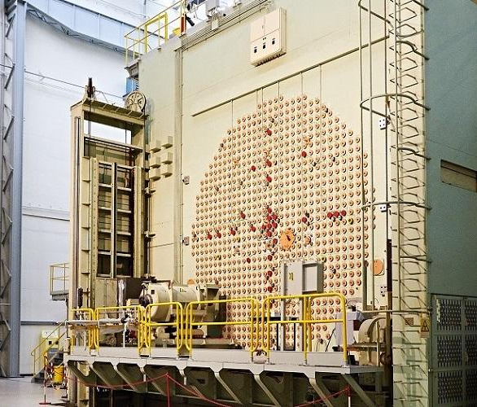
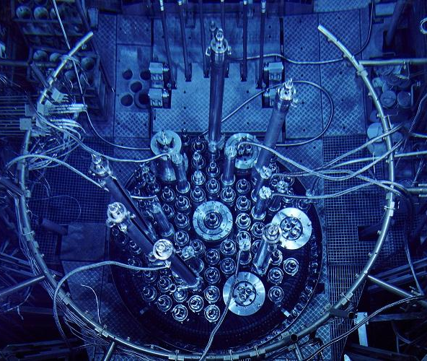
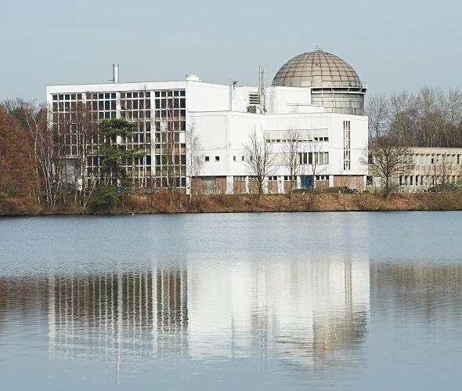
Infrastructures
BR1
BR2
BR3
First research reactor in Belgium
Air-cooled graphite-moderated reactor
Irradiation of components, calibration of measuring instruments, performing analyses and training nuclear experts
Materials testing reactor
Supplier of medical and industrial radio-isotopes
Production of high-quality semiconductors (doped silicon)
First pressurized water reactor in Europe
Pilot project to show the technical and economic feasibility of the dismantling of a reactor under real conditions

Slide 6
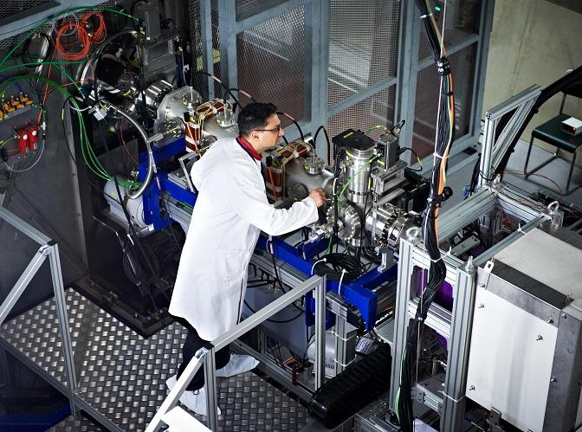
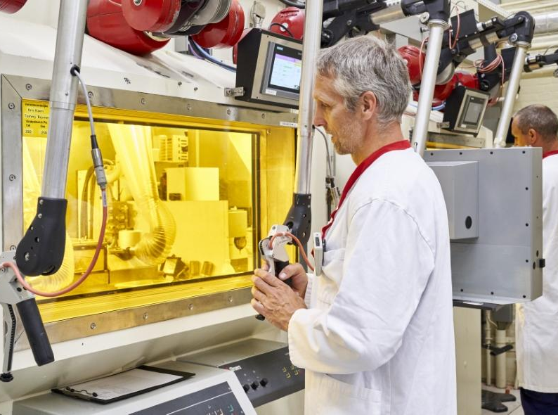
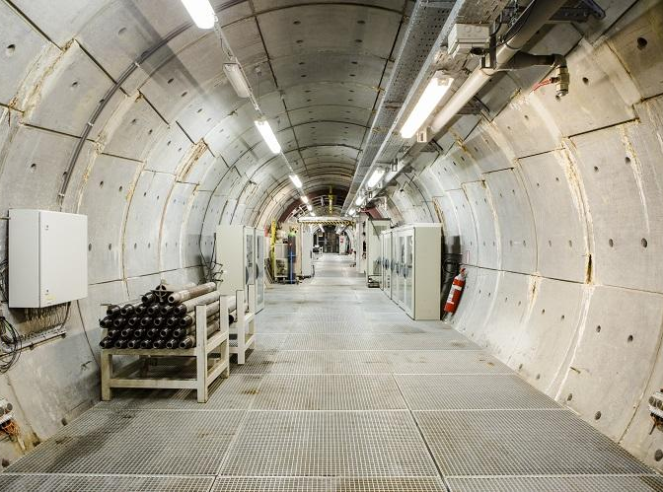
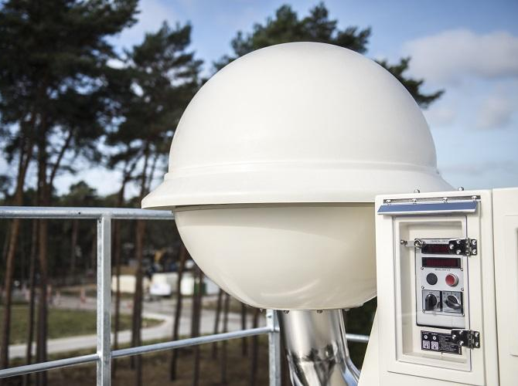
Infrastructures (II)
VENUS
LHMA
HADES
SNOW-WHITE
Zero power reactor
Nuclear reactor physics
Studies of new reactor systems
Testing reactor calculations
Mini MYRRHA
Laboratory for high and medium activity
Able to handle hazardous materials, radioactive and/or toxic.
Support and service to research groups and industrial clients
225 meters below ground level
To test the geological disposal in layers of Boom clay under real conditions
Detect very low concentrations of radioactivity in the airborne dust.
JL-900 Early Warning System

Slide 7
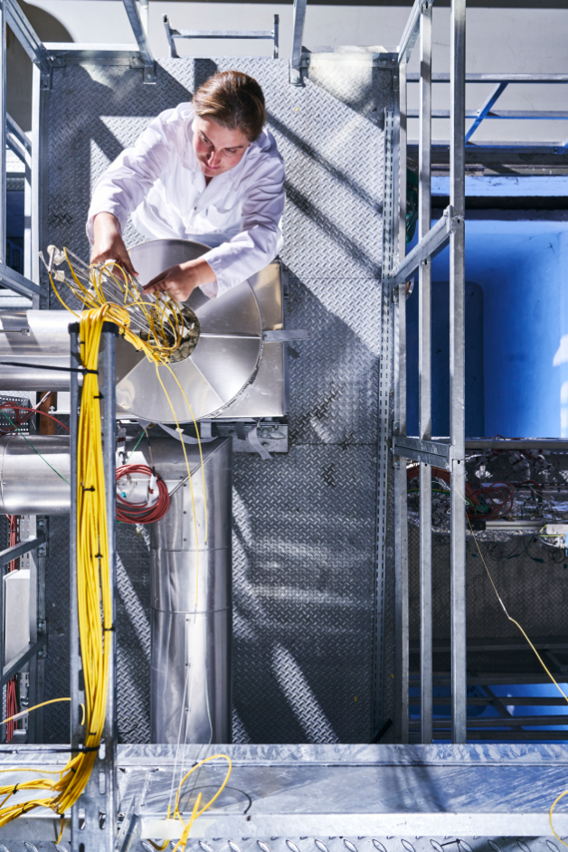
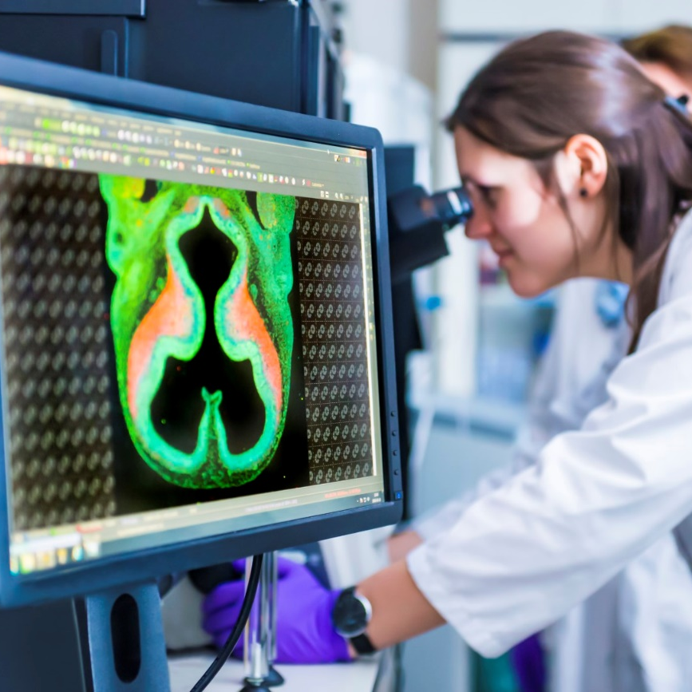
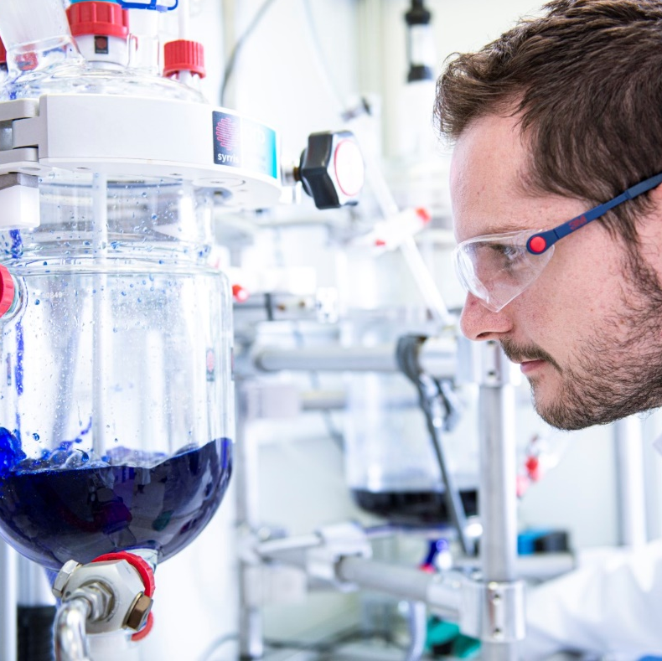
Strategic Projects
MYRRHA
NURA
development of the next-generation radiopharmaceuticals for targeted cancer treatment
RECUMO
decontaminate the current and future highly radioactive residues from the production of radioactive isotopes for medical purposes
MYRRHA
NURA
RECUMO

Slide 8
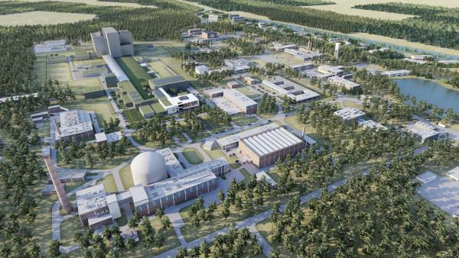
MYRRHA
The world's 1st large scale Accelerator Driven System
Multi-purpose hYbrid Research Reactor for High-tech Applications)
Subcritical nuclear reactor
Driven by a high power linear accelerator.
Turning off the proton beam results in an immediate and safe halt of the nuclear reactions.

Slide 9
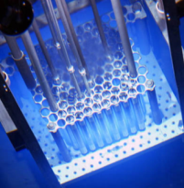
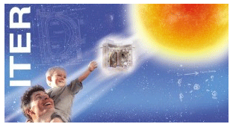
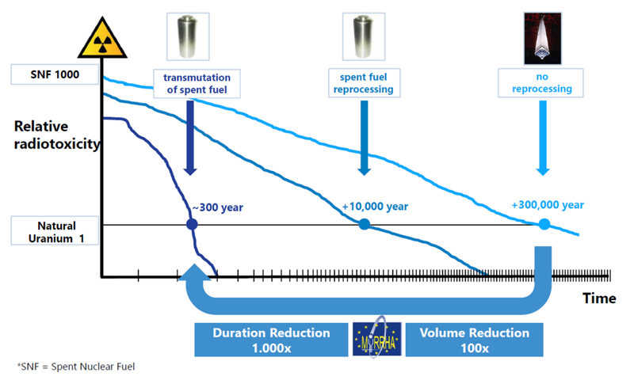





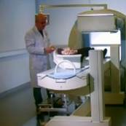
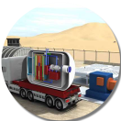
MYRRHA - Applications
Fission GEN IV
Multipurpose
hYbrid
Research
Reactor for
High-tech
Applications
Fusion
Fundamental research
Waste
Radio-isotopes
SMR LFR
  Demonstrate ADS concept at pre-industrial scale
Transmutation demonstration
Multipurpose & flexible irradiation testing facility
An attractive tool for education and training of young scientists and engineers
A medical radioisotope production facility

Slide 10
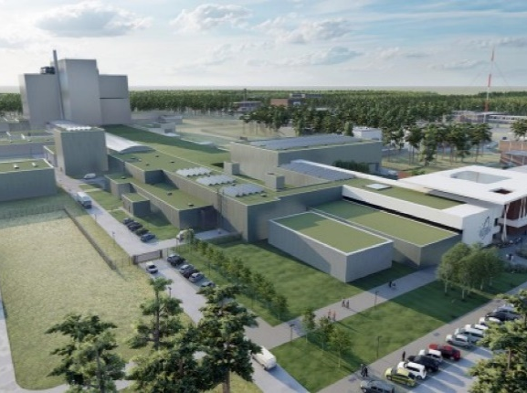
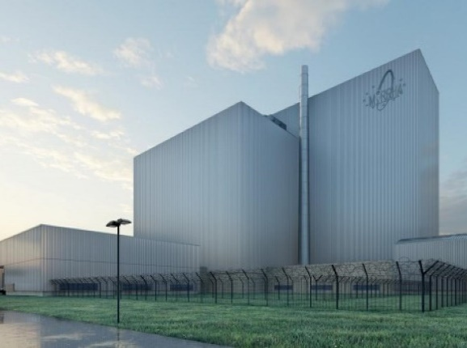
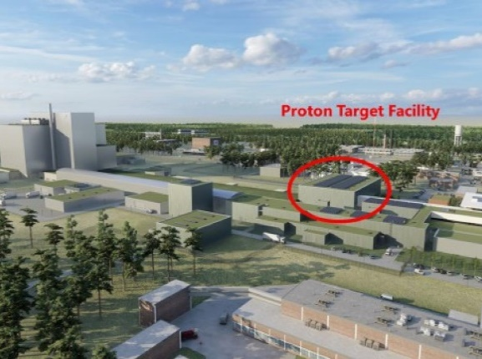
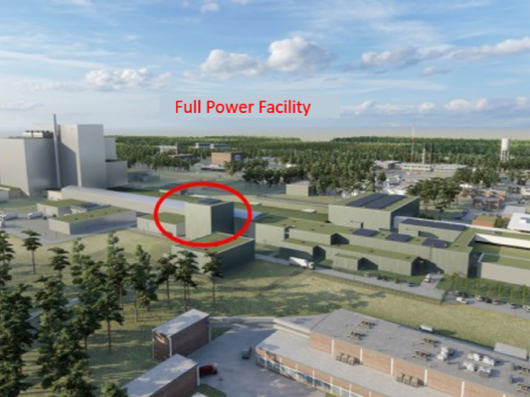
MYRRHA = 4 major components
The Linear Accelerator
The LBE cooled reactor
The Proton Target Facility (PTF)
The Full Power Facility (FPF)
In 400 m to an energy of 600 MeV
Focus on reliability
Pool type reactor
Sub-critical design
Lead-bismuth eutectic (LBE) as coolant
Fundamental science or solid-state physics and biology
Production of radioisotopes
Isotope Separation On-Line (ISOL) system
Fine-tuning the proton beam energy
Investigating irradiation damage
Fusion research

Slide 11
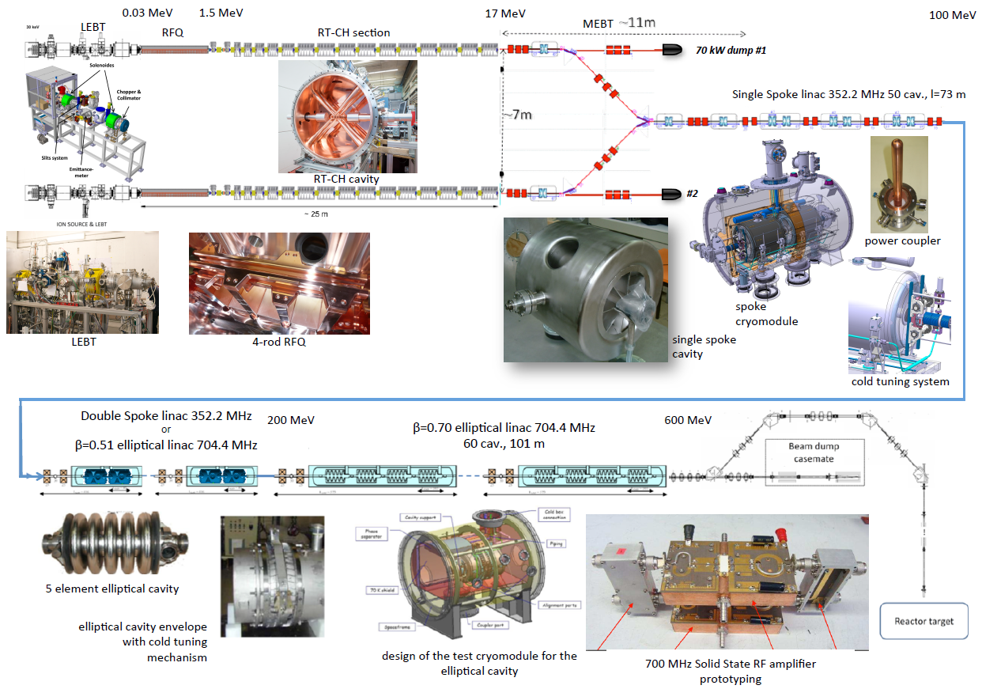
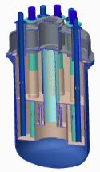
MYRRHA – Phases
  Phase 1 (approved, financed by Belgium Govt.)
    100 MeV LINAC + PTF & FPF implementation
    Design and pre-licensing of the reactor
    R&D for 600 MeV linac
Phase 1 – 100 MeV
  Phase 2
  extension of the LINAC to 600 MeV
Phase 3
reactor implementation (start in 2034)
Phase 2 – 600 MeV
Phase 3 – Reactor

Slide 12

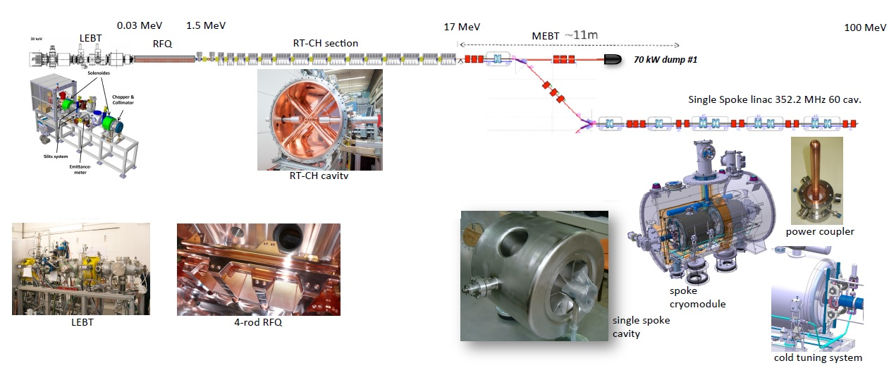
Phase 1 – MINERVA
Objectives
Demonstrate reliability as required for ADS
Reliability goal evaluation
Fault tolerant schemes implementation
Applications
Fundamental research
Develop new medical isotopes
Include design considerations for upgrade use with fusion material research

Slide 13
MINERVA LINAC - Requirements
High reliability requirements
  Mean Time Between Failures (MTBF) > 250hrs
    Allowed beam trips > 3 sec – Max. 10 per 90 day operation
    Allowed beam trips > 100 ms – Max. 100 per day
    Allowed beam trips < 100 ms – “unlimited”
High availability requirements
  Low Mean Time To Recover (MTTR)
  Failure detectability mechanisms
Achieving reliability
  Conservative design: Use mature technologies and components, not pushing their technological limits
    Solid State (SS) RF amplifiers
    Modular DC power supplies
    Digital Low Level RF (LLRF) control – MTCA based
  Implement redundancy
    Serial redundancy in the main LINAC
    Parallel redundancy in the injector
Achieving availability
  Modular design for key elements
    Solid State (SS) RF amplifiers
    Modular DC power supplies
    Digital Low Level RF (LLRF) control
  Hot swappable elements
  Low average corrective maintenance time
  Predictive maintenance

Slide 14
RF System – 17MeV Injector architecture
Working freq. @176,1 MHz
[1+2+7+1+8+1]x LLRF
Additional system elements
  RF distribution system -> Coaxial rigid line
  Monitoring elements -> RF monitoring Couplers
  RFQ: Radio-Frequency Quadrupole QWR: Quarter Wave Resonator
  CH: Cross-bar H mode cavity CHR: CH cavity used for Rebunching

Slide 15
RF System – 100MeV LINAC Architecture
Working freq. @352,2 MHz
[2+60]x LLRF
Additional system elements
  High power RF circulators + Loads
  RF distribution system -> Coax rigid line
  Monitoring elements -> RF monitoring Couplers
  SS: Single Spoke cavity SSR: Single Spoke cavity used for Rebunching

Slide 16
MTCA4 developments
MTCA is considered in 4 disciplines
  LLRF & cavity tuning
  Beam Diagnostics
  Machine Protection
  Timing System

Slide 17
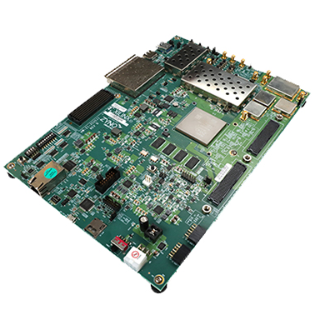
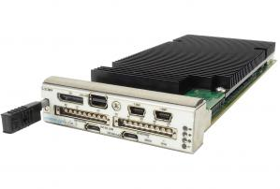
MTCA Current Developments
INJECTOR LLRF (176MHZ)
Superconducting LINAC LLRF (352MHz)*
Direct sampling topology (oversampling)
Zynq RFSoC – ZCU111 proof of concept
Vadatech AMC573 prototype
Downconverter based
IOxOS IFC1420 + RDC1470 (prototype)
CTS: separate module
*MTCA.4-Based LLRF System Prototype Status for MYRRHA, C. Joly, LINAC2022

Slide 18
LLRF - 17MeV Injector architecture & Test Stand*
RF Gallery to injector
  20 individual LLRF systems distributed along the RF gallery
    Freedom on rack distribution
    Coaxial rigid line used as TXL
*MYRRHA-MINERVA INJECTOR STATUS AND COMMISSIONING, A. Gatera, HB2021

Slide 19
MTCA Future Developments
Beam Diagnostics
  BPM, BCM, BLM, Beam profile,…
Machine Protection
  Fast interlocks and local protection system
  owned by the LLRF system
Accelerator Global Timing & Synchronization System
  Current MRF EVM & EVR
  Replace with COTS White Rabbit solution

Slide 20
Conclusions
  MINERVA is the 1st phase of MYRRHA implementing a 100 MeV SRF linac
  MINERVA requires 20 LLRF systems at 176.1 MHz and 62 LLRF systems at 352.2 MHz CW and CW_P capable.
  Experience from prototype MTCA based LLRF systems in the Injector and Cryo test stands will be the basis for future technical specifications and developments
  High availability requirement is THE main challenge
  A lot of work still to be done

Slide 21
SUPPLEMENTAL MATERIAL

Slide 22
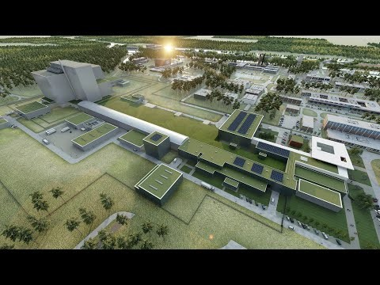
MYRRHA – Phases

Slide 23
Copyright © SCK CEN
PLEASE NOTE!
This presentation contains data, information and formats for dedicated use only and may not be communicated, copied, reproduced, distributed or cited without the explicit written permission of SCK CEN.
If this explicit written permission has been obtained, please reference the author, followed by ‘by courtesy of SCK CEN’.
Any infringement to this rule is illegal and entitles to claim damages from the infringer, without prejudice to any other right in case of granting a patent or registration in the field of intellectual property.
SCK CEN
Belgian Nuclear Research Centre
Foundation of Public Utility
Registered Office: Avenue Herrmann-Debrouxlaan 40 – BE-1160 BRUSSELS
Operational Office: Boeretang 200 – BE-2400 MOL

