Slide 1
2022 microtca workshop
Jess Isquith
President, PICMG
jess@picmg.org

Slide 2
Agenda
PICMG Overview
Value of open specifications
Current Initiatives
PICMG Spec develop process
PICMG Leadership Team
Jess Isquith, President
Doug Sandy, Chief Technical Officer
Dylan Lang, Treasurer/Chief Financial Officer
Valerie Andrew, VP Marketing

Slide 3
PICMG* [PCI Industrial Computer Manufacturer’s Group]
Founded 1994 as a non-profit consortium
Focus on open standards for embedded computing
~ 130 members companies
Deep engineering expertise in member companies:
Electronic, mechanical, packaging, and thermal design
High speed signaling and simulation
Software and High Availability skills
Rigorous Intellectual Property policies
Patent landscape known to implementers
No PICMG standard requires a license to implement (so far)
Over 50 standards released to date
More than $10B in global revenue
Wide range of technologies including small form factor, networking, high-availability architectures, rugged computing and management
*Pronounced “Pick-M-G” or “Pick-Mig”

Slide 4
Overview: 28 years of Specifications
Key Principles
Modular
Scalable
Interoperable
Results to date
100s of participating companies
100s of thousands of work hours
Global organization (Members from >20 countries)
Over 50 specifications
Billions of dollars in PICMG compliant products
Collaboration will always be critical to PICMG

Slide 5
Value of Open Standards
Proprietary Solution
Typically developed, built, and maintained by a single vendor – Little or no collaboration
Generally expensive and rarely the latest technology
Only the largest companies have all of the requisite skills to be experts on all elements
Upgrades developed on vendor’s timetable – the vendor “owns” you
Open Standard Solution
Generally developed by non-profit consortia with many members that have a wide range of skills
Multiple vendors provide price and feature competition
If customers don’t like their vendor(s) they can go someplace else
Technology and improvements developed on industry timetable
Open Standards encourage innovation and differentiation amongst multiple vendors – interoperability is key

Slide 6
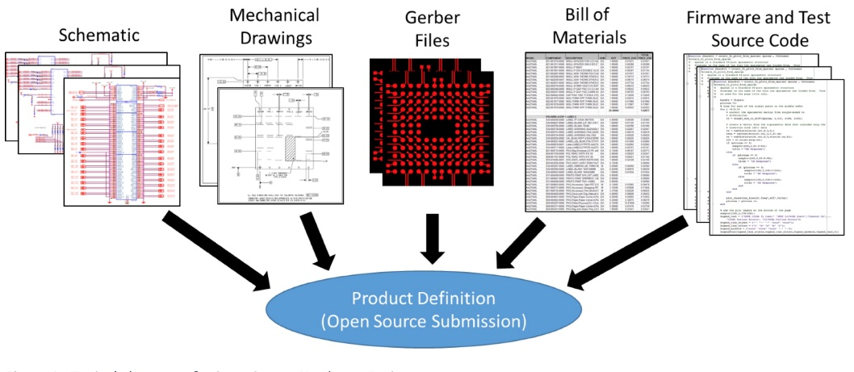
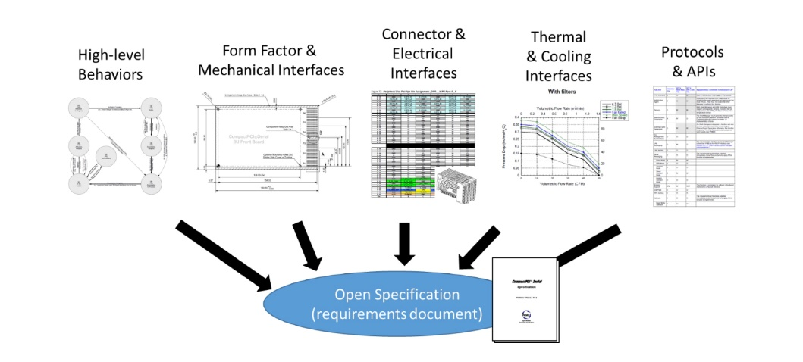
Open Specification vs. Open Source

Slide 7
2022/2023 PICMG Initiatives
IIoT
Initiatives
CompactPCI Serial / Space
COM-HPC
COM Express
MicroTCA
ModBlox7
Far Edge
Acromag
ADLINK
Advantech
AMI
Amphenol
congatec
Elma
Emerson
Ept
Fastwel
GE Automation
HEITEC
Intel
Kontron
MEN
Avnet
N.A.T
nVent
Samtec
Seco
Supermicro
TE Connectivity
Trenz Electronic
University Bielefeld
VersaLogic Corp
ADLINK
Advantech
Amphenol
Avnet Integrated
Bielefeld University
congatec
duagon
ept
Eurotech
FASTWEL
Intel
Kontron
nVent, Schroff
Portwell
SECO
Supermicro
TE Connectivity
ADLINK
AMI
Arroyo Technology
Avnet
Elma Electronic
ept
Intel
Lodz University
MEN Mikro
nVent
Samtec
TE Connectivity
Trenz Electronic GmbH
Triple Ring Technologies
Amphenol
Atom Computing*
BAE
Comtel
DESY
Embeck
ept
ESS
MicroLab*
N.A.T.
nVent
powerBridge
Samtec
University of Lodz
VadaTech
W-IE-NE-R Power
ADLINK.
Ci4Rail
EKF
Elma Electronic
ELTEC
Embeck
ept
General Micro
HEITEC
Hirose
Intel Corporation
Kontron
nVent, Schroff
Samtec
Sealevel Systems
Tews Technologies
Acromag, Inc.
ADLINK
Airbus Defence Amphenol
EKF
Elma Electronic
Embeck
European Space Agency
FASTWEL
Hartmann Electronic
HEITEC
Lodz University
duagon
National Instruments
nVent
Paul Sherrer Institut
Samtec
TE Connectivity
Dolphin
Trenz
ADLINK
Avnet Embedded
EKF
ept
ExxonMobil
Georgia Research Tech Institute
Hirose
Intel
nVent, Schroff
OpenSystems
Phoenix Contact
Portwell
Samtec
Schneider Electric
Yokogawa

Slide 8
Markets Served
 | COM-HPC COM Express | ModBlox7 | CompactPCI Serial | HPM | MicroTCA / AMC | AdvancedTCA | SHB
Aerospace | X | X | X | X | X
Defense | X | X | X | X | X | X | X
Drones / UAV | X | X | X | X | X
Energy | X | X | X | X | X |  | X
Gaming | X
Industrial Automation | X | X | X |  | X |  | X
IIoT | X | X | X |  | X
Medical | X | X | X | X | X
Physics | x |  |  | X | X | X | X
Railway | X | X | X | X | X
Telecommu-nications | X |  |  | X | X | X
Test / Measurement | X | X | X | X | X | X

Slide 9
SPECIFICATION DEVELOPMENT
Process
3 exec members sponsor a new initiative
Develop initial statement of work
CTO Review
Call for participation
Committee formed
Chairperson, Editor and Secretary elections
Committee finalizes SOW
Specification work begins
Regular calls with role and IPR acknowledgements
Draft specification reviewed by CTO
Member review
Necessary updates made by committee
Ratification vote

Slide 10
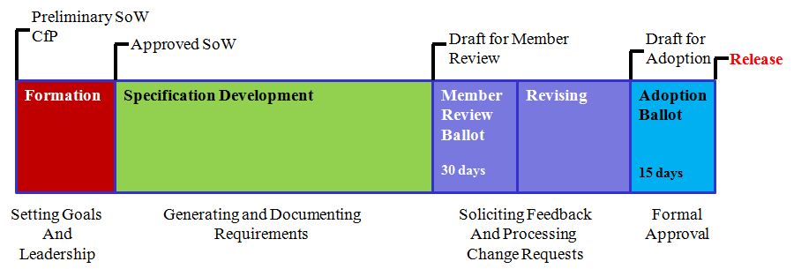
Technical Subcommittees
Com-HPC Base Spec 1.15
Com-HPC Carrier Design Guide
Com Express 3.1
IIoT Network Architecture
IIoT Redfish Schema
CPCI-S Extensions
MicroTCA Next-Gen
ModBlox7
Far-Edge

Slide 11
MicroTCA Next generation
Primary Goal
Address the ever-increasing demand for power and throughput in new systems.
Potential elements:
100Gb Ethernet
PCIe GEN5
Overcome 80 W AMC limitation
Increase power / slot
Backward compatibility
The leaders are here and will discuss more details over the next two days
Technical working group members
Amphenol
Atom Computing*
BAE
Comtel
DESY
Embeck
ept
ESS
MicroLab*
N.A.T.
nVent
powerBridge
Samtec
University of Lodz
VadaTech
W-IE-NE-R Power

Slide 12
Far edge: Open Standards for Edge processing industries
Sponsors: ExxonMobil, GTRI, Samtec, Emtec & Avnet
Chair: Aaron Loggins
Editor: Dylan Lang
Secretary: Steve Bitar
Open Group / OPAF Liaison Agreement
Roster
ADLINK
Avnet Embedded
EKF Elektronik
ept GmbH
ExxonMobil
Georgia Research Tech Institute
Hirose
Intel
nVent, Schroff
OpenSystems
Phoenix Contact
Portwell
Samtec
Schneider Electric
Yokogawa
PICMG team is developing an open specification in alignment with OPAS section seven.
PICMG / OPAF task force
Goal: Develop an Open Specification for broad process industry use as an alternative to Industrial PCs (IPC), Programmable Logic Controllers (PLC), Distributed Control Systems (DCS) and their associated I/O modules.
Consolidate IPC, PLC and DCS functionality into a single hardware specification.
It is not too late to join!

Slide 13
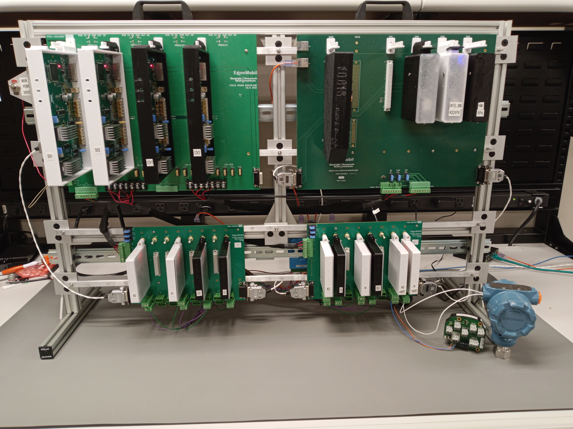
Picmg Far-Edge
Pluggable modules: Compute, Switch, I/O, Power
Key attributes:
Interoperability
high availability
Upgradeability
Scalable
Future-proofed
Power Backplane
Compute Backplane
Two I/O Backplanes
Prototype Concept from FOCIS from GTRI

Slide 14
Modblox7
First open specification for box PCs
Coplanar board-to-board connectors couple each unit to its neighbor.
7HP width pitch
Range of device combinations in increments of 7HP
Flexible mounting for wall, din-rail, and 19″ subrack installations.

Slide 15
Resources
General
www.picmg.org
Design Guides
Shortform specifications
Product Showcase – Add your products!
Active MicroTCA marketing group
Updating forms, web content, Wikipedia
Embedded World 2023 booth
Specifications available for purchase on the website (We prefer you join, participate and receive the specs via membership)
Design Guides and more on the PICMG Web site:
Physics Design Guide for Clocks, Gates & Triggers in Instrumentation
Standard process models and APIs
Standard device models and APIs
PICMG® MTCA.4 PCI Express Hot Plug Design Guide
Standard Hardware API Design Guide
Always interested in application stories, blogs and other contributed materials

Slide 16
Benefits of membership
Early access to key technology
Participate in specification development (requirements through implementation)
Leverage PICMG promotions and marketing efforts
Develop relationships with thought leaders and suppliers
Gain visibility and leads from your products and content on the PICMG Web site
Flat organization – in a good way!
Low-cost membership
Join and participate!

Slide 17
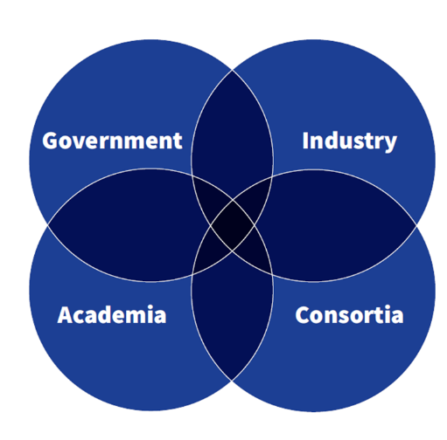
Future
Continued support for MicroTCA
Greater support for DESY MicroTCA Technology Lab
Value of Open Standards / Specifications vs. proprietary solutions remain the same
Continued Globalization of requirements
More diverse engineering force
Greater collaboration
Membership and Participation are the foundation of all successful open specifications

Slide 18
Thank You
Jess Isquith
PICMG, President
jess@picmg.org
Open Standards encourage innovation and differentiation amongst multiple vendors – interoperability is key
c
Image copyright N.A.T.

